Slide 1
Victimisation – 60+years
Year 2008-2018
Professor Saviour Formosa
CrimeMalta Observatory
Social Affairs Committee Presentation – 13 March 2019

Slide 2
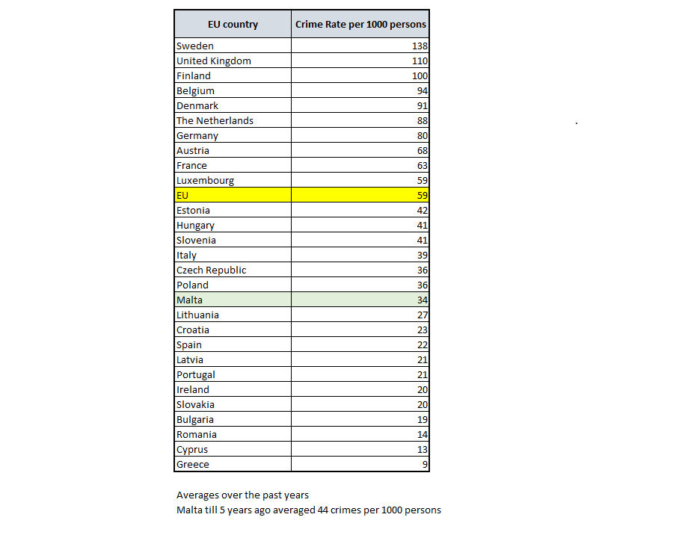
Understanding the Situation
Malta in the EU
UNODC
United Nations Office on Drugs and Crime
Scope: To understand the realities of Crime in the Maltese Islands
Rankings: 2015 (UNODC latest comparative EU28 data)
  Theft – 4th (higher than EU average)
  Homicide - 14th (lower than EU average)
  Assaults – 14th (lower than EU average)
  Robberies – 9th (lower than EU average)
  Burglary – 16th (lower than EU average)
  Drugs – 20th (lower than EU average)
  Sexual Offences– 12th (lower than EU average)
  Rape – 15th (lower than EU average)
  Sexual Assault– 13th (lower than EU average)
Malta has highest number of Police Officers per 100,000 persons
(519 officers)

Slide 3
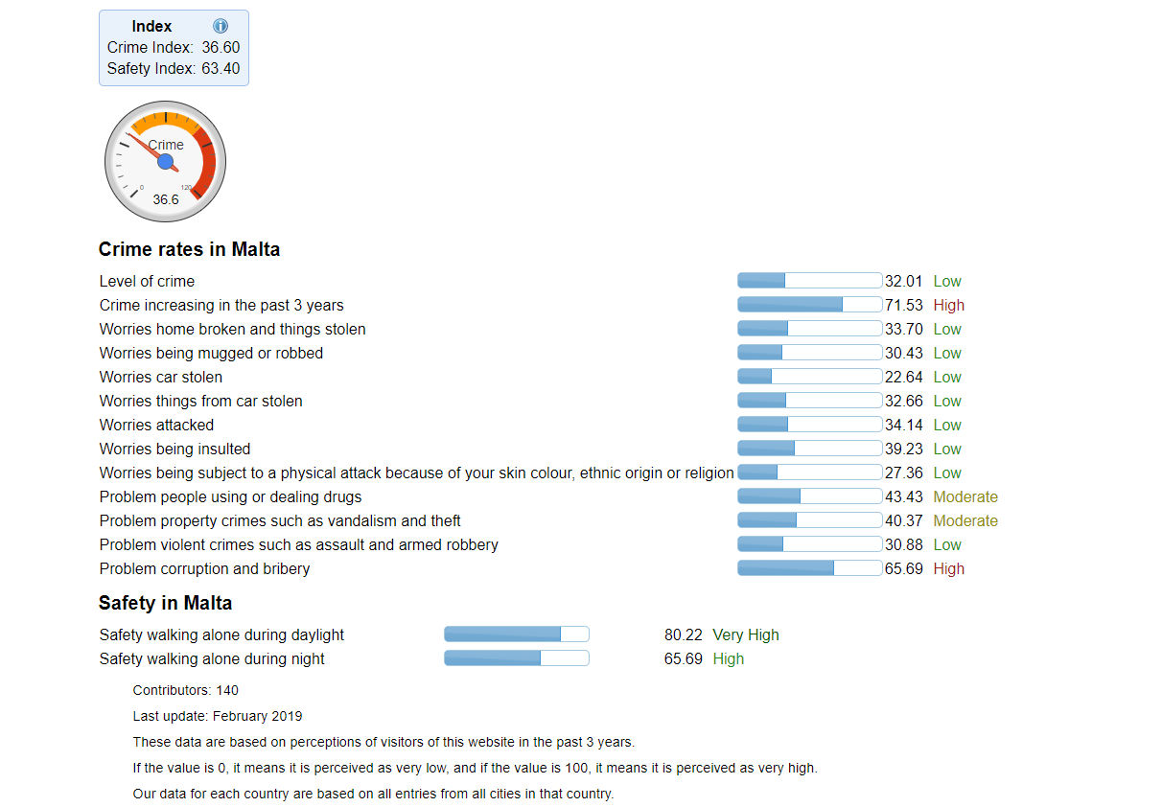
Online Surveys…
Perceptions
Numbeo.com

Slide 4
Trends
What did
&
What should have occurred
Long-term analysis exhibits a continued generic trend line decrease in reported crime
2018 experienced a major decrease where crime reports show a reversal of the 2010-2016 phenomenon – a 7 point decrease
15,925 reported offences
The Maltese affluence rate results in wider Opportunities for offenders, such that crime has diversified
The increasing resident population (460,000) should have rendered an additional 1,563 victims in 2018
The steady increase in tourist arrivals (2,600,000) should have rendered an additional 3,588 victims in 2018
Malta’s crime rate from 42 crime per 1000 persons to one where the rate has reached 34 crimes per 1000 persons

Slide 5
Trends
Significant Firsts
A major shedding of crime by 7% or 1,211 cases
Bodily harm has been pushed further down the league due to a relatively large increase in fraud
Displacement is also very evident as the migration of crimes from one zone to another becomes more pronounced.
San Giljan’s rate of crime dropped from a height of 19.5 in 2012 to 10.6% in 2017 and again to 9.4% in 2018, a drop of 18% from 2017, the lowest in the last 14 years.
In terms of societal reaction, moral panic still plays a part in rendering a perception that crime is increasing, when the facts depict a stabilised scenario.
Expected victims: 21,600 - Observed victims: 15,925
Expected Maltese victims: 13,800 victims – Observed 12,237 victims – 33 per 1000
Expected Foreign victims: 7,800 victims – Observed 4,212 victims – 3 per 1000
Victims are mainly male Maltese residents, aged falling within the 40-59 year cohort. Victims aged less than 18 years fell to 3.3%.
Foreign victims hail from 161 countries
Mondays, January-May/August and the 00:00-03:00 comprise the main functional temporal aspects of Maltese crime reporting.

Slide 6
Figures
Main Shifts
2018: 15,925 reported offences.
A major decrease in crime reports over the 2018 period comprising an absolute decrease of 1,211 crimes (7.1%) indicating a reversal 2010-2016 ‘increase’ phenomenon.
The previous singular crime phenomenon has been brought to heel - Pickpocketing decreased by 995 offences in 2018, a decrease of 46% from the previous year from 2,144 cases.
Most other categories of theft have decreased apart from theft from factories by employees, mugging, religious temples, occupied residences, shop lifting, snatch and grab, theft from sea craft and theft from vehicle.

Slide 7
Figures
Main Shifts
Theft comprises 41% of all offences reported to the Police, down from 48.2% in 2017, the lowest in 14 years (2004) when the rate was that of 62.4% of all reported offences.
Damages, has seen a slight increase to 24.7% of all offences up from 22% in 2017, increasing through Involuntary Damage by Hit and Run incidents and Wilful damage by Other Means.
Domestic Violence has increased its previously stable 7% rate to 8.4% of all offences, to reach 1341 cases, with a 10% increase in Psychological Harm and 8% Slight Bodily Harm with Physical Force.
The 4th highest ranking offence, Bodily Harm, has been pushed to 5th ranking. Bodily Harm which had registered a year on year decrease initiated in 2009 down to 5%, increased slightly to 5.6%
In turn, Fraud is now4th ranking, again experienced an increase of 31% (245 additional cases) over the previous year reaching 1032 cases in 2018. The main increase was registered as Fraudulent Gains.
These 5 categories of crimes comprise 88.1% of all crime reports

Slide 8
Figures
Main Shifts
Computer related crime experienced a 20% increase over the previous year, through password disclosure, unauthorized access and copying / disclosure / possession of data.
Threats and Public Violence has increased to 322 in 2018, mainly through stalking, blackmail and causing fear of violence, though harassment experienced a reduction in reporting.
Theft from Residences has again increased by 31 cases or 5% as compared to 2017 reaching 623 cases.

Slide 9
Victims
Victims are mainly Maltese residents (74.3%), followed by UK residents (2.5%), whilst Italians, French, Germans and Spanish comprise other source countries whose residents suffered victimisation.
Main age cohort that is victimised pertains to the 40-59 year cohorts, followed by the 20-29 year and the 30-39 year and the 60+ cohorts respectively.
Domestic violence was mainly experienced by the 40-59 year cohort, followed by the 30-39 year cohort.
Under 18 were mainly victims of pornography and sexual offences, when compared to the other age cohorts, whilst the 60+ cohort were mainly victims of forgery, fraud and theft.
In terms of gender, main victims’ gender is male, growing over the years up to 57.6% in 2018, whilst females make up 42.2% of victims.
Females were mainly victims of prostitution, trafficking in persons, crimes against public peace, sexual offences, pornography and domestic violence. Males were mainly victimised for arson, violence against public officer, forgery, damage, bodily harm and fraud.

Slide 10
Victims: 60+
Counts
Persons aged 60+ have seen a steady increase in victimisation which was reversed in 2018
Year | Count | Difference Count | Difference %
2008 | 1650
2009 | 1584 | -66 | -4.0
2010 | 1829 | 245 | 15.5
2011 | 2040 | 211 | 11.5
2012 | 2184 | 144 | 7.1
2013 | 2516 | 332 | 15.2
2014 | 2575 | 59 | 2.3
2015 | 2608 | 33 | 1.3
2016 | 3114 | 506 | 19.4
2017 | 3157 | 43 | 1.4
2018 | 2805 | -352 | -11.1
Total | 26062

Slide 11
Victims : 60+
2008-2018
Victims of Theft (62%), Damages (18%), Domestic Violence (4%), Bodily Harm (4%) and Fraud (3%)
2017 – 2018 changes saw decreases in Theft (-25%) and Attempted Offences (-14%)
2017 – 2018 changes saw increases in Damages (+2%), Domestic Violence (+15%), Bodily Harm (+56%) and Fraud (+58%).
Offence | 2008 | 2009 | 2010 | 2011 | 2012 | 2013 | 2014 | 2015 | 2016 | 2017 | 2018 | Grand Total | % of Total | Diff Count | Diff %
THEFT | 1021 | 1053 | 1227 | 1445 | 1409 | 1403 | 1519 | 1532 | 1962 | 2042 | 1523 | 16136 | 62 | -519 | -25
DAMAGE | 251 | 200 | 250 | 222 | 319 | 583 | 563 | 594 | 630 | 552 | 563 | 4727 | 18 | 11 | 2
ATTEMPTED OFFENCES | 192 | 136 | 146 | 149 | 187 | 134 | 144 | 93 | 115 | 171 | 147 | 1614 | 6 | -24 | -14
DOMESTIC VIOLENCE | 26 | 39 | 45 | 61 | 83 | 93 | 95 | 110 | 121 | 124 | 143 | 940 | 4 | 19 | 15
BODILY HARM | 81 | 82 | 78 | 62 | 68 | 89 | 78 | 98 | 94 | 72 | 112 | 914 | 4 | 40 | 56
FRAUD | 41 | 41 | 41 | 49 | 51 | 139 | 102 | 76 | 92 | 89 | 141 | 862 | 3 | 52 | 58
-- | -- | -- | -- | -- | -- | -- | -- | -- | -- | -- | -- | -- | -- | -- | --
Grand Total | 1650 | 1584 | 1829 | 2040 | 2184 | 2516 | 2575 | 2608 | 3114 | 3157 | 2805 | 26062 | 100 | -352 | -11

Slide 12
Victims : 60+
2008-2018
2017 – 2018 changes in as follows:
Theft: -1% Residences occupied and -9% residences exterior
Theft: +5% Residences vacant
Theft: -47% Pick-Pocketing
Domestic Violence: +44% in Psychological Harm
Domestic Violence: -17% GBH
Domestic Violence: -50% SBH
Bodily Harm: +53% SBH and +70% GBH
Fraud: +65% in Fraudulent Gains and -17% in misappropriation

Slide 13
Victims : 60+
2008-2018
Gender: 64% Males – 36% Females
Nationality: 78% Maltese – 22% International
Time of Victimisation:
  08:00 – 12:00 29%
  12:00 – 18:00 30%
  18:00 - 21:00 11%
  21:00 – 08:00 30%

Slide 14
Morphing of the Maltese Safety Scenario
- a way forward
Changes from a multi-thematic to a spatial to a virtual structure
From a What occurs approach to Where they occur, How they occur and Why
From a Social-Space scenario to a Private-Space scenario to a Technological-Space
Move away from the perception that the mitigation is simply a role that the Police force should fulfil
Need for Local Councils and Regions to take up mitigation measures, whilst the business community is also encouraged to put in its fair share to reduce offences within their businesses and also to directly cooperate in structural-financial-operational activities with the Malta Police Force to help increase safety and security in their areas.
Move towards collective Social Responsibility
Social Capital is provided through the PREFET structures, of which the Police Force form a part, but the essential aspects that will pivot towards offence mitigation lies in the enhancement of Social Cohesion

Slide 15
Morphing of the Maltese Safety Scenario
- a way forward
Requiring a mitigation shift in policing, personal safety and preparedness in technological advances.
Reduction of Moral Panic by the media and the Responsible Others
Emphasis should be now taken to the next level through an educational awareness campaign starting from the early ages to elder adults
The implementation of the 2017 Crime Prevention Strategy is a veritable vehicle for such a process
Need to initiate thinking about new crimes that will occur over the next years: crimes that have yet to be conceived by offenders as the next societal change will occur, mainly in the digital arena

Slide 16
Victimisation – 60+years
Year 2008-2018
Thank You
saviour.formosa@um.edu.mt

