Slide 1
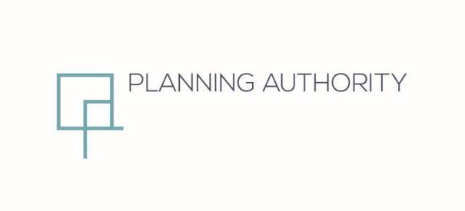
Partial Review to NWLP (2006)
Burmarrad
Commercial Area
Public Consultation Draft
December 2018

Slide 2
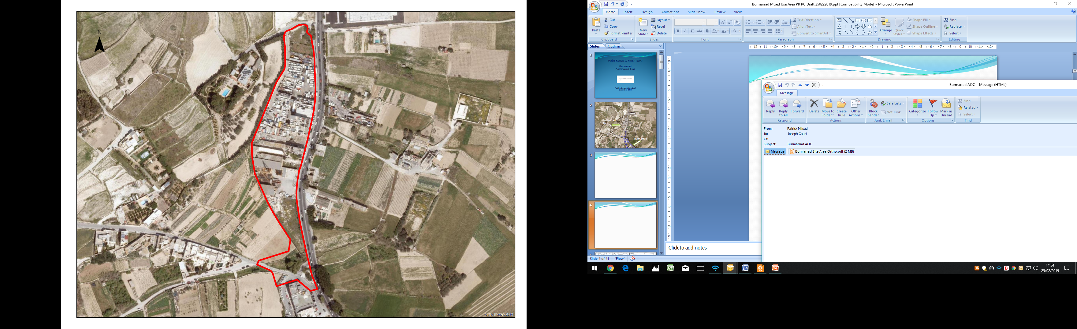
Burmarrad AOC
Burmarrad

Slide 3
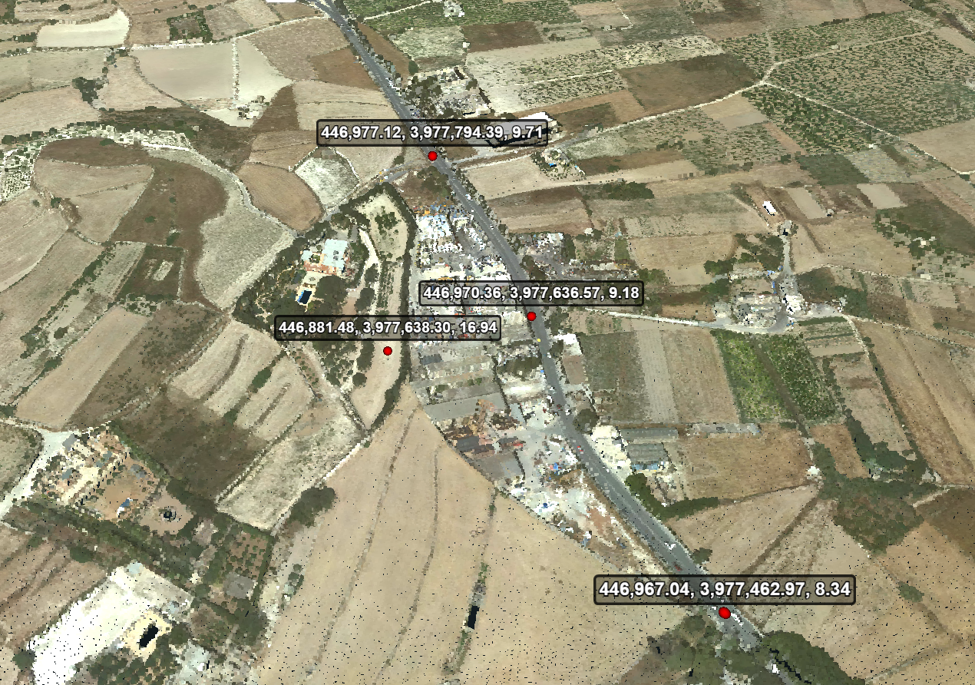

Slide 4
Government Objectives

Slide 5
18th October 2018 – Request by Government
8th November 2018 – issued for public consultation
30th November 2018 – end of public consultation
4 submissions received:
    1 private individual
    1 FAA
    1 private architect
    1 ERA

Slide 6
To designate the site currently covered by policies NWCM 8 and NWSP 26 of the North West Local Plan into a Commercial Area;
To formulate a development framework which is common for the whole site;
To remove the requirement for comprehensive planning;
To replace the currently allowable land-uses with those allowed in Category D of the Use Classes Order (SL552.15);

Slide 7
  To allow a maximum building height of 17.5m throughout the site;
  To revise or delete all other provisions in the current policies which are deemed to run counter to the overall objectives set out in (a) to (e) above.
  This review will require amendments to:
  The current provisions of policies NWCM 8 and NWSP 26 and map 45A of the North West Local Plan of 2006.

Slide 8
Amended Policy NWCM 8

Slide 9
NWCM 8 Areas of Containment
The Local Plan designates Areas of Containment in the following localities:
Burmarrad.
The boundary of this Area of Containment is shown on Area Policy Maps 45 and 45A.
The PA has reviewed operations within this Area of Containment and has prepared a scheme, as indicated in policy NWSP 26, identifying the range and scale of acceptable uses, mitigation measures to reduce negative impacts and access improvement schemes.
This existing built up area is being designated as an Area of Containment in order to prevent its further outward expansion. As far as possible the boundaries of the designated areas have been delineated to provide an appropriate building depth and block layout thereby improving the current irregular layouts.

Slide 10
Amended Policy NWSP 26

Slide 11
NWSP Burmarrad Commercial Area
  Containing development within the AOC boundary
  Reducing conflicts
  Introduce service road and upgrade junction
  Mitigate impacts on surrounding area

Slide 12
NWSP Burmarrad Commercial Area
Planning Parameters
  Class 4 uses
    4A offices (up to 30% of GDF)
    4B Retail
    4C and 4D (Food and Drink with/out cooking)
  Building Height Limitation 17.5 m from Triq Burmarrad
  3 m setback on upper two floors on side facing ODZ
  Underground development allowed under all site
  3 m pedestrian footpath along side of AOC facing ODZ
  Designed back elevations and party walls

Slide 13
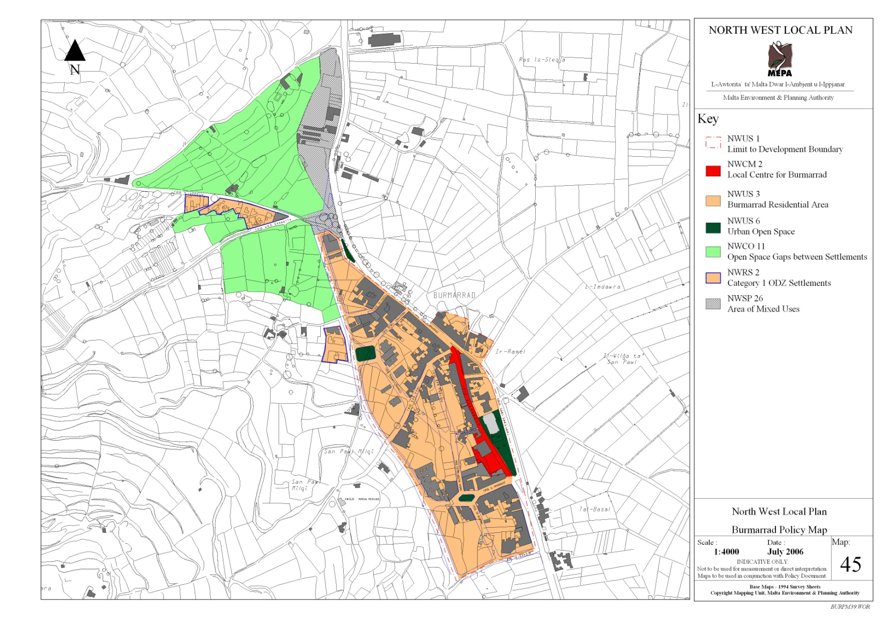
NWSP Burmarrad Commercial Area
Transport Measures
  Road widening
  Junction improvement
  8 m service road
  Cost of the service road, any road widening and the required junction redesign
Surrounding Context
  Existing yard used for heavy vehicle parking to be closed down and site rehabilitated

Slide 14


Slide 15
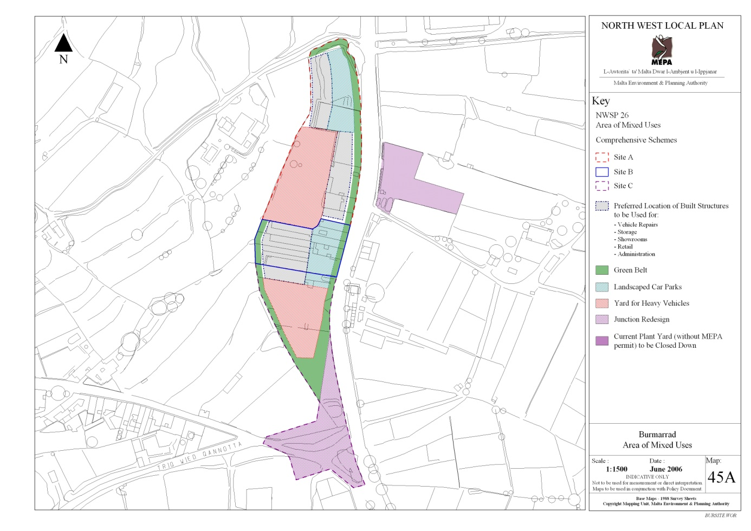

Slide 16
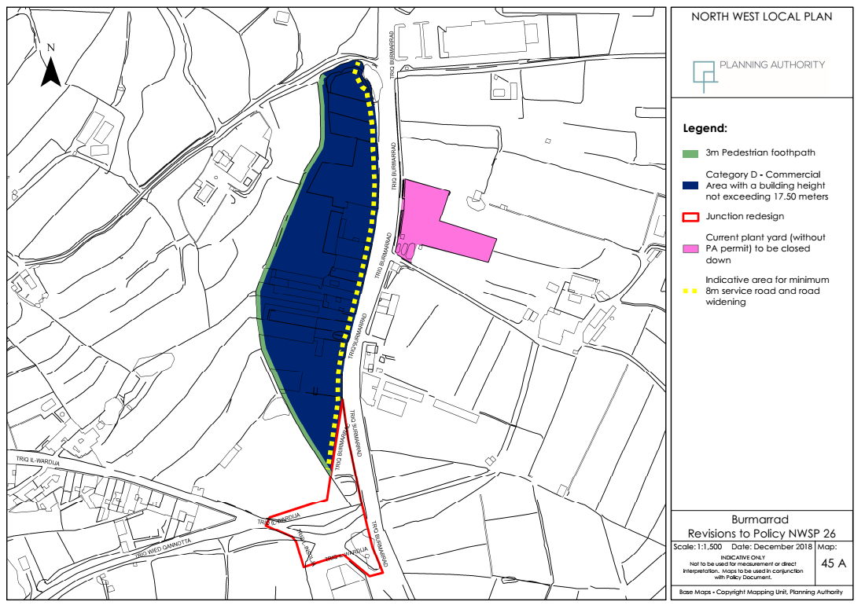

Slide 17
Public Consultation
19th February 2019 – 2nd April 2019
Nwlp.burmarrad@pa.org.mt

