Slide 1
An Investigation of Property Transfers between 2006 and 2013:
The Expropriation of the property at Fekruna Bay, st Paul’s Bay
Special Audits & Investigations

Slide 2
Background
  In 1996, Government expropriated foreshore of 1,347sqm to ensure public access to Fekruna Bay following residents’ concerns.
  The directors of Fekruna Ltd filed an application in the Constitutional Court against the CoL on 24 July 1996, citing that the expropriation breached their fundamental human rights.
  The Court declared the expropriation as null.
  Following the resolution of the court case through an appeal in 2004, whereby the former decision was revoked, Government acquired the foreshore through a contract dated 30 May 2007 for €1,174,046.

Slide 3
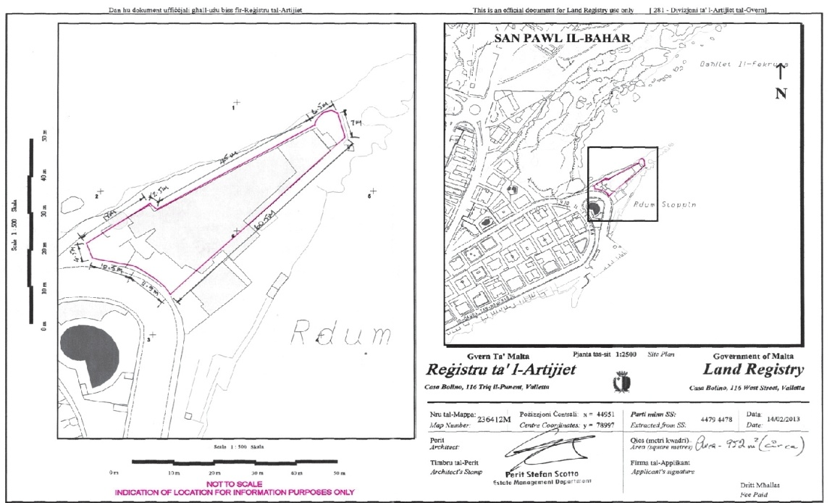
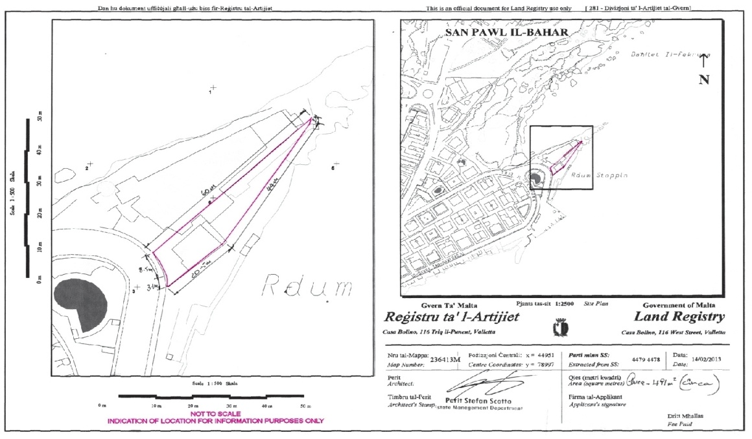
Background
  On 5 March 2013, Government and Fekruna Ltd entered into a contract of exchange whereby Government acquired the rest of the property at Fekruna Bay, valued at €4,972,007, and transferred land in San Gwann and Swieqi valued at €4,271,583 to Fekruna Ltd as compensation.

Slide 4
Terms of Reference
Good Governance
Transparency
Political Pressure
Accountability
Value for Money

Slide 5
Methodology
Interviews
Clarifications/queries
Documentation, incl. IAID report

Slide 6
Timeline
Date (2010) | Details
20 January | DG GPD informed Fekruna Ltd that Government was considering acquiring its property for a public purpose through an amicable agreement and requested it to submit a valuation. DG GPD also noted that a committee (PEC) had been set up to carry out negotiations.
6 February | Fekruna Ltd stated it was willing to negotiate, submitted a valuation of €6,750,000 and indicated its willingness to exchange the property with other government-owned lands or accept part exchange and part compensation.
9 June | Fekruna Ltd updated its valuation following a meeting with the PEC to between €6,750,000 and €7,500,000.
18 June | Following a review of Fekruna Ltd’s revised valuation, Adviser PS Revenues and Land estimated the property’s value at €5,000,000.

Slide 7
Timeline
Date (2010) | Details
28 June | In view of the considerable disparity, the PEC agreed to seek another valuation from an independent architect.
10 July | Architect D estimated the value at €5,000,000.
13 July | PEC requested Architect E to provide another valuation of the property.
27 July | Architect E valued the property at €5,100,000.
3 August | Secretary PEC informed Minister MFEI, through PS Revenues and Land, that three architects had all independently valued the property at €5,000,000. Authorisation to proceed with negotiations was requested.
8 October | Minister MFEI and PS Revenues & Land authorised the request.

Slide 8
Timeline
Date (2012) | Details
undated | Government-owned lands in San Gwann, San Pawl tat-Targa and Swieqi were identified for possible exchange.
21 January | Architect D’s estimate of freehold value of San Gwann site: €2,635,000.
23 January | Architect D’s estimate of freehold value of Swieqi site: €2,500,000.
18 April | In a meeting held between DG GPD and Director Fekruna Ltd, the issue of payment of capital gains tax was raised.
undated | A GPD file office note indicated that Director Fekruna Ltd deemed the valuations of the San Gwann and Swieqi sites as too high. DG GPD proposed the setting up of an arbitration committee (AC).

Slide 9
Timeline
Date (2012) | Details
November | AC submitted its valuation report to DG GPD. The San Gwann site was valued at €2,465,000, while the Swieqi site was valued at €1,806,583. Aggregate value of €4,271,583.
27 December | DG GPD referred AC report to Minister MFCC. Ministerial authorisation was requested for: GPD to obtain a written request from the competent Ministry to expropriate; the exchange of the San Gwann and Swieqi sites; and the lodgement of a request to MFEI for €725,000 (the remaining balance of compensation due to Fekruna Ltd) which would be immediately paid to the CIR for capital gains tax and duty on documents.
28 December | Minister MFCC granted approval.

Slide 10
Timeline
Date (2013) | Details
11 January | In correspondence to Minister MTCE, DG GPD indicated that a formal request was to be made for the expropriation.
16 January | The letter dated 11 January 2013 was acknowledged by the Private Secretary to Minister MTCE; however, no formal request by the Minister MTCE was made.
27 February | The CoL, through the DG GPD, requested Minister MFCC’s approval for the acquisition of the property at Fekruna Bay for €5,000,000 by absolute purchase.

Slide 11
Timeline
Date (2013) | Details
27 February | DG GPD granted approval.
28 February | Minister MFCC granted approval.
28 February | Fekruna Ltd informed DG GPD that the Company was willing to accept the sites at San Gwann and Swieqi as valued by the AC.
28 February | In correspondence addressed to Minister MFCC, DG GPD expressed concern over the imprudence of concluding the expropriation given the proximity of the general election.

Slide 12
Timeline
Date (2013) | Details
28 February | Minister MFCC instructed DG GPD to proceed, stating that the case dated back several years and that the process to identify the lands to be exchanged had commenced in 2010. Furthermore, the delay in sourcing funds was not attributable to GPD or MFCC and there was an evident public purpose.
4 March | The President’s declaration was published in the Government Gazette.
5 March | Contract of exchange between Government and Fekruna Ltd.
15 March | Demolition of the property at Fekruna Bay commenced.

Slide 13
Conclusions
Public Purpose
Governance
Arbitration
Prudence
Price and Value for Money

Slide 14
Public Purpose
Public purpose tied to Government’s efforts to acquire land outside development boundaries to:
  return it to its original state,
  ensure better public access, and
  preserve it for future generations.
Other sites had been identified by OPM and MEPA, but negotiations for their acquisition had stalled.
Although the property was within development boundaries, the expropriation served the intended public purpose.

Slide 15
Governance
The NAO considers the setting up of the PEC as a positive development, shifting negotiations from individual GPD officials to a committee.
The PEC retained adequate records of its meetings, allowing the NAO to verify key developments.
The property was within development boundaries and was included within a specific development zone in July 2006:
  residential as well as commercial use,
  increase in property value.
Developments in 2007 regarding the expropriation were deemed incongruent with the new classification and a shortcoming in good governance.

Slide 16
Governance
Decision to acquire property through amicable settlement differed from GPD standard procedure.
While somewhat anomalous, this was not in breach of statutory provisions.
Budgetary limitations lead to the resort to an amicable agreement and conditioned it to adopt different procedures.
Documentation for October 2010-January 2012 did not include any records of:
  meetings held between the DG GPD and the Director Fekruna Ltd,
  the identification of government-owned lands for exchange,
  how the Director Fekruna Ltd was informed of these sites, and
  initial negotiations on the valuation of the government-owned lands.

Slide 17
Arbitration Process
1. no set procedure for appointment of members on the AC.
2. unclear/no formal terms of reference.
3. decision to adopt the mean of the valuations of the San Ġwann site despite the Chair deeming the Government valuation more realistic.
4. gaps in documentation.
1. pragmatic course of action to address the disagreement, particularly in view of the indicated budgetary constraints.
2. GPD maintained control over the arbitration process.
3. ensured resolution within the intended timeframe.

Slide 18
Resort to Arbitration
The NAO maintains serious reservations regarding the resort to arbitration.
The Land Acquisition (Public Purposes) Ordinance allows agreement to be reached on expropriated land, but does not refer to the valuation of government-owned lands given in exchange.
The only provision regulating the exchange of government land is Article 13 of the Schedule (Article 3) of the Disposal of Government Land Act, which does not address this matter.
Arbitration, if any, was to be resorted to in the establishment of value of the Fekruna Bay property.
Negotiations on the value of government-owned land present an added and unwarranted risk to Government.

Slide 19
Prudence
This Office acknowledges the validity of arguments supporting prudence under the circumstances of the case.
However, the NAO similarly deems valid the drive to conclude a process that had long been outstanding.
No legal stipulation of what functions of government come to a halt, and when, once an election is announced.

Slide 20
Price and Value for Money
Fekruna Bay property was valued at €4,972,007. Lands in San Ġwann and Swieqi were valued at €4,271,583.
The difference (€700,424) was offset against amounts due by the Company for tax and duty (€721,544).
Government should recoup the overpayment (€21,119).

Slide 21
Price and Value for Money
Property / Land | IAID report values (€) | Contract of exchange values (€) | Difference (€) | Impact on public funds
Fekruna Bay, St Paul’s Bay | 4,097,000 | 4,972,007 | (875,007) | against
San Ġwann | 2,310,000 | 2,465,000 | 155,000 | in favour
Swieqi | 2,214,000 | 1,806,583 | (407,417) | against
Overall Impact |  |  | (1,127,424) | against
In the case of the Fekruna property, subjectivity could have been mitigated by not providing the architects engaged with the valuations.
The variance for the Swieqi site was partly attributable to the applicable development policies.

Slide 22
Price and Value for Money
Public purpose in comparison to outlay by Government.
Concerns emerge when one considers the adverse overall impact on public funds of €1,127,424, equivalent to 22.5 per cent of the €5,000,000 transaction.
Negotiating constraints imposed on the GPD rendering the ascertaining of whether value for money was secured by Government as debatable:
  the political commitment to achieve the objective of returning private land to the public,
  the timeframe within which this was to be attained, and
  that compensation was to be settled amicably through the exchange of land.

