Slide 1
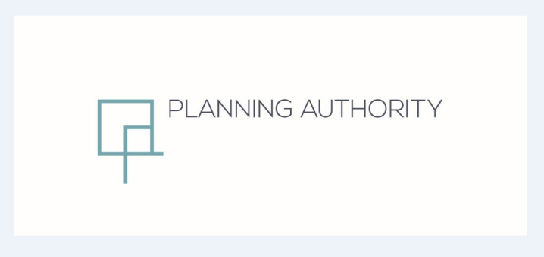
Partial Review to CMLP (2006)
Rationalisation Site at Is-Sghajtar
Mosta
Standing Committee on the Environment and Development Planning
Meeting 28th May 2018

Slide 2
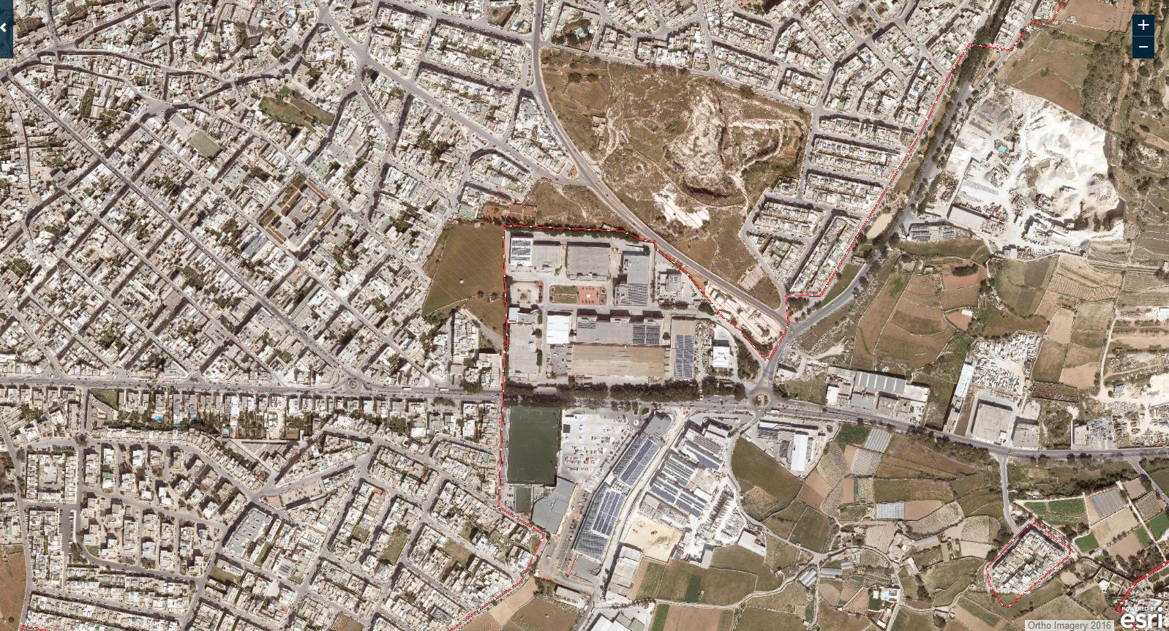

Slide 3
Objectives
The Objective of this Partial Local Plan Review has been set as follows:
• To establish building height, zoning and road alignments for the
rationalization site.
The public consultation was carried out from 24th November to 16th December 2016.
3 submissions were received

Slide 4
Objectives
Public comments as follows:
The allocation of a mixed-use area to serve as a transition from the
commercial zoning to the residential zoning.
• objection to access from Valletta Road
• adequate infrastructure and waste management facilities are to form part of the development;
• allocation of public open green space within the proposed scheme;

Slide 5
Policy Context - SPED
Policy TO1.7 requires the management of available space in a sustainable manner
Policies UO3.5, 3.6 , 3.7 and 3.9 control the proximity of non-residential uses in urban areas, building heights and densities and require protection and greening of open spaces

Slide 6
Policy Context – Local Plan
2006 Rationalisation of Development Boundaries Exercise allocated site as part of the development zone
2006 CMLP policy MO03 and Map MOB4 earmarked the land adjacent to the Mosta Technopark for predominantly residential development
Policy MO03 required a 6m landscaping buffer on the perimeter of the Mosta Technopark
Surroundings designated as a Residential Area with a building height limitation of 17.5m as per DC15

Slide 7
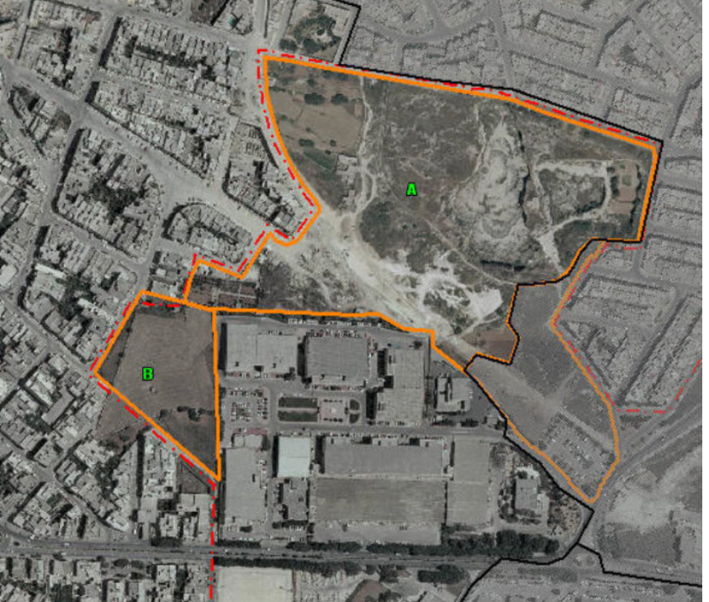

Slide 8
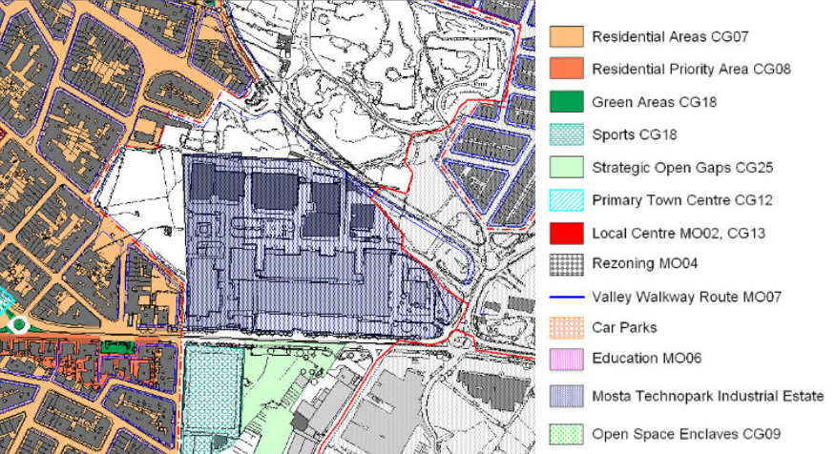

Slide 9
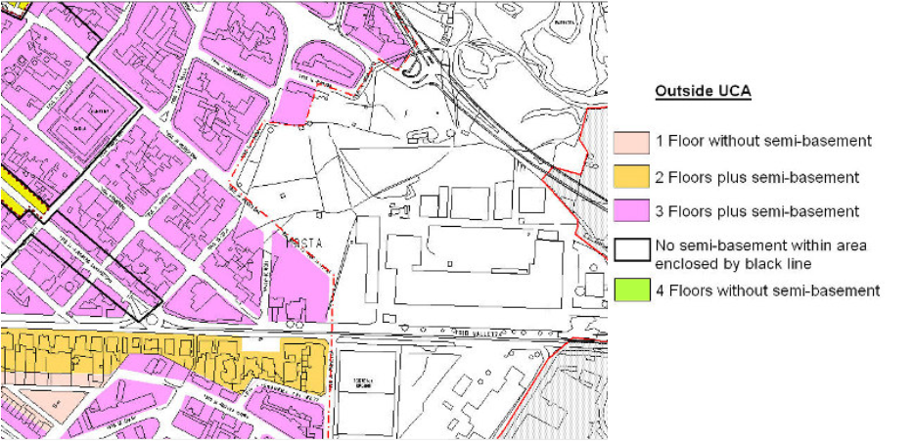

Slide 10
Policy proposals
Land use: Residential Area and Commercial Area as per local plan policies CG07 and CG14
Developable Area: around 12,300sqm
Public Open Space: around 3,400sqm
Building Heights: 17.5m as per DC15
Transport: Local roads, improved access onto by-pass as shown in layout scheme
Planning Gain: Monetary contribution to the Planning Fund towards the public open spaces at 55euros per sqm of developed footprint

Slide 11
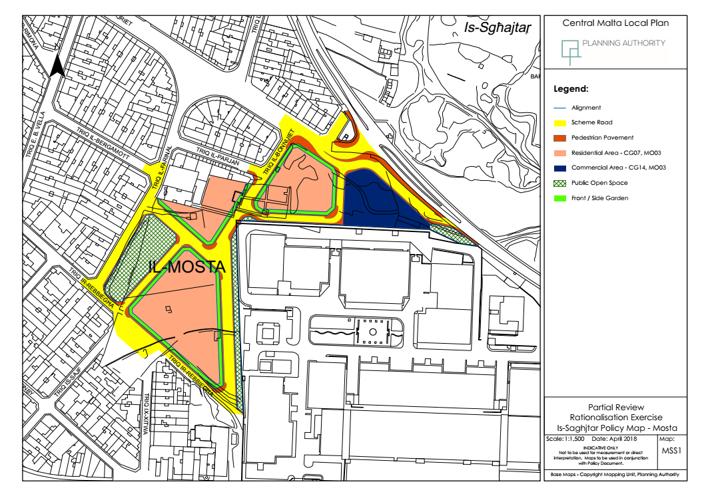

Slide 12
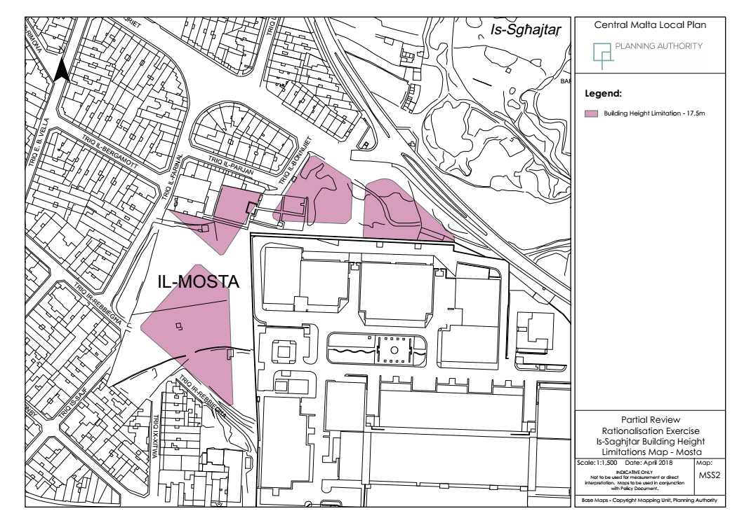

Slide 13
Public Consultation
Consultation open till 2nd July 2018
Submissions can be made to:
The Director of Planning
Planning Authority
Partial Local Plan Review of the Central Malta Local Plan (2006)
Is-Sgħajtar Site
St. Francis Ravelin, Floriana, FRN 1230
Or
mosta.sghajtar@pa.org.mt

Slide 14
Partial Review to CMLP (2006)
Rationalisation Site at Is-Sghajtar
Mosta
Standing Committee on the Environment and Development Planning
Meeting 28th May 2018

