Slide 1
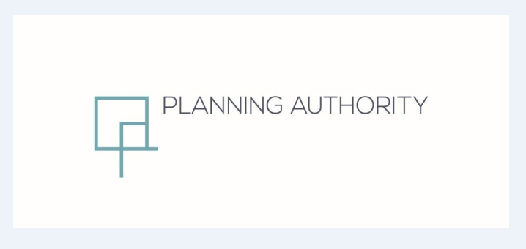
Partial Review to CMLP (2006)
Policy CG04
Maghtab Planning Strategy Area
Standing Committee on the Environment and Development Planning
Meeting 28th May 2018

Slide 2
Plan Adoption Process
Objectives received from Minister to prepare plan for Maghtab in August 2016;
2. Objectives published for consultation for three weeks in September 2016;
3. Draft Strategy published for consultation for six weeks in February 2017;
4. Parliamentary Standing Committee discussed strategy in March 2017;
5. Strategy approved by Executive Council without any amendments in May 2017;
6. Minister direction to carry out SEA Screening provided in August 2017;
7. SEA Screening process concluded no SEA is required in January 2018 ;
8. Discussion at Standing Committee - May 2018
9. Final Approval by Minister – to be provided

Slide 3
Objectives
A) To define the boundary for a Maghtab Planning Strategy;
B) To prepare a land use framework which designates distinctive character areas within Maghtab to address conflicting land uses;
C) To prepare a policy framework for each character area which seeks to:
Contain urban sprawl;
Protect the environment;
Strengthen agricultural activities;
Enhance residential amenity; and
Contain and regulate existing industrial and or commercial activities.
D) Identify additional measures to protect and enhance the character of the Maghtab Planning Strategy Area.

Slide 4
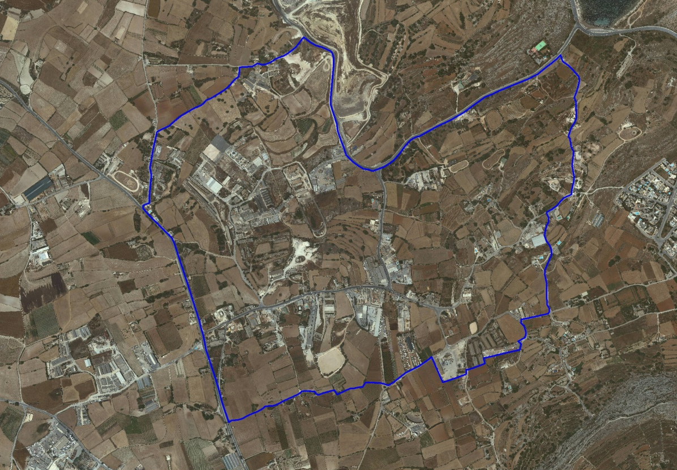
Maghtab Planning Area

Slide 5
Public Consultation on Objectives
Between the 19th September to 7th October 2016,
5 submissions received:
3 submissions from an SME garage industry and the Maghtab Residents Association showing an interest in the public consultation
1 submission relating to a large agricultural farming brownfield site requesting a change of use to light industrial and warehousing
1 submission that relates to a site outside the boundary of the area

Slide 6
Public Consultation on Draft Strategy
Between the 14th February 2017 and 30th March 2017.
15 submissions received – 14 individuals and ERA
11 submissions requesting further residential and industrial development;
2 submissions objecting to designation of animal husbandry area in close proximity to residences;
1 submission detailing landscaping requirements;
1 submission (ERA) mentions need to retain existing agricultural uses, clear illegal dumping, assess impacts from landfill on food production areas, mitigate noise and air pollution and detailed comments on individual policy provisions.

Slide 7
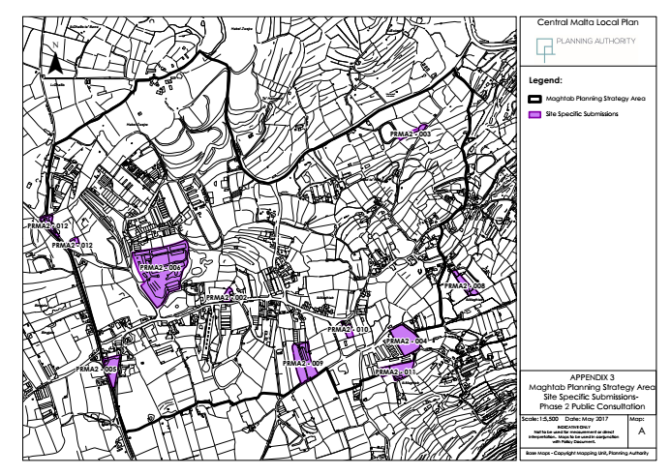

Slide 8
The Maghtab Planning Strategy Area - Issues
Lack of focused policy to address area specific issues
Conflicting land uses – animal farming, animal husbandry, residential, industrial
Deterioration of the rural landscape
Deterioration of residential amenity
Traffic and access

Slide 9
The Maghtab Planning Strategy Area – Policy Context
SPED Thematic Policies which safeguard rural areas from exploitation, control location design and operation of development, and seek mitigation of pollution
SPED Spatial Policies which protect good quality agricultural land, support agricultural development in rural areas, allow consideration of other development types, support the designations of rural settlements.
Central Malta Local Plan Policy CG04 for rural settlements
Rural Policy and Design Guidance 2014 provisions on agricultural and other development

Slide 10
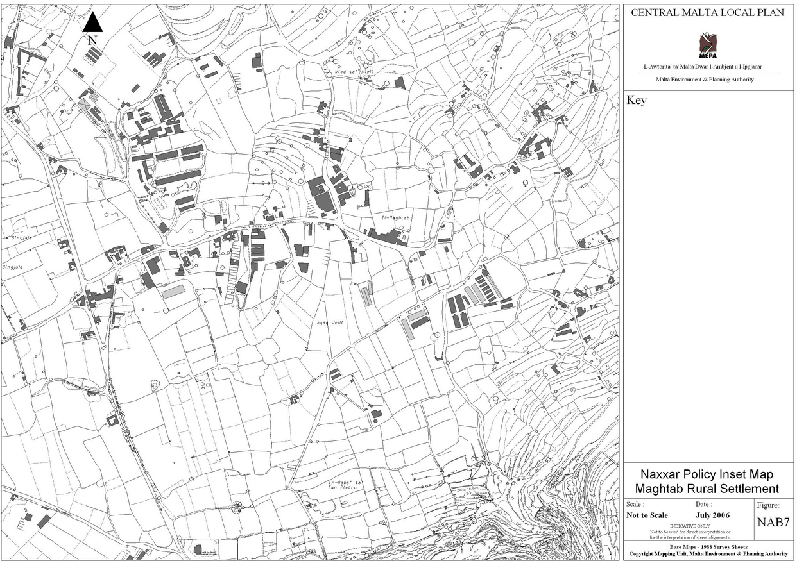
CMLP 2006

Slide 11
CMMB 01 The Maghtab Planning Strategy Area
The Strategy Area is subdivided into five main zones:
A) Animal Husbandry Area
B) (i) Arable Farming Areas
(ii) An Arable Farming Buffer Area
C) Maghtab Residential Settlement Area
D) Industrial Clusters and
E) Waste Management Utility Area
In cases of existing developments, the provisions of the Rural Policy and Design Guidance, 2014 (RPDG) shall be applicable.
Not Applicable to this area
Fireworks Factory Complexes Policy, 2014
Fuel Service Stations Policy, 2015

Slide 12
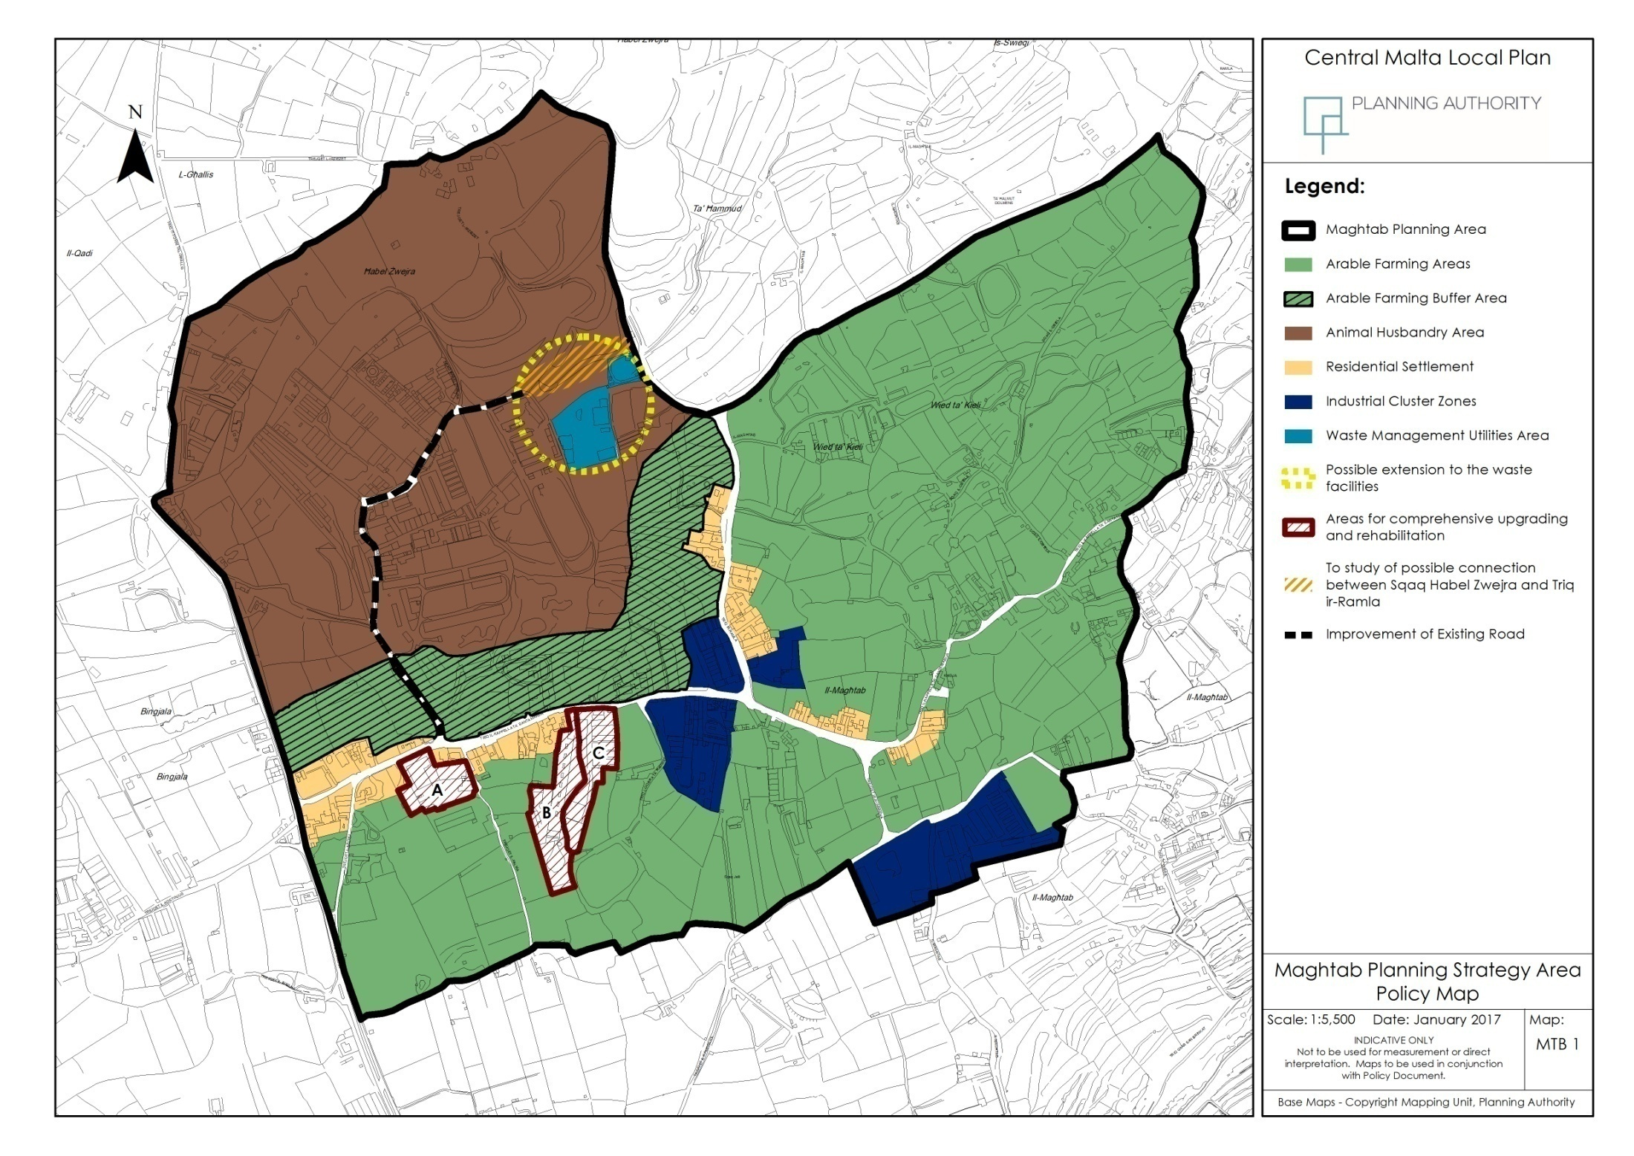

Slide 13
CMMB 02 Animal Husbandry Area
Consolidation, improvement, promotion and sustaining of the Animal Husbandry Area is through the upgrading of and extensions to existing and new Animal Husbandry Farms. Overarching requirements for upgrading, improvements and mitigation measures.
Applicable RPDG 2014 uses:
Policy 2.2A New farm dwellings for dairy or swine livestock
farmers
Policy 2.3A: Existing Livestock Farm Units (Including pre-1994 Farms)
Policy 2.3B: New or relocated Livestock Farms
Policy 2.4: Slaughterhouse development within operational livestock farms (rabbits and poultry only)
Policy 2.11 Small scale Photo voltaic Panels
Part 5: Animal Sanctuaries, Enclosures, Stables and Horse Riding/Sports Establishments

Slide 15
CMMB 03 Arable Farming Areas/Animal Farming Buffer Area
Improvement of land for arable and horticultural purposes in the Arable Farming Areas
Applicable RPDG 2014 uses:
Part 2 and Part 3
excluding the land uses relating to the policies and parts listed under Policy CMMB 02 - Animal Husbandry Area
No new animal farms or extensions within the Buffer Area

Slide 17
CMMB 04 Maghtab Residential Settlement Area
Designated as a Category 2 Rural ODZ Settlement where the provisions of CMLP (2006) General Policy CG04 apply excluding Sections B and C
Encroachments within the Arable Farming Areas shall only be considered provided the overall footprint of the proposed building does not exceed the 150 sqm in line with the provisions of Policy CG04.

Slide 19
CMMB 05 Industrial Clusters
Class 5A Light Industry
Class 5B General industry and
Class 6A Warehousing and Open Storage
The range of allowable industrial land uses within sites which already accommodate industrial activity shall be considered on a case by case.
Further development
Seeks to improve industrial activities and to reduce deleterious impacts on surrounding land uses.
Redevelopment or intensification
Leads to a general improvement in the site
The scale shall be considered within the context of existing development within the site and its immediate surroundings.
Introduction of mitigation measures to reduce impacts on adjacent residential land, including a 3m green landscaping buffer space.

Slide 21
CMMB 06 Site Specific Considerations
Sites A, B and C are identified for site specific consideration as sites that require comprehensive redevelopment due to their incompatibility with the proposed Residential Settlement
The following conditions apply:
Comprehensive planning
Redevelopment for residential development provided that each unit complies with Policy CMMB 04 in terms of footprint and floorspace
Site coverage is not to exceed 40% of the site area. The remaining 60% of the footprint is to be planned for access requirements, open space provision and green boundary landscaping treatment with tree planting
Overall height does not exceed two floors without semi basement
Development is to introduce rural design features within the new dwelling design
Underground development shall be restricted to the footprint of the building

Slide 22

Site Specific Considerations

Slide 23
CMMB 07 Waste Management Utilities Area
Extension, improvement and upgrading of existing and new waste management facilities, including the existing Maghtab Civic Amenity Site, will be supported
CMMB 08 Transport Access Improvements
Improve road access within the Maghtab Planning Strategy Area:
Sqaq Habel Zwejra and its connection to Triq ir-Ramla to introduce a more efficient circulation and access between the Animal Farming Area and the Waste Management Facilities and arterial road network

Slide 24
Partial Review to CMLP (2006)
Policy CG04
Maghtab Planning Strategy Area
Standing Committee on the Environment and Development Planning
Meeting 28th May 2018

