Slide 1
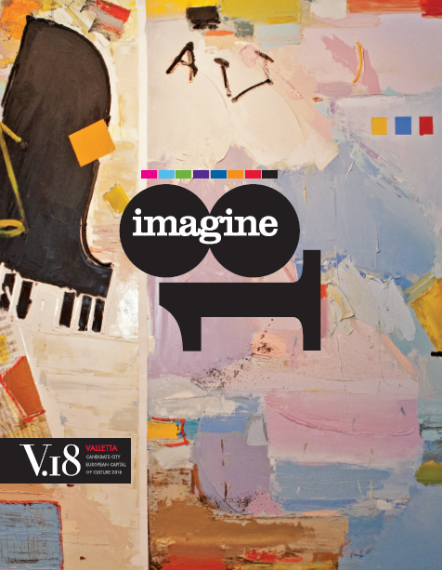

Slide 2


THE EUROPEAN CAPITAL OF CULTURE
  One of the most prestigious and high-profile cultural events in Europe.
  Title awarded to one city in 2 Member States each year.
  Cities can choose to include a surrounding region to amplify its impacts.
Selection based on the European dimension and city and citizens dimension.
VALLETTA CANDIDATE CITY EUROPEAN CAPITAL OF CULTURE 2018

Slide 3
WHAT MAKES A SUCCESSFUL ECoC?
BENEFITS & RISKS
Cultural, Economic and Social Benefits
Needs excellent concept and planning, time, money, political consensus, continuity…
THE CHALLENGES
To make every Capital a success
For each Capital to leave a legacy
VALLETTA CANDIDATE CITY EUROPEAN CAPITAL OF CULTURE 2018

Slide 4
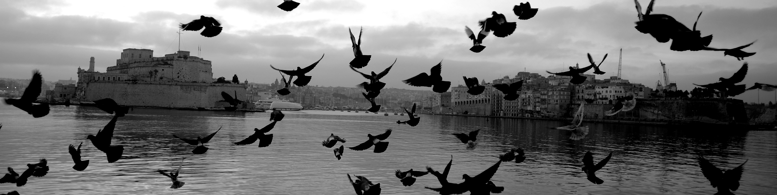
VALLETTA 2018
The Inter-Ministerial Commission for the ECoC was set up in 2009
Charter signed by all Local Councils in December 2010
The V.18 bid includes all of the Maltese Islands
One year ahead of process
VALLETTA CANDIDATE CITY EUROPEAN CAPITAL OF CULTURE 2018

Slide 5
VALLETTA 2018
V.18 passed through Pre Selection in January 2012
In October 2012, V.18 passed through the Final Selection Stage
It will be officially declared an ECoC in May 2013
Valletta will be one of the southernmost ECoCs ever
A unique European and Mediterranean dimension
VALLETTA CANDIDATE CITY EUROPEAN CAPITAL OF CULTURE 2018

Slide 6
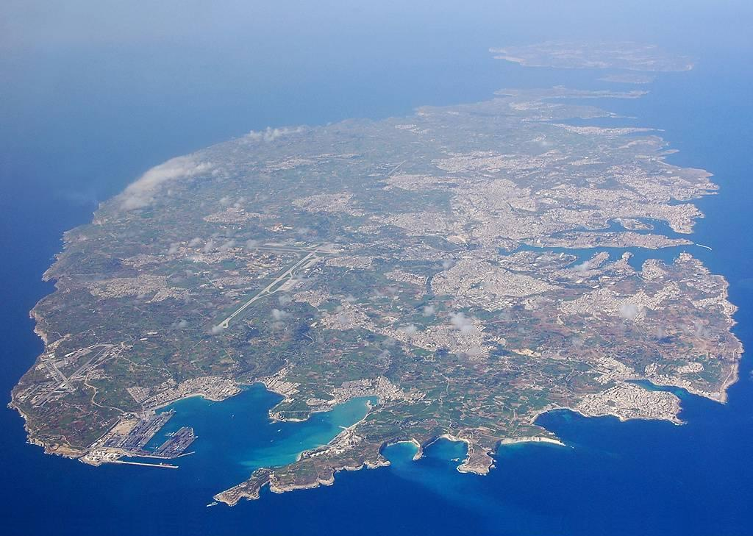
The V.18 bid is carefully designed to be inclusive
of all of Malta.
VALLETTA CANDIDATE CITY EUROPEAN CAPITAL OF CULTURE 2018
Notes:
Valletta, and hence Malta, has a unique geographical positioning
Our bid is carefully designed to be inclusive of all of Malta.

Slide 7
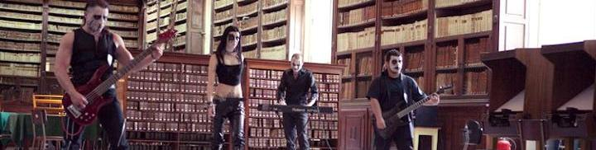
OVERALL VISION
An Environment of Exchange through Culture-Led Regeneration
Valletta and Malta as a lab for communication & creative expression
Building on existing initiatives, policy and infrastructure
To cause change in our cultural, economic and social landscape
Strategic and sustained change
Establish a legacy for as many people as possible
VALLETTA CANDIDATE CITY EUROPEAN CAPITAL OF CULTURE 2018

Slide 8
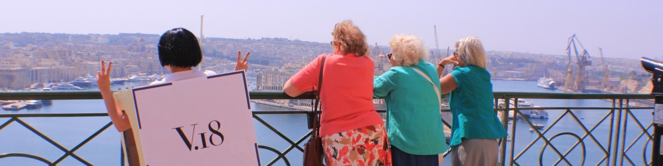
CONCEPT
Promote a mentality shift
Encourage people to experiment
Break through insularity and isolation
Develop a programme of excellence
Engage with everyone
Be of relevance to European partners & audiences
VALLETTA CANDIDATE CITY EUROPEAN CAPITAL OF CULTURE 2018

Slide 9
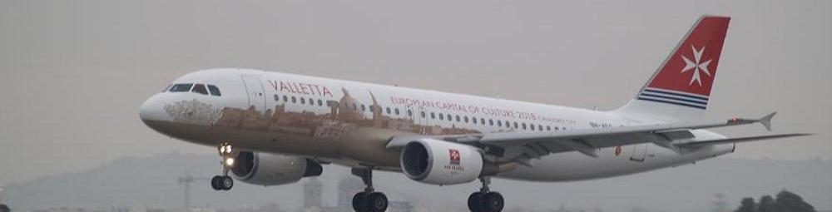
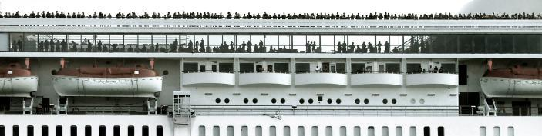
CHALLENGES
Capacity Building
Built Infrastructure
Digital Infrastructure
VALLETTA CANDIDATE CITY EUROPEAN CAPITAL OF CULTURE 2018

Slide 10
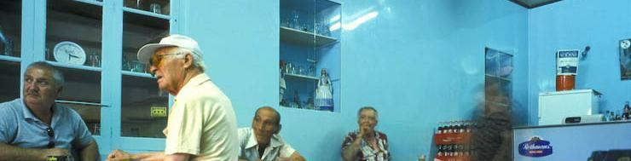
OBJECTIVES
  Making Careers of Culture
  Growing Internationally from the World within us
  Establishing Valletta as a Creative City
  Nurturing Sustainable Relationships with our Environment
VALLETTA CANDIDATE CITY EUROPEAN CAPITAL OF CULTURE 2018

Slide 11
THE PROCESS TO FINAL SELECTION
Engaging with public
Bottom-up approach
Thematic Area Coordinators
University of Malta
Developing skills
MCAST
Young Creatives
VALLETTA CANDIDATE CITY EUROPEAN CAPITAL OF CULTURE 2018

Slide 12
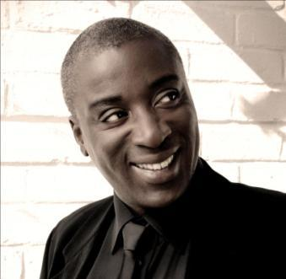
ARTISTIC DIRECTION
Internationally renowned conductor Wayne Marshall appointed as ARTISTIC DIRECTOR
Creative theatre artist and practitioner, Marc Cabourdin
Writer, actor, drama teacher and director, Coryse Borg
Lecturer & Artistic Director of the Malta Arts Festival, Mario Frendo
Trans-media writer, producer and lecturer, Jean Pierre Magro
Active theatre maker and actor, Paul Portelli
Visual artist, author, lecturer and curator, Raphael Vella
Composer, musician & Artistic Director of Għanafest, Ruben Zahra
VALLETTA CANDIDATE CITY EUROPEAN CAPITAL OF CULTURE 2018

Slide 13
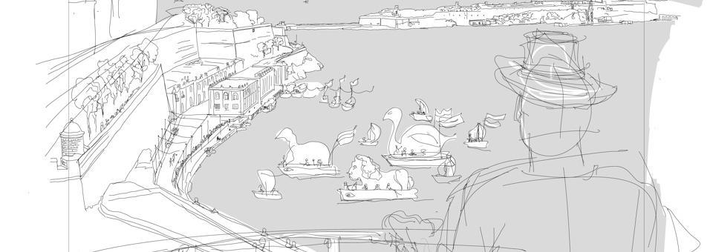
THE PROGRAMME
Engaging with the Public
Inclusive not Selective
Merging of better ideas to develop Potential
Focus on European Dimension
Balance between Projects and Overall Programme
VALLETTA CANDIDATE CITY EUROPEAN CAPITAL OF CULTURE 2018

Slide 14

THEMES
Generations
Routes
Cities
Islands
VALLETTA CANDIDATE CITY EUROPEAN CAPITAL OF CULTURE 2018

Slide 15
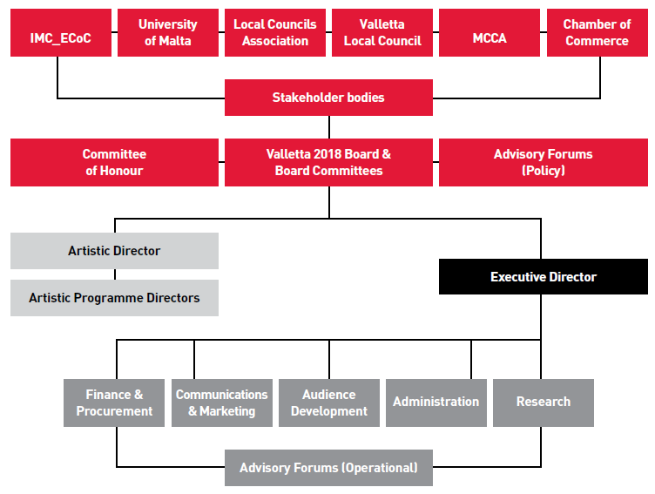
ORGANISATION & GOVERNANCE
VALLETTA CANDIDATE CITY EUROPEAN CAPITAL OF CULTURE 2018

Slide 16
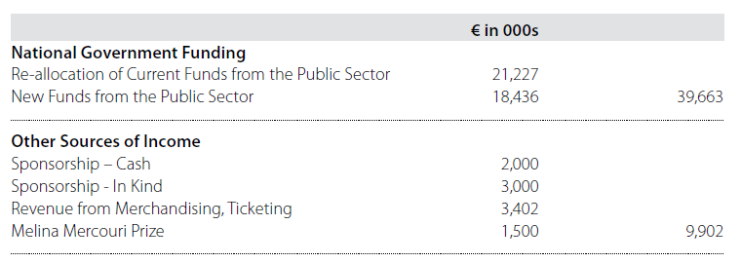
FINANCE
Sources of Income
Total Income
49,565
VALLETTA CANDIDATE CITY EUROPEAN CAPITAL OF CULTURE 2018

Slide 17
FINANCE
VALLETTA CANDIDATE CITY EUROPEAN CAPITAL OF CULTURE 2018

Slide 18
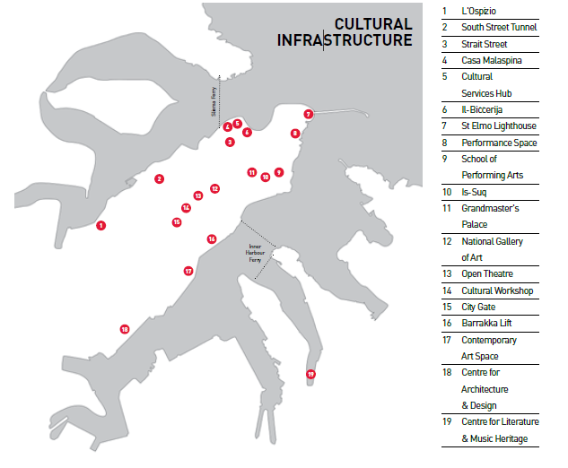
CULTURAL INFRASTRUCTURE
Cultural Infrastructure Projects Proposed and Supported by V.18
VALLETTA CANDIDATE CITY EUROPEAN CAPITAL OF CULTURE 2018

Slide 19

COMMUNICATION
Vision Revisited
National and EU dimensions
Artistic Direction
Links with Education
Public Goodwill and Participation
Media
Online and Social Web
Infrastructure Projects
VALLETTA CANDIDATE CITY EUROPEAN CAPITAL OF CULTURE 2018

Slide 20
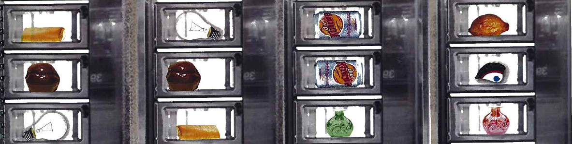
EVALUATION
Long-term evaluation
European networks support
Building on best practice and established models
Collaboration with University of Tilburg through
Eindhoven candidacy for 2018
Local networking and maximizing resources
VALLETTA CANDIDATE CITY EUROPEAN CAPITAL OF CULTURE 2018

Slide 21
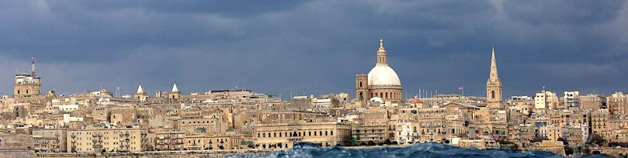
ROADMAP
May 2013 – Official Designation by the EU Council of Ministers
2014-2017 – Two Monitoring Meetings
2016 – Valletta 450th Anniversary
2017 – EU Presidency, 1st semester
2018 – Valletta 2018
Post 2018 – Strategy for Legacy
VALLETTA CANDIDATE CITY EUROPEAN CAPITAL OF CULTURE 2018

Slide 22
2013
2013 is an ‘extra’ year
First steps towards revision and definition of Cultural Programme
This process will be driven by the Artistic Direction Team, but structured by Executive Team
VALLETTA CANDIDATE CITY EUROPEAN CAPITAL OF CULTURE 2018

Slide 23
2013 - 2015
The definition of the Cultural Programme during this period will take place in direct relation to
The coordination of activities at local council level
The mapping and development of cultural infrastructure projects
The submission for, evaluation of and implementation of plans for Structural Funds-supported projects
The development of synergised education projects
The development of synergised community projects
The consolidation of the cultural framework in Malta in terms of governance, legal initiatives, economic and financial interventions, the establishment of Creative Europe and cultural practices and programming in general.
VALLETTA CANDIDATE CITY EUROPEAN CAPITAL OF CULTURE 2018

Slide 24
Intensive coordination will allow for the devising of projects in the Cultural Programme along three main strands:
Projects commissioned by the Foundation on a national and international level
Projects submitted for evaluation, joint development and selection by the artists, cultural operators, civil society organisations (CSOs) and cultural institutions to the Foundation
Projects commissioned by the Foundation on a local and micro level.
VALLETTA CANDIDATE CITY EUROPEAN CAPITAL OF CULTURE 2018

Slide 25
2016 - 2018
Final phase of review of plans for Cultural Programme
Review, development and finalisation will take place on the basis of the evaluation and assessment of the projects already established
2016 Support the celebrations for 450th Anniversary of the founding of Valletta
2017 Participate in the cultural programme marking the Presidency of Malta of the EU
VALLETTA CANDIDATE CITY EUROPEAN CAPITAL OF CULTURE 2018

Slide 26
2019 - 2020
The legacy phase is crucial to the success of Valletta 2018 over the long term.
BORDERS
VALLETTA CANDIDATE CITY EUROPEAN CAPITAL OF CULTURE 2018

Slide 27
MALTA TO HOST ECOC IN 2031
Malta will be hosting the title of European Capital of Culture in 2031 together with Spain.
VALLETTA CANDIDATE CITY EUROPEAN CAPITAL OF CULTURE 2018

