Slide 1


CONNECTING THE DOTS
The holistic service uniting all fronts in the fight against gender-based violence
LITTLE BITS AND BOBS

Slide 2


Who we are?
A group of professionals, survivors and activists who see solutions, not only challenges
What brought us together?
  The desire to create a service that is truly responsive
  The desire to change and tie together the existing services
2

Slide 3
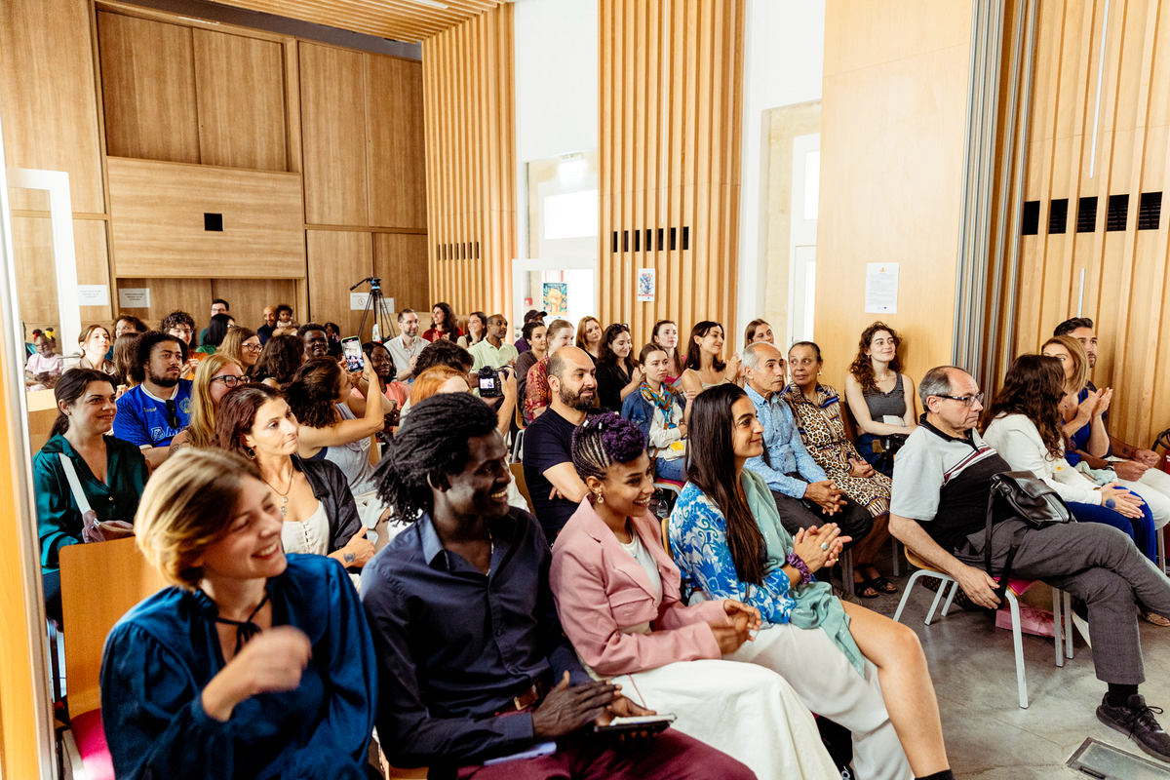

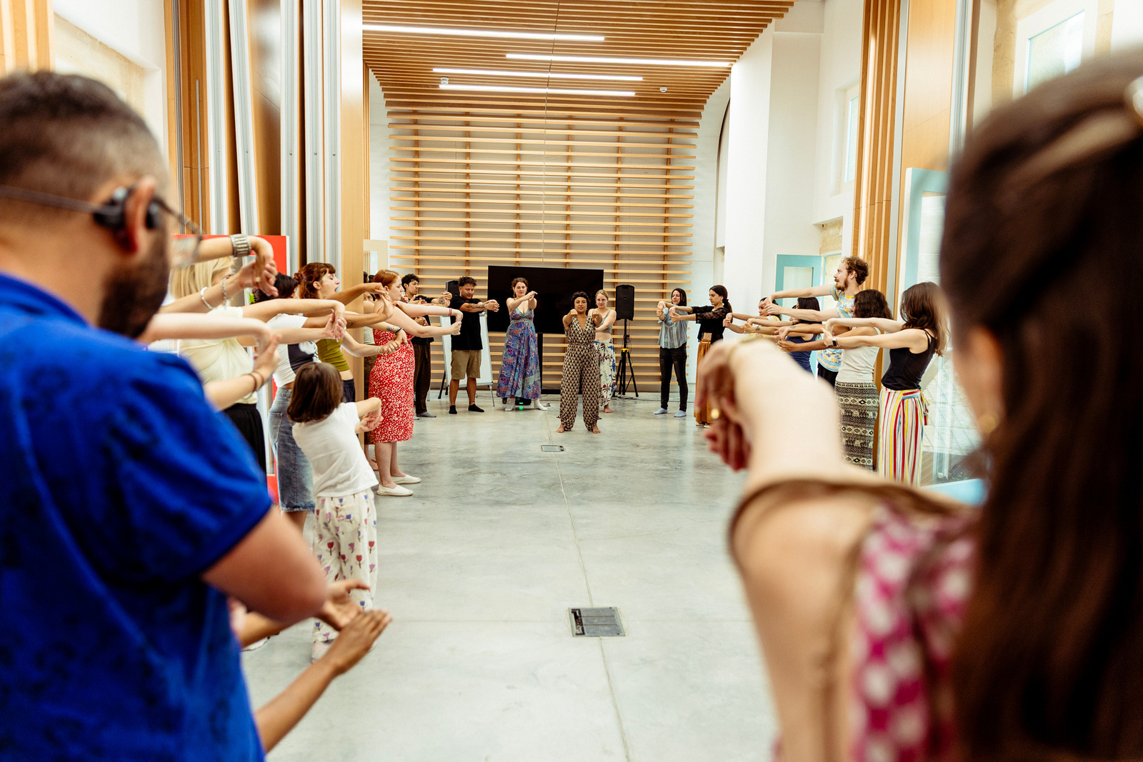
TAMA: A Brief History
Started in 2020, after a number of professionals from different NGOs and entities joined forces to create an organization that is truly able to address gaps in the system
For f ive years, we have collected data and piloted services:
    FGM perceptions
    Disability awareness
    Holistic, trauma-informed services for survivors of sexual and gender-based violence
    Training services for the education department
3

Slide 4

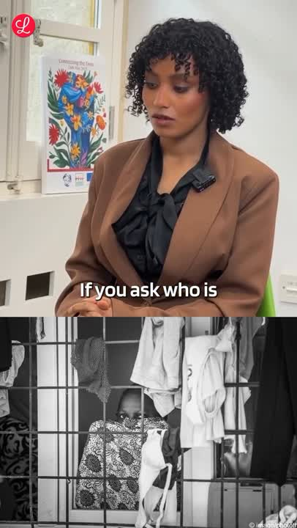
Our Work
For four years, we’ve piloted several services and areas of interest:
  FGM awareness raising campaign in reception centers, community perception survey, and a capacity building program.
  Disability rights awareness raising campaign.
  SGBV campaigning, awareness raising, community perception gathering and support services.
  SGBV survivor empowerment
  SGBV case management, initially providing psychological services to children in centers, then moving on to prevention and response.
  Sexual health campaigning.

Slide 5
Current Focus
Eventually, our areas of work have crystallised in two main areas of interest:
Capacity building for government agencies and service providers – multi-agency involvement is critical in any fight against any form of SGBV
Community based services in trauma-informed holistic health

Slide 6

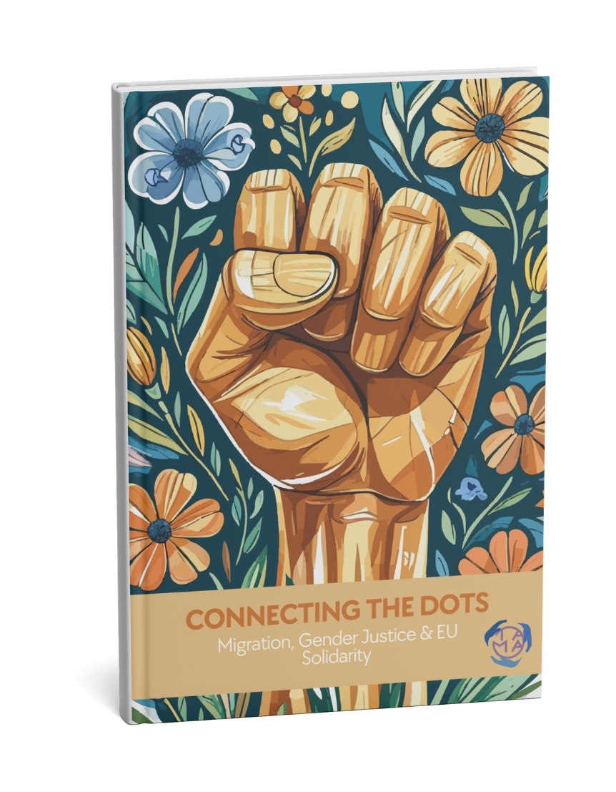
‘Connecting the Dots‘
The Handbook
Women and security are closely linked; where there is safety for women in a country, there is security.
How the handbook came to be:
TAMA’s institutional experience, along with feedback from the Bridging Borders advisory group and SGBV survivors from our community.
Basic principles laid out in the Handbook:
Versatile trauma informed approaches that allow any institutional partner to use
Culturally informed practices to facilitate community trust with institutions

Slide 7
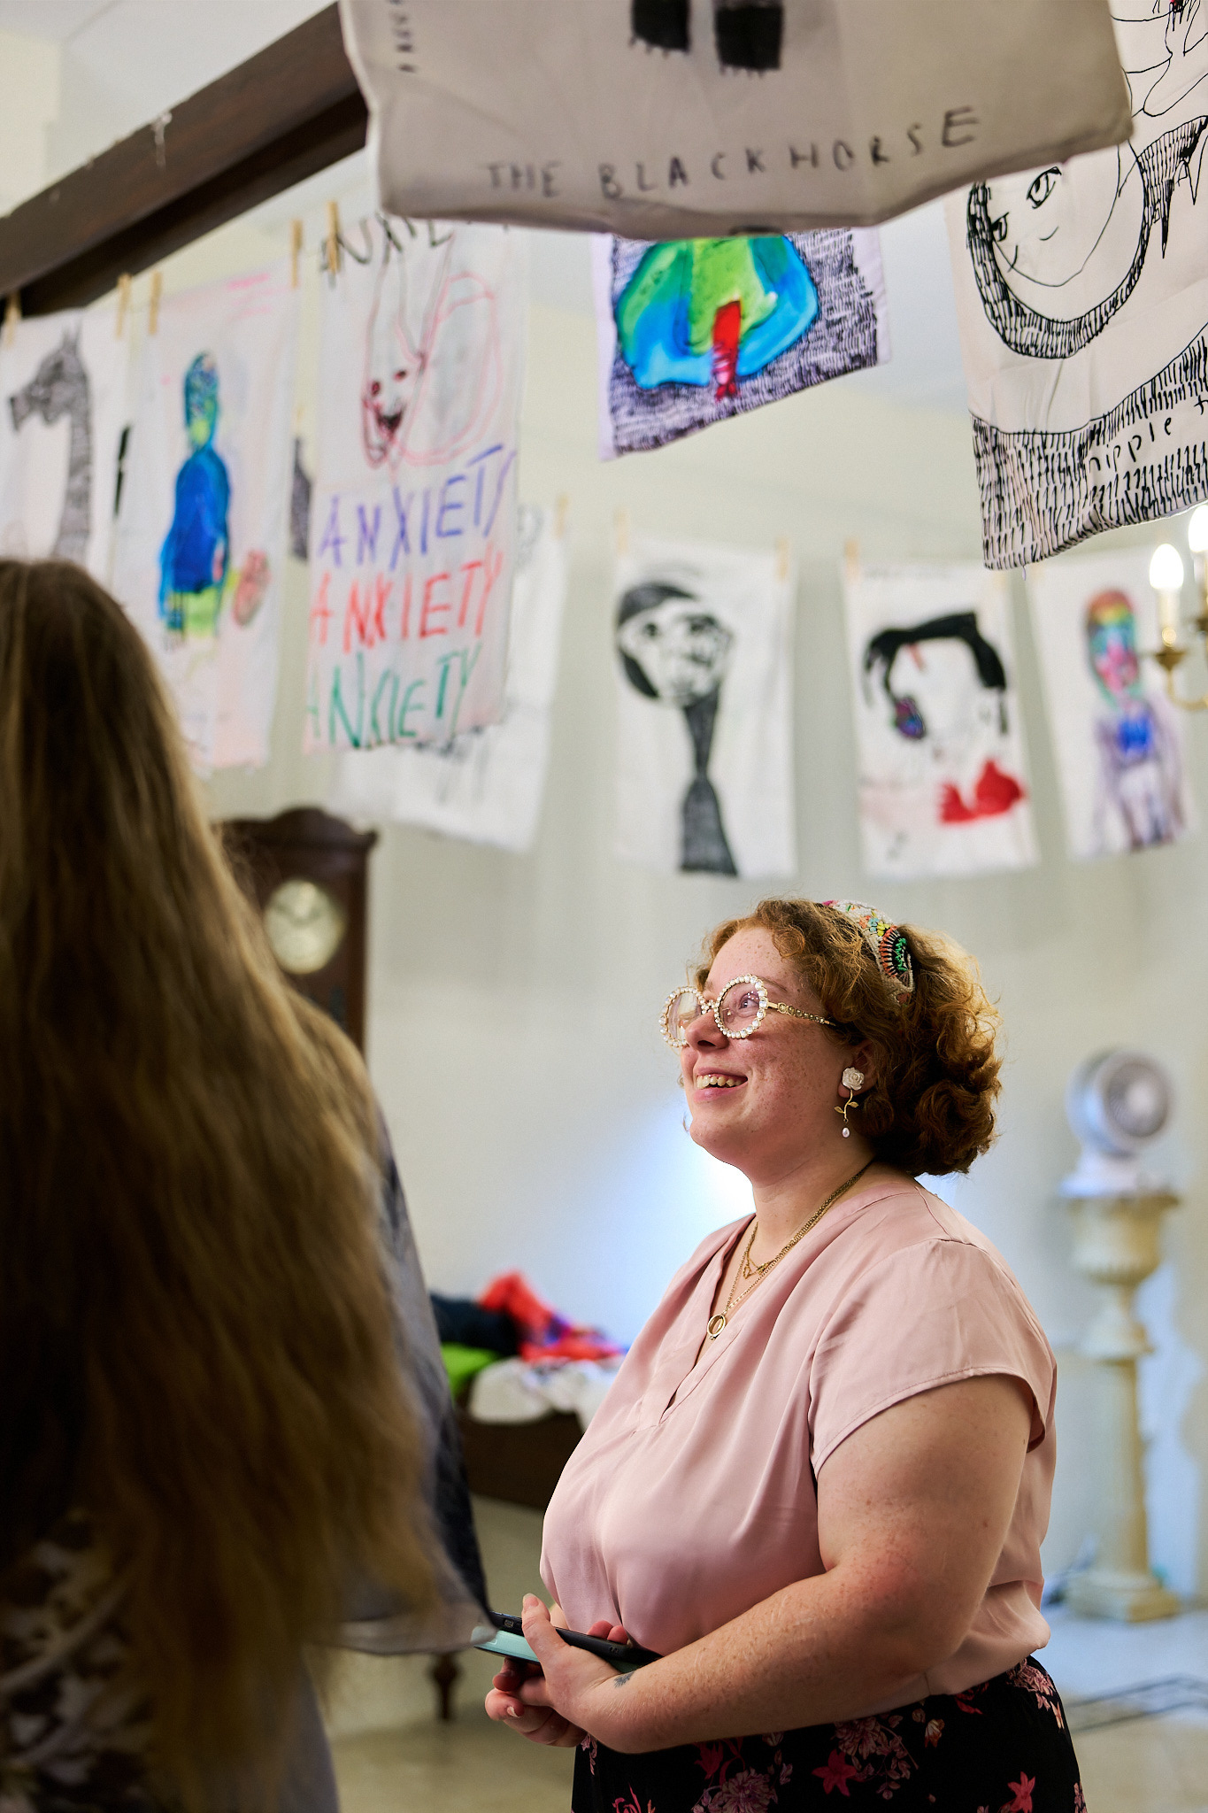
What we have learnt
We cannot establish safeguards without trust and trauma-informed practices
Here is what the community has had to say.
VSA and NSSS agents were highly welcoming but acknowledged that the first line of contact isn’t them.
VSA also welcomed referrals on suspected cases of FGM from NSSS

Slide 8
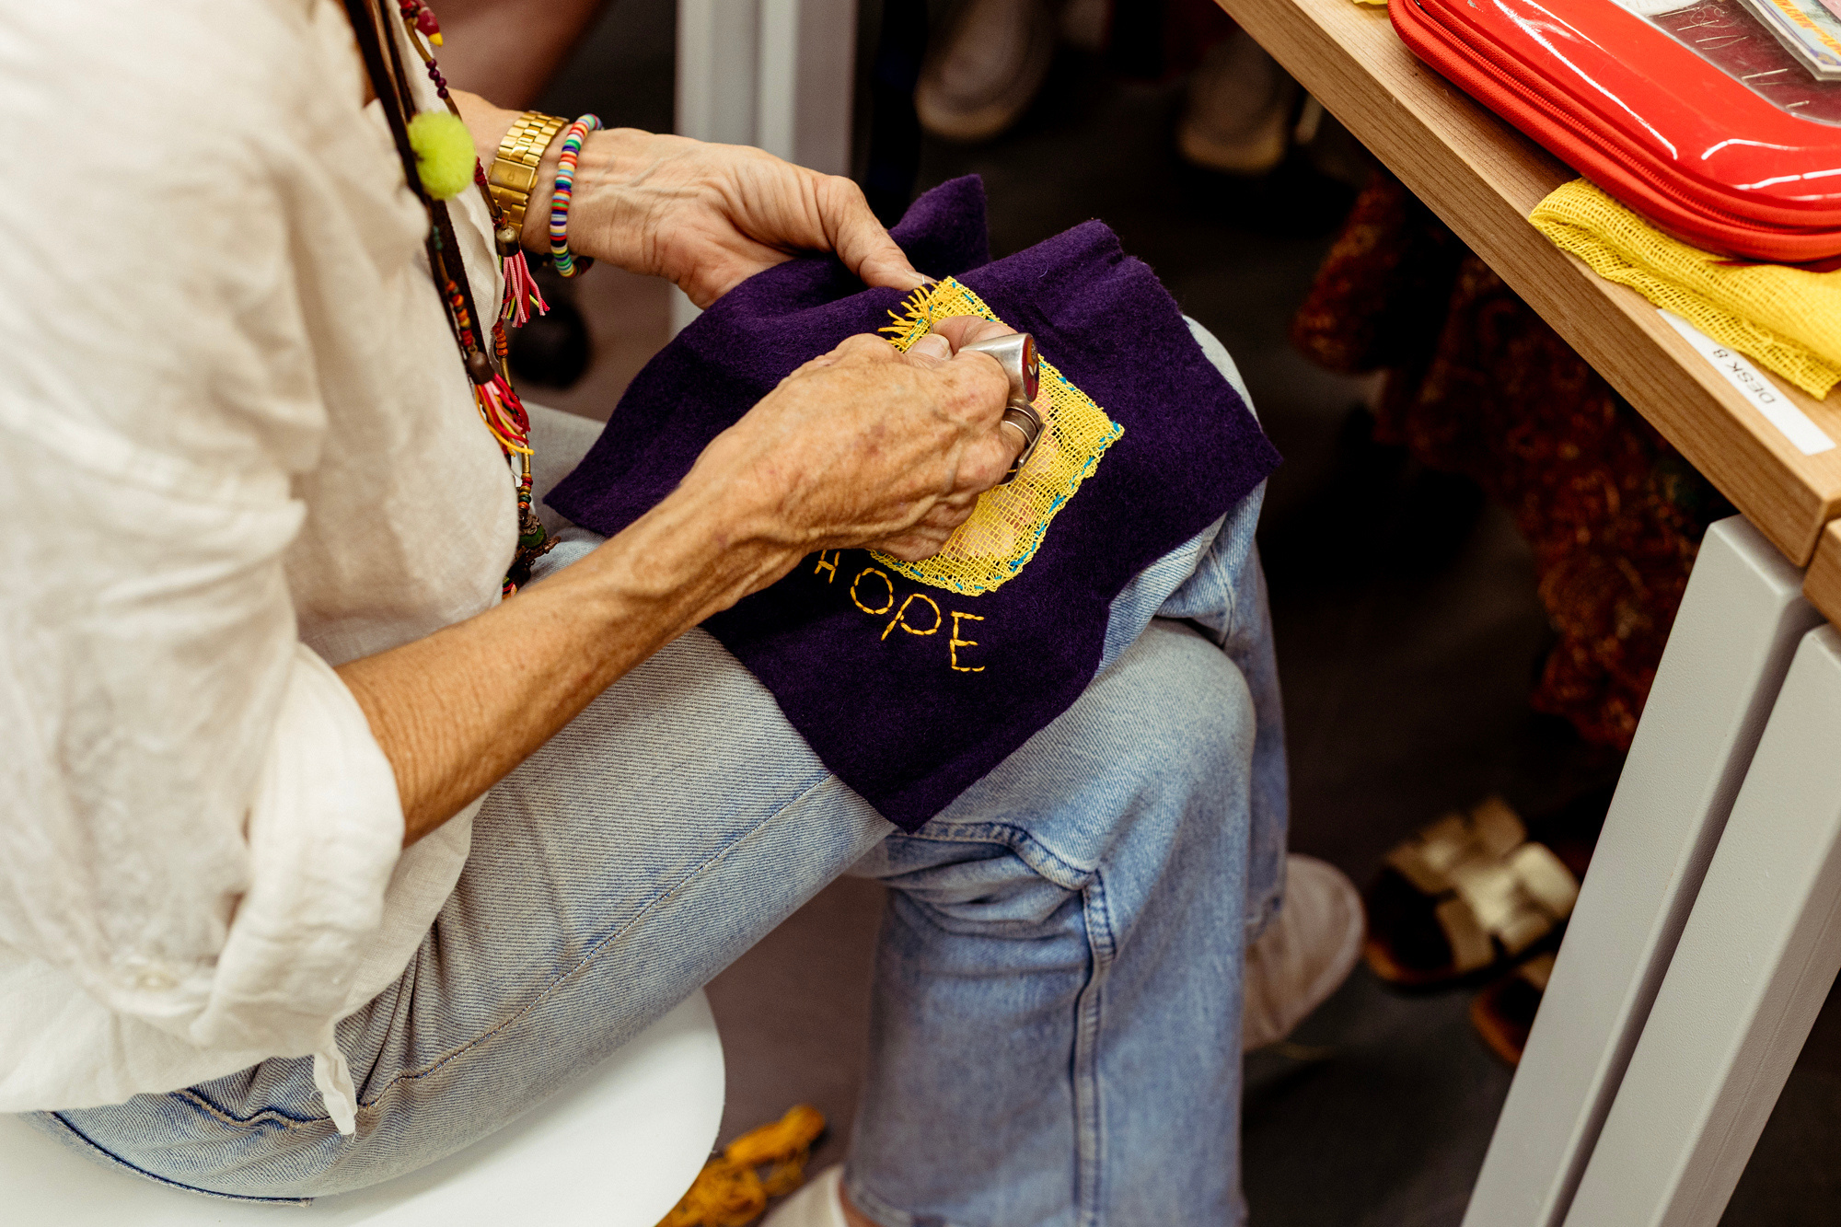
‘Connecting the Dots’
The Service
Holistic services which centralise ALL survivors. Most therapies deployed through this are non-verbal and therefore are culturally portable.
Prevention work
  The University of Malta, The Commissioner for Gender Based Violence and Domestic Violence, Victim Support Agency, Victim Support Malta, Agency for Welfare of Asylum Seekers, the National School Support Services, Queen Mary Medical University, have already either expressed interest or benefitted from tailored workshops.
  Prevention work can assist in raising efficiency at the level of reporting, and case management

Slide 9

‘Connecting the Dots’ The Service
High cost-benefit analysis:
  Group breathwork sessions address a wide variety of cultures, require limited interpreted support, and offer great impact in reducing trauma related symptoms
  Capacity building sessions: adequate training ensures policy implementation. In cases of newly developed policies, adding procedural safeguards can improve policy adherence

Slide 10
“YOU CAN EXPLAIN IT A THOUSAND WAYS, BUT YOU ONLY START TO UNDERSTAND BY LIVING IT.”
Thank You

