Slide 1

Office of the Commissioner for Children
Annual Report 2024
A selection of issues tackled, initiatives taken & recommendations made by the Office in 2024
Presentation to the Parliamentary Social Affairs Committee
29th October 2025

Slide 2
International Background
Escalation of wars in Ukraine and Middle East
Political success of far-right parties with anti-human rights ideology
Intensification of AI race
Global economy not yet back to pre-pandemic levels

Slide 3
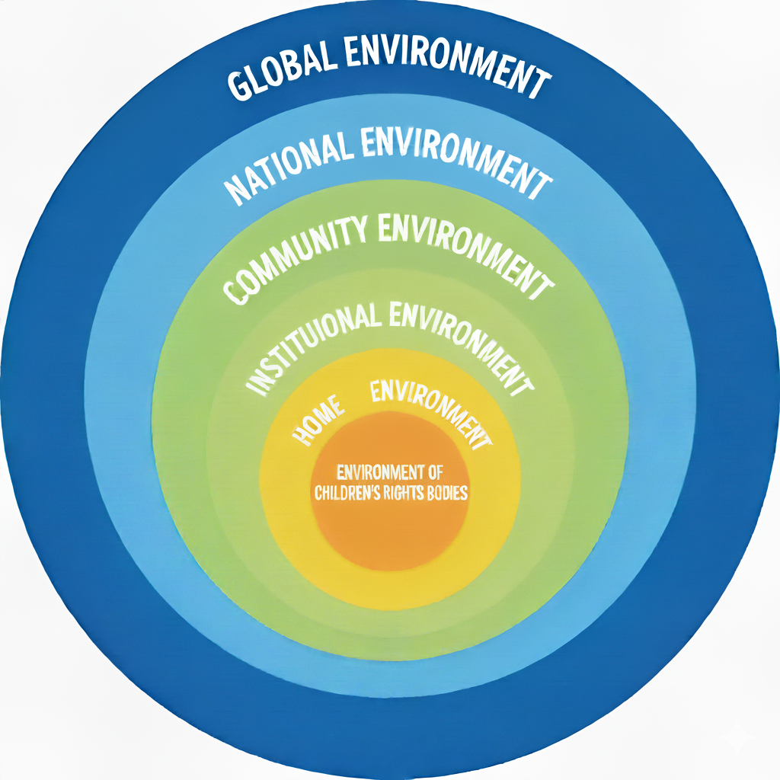
Structure
Children’s Rights Environments

Slide 4
Global Environment
Issues | OCFC Initiatives | OCFC Recommendations
Child Human Trafficking | Recommendations by CAB Rights4u workshop | Child-friendly version of the National Strategy and Action Plan on Combating Trafficking in Human Beings in Malta (2024-2030)
Internet Safety | Focus groups with over 200 children on Digital Services Act Study of prevailing patterns of use of digital technology by children in Malta Video and toolkits | Task force to assess implementation of the recommendations from study Monitor and evaluate outcomes of legal restrictions on children’s use of social media in France and Australia Extend remit of National Addiction Advisory Board to include problematic internet use Monitor emerging research into effects of AI on children
Age-appropriate films | Office participation in Film Classification Board | Expand use of films in schools to educate children on important issues Expand use of films in schools to educate children on important issues
Participation | EC advisory board on child participation | Enhance children’s knowledge of and participation in content and process of decision-making within EU structures.

Slide 5
National Environment
Issues | OCFC Initiatives | OCFC Recommendations
Child Participation | Focus groups in 15 schools Creativity competition to celebrate Office’s 20th Anniversary Development of tool to measure impact of child participation (VUĊI) | Produce large-scale murals and sculptures that are inspired by what children say Promote use of VUĊI Require all public or private entities that work with or for children to undergo training in use of child-friendly language, formats and means of communication.
Sexual Activity | Office position statement | Publish periodic reports on implementation of National Sexual Health Strategy 2025-2030
Mental Health | EU funding for ‘Empowering a Mentally Healthy Generation’ project | Strengthen resilience and mental health literacy in children and their significant others as part of A Malta Health Strategy for Malta 2020-2030.
Road Safety | Participation in Road Safety Council | Assess outcomes and update content of Malta’s Road Safety Strategy Give children frontline role in national awareness campaigns about safe and respectful use of roads. Ensure legislation regulating travel of children as pillions on motorbikes prioritises well-being of children.

Slide 6
Community Environment
Issues | OCFC Initiatives | OCFC Recommendations
Child-friendly towns & villages | Continuation of work towards setting up of quality label for child-friendly localities in Malta | Harness children’s voices to participate in process towards child-friendly quality label for their locality. Foster participation of all children in children’s local councils by organising elections to these councils.
Child-friendly streets | Participation in ‘Safety around schools’, initiative by Road Safety Council | Strengthen awareness and enforcement of speed limits on residential roads. Increase education and awareness of the principles of being good and safe pedestrian, with focus on dangers of jaywalking.
Substance abuse | Joint call for ban on semi-synthetic cannabinoid products | Ensure National Drugs Policy 2023-2033 is responsive to changing and emerging trends in the drugs scene, such as rise of legal drugs.
Vulnerable communities | Meetings with OASI Foundation, Qawra Community Centre, FSWS Regional Gozo Network | Ensure that councils of localities with higher-than-normal concentration of social problems are given necessary resources and expertise to run support programmes for families with children in distress.

Slide 7
Institutional Environment
Issues | OCFC Initiatives | OCFC Recommendations
Education on time management | Time management tipsheet | Strengthen teaching of time management skills in schools Address excessive or fitful homework as part of ongoing revision of National Homework Policy
Child protection in extra-curricular activities | Training given to ERA & Royal Academy of Dance on various child safeguarding issues | Introduce legislation for all organisations that work with children to have a Child Protection Policy in place and to train their staff in the implementation of the policy
Child-friendly visitation facilities at CCF | Visit, report & recommendations by Office | Ensure that parole and probation system is adequately resourced to enable more offenders to serve part of their sentence in community with their families and children
Child-friendly justice | Leaflet for legal professionals | Enhance training of legal professionals on child-friendly justice. Remove victim’s complaint as precondition for initiation of legal proceedings against perpetrators of crimes against children Better rehabilitation structures and programmes for juvenile offenders

Slide 8
Home Environment
Issues | OCFC Initiatives | OCFC Recommendations
Child poverty | Focus groups with children on child-friendly version of new National Poverty Reduction Strategy | Ensure National Action Plan for a Child Guarantee 2022-2030 is regularly monitored, evaluated, updated and coordinated with new poverty reduction strategy
Positive parenting | Participation in Positive Parenting Task Force | Carry out systematic review and evaluation of the National Strategic Policy for Positive Parenting 2016-2024 for formulation of renewed strategy Move legislation to give workers right to disconnect. Instil value of co-parenting in couples that are still together
Child marriage | Recommendations for changes to the law | Amend law so that no children can be married at any age or under any form of matrimony
Alternative care | Discussion and recommendations by ENYA | Ensure periodic formulation and implementation of a national strategy on the protection and rights of children in care as per Article 6(7) of the Minor Protection (Alternative Care) Act

Slide 9
Environment of Children’s Rights Bodies
Issues | OCFC Initiatives | OCFC Recommendations
Child Participation | Co-option of 6 children to newly constituted Council for Children 9 meetings of the Children’s Advisory Board (CAB) | Ratify and set up necessary legal and administrative structures for implementation of 3rd Optional Protocol to the Convention on a communications procedure.
Autonomy of OCFC | Continuation of process to give Office an autonomous administrative structure | Carry out review of the Commissioner for Children Act according to Paris Principles to grant inter alia the Office legal personality.
Networking of OCFC | Renewal of existing partnerships and formation of new collaborations with other entities | Set up national forum of organisations that work with and for children to foster collaboration.
Making children’s rights count | Participation in Government EXPO | Incorporate UN Convention on the Rights of the Child into laws of Malta.

Slide 10
Conclusion
“The prospects and prosperity of a nation are measured not by its GDP but by how much and how well it invests in its children. “

