Slide 1



The Journey of Mental Health Services in Malta
PARLIAMENT 2025
Anton Grech

Slide 2
October 2014: NEW Mental Health act
JULY 2019: mental health strategy

Slide 3

Numbers ‘story’
October 2014
October 2014
Consultants : 12
In-patients: male: 318
        Female: 260
october 2025
Consultants: 23 (2)
in-patients: Male : 157 (49 %)
female : 90 (35%)

Slide 4
Mental health act 0ct 2014
In- Patients reviewed by specialist within 24 hours, and shorter time frames for emergency, observation and treatment orders
Multidisciplinary treatment plans
More involvement of patients in decisions
Community treatment orders

Slide 5

Embarked on a journey together to make this act functional

Slide 6

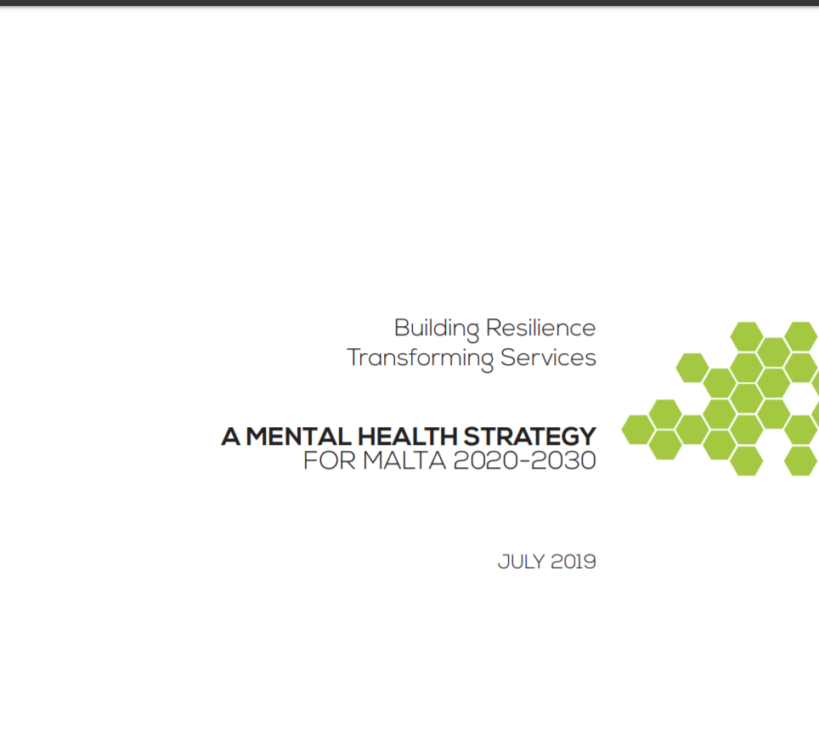

Slide 7
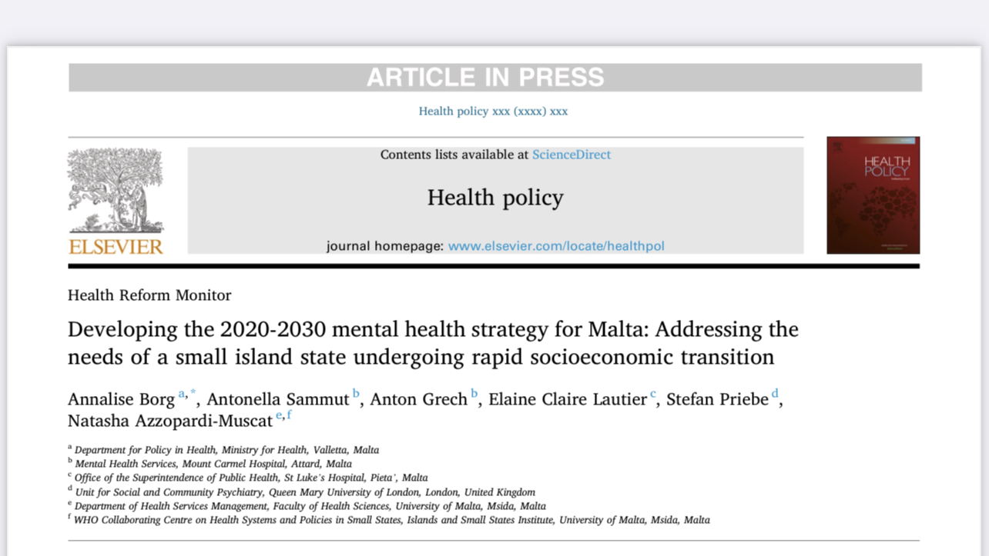

Slide 8
2018: Working Group with technical support from who
Wide consultation (around 50 face to face meetings with stakeholders and suggestions online)
19 Months

Slide 9
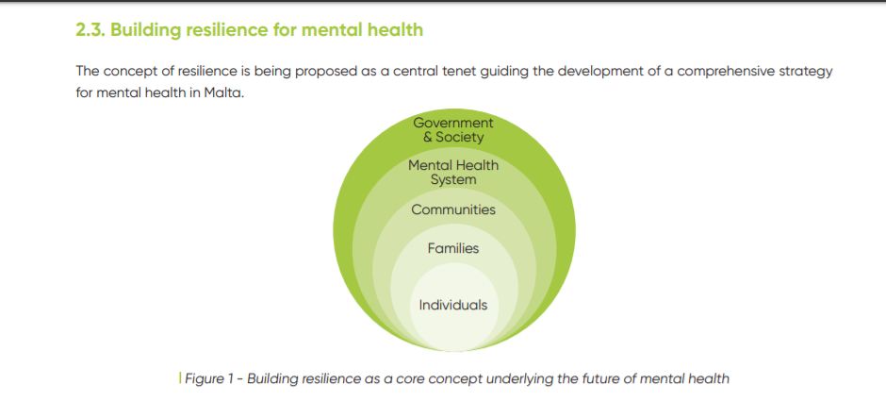

Slide 10
10 YEAR MENTAL HEALTH STRATEGY – 2020
COMMUNITY, COMMUNITY, COMMUNITY, COMMUNITY…..
PREVENTION (E.G. EMPHASIS ON EDUCATION AND HEALTH AT WORKPLACE)
EMPHASIS ON WELLBEING

Slide 11
10 YEAR MENTAL HEALTH STRATEGY – 2020
REGIONLISATION/ SECTORISATION
STRENGTHENING OF Specialities
MORE EMPHASIS ON STAFF TRAINING
NEW ACUTE PSYCHIATRY FACILITY
REPURPOSING OF MOUNT CARMEL HOSPITAL

Slide 12
Covid-19

Slide 13
Regionalisation
Malta 3 Regions and Gozo 1 region
New admissions according to region, followed up in region

Slide 14
Acute admissions
An acute admission team for each region
After 6 weeks transferred to Adult general Psychiatry team of region

Slide 15
Community
9998
Outreach team following community treatment orders (regionalized)
Increased the number of community clinics
1. in sectors
2. 7 Clinics
3. 9998 patietns
4. CTO’s: (M 135) ( F86 )

Slide 16
Community
9998
Increased psychologists
(29 Centres, 3318 patients)
Crisis home resolution team
(409 patietns)

Slide 17
Community
9998
24 hr helpline
(9830 calls)
24 hr presence at A+E general hospital
1. adults
2. child and adolescent

Slide 18
gozo
9998
psychiatric wing within general Hospital
Community outreach team (4 nurses from next Monday)

Slide 19
training
In-service training: e.g. De-escalation, suicide
Empower staff for cme, research and postgraduate

Slide 20
reaching out services
University
Mcast
Kana movement
Tal-ibwar

Slide 21
Strengthened Specialized services
Learning disability: more clinics, dar il-providenza
neuropsychiatry: FROM MEDICAL TO SIGNIFICANT NEUROPSYCHOLOGICAL INPUT, neurosurgery
PERINATAL SERVICES: INCLUDED NON MEDICAL MEMBERS TO TEAM AND INCREASED CLINICS

Slide 22
hospitals
Tender for psychiatric wing at mater dei hospital issued
Reopening of psychiatric unit coming months

Slide 23
Family doctors
Prescribing rights
Private gp’s

Slide 24
Suicide prevention strategy
Cabinet 28 January
Feeddback ready

Slide 25
What next in this journey?
Not isolated and integrated more within and across services
Mental health across minsitries

Slide 26
THanKYOU FOR YOUR ATTENTION

