Slide 1

Office of the Commissioner for the Promotion of Rights of People with Mental Disorders
Annual Report 2023

Slide 2
Perspectives on the Mental Health Situation in Malta and Gozo

Slide 3
Social Security Act (Chap. 318)
Part II
Diseases and conditions in respect of which free medical aid may be accorded
7. Nervous System Diseases:
“Dementia
Schizophrenia
Psychosis
Chronic Mood Disorders
Chronic Neurotic Disorders
Addiction Disorders
Chronic Psychiatric Disorders starting in Childhood
Chronic Eating Disorders”

Slide 4
Notes:
Chronic Mood (affective) disorders comprise disorders such as bipolar affective disorder and depression.
Chronic Neurotic Disorders comprise anxiety disorders and OCD.
Schizophrenia – this is reserved for patients with a clear diagnosis of schizophrenia.
Psychosis – This is for patients who do not fit the criteria for a diagnosis of schizophrenia.

Slide 13
Persons with Addiction Disorders 2011-2024 (POYC data)
Rate/10,000 population
Number of persons

Slide 15
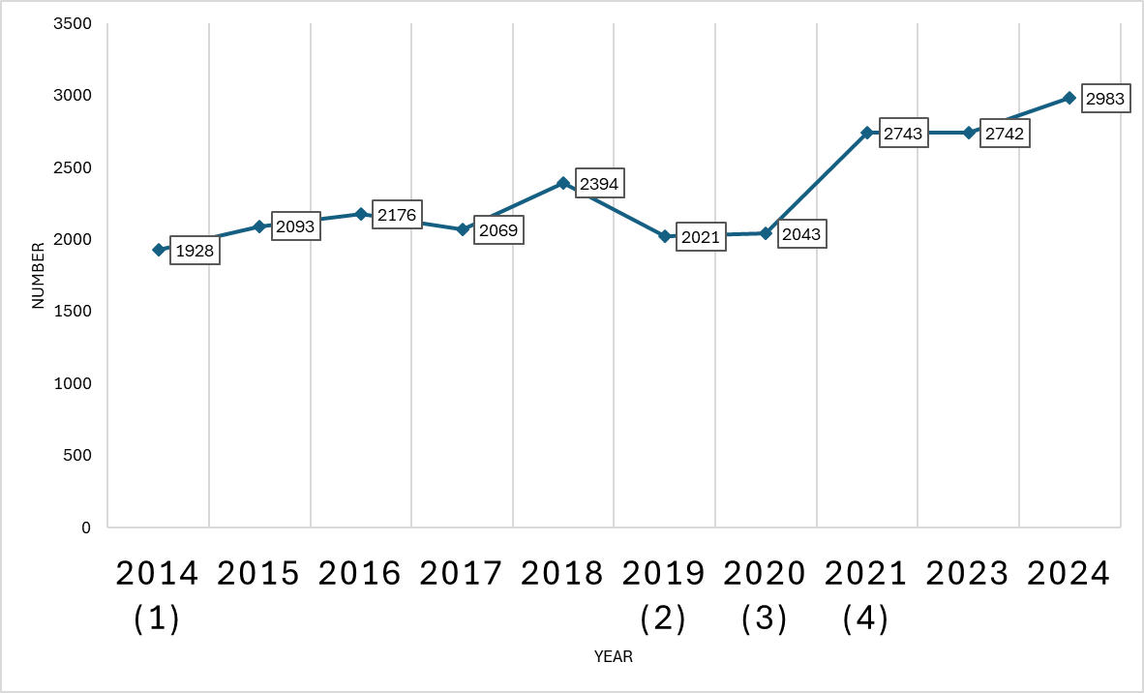
Patients using Drug Control Card 2014-2024
Notes:
October 2014 - Data was never received by POYC Admin office.
October – December 2019 – Data not fully recorded during launch of CARE. Activity fully resumed in Jan 2020.
April and May 2020 - Dip resulting from change in strategies during the outbreak of the pandemic
December 2021 – still needs to be registered in excel

Slide 18
Comparison of Capital Budget allocation 2024 - 2025
MHS - remained stable at €1.5million
PHC - ↑ c 8.3% from € 1.2 million to € 1.3 million.
MDH - ↑ c 11.8% from € 10.9 million to € 12.2 million
MFH - ↑ c 3.6% from € 81.3 million to € 84.2 million

Slide 19
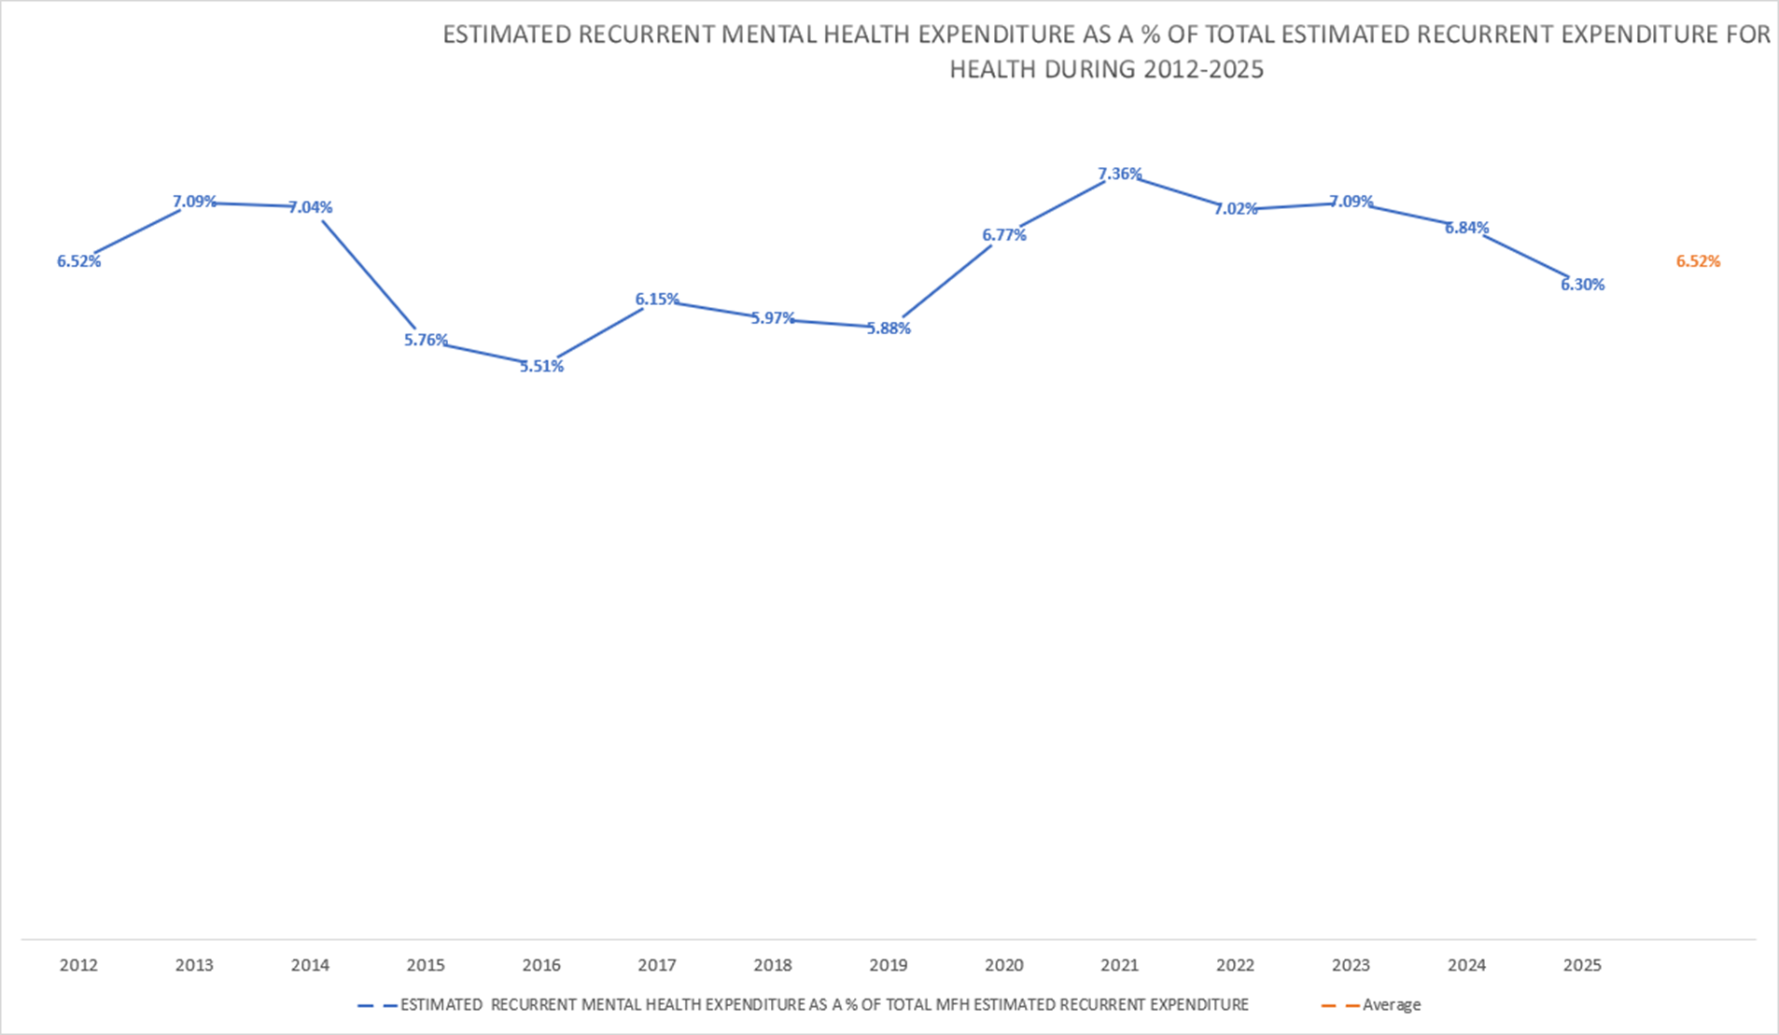

Slide 20
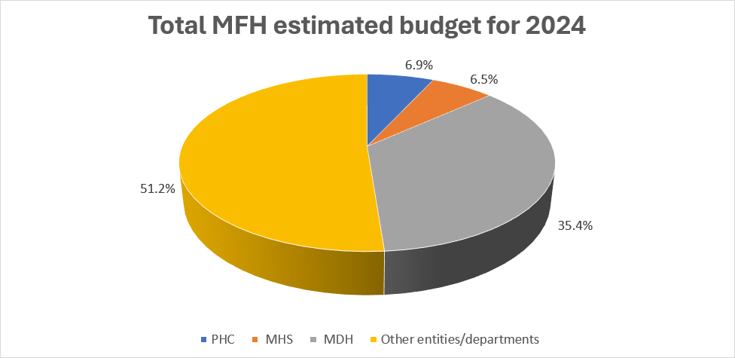
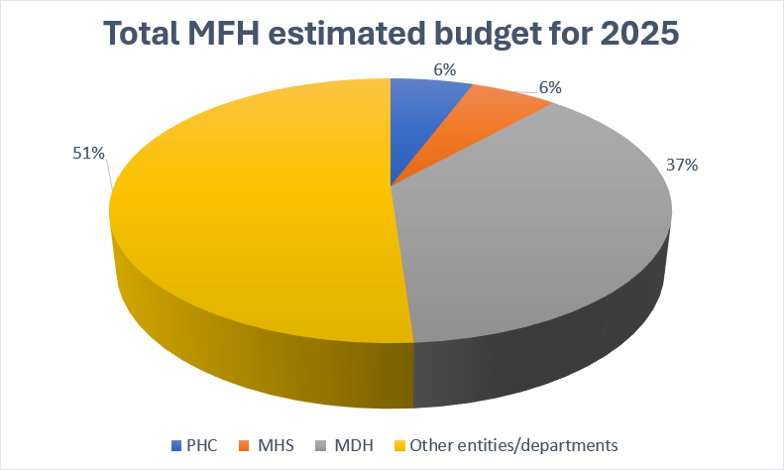
Budgetary allocation for Health 2024-2025

Slide 21
Analysis of data held by the Office of the Commissioner

Slide 22
Number and rate per 10,000 population of NEW cases registered in the Involuntary system by year
Notes:
An increase in the number of new cases registered in the involuntary care system for the year 2022 and 2023 can be noted. The incidence rate of new cases being registered in the involuntary care system increased from an average of 4 new cases per 10,000 population between 2015 and 2021, to 5 per 10,000 population in 2022 and 2023

Slide 23
Patients on Involuntary Care in 2023
From 2016 to 2021, the number of new cases plateaued at an average of 361 new cases per year.
In 2022, the number of new cases spiked to 497, followed by 511 new cases in 2023.
492 applications for CTO were approved in respect of 284 patients.

Slide 24
No. of IAOs received and No. of persons requiring IAO over the years
Notes:
An increasing trend in applications for IAO received and a corresponding increase in the number of patients requiring acute involuntary admission for observation over the years can be observed. Both the number of Maltese and non-Maltese patients is seen to be increasing, however, the rate of admission by IAO has remained stable over the years at an average of 1 per 1000 Maltese population and at an average of 2 per 1000 foreign population residing in Malta

Slide 25
Outcome of Involuntary Admissions for Observation
  773 applications for Sch 2 in respect of 628 individuals
  67.4% lasted <10 days (Observation Order - Sch 2)
  17.2% lasted <17 weeks (Treatment Order - Sch 3)
  1.0% exceeded 17 weeks (Continuing Detention Order - Sch 5)
  7.9% of admissions were placed on a Community Treatment Order after having undergone a period of involuntary inpatient stay lasting not more than 17 weeks

Slide 26
Number of Patients per Type of Schedule by Year

Slide 27
Number of Approved Applications by Year

Slide 28
Number of Minors admitted to MCH under Involuntary Admission for Observation (IAO – Sch. 2) 2015 – 2023

Slide 29
Rate of Inv. Adm. for Obs. in Minors /100,000 population

Slide 30
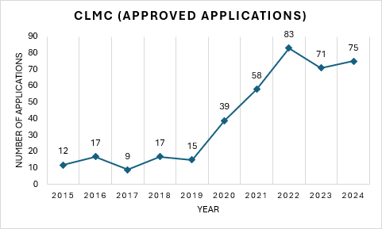
Number of persons issued with Certificate of Lack of Mental Capacity (CLMC)

Slide 31
No. of Pts on Involuntary Admission (IAO) put on a CTO within 17 wks. or less and no. put on CDO

Slide 32
No. of Persons on an IAO by age group over the Years
Notes:
Most patients admitted to MCH via IAO are aged between 18 – 44 years. This has remained consistent over the years as can be seen

Slide 33
Patients admitted IAO with Substance Misuse as 1⁰ or 2⁰ diagnosis (2017-2023)
Patients admitted as % of total patients
Number of patients
Notes:
Cannabis in Malta is legal, though there are limits regarding possession, consumption, and cultivation. In 2018, the Parliament of Malta legalized medical cannabis, and in December 2021, cannabis was also legalized for recreational and personal use

Slide 34
Rate/10,000 population of persons on IAO with substance misuse as their 1⁰ or 2⁰ diagnosis

Slide 35
Persons registered as Homeless
In 2022, pts reported as homeless – 30 cases
In 2023, pts reported as homeless - 37 cases

Slide 36
Responsible Carer signing applications for Involuntary Admissions for Observation (IAO)
Year | Percentage of IAOs
2022 | 25%
2023 | 27.7%
Notes:
Is he/she being appointed by the patient him/herself, or taken to be the next of kin by default?

Slide 37
Beyond Hospital Data

Slide 38
Employee Support Programmme
2022
  4,131 professional services accessed by 379 new individuals
  132 informative sessions held regarding mental well being accessed by 2,788 employees
2023
  1870 face to face sessions
  1,212 online sessions
  430 persons
  116 informative sessions given to 3,136 employees
(Source: Government of Malta (N.d.). Gov.Mt. Available at: https://www.gov.mt/en/Government/Government%20of%20Malta/Ministries%20and%20Entities/Annual%20Government%20Reports/Documents/Annual%20Reports%202023/Uffi%C4%8B%C4%8Bju%20tal-Prim%20Ministru.pdf (Accessed 23rd September 2025).

Slide 39
MCAST
Year | Well Being Centre | Outreach sessions
2022 | 3558 - 331 service users
2023 | 3645 | 47
2023/24 | Almost without services of a psychiatrist. Resumed towards end of academic year
2024/25 | Trade Union Dispute – no service provision except for crises cases

Slide 40
Activity at MCAST Wellbeing Centre 2019-2025
Scholastic Year | Male | Female | Other
September 2019 – August 2020 | 15 | 13
September 2020 – August 2021 | 34 | 42
September 2021 – August 2022 | 42 | 68
September 2022 – August 2023 | 53 | 63 | 12
September 2023 – August 2024 | 2 | 8 | 2
September 2024 – August 2025 | 26 | 45

Slide 41
Use of the Health and Wellness Centre at the University of Malta (2020-2024)
*Source: PQ 24277
 | 2020 | 2021 | 2022 | 2023 | 2024
New cases & Workshops | 727 | 845 | 1077 | 775 | 741*
Use of Psychology/ Psychotherapist/ Counsellors | 548 | 604 | 684 | 517 | 454*
Psychiatric Referrals | 30 | 72 | 96 | 21 | 31*
Staff complement **
Full Timers:-
2 Social Workers
2 Psychotherapists
2 Psychologists
Part timers:-
5 Psychologists
5 Psychotherapists
5 Counsellors
* Source: PQ 2427
** Source: PQ 24284 – Seduta 325 (24/03/2025)

Slide 42
L-Istat tan-Nazzjon 2025
Who do people resort to when facing life challenges?
  61.6% discuss them with household family members
  57.4% have never sought the assistance of work colleagues

Slide 43
Number of Suicide cases over the Years 2011-2024

Slide 44
Hospital Admission for Observation with documented suicide attempt or ideation by year
Number of persons
Percentage of total admissions for observation

Slide 47
Adequate alternative & safe accommodation to unnecessarily hospitalised persons
  GGH – Long Stay Ward (TOTAL 29 PERSONS)
    21 waiting for a nursing home
    8 waiting for a hostel
  MCH (TOTAL 43 PERSONS)
    Male Ward 1B – closed and persons discharged. Only 1 re-admitted
    13 elderly patients waiting SVP transfer to new Psychogeriatric ward
    11 waiting Richmond placements
    2 elderly patients waiting AACC bed (in progress )
    8 waiting Villa Anna Theresa placement
    9 waiting Casa Nuovo placement
    Excluding an unspecified number of persons with no plans – migrants, homeless etc

Slide 48
We need to……
Address social determinants of Mental Health across the whole life course
  People working unhealthy long hours
  The stress resulting from issues of poverty (relative or real), unaffordable housing, environmental degradation and traffic congestion
  The changing social network and the increasing population of foreigners – workers and tourists
  The availability and misuse of drugs

Slide 49
……
Until the new psychiatric hospital is constructed, the current MCH facility needs to be maintained but also actively refurbished
But more important is the review of current operational procedures in preparation to the opening of the new hospital
More empowerment of patients and their carers – learn from their experiences

Slide 50
Feedback from Interviews carried out by the Office during visits to Licensed Mental Health Facilities

Slide 51
Boredom and idle time:
  Pts. experience significant boredom, esp. those without garden or leave permissions, often resorting to smoking to cope.
Smoking habits:
  Most interviewed pts. were smokers who reported increased smoking during admission, sometimes because of a rewarding system in wards.
Individualized activities needed:
  Pts. have diverse interests and skills, suggesting that personalized activities could better address boredom than group activities alone.

Slide 52
Limited resources for engagement:
  OT offers various activities and some wards have gyms BUT issues like non-functional computers and lack of a ward library limit patient engagement.
Laundry problems affect dignity:
  Pts. report lost clothing from hospital laundry, and some wards do not allow personal clothes; negatively impacting patient dignity.
Language and cultural challenges:
  Communication difficulties arise from staff and pts. speaking different languages and having different cultural backgrounds; complicating therapeutic relationships.

Slide 53
Limited staff engagement:
  Staff shortages, use of relievers, and language barriers reduce staff-pt interaction. Efforts to improve staff-to-pt ratios are noted.
Privacy concerns:
  Lack of lockable doors and windows in toilets and showers, combined with mixed-gender wards, raise serious privacy and dignity issues.
Mixed gender and mixed diagnoses ward issues:
  Cause of discomfort and safety concerns, esp. given pts’ vulnerabilities and potential for inappropriate interactions. Substance misuse pts require specific care and attention to the detriment of other vulnerable pts

Slide 54
Recommendations for Consideration

Slide 55
Traumatic experience of persons being admitted involuntarily to MCH
Sometimes persons are faced with an announced rapid response team presenting at their residence
Blue lights, ambulance and possibly police response vehicles
Use of cable tie lock belts
Several personnel accompany the patient - emergency ambulance responder, security officer, police officer and a nurse
Possible Union Directive

Slide 56
Recommendation 1 - Set up a tiered Emergency Mental Crisis Response Team
  Police based response – trained to de-escalate crises, stabilise a person and liaise with mental health providers
  Co-response model – multidisciplinary response- police and mental health professionals
  Community based model - non police response - no immediate threat of violence, possibly own transport

Slide 57
Recommendation 2: Perimenopause and Menopause
During this period of life, due to ↓ levels of oestradiol, there may be ↑ psychological symptoms such as anxiety, low mood, irritability, insomnia, feelings of low self worth including depression
↑ risk of osteoporosis – also due to ↓ mobility
Safe use of HRT should be considered when indicated
Source: Bulletin of British Journal of Psychiatry (13 Nov. 2023)

Slide 58
Recommendation -3 - Visiting Consultants
Long standing established practice at MDH of getting specialists from Tertiary Centres in UK.
Excellent recent conference organised by the Malta Association of Psychiatry – distinguished experts in the field gave keynote speeches.
Why not invite them together with their multidisciplinary teams to discuss the management of complex patients and possibly discuss our practices?

Slide 59
Recommendation - 4 - Low Threshold Unit (LTU)
Some persons are admitted to MCH for no real acute psychiatric reason but due to concomitant social issues - homelessness, substance misuse, being victims of usury or dysfunctional families or being TCN migrants.
An LTU offers an alternative
It minimises barriers to access with minimal demands on the person and offers voluntary services that do not require abstinence as a prerequisite for care.
Focuses on harm reduction and offers services such as basic needs whilst still offering basic life skills and helps to seek re-integration/responsibilities.
Serves as a navigator to access other services.

Slide 60
Recommendation - 5 - Collaboration between all stakeholders and maximising use of available resources
Many services are available, including several NGOs
Community Resource Mapping should be available to all Mental Health Providers and utilised depending on the patient’s expressed likes, dislikes, abilities, aspirations, etc.
Patient navigators should support patients and carers to access these resources to help them with their recovery and growth

Slide 61
Recommendation - 6 – Changing Mindsets
Transition planning across services should be increased – Youth to Adult, Perinatal to other services such as Adult Psychiatry and CYPS.
A reference person identified for each person to provide help between appointments. Must be able to effectively respond to the person’s needs.
Services should be flexible to adapt to the unique needs and wishes of persons with mental illness to fulfil their aspirations. Patients need to be served unconditionally and not the other way around .
(Source : From report with consultation with academics and stakeholders)

Slide 62
Other recommendations….
More monitoring and supervision of frail persons during feeding
Set up an Interagency, Multidisciplinary Suicide Mortality Review Board to better understand factors that could have led to the suicide and agree on LONG TERM support services to the relatives and loved ones

Slide 63
Finally
Mental Health and well being should not be associated only with Mount Carmel Hospital
Life course and whole of government approach
Mental Health is
APOLITICAL AND IS EVERYONE’S BUSINESS

