Slide 1

Richmond Foundation
VO/0017

Slide 2

Timeline
2020
Learning and Development Unit established
1770 Helpline available 24/7
Healthy Minds Work Program
Covid Impact
2018
2007
Launched Youth Mental Health First Aid
Certified as training centre
2002
1993
1999
Home Support Service
Later renamed to Community Support Services
KIDs in Development programme established
2016
Setting up of Richmond Foundation
Supportive Housing Scheme
Attard Hostel opened
2024
Dar Tereza
l
1996
2001
2006
2015
2017
2019
2021
Villa Chelsea
Rehabilitation Programme
Supported Employment Programme established
Floriana Hostel
Later moved to Paola Hostel
Opened Qormi Hostel
Launched Mental Health First Aid
Psychological Support Services established
Mosta Hostel and
Kappara Hostel opened
Certified as CPI training provider
OLLI Chat 24/7
Brief Intervention Support
Established
Staff and Organisation Support Programme
launched

Slide 3
Organisational Structure 2024
8
31
200
150
143
group residences
apartments
corporate clients
Healthy Minds Work
employees
residents
9850
150
€4.4 million
Individuals supported
Clients supported in the community
c.a. costs per annum

Slide 4
Severe Mental Illness in Malta
Notes:
Residential Services: All licensed as mental health facilities

Slide 5
Prevalence of Severe Mental Illness
Statistics are limited: No recent, comprehensive, population-wide studies specifically on severe mental illness (SMI).
What we know:
  General mental disorders: ~15–17 % of the population (lifetime prevalence).
  Schizophrenia: ~0.026 % (26 per 100,000).
  Psychotic episodes: 13 % of psychiatric admissions.
Best estimate (based on European & WHO data + Maltese strategy reports):
  ~3–5 % of the Maltese population may have SMI (schizophrenia, bipolar disorder, severe depression).

Slide 6

Challenges people with SMI face
People with severe mental illness face complex, lifelong challenges that go far beyond symptoms: health inequalities, poverty, stigma, and social exclusion are major barriers to living fulfilling lives

Slide 7
Complex Lifelong
Challenges in Severe Mental Illness
Health: Chronic illness, early death, meds side effects
Functioning: Daily living & cognitive difficulties
Social: Stigma, isolation, relationship strain
Economic: Unemployment, poverty
Legal/Safety: Homelessness, crime, victimization
Recovery: Fragmented care, poor support
Personal: Loss of autonomy, hopelessness, suicide risk

Slide 8
Richmond Foundation offers Community Mental Health Services
With the collaboration and support of government
Through coproduction with the client

Slide 9

Richmond
X
Ministry for Social Policy and Children's Rights

Slide 10
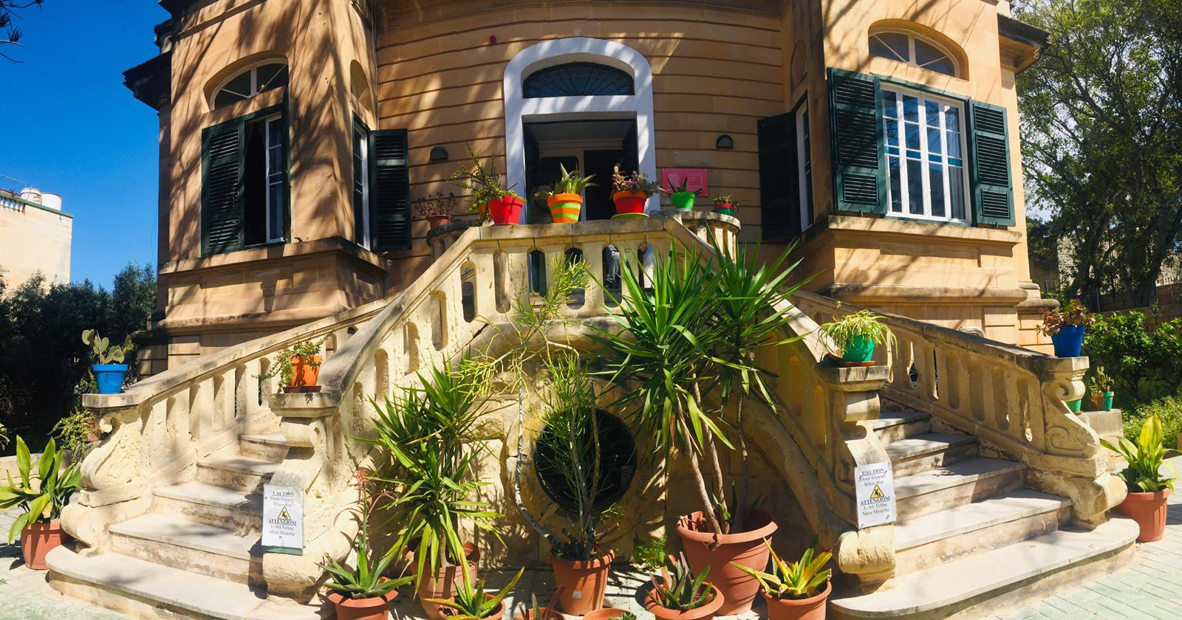
Rehabilitation
Residential l Day Care l Respite
A one-year programme, providing a therapeutic and supportive environment to our service users as well as hands-on support that is related to the activities of daily living.

Slide 11

Supportive Housing
Service
Housing l Therapeutic Support
Supporting clients with housing as most clients with SMI are homeless approx 67% (Barry et al 2024)

Slide 12

KIDs in Development
Residential l 3-year programme
Tailored for children aged 7 – 13, who experience severe emotional difficulties and challenging behaviour.
The focus is on developing healthy attachments and a sense of self-worth in a safe environment.

Slide 13
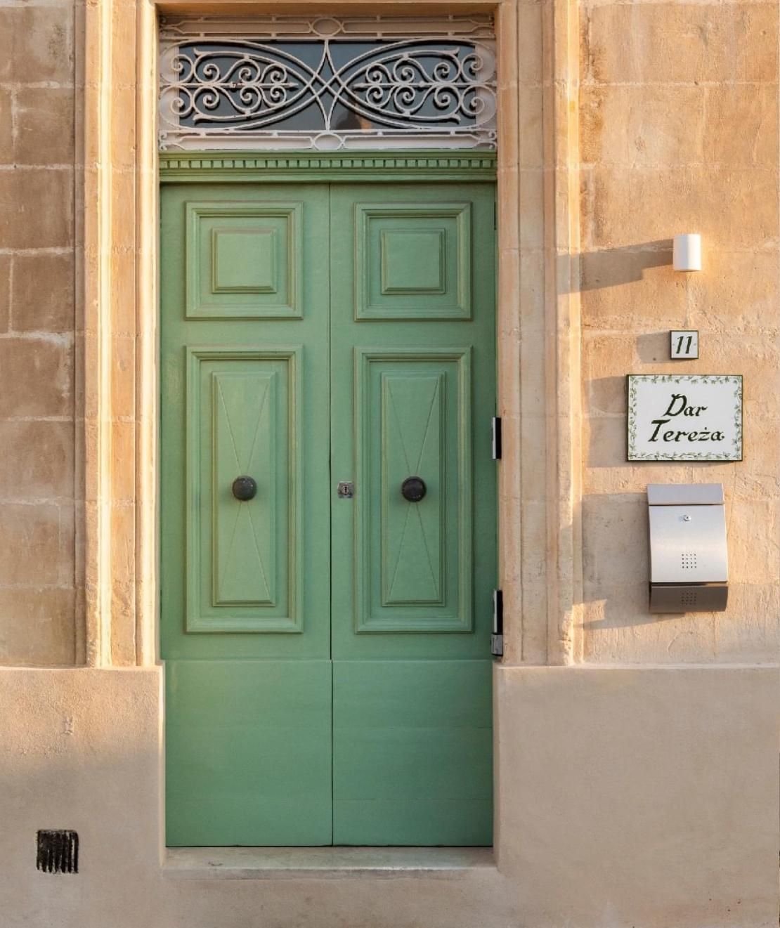
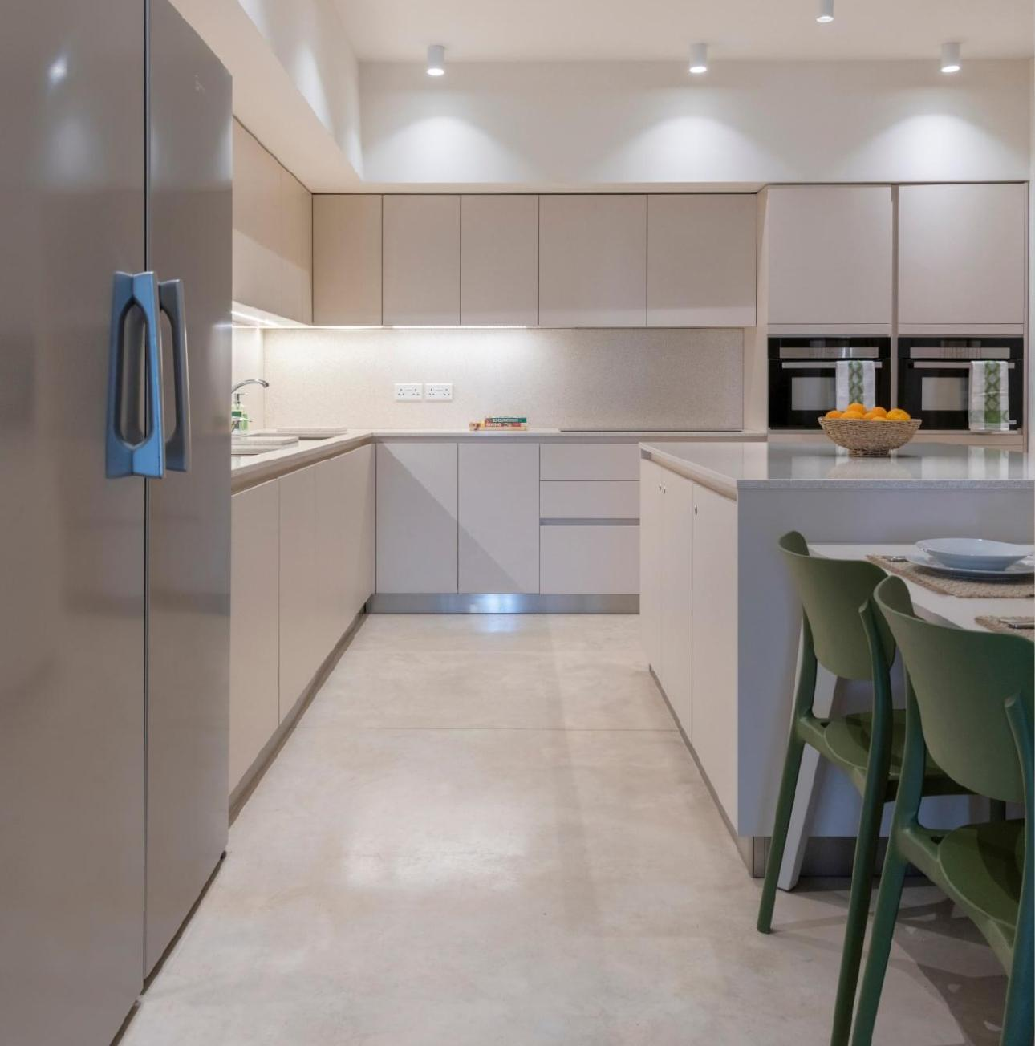

Dar Tereza
Residential l 3-year programme
To help mothers who suffer from mental health problems to be supported in the community without their children being taken away.

Slide 14
Richmond
X
Ministry for Health And Active Ageing

Slide 15
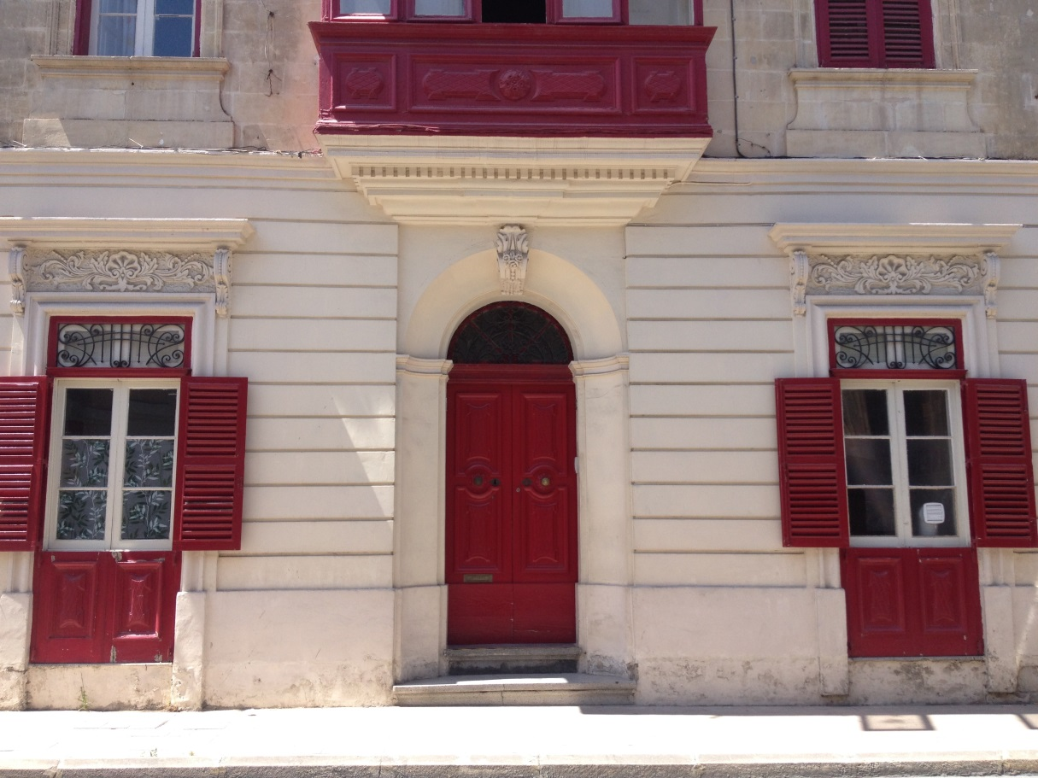
Assisted Living
5 long-term Residences l 24/7 staff support
Individuals who previously resided at Mount Carmel Hospital provided with accommodation and professional support to lead a good quality of life in the community.

Slide 16
Community Support
Services
Home Based l Therapeutic Support
Supporting more than 150 individuals with mental health problems and their carers in the comfort of their own home.

Slide 17

Psychological Support
Services
Helpline l Chat l Brief Intervention l Consult
Therapy l Event Support l Gift of Therapy
Qualified psychologists, counsellors and psychotherapists offering psychological support to individuals, couples and families.
1770 helpline & OLLi.Chat free to the public, which may be followed by free brief intervention support for the public.
In 2024 we had 7,280 persons contact us through phone calls and chats

Slide 18
Brief Intervention Service
Started in 1996
Pre-COVID we registered approx 400 to 600 callers a year.
In 2020 we experienced a surge in demand
2020 – 4,036
2021 – 11,044
2022 - 12,311
2023 – 7,850
2024 – 7,280

Slide 19
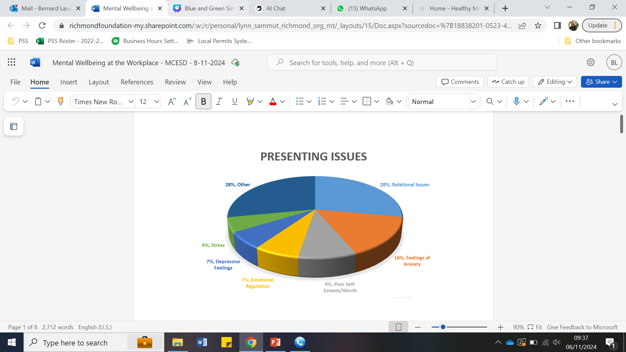

Slide 20
Gift of Therapy
Bridging the gap: Making therapy accessible
2024 Impact:
€80,000+ in free therapy services

Slide 21
Mental Health
at the Work-Place

Slide 22

Healthy Minds Work
Providing emotional and psychological support to the employees of corporate companies.
One of the largest Work Support Programs in Malta.
Healthy Minds Consult (Support to heads of department, HR etc.)
Healthy Minds Learn (Training)
Healthy Minds Talk (Therapy)
Healthy Minds Know (Research)

Slide 23



Healthy
Minds
Work
2025 - 201 companies
Employee Base Covers
50,000 Employees
2025 - 1, 352 employees (Sept)

Slide 24
Presenting Issues
at the Work-Place

Slide 25

Mental Health Issues that Impact the work place
01
Relational Issues
02
Feelings of Anxiety
03
Poor Self Esteem / Worth
04
Poor Emotional Regulation
05
Depressive Feelings
06
Stress
07
Other:
Chronic Mental Illness
Loneliness
Trauma
Suicidal Thoughts & Self-Harm
Bereavement
Substance Use & Addictions

Slide 26
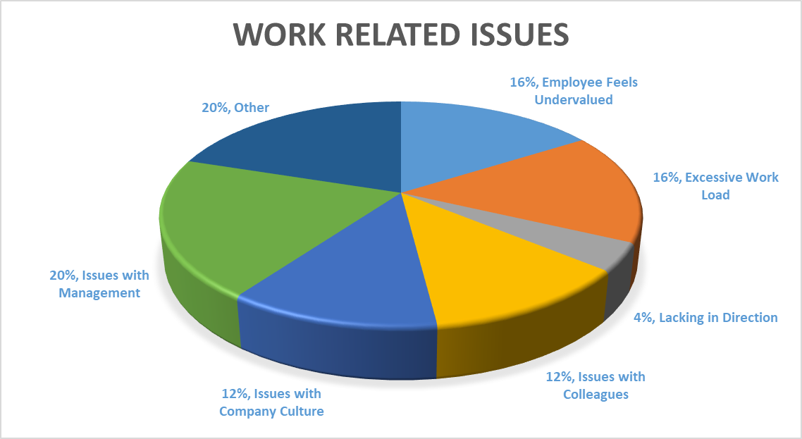

Slide 27
The Cost of Poor Employee Wellbeing
01
02
03
Presentism - €232M
Absenteeism - €116M
Turnover - €50M
the problem of workers’ being on the job but, because of illness or other medical conditions, not fully functioning.
an employee absence from work for lengths beyond what is considered an acceptable time span.
rate at which employees leave and are replaced within an organization.
A 4% GDP Level Impact - estimated above €400 million
Source: National Statistics Office of Malta

Slide 28

Return on Investment
  Deloitte Study; ROI £5: £1
  45% Absenteeism reduction
  50% Employee engagement increase
Source: Grant Thornton

Slide 29
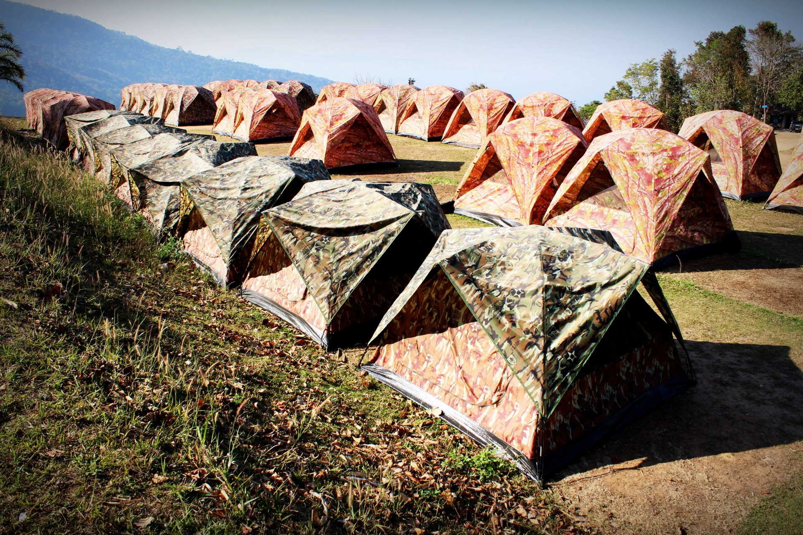
Wellbeing Event Support Services
Mental & emotional wellbeing support for event attendees who experience distress during the event
Qualified personnel on-site who can advise and help handle situations arising for attendees during an event to help provide a safe space and enhance the experience of the event
Staff are trained to deal with panic attacks, sensory overload, harassment, drug influences and other related experiences.

Slide 30

Disaster/Crisis Mental Health Services
Goal: Reduce distress, promote safety & recovery
Key Supports:
Psychological First Aid (PFA)
Crisis counselling & emotional support
Practical help (shelter, info, resources)

Slide 31
Richmond Foundation Training Institute
Training l Support l Consultation
Accredited in 2018, Richmond Foundation’s Training Institute empowers individuals and organizations with knowledge and skills to promote mental well-being through accredited courses like Mental Health First Aid, tailored corporate training, and professional development programs.

Slide 32
Mental Health First Aid Malta
Introduced by Richmond Foundation in 2015
Part of an internationally accredited and evidence based program
Over 11,000 people trained in Malta to date
Widely adopted across workplaces, schools, and community at large

Slide 33
Mental Health First Aid Courses
Standard Adult MHFA
Youth MHFA
Teen MHFA
Older Persons MHFA
MHFA Workplace
MHFA for Intellectual Disabilities (ID)
MHFA for Gambling Problems

Slide 34
Coming up in 2026
With the support of the Ministry for Inclusion and the Voluntary Sector and in collaboration with Agenzija Sapport we will supporting persons with dual diagnosis of intellectual disability and mental illness in residential services in the community.
ERDF Mosta Project
Mental Health First Aid Italia
Psychosocial Risk Management Services

Slide 35
Thank you

