Slide 1




Ghabex
Shelter
Yvonne Fiorini Lowell

Slide 2

The Għabex Emergency Shelter was set up in October 2000. It aims to provide an immediate safe environment to female victims of domestic violence and their children, who require urgent protection. The service offers a setting conducive to self-healing for women and their children who suffer emotional, physical, sexual, and any other form of domestic violence.
History

Slide 3
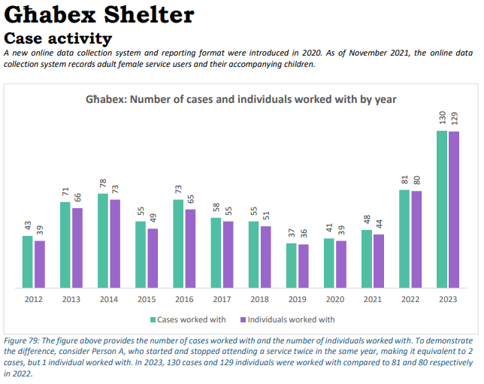
Statistics
APPOGG Yearly report a2023 (f).pdf (gov.mt)

Slide 4

Our Dedicated Team
Service Area leader
Residential Social Worker
10 Support workers

Slide 5
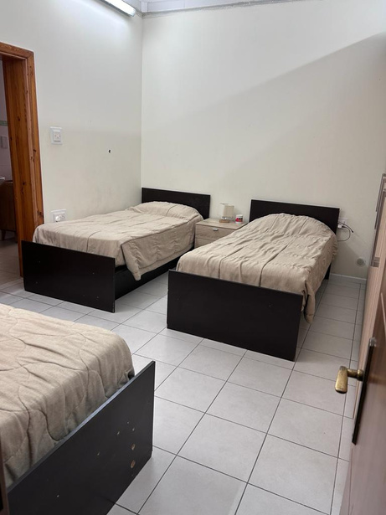
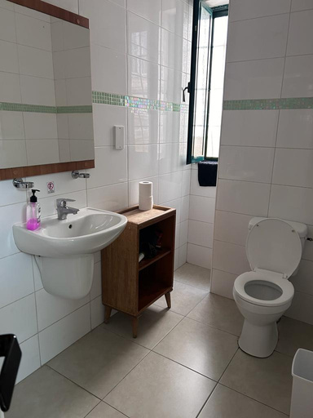
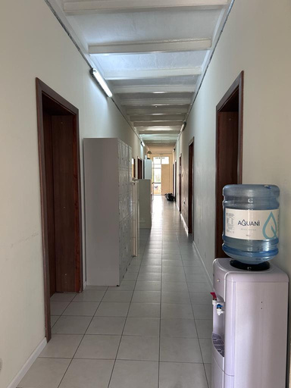
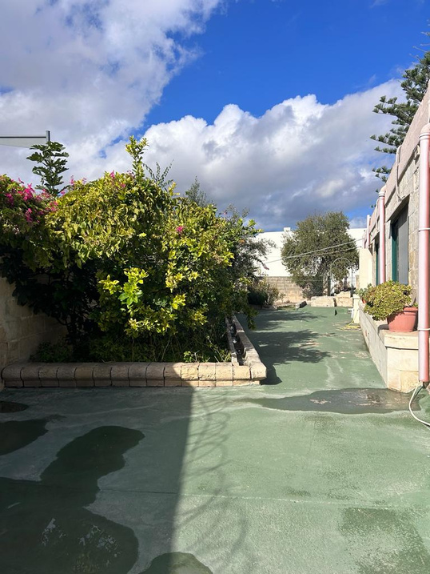
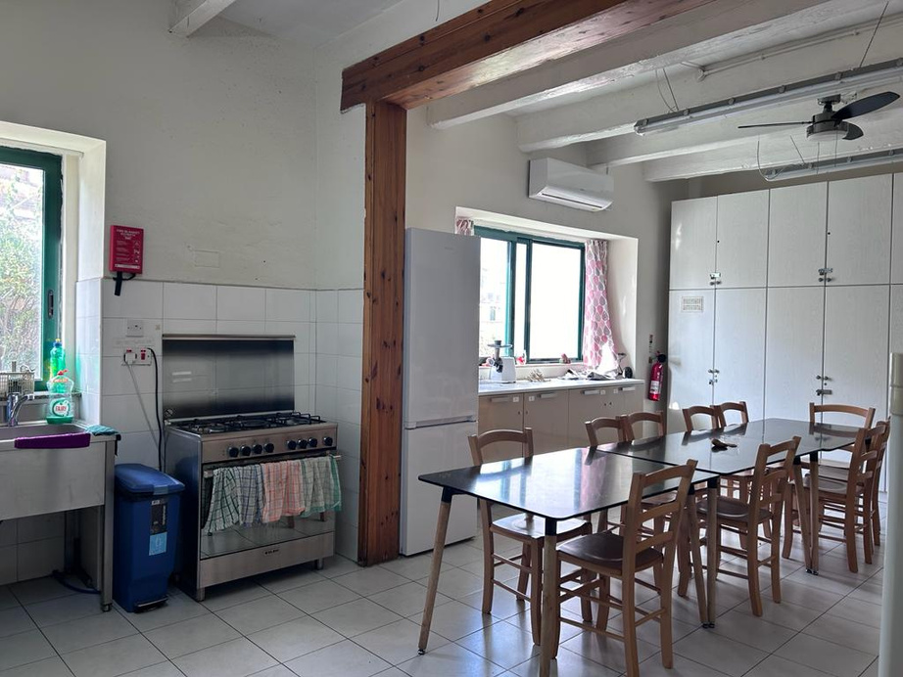
The Premises

Slide 6


Who refers?
Risk Assessors – Gender-Based Domestic Violence Hubs
Domestic Violence Unit (DVU)
Supportline 179

Slide 7
Domestic Abuse & Safety Concerns
Mental Health Issues
Addictions
Medications
Child custody arrangements
Admission Check List

Slide 8

Policies & Agreement upon Admission

Slide 9
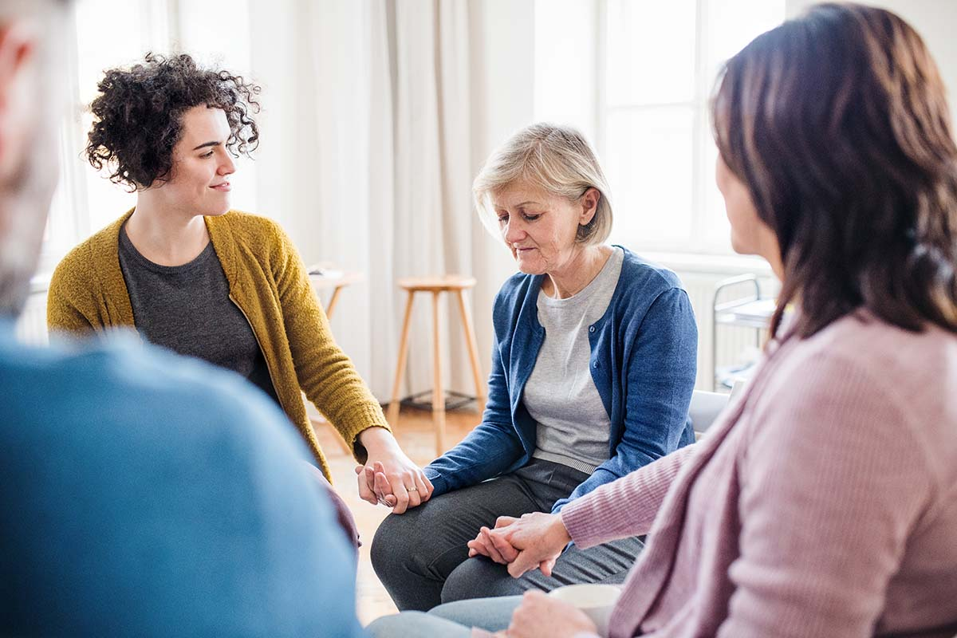
Children’s group
Women’s group
One-to-one sessions with Social Worker and daily support
Assistance to access legal support
Accompanying residents
Support to children’s educational needs
Liaising with other services
Accessing police assistance when necessary
Encouraging independent living
Childminding
Organising professional meetings/care plans
Support offered at Ghabex Shelter

Slide 10
We cannot accept victims who are dependent on treatment to enter without their medication
We do not accept unaccompanied minors
Generally, residents are admitted for three months
The social worker and leader are always on call to ensure 24/7 support to staff and women who need to access the service
Important Points

Slide 11
Success Story 1
C was 61 when she was admitted to Ghabex. This was not C’s first admission to a DV shelter, but her 6th. C disclosed that she married when she was 16 years old to a man who she never wanted to marry due to his severe alcoholism and his behaviour as a result.
C suffered from immense abuse, mostly physical and emotional, C always wanted to protect her children so whenever she would enter a shelter, she would return home for their sake.
Finally, C decided to once again contact DVU and was then admitted to Ghabex. With the shelter’s support, C finally managed to conduct a police report and subsequently end her marriage and separate from her husband. Today C is in the process of buying her own apartment and living the life she deserves.

Slide 12
Success Story 2
G was 37 years old when she was admitted to Ghabex with a presenting problem of psychological, physical and financial abuse from her brother, who was a substance misuser.
G was diagnosed with schizoaffective disorder but was consistent with her medication and her follow-up appointments. Unfortunately, both her parents had passed away
Due to his addiction, her brother used up all his inheritance money and began to turn to G to use hers, whenever G refused to give him money she suffered from physical and psychological abuse, so often she would give in.
G got in touch with the Domestic Violence Unit and requested to be admitted to a DV shelter. With the shelter’s support G was able to set up a separate bank account, learn how to budget and how to be independent.

Slide 13
Thank you!

