Slide 1

- The Good Shepherd sisters –
Dar Merħba bik Foundation
Est. 1980

Slide 2
The Foundress of the Good Shepard sisters is
St. Euphrasia Pelletier
(1796-1835) her motto was
'One person is worth more than the whole world'

Slide 3





The good shepherd sisters in Malta
1858
Interim
1868
1980
2019
Arrived in Malta
Opened a school in Lija
Moved to Balzan
Started working with women and girls in difficult situations
Founded Malta’s first DV shelter Dar Merħba Bik
Inauguration of Dar Santa Bakhita

Slide 4

The Foundation
Drawn by love, passionate for justice
A history of over 150 years of helping women and girls.
Reconciliation - self, others / society and God.
The aim is to show love, respect and dignity, to give a helping hand to those who have been deprived of these sentiments, aid in instilling hope for a better future for all who enter through our doors and to feel empowered to live a dignified life and fight for justice.

Slide 5
Dar Merħba Bik
Foundation
First Stage Domestic Violence Shelter
Hosts 14 families
Caters for emergency cases and safety issues.
Second Stage Domestic Violence Shelter
Hosts 3 families
Focuses on long term skills and reintegration.
Dar Merħba Bik
Est. 1980
Dar Santa Bakhita
Est. 2019

Slide 6
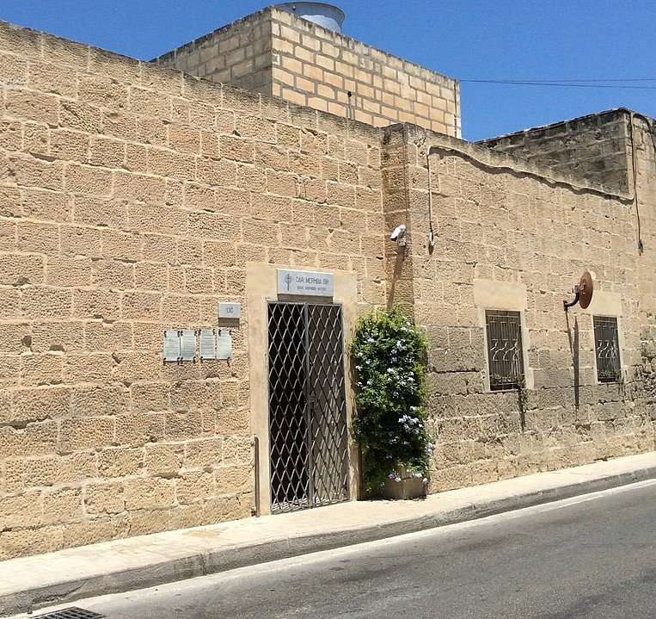
Dar Merħba Bik
First stage emergency domestic violence shelter - 24/7.
Hosts up to 14 women and their children at one go.
Abuse may be physical, emotional and psychological, financial and/or sexual.
Focusing on creating a safe home away from home both physically and emotionally.
Collaborates closely with Appogg’s Domestic Violence Unit (DVU).
Aiming to rebuilding genuine self-worth.

Slide 7

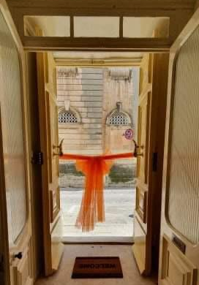
Dar Santa Bakhita
Second stage domestic violence shelter: 24/7.
Hosts up to 3 women and their children at one go.
Inaugurated in 2019 - Served as a staff accommodation during Covid-19 lockdown
Residents would have completed a programme in any first stage DV shelter.
Offers a 1 year stay for women who require further assistance until they are able to become fully independent.
Offering a better opportunity to break the cycle of violence for those who require it by allowing the time to save up and budget, learn new skills reassure their place in outer society whilst living in a semi independent supportive setting.
The aim of this facility is to fully prepare our women for an independent life.

Slide 8
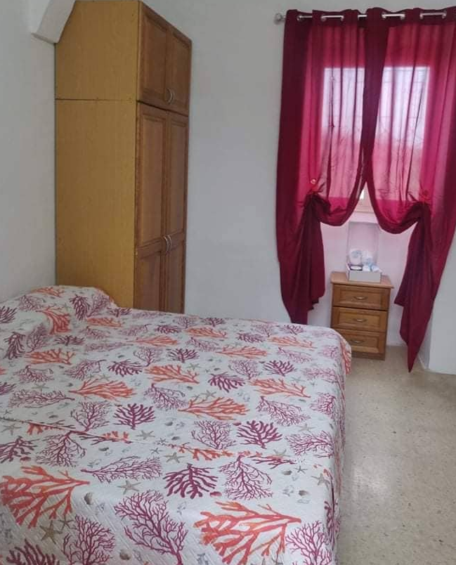
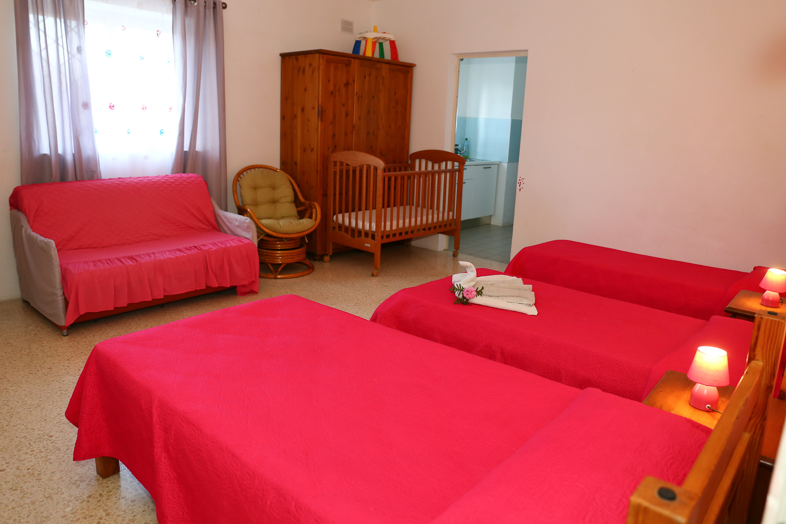
Flatlets of the foundation
​Each family unit usually has their own personal flatlet.
Each Flatlet has its own personal bedroom, bathroom and kitchenette.
Needs such as baby beds, playpens and nappy changers will be provided for the room.
Wi-fi is also available throughout for those who need to be working from home .
Various pets are accepted for the residents to bring along.

Slide 9
Residents
Women
Living in domestic violence situations
18 +
Able to live independently
Do not have a drug or alcohol dependency problem

Slide 10
Safety measures and secured Facilities
- offers high safety and security measures – protected parking area - double doors – alternating garage doors – walled spacious outside green areas – CCTV cameras – accompaniment -

Slide 11
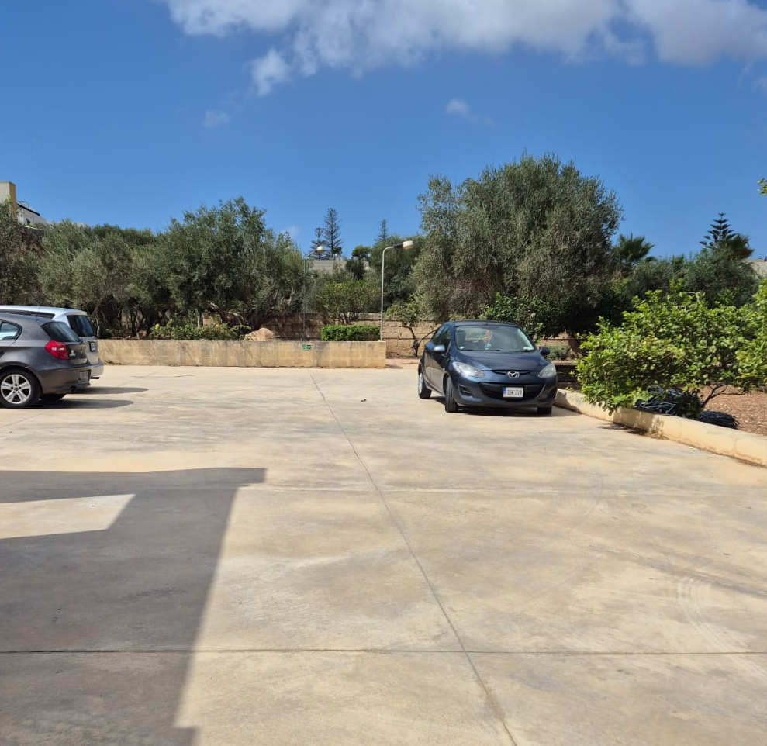
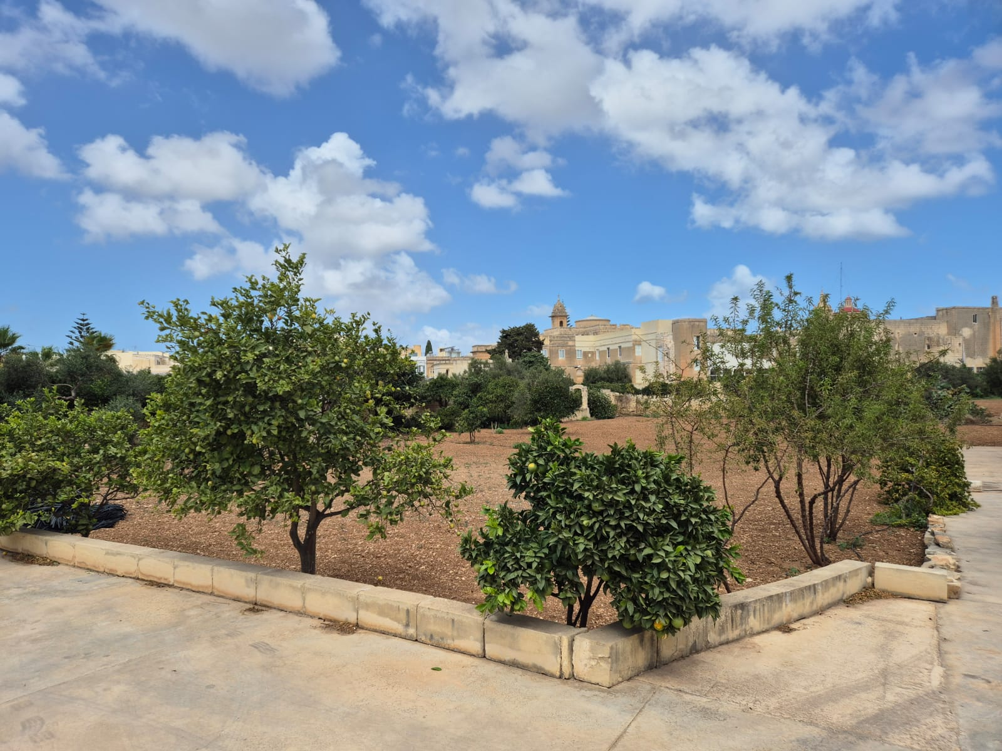
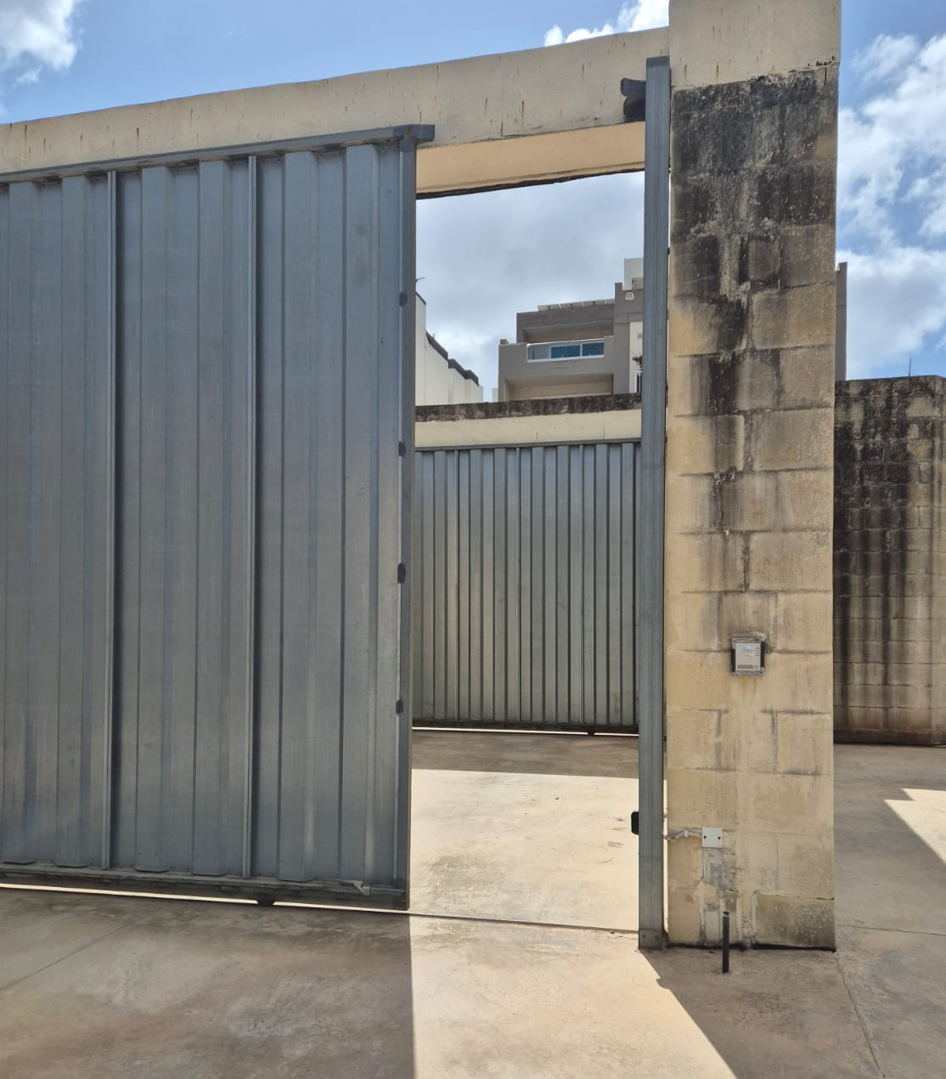
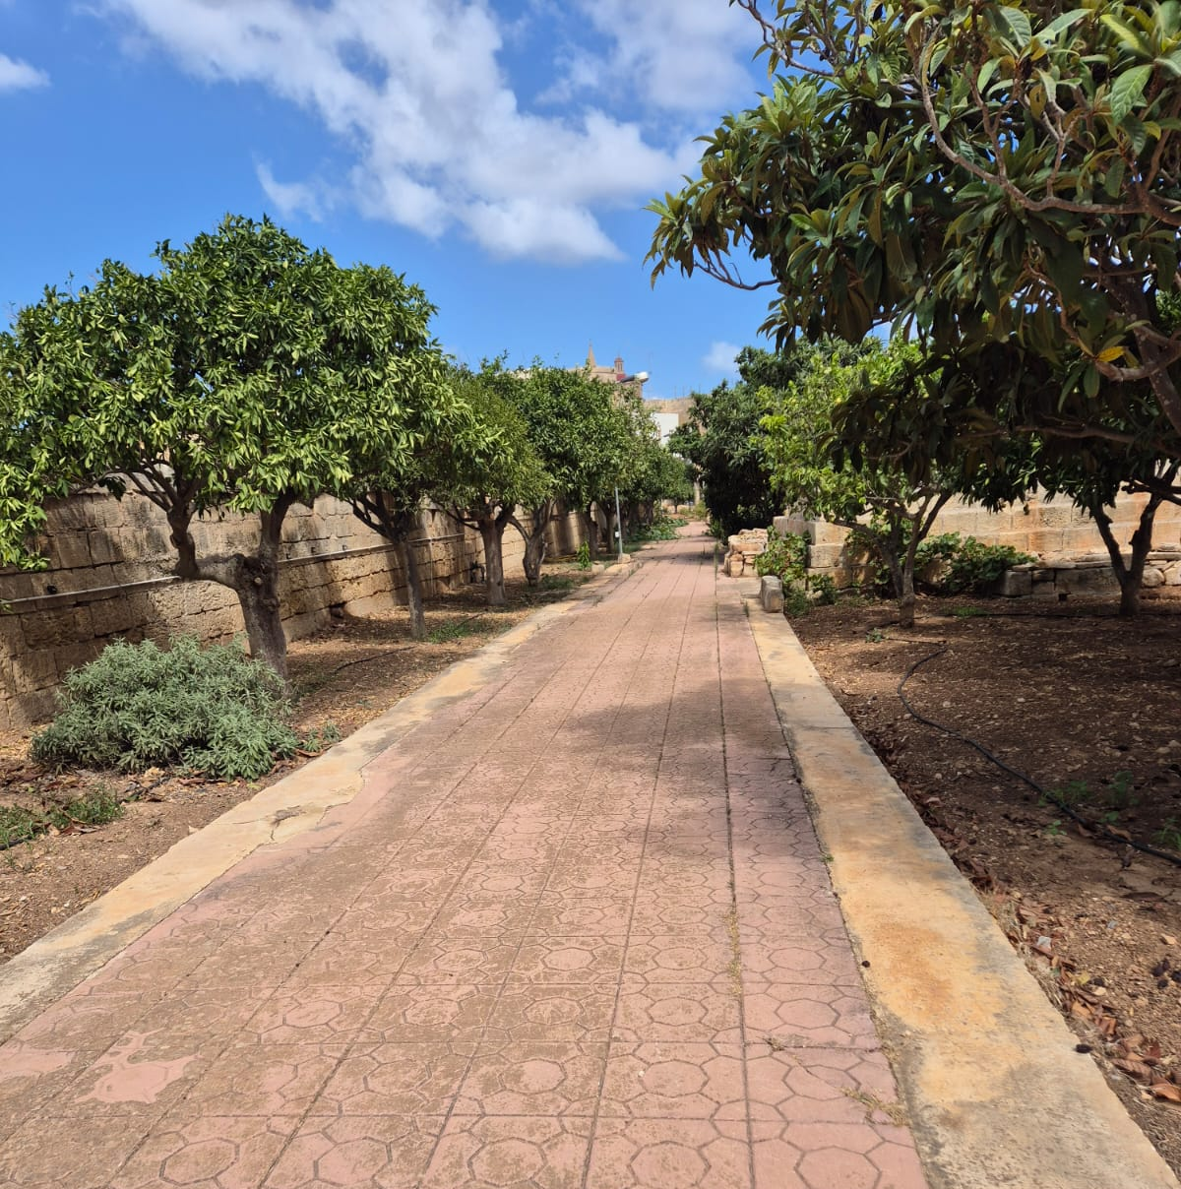
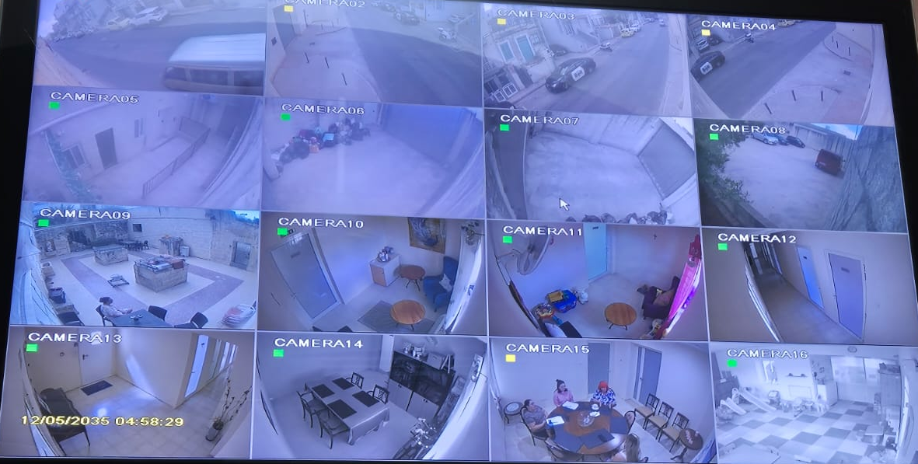

Slide 12
Dar Merħba Bik
Statistics

Slide 13
2023
62 admissions and 70 children

Slide 14
2024
(to date)
44 admissions & 44 children

Slide 16
Difficulties and limitations faced by victims of DV

Slide 17
1. court orders are not Timely or enforced
​When perpetrators do not adhere to Court orders, they frequently face no repercussions which encourages recidivism.
There are very little enforcements for those breaking probations, bails and Court mandated decisions such as alimony. Any change becomes the responsibility of the victim once again where they are to report and appear in Court with no guarantee of repercussion or serious action.
Court authorisation is required to limit a perpetrator from picking up a child from school. During this time, children would be unable to attend school irrespective of the duration of the process.
Court hearings initiated months after an incident, limits the progress of clients as well as increases the safety issues for the survivor once again.

Slide 18
għajjejt bis-sistema u nirraporta
- Resident

Slide 19
2. The reality of the victims is to be taken into consideration
​Some protection orders are issued with loopholes, not limiting the perpetrator from going to the matrimonial home (which the victim is supposedly living in).
Children (as well as adults) set to testify regarding their own abuse are having their hearing deferred, not due to unforeseen circumstances but out of poor planning of running order, causing further re-traumatization.
Victims being ordered by the Court to attend expensive sessions / appointments despite her not affording to pay for them with no alternative.
Until Court cases are heard , Temporary Protection Orders are not being issued for the protection of the alleged victim. (include alimony and care and custody - bargaining tools to control clients into dropping cases or TOPs/ POs.)

Slide 20
3. Alternative school Transport
​Mothers are being asked to transfer the children’s school, without the consideration of further change and further traumatization of the child.
Given that the majority of the children in such situations, will be residing with the mother at the shelters, the refusal of special transport causes the mother to consider leaving the shelter or to put herself in unsafe situations to avoid causing further change to her child.

Slide 21
għiduli fejn u kif immur wara hawn
- Resident

Slide 22
4. Housing for DV survivors
Despite of applying for housing accommodation and writing reports explaining the client’s experience, DV clients do not have a specific scheme for their particular needs, due to their situation. (enhanced safety, rent alternatives , further subsidisation)
There are not enough DV shelters around Malta to cater for the rising issues of DV. There are also not enough second stage accommodation for women to have the opportunity to have a smoother transition back into the community.
There is a gap in adequate shelter for people who do not classify for the requirements of all shelters or for accommodation following shelters such as: people with impairments, those with addictions and dependencies, different genders, the elderly , people with chronic illnesses and other specific realities.

Slide 23
I felt humiliated
- Resident

Slide 24
5. Police force
Police officers have given incorrect information to residents and victims are not always met with necessary support and the sensitivity they deserve.
Whilst reporting, clients have been questioned why she took so long to report, and were falsely told that they were unable to report incidents which occurred more than 3 months prior.
Survivors’ immediate needs (ex: suicidal ideations, injuries etc) are not always adhered to when going to report. It would be ideal that a professional with psychological background would be present to offer support and containment.
Women who are looking for first time help and rushing for safety do not have a safe place in their locality to go to as they are finding that their local police stations are closed.
Police stating they are not incentivised to execute their job well as they are disregarded and discredited when they do.

Slide 25
6. Undocumented migrants/ stateless people
Status may dependent on attachment to the perpetrator. Separating from perpetrator might seem unwise in their situation.
Accessing help might increase the risk of getting noticed and deported.
Immense difficulty in accessing healthcare which is against very expensive payment (unaffordable).
Unable to work as well as apply for social benefits. Children are unable to go to school (fundamental human right)
The fact that this person would be going through DV is not taken inro consideration.

Slide 26
7. Assessment tool
Professional judgment is not considered in current assessment tools, therefore additional risk factors seen during the assessment cannot be accounted for in the result, resulting in lower scores.
Stalking is required to be a repetitive to be deemed dangerous by assessment tools.
The assessment tool to determine the risk of the victim, omits certain realities which therefore they are simply not accounted for.

Slide 27
Tilfuli l-’file’ bl-applikazzjoni tiegħi, jien la nista’ naħdem u kieku ma kontx f’shelter, m’għandix biex nitma’ lit-tfal.
- Resident

Slide 28
8. Other
There is a lot of misinformation about the services available for DV victims and what utilizing them would mean.
Enforcement of the Istanbul convention specifically having the alleged perpetrator leave the matrimonial home and having repercussions in place for those who return following the removal form the home until legal to do so.
Intensive training for professionals working with the victim regarding Mental Health First Aid and DV Risk Factors.
All social sectors are not invested in enough to ensure that adequate recourses for optimum functioning.
Better legal screening for people with criminal history

Slide 29
THANK YOU
For your time and attention !

