Slide 1
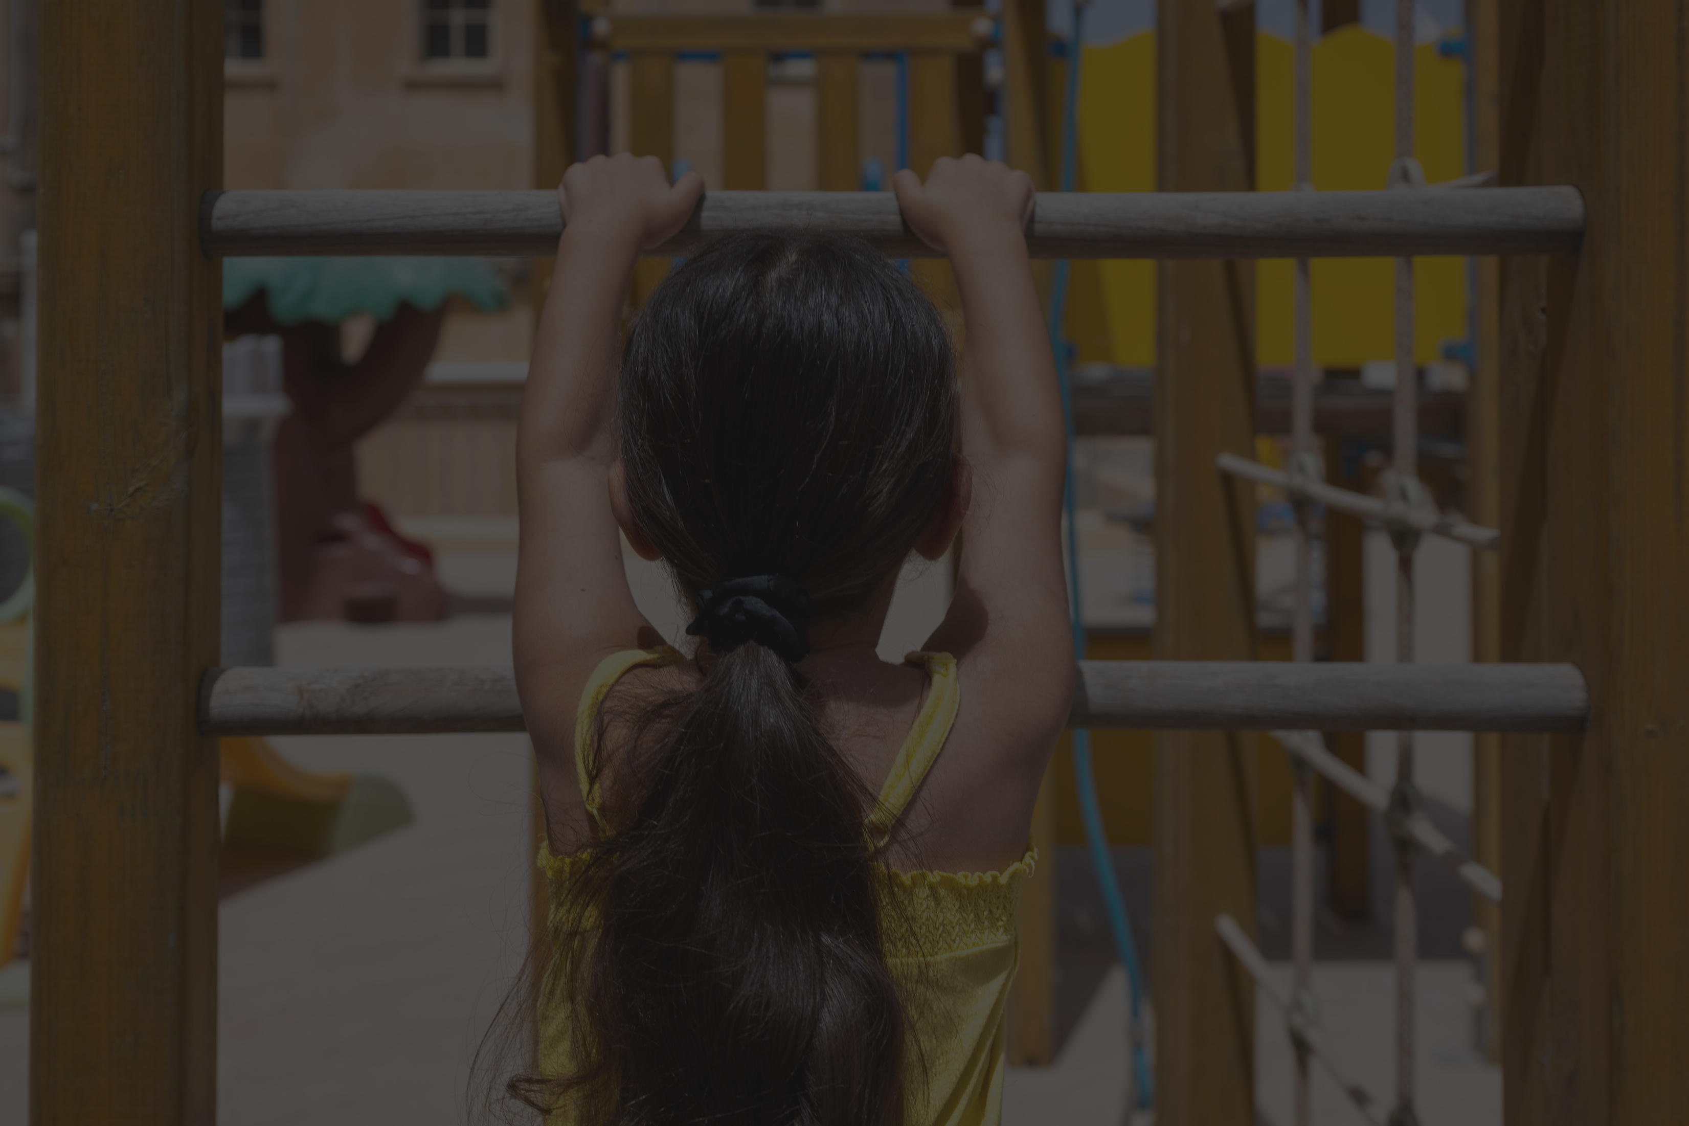


Il-Milja
IL-MILJA
FONDAZZJONI SEBH
Supporting women and their children to escape violence and find a life free of abuse
September 2024

Slide 2

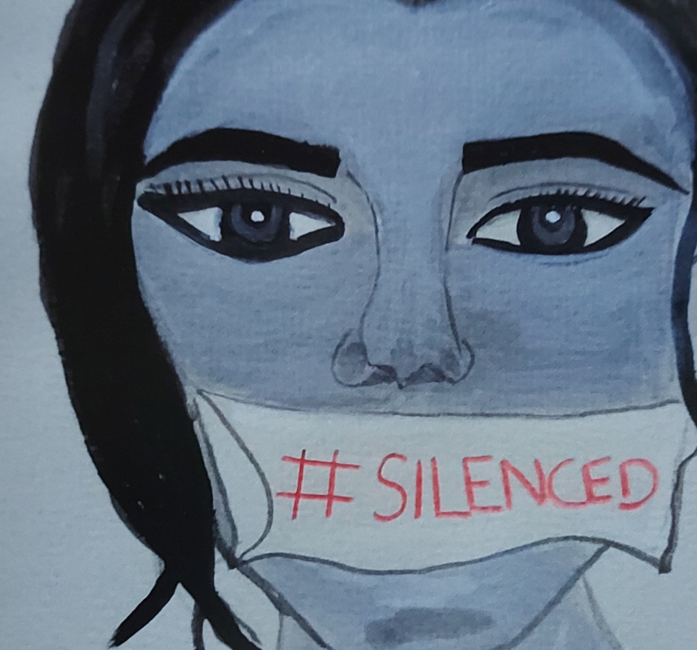
Il-Milja
WHO WE ARE
  Milja is part of the Family Services within Fondazzjoni Sebħ
  Fondazzjoni Sebħ is an NGO which falls under the Archdiocese of Malta
  The service was previously Dar Qalb Ta’ Gesu since the year 2000 and changed to Il-Milja in 2021.
  Milja is a second stage shelter for women and their children who are escaping various forms of violence.
  At any given time Milja supports 12 families (up to 41 individuals). Some may come alone, with young children, with adult children or even with their pets whilst seeking safety.
  Residents can stay at Milja for a maximum of 18 months, with a possible further extension of another 6 months where needed.
Drawing by one of Milja residents

Slide 3
Il-Milja
  Any woman seeking safety is entitled to a referral to a shelter, whether they proceed with a police report or not.
  All referrals are voluntary
REFERRAL PROCESS
Being a second stage shelter means:
Exceptions for accepting emergency referrals
Routes for referrals
Once referral is received
  Primarily women and families would go to an emergency shelter prior to coming to Milja
  where risk is very high women would make use of an emergency shelter as our residents go to work, to school etc and to lower risk to them.
  When other emergency shelters (Dar Merhba Bik and Ghabex) are full and someone is in need of a shelter
  when adult children are accompanying their mother
  in some instances when there are accompanying pets
  For location reasons
  All referrals come from FSWS, most often from DVU, in line with the PSP.
  In instances when referrals come from other organisations or someone contacts us directly, we will gather the initial information and refer to DVU for them to also assign a worker.
  For emergency referrals the police would bring the person directly from the hub
  Referrals are reviewed and safety concerns weighed with needs of the family.
  When a woman/family is residing within an emergency shelter, then a pre admission meeting takes place with them.

Slide 4
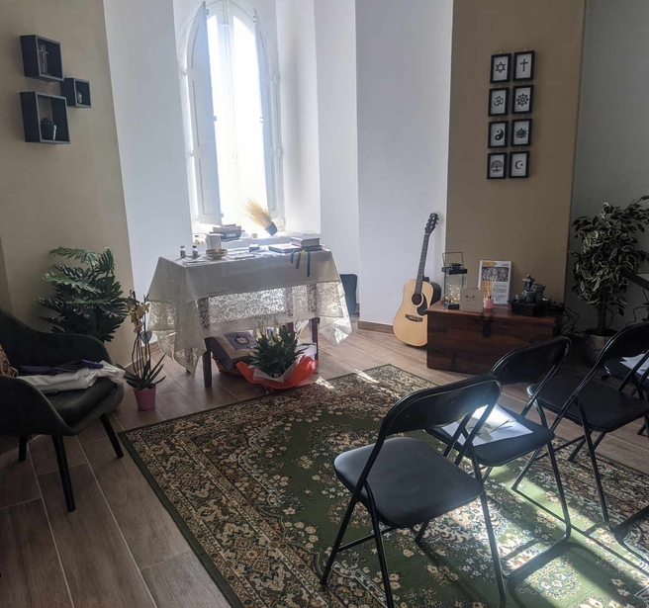
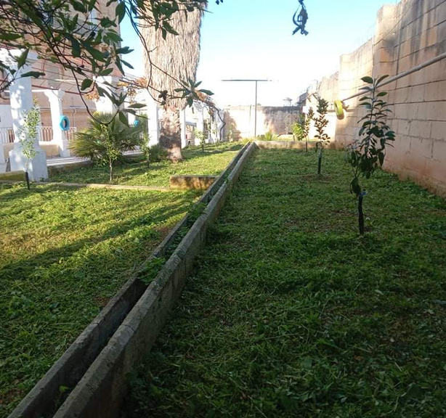
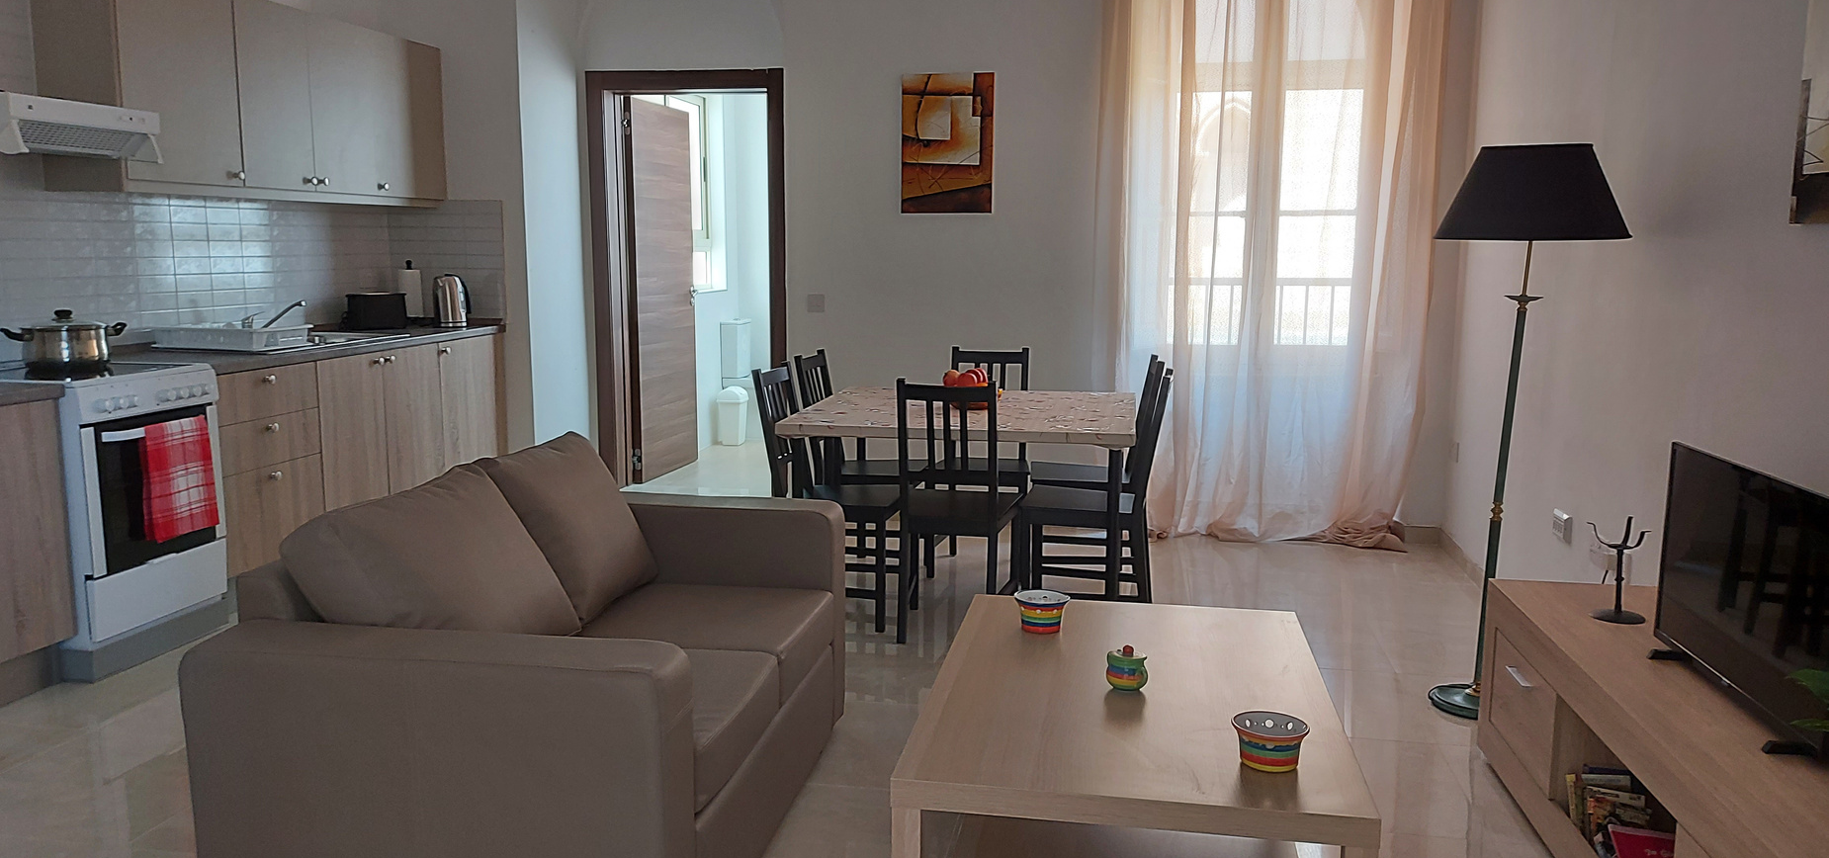
Il-Milja
CREATING A SAFE SPACE
01
Milja offers modern and spacious areas which convey dignity and physical and psychological safety.
02
Common areas include an adult therapy room, children therapy room, spiritual room, art room, gym space, communal living and dining room, communal garden amongst others
03
Each family have their own flat within the shelter which offers a kitchen, living room, bathroom and either 1/2/3 bedrooms. This offers space for the family to continue functioning as such.

Slide 5
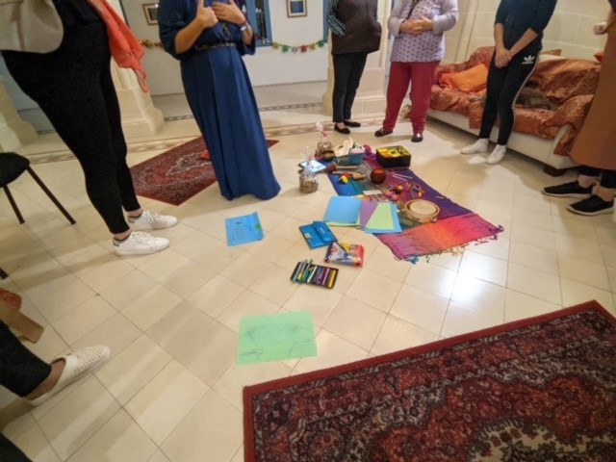
Il-Milja
OUR CARE
Professional Support
Care Plans
Round the clock support
A residential social worker is allocated to each family who is based in the shelter providing ongoing support. Il-Milja also fundraises to provide therapeutic support to those who need it without delay and connects residents with any other professional services they need such as legal, medical etc.
Every family, together with their social worker build a care plan. This care plan will consider the needs of the woman individually, those of the children individually and the needs of the family as a whole. The whole team then support the family in actualising the care plan.
The team at Il-Milja are available for residents 24/7. A dedicated home team and care team support the residents daily with their holistic needs. All team members are qualified for their role and receive ongoing CPD.
Nature of Residential Care
Rebuilding the Self
Residential care means that there would be daily contact with the woman or family. This allows for ongoing assessment of needs and supporting the woman in times of fear, sadness, anger, frustration and happiness.
As well as focusing on the legal, medical, psychological, social, familial needs of the family, Il-Milja focuses on projects and activities which give the family room to heal, reconnect and to gain self value.

Slide 6
Il-Milja
AMPLIFYING THEIR VOICES
At Il-Milja the residents are encouraged to voice any suggestions, concerns and recommendations for change. Every opportunity is sought to empower them to voice their feelings and to understand their value.
Subcommittees
Groups
Our Journey, Our Voice
The women and children are involved in subcommittees where decisions are taken about things happening in the shelter. This places them at the heart of decisions and shows that their opinion is valid and matters. Such subcommittees include social activities, health and safety, spiritual and children’s subcommittees.
Residents have group meetings, where they discuss ongoing matters in the shelter and another one where they use it as a space for group sharing and reflection. A monthly group is also held for the children.
We currently have an ongoing project where current resident and ex residents are preparing recommendations for policy change based on barriers they have found in the system.

Slide 7

Il-Milja
ADVOCACY
As well as providing daily support, we feel an obligation to echo the voices of the women we work with, to break down barriers and to do our part in shining a light on and preventing violence against women.
Training
Stand With Sebħ
Collaborations
We provide training in working sensitively with victims of trauma and DV. We have delivered such training to numerous professionals including social workers, psychologists, healthcare, educational, lawyers, police, HR managers etc and we have also been commissioned to give awareness talks to the general public.
Stand with Sebħ is a yearly campaign when our teams take to the streets and engage hundreds of companies and businesses to stand against violence. During every visit information about services available for victims of violence is given.
Throughout the year we collaborate with various stakeholders to directly or indirectly address barriers and gaps in services.

Slide 8
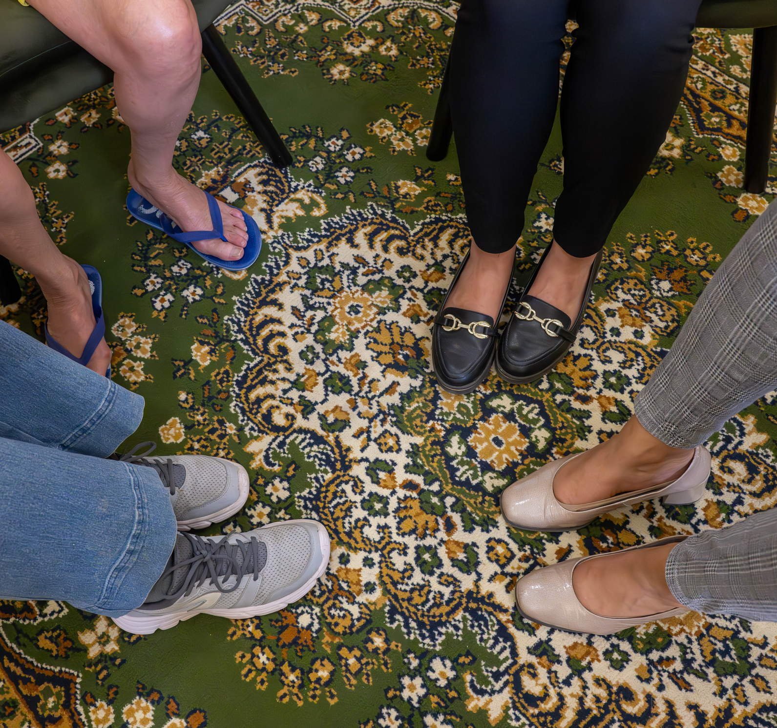
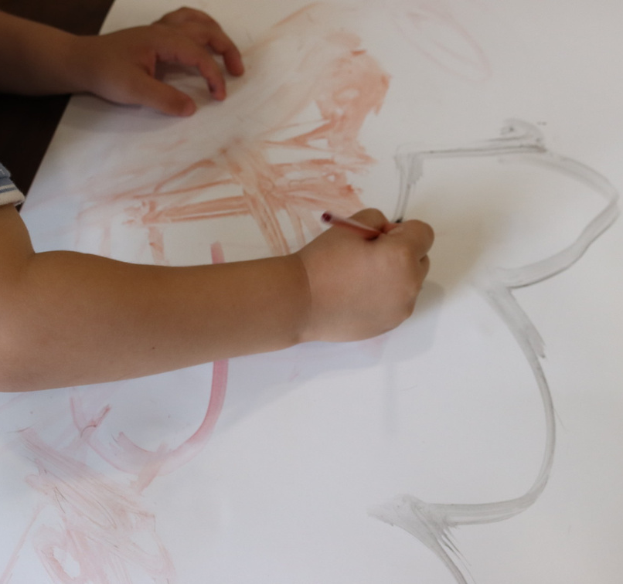
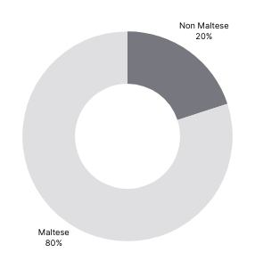

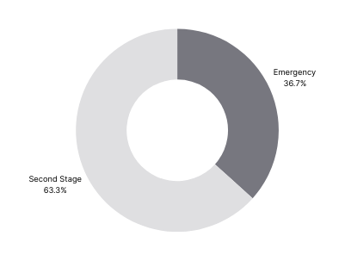
OUR REALITIES
In the last 24 months, Milja provided refuge to :
71
30
including
41
10
individuals
women or families
children
pets
women between the ages of
children between the ages of
19-77
0-19
4 women were pregnant whilst at Milja

Slide 9
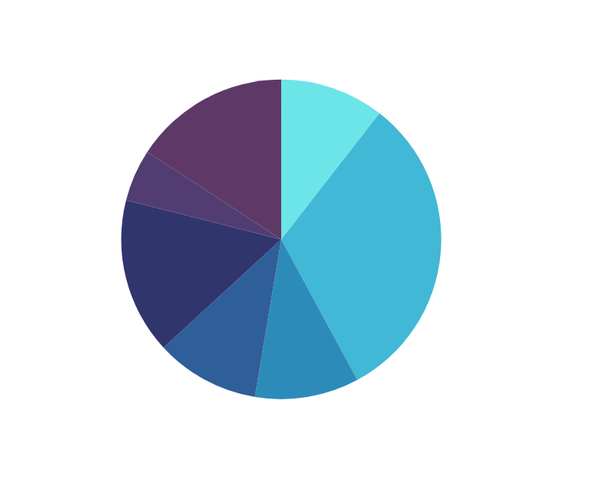
THEIR DIFFICULT REALITIES
Whilst at Milja some instances experienced by our women:
  Perpetrator turning up outside the shelter
  Child’s medical appointments and procedures being cancelled as father never turned up to sign
  Children being asked to change school due to moving to the shelter for 18 months
  Perpetrator turning up drunk at the child’s school whilst under a protection order
  Women having to change their schedule to accommodate access arrangements for the father of their children
  Maintenance not being given although granted from court
  Children not being able to attend school due to joint custody arrangements and safety issues
  Women having no support with her other children when her other child needed an operation
  Being faced with judgement for being a victim of abuse and for residing in a shelter
  Feeling like they had no other option but to return to their perpetrator
  Not being able to work due to fear of perpetrator turning up at place of employment
  Having no-one to look after their children when sick and losing their job as a consequence
  Having no income as husband receives pension
  Having to deal with increasing aggression from teenagers who have witnessed violence with a lack of services available to them
  Having to face their perpetrator in court (sometimes after a year of not seeing him)
  Court proceedings still ongoing when stay at shelter comes to an end
  Excessive rental prices which limit and delay options for moving on
Modes how women and families moved on following their time at Il-Milja.

Slide 10
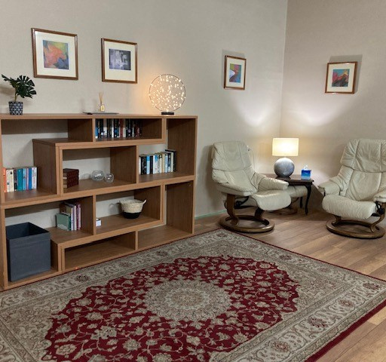
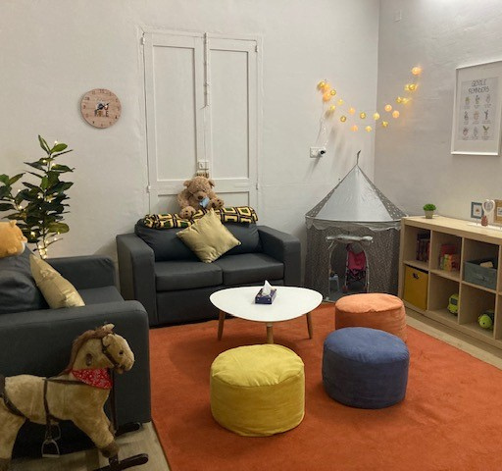
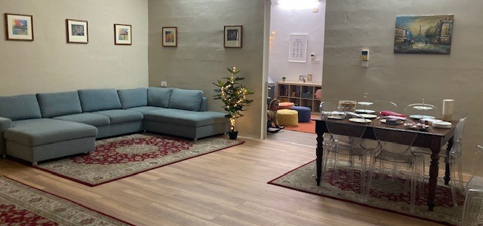
Il-Milja
AFTERCARE SERVICES
01
Aftercare services are offered to the women and families once they have been with Milja for one year. This gives additional support to women during the transitional stage.
02
Women can continue to make use of the aftercare services which also offer holistic support once the women have moved to the community. Social work and therapy would remain ongoing if needed and wanted.
03
Fondazzjoni Sebh are in the process of completing semi independent apartments for those women and families that can benefit from more time than is offered in the shelter eg. those studying, elderly etc.

Slide 11
Il-Milja
THANK YOU
Together we can create safer spaces for the needs of our women and children

