Slide 1



Malta Women’s Lobby
Prof. Anna Borg (2024)
Notes:
Umbrella organisation-

Slide 2
The issue of Violence on Women and Girls
To ask some long overdue questions

Slide 3

Q1: Are we really recognising the severity of the problem and prioritising it?
Every 4th women (26%) that you know who is in a relationship in Malta has experienced intimate partner violence (NSO, 2022). This means it affects tens of thousands of women.
Violence ruins people’s lives and that of their loved one. Women don’t feel safe in their own home, at work, and in the streets.
Are we really treating this issue seriously enough? Are we giving it the priority it merits?
Or have we become immune to this horrible reality to the point that violence on women has become normalised?
Notes:
26% of the total female population (15+) in our country would amount to tens of thousands of women being afflicted.
Not to mention the Victim Blaming!

Slide 4
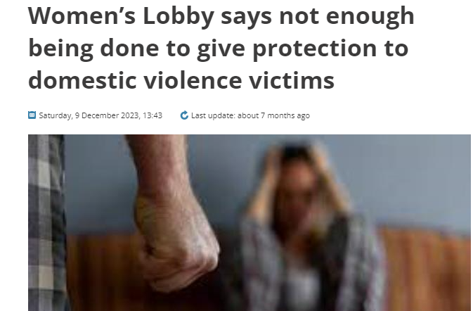
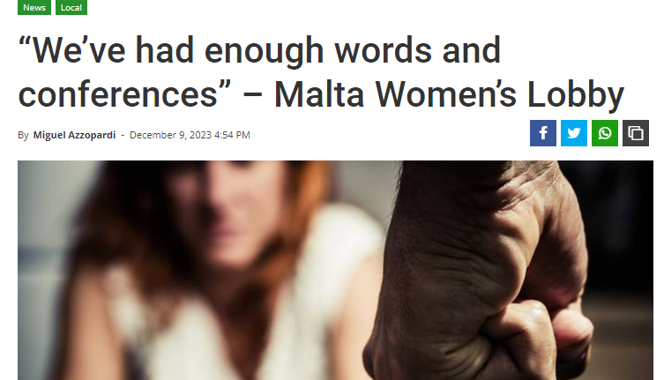
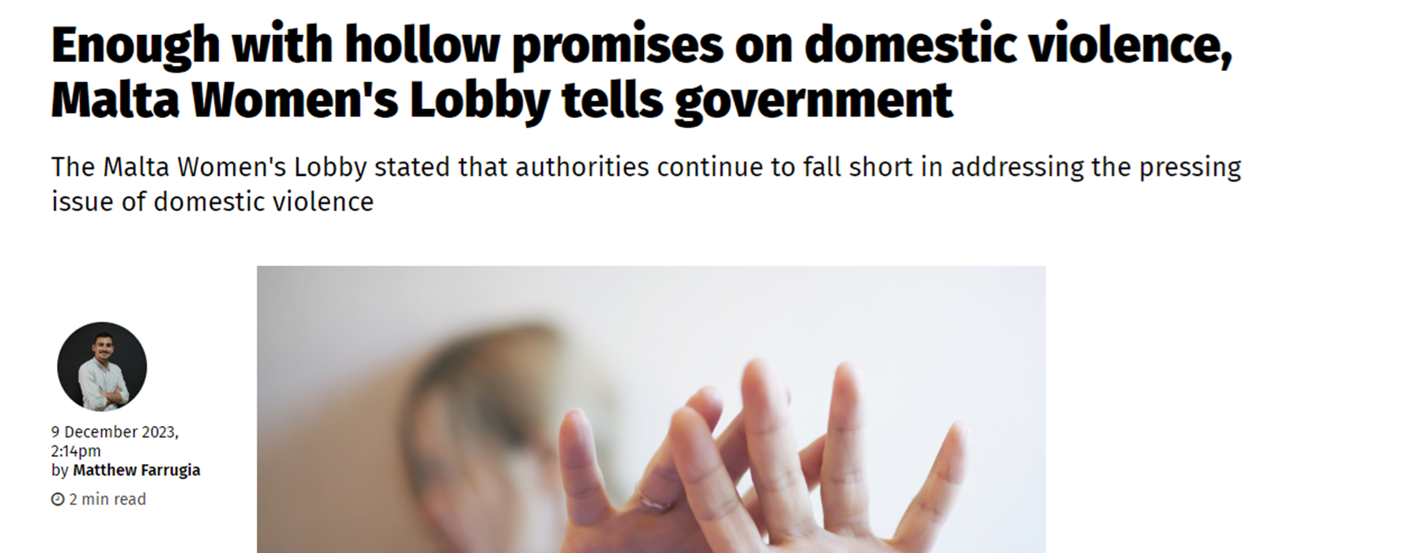

Press Releases – Issue of Violence on Women
Notes:
We have been repeating the same thing ad nauseum. Yet these seem to fall on deaf ears. T

Slide 5
Violence Against Women is NOT a priority
We learnt last week that the second hub for victims of violence, will only be opened in 2025 (because refurbishing the Rabat Police Station is more important!). Why?
The Grevio Report of 2020 had already recommended the use of electronic tagging, and yet four years later these have not materialised. Why?
Notes:
I can continue the list: Lack of resources, case overload, one magistrate for many years dealing with this issue etc etc

Slide 6
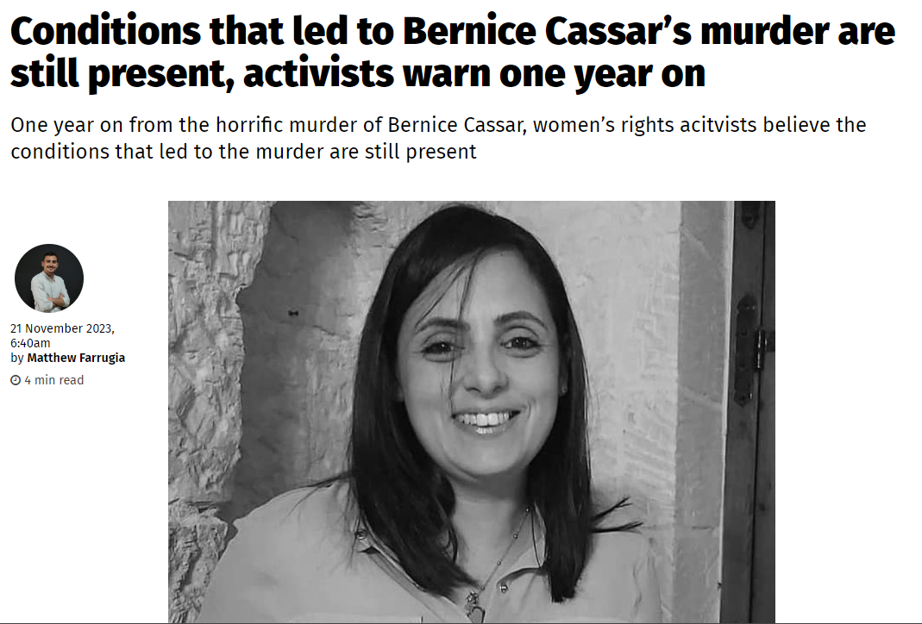
Notes:
Women experiencing violence still live in fear and do not feel sufficiently protected.

Slide 7
Many unanswered questions
If Violence on Women was considered as a serious threat:
Who do the Police NOT share information about the aggressor’s past crimes with the risk assessors?*
Why are perpetrators sometimes allowed to break the conditions of a Temporary Protection Order? What do the Police SOPs specify on this?**
Is one risk assessment sufficient? Or should they be ongoing since things evolve and change?
Why was a perpetrator allegedly on a 24 hours terrorist watch list since 2015, who openly mocked the police, not arrested?
Is anyone ever held accountable in case of gross negligence that leads to the death of a person?
Notes:
* In some countries it is the Police who carry out the risk assessments.
**There were no SOPs till 2023! Did we need to wait for the Valenzia Inquiry to issue SOPs on such an important subject affecting so many people?

Slide 8
In the UK, the Police are treating the issue of Violence against Women and Girls in the same way they approach counter-terrorism*
They are focusing on 4 key areas (4 P’s):
Prepare the police
Protect the Victim
Pursue the Perpetrator
Prevention of Harm
They specifically focus on Domestic Abuse, Rape and serious sexual offences, child sexual abuse and exploitation and Tech enabled VAWG such as online stalking and harassment.
*Adapted from: https://news.npcc.police.uk/releases/police-chiefs-adopt-a-counter-terror-approach-to-tackling-violence-against-women-and-girls
We need a well coordinated, ambitious approach been adopted to tackle the serious problem of VAWG?
Notes:
The areas of threat to Women and Girls are:
Domestic abuse
Rape and serious sexual offences
Child sexual abuse and exploitation
Tech enabled VAWG such as online stalking and harassment

Slide 9
In the UK, the Police are treating the issue of Violence against Women and Girls in the same way they approach counter-terrorism*
They are focusing on 4 key areas (4 P’s):
1. Prepare – Ensuring readiness to tackle VAWG by having the right capabilities, capacity and culture within the police sector (including the ability to respond and collect evidence, including digital evidence in order to respond to tech enabled VAWG
*Adapted from: https://news.npcc.police.uk/releases/police-chiefs-adopt-a-counter-terror-approach-to-tackling-violence-against-women-and-girls
We need a well coordinated, ambitious approach been adopted to tackle the serious problem of VAWG?
Notes:
Improving the digital forensic response to tackle gaps in capability and capacity to process digital evidence and respond to tech enabled VAWG

Slide 10
In the UK, the Police are treating the issue of Violence against Women and Girls in the same way they approach counter-terrorism*
2. Protect the Victim – Adopt a victim-centred approach focused on protecting the victims and keeping the community safe and ensuring a high-quality service
*Adapted from: https://news.npcc.police.uk/releases/police-chiefs-adopt-a-counter-terror-approach-to-tackling-violence-against-women-and-girls
We need a well coordinated, ambitious approach been adopted to tackle the serious problem of VAWG?
Notes:
Improving the digital forensic response to tackle gaps in capability and capacity to process digital evidence and respond to tech enabled VAWG

Slide 11
In the UK, the Police are treating the issue of Violence against Women and Girls in the same way they approach counter-terrorism*
3. Pursue the Perpetrator – Focusing on the tackling the perpetrators through investigation and evidence-led prosecutions.
*Adapted from: https://news.npcc.police.uk/releases/police-chiefs-adopt-a-counter-terror-approach-to-tackling-violence-against-women-and-girls
We need a well coordinated, ambitious approach been adopted to tackle the serious problem of VAWG?
Notes:
Improving the digital forensic response to tackle gaps in capability and capacity to process digital evidence and respond to tech enabled VAWG

Slide 12
In the UK, the Police are treating the issue of Violence against Women and Girls in the same way they approach counter-terrorism*
4. Prevention of Harm – Early intervention, rehabilitation and problem-oriented policing (POP) –using crime data in designing strategies and tactics and engaging community representatives and others in the analysis and planning process.
*Adapted from: https://news.npcc.police.uk/releases/police-chiefs-adopt-a-counter-terror-approach-to-tackling-violence-against-women-and-girls
We need a well coordinated, ambitious approach been adopted to tackle the serious problem of VAWG?

Slide 13
Call to Action
What needs to be done to address these questions?
How? Who? How much money needs to be invested? How many more resources? What needs to change? What can be improved?
Until we have clearer answers, more women will be taken away by inaction (or little action), indifference, and lack of accountability.
Then it will be too late!
So how do we take this forward? That is the big question.
Notes:
Women in Malta deserve to live without fear. The safety of women should not be compromised by bureaucratic inefficiencies or political inaction. We’ve absolutely had it up to our eyeballs with predictable political rhetoric, victim-blaming and the usual paying of lip service

