Slide 1


Maltese Association for Community Development
MACD Committee

Slide 2

Agenda
Who we are
01
Mission and Vision of MACD
02
Community Development
03
THE COMMUNITY DEVELOPMENT PRACTITIONER
04
THE IMPACT OF COMMUNITY DEVELOPMENT
05
FUTURE PLANS AND GOALS
06

Slide 3
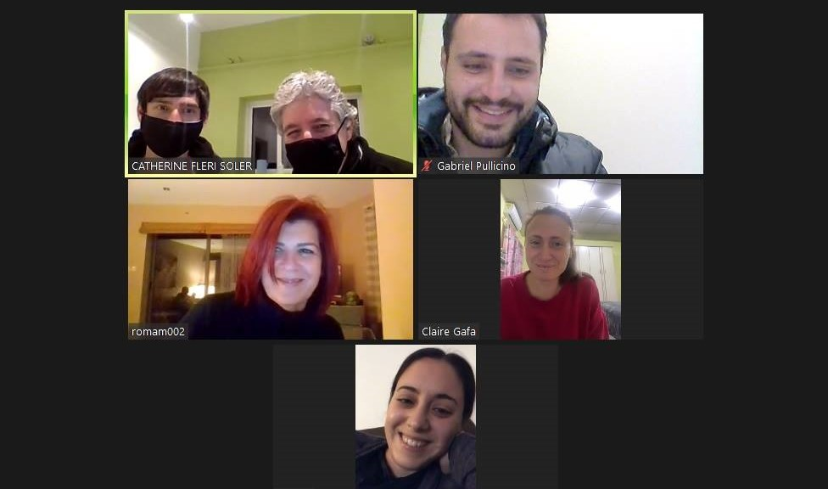
Who we are
MACD was established in 2017.
Received VO status in 2019 and officially launched in January 2020.
Members of IACD
MACD has two aims:
To advocate for the advancement of the profession of Community Development and underscore the critical importance of expanding opportunities within this field. Despite its longstanding presence in Malta, the profession has not yet garnered the required recognition.
To endeavour towards the formal recognition of Community Development Practitioners as a legally recognised profession.

Slide 4

Mission and Vision
The Mission
The Mission of the Association is: ‘To put Community Development at the forefront in promoting social justice, equality and inclusion through participatory community-oriented initiatives within the local context’.
The Vision
To promote CD practice, further education , research and support in Malta;
To establish CD as a profession (in the local context);
To establish and maintain standards of practice in CD;
To establish networks with entities/individuals in relation to community wellbeing;
To mediate with these entities when necessary to enhance community wellbeing;
To promote education and build capacity of its members.

Slide 5

Endeavours to enhance the well-being and resilience of local communities through collaborative efforts aimed at addressing their needs and aspirations.
Facilitates active involvement and engagement of community members in decision-making processes, fostering social cohesion and inclusivity.
Builds relationships for a healthier environment, and thus, better wellbeing.
Builds local capacity, strengthens social networks, and advocates for positive change.
Is a process of coming together for growth.
Involves the community for positive change.

Slide 6
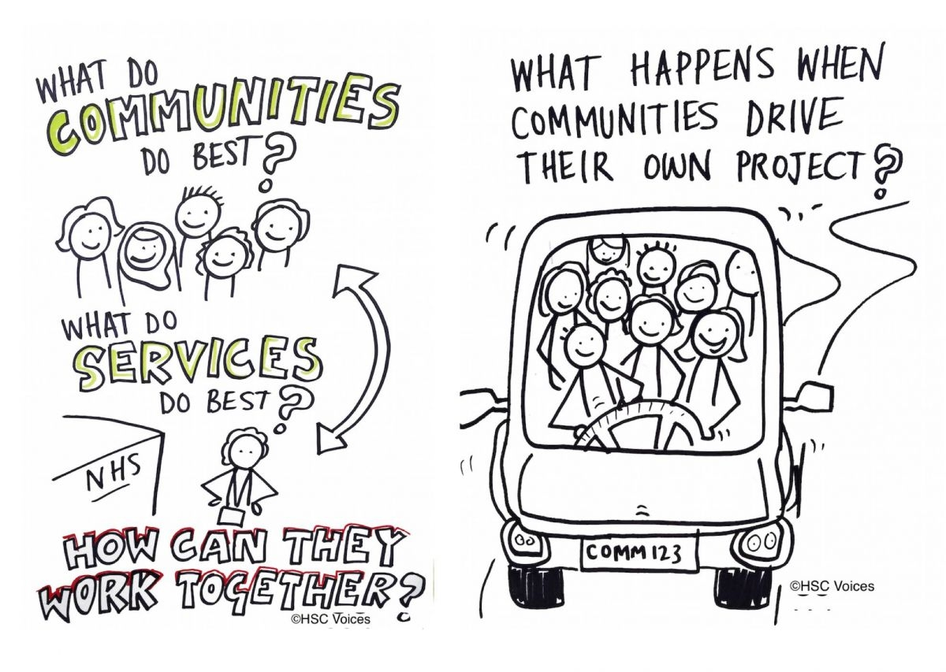
The Process
Map and get to know the community and its members.
Identifying both strengths and weaknesses in the community.
Facilitate critical thinking process.
Recognising resources and strengthening them (capacity building).
Finding solutions from within the community.
Working collectively for the desired change.

Slide 7

Methods
Critical Community Development (Paulo Freire; Margaret Ledwith)
Asset-Based Community Development (John Mc Knight & John Kretzman; John McKnight & Peter Block; Cormac Russell)
Participative Community Development
Needs-Led Community Development

Slide 8

The Importance of Community Development
Building Social Cohesion:
  Strengthening relationships and trust within the community
  Encouraging active participation and civic engagement
Enhancing Quality of Life:
  Improving access to essential services and resources
  Promoting health, education, and economic opportunities
Sustainable Development:
  Ensuring long-term growth and resilience of communities
  Addressing environmental, social, and economic challenges

Slide 9

Community Development Practitioner
Local Engagement and Understanding
Building Trust and Relationships
Identifying Needs and Assets
Empowerment and Capacity Building
Facilitating Participation and Inclusion
Sustainability and Long-Term Impact
Conflict Resolution and Social Cohesion
Advocacy and Policy Influence

Slide 10
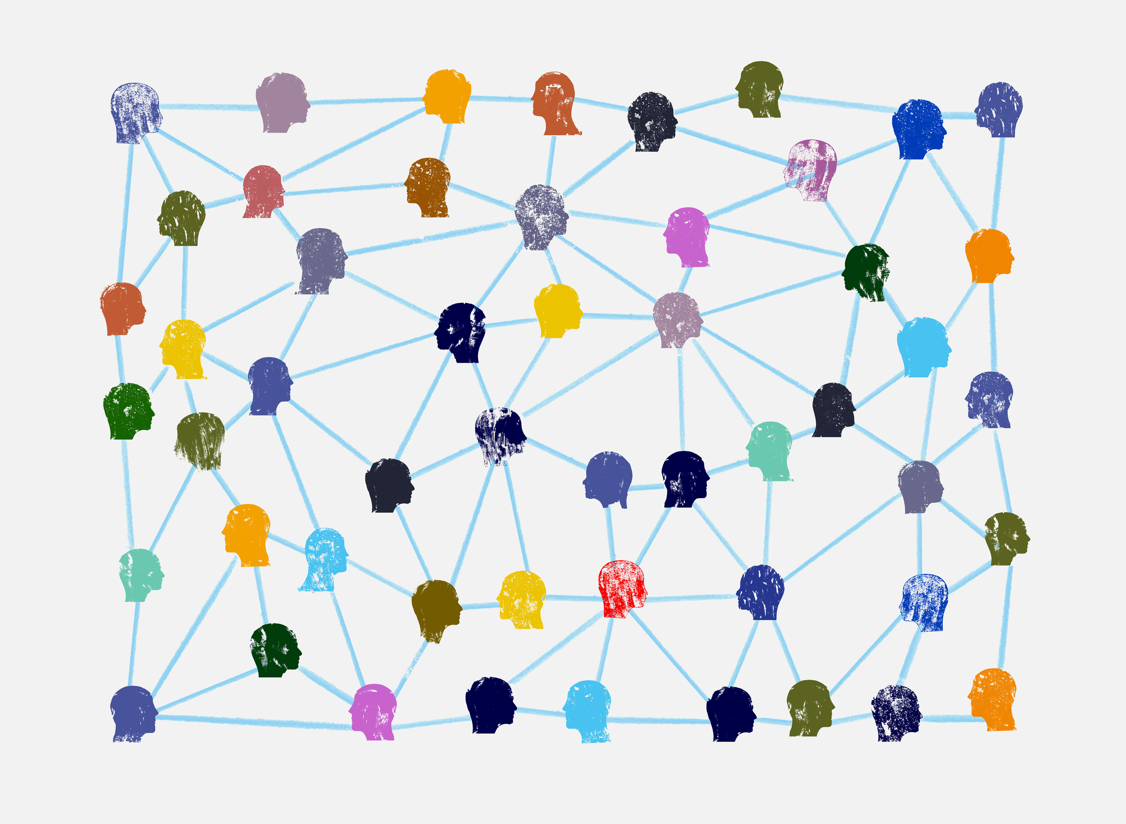
Success stories & Impact
1. Asset Based Community Development mapping:
Discover
Connect
Mobilize
2. Networking:
Getting stakeholders together to discuss themes that affect the community and mobilize for a positive change.

Slide 11

Transferability of the approach
Social Work especially, work with persons experiencing poverty/ mental health/ children
Healthcare (e.g. community nursing, health promotion)
Youth work
Work in schools (with students and with parents)
Migrants
Environment
Local Councils

Slide 12
Community Development Profession ACT - Draft
Professionalization of community development refers to the formal recognition of community development as a distinct profession, often with specific training programs, certification processes, and professional associations
To legally underpin the practice of Community Development.
To regularise, recognise and strengthen community development work and skilled workers in the field.
To put Community Development practitioners on par with other professions in the social field by introducing a professional warrant for community development workers.
Set professional standards for Community Development practitioners.
To establish community development code of ethics and standards.
Community Development is a recognised profession in various countries including the UK, Canada, Australia, New Zealand and South Africa among others

Slide 13
Community Development Profession ACT - Highlights
Law establishes "community development work" in Malta as a practice-based profession and an academic discipline that promotes participative democracy, sustainable development, rights, economic opportunity, equality and social justice, through the organization, education and empowerment of people within their communities, whether these be of locality, identity or interest, in urban or rural settings.
Community development practitioners engage with people, organisations and institutions within their communities, including the voluntary sector and support them in realising their potential and address life’s challenges critically and creatively to bring about social change.

Slide 14
Community Development Profession ACT - Highlights
Qualifications
  Must be in possession of the Honours Degree in Youth and Community Studies conferred by the University of Malta, or an Honours Degree in Social Work or Social Policy conferred by the University of Malta, or is in possession of an Honours Degree in Health and Social Care (management) conferred by MCAST or a Masters in Community Action and Development conferred by the University of Malta, or a Masters in Youth and Community Studies or a PhD in Community Development or of another professional qualification recognised as equivalent for the purpose by a Member State, obtained from a university or college:
  Provided that in respect of applicants coming from third countries whose qualifications have not been recognised in a Member State, the Board may, in respect of such qualifications, require the applicant to sit for and pass a professional proficiency test;

Slide 15
Community Development Profession ACT - Highlights
Experience
Satisfises the Board that they have received adequate experience in the practice of the profession of community development practitioner for an aggregate period of at least two years full-time or its equivalent on a part-time basis following the completion of such degree or such other professional qualification.

Slide 16

Way forward
Continue to promote Community Development and its approach with different stakeholders.
Continue to work on the professionalisation of the Community Development Practitioner.
Provide practitioners with more educational training on community development and related information.
Advocate for more formal education in community Development

