Slide 1

ANNUAL REPORT 2021-2022

Slide 2
Session 1 – 20th March 2024

Slide 3
Challenges and Opportunities (2021)
Call for Action(2022)

Slide 4
Why the delay?
Academic, scientific and analytical
Describing and highlighting areas of concerns
Bringing them to the attention of House of Representatives
Triggering concrete action

Slide 5
Why all this?
    Is there a problem?
        How big is the problem?

Slide 6
7. Nervous System Diseases:
………
(h) Dementia
(i) Schizophrenia
(j)Psychosis
(k) Chronic Mood Disorders
(l) Chronic Neurotic Disorders
(m) Addiction Disorders
(n) Chronic Psychiatric Disorders starting in Childhood
(o) Chronic Eating Disorders
……..
Social Security Act (Chapter 318)
Part II
Diseases and conditions in respect of which free medical aid may be accorded

Slide 16
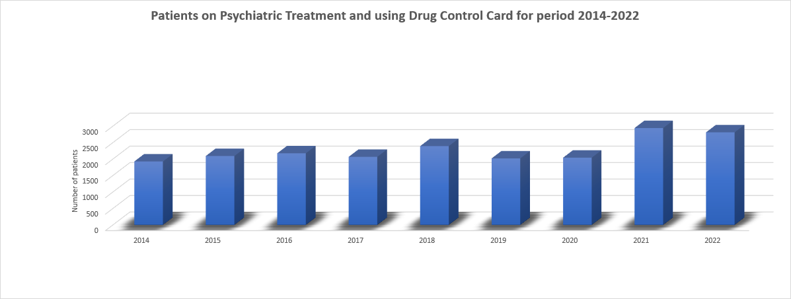
(POYC data)

Slide 17
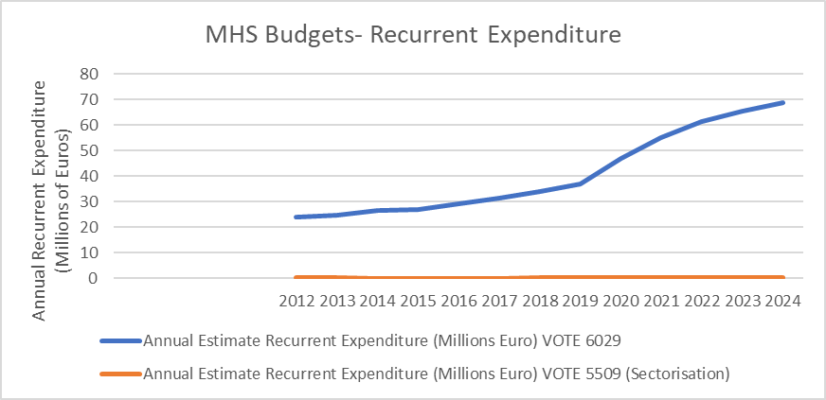

Slide 18
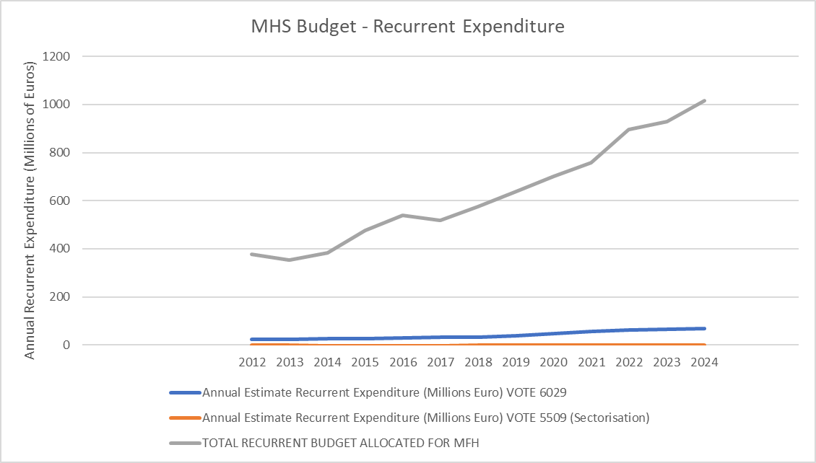

Slide 19
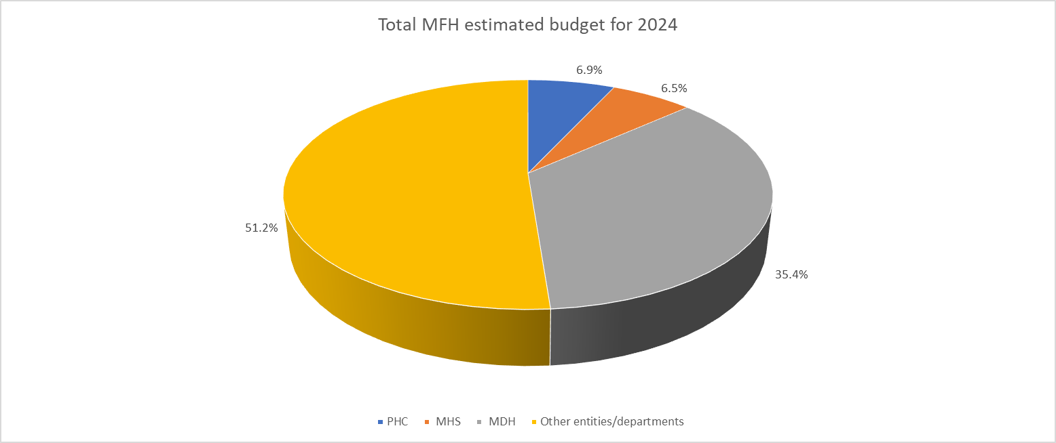
2024 total budget allocation – recurrent and capital

Slide 20
Analysing data at end of 2022 of involuntary care given at Mount Carmel Hospital -1
The total number of new cases in the involuntary care system was 497 - a 38% increase over the average of 361 new cases per year registered from 2016 to 2021. (Annex 1- section 1 of the annual report).
Involuntary admission for observation (Sch 2 – IAO ) 740 approved applications in respect of 620 individual patients.
  64.7% lasted <10 days
  16.5% lasted >10 days but <17weeks
  2% were put on Continued Detention Order >17 weeks
Community treatment orders (Sch 7 – CTO) 418 approved applications in respect of 252 patients.
(Annex 1- section 2 of annual report)

Slide 21
Analysing data at end of 2022 of involuntary care given at Mount Carmel Hospital -2
Of the 620 persons under IAO,
68.4% were Maltese/Gozitan
31.6% were non-Maltese, of whom
  66.3% were males
  48.5% came from EU/EEA or other European countries
  51.5% came from non-EU countries
A total of 30 patients (4.8%) were classified as homeless
(Annex 1 - section 3.2.3).

Slide 22
Analysing data at end of 2022 of involuntary care given at Mount Carmel Hospital -3
Of the 740 Sch. 2 (IAO) applications, only 25% were signed by a responsible carer. An education campaign to increase awareness and the important roles of Responsible Carers needs to be undertaken.
(Annex 1 - section 3.3).
72 persons (11.6%) were admitted under Sch. 2 due to suicide attempt. Another 89 patients (15.5%) had documented suicide ideation
(Annex 1- section 3.6).

Slide 23
Year 2011-2021 | No. of suicides/yr n=277 | % Male | % Females | Average age | Lowest –Highest age | <25 years of age | >65 years of age
2011 | 19 | 100 | - | 45 | 18-69 | 3 | 1
2012 | 26 | 77 | 23 | 50 | 18-98 | 1 | 5
2013 | 22 | 100 | - | 47 | 21-77 | 3 | 1
2014 | 30 | 87 | 13 | 50 | 14-96 | 4 | 6
2015 | 36 | 81 | 19 | 43 | 17-72 | 2 | 3
2016 | 21 | 86 | 14 | 44 | 25-83 | 1 | 1
2017 | 25 | 80 | 20 | 48 | 15-80 | 3 | 5
2018 | 22 | 82 | 18 | 42 | 18-80 | 3 | 2
2019 | 21 | 91 | 9 | 45 | 21-82 | 3 | 4
2020 | 21 | 68 | 32 | 45.5 | 23-67 | 1 | 1
2021 | 34 | 73 | 27 | 43.5 | 14-73 | 6 | 3

Slide 24
Positive salient remarks from 2021 report
The gradual implementation of the Mental Health Strategy published in 2020
the refurbishment and the improved environments in some of the wards in Mount Carmel Hospital
the transfer of stable chronic mental patients to community residential facilities
the ongoing planning for the new acute psychiatric hospital on Mater Dei Campus
the various campaigns to increase mental health literacy
the introduction of new services, as well as the ongoing staff training and specialisations

Slide 25
Session 2 – 3rd July 2024

Slide 26
Some of the issues raised in past but still need addressing (cont.)
The sense of patient inactivity, especially in the afternoon and evening hours
The increased number of mental health problems in young people, migrant and foreign workers
The burden of substance misuse
Need for greater collaboration by all stakeholders working in the field of mental health
The active participation of patients and their responsible carers in patient care plans
The slow process of digitalisation of patient medical records
The delayed set up of full-time crisis intervention teams on site at MDH

Slide 27
(cont.)
Some of the issues raised in past but still need addressing
8. Closed Psychiatric Unit within MDH
9. The lack of cohorting of in-patients by disease condition & according to their respective needs, gender - issue often raised by service users
11. The slow introduction of new medicines in the Government Formulary
12. The inadequacy of smoking areas in the wards
13. Patients not requiring hospitalisation are kept there due to lack of appropriate therapeutic and supportive services in the community
14. Lack of interpreter services and cultural mediators for foreigners

Slide 28
Some of the key actions taken by this office in 2022
Initiated discussions to address the lack of a current valid mental health facility licence in compliance with SL 262.04 of the Dementia Wards at Saint Vincent De Paule (SVP).
In line with art 42 of the Mental Health Act, this Office started requesting monthly updates from licensed mental health facilities regarding any death of patients with mental health problems
Consulted with the State Advocate's Office and organised an online meeting with relevant stakeholders regarding refusal of treatment in patients involuntarily admitted
Reviewed community treatment orders initiated in the private sector
Reviewed the process for administration of Electro Convulsive Therapy in MDH
Brought to the attention of various stakeholders the obligations set by Art 35 of the MHA regarding the conducting of clinical trials, medical or scientific research on patients with mental health problems

Slide 29
Some of the key actions taken by this office in 2022
In view of the increased prevalence of mental health problems in children and adolescents, this office initiated discussions to introduce the delivery of Mental Health First Aid training for all year 9 students (aged 13 years) and their educators in all schools – Public, Private, Church and Independent
Started planning a stakeholders forum intended to bring together all entities involved in services related to mental health in the country
Started an internal exercise to propose amendments to the current MHA. This followed a meeting held at the Ministry for Health as regards MDH not being licensed to offer mental health services despite psychiatric services being offered. We need to clarify/amplify the role of the Responsible Carer
Started studying the prevalence and characteristics of individuals who died by suicide in Malta since 1995
Triggered discussions about safeguarding the rights of persons who go on hunger strikes in the context of the World Medical Association (WMA)’s Malta declaration on hunger strikes

Slide 30
Some of the key actions taken by this office in 2022
Since a person suffering from a longstanding chronic mental disorder, living with his/her parents and who has a difficulty in securing / retaining a paid employment, is not entitled to social assistance, we submitted to DSS a proposal for a BM for 2023 so that such persons are entitled to 50% of the stipulated amount of social assistance as established from time to time
Continued lobbying support for persons with chronic mental health problems with functional disability as verified by WHO DAS tool to be considered eligible for Disability pension

Slide 31
In Conclusion
Since Mental Health is a universal human right - everyone, whoever and wherever they are, has a right to the highest attainable standard of mental health.
A round table forum should be organised between all political parties to agree on common positions related to mental health problems.
An authority with representatives from all political parties, NGOs and other stakeholders should ensure that measures conducive to mental health wellbeing are implemented across all ministries, places of work and in the community. Everyone has a contributory role.
Increased financial commitments to support preventive measures and support mental health services – both in-hospital and in the community, and support and enhance recruitment of more trained professionals.
Review of public procurement procedures to ensure efficient implementation of the various projects related to mental health issues including preventive measures, therapeutic –in-hospital and community wide, as well as, those related to rehabilitation

Slide 32
Finally
Taking note of the recent visit to MCH by the Prime Minister and the Minister for Health,
  The major refurbishment of MCH and community clinics should become a national priority and implemented at the soonest
  The Psychiatric Unit in MDH should be reopened at the soonest
  Parts of MDH should be licensed as Mental Health Facilities (Postpartum psychosis and A&E)
  Make use of the open land surrounding MCH as well as St. Luke Hospital
  No person should be kept in a psychiatric hospital if such a need does not exist, simply because of lack of supportive and therapeutic services in the community.
  The model of Dar Kenn għal Saħħtek should be extended to other specific care needs.

Slide 33
To the person with mental health problem, time is not on his/her side.
We owe them a lot.

