Slide 1
Social Work Education: key developments

Slide 2
The early years: a struggle for recognition.
1990: The Ministry for Social Policy published a Green Paper entitled “A Caring Society in a Changing World” which articulated government’s plans for social welfare reform.
These saw social workers as key to the planned reform (Cole, 2003, Cole and Kenely, 2022).
The document also highlighted the importance of social work education and training and proposed a warrant for social workers (Ministry for Social Policy, 1990).

Slide 3
The early years: a struggle for recognition.
1993: The generic B.A (Hons) degree in social work was first offered and has continued to be offered to date. This has meant that social work education in Malta has always been offered at a University level.

Slide 4
The early years: a struggle for recognition.
1996-1997: A Post-graduate Diploma in Social Work was offered only once and was successfully completed by five students. This course may be considered the pre-cursor of the Master of Social Work which was developed in later years.
2002: The Diploma in Social Work was discontinued in view of the prospective Social Work Profession Act (Cap. 468) which established the honours degree in social work as the minimum qualification for the practice of social work in Malta. The course had been offered since 1983.
Notes:
As we heard from ‘Our shared roots’ panellists, the 1990s saw a number of major developments in the social welfare sector. This expansion of services resulted in a clamour for more social workers. The university was now offering the BA (Hons) degree on a full-time and part-time basis and the part-time Diploma in Social Work. In order to respond to the increased need for social workers a Post-graduate Diploma in Social Work was offered between 1996-1997.

Slide 5
The new Millenium: Time for consolidation
2000-2010: The Department of Social Policy and Social Work collaborated with the business arm of the University to offer a number of post-qualifying courses in Social Work Management, Social Work Supervision and Working with Children and Families.
2008: The first PhD in social work was conferred by the University of Malta.
2009: The first taught specialist Master of Arts (Social Work) and Master of Arts (Social Policy).
Notes:
These were a response to the new needs for continuous professional development created by the regulatory legislation and increased service specialisation and complexity.
These were key landmarks as they helped to assert social work and social policy as respected academic disciplines. The MA courses focused on the specialist areas of ‘Children and Families’. Thirteen students successfully completed studies leading to an MA (Social Work) in 2012 and another 8 students in 2016. These courses were offered twice. The MA Social Policy has been offered more recently with other specialist focuses.

Slide 6
The new Millenium: Time for consolidation
2018 : The Department started offering a Master of Social Work. This course provides a master entry into the social work profession. This was a response to a renewed clamour for more social workers; to the acknowledgment of the ever-growing complexity of social work practice and to the awareness that a number of graduates from related fields would benefit from an entry route to social work (Cole & Kenely, 2022).
To date, nine people have graduated from this programme which is gaining momentum and there are currently 15 students registered on it.

Slide 7
The new Millenium: Time for consolidation
2020 : A Master of Arts by Research in both Social Work and Social Policy and a Master of Arts in the Management of Social Care Services were offered. This latter programme of studies is being offered at the request of the Foundation for Social Welfare Services (FSWS) and in collaboration with the Faculty of Economics Management and Accountancy.

Slide 8
Routes into Social Work
BA (Hons) Social Work
4 years full time
6-8 years part time
Master of Social Work
2 years full time
4 years part time

Slide 9
Pillars of Social Work
Education
Social Work Theory and Methods
Helping Skills Training
Practical Placements
Personal and Professional Development
Research

Slide 10
TWO
Practical Placements
First placement – Engagement and Assessment
Second placement – Intervention and Evaluation
BA (Hons) – 700 hours of placement
MSW – 750 hours of placement
Notes:
Placements are 30 ECTS of 120 MSW – a quarter of the course
Application of theory to practice
Undertaken with different client groups:
children (CPS, fostering, adoptions, LAC), youth, families, hospital, oncology, addictions, corrective services, mental health, domestic violence, disability, elderly

Slide 11
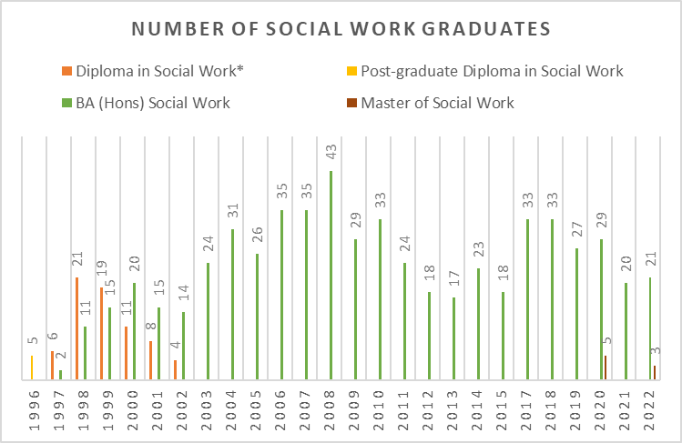
Source: Office of the Registrar, University of Malta.

Slide 12
Moving Forward
The Department of Social Policy and Social Work recently conducted a tracer study of social workers. A total of 180 people responded to the survey from a total of 670 local graduates in social work. This gives a response rate of 26%. The results are interesting and merit consideration. I would like to point out one or two aspects.

Slide 13
Moving Forward
the young age at graduation, 117 out of 180 graduated at 23 years or less;
that a large proportion were satisfied with the quality of the social work programme and with how it had prepared them for practice; and
that 68.3% (n=123) have pursued further studies.

Slide 14
Moving Forward
The social work profession has made huge strides in asserting itself as a respected profession in the Maltese landscape. The same could be said for social work education.
The Department of Social Policy and Social Work, besides the many offerings of courses at both an undergraduate and Master level, prides itself on the number of students reading for a PhD in both social work and social policy (Cole & Kenely, 2022).

Slide 15
Some thoughts about “Social welfare professionals” drawn from a statement by the Malta Social Work Profession Board, The Maltese Association of Social Workers and the Department of Social Policy and Social Work, University of Malta in February 2022.
The title “social welfare professional” or variants of the title suggest:
a theoretical and practical preparation leading to an acknowledged professional qualification, this is not the case for social welfare professionals who in most instances have a degree that does not lead to a recognised profession;

Slide 16
Some thoughts about “Social welfare professionals”
The title “social welfare professional” or variants of the title suggest:
that a person is obliged to work within the bounds of a Code of Ethics; and
that the person has been given a warrant, thus implying that the community sanctions them to practise the profession, this is not the case for “social welfare professionals”.

Slide 17
Some thoughts about “Social welfare professionals”
It is expected that the job descriptions of "social welfare professionals" should be distinct from those of social workers, but this is not the case.
Their roles, tasks, and responsibilities ought to be different and made known to clients.

Slide 18
Some thoughts about “Social welfare professionals”
Agencies that employ "social welfare professionals" cater to vulnerable clients who face various physical, emotional, and psychological challenges.
It is extremely important that they are given the best service and that they understand fully who is providing them with the service. It is of concern that clients share very sensitive personal information with “social welfare professionals” who are not bound by a Code of Ethics.

Slide 19
“Social welfare professionals”
So what can be done:
The role of the “social welfare professionals” has to be clearly defined as supportive to that of social workers. Perhaps the nomenclature, “support workers” or similar could be used.

Slide 20
“Social welfare professionals”
So what can be done:
“Support workers” should not carry case responsibility however there are many support tasks that they could do such as accompanying clients to important appointments, ongoing monitoring of clients, following up on referrals, helping with applications for services, completing forms, coaching for certain tasks, etc.
All of these must be carried out under the supervision of social workers who have responsibility for the cases.

Slide 21
“Social welfare professionals”
So what can be done:
Social welfare professionals who are graduates in various areas are to be given incentives to read for the Master of Social Work (MSW).
Steps should be taken to ensure that the conditions of work of social workers guarantee the retention of social workers in employment. These conditions should not pertain to salaries only but are also related to the respect and status of the profession including increased professional autonomy.

Slide 22
References:
Abela, M. (2003). History of Social Work in Malta:1980-2001. (Unpublished
undergraduate dissertation). University of Malta, Malta.
Cole, M. (2003). The practice and experience of social work supervision: An
analysis of supervisory practices in Malta. (Unpublished doctoral thesis).
University of East Anglia, England.
Cole, M. & Kenely, N. (2022) Social Work. In S. Vella & E. Galea-Curmi (Eds.), Social Policy in Malta: an introduction" (pp.223-240).
Ministry for Social Policy. (1990). A caring society in a changing world: proposals for a social welfare strategy for the nineties and beyond [Green Paper]. Malta: Ministry for Social Policy, 2/90.

Slide 23
References:
Pace, C. (1983, November 24). Behind the Tourist Curtain. Social Work Today, 14, 20-21.
Social Work Profession Act https://legislation.mt/eli/cap/468/eng/pdf
[Accessed 8th November 2023].

Slide 24
Thank you
Department of Social Policy and Social Work, University of Malta.

