Slide 1



SAFEGUARDING
SOCIAL WORK
IN MALTA & GOZO
10 July 2023

Slide 2
SCOPE
  To safeguard the social work profession by ensuring that all who practice social work are qualified to do so
  To ensure that vulnerable service users receive an adequate service by qualified individuals and who as a result are protected by law

Slide 3

MASW ackowledges that there is a shortage of social workers.
MASW believes however that the solution to this shortage is not solved by employing unqualified individuals

Slide 4
SOLUTION
1
2
3
PROMOTE SOCIAL WORK
ENCOURAGE MORE PEOPLE TO ENTER THE PROFESSION
RETAIN EXISTING SOCIAL WORK GRADUATES
The following recommendations were sent to the Minister on 27.09.2022 & 06.03.2023 by MASW SWPB & Department of Social Policy and Social Work.

Slide 5
RECOMMENDATIONS
  Persons holding a first degree who wish to enter the social work profession should be encouraged by employers to enrol in the Master of Social Work (MSW) to ensure practice according our laws and the profession's code.
  Social work students to be offered a higher stipend.

Slide 6
RECOMMENDATIONS
  Social work students to be paid while carrying out their university placements, which involve a total of 750 hours of direct work in social work agencies, under supervision
  The prestige of the profession needs to be enhanced

Slide 7
RECOMMENDATIONS
  The salary structure needs to be revised to reflect the prestige, expertise and risks involved
  No unqualified person should be engaged to fulfill a social worker’s role. This would be unlawful and impact negatively on our client group and society's perception of the profession

Slide 8
RECOMMENDATIONS
  Avoid having multiple social workers working on the same case
  Improved career progression opportunities for social workers to encourage retention
  The profession needs to be promoted more on a national level, in order to attract people to study and become social workers.

Slide 9
Other countries face the same situation
According to BBC News (December 2022), Wales had about 485 social work vacancies at the end of 2022 and the Welsh government said “We are working with the sector to improve recruitment and retention of social workers including through actions set out in the recently published social work workforce plan.”
This plan is based on a three year plan to attract more to the social work profession and to retain current social workers.

Slide 10
Social work assistants
MASW acknowledges the importance of individuals employed to support and assist social workers in their role.
However both job title and job description should be reflective of the fact that it is a supportive role and any false claims of being a social worker or carrying out the work of a social worker should be reprimanded in line with the law.

Slide 11
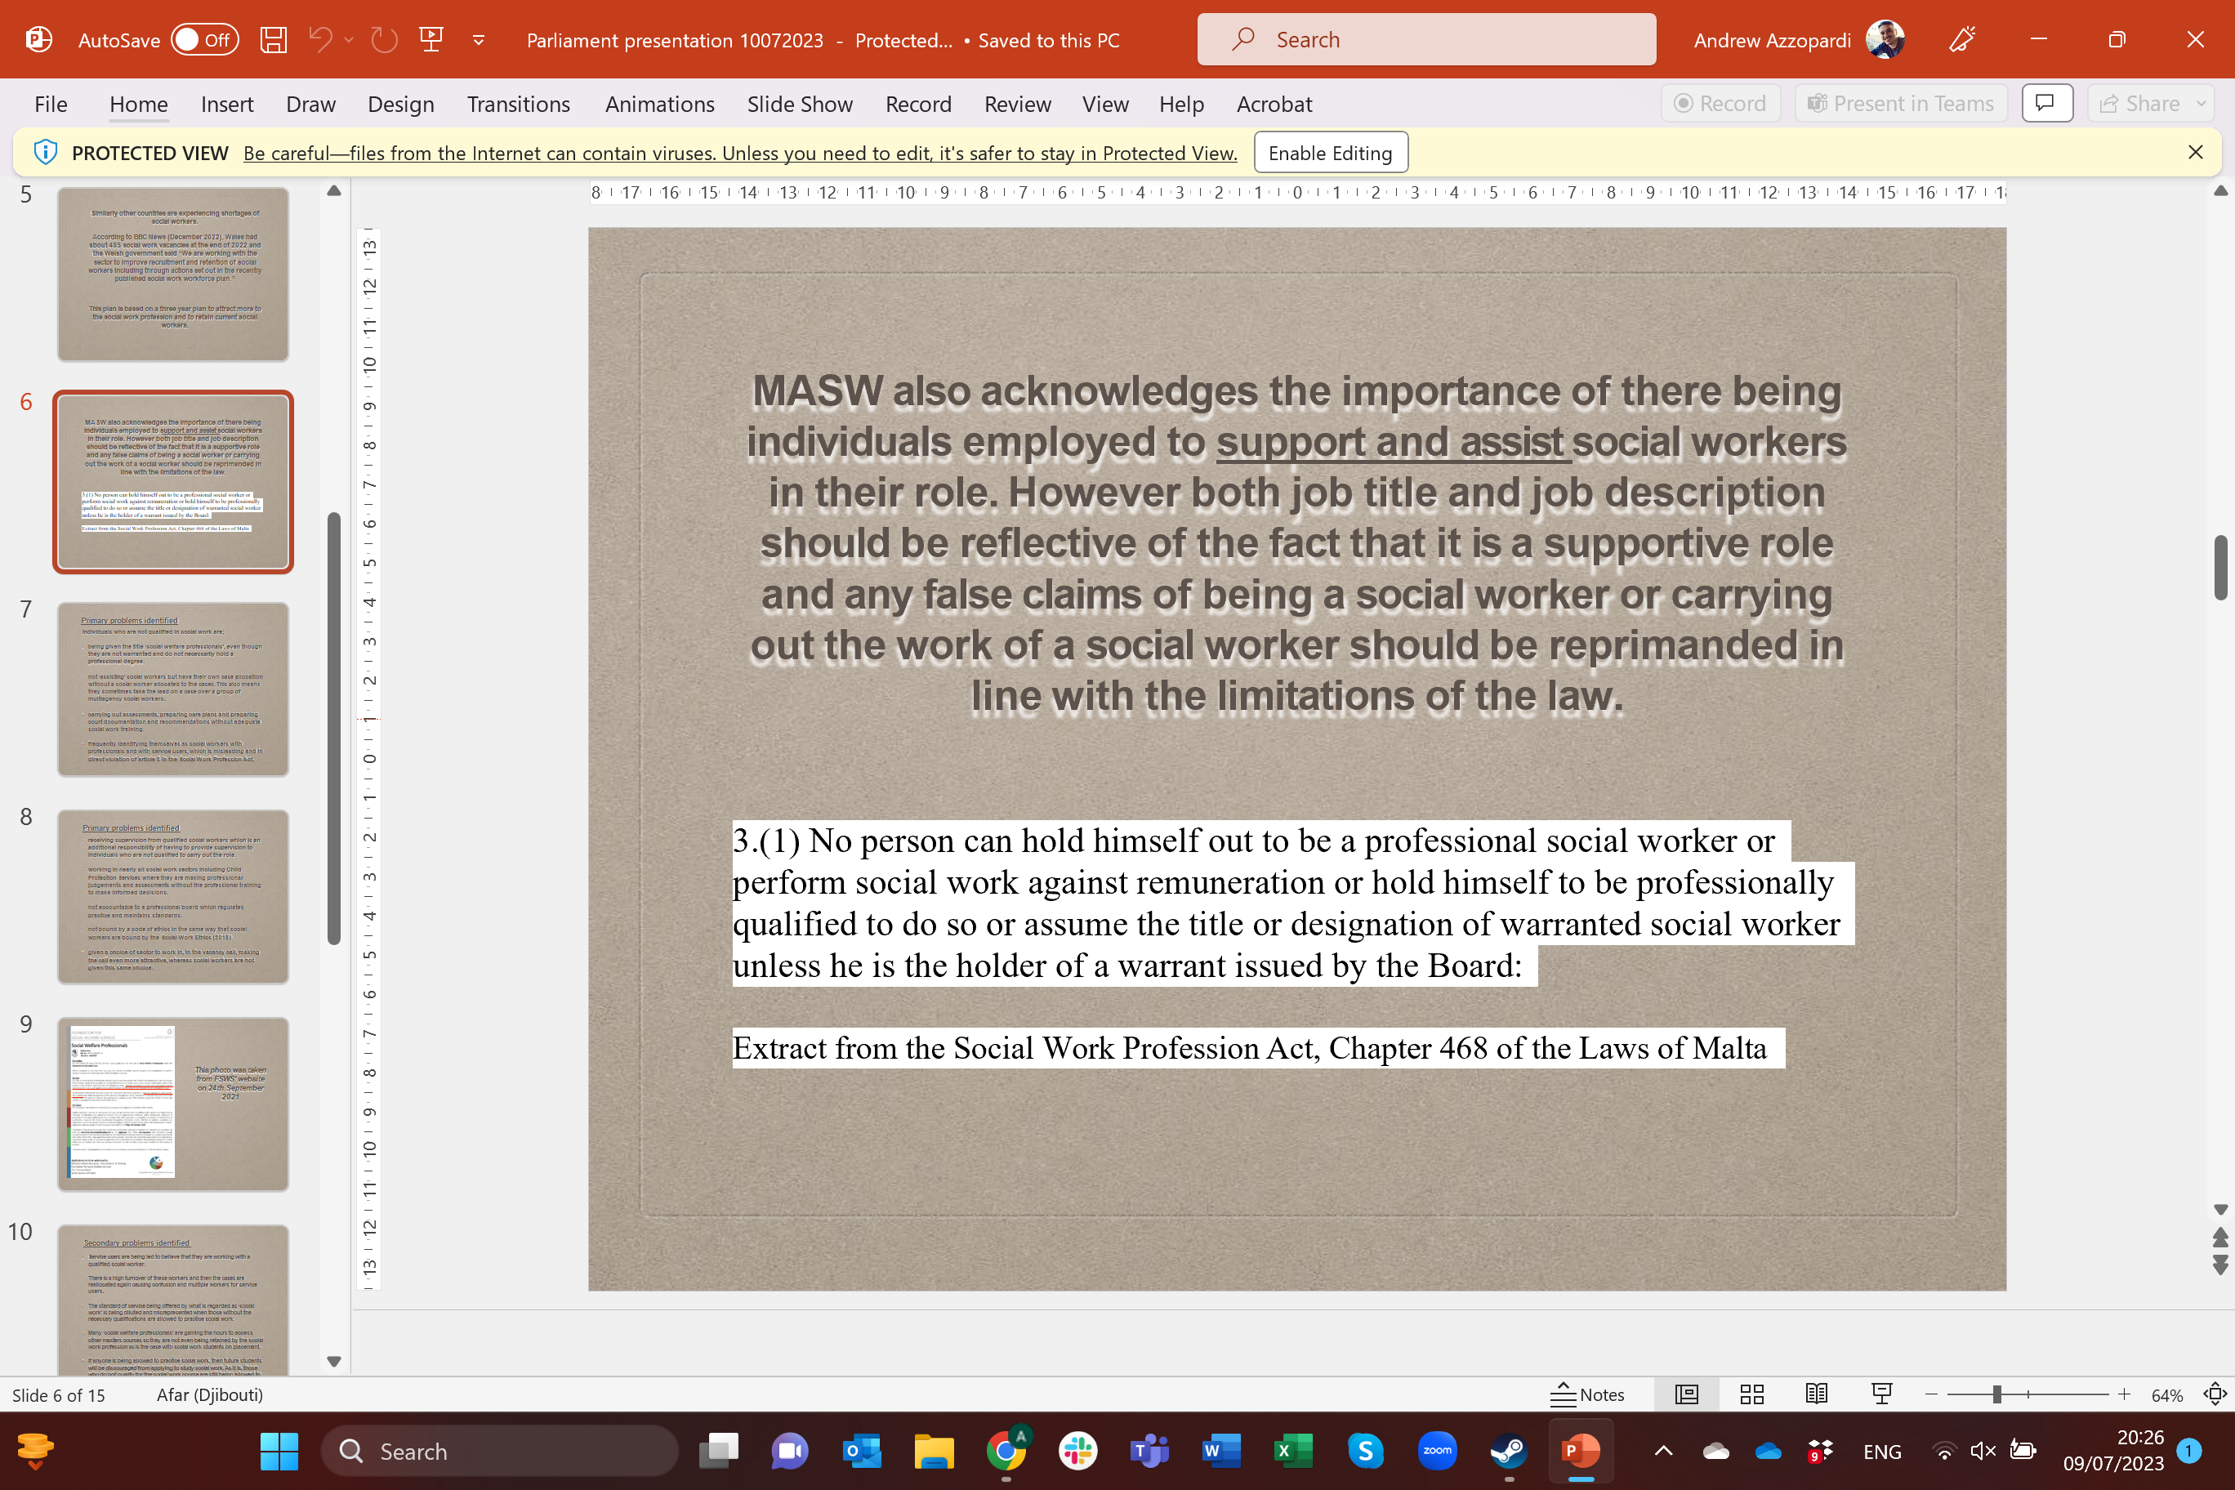

Slide 12
Primary problems identified

Slide 13
Individuals who are not qualified in social work are:
  being given the title ‘social welfare professionals’, even though they are not warranted and do not necessarily hold a professional degree.
  not ‘assisting’ social workers but have their own case allocation without a social worker allocated to the cases.This also means they sometimes take the lead on a case over a group of multi-agency social workers.

Slide 14
  carrying out assessments, preparing care plans and preparing court documentation and recommendations without adequate social work training.
  frequently identifying themselves as social workers with professionals and with service users, which is misleading and in direct violation of article 3 in the Social Work Profession Act.
  receiving supervision from qualified socialworkers which is an additional responsibility of having to provide supervision to individuals who are not qualified to carry out the role.

Slide 15
  working in social work sectors including Child Protection Services where they are making professional judgements and assessments without the professional training to make informed decisions.
  not accountable to a professional board which regulates practice and maintains standards.
  not bound by a code of ethics in the same way that social workers are bound by the Social Work Ethics.
  given a choice of sector to work in, in the vacancy call, making the call even more attractive, whereas social workers are not given this same choice.

Slide 16
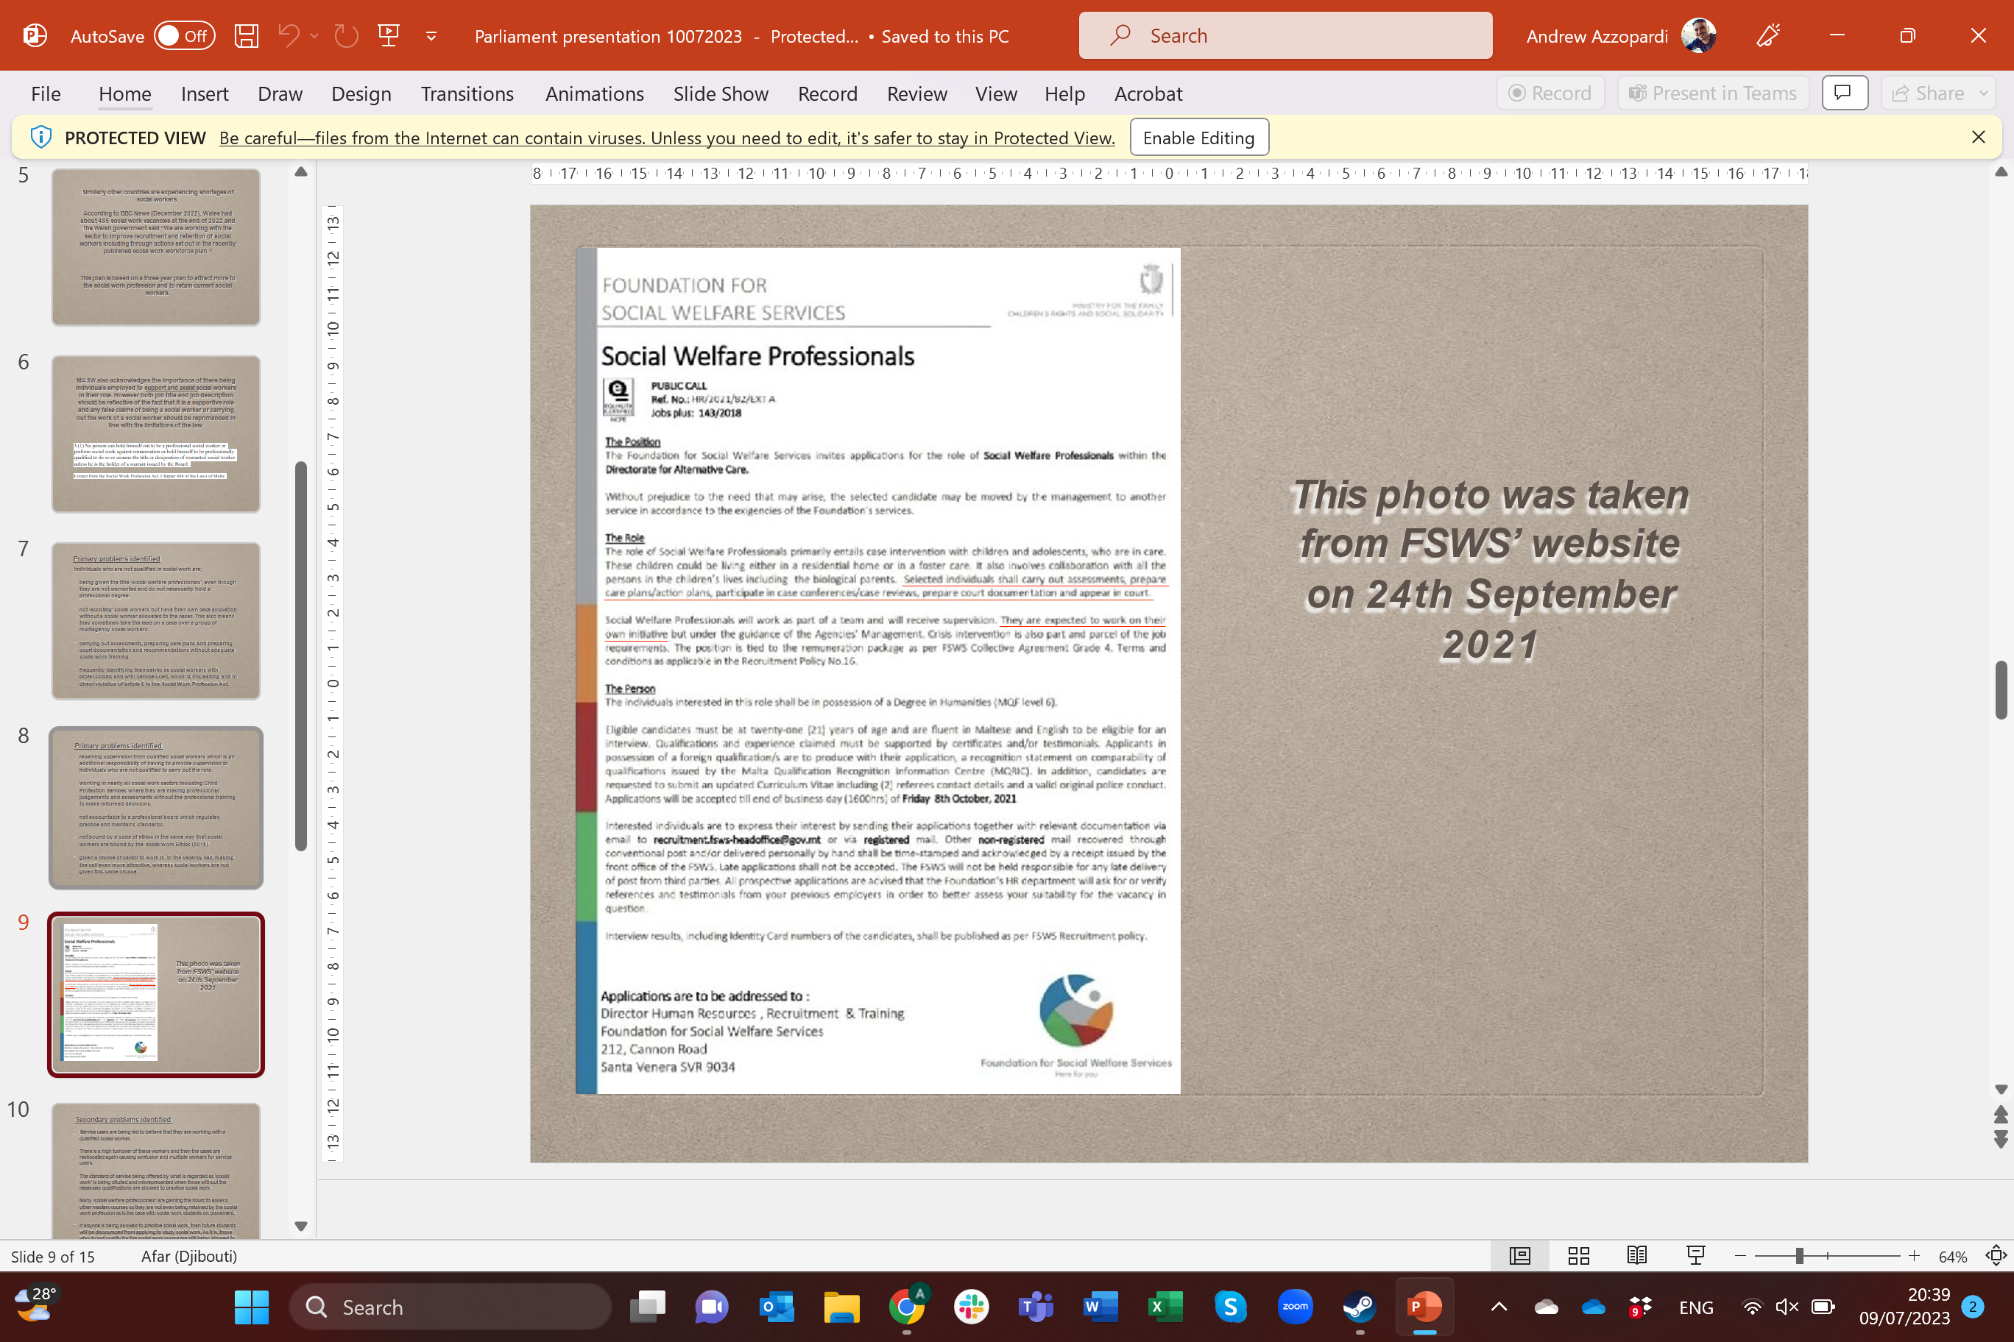
Photo taken from FSWS’ website on 24 September 2021

Slide 17
Secondary problems identified

Slide 18
  Service users are being led to believe that they are working with a qualified social worker.
  There is a high turnover of these workers and then the cases are reallocated again causing confusion and multiple workers for service users.
  The standard of service being offered by what is regarded as ‘social work’ is being diluted and misrepresented when those without the necessary qualifications are allowed to practice social work.

Slide 19
  Many ‘social welfare professionals’ are gaining the hours to access other masters courses so they are not even being retained by the social work profession as is the case with social work students on placement.
  If anyone is being allowed to practice social work, then future students will be discouraged from applying to study social work. As it is, those who do not qualify for the social work course are still being allowed to practice with no training.

Slide 20
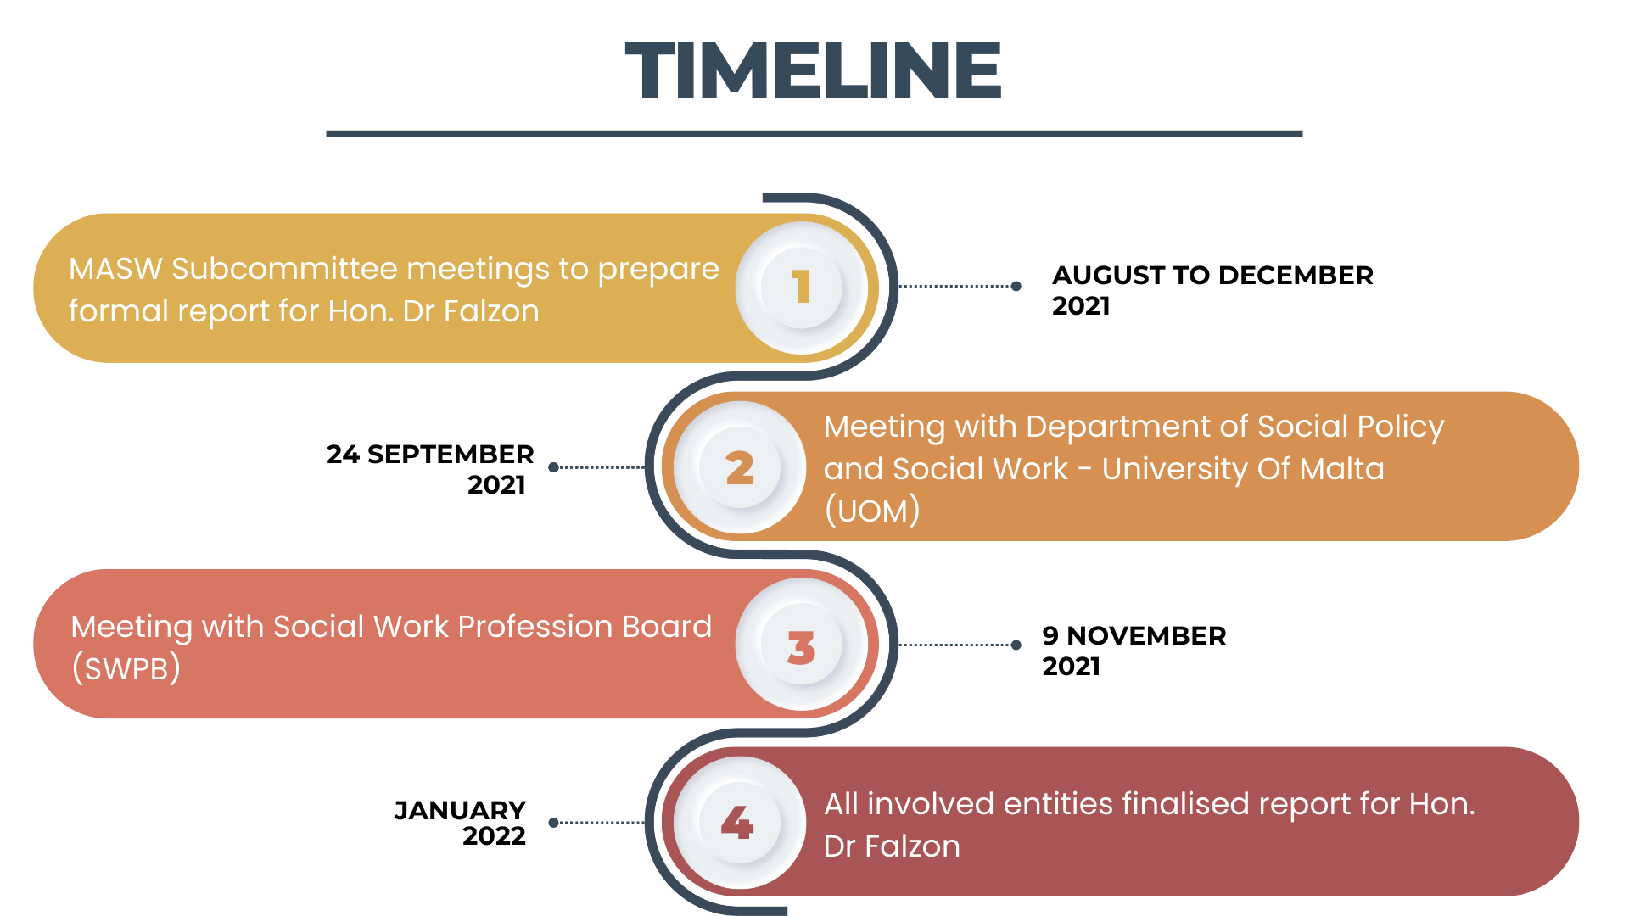

Slide 21
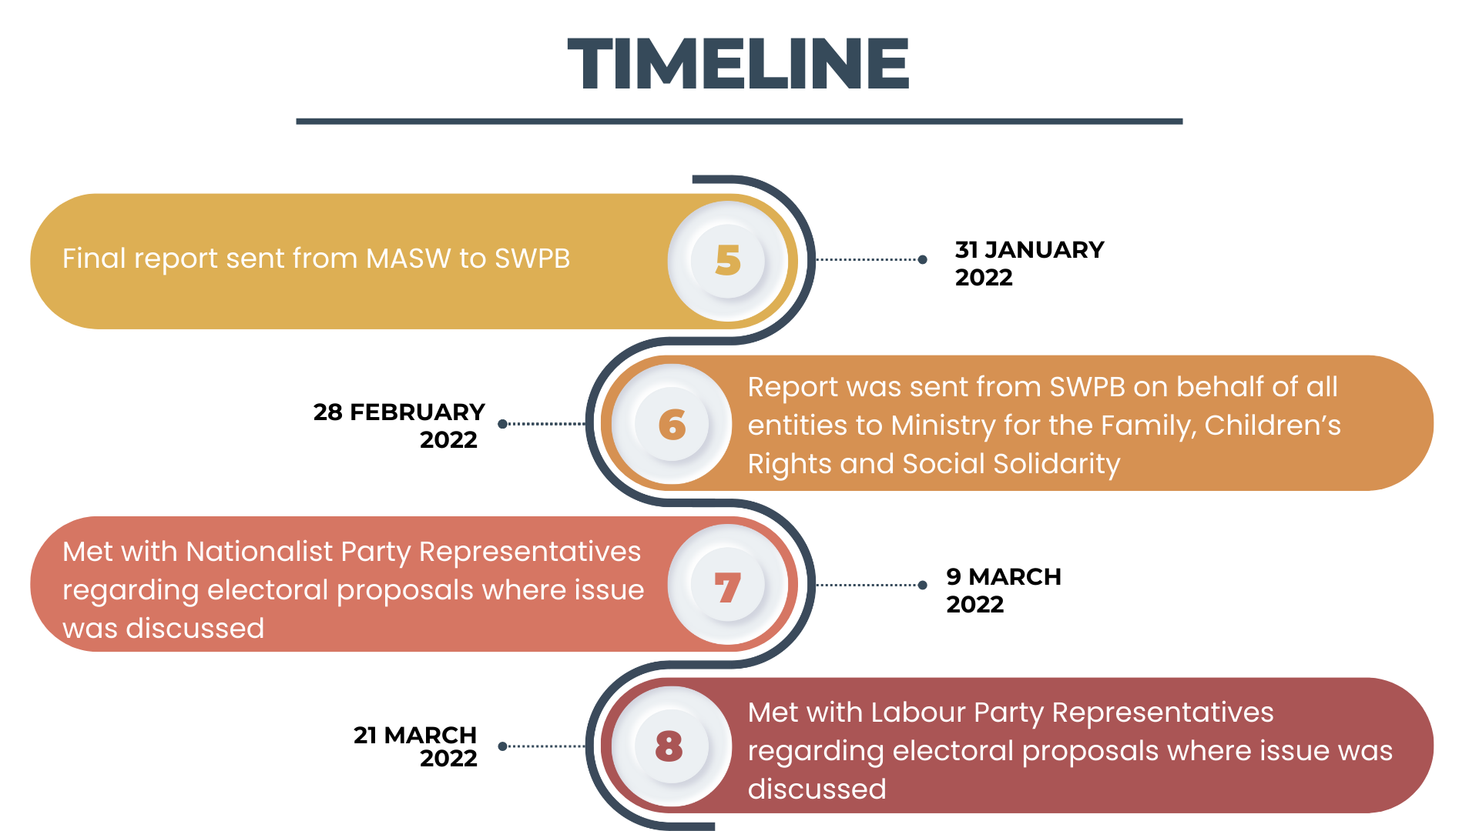

Slide 22


Slide 23
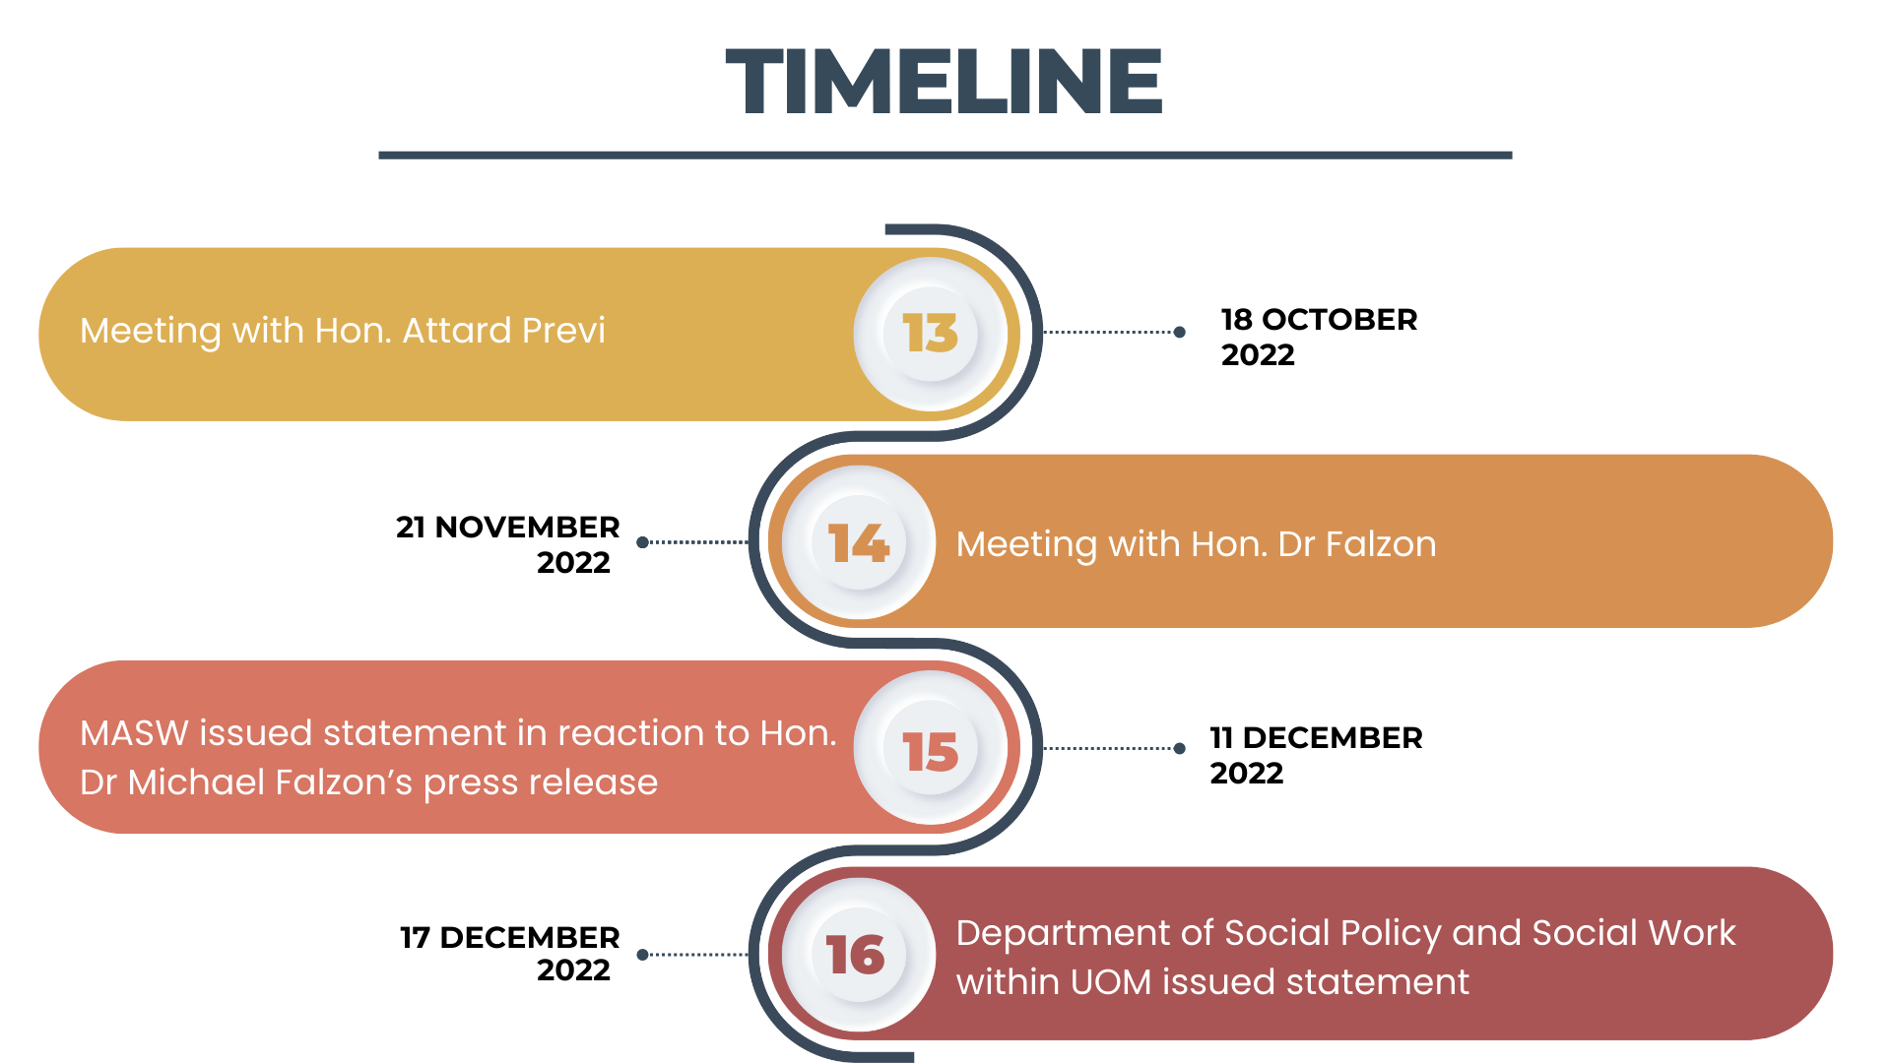

Slide 24
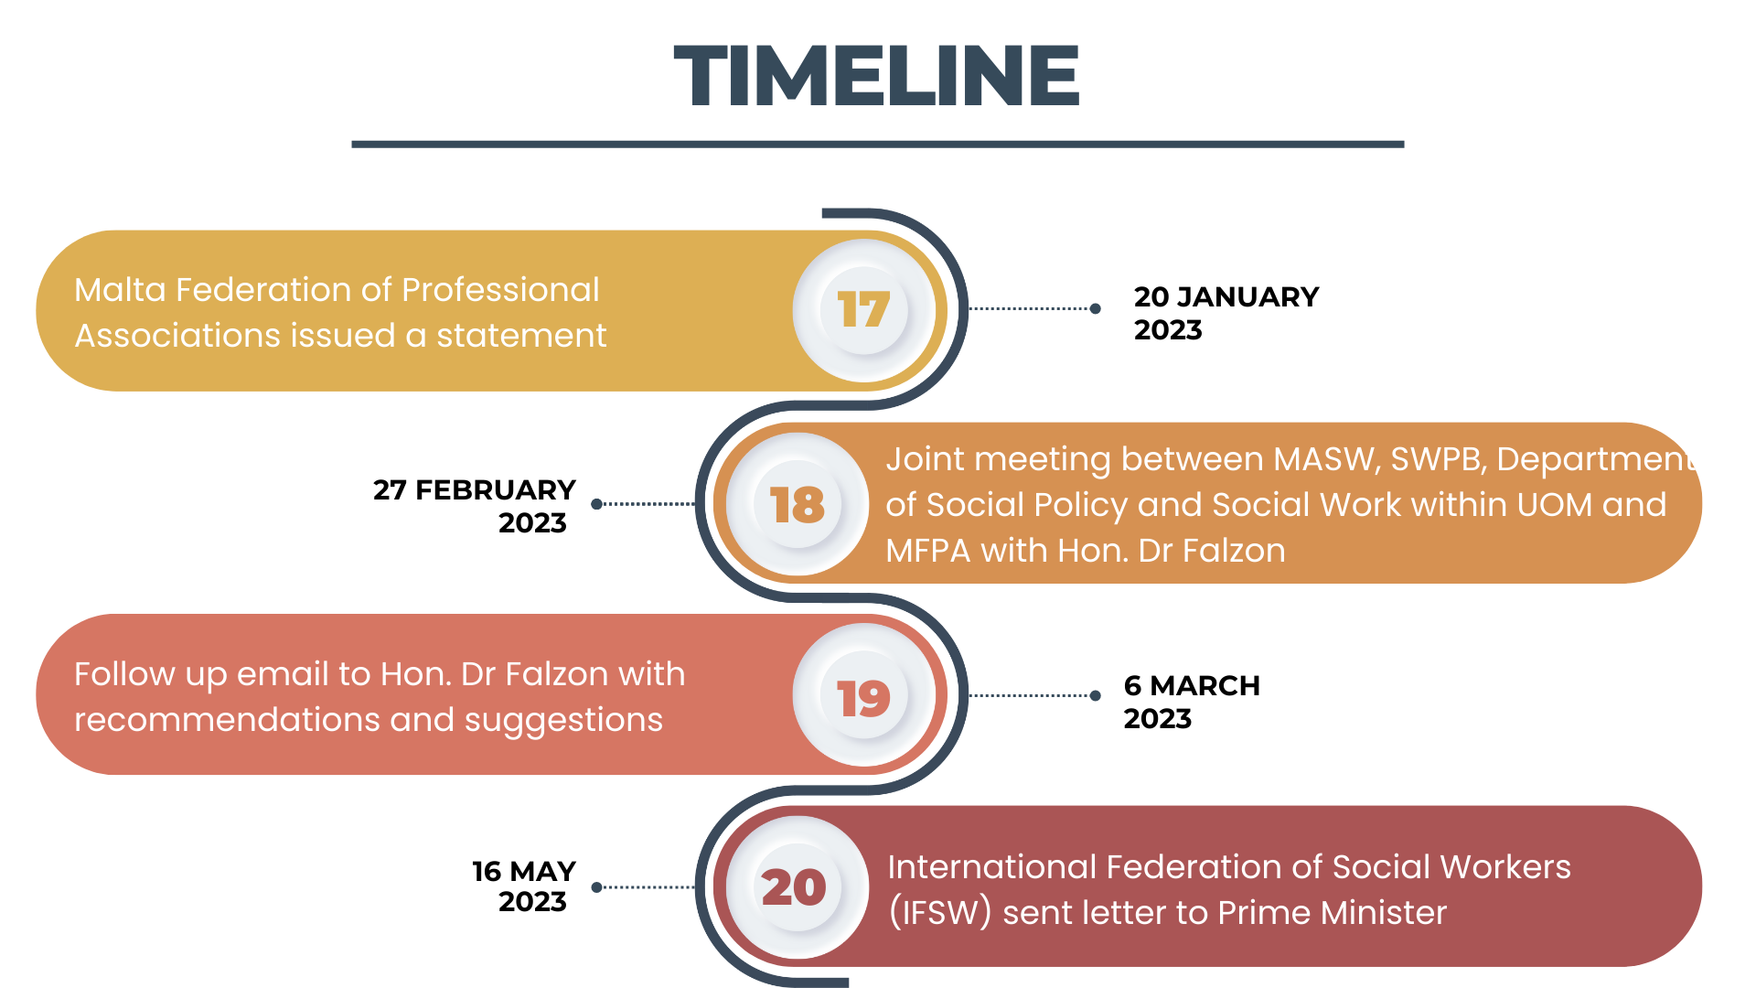

Slide 25
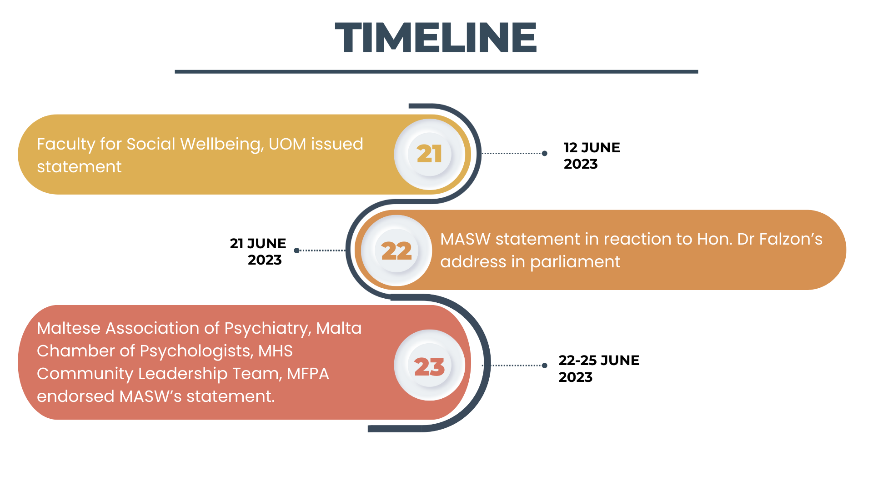

Slide 26
MASW's proposed solutions

Slide 27
  Maintain these workers to assist and support
  To change their job title to remove the word ‘professional’ and to reflect the supportive role eg. Social support worker etc
  To change their job call and description to be reflective of the supportive role with clear distinctions between their role and that of the social worker overseeing the case

Slide 28
  To make better use of the MSW course which is an entry point into the profession for those with a first degree in another area
  To have a national strategy to promote the social work profession and increase the esteem surrounding the profession with better conditions for existing and future social workers

Slide 29
Concluding remarks

Slide 30
  The skills, training and expertise that is learned by social workers is unique and essential when working with vulnerable service users and these standards must be maintained to safeguard the Maltese society.
  Social work is a prestigious profession with professionals working in most social sectors. The social work profession needs to be safeguarded and enhanced for it to receive the prestige it deserves and for social workers to receive the recognition for the valuable work given daily.

