Slide 1
2024 annual reports of the EU auditors
26 November 2025
George-Marius Hyzler

Slide 2
Contents
Introduction
Annual Report 2024 Overall results
Mentions of Malta in the ECA’s publications
ECA’s Special Reports and Reviews
My responsibilities at the ECA
Slide 2

Slide 3
2024 annual report
European Court of Auditors
Introduction

Slide 4
European Court of Auditors
The European Court of Auditors is the independent external auditor
of the European Union.
Mission: Through our independent, professional and impactful audit work,
assess the economy, effectiveness, efficiency, legality and regularity of EU action
in order to improve accountability, transparency and financial management, thereby enhance citizens’ trust and respond effectively to current and future challenges facing the EU.
We are based in Luxembourg and employ around 960 audit, support and administrative staff of all EU nationalities.
Slide 4

Slide 5
Our statements of assurance
Every year, we audit the EU’s consolidated accounts and the accounts of the European Development Funds and provide two separate audit opinions on three matters: whether the accounts are reliable, and whether EU revenue was received and payments were made in accordance with the relevant rules. These checks form the basis for our two statements of assurance.
Our audit includes testing a statistically representative sample of transactions and evaluating supervisory and control systems to determine whether revenue and payments are calculated correctly and comply with the legal and regulatory framework.
Our statement of assurance is based on evidence obtained from audit testing in accordance with international auditing standards.
We consider that the estimated level of error is material when it exceeds the threshold of 2 %.
Slide 5

Slide 6
2024 annual report
European Court of Auditors
Overall results

Slide 7
2024 annual report – Overall results
We provide a clean opinion on the reliability of the 2024 accounts of the EU.
We also provide a clean opinion on the legality and regularity of revenue transactions for 2024.
We provide two separate opinions on the legality and regularity of expenditure for 2024, as the Recovery and Resilience Facility (RRF) is a temporary instrument delivered and financed in a way that is fundamentally different to EU budget expenditure:
our opinion on the legality and regularity of EU budget expenditure is adverse;
our opinion on the legality and regularity of expenditure under the RRF is qualified.
Slide 7

Slide 8
Estimated level of error in EU budget expenditure
We estimate that the overall level of error in EU budget expenditure is material at 3.6 % (2023: 5.6 %). A substantial proportion of this expenditure, subject to complex rules, mainly reimbursement-based, is affected by error.
Source: ECA.
Slide 8

Slide 9
Estimated level of error: main MFF headings
Comparison of the estimated levels of error for MFF headings 1, 2, 3 and 6 (2020‑2024)
(*) We did not provide a specific assessment for ‘Neighbourhood and the world’ between 2020 and 2023.
Source: ECA.
Slide 9

Slide 10
Recovery and Resilience Facility: €59.9 billion
Amount subject to audit: €59.9 billion
We found that 12 out of the 395 milestones and targets examined were affected by quantitative findings. These concerned six out of the 28 RRF payments and five of these payments were affected by material error. We issued a qualified opinion on RRF expenditure.
We do not conclude on two milestones in one member state due to ongoing case at the Court of Justice of the European Union
(C- 517/24). The satisfactory fulfilment of these milestones was a precondition for any RRF payment to that member state.
We estimate the minimum financial impact of these findings to be above our materiality threshold. Given the nature of the RRF spending model, we do not provide an error rate comparable to other EU spending areas.
These 12 findings related to: the unsatisfactory fulfilment of six milestones and targets, four projects starting before the eligibility period, one case of double funding and one case of reversal of a target.
Slide 10

Slide 11
Risks and challenges
Outstanding EU borrowing from the markets increased by more than 30 % in 2024. By 2027 outstanding EU borrowing could exceed € 900 billion, nearly ten times the 2020 level prior to NGEU.
Programmes funded by outstanding EU borrowing, as at end 2024
Non-repayable (€254.7 billion)
Repayable by member states (€249.3 billion)
Repayable by non-EU countries (€47.1 billion)
(billion euros)
NGEU top-ups 66.9
(12 %)
NGEU grants 187.8
(34 %)
Total
€551
billion
NGEU loans 108.7
(20 %)
EURATOM 0.3 (0 %)
Ukraine Facility 13.1 (2 %)
MFA other 4.7 (1 %)
BoP 0.2 (0 %)
MFA Ukraine 11.0 (2 %)
MFA+ 18.0 (3 %)
EFSM 42.0
(8 %)
SURE 98.4
(18 %)
BoP: Balance of Payments
EFSM: European Financial Stabilisation Mechanism
MFA: Macro-Financial Assistance
NGEU: NextGenerationEU
SURE: Support to mitigate Unemployment Risks in an Emergency
Source: ECA, based on the 2024 consolidated annual accounts of the EU.
Slide 11

Slide 12
2024 annual report
Mentions of Malta

Slide 13
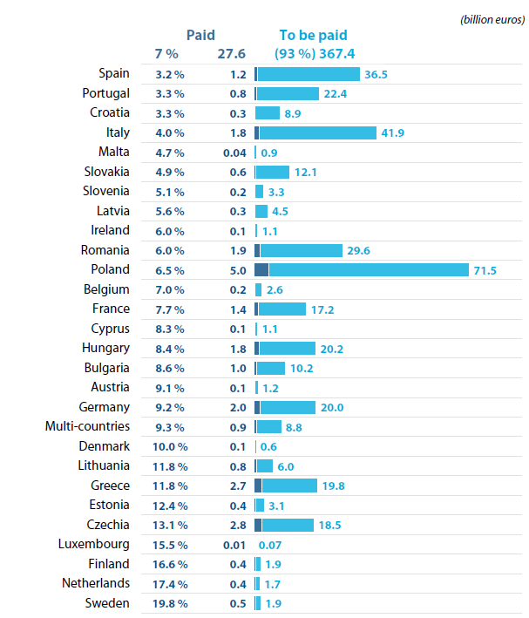
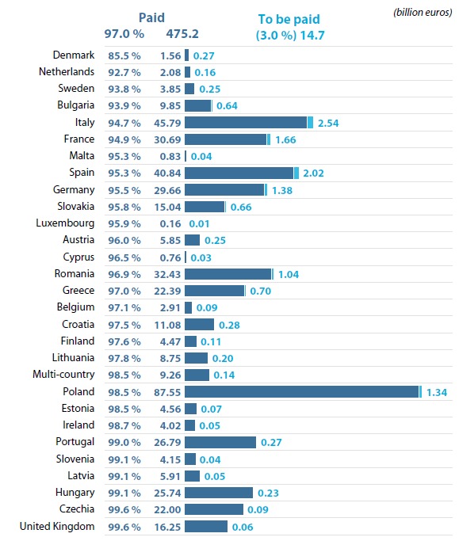
Absorption of 2014-2020 shared management funds under the CPR, as at end 2024
Absorption of 2021-2027 shared management funds under the CPR, as at end 2024
Slide 13

Slide 14
Expected cumulative inflation by member state for the period 2019-2027
Average inflation in the EU fell back to 2.6 % in 2024 (2023: 6.4 %; 2022: 9.2 %) and is expected to fall further in 2025 and 2026. Based on the Commission’s and the IMF’s inflation forecast, we estimate the EU budget could lose around 13.9 percentage points of its purchasing power by the end of 2027. As illustrated below, inflation does not affect all member states to the same extent.
Member States
Euro area
Non-euro area
Average euro area
29 %
Average EU
33%
cumulative inflation by member state for the period 2019-2027
Source: ECA, based on Eurostat and Commission’s European Economic Forecast – Spring 2025 and for 2027 IMF inflation rate, average consumer prices.
Slide 14

Slide 15
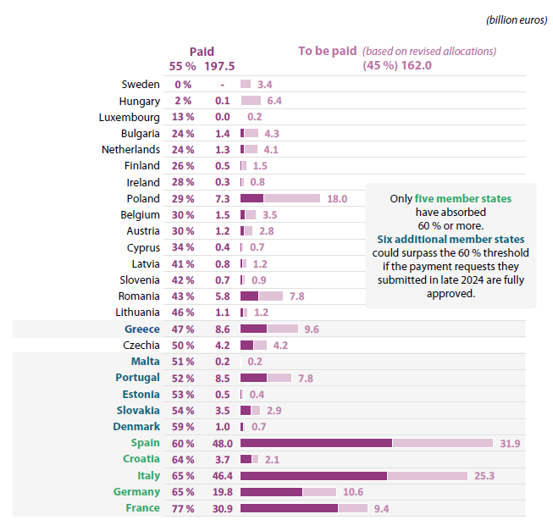
RRF grants paid and amounts to be paid as at 31.12.24
Slide 15

Slide 16
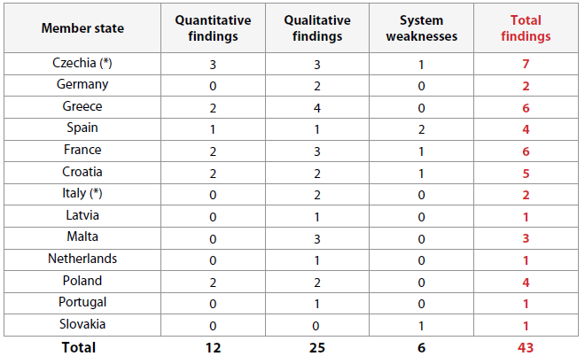
Recovery and resilience facility: audit results
Slide 16

Slide 17
Special Reports and Reviews
2024 - 2025

Slide 18
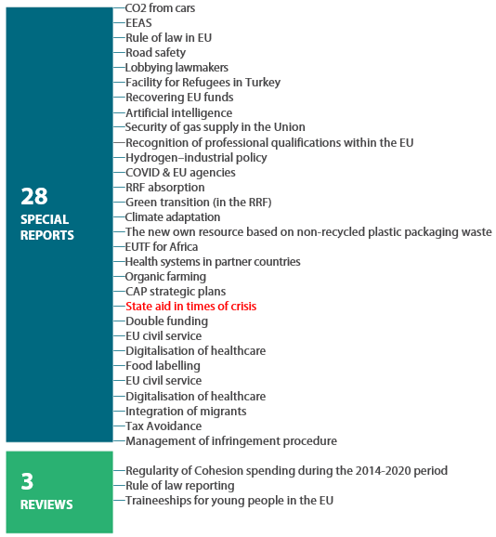
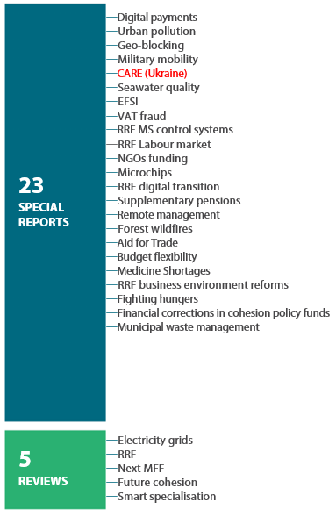
Publications of Special Reports and Reviews
2025
2024
Slide 18

Slide 19
Special Report 05/2025
Cohesion’s Action for Refugees in Europe (CARE)
CARE did not provide any additional money, but it did allow member states to reallocate some remaining EU cohesion policy funds flexibly and swiftly to projects addressing the migratory challenges and the consequent needs of refugees fleeing Ukraine.
However, there is a lack of specific data on and monitoring of the money spent to address these migratory challenges. This is likely to hinder any assessment of CARE’s effectiveness.
Main conclusion
Slide 19

Slide 20
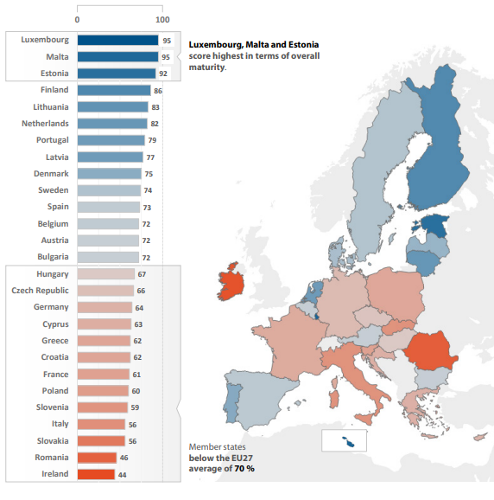
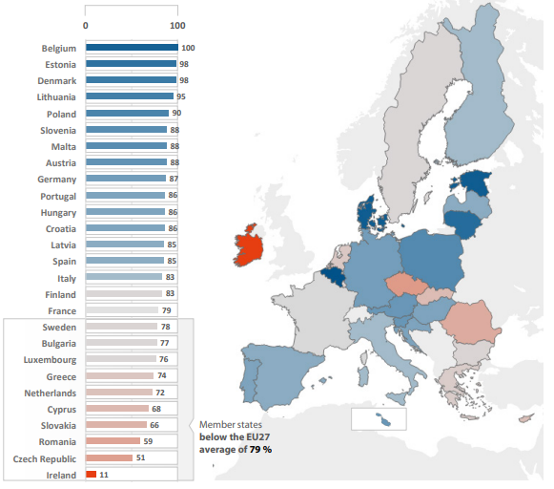
Special Report 25/2024: Digitalisation of Health Care
Maturity of online health-related services
European citizens’ access to their electronic health records
Slide 20

Slide 21
My responsibilities at the ECA
2024 - 2025

Slide 22


George Hyzler,
Member of Chamber III, External Action, Security and Justice
Union civil protection mechanism(rescEU)
Large-scale cyber attacks
(in progress)
Return and reintegration of Migrants
European Defence Fund
(to start in 2026)
Slide 22

Slide 23
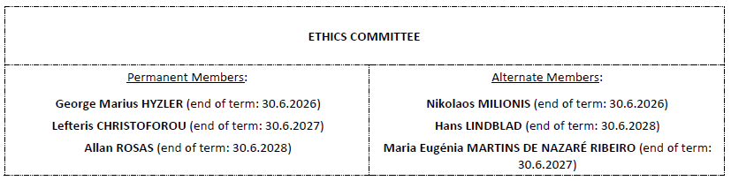

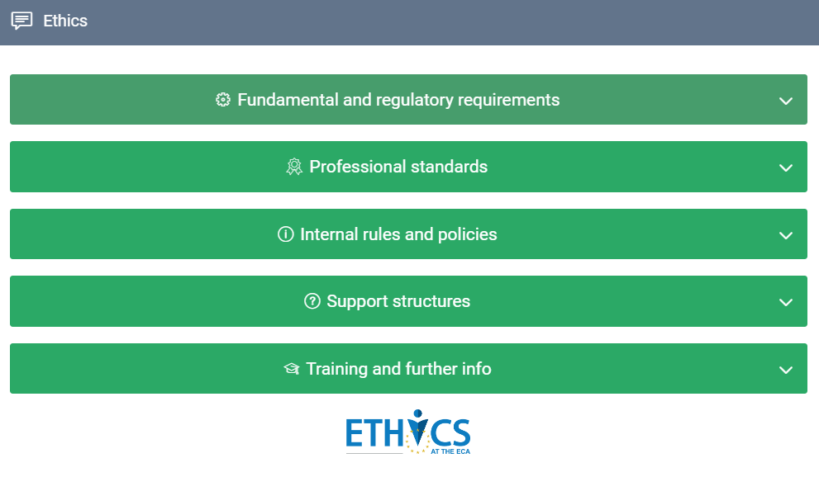

ECA Representative to the EU Inter-institutional ethics body
Chairperson of the Ethics Committee
Slide 23

Slide 24
European Court of Auditors
Questions?

Slide 25
Contact Details
George-Marius Hyzler
Member
+352 4398 47467
georgemarius.hyzler@eca.europa.eu
European Court of Auditors
12, Alcide de Gasperi
1615 Luxembourg
eca.europa.eu
eca-info@eca.europa.eu
@EUauditorsECA
NB: It should be noted that due to rounding, some totals in the figures in this document may not equal the sum of the individual items.

