Slide 1

European Stability Mechanism
Annual Report 2023
Ministry For Finance
November 2024

Slide 2

Presentation Outline
ESM Governance & Financial Reports
Macroeconomic Environment
Programme Country Experiences
ESM Rating
Lessons learned from crises
Conclusions

Slide 3

ESM Governance & Financial Reports 2023

Slide 4
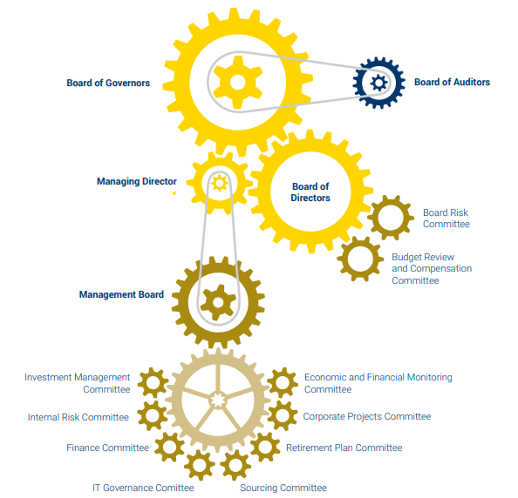
Institutional Framework

Slide 5
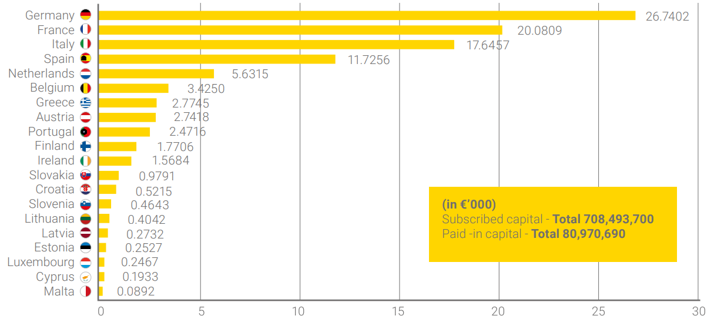
ESM shareholders & contribution key
(%)

Slide 6
ESM Financial Report 2023
Item | 2023 | 2022
Paid-in Capital | €80.97bn | €80.97bn
Total Balance Sheet | €808.36bn | €812.74bn
Total Share Holders’ Equity | €711.22bn | €704.89bn
Total Cash Position | €17.11bn | €55.57bn
Profit | €0.32bn | - (€0.06bn)
General administrative expenses | €0.094bn | €0.087bn

Slide 7
EFSF Financial Report 2023
Item | 2023 | 2022
Total Balance Sheet | €191.90bn | €193.04bn
Total Share Holders’ Equity | €0.88bn | €0.74bn
Total Cash Position | €4.29bn | €5.52bn
Total Comprehensive Income | €0.129bn | -(€0.030bn)
Administrative expenditures | €0.034bn | €0.034bn

Slide 8

Macroeconomic and Financial Environment

Slide 9
External environment was challenging in 2023; geopolitical tensions, tight monetary policy
Euro area largely stagnated in 2023, growing only by 0.4%.
Economic growth in most former ESM/EFSF programme countries surpassed euro area average in 2023.
Amongst these countries, Ireland experienced a contraction following a period of strong economic growth.

Slide 10
In 2023, the EU started to transition towards a redesigned fiscal framework
The fiscal deficit declined slightly in 2023, to 3.6% of GDP
Euro area debt-to-GDP ratio continued to decline on the back of still-high inflation.
The euro area financial sector proved robust, with NPLs remaining at historical lows

Slide 11

Programme Country Experiences
11

Slide 12
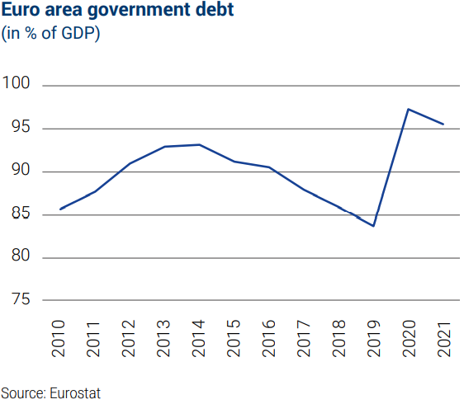





Real GDP growth: -5.5%
Unemployment: 4.3%
Headline inflation: 5.2%
General Govt. primary balance: 1.7%
Debt to GDP: 43.3%
----------------------------------
Main risks under the Early Warning System:
Banking risks from commercial real estates
Large interest rate increases
Highly leveraged property funds
Rising costs of ageing
Real GDP growth: 2.3%
Unemployment: 11.1%
Headline inflation: 4.2%
General Govt. primary balance: 1.7%
Debt to GDP: 163.9%
----------------------------------
Main risks under the Early Warning System:
High level of public and external debt
Legacy of unstructured NPLs
Wide external deficits
Weak productivity growth
Banking sector vulnerabilities
Real GDP growth: 2.7%
Unemployment: 12.2%
Headline inflation: 3.4%
General Govt. primary balance: -1.6%
Debt to GDP: 105.1%
----------------------------------
Main risks under the Early Warning System:
High debt level
Rising costs of ageing
Weak productivity growth
Climate risks
Investment gaps
Real GDP growth: 2.6%
Unemployment: 5.8%
Headline inflation: 3.9%
General Govt. primary balance: 1.7%
Debt to GDP: 73.6%
----------------------------------
Main risks under the Early Warning System:
Geopolitical developments
Tight financial conditions
Real GDP growth: 2.5%
Unemployment: 6.5%
Headline inflation: 5.3%
General Govt. primary balance: 2.7%
Debt to GDP: 97.9%
----------------------------------
Main risks under the Early Warning System:
Low long-term growth
Rising costs of ageing
12

Slide 13
In 2023, the EFSF received its first 2 scheduled repayments from Greece of €1.7bn. Outstanding nominal amount of loans granted to Greece is €59.8bn under the ESM and €140.1bn under EFSF
The ESM and EFSF agreed on 27 November to waive the prepayment triggered by Greece’s planned early repayment of €5.3bn to the Greek Loan Facility.
On 11 December, Spain repaid €3.6bn to the ESM, its second scheduled repayment.
Scheduled repayments are expected to start in the coming years for Portugal (2025 to 2050)
13

Slide 14

ESM Rating
14

Slide 15
ESM Credit Ratings
 | Long-term rating | Short-term rating | Rating Outlook
S&P | AAA | A-1+ | Stable
Fitch | AAA | F1+ | Stable
Moody's | Aaa | P-1 | Stable
DBRS Morning Star | AAA | R-1 (high) | Stable
Scope | AAA | S-1+ | Stable
The overall credit rating outlook remained stable
The combined funding programme reached €28bn in 2023, split into €20bn for the EFSF and €8bn for the ESM.
Credit rating agencies issued positive outlooks and ratings across most of the issuers and derivate counterparties.
Source: ESM Annual report 2023
15

Slide 16
Applying the lessons learned to unknown challenges ahead
Lesson 1:
Coordinated action works
ESM, European Commission, European Investment Bank each introduced coordinated financial support schemes
Expanded its toolkit
This helped the euro area to withstand large exogenous shocks (pandemic and war in Ukraine)
Lesson 2:
A reassuring presence
ESM diminishes the risk of losing access to financial markets
This knowledge reassures investors, regardless of financial stress at the moment
Lesson 3:
Prevention pays
Crisis prevention is less costly than crisis resolution
Therefore, ESM is increasing its attention to early detection of risks to financial stability
Lesson 4:
Future proofing the ESM
Coping with uncertainty requires alertness, agility and preparedness
ESM stands ready to provide a backstop to the Single Resolution Fund
16

Slide 17

“Going forward, it is imperative to remain vigilant, adaptable, and cooperative in pursuit of a more robust and prosperous future. The ESM, which is based on the principle of solidarity, is ready to do its part.” - Pierre Gramegna, ESM Managing Director
Conclusion
17

