Slide 1
2022 annual reports of the EU auditors
November 2023
Dr George Hyzler

Slide 2
European Court of Auditors
The European Court of Auditors is the independent external auditor of the European Union.
Mission: Through our independent, professional and impactful audit work, assess the economy, effectiveness, efficiency, legality and regularity of EU action in order to improve accountability, transparency and financial management, thereby enhance citizens’ trust and respond effectively to current and future challenges facing the EU.
We are based in Luxembourg and employ around 950 audit, support and administrative staff of all EU nationalities.
Slide 2

Slide 3
2022 annual report
European Court of Auditors
Overall results
Slide 3

Slide 4

2022 Annual Report figures
Figures for financial year 2022
EU budget spending per MFF heading: €196 billion
RRF Grants: €47.2 billion
Total payments: €243.2 billion
Revenue: €245.3 billion
Audit population
EU budget spending per MFF heading: €166,8 billion
RRF Grants: €53,7 billion (RRF grant payments plus cleared pre-financing expenditure ca €6bn)
Total payments: €220,5 billion
Revenue: €245.3 billion
Slide 4

Slide 5
2022 EU budget spending per MFF heading
Slide 5

Slide 6
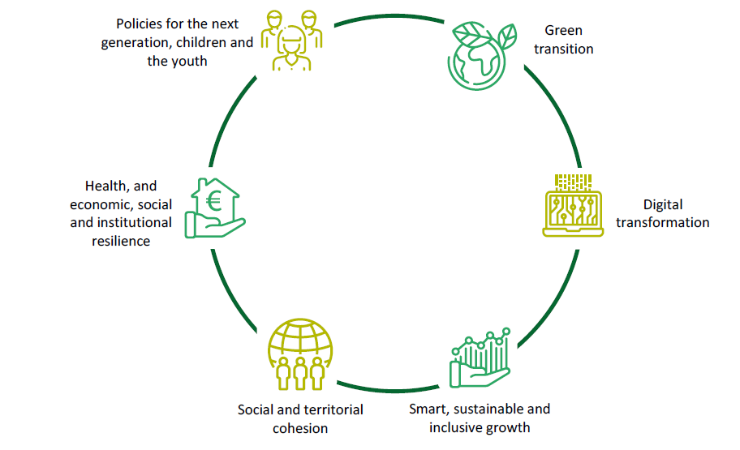
Recovery and Resilience Facility: six pillars
Slide 6

Slide 7
2022 annual report – Overall results
We issue a clean opinion on the reliability of the 2022 accounts of the EU.
We also issue a clean opinion on the legality and regularity of revenue transactions for 2022.
We provide two separate opinions on the legality and regularity of expenditure, as the RRF is a temporary instrument delivered and financed in a way that is fundamentally different to EU budget expenditure :
– our opinion on the legality and regularity of EU budget expenditure is adverse (2021: adverse);
– our opinion on the legality and regularity of expenditure under the Recovery and Resilience Facility is qualified (2021: clean).
Slide 7

Slide 8
Estimated level of error for EU budget spending (2018-2022) and audit population by risk
Slide 8

Slide 9
Estimated level of error: main MFF headings
The level of error is mainly driven by ‘Cohesion, resilience and values’, followed by ‘Natural resources and environment’. Eligibility errors still contribute most to the estimated level of error for high-risk expenditure.
Estimated levels of error for MFF headings 1, 2 and 3 (2018‑2022)
Slide 9

Slide 10
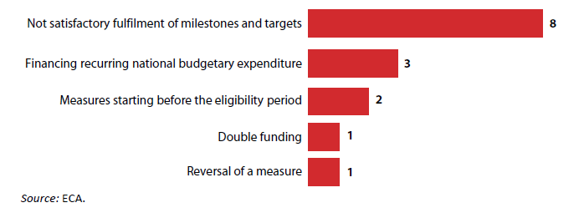
RRF expenditure
For RRF expenditure, in 2022, the Commission made 13 grant payments to member states which included a total of 274 milestones and all 37 targets.
We identified quantitative findings in 11 payments. Six of these payments were affected by material error, and we are issuing a qualified opinion on RRF expenditure.
15 of the 281 milestones and targets were affected by regularity issues (concerning 11 out of the 13 payments made to the Member States)
Slide 10

Slide 11
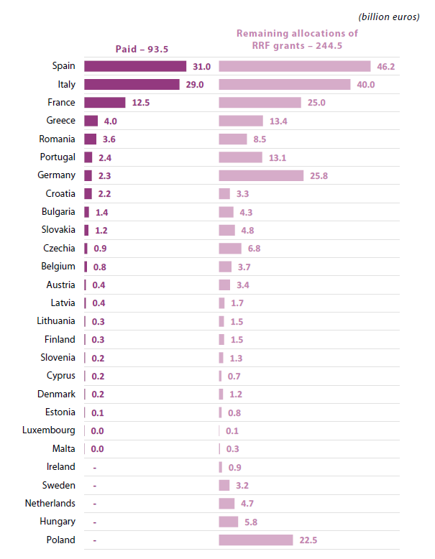
RRF grant payments and remaining allocations at end 2022
Slide 11

Slide 12
Absorption of 2014 – 2020 funds
Slide 12

Slide 13
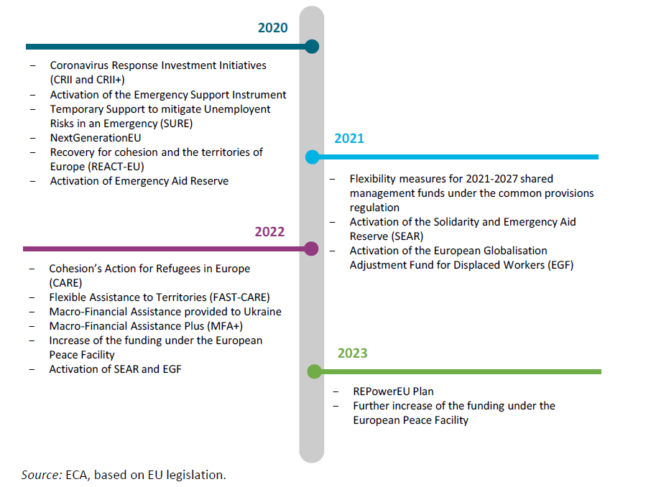
Key EU crisis response measures in 2020-2023
Slide 13

Slide 14
Risks and challenges for the EU budget
Borrowing costs for EU debt increased significantly
New borrowing for NGEU entails interest rate risk for the EU budget (cost of funding increased from 0.14 % in the second half of 2021 to 2.60 % in the second half of 2022);
Russia’s war of aggression against Ukraine increases risks to future EU budgets
The EU budget’s exposure to Ukraine more than doubled in 2022 compared to 2021 (from €6.7 billion to €15.6 billion) and the approval of an additional €18 billion for the MFA+ at the end of 2022 will significantly increase this exposure for future budgets.
Increased risk of member states losing out on funding
The parallel and delayed implementation of several instruments (the remaining 2014-2020 ESIF programmes, the 2021-2027 shared-management funds and RRF) increases the risk of decommitments for shared management funds later in the period.
High inflation affects the EU budget
On the basis of the Commission’s inflation forecast, we estimate the EU budget could lose nearly 10 % of its purchasing power by 2023.
Slide 14

Slide 15
Budgetary and financial management
Outstanding commitments from the EU budget and NGEU grant funding reached a record level of €452.8 billion at the end of 2022 (€341.6 billion in 2021).
The EU debt from the borrowing from the markets increased significantly in 2022 to €344.3 billion by year-end (2021: €236.7 billion), mainly due to new borrowings for NGEU, SURE and MFA.
The EU budget’s exposure to potential future obligations was €248.3 billion by the end of 2022 (up from €204.9 billion in 2021), mainly due to the additional NGEU and SURE loans provided to member states and the MFA loans provided to Ukraine.
The EU budget’s exposure to Ukraine more than doubled in 2022 compared to 2021 (from €6.7 billion to €15.6 billion).
Slide 15

Slide 16
We contribute to fighting fraud
As the EU’s external auditor, the ECA does not have a mandate to investigate cases of suspected fraud against the EU’s financial interests.
Our estimate of the level of error in the EU budget is not a measure of fraud. In the vast majority of errors we come across in our work, we do not suspect indications of fraud.
When we suspect that we have come across illegal activity, we report it to the European Anti-Fraud Office (OLAF) and to the European Public Prosecutor’s Office (EPPO).
In 2022, we reported to OLAF 14 cases (2021: 15 cases) of suspected fraud that we had identified during our audit of 2021 expenditure of which OLAF has already opened two investigations. In parallel, we reported six of these cases to the EPPO, which has opened three investigations. During our audit of 2022 expenditure, we already identified 14 cases of suspected fraud.
Slide 16

Slide 17
2022 annual report
European Court of Auditors
References to Malta
Slide 17

Slide 18
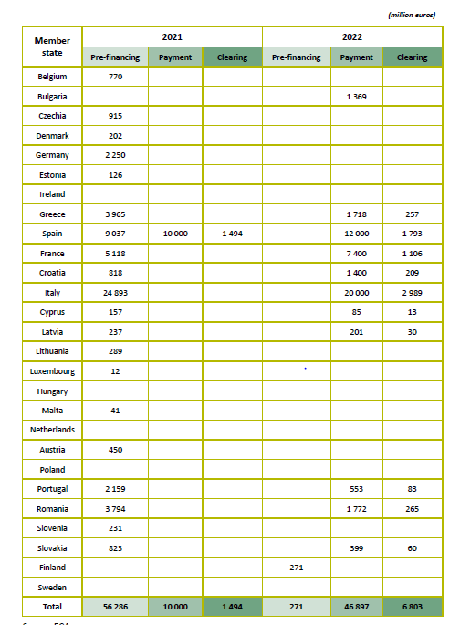
RRF grant payments by member states as of 31 December 2022
Slide 18

Slide 19
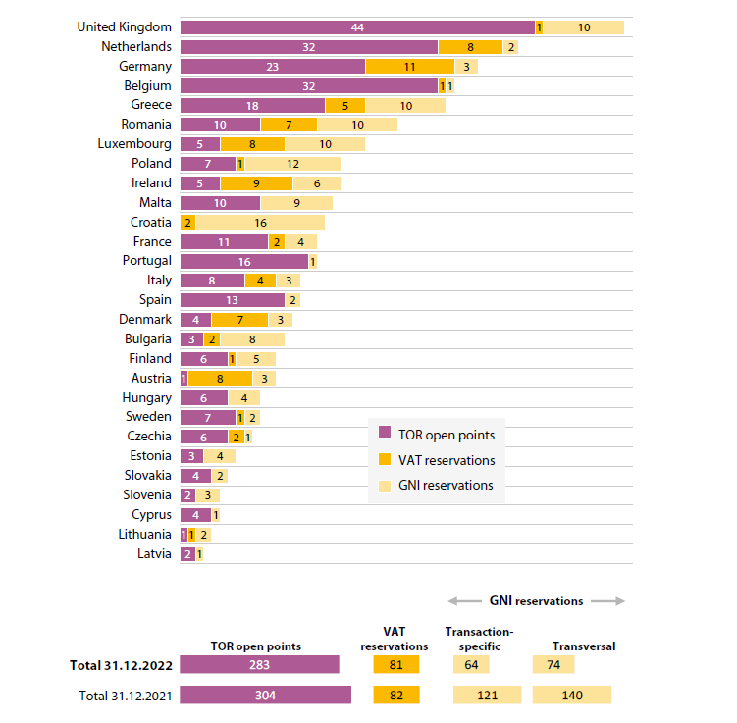
Own Resources: Outstanding GNI reservations, VAT reservations, TOR open points as at 31 December 2022
Slide 19

Slide 20
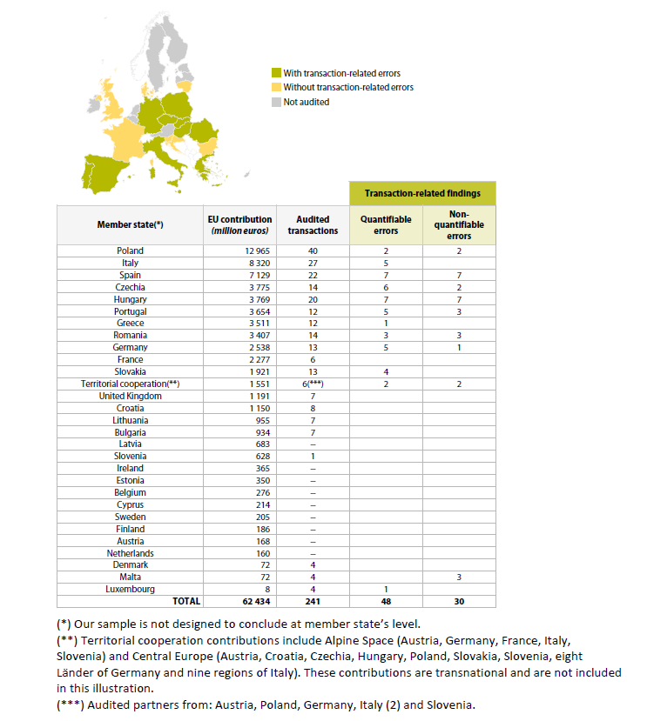
Non-quantifiable errors for Malta in Cohesion policy expenditure – “Other Compliance Issue”
Slide 20

Slide 21
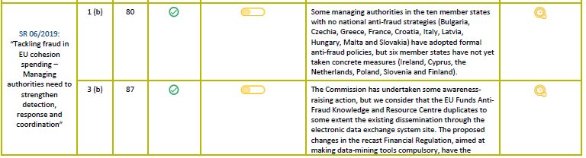
Follow-up of 2019 special report recommendations
Slide 21

Slide 22
European Court of Auditors
Our reports
Slide 17

Slide 23
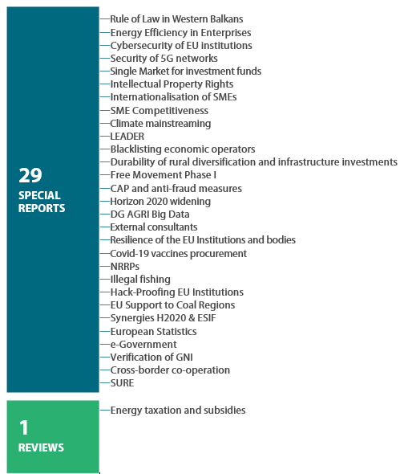
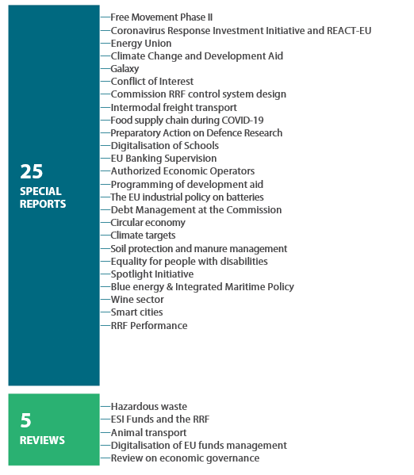
Publications of Special Reports and Reviews
2022
2023
Slide 22

Slide 24
Special Report 6/2023: Conflict of interest in EU cohesion and agricultural spending
Audit objective: To examine whether the Commission and the Member States put in place effective policies and procedures to address the conflict of interest issues in Common Agricultural Policy and Cohesion payments
Member States have procedures to manage conflicts of interest (self-declarations, staff rotation, policies on “revolving doors”), but certain weaknesses remain
Efforts to increase transparency on EU funding beneficiaries are ongoing AML Directive – registers of beneficial owners
Delays in the transposition of the directive on protecting whistleblowers
Member States place great emphasis on detecting conflict of interest in procurement but pay insufficient attention to some red flags
Audit bodies in Member States found weaknesses in the management of conflicts of interest
Slide 23

Slide 25
European Court of Auditors
Office of Dr George Hyzler
Slide 17

Slide 26
George Hyzler, Member of Chamber II, Investment for cohesion, growth and inclusion
Reporting Member for:
Task Name | Product type | Task objective
Cohesion’s Action for Refugees in Europe (CARE) | Special Report | To examine whether Member States deployed EU CARE/ FAST cohesion policy funds effectively, efficiently and economically to support refugees fleeing from Russia’s invasion of Ukraine.
State aid in times of crisis | Special Report | To assess how the Commission adjusted state aid rules in relation to RRF and cohesion funding to ensure the effective application of EU state aid rules addressing distortive economic effects to EU businesses following COVID-19 and the invasion of Ukraine, and to examine how Member States applied these rules, including the temporary exceptions.
Slide 23

Slide 27
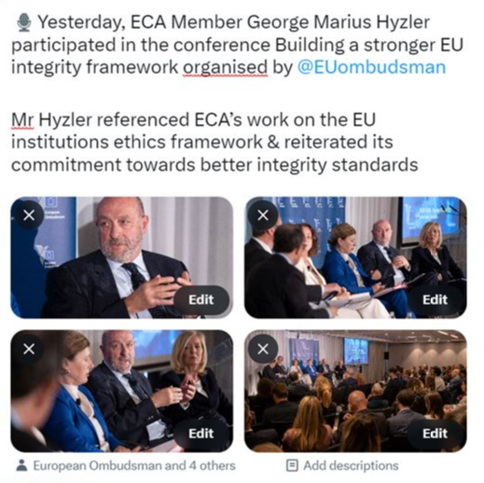
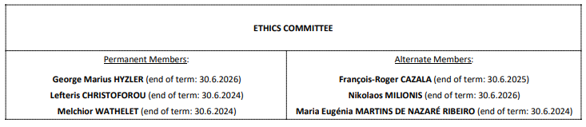
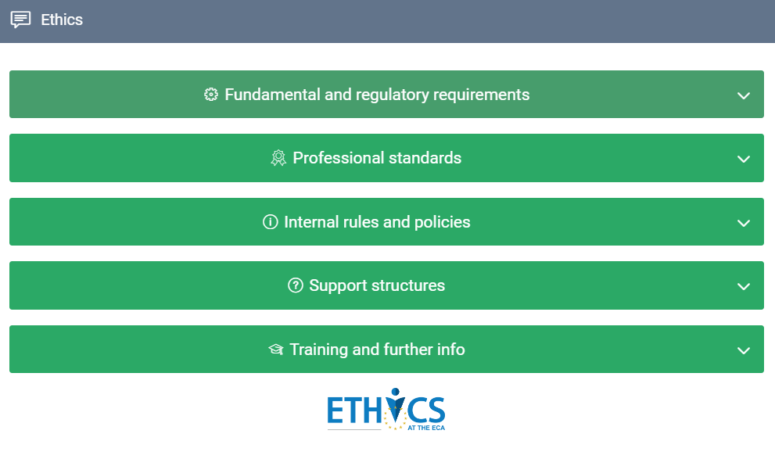
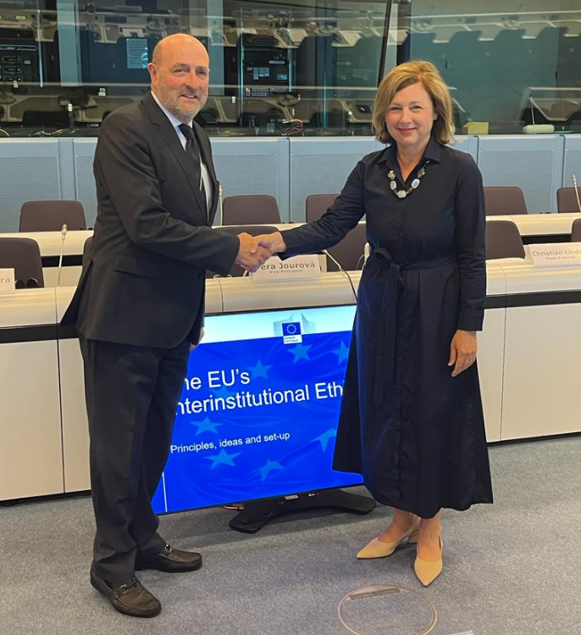
ECA Representative to the EU Inter-institutional ethics body
Chairperson of the Ethics Committee
Slide 24

Slide 28
European Court of Auditors
Questions?
Slide 25

Slide 29
Contact Details
Dr George Hyzler
Member, European Court of Auditors
+352 4398 47467
Georgemarius.hyzler@eca.europa.eu
European Court of Auditors
12, Alcide de Gasperi
1615 Luxembourg
eca.europa.eu
eca-info@eca.europa.eu
@EUAuditorsECA
@HyzlerGeorge
Slide 26

