Slide 1

Central Bank of Malta
Annual Report 2022

Slide 2
Central Bank of Malta
Annual Report 2022
The ECB’s Monetary Policy

Slide 3
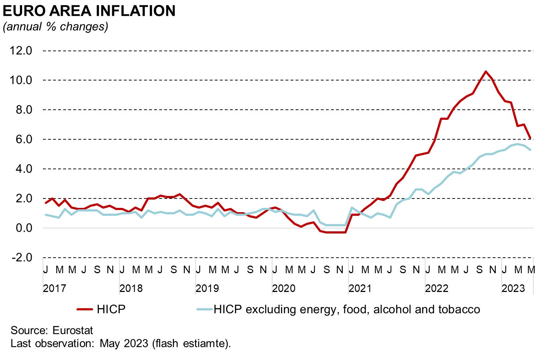
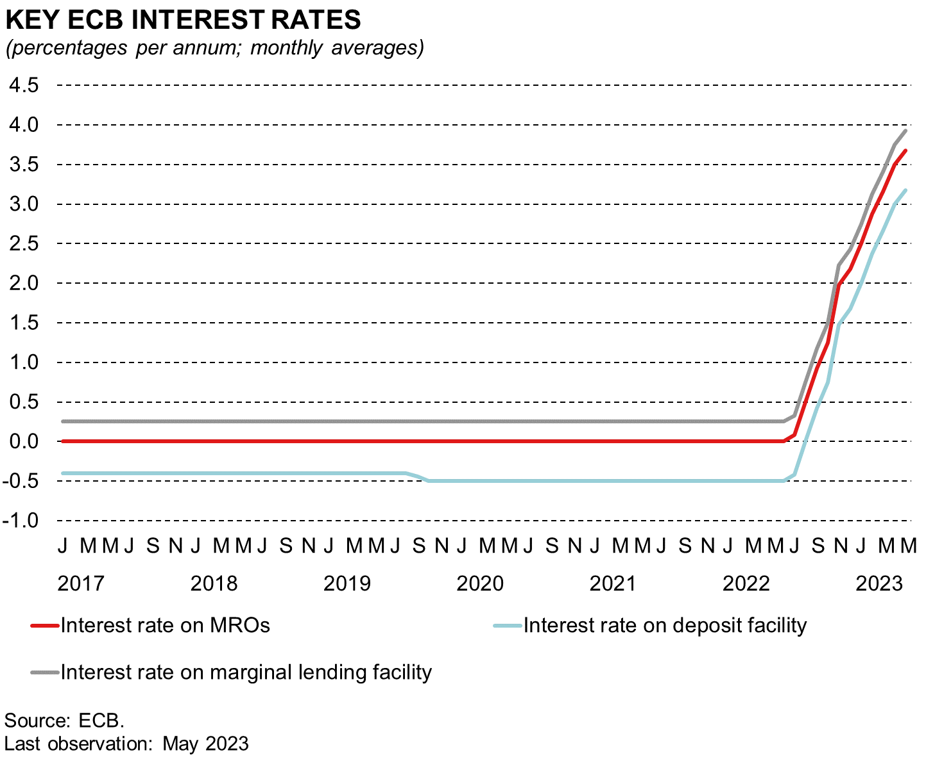
ECB raises interest rates to fight high inflation
Notes:
SLIDE 1: ECB begins to raise interest rates to fight high inflation
In 2022, the ECB’s Governing Council began to raise interest rates in the context of heightened inflationary pressures.
Indeed, overall inflation in the euro area rose from just above 5% in January 2022 to a peak of 10.6% in October last year, before retreating to 6.1% in May 2023, which is still high from a historical perspective and well above the 2% policy aim.
While in part this reflected higher energy costs and rising food commodity prices, HICP excluding energy and food also increased. The latter was still fairly moderate in January 2022, when it stood at 2.3%, but rose to 5.2% by December. It rose further to 5.7% in March 2023, and since then has moderated somewhat to 5.3% in May. Underlying inflation could be reaching a turning point, but signs of a turning point are less clear than for overall inflation (a similar picture globally).
The Governing Council took firm decisions to achieve its inflation objective of 2% over the medium term. The interest rates on the deposit facility, the main refinancing operations and the marginal lending facility were raised by a total of 250 basis points during the second half of 2022, ending the year at 2.00%, 2.50% and 2.75%, respectively.
Further increases were announced in February, March, April, May and June 2023, bringing the key policy rates to 3.50%, 4.00% and 4.25% respectively. (Chart does not include June increase as it shows monthly averages up to May).
These rate hikes were implemented as inflation remained elevated and broad-based, while incoming information suggested that overall inflation would remain above the policy aim for some time.
At the same time, pipeline pressures from earlier cost increases remained strong in the context of a very tight labour market.

Slide 4
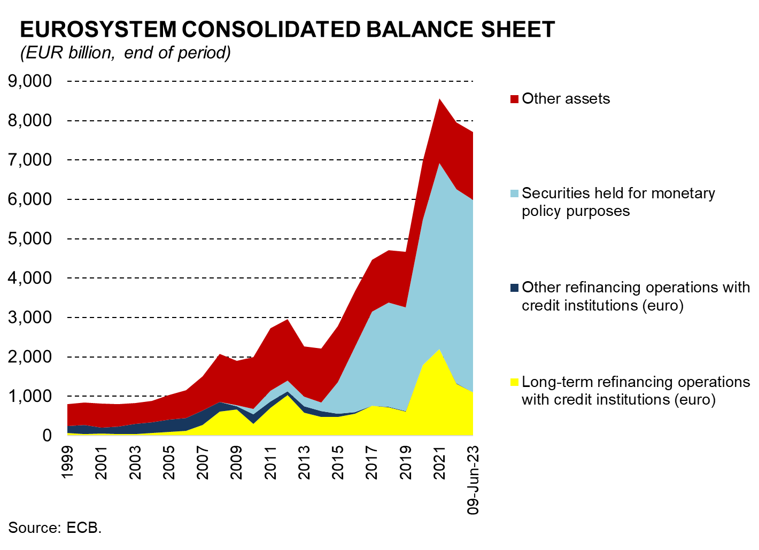
A reduction in the Eurosystem balance sheet
complements interest rate increases
Notes:
SLIDE 2
Policy rate increases were complemented by a reduction in the size of the Eurosystem balance sheet. Net asset purchases ended, and banks began to repay some of their targeted long-term refinancing operations (TLTROs).
As the light blue area in the chart shows, net asset purchases under the pandemic emergency purchase programme (PEPP) ended at the end of March 2022, while those under the asset purchase programme (APP) ended as of 1 July.
Full APP reinvestments ceased at the end of February 2023. From March 2023, the APP portfolio has been falling by €15 billion per month and is expected to do so until the end of June 2023. Thereafter it is expected to decline with redemptions, as on 15 June the GovC confirmed an earlier announcement that APP reinvestments will end as from July.
In the case of PEPP, reinvestments are expected to continue until at least the end of 2024.
Measures were also taken to reduce TLTRO-III balances (yellow area), by adjusting the applicable interest rates and offering additional voluntary early repayment dates.
Consequently, outstanding TLTRO-III balances have fallen from around €2.2 trillion at end 2021, to €1.3 trillion at end 2022 and have declined slightly further during the first half of 2023. These balances are expected to fall further as these operations mature and in fact account for most of the decrease in the Eurosystem balance sheet since end 2022.

Slide 5
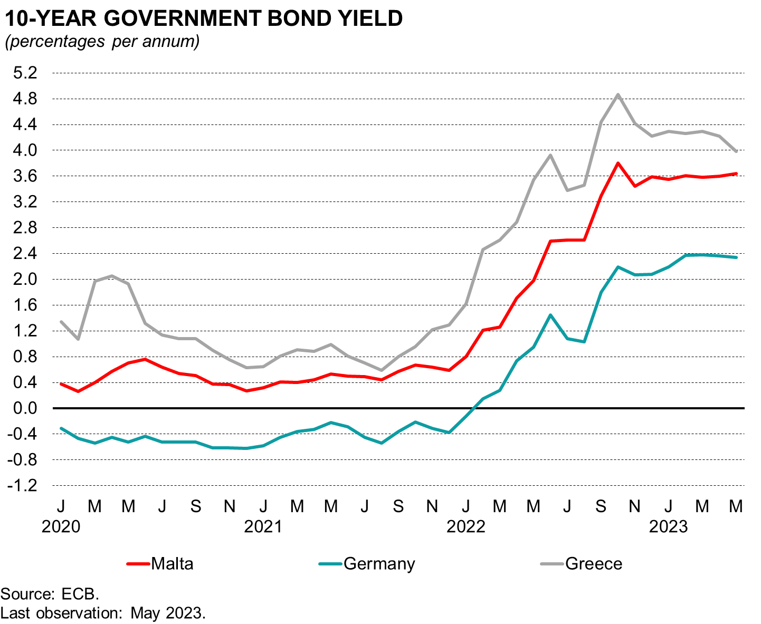
ECB interest rate hikes have transmitted to
sovereign yields
Notes:
SLIDE 3: ECB interest rate hikes have transmitted to money market rates and sovereign yields
Increases in ECB rates have broadly transmitted to sovereign yields in the euro area.
The benchmark ten-year yield for the euro area as a whole has broadly increased by 293 basis points between January 2022 and May 2023.
Similar increases can be seen at country level. Although there were some differences across countries, spreads generally remained contained.
In part this was due to the Governing Council’s decision to announce the Transmission Protection Instrument in July 2022. This tool is designed to enhance the resilience of the euro area to shocks by preventing disorderly market dynamics that pose a serious threat to the transmission of monetary policy. The tool can be activated in jurisdictions experiencing a deterioration in financing conditions that is not warranted by country-specific fundamentals.
Sovereign bond have been more stable recently and have broadly been following risk free (10-year OIS) rates. They have also been resilient amid recent banking sector turbulences in the US. The recent stabilization in rates may reflect the expectation of more moderate inflation rates over the medium term (yield curve inversion). Furthermore, the 10-year yield has been falling in Greece in recent months amid expectations that the country would soon restore its investment grade status.

Slide 6
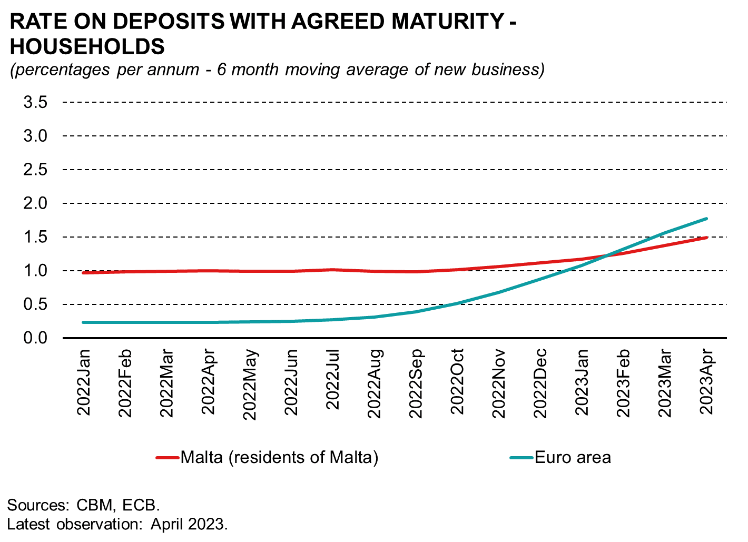
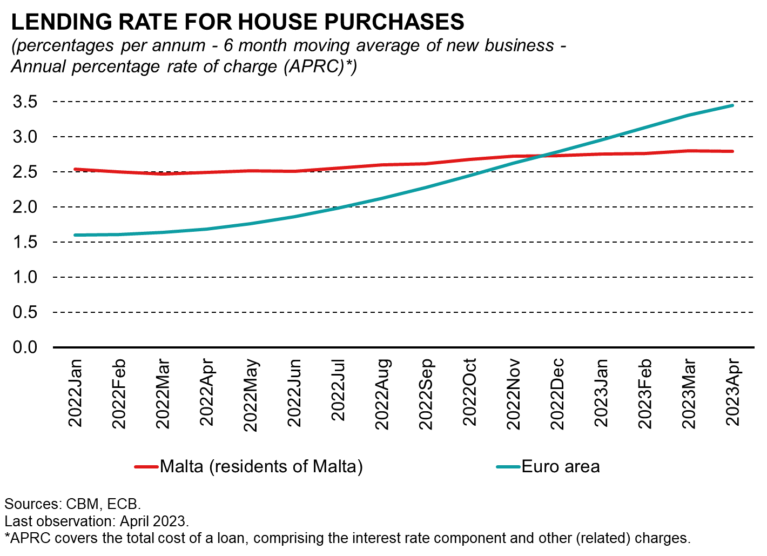
Households' rates are being affected to different degrees…
Notes:
SLIDE 4: Households’ rates are being affected to different degrees…
As sovereign yields often serve as a benchmark for pricing other financing instruments, these costs eventually affect yields on bank bonds and banks’ wholesale funding costs. But, if monetary policy is to have an impact on inflation, it must be transmitted to broader interest rates in the economy. In this slide, I will look at bank deposit rates and lending rates for households.
The passthrough is not necessarily immediate as it depends on starting levels of rates and contractual terms (e.g. whether loan contracts are set at fixed or variable interest rates).
Banks’ funding preferences (e.g. deposits vs wholesale funding) and assessment of credit risk across different classes of borrowers also play a role.
In general, household lending and deposit rates in the euro area have moved up following the latest ECB rate hikes. We are also seeing this in Malta, but the response has been slower.
This partly reflects the fact that banks in Malta are highly liquid and have no immediate need to attract more deposits. Moreover, starting levels were also higher than those in the euro area.

Slide 7
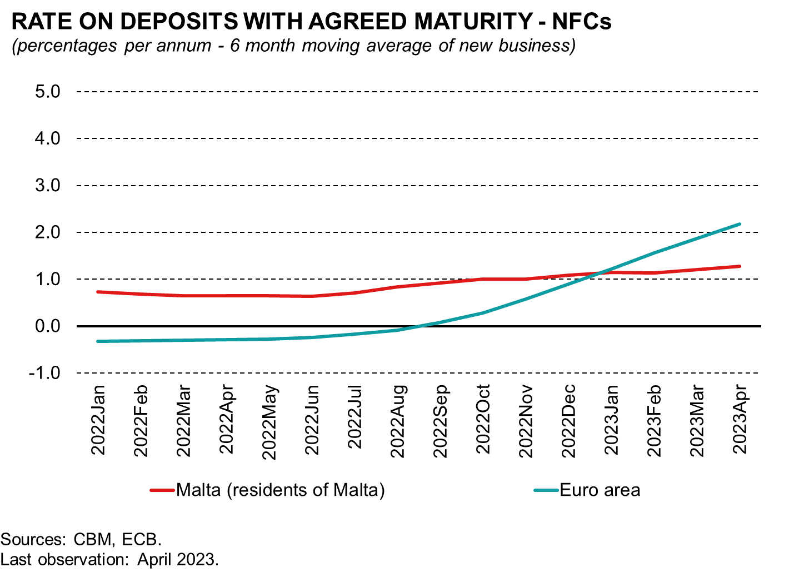
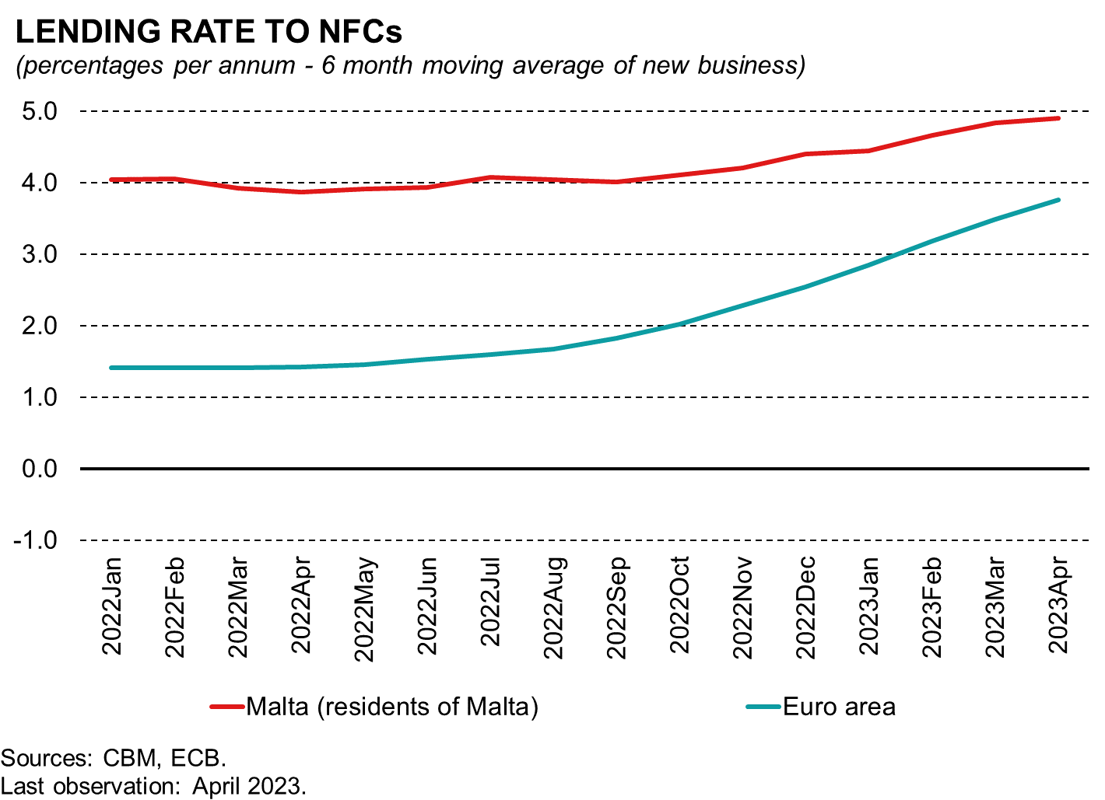
… and so are interest rates for corporates
Notes:
SLIDE 5: … and so are rates for corporates
A similar picture emerges when one looks at deposit and lending rates offered to non-financial corporations. Here too interest rates have responded more slowly compared to the euro area.
Before I conclude, I would like to note that the abrupt change in the inflation environment and the monetary policy response to it – not only in the euro area but also in other advanced economies – has affected negatively the financial performance of central banks.
In the case of the Eurosystem, the increase in policy rates automatically generated a higher expense on the deposits that credit institutions hold with their national central bank. While interest rates on assets held by central banks, such as bonds, should also increase, this takes time.
Although the tightening monetary stance that began in 2022 has had an adverse impact on our financials, such negative effect is inevitable in the fight against inflation. Furthermore, central banks in the Eurosystem have set aside financial buffers to cater for these situations.
Finally, it is worth remembering that the ECB’s primary aim is price stability, not profits. Experience has shown that central banks can conduct monetary policy effectively irrespective of their profitability.
Deputy Governor Demarco will be elaborating on the Central Bank of Malta’s financial results later on.

Slide 8
The monetary policy outlook: further tightening likely
Data-dependent monetary policy.
Inflation is likely to remain too high for too long.
The balance of risks between doing too much and doing too little is increasingly important.
Notes:
SLIDE 6 –
I am going to conclude with a few comments on the monetary policy outlook. Elevated uncertainty (geopolitical tensions, financial stability risks, macroeconomic slowdown) reinforces the importance of a data-dependent monetary policy.
The Eurosystem June 2023 projections tell us that headline inflation will remain high for too long even if the peak may be past:
HICP: 5.4% in 2023, 3.0% in 2024 and 2.2% in 2025.
HICPX: 5.1% in 2023, 3.0% in 2024 and 2.3% in 2025 (similar profile to overall HICP, but higher at the end).
As policy rates have increased significantly over a relatively short time period (by comparison with previous rate hike cycles) and is now in restrictive territory, the balance of risks between doing too much and doing too little is increasingly important. For sure, we may need to do more to tackle inflation, and especially core inflation, so as to bring it back to target.
However, we must also stay vigilant not to overdo the pace and length of the tightening cycle.
____________________end

Slide 9
Central Bank of Malta
Annual Report 2022
The Maltese Economy

Slide 10
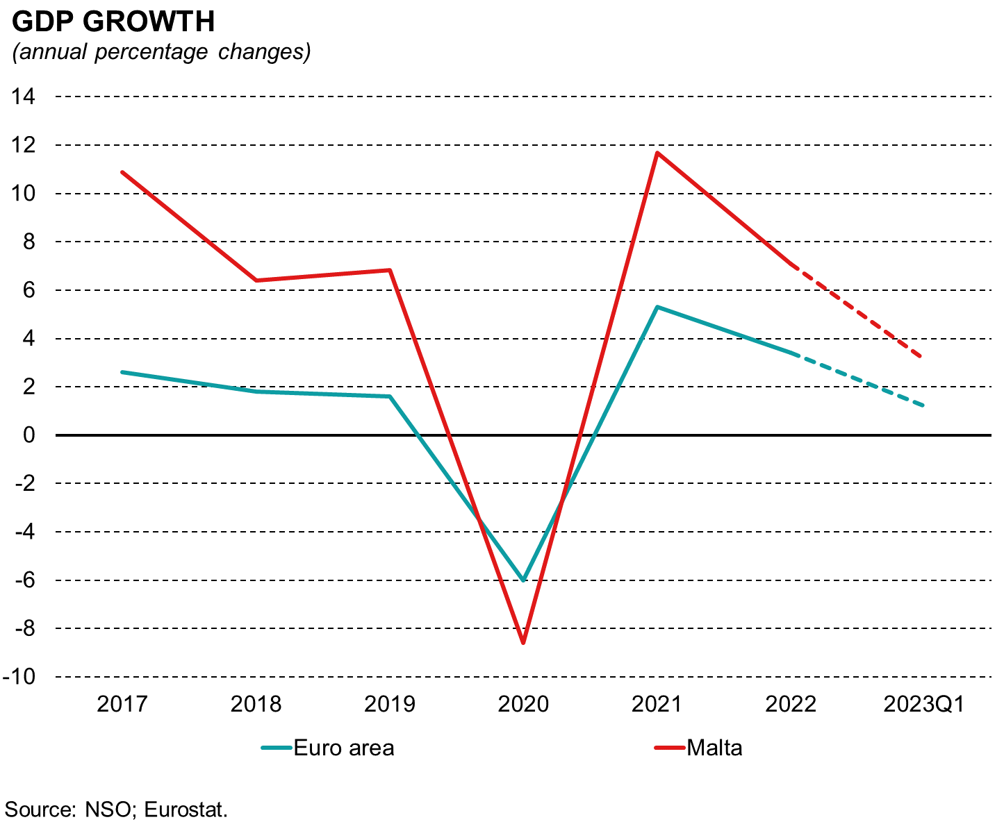
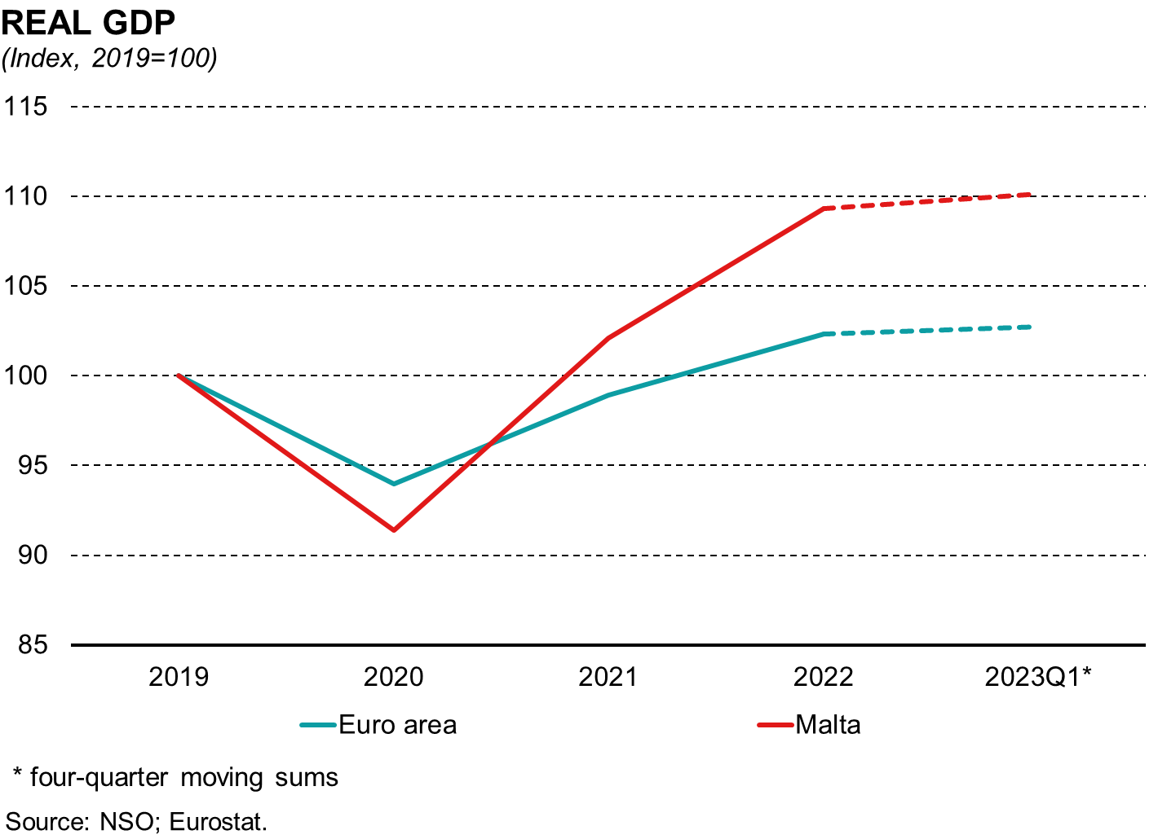
GDP growth moderates from the high rate of 2021,
when the economy had just started to re-open
Notes:
During 2022 Malta’s GDP rose by around 7%. While this was below the rise seen in the previous year, the pace of economic expansion remained well above that in the euro area.
Economic growth in the euro area in fact was about half that observed in Malta. While due to its greater degree of reliance on contact-related services, the Maltese economy had been harder hit by the pandemic, contrary to expectations, GDP had already recovered from the pandemic shock, a year earlier than in the euro area.
Furthermore, by the end of last year, the Maltese economy was almost a tenth larger than it had been in 2019, while the euro are economy was just 2% larger. This attests to the great flexibility of the Maltese economy and the resilience of Maltese households and firms to large external shocks.
That said, an important element behind this resilience and the following rapid recovery was the stimulus provided by Government during this period. This helped sustain domestic demand and protected the economy’s productive capacity.
In the first quarter of 2023, annual real GDP growth decelerated to 3.1% (5.2% in Q4 2022).

Slide 11
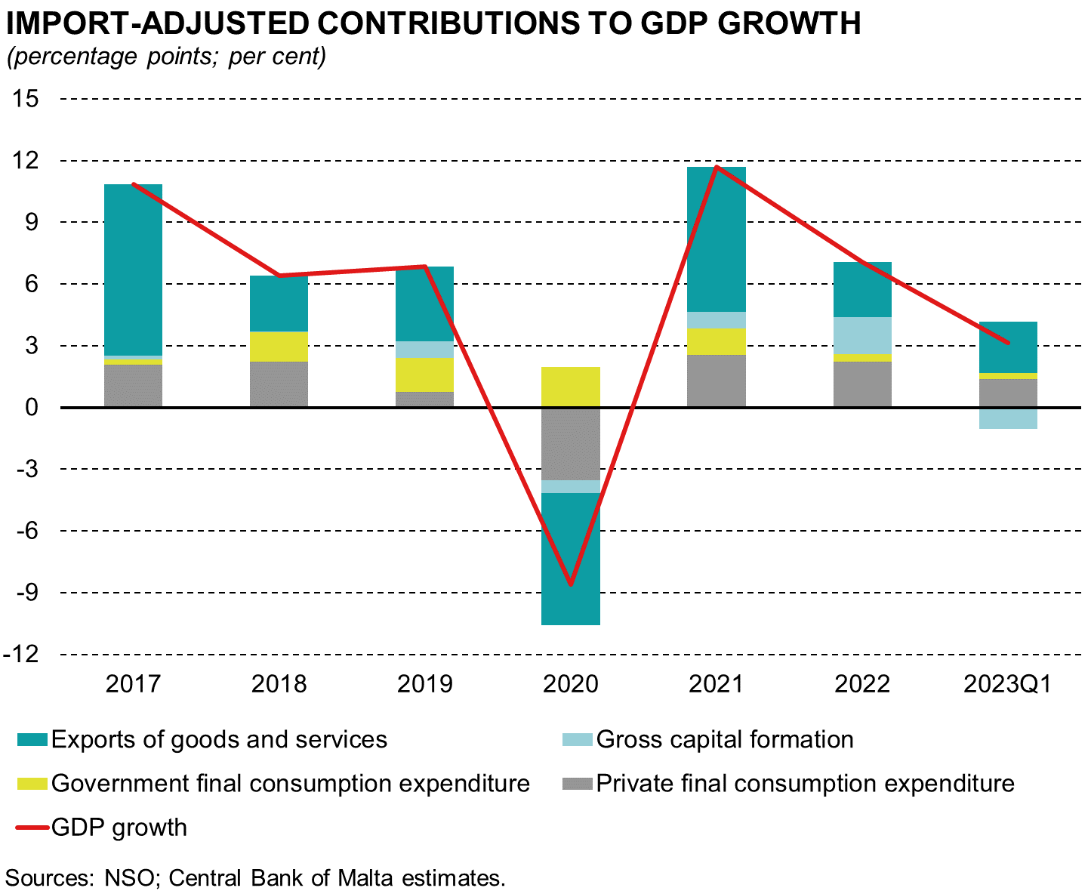
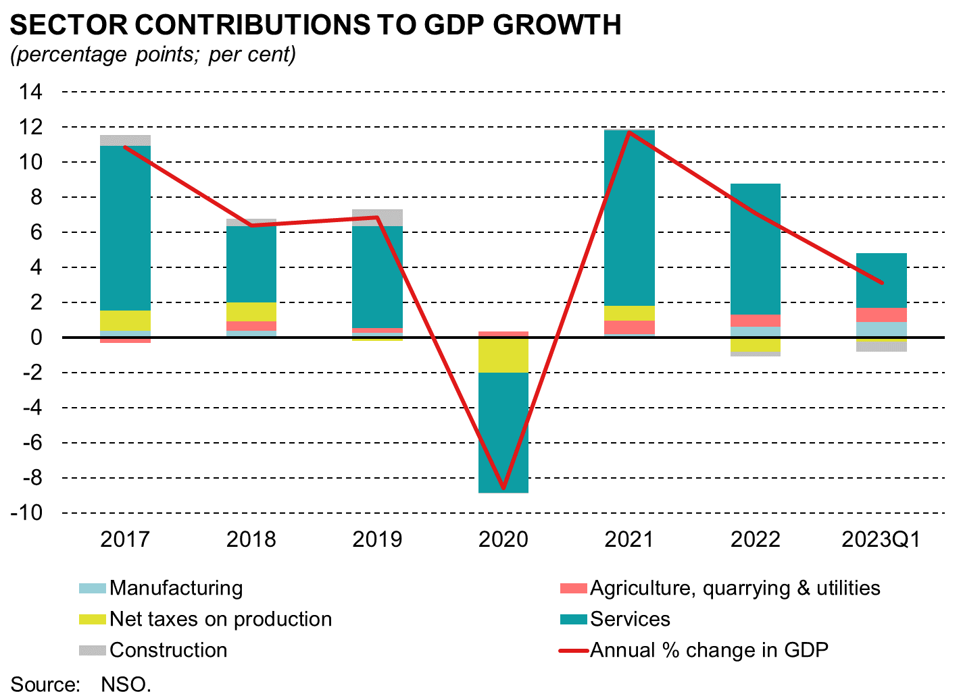
2022 growth mainly underpinned by domestic demand
Notes:
When one looks at headline figures, it would appear that last year’s growth was solely driven by domestic demand as net exports fell. However, this reflects a large rise in imports of machinery, particularly aircraft, which then appears as a surge in investment.
If one removes this import content, the contribution of investment to growth is more moderate, while that of external trade becomes much more apparent When adjusting for imports, external trade was in fact the main driver behind the GDP expansion last year, followed by private consumption.
From a sectoral perspective, growth remained driven by services. About half of the growth observed in the services sector reflected the recovery of retail, hotels, restaurants and transport. The rest of the expansion in services was due to the export-oriented services sectors such as professional services, financial services, information and communication, and remote gaming.
Manufacturing also contributed positively, while the contribution to growth of public administration and health declined compared to the previous year. Construction activity also declined somewhat.
In the first quarter of 2023, the contribution from domestic demand was negative. Furthermore, in contrast with previous four quarters, net exports contributed positively to growth, in part reflecting a correction in import-intensive investment in the aviation sector from recent extraordinary levels.
After adjusting for imports, the contribution of domestic demand falls but remains positive. The main driver behind the growth in domestic demand is private consumption, while GFCF retains a negative contribution once adjusted for imports.
Furthermore, the services sector remained the main driver behind the rise in economic activity, with most of the increase stemming from the sector comprising professional, scientific, administrative and related activities. This was followed by the sector comprising wholesale and retail trade, transportation, accommodation and related activities.

Slide 12
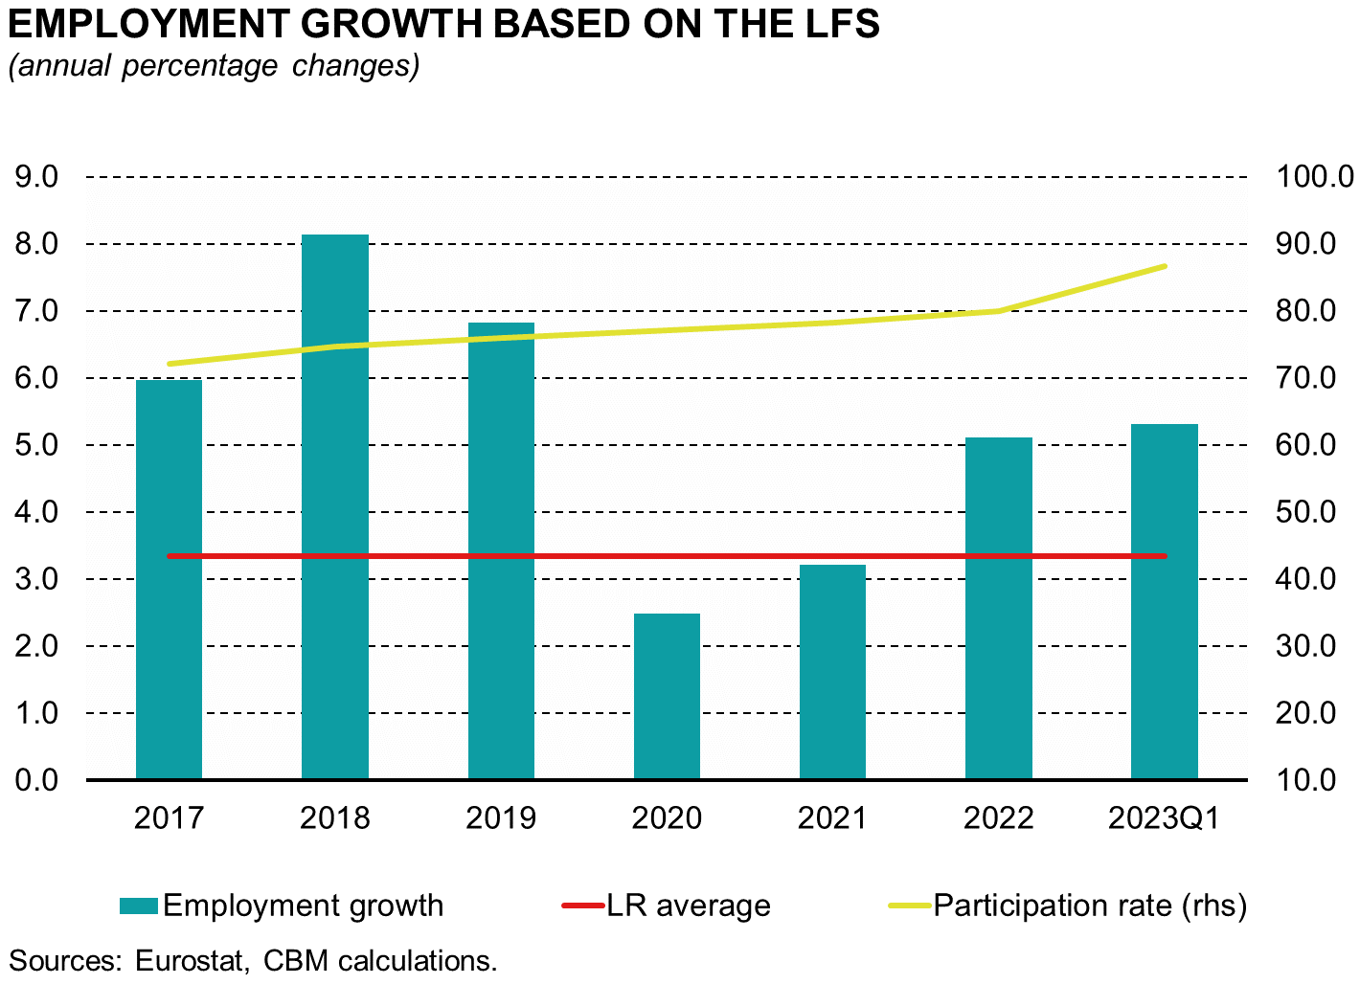
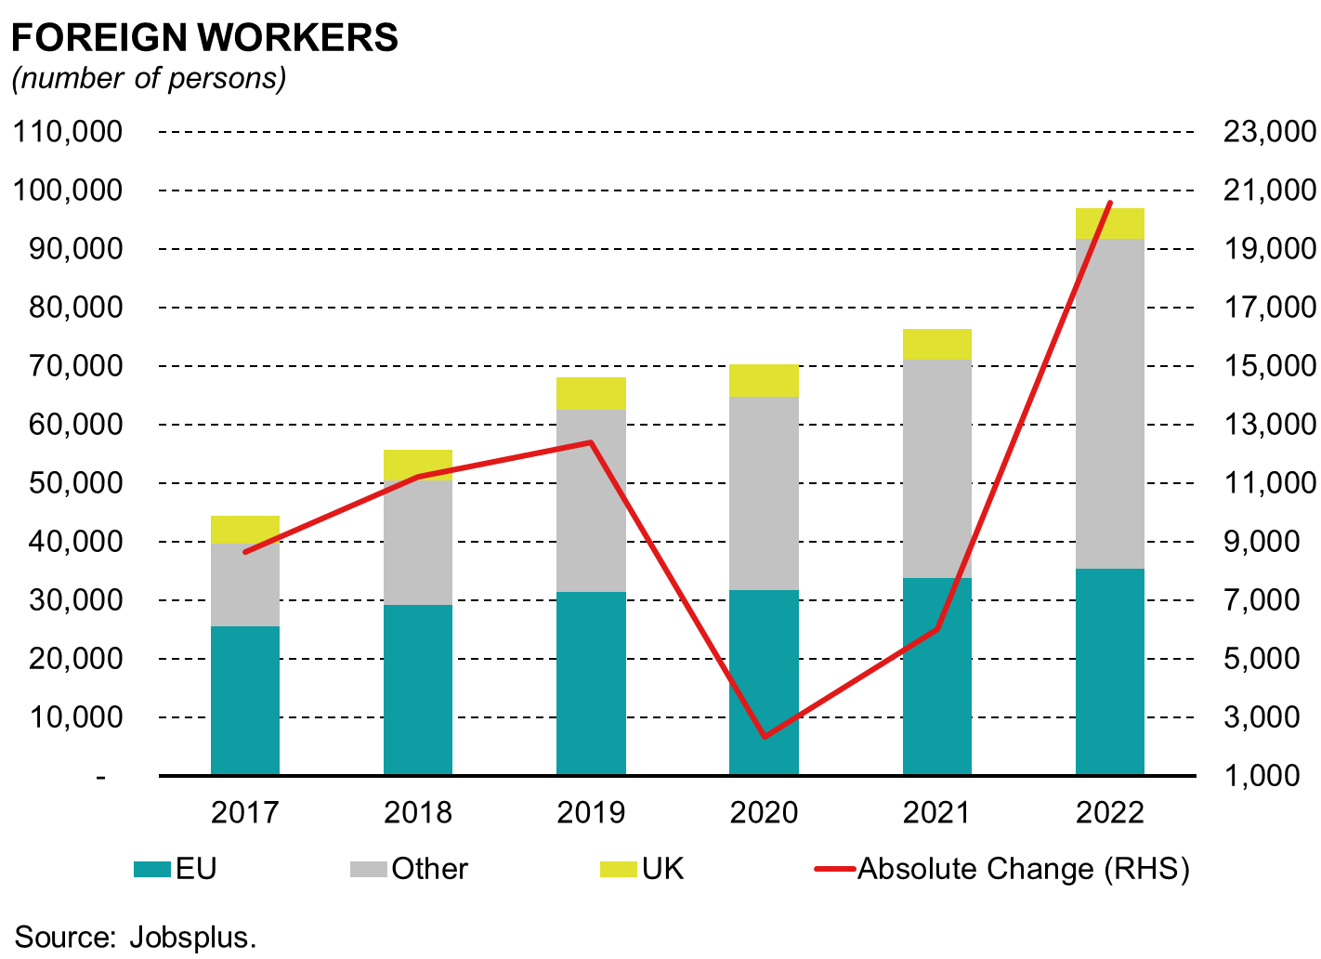
Employment, stock of foreign workers grow at a faster pace
Notes:
In 2022, employment continued to expand sharply, at a rate which though below that seen before the pandemic, was about one and a half times the historical average.
The labour participation rate in fact exceeded the 80% mark, when just five years before it hovered around 70%. Consequently, Malta’s employment rate is now far higher than that in the euro area.
During 2022, net inflows of foreign workers recovered further from the sharp drop in the pandemic, and exceeded 2019 levels. Furthermore, these flows differed from those in earlier years as they are now increasingly driven by third country nationals. In fact these now account for a larger share of the total stock of foreign workers.

Slide 13
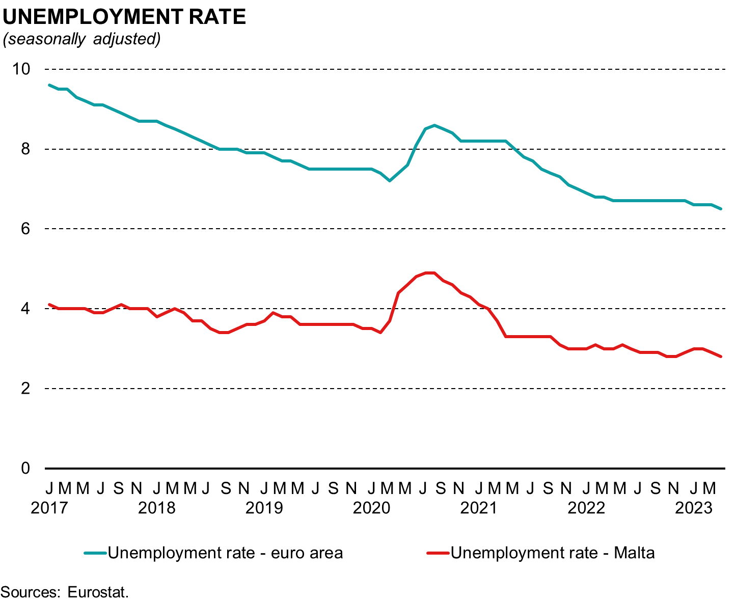
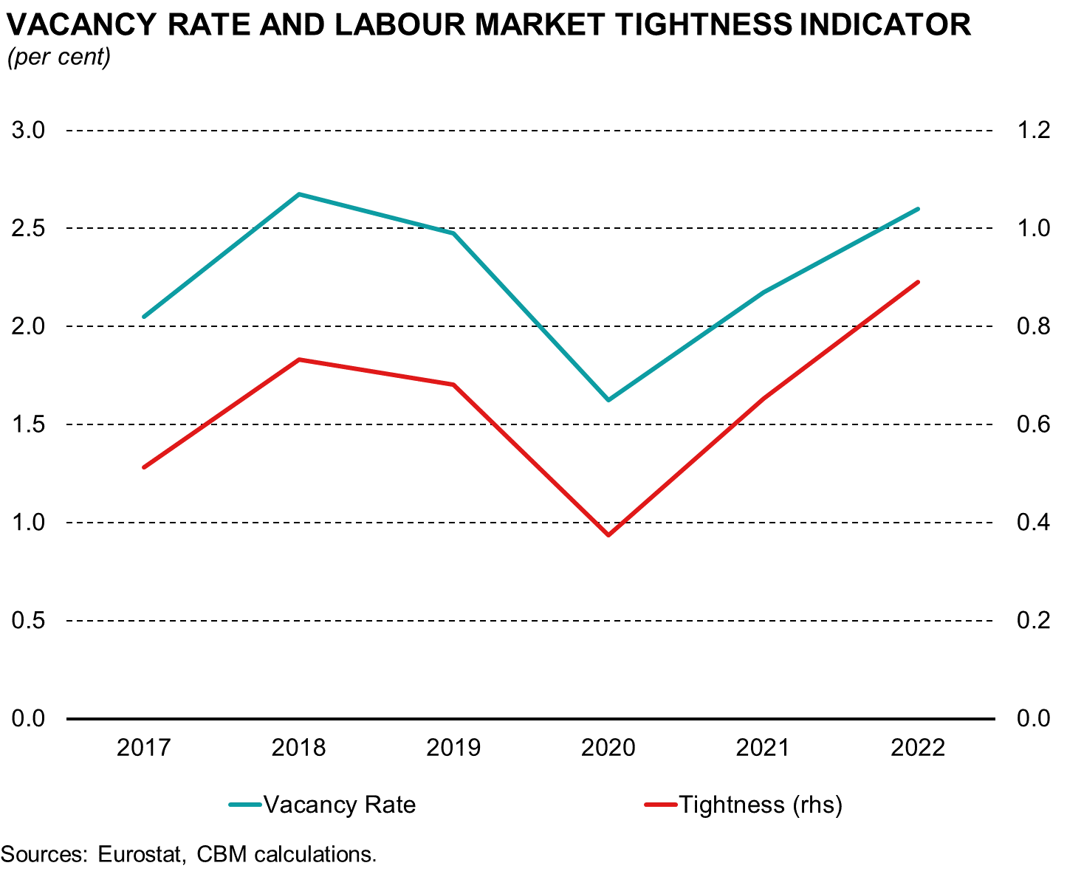
Unemployment rate at historic low, labour tightness indicators at elevated levels
Notes:
Despite the large rise in labour participation and the increase in net inflows of foreign workers, the unemployment rate continued to fall. Labour supply growth continued to be lower than the rise in labour demand.
Consequently, Malta’s unemployment rate fell to historical lows, going below 3% in 2022 for the first time ever. This rate was well below half the euro area average. While the number of jobless persons fell below its pre-pandemic level, the amount of job vacancies exceeded those in 2019.
This implies that the tightness of the labour market now exceeds that observed before the pandemic, with the vacancy rate for the first time in history nearly equalling the unemployment rate.

Slide 14
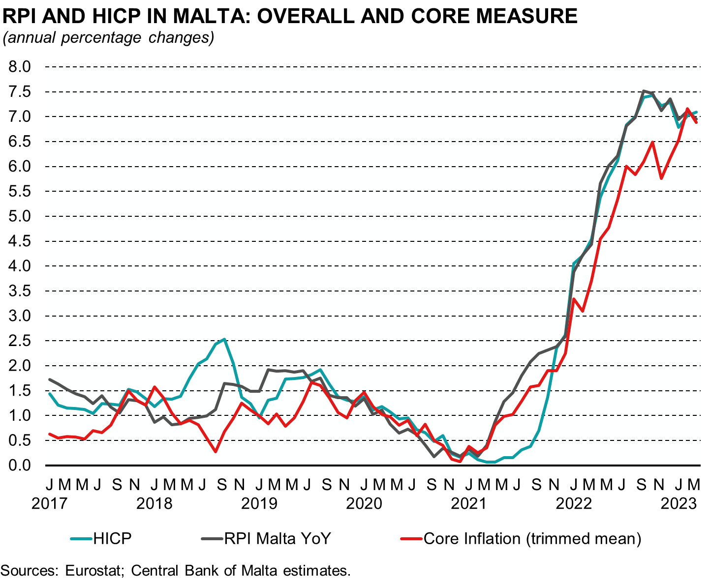
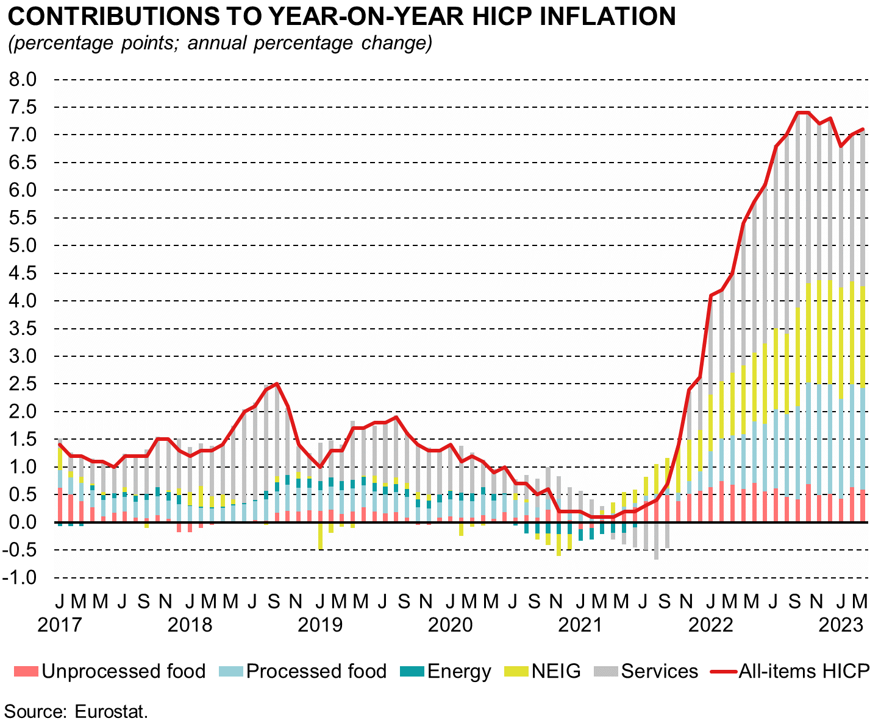
HICP inflation increases strongly in 2022 in an environment
of elevated international price pressures
Notes:
HICP inflation in Malta averaged 6.1% in 2022, up from 0.7% a year earlier. The RPI also increased.
The rise in inflation occurred in an environment of elevated international price pressures, amid lingering supply bottlenecks and renewed trade disruptions following the outbreak of the war in Ukraine. Indeed, inflation has continued on its upward path evident since May 2021. HICP inflation rose from 4.1% in January, to a peak of 7.4% in September and October 2022, before falling marginally to 7.2% in November and 7.3% in December.
Food and consumer goods inflation were quite substantial, though they remained lower than the euro area average. On the other hand, services inflation was much more pronounced here in Malta, driven in part by the tightness of the labour market.
Another factor was the rise in restaurant and hotel prices, which reflected both the strong recovery in foreign tourism as well as buoyant domestic demand. Yet even though services inflation was much more pronounced than in the rest of Europe, Malta’s inflation rate was far below the euro area average.
This was due to the Government’s policy of freezing energy prices, which meant that these had no contribution to inflation in Malta, which contrast with the situation in Europe where energy accounted for just under half of overall inflation.
Inflation moderated somewhat in the first months of 2023, standing at 6.4% in April and 6.3% in May. (Charts include data up to April, as May components and May RPI are not available yet).

Slide 15
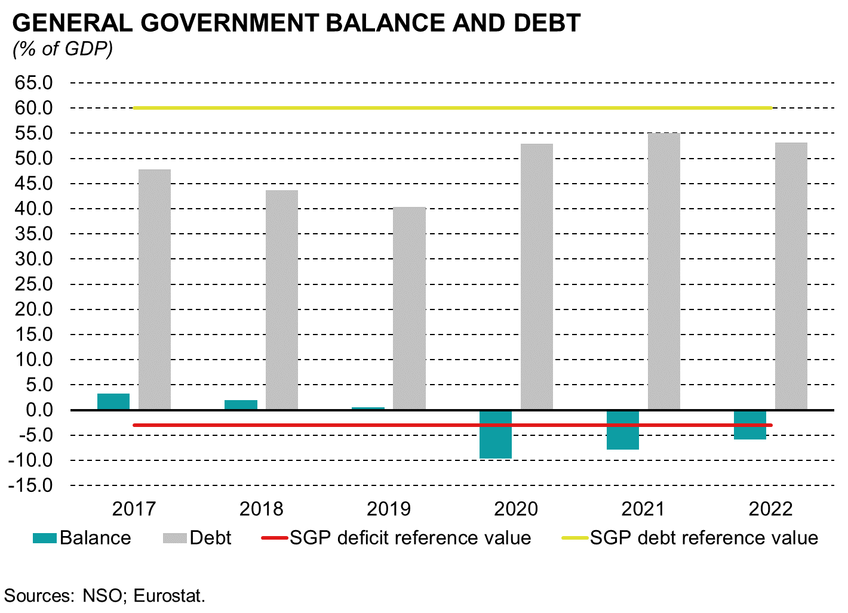
Government debt remains below 60%
Notes:
The policy of keeping energy prices constant had a significant impact on Government finances. Malta’s fiscal deficit, though declining in 2022, remained elevated as falling pandemic-related spending was partly offset by rising support to the energy provider and to fuel importers. The fiscal position, which prior to the pandemic had been amongst the best in Europe, is now characterised by a deficit that is nearly over one-and-a-half times the euro area average (MT: -5.8%, EA: -3.6%).
However, the significant economic expansion is dampening the rise in the debt burden. The latter remained well below the 60% Maastricht treaty reference value. At around 53% of GDP, Malta’s debt ratio also compares very well with the c.92% euro area average.

Slide 16
GDP is expected to continue to grow
Notes:
Looking forward, the Central Bank expects the Maltese economy to continue to outperform the euro area over the coming years. While GDP growth will moderate from last year’s figures it will remain quite substantial at close to or over 3.5%, which is slightly above what we believe constitutes Malta’s potential growth rate. We expect this to happen mostly as domestic demand should continue to grow at above-average rates due to two factors.
Firstly households and firms have accumulated huge amounts of savings during the pandemic, which they are now gradually running down. Secondly they have been shielded from the large shocks that have affected households and firms in neighbouring economies, leaving them more able to conduct discretionary spending. At a time when foreign demand is expected to decline somewhat, this bouyant domestic demand will remain the main driver of growth. The Bank expects investment to also remain strong, while employment growth should moderate gradually without any significant impacts on unemployment. Inflation is set to decline but remain above the 2% target till the end of the projection horizon. Moreover in coming months, Malta’s inflation will be higher than that in the euro area, as the latter has started to benefit from a reduction in energy prices which will push the euro area’s headline inflation rate lower. The drop in foreign energy inflation will however benefit the Maltese Government finances, as the cost of energy subsidies should gradually recede while rising economic activity will continue to push upwards tax revenues.
Turning to risks to these projections. We believe that this year the balance of risks is slightly to the downside as stronger than envisaged weakness in the international economic environment, which could lead to lower exports.. These would impact negatively economic growth, inflation and the fiscal position. The impact of monetary policy on economic activity abroad could also be higher than expected. On the other hand labour market tightness could lead to higher than expected wage growth, which could boost domestic demand further though at the cost of higher inflation.

Slide 17
Central Bank of Malta
Annual Report 2022
Overview of the
banking sector
Notes:
Good morning
Today I will be giving you a brief overview of the developments in the banking sector for 2022 focusing on the core domestic banks given their strong links with the Maltese economy.
At the outset, I would like to stress, that our banking sector is resilient, with strong capital and liquidity positions. The resilience of the sector has been tested during the great financial crisis and more recently, in the pandemic. So far, our banks have emerged relatively unscathed even during the most recent episodes of banking turmoil. Indeed, since the great financial crisis significant steps have been taken to strengthen the European Union’s institutional and regulatory framework. This has, in turn, strengthened the European banking system to better withstand crisis situations.

Slide 18
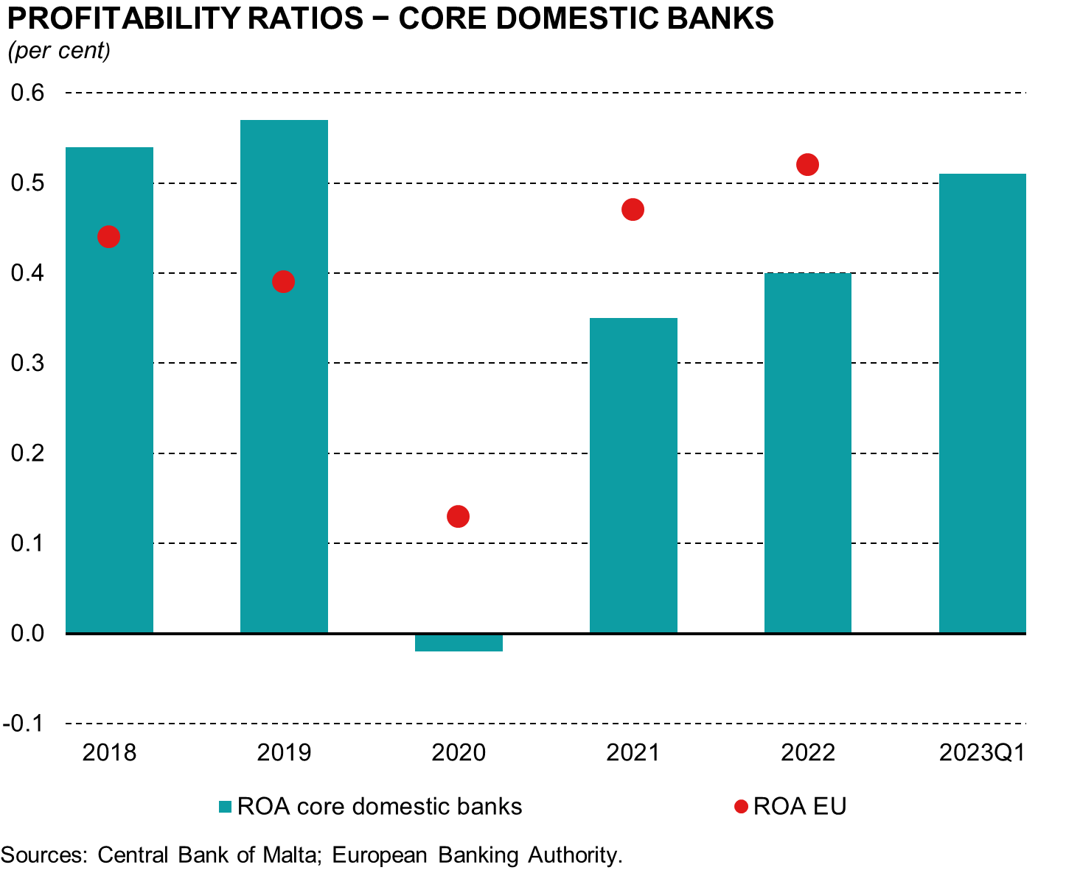
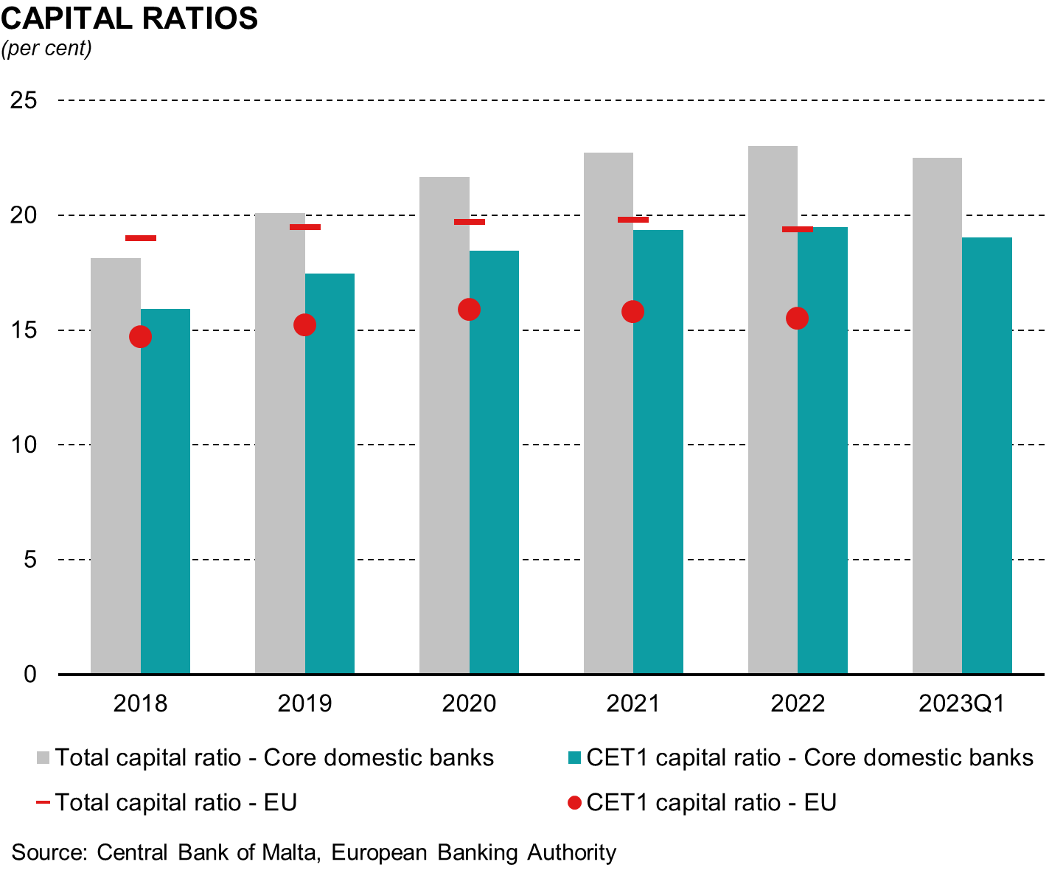
Profitability continued to recover
Capital ratios are healthy
Notes:
S2 LHS - Profitability continued to recover:
Profitability continued to recover following the declines experienced during the pandemic where banks had cautiously stepped up their impairment charges which were then released in the following year. The left-hand chart shows that on average in the last three years (since 2020), the Return on Assets of the Core Banks was below that of EU banks. It should be noted that during the pandemic, local banks, apart from loss of profits from subdued business, were very prudent and provided for any foreseen potential losses on their lending portfolios. While in 2021, the ratio remained below that of the EU, the recovery was stronger for the Maltese banks than in Europe, turning a loss into a profit. In 2022 these banks reported an increase of about 28% in pre-tax profits, but, profitability was affected by one-off events, which if excluded, the return on assets (ROA) would be more in line, and even surpass, that of EU banks. The recovery persisted in the first quarter of 2023 (with figures showing a 4 quarter moving sum ratio)
RS2 RHS - Capital ratios are healthy:
As seen in the right-hand panel, overall capital levels remained strong. The Total Capital Ratio and Common Equity Tier 1 capital of the core banks stood at around 23% and 19% respectively (valid for both 2022 and Q1 2023), which are well-above the EU averages. This shows that our banks follow rigorously regulatory and prudential requirements while taking into consideration the expansion of their business activities.

Slide 19
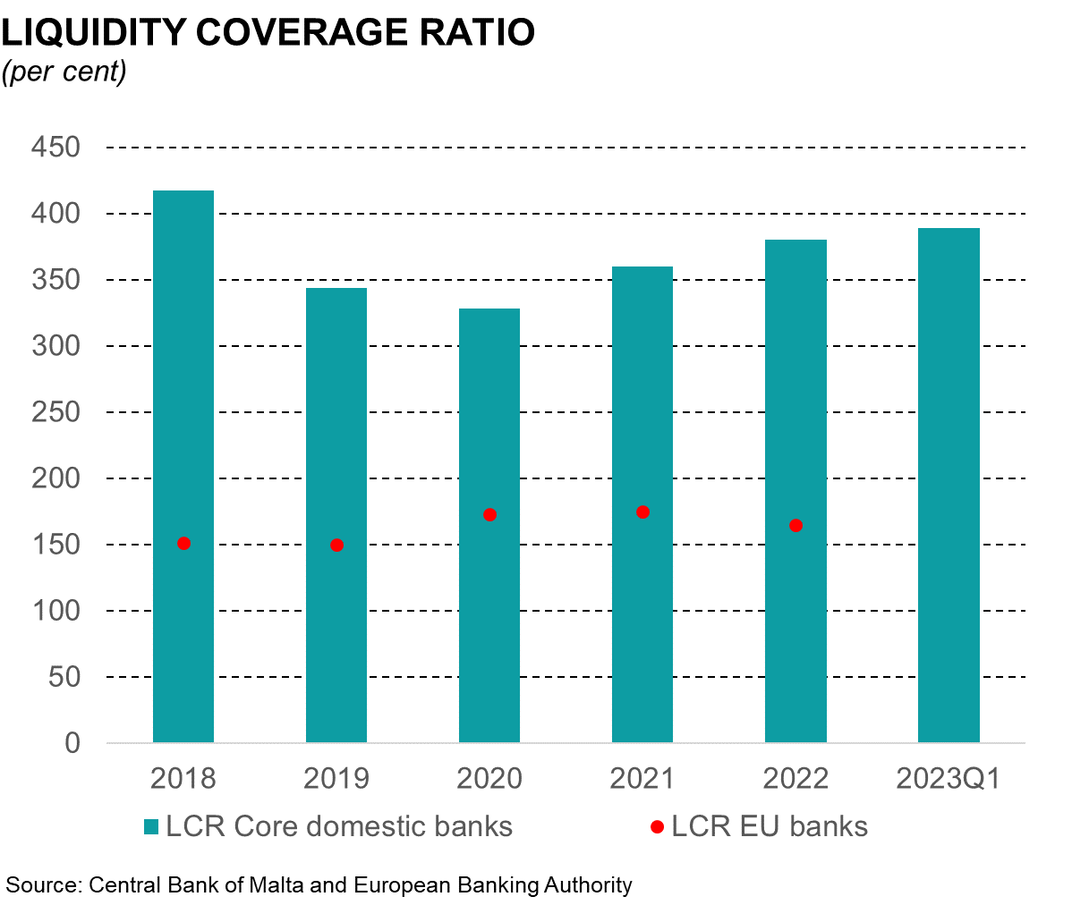
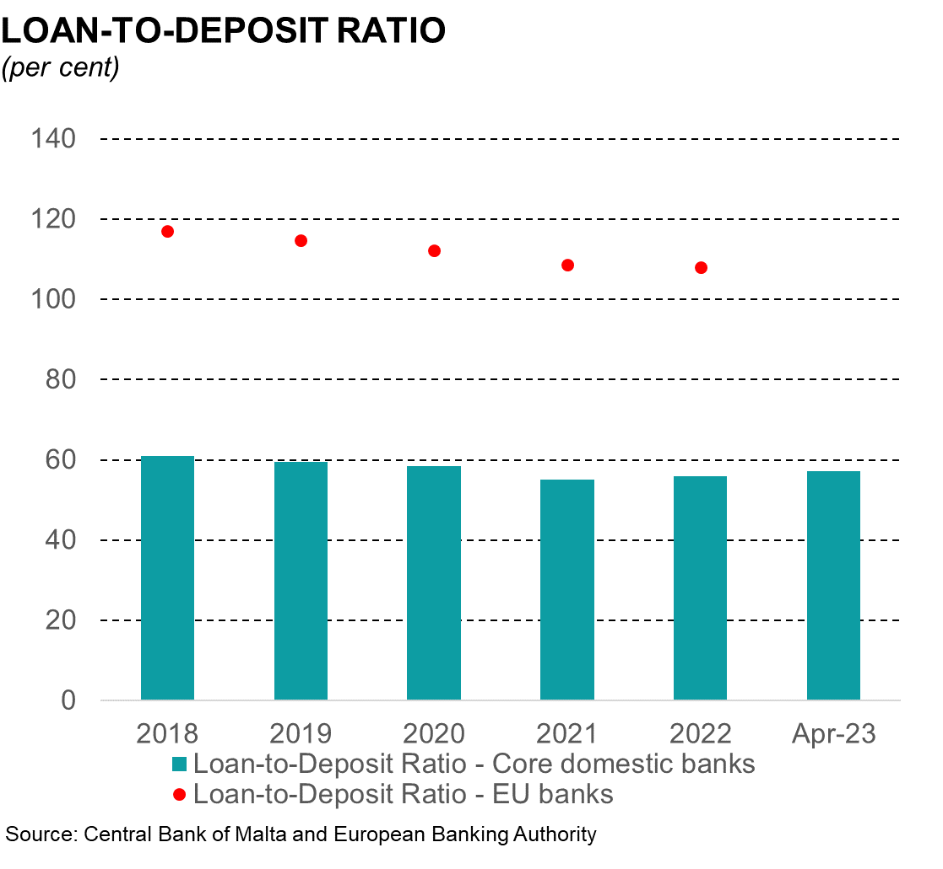
Liquidity remained strong supported by ample deposits
Notes:
LHS – Liquidity Coverage ratio
The strong liquidity of the banks is shown by the overall high Liquidity Coverage ratio which stood at around 390% in March 2023, significantly exceeding the minimum requirement of 100% as well as the average (165%) for the EU banks.
LHS – Loan to Deposit Ratio
At around 57% in April 2023, the Loan-to-deposit-ratio is by far below the 108% of EU Banks (Dec-23), also indicating ample liquidity in the system.

Slide 20
Amidst the current financial turmoil...
Maltese banks remain resilient
Issues were idiosyncratic in nature
Outside EU – subject to different regulatory system
No direct impact on domestic banks arising from the collapse of SVB, SIG and CS:
The Central Bank continually monitors risks to financial stability – very strong, consistent results
Liquidity;
banks resilient to deposit withdrawal stress tests
Shocks to short-term and long-term liquidity
Price changes in banks’ bond holdings
Impact of interest rate movements & general stress test
Banks have ample eligible assets for funding
LCR 363%
NSFR 187%
Only 27% subject to daily price adjustments
Net positive impact from rise in interest rates
Notes:
SL 4 - Amidst the current financial turmoil... Maltese banks remain resilient
As mentioned in my introduction, Maltese banks remained resilient.
The issues related to SVB, Signature Bank and Credit Suisse were rather idiosyncratic in nature and occurred outside the Euro Area where different regulations apply. Of course, the collapse of Credit Suisse could have had a ripple effect across the Eurozone. But, its quick sale to UBS, has helped stem the potential threat for contagion, though indirectly, global banks’ equity and debt were strongly affected on financial markets.
The Central bank’s stress tests reveal that the local banks can withstand a certain degree of deposit outflows given that they are highly liquid, even when subject to severe shocks assessed under various adverse scenarios. Furthermore, they hold ample Eurosystem-eligible assets which they can pledge to obtain funding from the Central Bank.
Bond holdings are also assessed in isolation and tested against a deterioration in credit quality namely an increased risk of default, and price changes. Results show that all banks remain well-capitalised and exceed their regulatory requirements.
Furthermore, the Central Bank carries out scenarios of Interest Rate Risk in the Banking Book (IRRBB) to assess the impact of changes in interest rates on the banks’ interest-bearing assets and liabilities. In the hypothetical scenarios which feature increases in interest rates, bond prices drop as yields increase and banks need to take into account unrealised losses. However, results show that increases in interest rates lead to a larger increase in interest income than in interest expense and revaluation losses, given the composition of their balance sheets. This results in a net positive impact on profitability and ultimately capital.

Slide 21
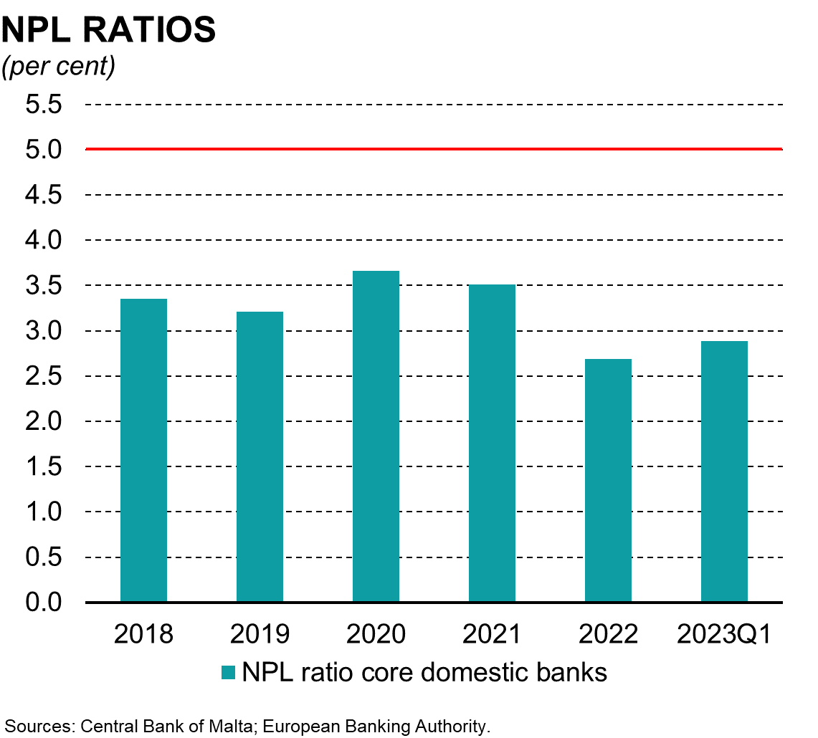
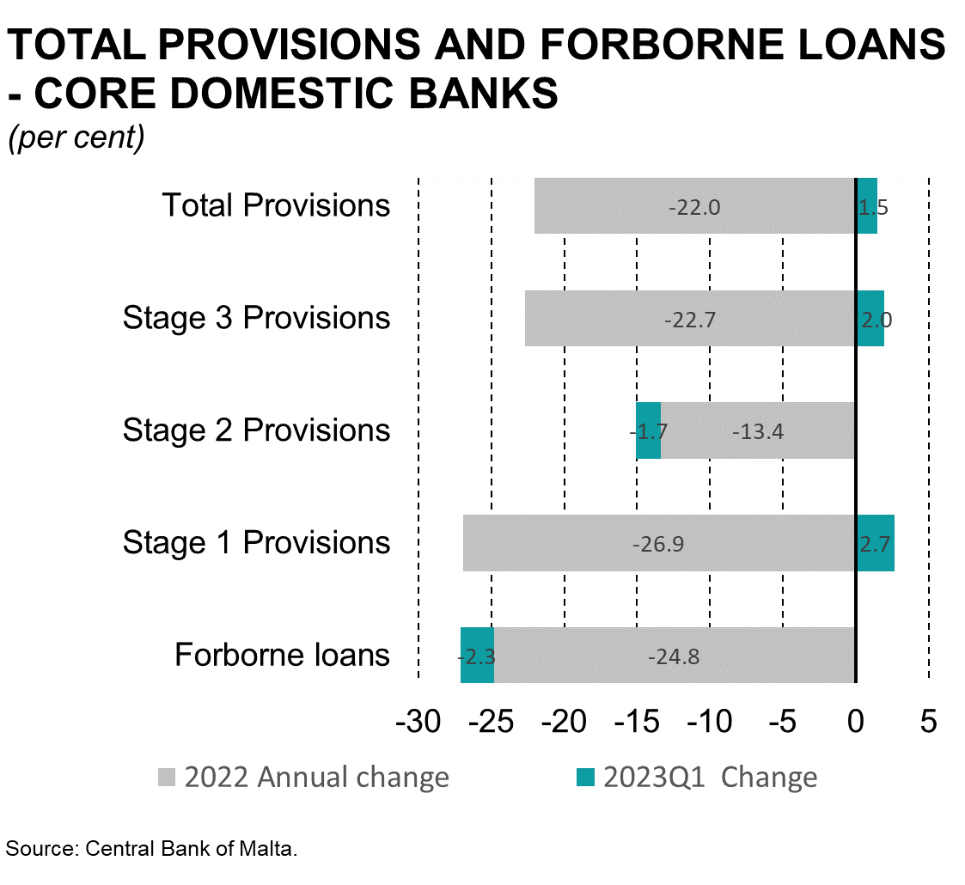
Quality of loan books improved
EBA 5% Threshold for NPL Reduction Strategy
Notes:
SL 5 - Quality of loan books improved
LHS - NPL Ratios:
The quality of the loan books improved, and the balance sheets of the core banks are not showing any significant signs of weakness with an overall Non-Performing Loan ratio standing at around 2.7% in 2022 down from 3.5% a year earlier. The total coverage ratio also improved, and taking into consideration the collateral underlying such exposures, non-performing loans will be more than fully covered. To note however, that a slight increase in the NPL ratio was reported in the first quarter of 2023, but at 2.9% this remains significantly below the 2021 level.
RHS - Total provisions and Forborne Loans – Core Domestic Banks
As we can see on the right-hand side, last year overall provisions declined by 22% mainly due to larger drops in provisions for loans classified as IFRS Stage 3 (-22.7%) and Stage 1 (-26.9%). Meanwhile in the first quarter of 2023, provisions increased slightly, up by 1.5%, driven by Stage 3 and Stage 1 provisions)
Forborne loans also declined over the previous year, down by about 25% (24.8%), and dropped by a further 2.3% in Q1 2023. This mainly reflects the strong economic recovery from the pandemic shock. However, challenges remain, as inflationary pressures and the monetary policy response could affect borrowers’ repayment capabilities, resulting in a deterioration in asset quality.

Slide 22
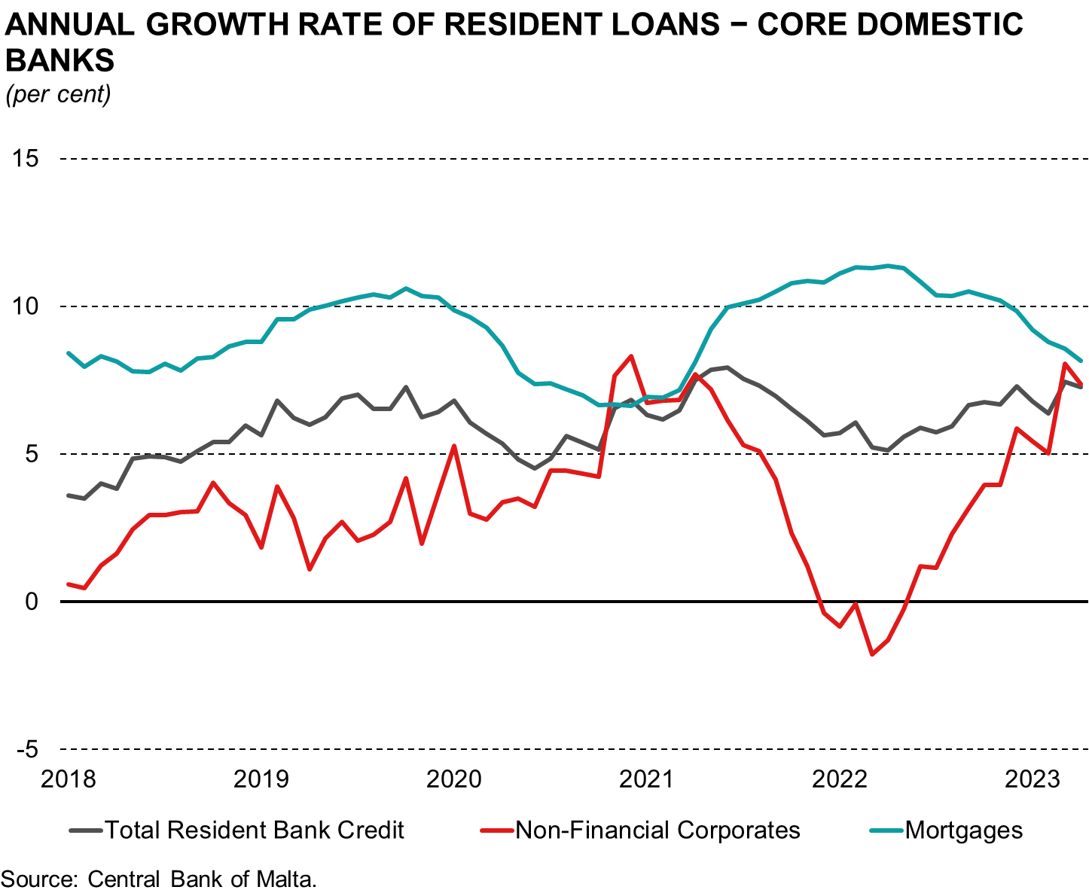
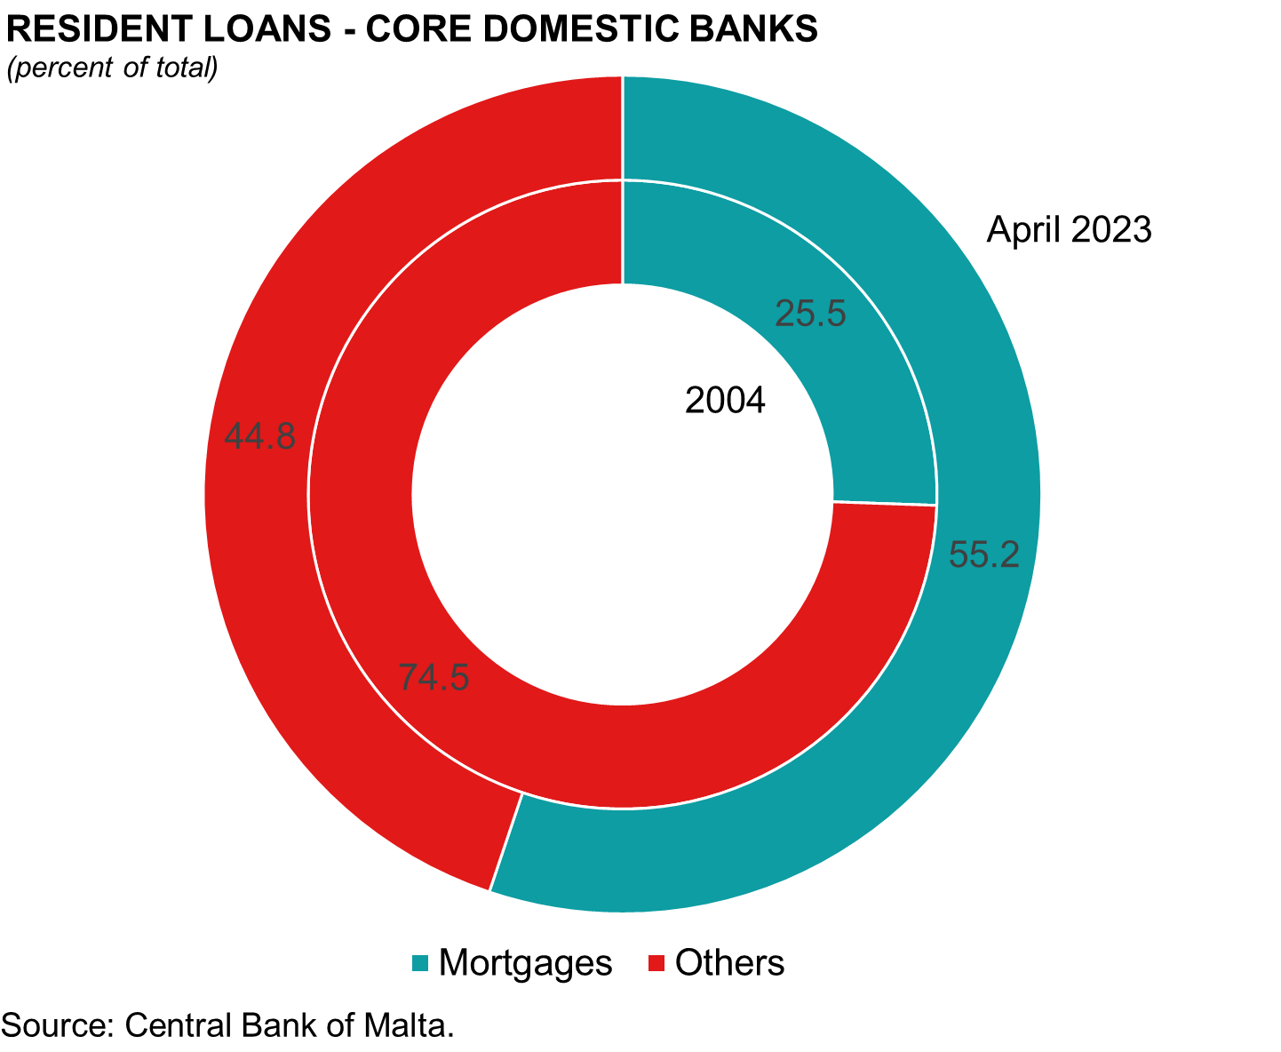
Growth in mortgages remained strong and NFC loans are recovering
Notes:
S6 - Growth in mortgages remained strong and NFC loans are recovering
LHS Annual Growth in Resident Loans – Core Domestic Banks:
Turning to credit dynamics. As can be seen in the left-hand panel, growth in resident lending by core domestic banks continued to trend upwards driven by strong, although decelerating, growth in mortgage lending. Such strong concentration in mortgage lending is clearly visible in the right-hand side where the share has risen to about 55% from 26% going back to the earliest comparable data of 2004.
Loans to corporates picked up momentum, growing by 7.4% in April 2023, mainly driven by the real estate sector, as projects are coming on stream due to pent-up demand following the pandemic.

Slide 23
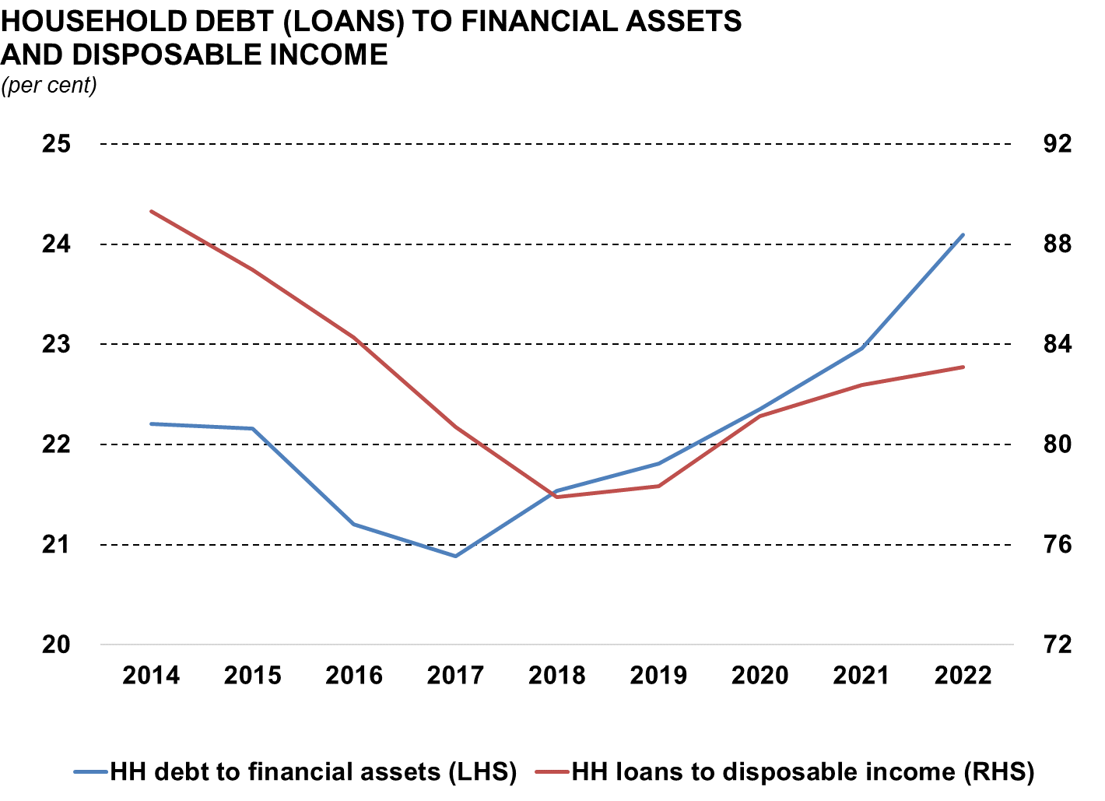
Households’ leverage is still rising…
Notes:
SL 7 - Households’ leverage still rising…
Households’ leverage is rising, and this has been growing since 2017. While households’ financial wealth remains strong, household debt has been growing at a faster pace than their financial assets and disposable income, leading to rising debt servicing costs. This must be also seen in the context of a rising interest rate environment.
Indeed, household debt-to-disposable income increased by 0.7 percentage points to 83.1% in December 2022, while household debt-to-financial assets rose by 1.1 percentage points to around 24%.

Slide 24



Implementation of a sectoral Systemic Risk Buffer in Malta
Instrument type | Scope and Application | Calibration | Measure Review
Targeted measure to increase bank resilience | Domestic mortgages to households secured by RRE Preserve existing capital | 1.5% on RWA of mortgages; subject to phase-in period | Review of the measure at least every 2 years
Notes:
SL 8 - Implementation of an sSyRB in Malta – (to integrate in another slide)
To address the rising cyclical risk and the increased concentration in banks’ loan books, the Central Bank together with the MFSA, agreed to implement a sectoral systemic risk buffer. This buffer is applicable to Maltese Banks involved in mortgage lending and is set at 1.5% of risk-weighted assets on mortgages with the first phase-in applicable in September of this year. The rate will rise to the full 1.5% in March 2024. With the implementation of this measure, the authorities are locking-in existing management buffers. Thus, banks are not expected to raise more capital to meet this buffer requirement. The measure will be reviewed at least every two years also taking into consideration market developments.
TO CONCLUDE, the sector remained resilient on the back of a recovery in profits, improved asset quality, ample liquidity as deposits continued to increase, and strong capital positions. This is also evidenced by the results of our stress tests which feature in our Financial Stability Report. Thank you for your attention.

Slide 25
Central Bank of Malta
Annual Report 2022
CBM Financial Results

Slide 26




Balance Sheet Development
Deposits by credit institutions
decreased by €1,863m to €5,844m
Government deposits
decreased by €234m to €573m
Balance sheet
contracted to
€10.47 billion
Mainly reflected by a decrease of €1,866m in the TARGET2 balance to €5,456m
Demand for banknotes increased by €171m to €2,302m
Notes:
As the Governor mentioned earlier on, the primary objective of Eurosystem central banks is that of achieving price stability. In 2022, the monetary policy stance of the Eurosystem and that of other central banks of advanced economies shifted rapidly, resulting in a rapid and steep rise in interest rates.
This shift in the monetary policy stance had an impact on the financial results of central banks, including that of Malta, which led to a contraction of €1.9bn in its balance sheet, largely driven by the response of credit institutions in making early repayments of TLTRO III borrowing, financed from deposits held with the Bank, after the favourable funding conditions ended late in the year.
Additionally, deposits of credit institutions with the Central Bank were also reduced partly to finance a one-off expense incurred during that year, as well as to purchase bonds after the rise in yields.
Government deposits with the Central Bank also decreased as the opportunity cost of holding liquidity increased as government bond yields rose rapidly in response to monetary policy tightening through the hike in interest rates.
These movements in the Central Bank balance sheet were partly offset by an 8% rise in demand for banknotes, reflecting the strong growth of the Maltese economy during that year, as was highlighted earlier by the Chief Economist.
As a result, the Bank’s TARGET 2 balance in the Eurosystem decreased to €5.5bn at the end of 2022.

Slide 27

Financial Result
Net interest and other income: €68.0 million
.
.
Realised gains and write-downs: -€32.9 million
.
2022 financial result
after the transfer
from provision
€0
Monetary income: -€26.8 million
.
.
Operating expenses: -€29.2 million
Release from provision: €20.9 million
Notes:
The shift in the monetary policy stance also impacted the Bank’s income and expenditure account for the year ending December 2022, recording a financial result of zero.
While financial assets of the Bank, acquired in recent years at a time when yields were low or even negative, continue to be held on the Bank’s books with the same coupon, remuneration on deposits held at the Central Bank responds instantaneously to the Monetary Policy tightening by the Eurosystem, with remuneration rates on deposits at the Central Bank switching from a negative to a positive rate by the end of summer. Currently the DFR stands at 3%.
This development was reflected across the Euro area, such that monetary income pooled for the whole Eurosytem took a hit, which for the Central Bank of Malta meant a more adverse impact of €9.4m on monetary income compared to the previous year.
Furthermore, the rapid unwinding of the accommodative monetary policy stance in 2022 resulted in a sharp fall in bond prices globally, which led to write-downs in the value of such assets, impacting negatively the CBM financial result by €32.9m.
Meanwhile, the Bank’s operational costs increased by €1.4m or 5.8%, but less than the rate of inflation. Most of the increase in expenditure was attributable to higher IT-related costs from the Bank’s investment in modernising its operating infrastructure in recent years, including the introduction of a dedicated Treasury Management System towards the end of 2022. On the other hand, increases in staff costs remained contained at just 2.3%.
As a result of these developments, the Bank released €20.9m from its provision for financial risks, which it had accumulated from profits set aside during the previous ten years, building a cushion of €128.8m to deploy in circumstances as those experienced last year, where the adverse effects of the interest income mismatch arising from the assets and liabilities held on the Bank’s balance sheet are expected to continue to persist for some time.

Slide 28
Central Bank of Malta
Annual Report 2022
Q&A

Slide 29
Central Bank of Malta
Annual Report 2022
Thank You!

Slide 30
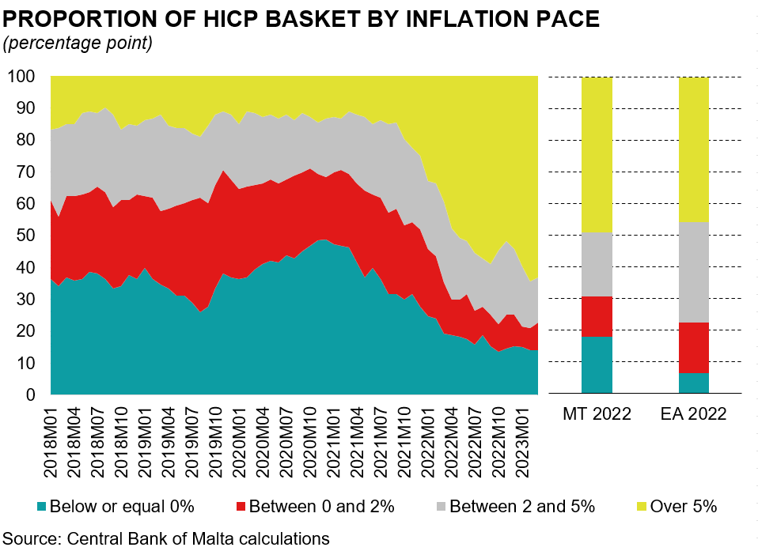
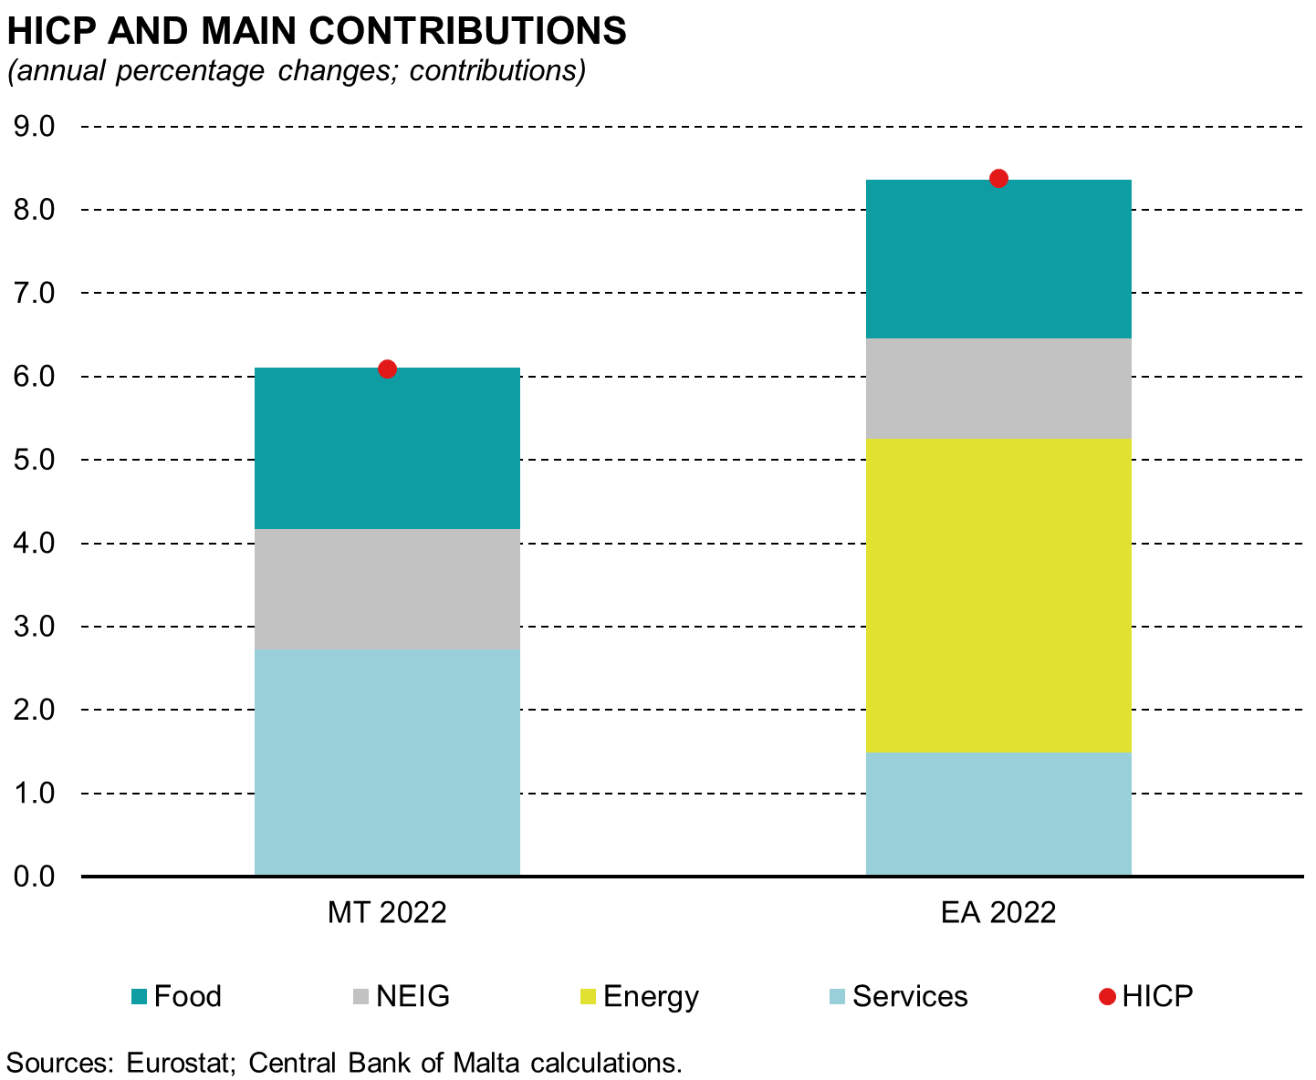
The share of subcomponents with annual increases of more than 5% increased
Notes:
The chart above shows a distribution of price changes whereby subcomponents of HICP are categorised into four classes of inflation rates: i) annual rates below or equal to 0%; ii) between 0 and 2%; iii) between 2% and 5% and iv) over 5%. This disaggregation indicates whether the recent surge in inflation is broad-based across HICP items or if it is driven only by selected components of the consumption basket.
In recent months, the share of subcomponents registering inflation rates in the lowest two inflation bands has declined in both Malta and the euro area. As a result, there has been a substantial rise in the share of subcomponents with year-on-year price increases of more than 5%.
Indeed in 2022, the share of items with inflation rates of more than 5% stood at 49.0% and 45.4% in Malta and the euro area respectively, up from 15.6% and 8.5% in 2021. Similarly, the share of items with inflation rates between 2% and 5% in the euro area has increased from 26.3% to 32.0%. On the other hand, the share of this interval for Malta decreased from 22.7% to 20.3% in 2022.
Furthermore, Malta’s inflation rate was below that of the euro area, in part due to certain subcomponents that are of an administrative nature, i.e., where prices are determined or partially determined by government. This is reflected in the share of items with stable or falling prices, shown by the teal shaded area.
The share of such items in Malta exceeds that of the euro area. Indeed, this stood at 18.0% for Malta, while it was 6.3% in the euro area. Apart from energy, the items falling in this interval include post-secondary and tertiary education as well as passenger transport by bus.

