Slide 1





2025-230

Slide 2

Objective
To improve the quality of life of families through the adoption of appropriate national policies and action plans
Why Families?
Families are the backbone of society.
The Family embraces the life course of individuals, from childhood to ageing.
It is the responsibility of Government to ensure that families are appropriately supported so that families continue to provide a nurturing environment, where individuals are able to grow and prosper.

Slide 3

Fostering Comprehensive Stakeholder Engagement
Initial Discussions in 2022 during a National pre-consultation Event
Final Pre-Consultation Event in January 2025 with key stakeholders
National Discussion Document 2024 that served for further Bi-Lateral Consultations
Interministerial Consultation in February 2025
2022
2025

Slide 4
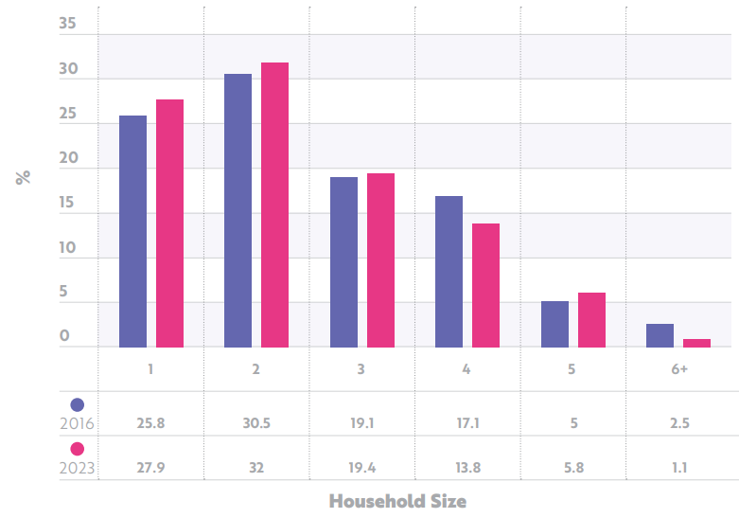
National Context: Demography
As of January 2024, the estimated population has reached 563,443.
Households with 2 persons are the majority, followed by single-person households.
The number of three-person households has remained stable, but there has been a reduction in larger households of 4 or more persons.
This reflects a decreasing fertility rate.

Slide 5
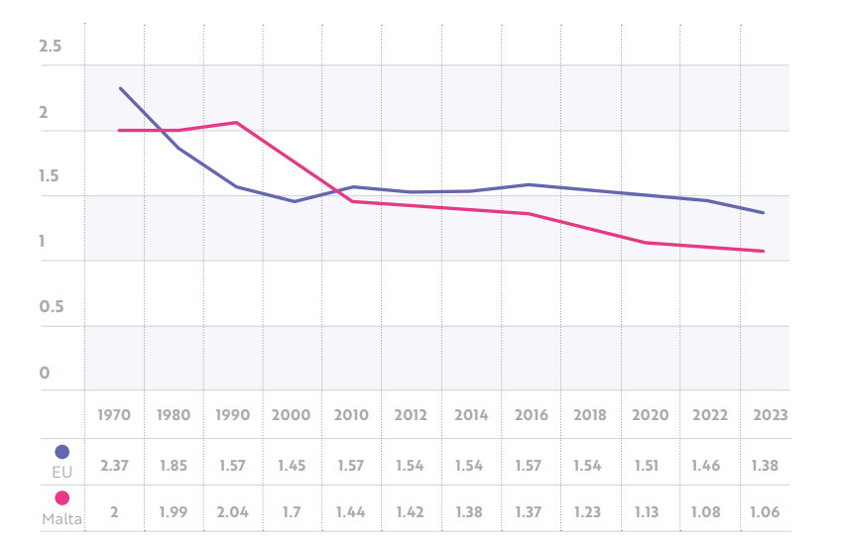
Fertility
The total fertility rate has now fallen to 1.06 births per woman in 2023, the lowest fertility rate in Europe, and one of the lowest globally.
Malta has also seen a long-term decline in the crude birth rate, which decreased from 9.6 in 2015 to 8.1 in 2023.
When the average fertility rate falls to 1.5, it could mark a critical threshold where a self-reinforcing cycle of declining fertility rates may perpetuate, leading to further decreases in future birth rates.

Slide 6
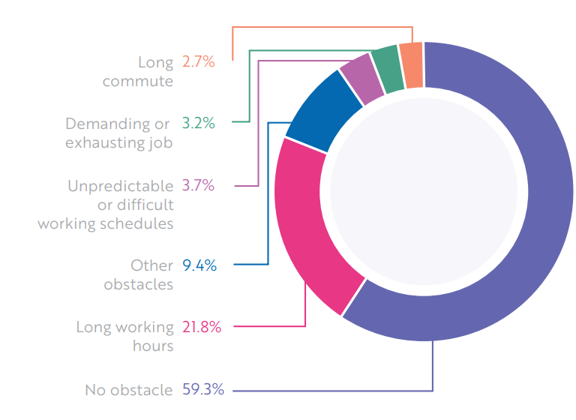
Labour Market
Data from the 2023 Labour Force Survey reveals an 87.1% employment rate for males and a 73.2% rate for females in the third quarter of 2023.
While the gender gap persists, it has narrowed down from 17.8% in 2020 to 13.8% in 2023.
Balancing Work and Family Life
Long working hours (21.8%) was the most common obstacle for reconciliating work and family life.
Share of persons teleworking more than doubled between 2019 and 2020 – COVID 19 Pandemic.

Slide 7
Proposed
National
Priorities
Social Justice for the Families
Healthy Relationships
Empowerment through Knowledge and Skills
Enhancing Malta’s Fertility Rate
71 New Policy Actions
The proposed Social Plan for the Families prioritises the following four main themes on which to design the required actions and measures:

Slide 8
Social Justice: Flagship Measures
Family Assistance Fund
Inclusive Housing Market
Mentorship Programmes
Strengthening Coverage of Services

Slide 9
Healthy Relationships: Flagship Measures
Maternity, Paternity and Parental Leave
Paid time-off for Prenatal Appointments
Flexible Working or Reduced hours
The Perinatal Programme
Villages for the People

Slide 10
Empowerment: Flagship Measures
Inclusive Parenting Programmes
Leave for Parental Courses
Financial Capability Skills
Digital Safety Education

Slide 11
Enhancing Fertility: Flagship measures
Financial Incentives
Increase in Children’s Allowance
Housing and Home Improvement
Child Minding Allowance
Refund on Extracurricular Activities

Slide 12
1. High-Level Group established to oversee implementation and assess impact
- Includes key ministries, civil society reps, and family welfare experts
- Develops a monitoring framework with clear indicators and timelines
- Uses quantitative data and qualitative feedback (e.g., surveys, focus groups)
2. Biennial public reports ensure transparency and accountability
3. Feedback channels allow families to share experiences and concerns
- Ensures the Plan remains effective, adaptive, and family-focused.
Monitoring & Evaluation

Slide 13


THANK YOU
Ms Alexia Vella
Director General,
Strategy and Implementation,
MSPC

