Slide 1

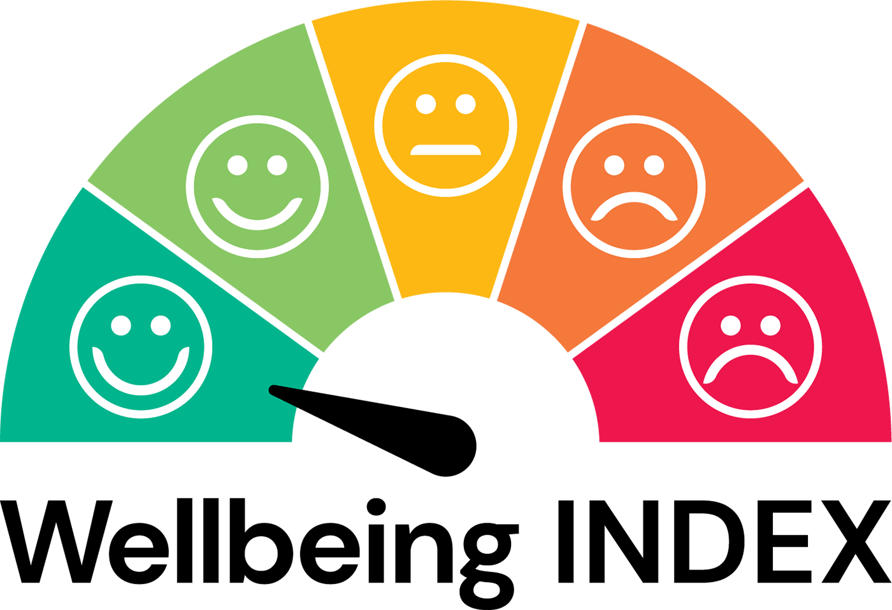



THE MALTA WELLBEING INDEX
Wellbeing Data in Policy
Prof. Marie Briguglio
With special thanks to:

Slide 2
INTRODUCTION

Slide 3
Wellbeing is on the agenda
At the 1st National Conference of the PFWS 2018 “There is a need for regular and robust national wellbeing statistics and research to compare the wellbeing of different segments of Maltese society, over time, and with other countries and to guide policy.”
Policy-makers worldwide increasingly see wellbeing as the overarching goal of public policy.
Richard Layard:
“It's in politicians' self-interest to make policies for happiness”
“It’s not the economy, stupid: wellbeing is the real vote-winner”
Notes:
Richard Layard: ‘It's in politicians' self-interest to make policies for happiness’ | Society books | The Guardian
It’s not the economy, stupid: wellbeing is the real vote-winner | Richard Layard | The Guardian
The general point, which has been confirmed by studies of European elections since the 1970s and studies of the Trump vote in the US, is that the higher their level of life satisfaction, the more people are likely to vote for the existing government – or parties currently in power. This explains more of the variation in election outcomes than the economy does. So people’s votes reflect more how they feel in terms of non-economic causes of their enjoyment of life than the economic causes. This is why the case for government making wellbeing their target is also based on their own self-interest. If it wants to be re-elected it should not just go for economic growth but all the things that matter to people.

Slide 4

Wellbeing policy is now a global movement
In 2011, the UN invited countries “to pursue the elaboration of additional measures that better capture the importance of the pursuit of happiness and wellbeing in development with a view to guiding their public policies” (UNGA, 2011, pp. 1).
In 2018 the 6th OECD World Forum on the future of wellbeing led to enhanced cooperation to contribute to the advancement of the measurement of wellbeing….
In 2019 EU council agreed “People’s wellbeing is a principal aim of the EU” demanding a wellbeing economy perspective, “a policy orientation and governance approach which aims to put people and their wellbeing at the centre of policy and decision-making…
NOW
Global efforts to move beyond GDP and to wellbeing policy, e.g. Wellbeing in SDG3, WEALL, UNECE, IMF, Economy of Francesco, UN Summit for the Future, OECD World Forum, EU Sustainable and Inclusive Wellbeing
Notes:
Mention 2025 SNA Update, Summit of the Future

Slide 5
Wellbeing can be measured
A complex, multi-faceted construct Pollard & Lee (2003)
“Wellbeing exists in two dimensions, subjective and objective. It comprises an individual’s experience of life as well as a comparison of life circumstances with social norms and values” WHO (2012)
Working definition of wellbeing “functioning well and feeling good”. Ryan and Deci (2001)
Linked to the way that wellbeing is now widely measured:
objective measures of the multidimensional conditions needed to flourish
subjective measures of how people evaluate their own lives and their feelings
e.g. OECD BLI
On a scale of 0-10 where 0 is not at all satisfied and 10 is completely satisfied, overall, how satisfied are you with your life these days?

Slide 6
2. OVERVIEW - WELLBEING INDEX

Slide 7
5 years of the wellbeing INDEX project yielded…
4 DETAILED REPORTS
5 POLICY BRIEFS
20+ ANNUAL DATA & INTERACTIVE CHARTS
6 CONFERENCES IN PARLIAMENT
6 INFO NOTES & 6 VIDEOS
1 RESEARCH NETWORK 1 STAKEHOLDER NETWORK
STAKEHOLDERS (17)
NEWS ARTICLES & MEDIA MENTIONS (80+)
CONFERENCES, SEMINARS, MEETINGS
TV, RADIO, NEWS, FESTIVALS, EXHIBITIONS
SCHOLARLY PUBLICATIONS
MAINTENANCE OF DATA, WEBSITE, OUTREACH
PUBLIC SECTOR TRAINING COURSE
REPOSITORY OF INTERVENTIONS
MOU NSO - UM - MFWS
RESEARCH VIA SCHOLARSHIP FUND
GLOBAL UPDATES

Slide 8
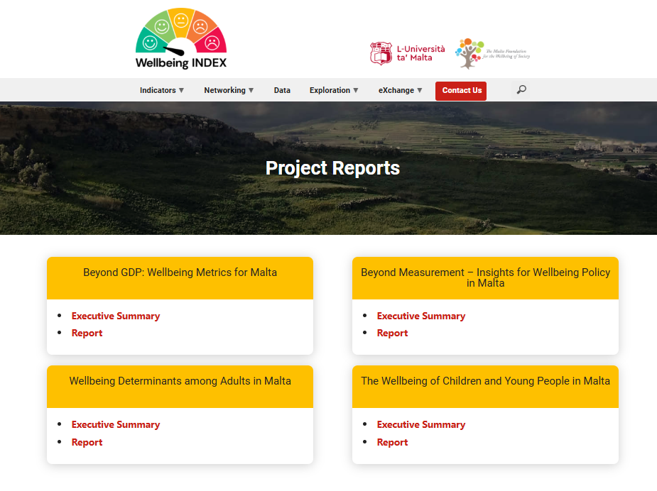

Slide 9
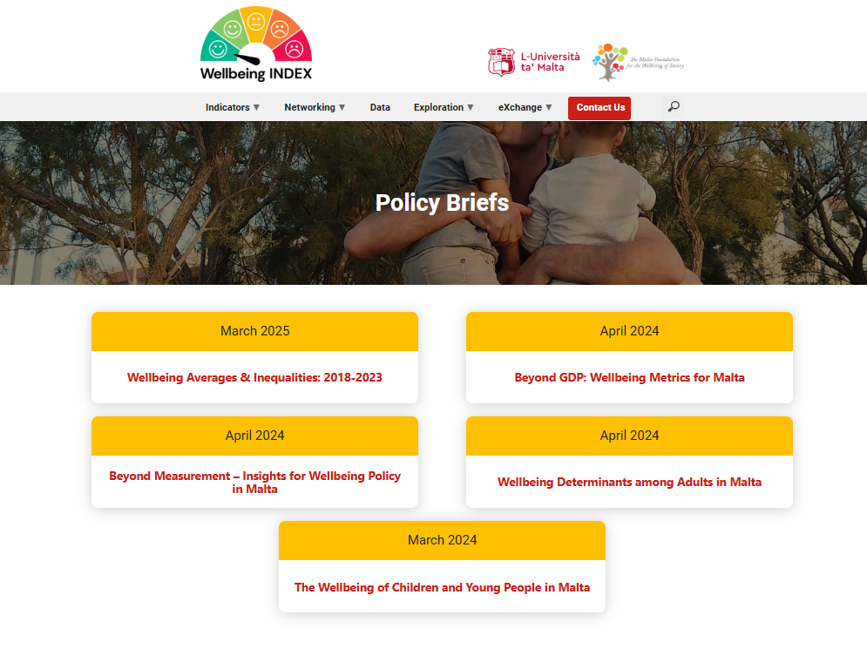

Slide 10
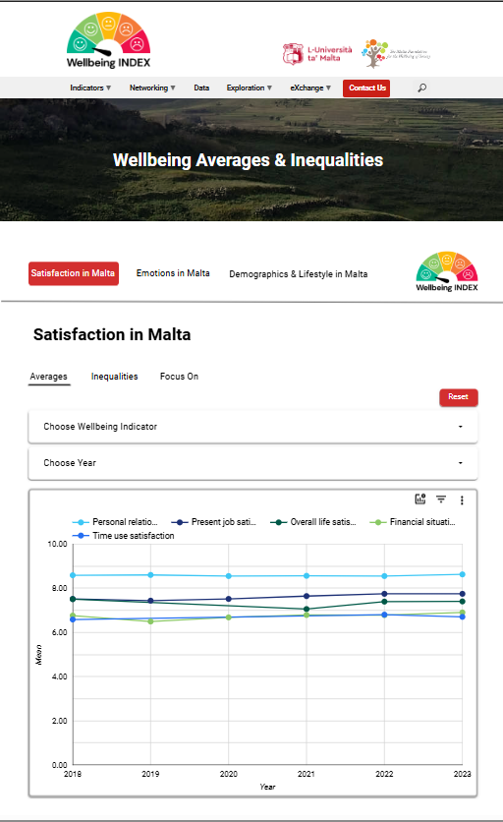

Slide 11
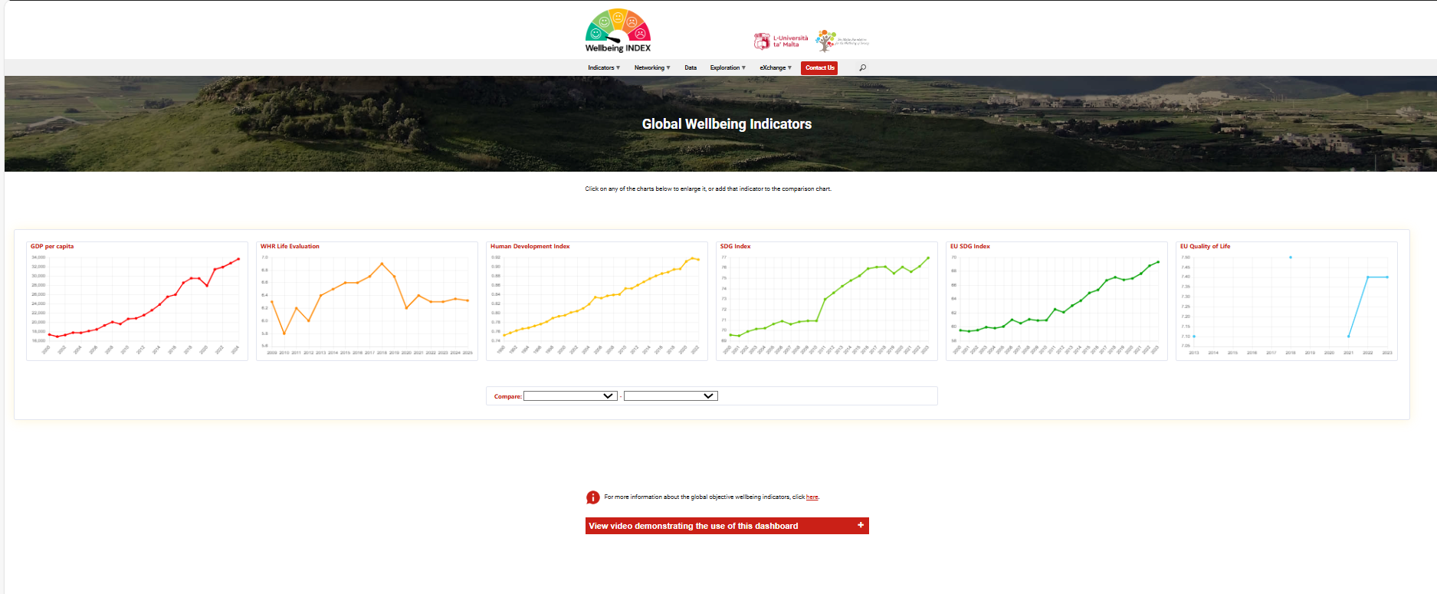

Slide 12
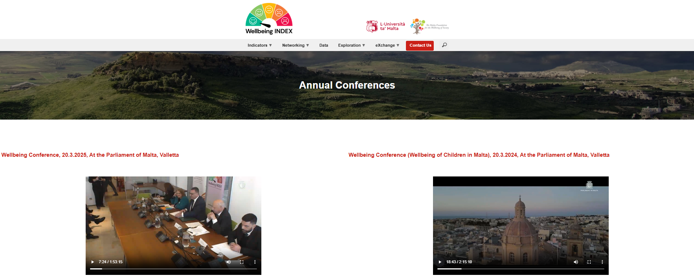

Slide 13
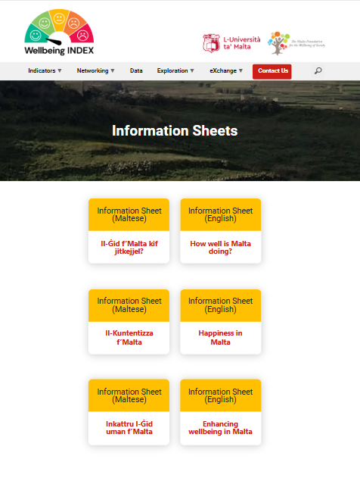

Slide 14
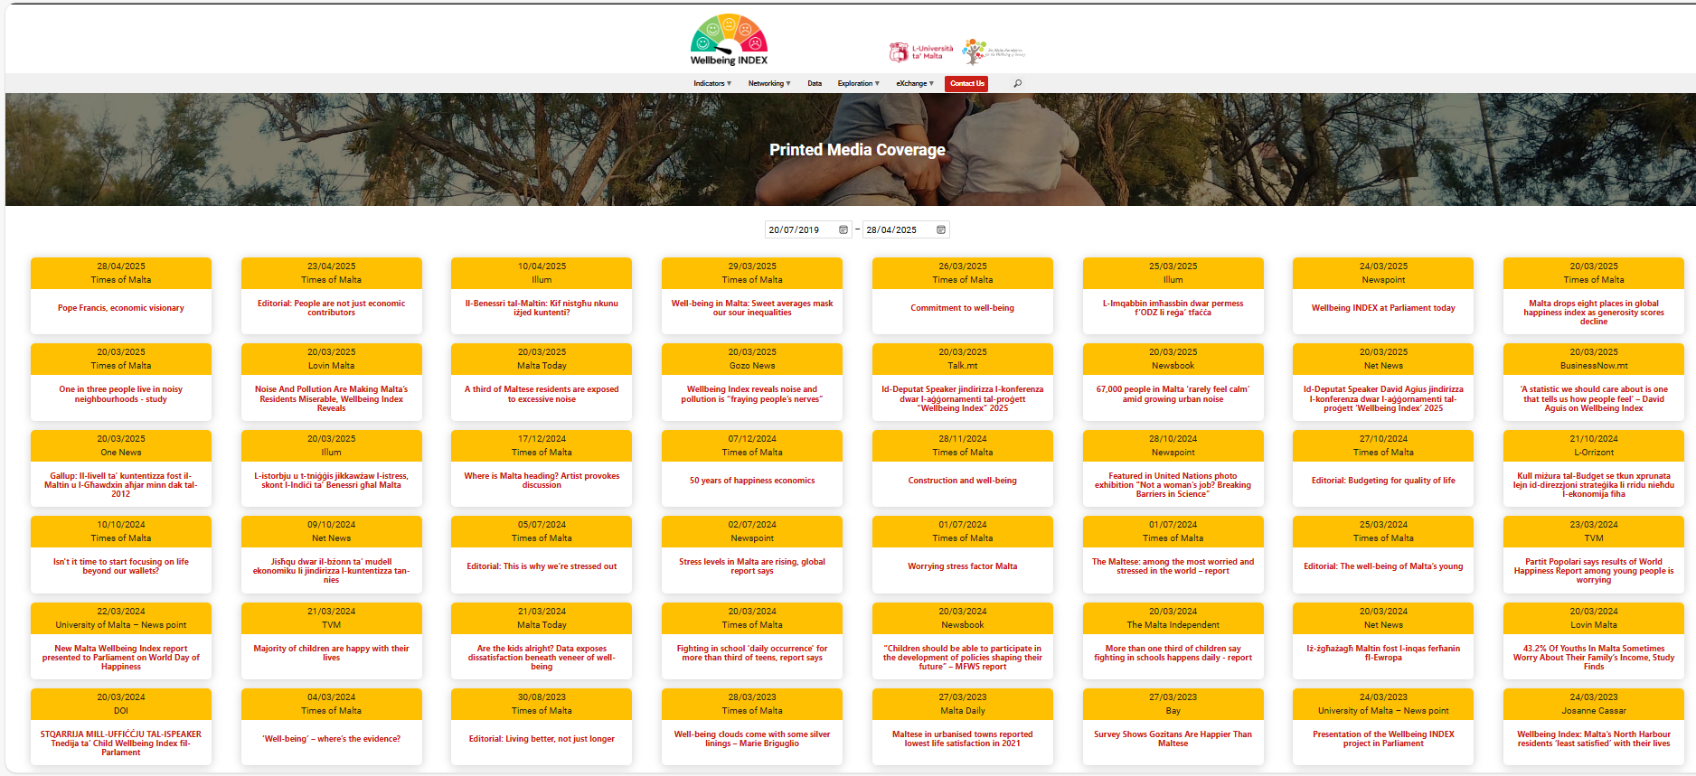

Slide 15

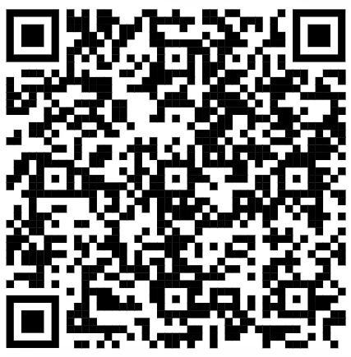
A growing stakeholder network
Annual Conference
Wellbeing Updates
Form part of the network
No commitment is required.
Stakeholders register their interest in the project.
https://wellbeingindex.mt/wp/networking/research-network/
Notes:
Wellbeing around the world and in Malta

Slide 16
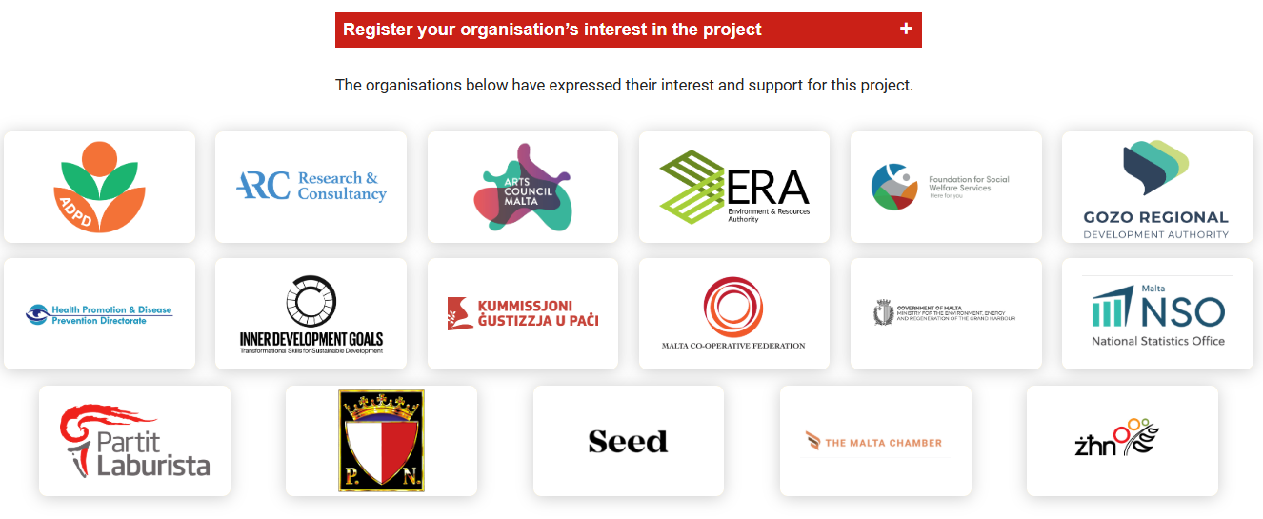

Slide 17

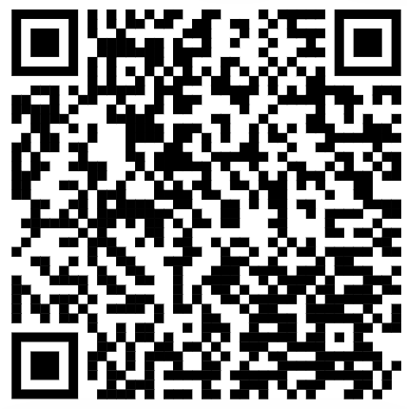
…Rising public involvement
Interested public can sign up for
Updates on the project (info sheets etc…)
Wellbeing in Malta (Data, insights, trends)
Global updates (Beyond GDP)
https://wellbeingindex.mt/wp/networking/subscribe/

Slide 18
3. A FOCUS ON THE DATA

Slide 19
Wellbeing data matters for policy
Data on how we are feeling beyond what we are doing
to inform evidence
to inform policy and Malta Vision

Slide 20
We do have data...
WHO WE ARE
Age
District
Sex
Equivalised Income
Dependent children
Country of Birth
Marital Status
Education Level
Employment
Perceived General Health
Crime, violence, vandalism Environmental problems
Dwelling problems
Material Deprivation
Voluntary Work
Leisure
HOW SATISFIED?
Life
Relationships
Job
Finances
Time use
HOW WE FEEL
Happy
Calm and peaceful
Downhearted and depressed
Down in the dumps
Nervous
Lonely
EU-SILC (Statistics on Income and Living Conditions), by the NSO using EU methodology
4,000 households, 10,000 people interviewed, followed for 4 years
Sampling frame: 2021 census (more foreigners than 2011).
Private households and their current members residing in Malta and Gozo
Caveats: Persons in institutions, Children <16, Foreigners undersampled but weighted
Time trends (over 6 years)
Distributions (histograms)
Disaggregations (inequalities)

Slide 21
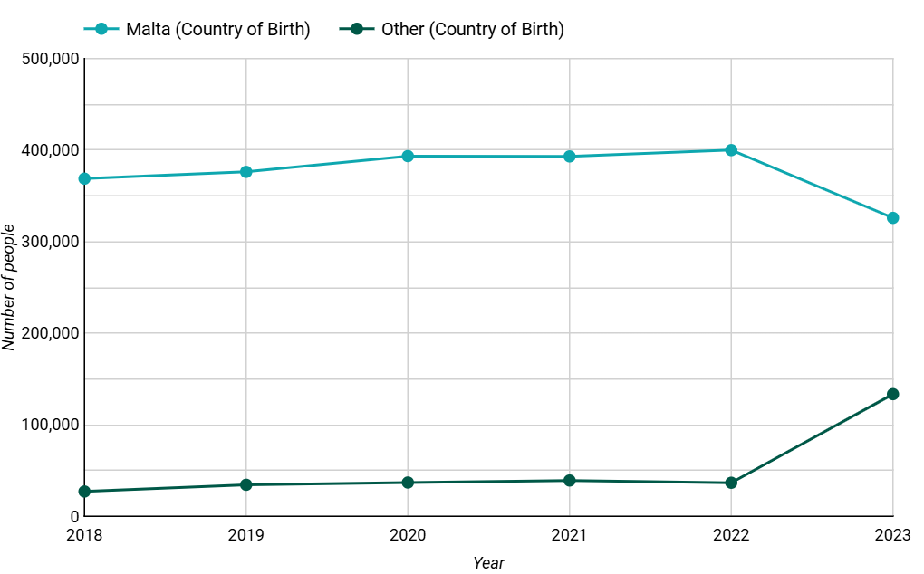
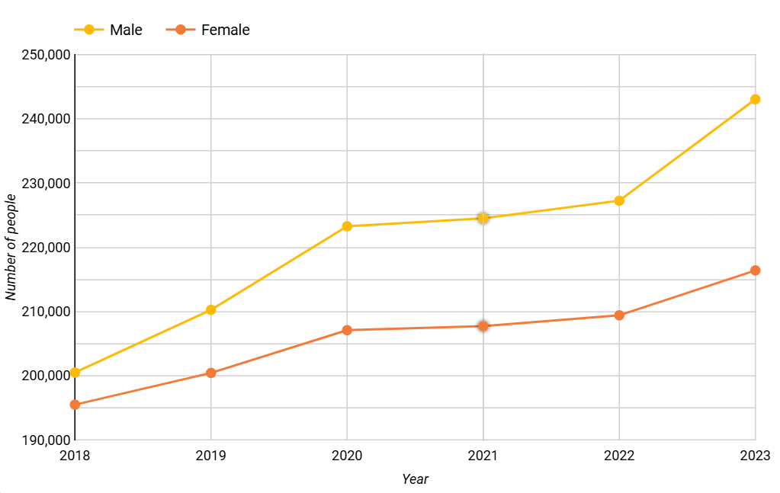
Malta is changing…
Country
Population increased
Larger number of foreigners now 133,446.
Increasingly more men than women (+26,650)
Ageing despite the influx of young foreigners.
NH and N take 50% of the population. Only 7.9% of the population live in Gozo (36,155)
Sex

Slide 22
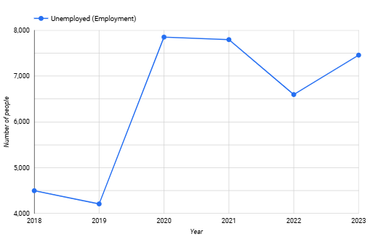
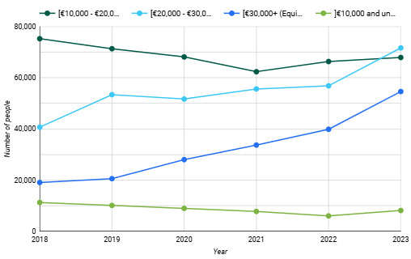
We’re getting richer…
Unemployment
Unemployed declining after COVID
People richer, yet 8,079 earn <10K.
Deprivation stabilized at 40,990
Key correlates of wellbeing.
Income

Slide 23
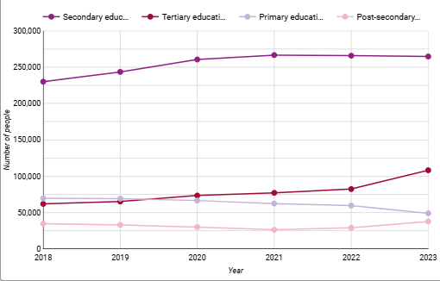
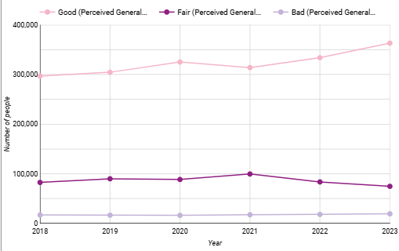
…more educated & healthier
Education
The population became more educated on average during these 6 years.
People with bad health declined 2018 to 2020, but increasing after the pandemic. Currently 19,015 are ill or very ill - not living in institutions.
Key correlates of wellbeing.
Health

Slide 24
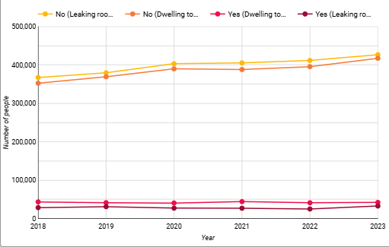
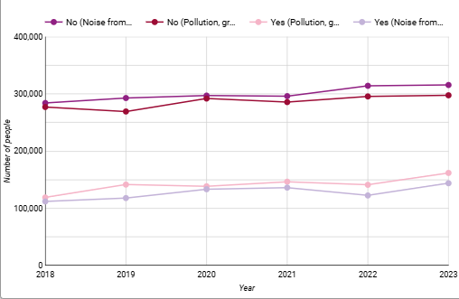
Better inside, worse outside
Dwelling
Housing Fewer people living in poor housing (leaking roof and dwellings without light) but 42,069 live in a dark dwelling and 32,771 leaking roof
Crime People living near crime decreased till 2021 and then increased in 2022 and 2023
Noise and Pollution Far more people living with noise (143,684) and pollution (161,708).
Key correlates of wellbeing.
Environment

Slide 25
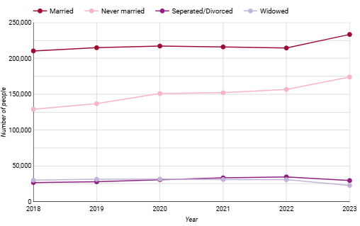
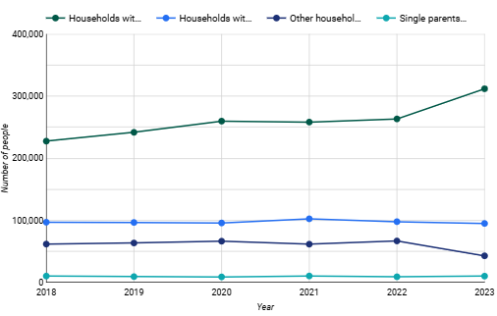
Less family, more friends
Status
Marriage Increase in separations/divorce.
Children The number of people having children in decline.
Social Getting together with friends/family for a drink/meal decreased in COVID and then increase
Leisure People who don’t afford to regularly participate in a leisure activity decreasing
Volunteering - the number of people who do no volunteer at all has increased
Children

Slide 26
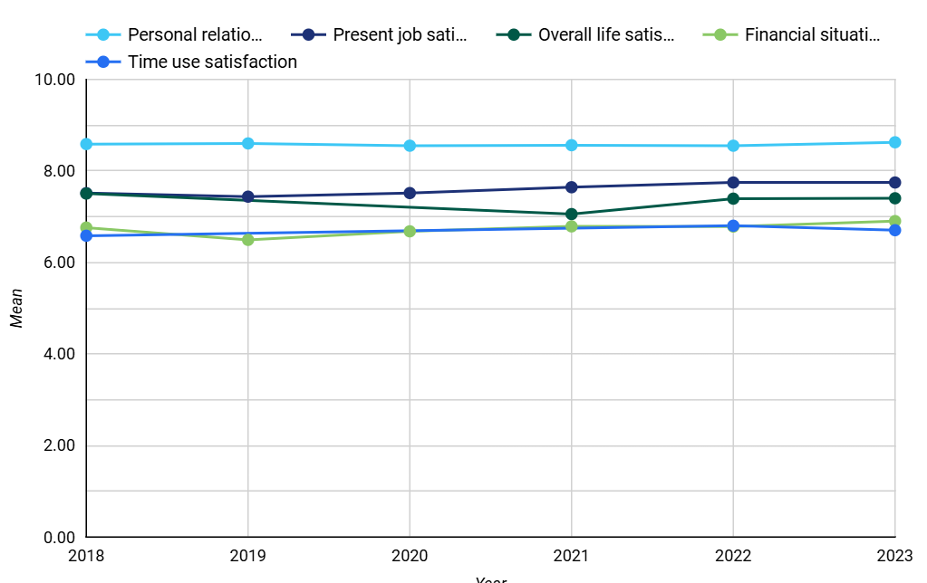
We’re slightly more satisfied - except with time
5 satisfaction indicators
In 2023, relative to 2022
We did better on personal relationship and financial satisfaction.
We flat-lined on life satisfaction and job satisfaction.
We did worse on time satisfaction - where we were already low.
Notes:
Sodisfazzjon bil-ħajja, bis-sitwazzjoni finanzjarja tad-dar, bix-xogħol attwali tiegħek, bir-relazzjoni personali mal-familja, ħbieb, ġirien u nies oħra li taf
nervuż/a u aġitat/a, kalm/a u seren/a, qalbek maqtugħa u dipressat/a, ferħan/a, tħossok waħdek

Slide 27
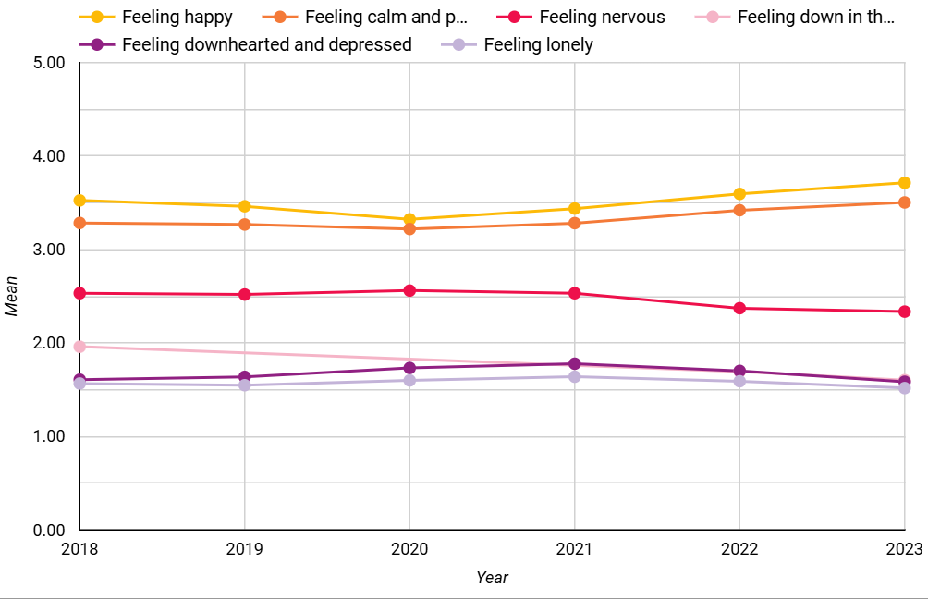
We feel positive more often, negative less often
6 emotion indicators
In 2023, relative to 2022, all trends are positive - marginally.
Notes:
Sodisfazzjon bil-ħajja, bis-sitwazzjoni finanzjarja tad-dar, bix-xogħol attwali tiegħek, bir-relazzjoni personali mal-familja, ħbieb, ġirien u nies oħra li taf
nervuż/a u aġitat/a, kalm/a u seren/a, qalbek maqtugħa u dipressat/a, ferħan/a, tħossok waħdek

Slide 28
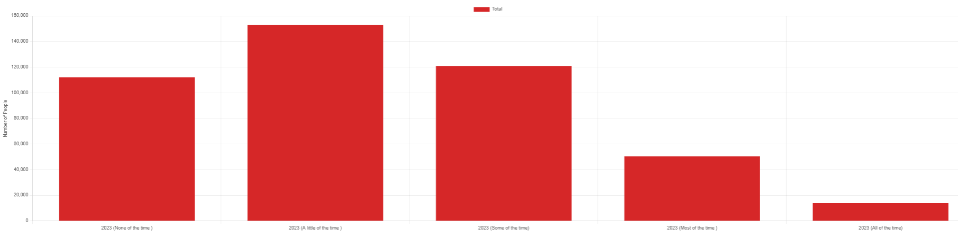
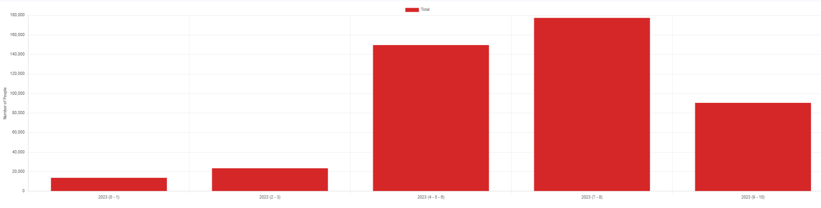
But a small % of REAL people…
Nervous
Feeling
nervous: 64,178 people feel nervous all or most of the time; a further 120,854 at least some of the time
down: 19,944 downhearted and depressed all or most lonely: 13,110 feel lonely most or all of the time
calm: 67,703 people feel calm only little or none of time
happy: 29,820 feel happy only little or none of time
Satisfaction with
time 37,110 have time satisfaction less than 4
finance: 24,639 have financial satisfaction at less 4
life: absolute misery increased (0-1) 8323 (5398 in 2022)
Time use
Notes:
Feeling nervous axis: None of the time, A little of the time, Some of the time, Most of the time, All of the time
Time use axis: 0-1, 2-3, 4-6, 7-8, 9-10

Slide 29
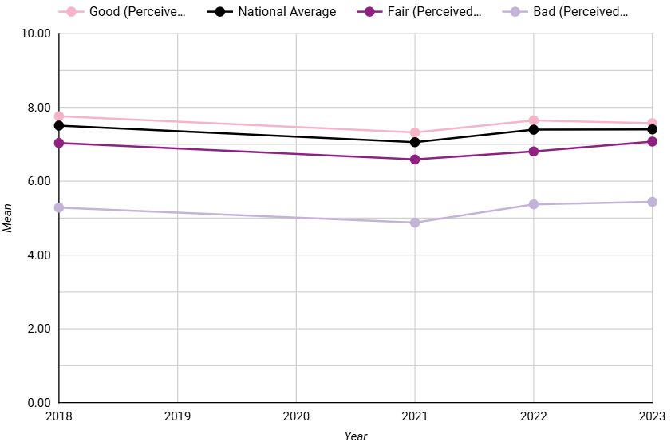
Lower life satisfaction if we have bad health
People in bad health consistently do much worse on ALL indicators (less on time use).
For instance, life satisfaction of those with bad health around 2
points lower on the 11-point scale.
Notes:
LS by health

Slide 30
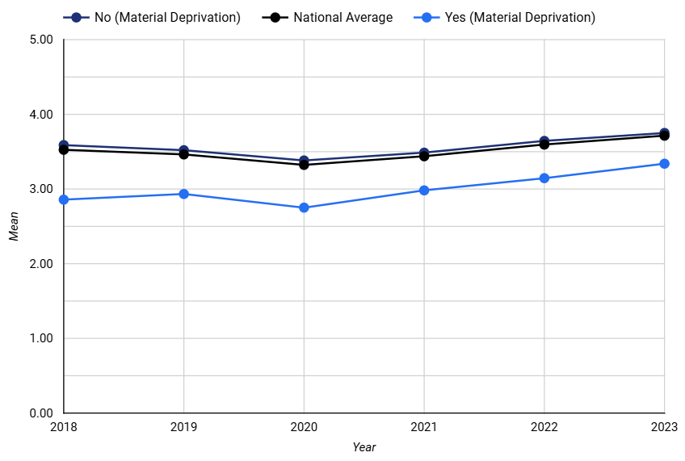
Lower happiness among materially deprived
Material deprivation
results in significantly lower satisfaction on all 5 indicators, less positive
and more negative emotions.
Notes:
Feeling happy by MSD

Slide 31
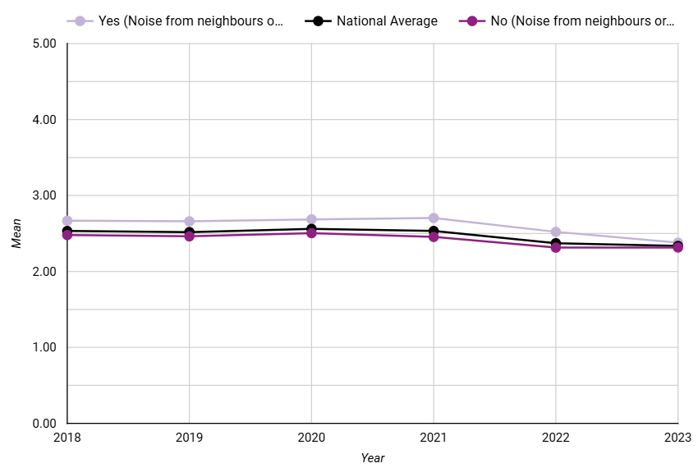
More frequently nervous if we live in noise
Poor housing associated with more negative emotions and
satisfactions - link to income and material deprivation.
Noise and pollution makes a difference to levels of nervousness.
Crime also linked to lower satisfactions in all domains and negative emotions.

Slide 32
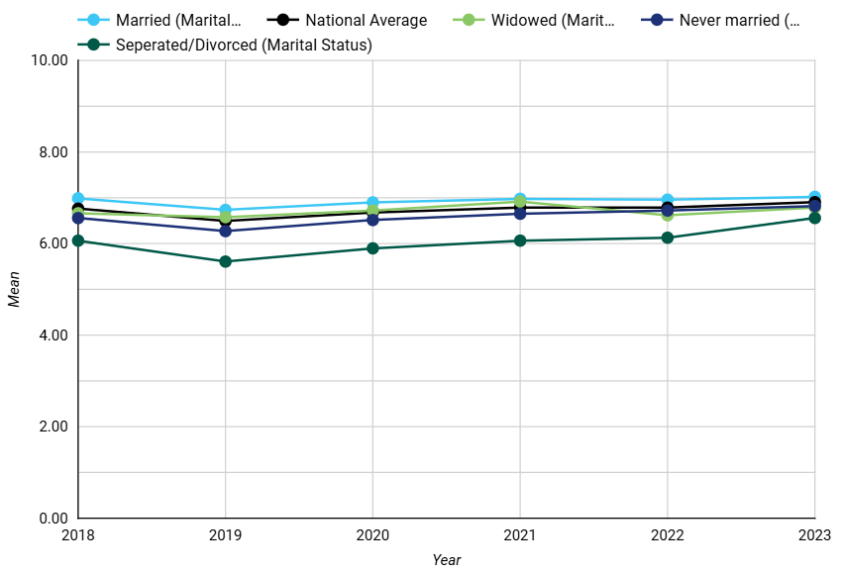
Lower financial satisfaction for separated/divorced
Married and singles do better on most indicators.
Never married less satisfied with their relationships but experience more positive and less negative emotions.
Separated/divorced do worse on all indicators.
Widows high time use satisfaction, high loneliness.
Notes:
Financial satisfaction by Marital Status & Children

Slide 33
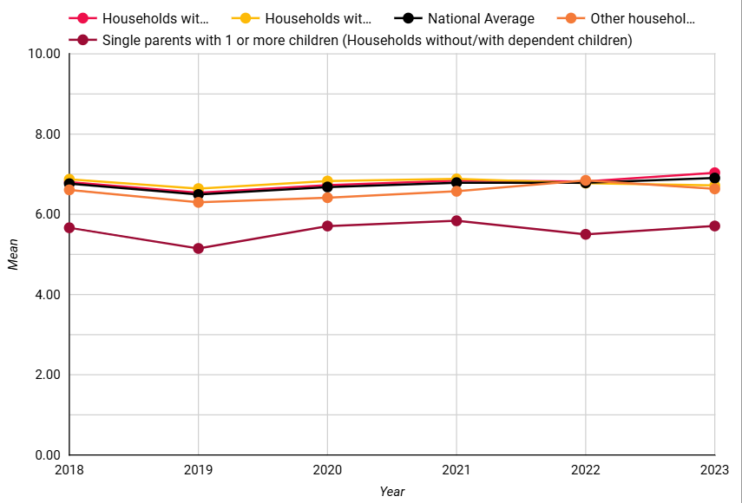
Lower financial satisfaction for single parents
Households with children report higher life relationship satisfaction and more positive emotions.
Single parents score badly on almost all fronts.
Notes:
Financial satisfaction by Marital Status & Children

Slide 34
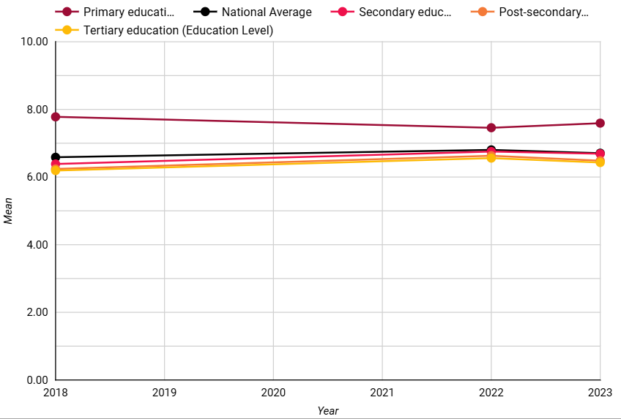
Higher time use satisfaction if low educated
Tertiary educated have higher frequency of positive emotions and a lower frequency of negative emotions.
Financial, job and life satisfaction increase with increasing education, but time use satisfaction falls
Highest satisfaction in time use among primary educate.
Notes:
Time use by education

Slide 35
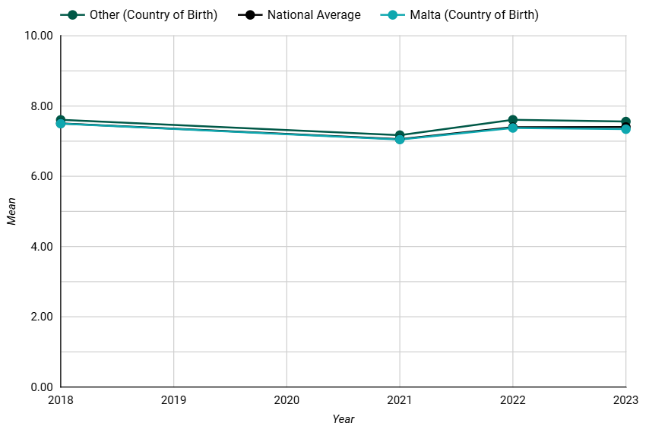
Higher life satisfaction among foreigners
Foreigners consistently have slightly higher life satisfaction, feel more positive and less negative emotions than those born in Malta.
Notes:
LS by Country of Birth

Slide 36
4. KEY TAKEAWAYS FOR POLICY

Slide 37
What has INDEX suggested to date?
Regularly report data on subjective wellbeing and inequality - disaggregation and longitudinal.
Improve data collection on underrepresented groups, including children.
Tackle wellbeing issues: income, health, housing, noise, social interaction, and time satisfaction.
Integrate wellbeing into core policy visions and forthcoming legislation.
Include wellbeing and mental health as a key educational objective.
Subject legislation and policy as well as annual budget to wellbeing impact assessments.
Build capacity and offer training opportunities for all key players involved.
Champion for wellbeing, integrate wellbeing within policy framework.
Develop policy for mental health of children and young people & strategy to promote sport and nature.
Engage in international developments to ensure relevance to Malta.
Notes:
A national policy on the promotion of mental health of children and young people, drawn up by an inter-ministerial committee together with the children and young people themselves, and in consultation with parents, schools, the community and mental health services. Such a policy needs to recognise that mental health is a right for all children and young people.
This policy may also include a national strategy to promote physical exercise, sports and nature-based activities for children and young people.
A whole school, systemic approach to wellbeing and mental health requires the mobilisation of the whole school community in collaboration with other stakeholders, in promoting the wellbeing of all its members.

Slide 38
Where can we do better (by global comparison)?
SDGs: Underachievement in science, research and development, obesity, environmental, corruption perceptions, work accidents/deaths and inequality (Lafrortune et. al, 2024).
OECD’s Better Life Index: Long hours of work, low school-leaving age/educational attainment, poor environmental quality, inequality and obesity (Justice and Peace Commission, 2020).
In the WHR, Malta ranks poorly on corruption perceptions (Helliwell et al, 2023).
In Gallup Emotions Survey, 64% of the Maltese reported experiencing a lot of worry - in contrast with 42% world average. Maltese people also show low frequencies of enjoyment and high frequencies of negative affect. (Gallup, 2021).
Eurostat data also reveals people in Malta to feel nervous more often than the average European and feel less satisfied with their leisure time (Briguglio, 2022).
Children in Malta rank in the bottom third for all wellbeing domains for children in rich countries (mental well-being, physical health and skills), high rates of obesity (Gromada et al, 2020) least likely to agree that there are enough places to play (Briguglio, 2020).

Slide 39
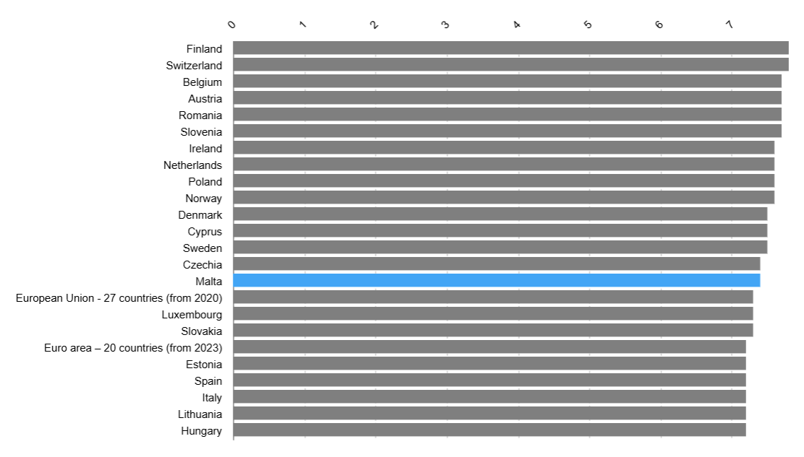
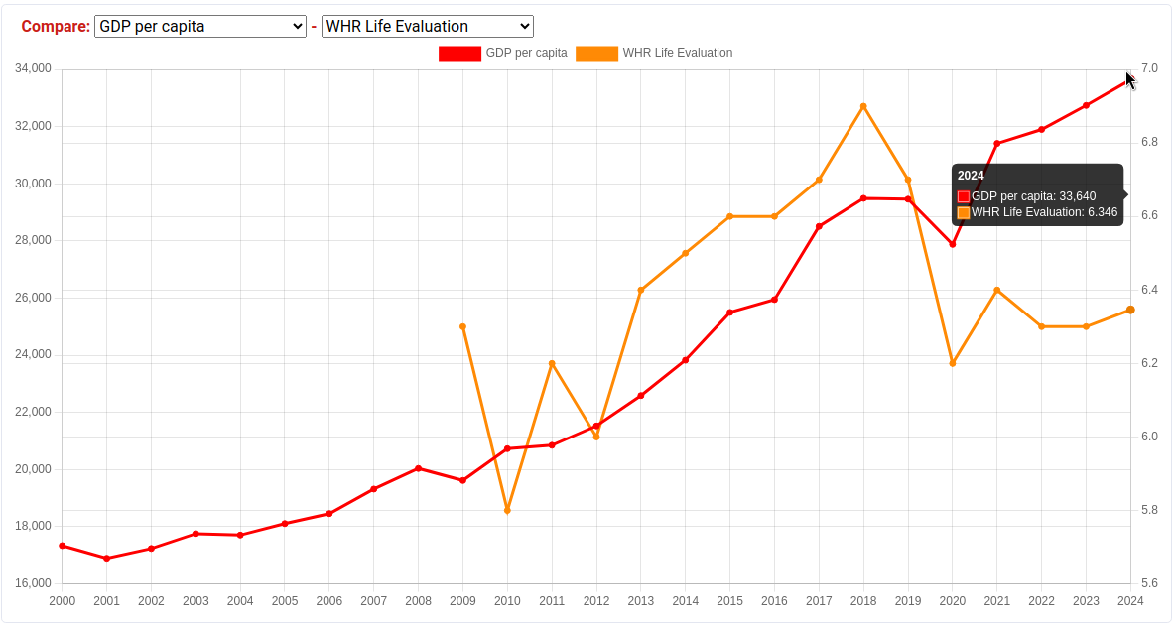
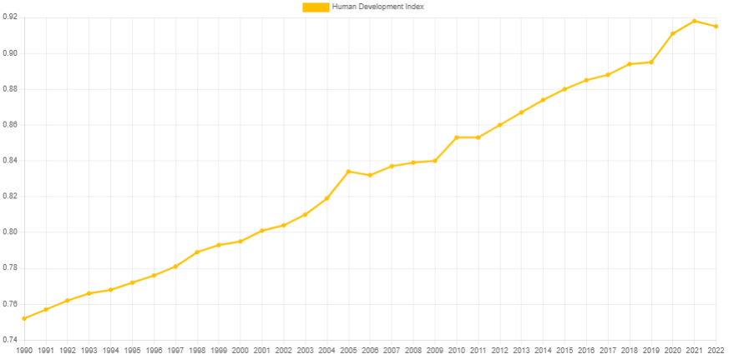
How does this link to Vision 2050?
Malta aims to reach
The top five EU countries in terms of overall life satisfaction (Current 15th)
Top 20 in the global Human Development Index rankings, by 2050, top 10 (Current 24th).
Median disposable income to reach 135% of the EU27 average by 2050, up from 93% in 2023.

Slide 40
Reflections on Vision 2050
On global trends: Malta joining the OECD means the Better Life Index will be an important metric
On the definition & measurement of wellbeing: Beyond average life satisfaction consider subjective indicators (emotion), objective wellbeing determinants, & disaggregations.
On the interventions: See underperforming areas for quality of life/wellbeing endgames.
On Streamlining strategies: Flag the conflicts; Identify tensions between future generation goals and present ones. Extend ambition beyond existing strategies.
On governance: Emphasis on evidence, wellbeing impact assessment. Need for capacity building the public sector, monitoring and enforcement.
On public sentiment analysis: Missing inputs of children, underrepresented groups.
Notes:
For instance, the 2017 Children’s Policy aimed to promote the rights of children and “their overall wellbeing” (Ministry for the Family, Children’s rights and Social Solidarity, 2017, pg. 4), the 2020 environmental vision for Malta has been called “Wellbeing First” (Environment and Resource Authority, 2020), the 2021 Smart Specialisation strategy features “Health and Wellbeing” as one of six areas of focus (The Malta Council for Science & Technology, 2021), the new Social Vision for Malta 2035, was crafted “with the ultimate objective being to improve social wellbeing and provide a better quality of life to citizens” (Ministry for Social Policy and Children’s Rights, 2022, pg. 9).
Given the increased emphasis on wellbeing measurement and policy at EU level, (European Commission, 2023), and at UN level (UNECE, 2023), it is likely that these issues will acquire increased importance in Malta’s policy-making agenda. In late 2023, Malta also announced its intention to join the OECD (Ellul 2023), paving the way for its participation in a multidimensional, internationally comparable wellbeing index as part of the Better Life Index initiative.

Slide 41


Thank You
www.wellbeingindex.mt
wellbeingindex@um.edu.mt
With special thanks to:

