Slide 1

MARAM
Multi-Agency Risk Assessment Meeting
September 2024

Slide 2
Multi-Agency Risk Assessment Meeting
Ms. Ruth Sciberras – Chairperson
Ms. Colette Farrugia Bennett – Vice Chair
Assisted by: Mr. Jean Taliana & Ms. Mandy Micallef - MARAM Coordinators

Slide 3
Timeline 2023-2024
Feb. 2023
Inquiry by Magistrate Geoffrey Valencia and Ms Ruth Sciberras appointed as Chairperson.
Feb. 2023
Entities – DVU, STOP, MPF, Education, Health, DPP, Sedqa, CPS & VSA
DMO- Designated MARAM Officers
Apr. 2023
MARAM Coordinators.
June 2023 – 3rd September 2024
661 referred cases (40 MARAM meetings)

Slide 4
MARAM Roles
The Chair
Facilitates the meeting.
The MARAM Coordinators
Collates the referrals and sets the agenda.
Designated MARAM Officers (DMO)
Malta Police Force (GBDV), Child Protection Services, Health, Probation, Sedqa, Domestic Violence Unit, STOP, Education & Victim Support Agency . They submit referrals and gather updated information about the case, including from relevant NGO'S.

Slide 5
What is a Multi-Agency Risk Assessment Meeting (MARAM).
MARAM is a meeting where information is shared on victims at the highest risk of serious harm or murder as a result of domestic abuse.
The role of the MARAM is to facilitate, monitor and evaluate information sharing to enable appropriate actions to be taken to ensure public safety.
The responsibility is to take appropriate action with individual entities. The first steps with regards to the MARAM system involves the Risk Assessment Tool which requires a completion of all incidents of domestic violence. Risk Assessment is carried out by the risk assessors at the GBDVU.
If an individual is identified as ‘high risk’, key services meet for a MARAM review and decisions about future action is decided.

Slide 6
What is a Multi-Agency Risk Assessment Meeting (continued)…
At the heart is the assumption that no single entity or individual can see the complete picture of the life of a victim, but all may have insights that are crucial to their safety.
On average, 15-25 high-risk cases discussed every fortnight.

Slide 7
Why we share information...
Responsible information sharing is
Key to enable organisations and professionals to protect victims and their children.
It enables
Timely action to be taken before children are subjected to further abuse,
Risk assessment and safety planning having full knowledge of all the facts,
Entities to protect victims and children and allows them to feel confident that they can provide a safe, quality service to sufferers.

Slide 8
Benefits of a Multi-Agency Approach...
Multi-agency working is an effective approach to safeguarding and came about because tackling multiple areas of an individual’s situation is a much more effective way of improving it than placing all the emphasis on one particular area.
Early effective risk identification
Improved information sharing
Joint decision making
Coordinated action to assess, manage and reduce risk.

Slide 9
Benefits of a Multi-Agency Approach...
Early effective risk identification
Improved information sharing
Joint decision making
Coordinated action to assess, manage and reduce risk.

Slide 10
MARAM Referral Criteria
Visible High-Risk
Professional Judgement
Potential Escalation
Repeat Referrals

Slide 11
1.Disclosure of Domestic Abuse
2.Some entities take immediate safety actions e.g. DVU, Police & Child Protection
4.Case meets MARAM referral threshold
5.Designated MARAM Officer (DMO) makes referral to MARAM Coordinator
6.MARAM Coordinator prepares agenda
7.DVU/VSA contact Victim
8.Information is researched and gathered by the DMO within each organisation...
3.Risk indicator checklist completed with victim
The MARAM
Process

Slide 12
Outcomes of MARAM
To share information to increase the safety, health and wellbeing of high-risk victims, adults and their children.
To determine whether the perpetrator poses a significant risk to any particular individual or to the general community.
To jointly construct and implement a risk management plan that provides professional support to all those identified are at high-risk to reduce the risk of harm.
To reduce repeat-victimisation/repeat-offending.
To improve agency accountability & support for professionals involved in high-risk domestic abuse cases.
To provide an audit trail.

Slide 13
MARAM
Statistics: 40 Meetings June 2023 – 3rd September 2024
YEAR | Cases discussed during MARAM | Female Victims | Male Victims | Children involved in cases
June - Dec 2023 | 267 | 246 | 21 | 273
Jan- August 2024 | 394 | 373 | 21 | 376
Total | 661 | 619 (93.65 %) | 42 (6.35 %) | 649

Slide 14
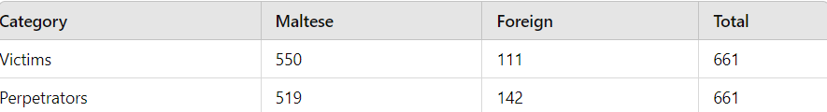
Maltese / Foreigners referred to MARAM
June 2023 – August 2024

Slide 15
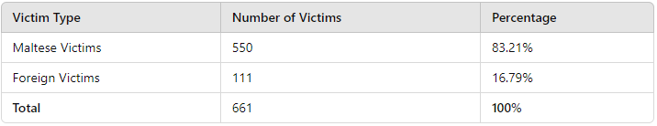
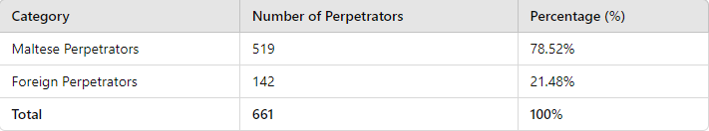
Percentages – Maltese/ Foreign

Slide 16

MARAM
Type of cases
YEAR | Cases discussed during MARAM | *IPV | *CPV (Minors under age of 18) | *CPV (Adult child) | *CPV total | Parent to child | Other relative | Siblings
June - Dec 2023 | 267 | 233 | 3 | 19 | 22 | 7 | 2 | 3
Jan- August 2024 | 394 | 361 | 6 | 18 | 23 | 1 | 2 | 7
Total | 661 | 594 | 9 | 37 | 45 | 8 | 4 | 10

Slide 17
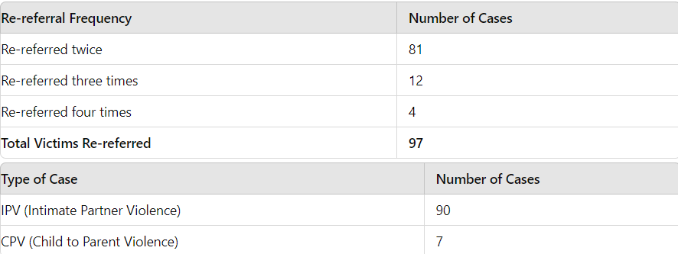
Repeat Cases

Slide 18
Flagged Cases
So far in 2024 a total of
14 cases
were flagged
to Court.

Slide 19
MARAM TRAINING
Visit to Bedfordshire Police and MK-Act Domestic Abuse Intervention Service held between the 3rd and 7th of July 2023.
To observe the Bedfordshire Police and how they handle a MARAM with other stakeholders involved,
Furthermore, MARAM administration attended for a one-day training at MK-Act (specialist domestic violence service in Milton Keynes). This training provided a deeper understanding of the process and role of MARAC, which entails sharing all relevant information about a victim, representatives discuss options for increasing safety for the victim and turn these options into a coordinated action plan. The principles of an effective MARAC were thus shared, for us to be able to implement such a system to our recently established MARAM in Malta.
Back in Malta this training was then shared with over 120 professionals from different entities.

Slide 20
MARAM Training & Public Outreach Overview
All Designated MARAM Officers
Risk Assessors
NGO's & Shelter Professionals
Child Protection Services
Social Care Standards Authority Staff
Gozo Police
GBDV Police Officials
Perinatal Mental Health
FSWS Gozo
TV & Radio Presence: Chairperson and MARAM administration regularly engage in TV programmes and radio talk shows to raise awareness of MARAM’s role in addressing domestic violence.

Slide 21
Certification in Risk Assessment Tools
DANGER ASSESSMENT - The Danger Assessment (DA) was originally developed by Professor Campbell (1986) with consultation and content validity support from battered women, shelter workers, law enforcement officials, and other clinical experts on battering. The DA helps to determine the level of danger an abused woman has of being killed by her intimate partner.
Professor Campbell and one of her collaborators Ms. Richelle Bolyard came to Malta in 2023 and gave training to about 200 professionals from various entities such as Malta Police Force, MARAM Admin & DMOs, FSWS (Malta & Gozo). Collaborations are still ongoing, to develop valid Maltese version of this tool.
ONTARIO DOMESTIC ASSUALT RISK ASSESSMENT - The ODARA is an actuarial tool for estimating the risk that a domestic violence offender will assault a partner again. The Domestic Assault Risk Assessment (ODARA) is a tool used to determine the likelihood that someone who has already assaulted a former or current intimate or dating partner, will do it again. This training is available online and was taken by several professionals including MARAM administration.

Slide 22
MARAM EVALUATION
Evaluation of the multi-agency risk assessment meeting structure in Malta by
Mr. Christopher Bull - 30th April to 3rd May 2024.
  The establishment of the Maltese MARAM has been a significant advancement in the protection and support of domestic violence victims within Malta. Since its inception in January 2023, the agency has demonstrated a commitment to improving victim safety and providing a structured, effective response to high-risk cases.
  The progress observed in the initial stages of MARAM’s operations is commendable. The agency has already begun to show tangible benefits, ensuring that referred victim’s cases are heard and protected to the best of the group's ability. The high volume of cases managed by MARAM highlights the pressing need for such an agency and underscores the dedication of its members.

Slide 23
MARAM EVALUATION
cont/...
  However, to maintain and enhance the effectiveness of MARAM, some recommendations have been put forward. These include managing the caseload to ensure focus and efficiency, improving information sharing among agencies, ensuring consistency in group attendees, and implementing SMART action plans. Furthermore, the establishment of a MARAM Steering Group and the integration of the Domestic Violence Prevention Act into the discussion of high-risk cases are crucial steps towards a more comprehensive approach to victim safety.
  The recommendations also emphasize the importance of innovative safety planning, such as the provision of safety devices and the exploration of additional funding and resources to support victims.
  In conclusion, with continued dedication and the implementation of the proposed recommendations, MARAM is poised to make a significant and lasting impact in protecting domestic violence victims at the highest risk of harm.

Slide 24
Sample Action Plan
Action Plan: Case 1 MARAM: 40 | Discussed on: 3rd September 2024
Victim: | Jane Doe xxxxxxM
Perpetrator: | John Doe xxxxxA
Children: | Miss Doe xxxxxxxxL
RA Grading: | 18 Extreme Danger
Entity | Actions taken prior MARAM | Actions to be taken | Actions taken after MARAM | Completed date
DVU | Monitoring Intake Team- Social Worker’s name | To provide feedback re. Victim’s residing address
Risk Assessment Services | / |  |  | N/A
MPF | Perpetrator wanted his lawyer to be present, will be spoken to in front of his lawyer by MPF. Report dated 26th Month 2024 – Jane lodged a police report against her husband John. Insp informed. Charges will be issued against perpetrator. | To provide feedback about possible ownership of weapon/ To provide court date

Slide 25
CPS | On the 27th Month 2024, Jane Doe (mother) called CPS and explained that she had just lodged a report at GBDV and was guided by the police to contact CPS. She explained that she is currently beginning the process of separation from her husband. - She wants support because father is insisting on seeing their daughter but she does not trust him around daughter. - Case is on the intake team. | To provide update regarding case
EDUCATION | To start school next scholastic year 24/25. | To provide feedback from School.
DPP | Mr. Doe is still an active case- On treatment order, has a pending case - regarding theft. | DMO to give feedback to Probation Officer regarding latest report
STOP | / |  |  | N/A
SEDQA | / |  |  | N/A
VSA | Jane Doe was contacted on 31/08/24 re case GHQ/GBDV/xxxx/2024 and referred for emotional support at VSA. Emotional Support Jane Doe - 1st appointment: 14/09/2024 Case is Active.
Health | / |  |  | N/A
Other Remarks:

Slide 26
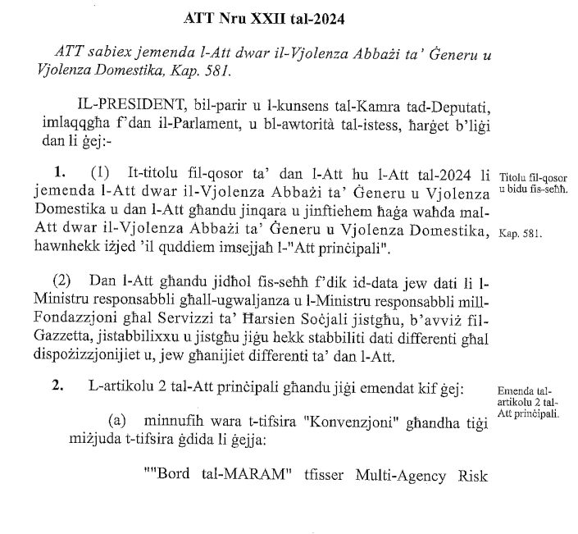
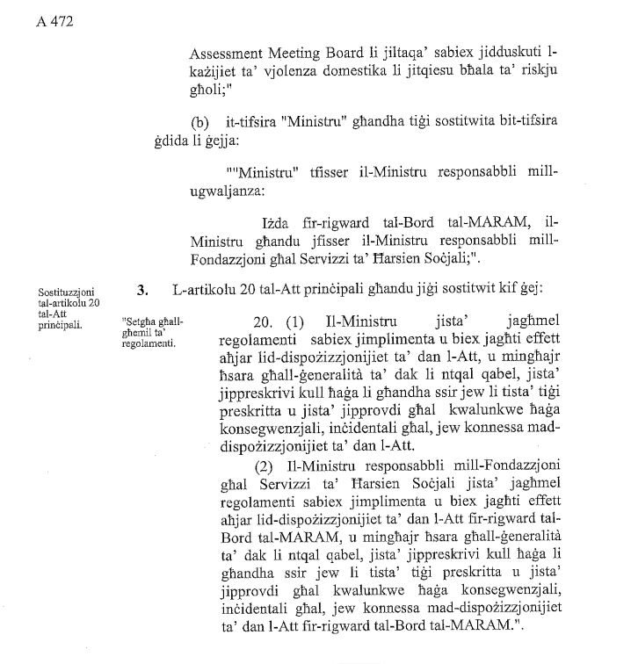
Att Nru XXII tal-2024

Slide 27
WAY FORWARD
Work on Subsidiary Legislation - Ongoing Work on Subsidiary Legislation through Meetings on the new Subsidiary legislation, now at the final stages.
Ongoing online meetings with Profs. Jacqueline Campbell, Profs. Nancy Perrin and Ms. Richelle Bolyard from the John Hopkins School of Nursing on the newly introduced Danger Assessment tool. MARAM is also part of a team working on the Validation Process. 40 interviews with Maltese-speaking participants were conducted to ensure accurate and culturally relevant translation to Maltese of the Danger Assessment Tool.
Ongoing work on a MARAM software database, soon to be launched, which will allow DMO's to use an online referral system. This will help in making the referral process more efficient. Data collection will also be more accurate.

Slide 28
WAY FORWARD
Meetings with more entities to improve collaboration and to continue to encourage them to take prompt action, when necessary.
Work on more information sharing agreements, as relevant and proportionate information about the situation, combined with shared expertise, enable identification of risks and effective safeguarding.
To take further training to continue to enhance the effectiveness of MARAM in the best interest of victims and their families.
Maintain regular media presence to reinforce the public’s understanding of domestic violence prevention efforts.

Slide 29

Thank You!
MSPC
Ministry for Social Policy & Children’s Rights.

