Slide 1
Partial Review of the GCLP (2006) Ghajnsielem and Xewkija
Amended Final Draft
following SEA Screening
January 2026
Presentation to the Parliamentary Standing Committee on Environment, Climate Change and Development Planning
25th March 2026

Slide 2
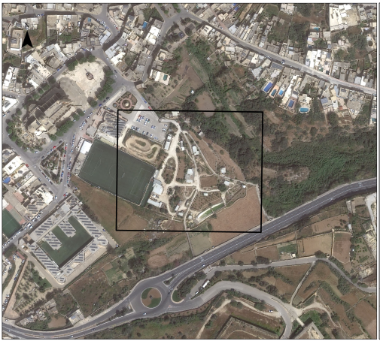
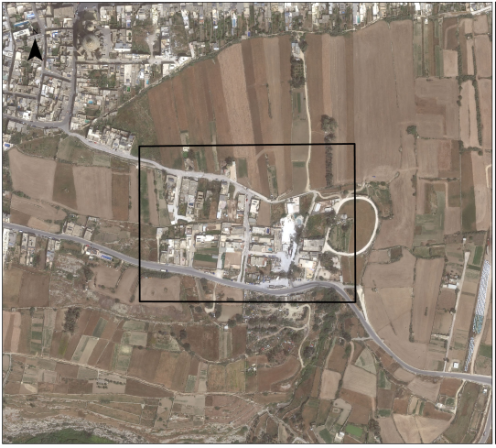
Ta’ Passi
Ghajnsielem
Torri Gorgun
Xewkija

Slide 3
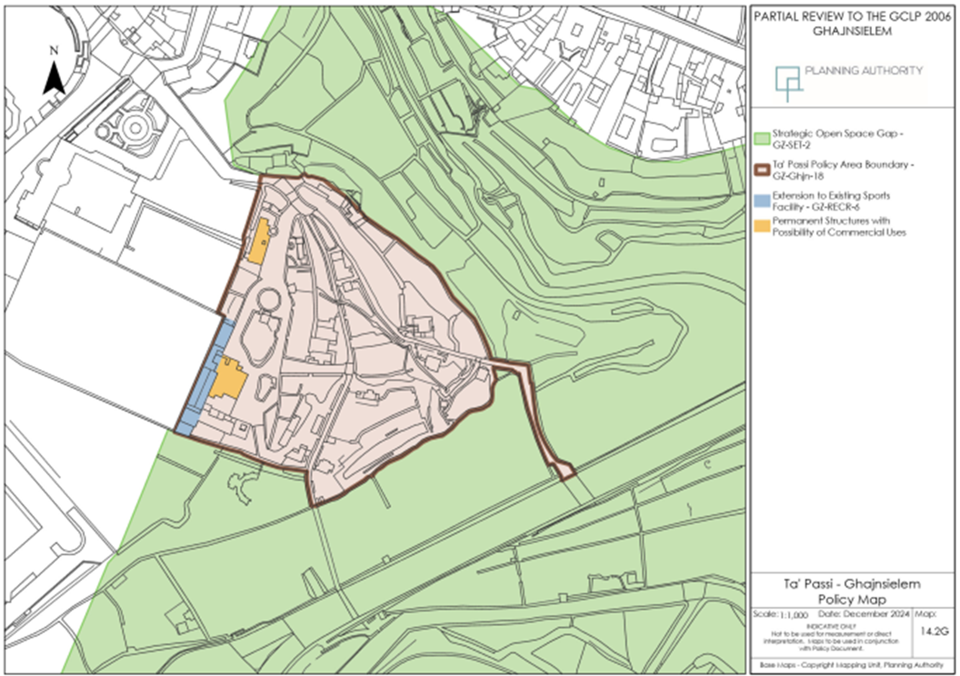

Slide 4
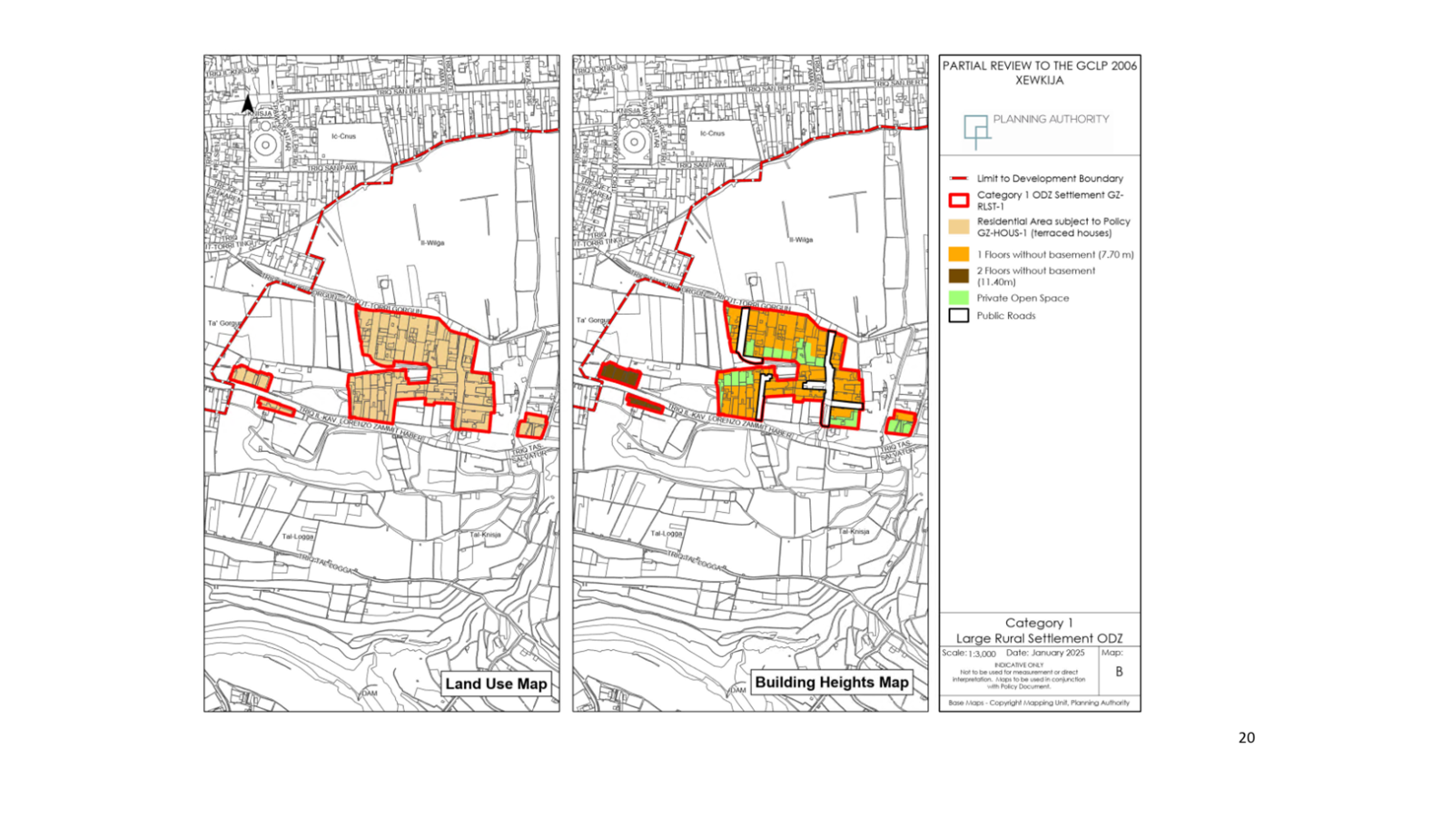

Slide 5
PUBLIC CONSULTATION
Public Consultation on Objectives held between the 15th of October and 6th of November 2024, generated 63 submissions.
2nd round of Public Consultation on the draft partial review, between 21st of March and 5th of May 2025, generated 6 submissions.
1 submission unrelated to this review.
3 submissions by private individuals.
3 submissions by Partit Nazzjonalista, the Malta Sociological Association and BirdLife Malta.
Draft of the partial review was presented and discussed with the Parliamentary Committee for the Environment, Climate Change and Development Planning on the 30th of April 2025.

Slide 6
GHAJNSIELEM – 2nd STAGE PUBLIC CONSULTATION MAIN ISSUES
Expression of agreement to the proposed revisions.
To carry out a social impact assessment.
The inclusion of provisions to mitigate against noise pollution and discouraged the hosting of large events such as music festivals.

Slide 7
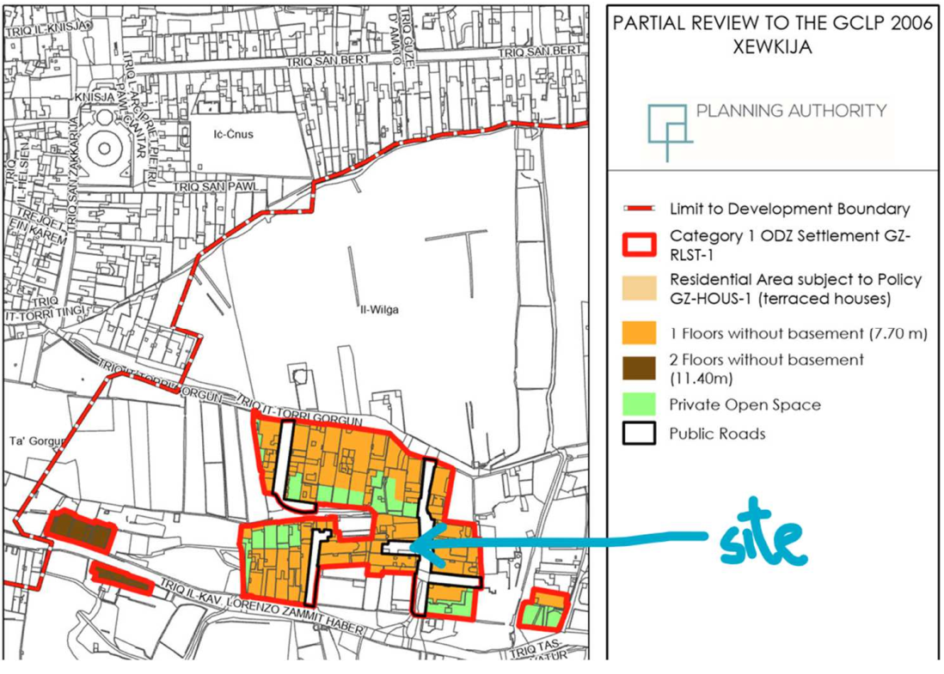
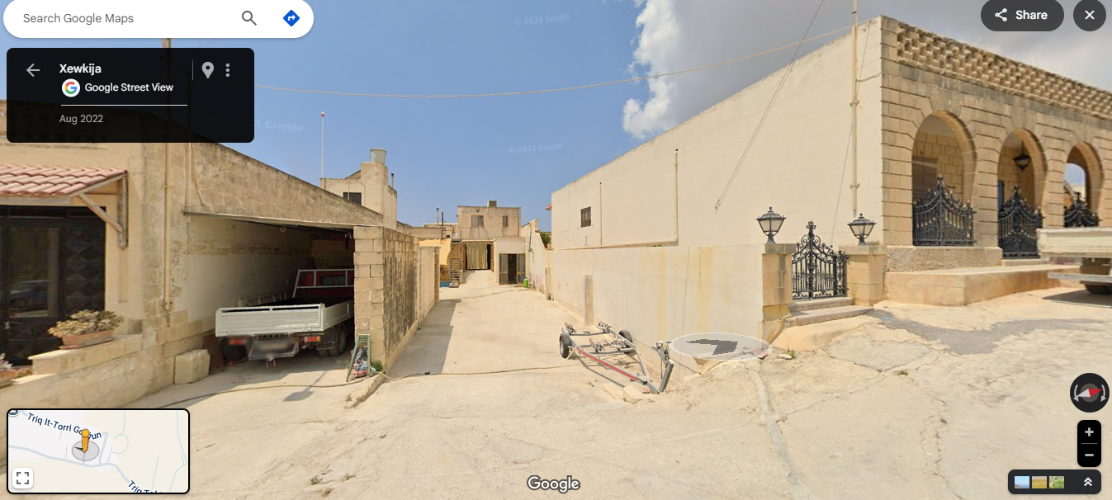
XEWKIJA – 2nd STAGE PUBLIC CONSULTATION MAIN ISSUES
Two submissions were objections to the proposed designation of a category 1 rural settlement .
The revisions are deemed not transparent as no information has been made available regarding the legality of the existing buildings in this area.
Partial review is considered as a means to regularise illegalities
To carry out a social impact assessment
Partial Review intended to revise Local Plan policies related to Category 2 and 3 rural settlements,
GCLP policies GZ-RLST-2 & GZ-RLST-3
NWLP policies NWRS 3 & NWRS 4
CMLP policy CG04
SMLP policies SMSE07 & SMSE08
Request that a parcel of land indicated as a Public Road, be included as part of the Residential Area and made available for development.

Slide 8
2nd STAGE PUBLIC CONSULTATION
Executive Council approved the document without any changes and referred it to the Minister on the 20th May 2025
Minister provided clearance to carry out SEA Screening on the 29th October 2025

Slide 9
SEA Screening

Slide 10
Consultation with Designated Authorities
Consultation held between the 30th of October and 1st of December 2025
Consulted Designated Authorities | Submissions Received
Environment and Resources Authority | 
Superintendence of Cultural Heritage | 
Climate Action Authority | 
Environmental Health Directorate | 
Energy and Water Agency | X
Transport Malta | X
Ministry for Agriculture, Fisheries, and Animal Rights | X

Slide 11
Comments Received from ERA
Ghajnsielem
ancillary structures, passageways, seating and features are kept low-key and away from the valley as much as possible so as to convey an informal rural character,
Strategically, no significant impacts are envisaged from this proposal.
Xewkija
Strategically, no significant environmental impacts are envisaged.

Slide 12
Directorates’ Reaction
Ghajnsielem
65% of the total site area (excluding the area for ancillary sports facility) remains predominantly open. Within this area, only planting of trees typical of maquis or archaeophytic fruit trees typical of rural areas shall be permitted.
27% of the total site area (excluding the area for ancillary sports facility) is designated for passageways and interspersed seating areas together with water features as part of the predominantly open area.
Only 8% of the site area (excluding the area for ancillary sports facility) is allowed for small scale roofed over structures.
For two of these structures a location abutting the limit to development boundary has been allocated.
The remaining structures have to be low lying and small in scale and the policy also include provision guiding their location and materials to be used.
All these allocations and provisions are aimed to ensure that an informal rural character is conveyed.

Slide 13
Comments Received from SCH
Ghajnsielem
There are no immediate concerns from a heritage point of view,
SCH recommends that low-lying buildings are retained throughout, and that any new development remains in line with the surrounding area.
Should the development of underground parking lots be proposed, further assessment will be required.
Xewkija
From a heritage point of view, there will be minimal impact in designating the area as a rural settlement,
Two cultural heritage points of significance nearby:
  the area of the Gourgion Tower, north of the present settlement; this tower was dismantled in 1943; and
  an olive/wine press from the Late Punic/Early Roman period
As a result, development may require further assessment,
The current low lying building height should be retained and basements and below ground pools should be restricted.

Slide 14
Directorates’ Reaction
Ghajnsielem
The policy has been amended to include provisions to minimise the extent of excavations and underground development within the site,
Such development has been limited to the development of passageways, seating areas and water features.
Xewkija
Provision that development may require further assessment by the Superintendence of Cultural Heritage to ensure the protection of any potential archaeology, has been added to the policy.

Slide 15
Comments Received from CAA
The proposed review of the local plan for Għajnsielem and Xewkija is not expected to have a significant impact on the emissions from the Land Use and Land Use Change and Forestry sector. To this extent, the Climate Action Authority is in favour of the plan proposed, as long as proposed plans remain within the stipulated limits.
Comments Received from EHD
The Environmental Health Directorate notes that the proposed objectives do not give rise to significant public health concerns. The Directorate supports the objectives as presented.

Slide 16
Policy Changes
Ghajnsielem
Introduction of an additional safeguard to address SCH concerns.
Within the Ta’ Passi Policy Area Boundary as indicated on Map 14.2G, minimal excavations or underground development related to the development described under (c) above only shall be considered.
(c ) refers to the proposed passageways and water features

Slide 17
Policy Changes
Xewkija
Introduction of an additional safeguard to address SCH concerns.
Land uses which fall within those identified by Policy GZ-HOUS-1 will be permitted within this group of Category 1 ODZ Settlements except for the settlement indicated on Maps A and B of the GCLP Partial Review for Ghajnsielem and Xewkija (2025) where only residential units (terraced houses) shall be allowed and may require further assessment by the Superintendence of Cultural Heritage to ensure the protection of any potential archaeology.

Slide 18
Conclusion of SEA Screening
This PP acknowledges the development and modifications within both sites subject to this PP and draws boundaries around both sites in order to control urban sprawl within the surrounding areas. The PP also acknowledges the established land uses within both areas and now provides policy direction to regulate these land uses.
The SEA Screening established:
  An AEI, SSI and SPA are located away from the sites at Ghajnsielem and Xewkija,
  Ghajnsielem site is located within the lower coralline aquifer protected in terms of the WFD and lies adjacent to Wied l-Imgarr,
  The Xewkija site is located within a ground water protection zone for drinking water supply within the lower coralline aquifer protected in terms of the WFD and Il-Wied ta’ Mgarr ix-Xini is located 250m away.
  Both areas are located within areas of high value for water.

Slide 19
Conclusion of SEA Screening
  In terms of air quality, it has been established that both areas have high quality air and the vulnerability to noise are low since noise levels from major roads are less than 50 decibels.
  The EHD has indicated that the PP does not give rise to significant public health concerns,
  The PP has taken on board recommendations made by the SCH that address potential impacts on cultural heritage,
  In view that both sites are built up and modified areas and the policy provisions contained in the PP, it is considered that following its adoption, very small changes will result in terms of built development and land use within both sites subject to the partial review. Thus, the magnitude of change on biodiversity, flora and fauna, water, air quality, population and human health, landscape, natural assets and cultural heritage from the PP are expected to be negligible.
  A SEA is not required because the PP is unlikely to have significant environmental effects

Slide 20
Way Forward
The SEA Screening concluded that this Partial Review is unlikely to have significant environmental impacts at a strategic level if additional provisions are included as part of its policy provisions. These policy provisions are included in this report. The Planning Directorate recommends the Executive Council to refer the Amended Final Draft following SEA Screening to the SEA Focal Point for his final consideration.
This document was referred to the SEA Focal Point on the 28th of January 2026. In their reply of the 2nd of February 2026, the SEA Focal Point noted that, this review seeks to update the policy framework to better regulate existing development, contain urban sprawl, and strengthen environmental and planning safeguards, consultations with Designated Authorities did not identify any significant strategic-level environmental concerns and detailed environmental assessment will continue to be undertaken at the project stage, including through EIA and Appropriate Assessment procedures where applicable.
Discussion at the Standing Committee in terms of Schedule III of the DPA is required since sites are located ODZ.

