Slide 1
Partial Local Plan Review of the
2006 Local Plan Policies for Rural Settlements
Amended Final Draft following SEA Screening September 2025
Presentation to the Parliamentary Standing Committee on the Environment, Climate Change and Development Planning
15th October 2025

Slide 2
Scope
To update the Standing Committee on the process of the partial review to the Gozo and Comino Local Plan (2006), North West Local Plan (2006), Central Malta Local Plan (2006) and the South Malta Local Plan (2006) related to Category 2 and 3 rural settlements in terms of Schedule III of the Development Planning Act 2016.

Slide 3
Summary of Policy Proposals
Permit amenity structures to a dwelling in Category 2 and 3 Rural Settlements
Amenity structures defined as tool sheds, animal enclosures, pools, pool decks and showers/toilets with pools
Allow take-up of fresh land for amenity structures
Located at a reasonable distance from the dwelling
Limit - tool sheds to 10sqm and overall height of 2.75m;
- animal enclosures to 25sqm and 3.5m overall height;
- tool sheds and animal enclosures not more than 10% of curtilage of dwelling;
- swimming pools and deck areas to 75sqm;
- toilets and showers to 6sqm

Slide 4
Public Consultation
The public consultation exercise on the Minister’s Objectives was carried out between the 10th of October 2024 and the 6th of November 2024 and generated nine public submissions.
Second round of public consultation on the draft review was carried out between the 21st of March and 5th of May 2025.
11 submissions were received
8 by private individuals,
Partit Nazzjonalista,
Malta Sociological Association and
Birdlife Malta.
The public consultation draft was also presented and discussed with the Parliamentary Committee for the Environment, Climate Change and Development Planning on the 30th of April 2025.

Slide 5
2nd Public Consultation - Suggested Revisions
policy definition of an existing building and of corner sites should be amended,
any approved development must never generate blank party walls,
better quantification of “reasonable distance” for the location of the amenity structures. Not more than 2m and 1m respectively for Category 2 and Category 3 rural settlements,
any additions to a dwelling are to be confined to already committed areas,
clear boundaries should be drawn around all rural settlements,
Settlement Design Statements should be reinstated,
the carrying out of a Social Impact Assessment during planning and approval processes for developments in rural settlements.
policy should shift towards tightening restrictions on allowable land uses,
references to the RPDG 2014 should be refined to include clear limits to help prevent abuse of policies intended to support genuine agricultural activities.

Slide 6
2nd Public Consultation - Objections
the public consultation exercise is a sham as it is based on unsubstantiated and possibly false claims, based on reasoning that is faulty, and misleading. Additionally, court cases are being used to weaken the law rather than uphold the law,
the distinct policy aspects and the strategy for the identification of rural settlements in the 2006 Local Plan designations of the different rural settlement categories have been ignored,
the proposed review goes against a number of SPED objectives,
this review is an exercise that will allow the sanctioning of present illegal structures.
will allow fresh uptake of ODZ land,
the RPDG 14 should not have been applied to rural settlements,
the emphasis of policies for ODZ settlements should remain to contain development and urban sprawl and should not allow any take up of fresh land,

Slide 7
2nd Public Consultation - Objections
amenity structures are objectionable in rural settlements,
proposed amenity structures within ODZ, are incompatible within ODZ and inside rural settlements,
the provision of animal enclosures as amenity structures is objectionable for public health reasons, and inconvenience due to noises, smells to possibly diseases, allergies, infestations, and physical dangers.

Slide 8
Executive Council Decision
On the 20th of May 2025, the Executive Council and the Council approved the Final Draft and agreed to refer it to the responsible Minister for his endorsement without any changes and for instruction to initiate the SEA screening process in terms of Article 53(2)(c) of the Development Planning Act 2016 (Cap. 552).
On the 6th of June 2025, the Minister agreed with the Final Draft as adopted by the Executive Council on the 20th of May 2025 without changes and provided clearance to carry out SEA screening in terms of the SEA Regulations SL549.61.

Slide 9

SEA Screening
Consultation with Designated Authorities
Consultation held between the 17th of June and 17th of July 2025
Consulted Designated Authorities | Submissions Received
Environment and Resources Authority
Superintendence of Cultural Heritage
Ministry for Agriculture, Fisheries, and Animal Rights
Environmental Health Directorate
Energy and Water Agency | X
Climate Action Authority

Slide 10
Comments Received
ERA
No significant incremental impacts are envisaged,
Should seek to limit development in rural settlements and to contain it as close as possible to the existing built-up clusters,
Animal enclosures are to be constructed in natural timber or a small part in stone and the rest in natural timber,
Swimming pools & deck areas are to comply with criteria for such in RPDG 2014
A distance not exceeding 50m should be established between the proposed amenities and dwelling units,
Applicants should only be entitled to a structure, either a 10m2 tool shed or a 25m2 animal enclosure,
Interventions that would have an unacceptable adverse impact on natural habitats and features, as well as scheduled, listed, designated or protected areas, should not be permitted.

Slide 11
Council Decision
There are suggestions that would alter the scope of the of the partial review: the increase by 5sqm for additional accommodation, the revision of minimum footprint existing buildings to qualify for an extension
Policy amended to include a maximum distance of 50m.
Policy amended to include guidelines related to the design and materials used for the development of the permitted ancillary facilities, and that pump rooms are to be located completely underground,
Additional safeguards to policy include safeguards to natural habitats and features (including garrigue, maquis, rocky outcrops, cliffs, slopes, etc.), as well as scheduled, listed, designated or protected areas and land of agricultural value,
Amended criterion related to the size of tool sheds and animal enclosures; comprehensively not to exceed 25sqm or 10% of the curtilage whichever is the lowest.

Slide 12
Comments Received
Ministry for Agriculture, Fisheries & Animal Rights
Permitting non-essential amenity structures, such as swimming pools and decking areas, risks further taking up rural space and inadvertently contributing to land speculation,
Proposed changes were not brought forward to the Agricultural Consultative Council (ACC) for review,
The proposed amendments appear to offer relatively more lenient provisions for residential amenity structures than the RPDG 2014,
Policy amendments continue to uphold the principle of minimising fresh land take-up, especially for non-essential structures,

Slide 13
Council Decision
The permitted amenity facilities indicated by the review are intrinsically linked to the quality of the residential unit and its amenity value,
The partial review is not deemed to result in significant land take-up in the rural area and additional safeguards to protect agricultural land will further reduce such take-up,
The policy includes strict criteria on size and design and also regulates their location as deemed relevant and necessary for this development type,
Recommendation that policy should continue to uphold the principle of minimal take up of fresh land, would alter the scope of the partial review.

Slide 14
Comments Received
SCH
A number of suggestions relate to changes to parts of the policy that are not subject to this review,
Other suggestions related to the development effecting buildings worthy of retention due to their historical and/or architectural merit and/or other cultural heritage values and/or the contribution it makes to the character of the settlement and surrounding landscape,
Environmental Health
Both the positive and negative public health impacts should be assessed by the SEA,
Other comments related to tourism accommodation and sanitary facilities
Climate Action Authority
Land Use and Land Use Change and Forestry sector is very minimal in Malta within the context of total emissions generations.

Slide 15
Council Decision
Suggestions to review parts that were not listed in the published objectives, extends beyond the scope of this review,
Policy amended to include safeguards to buildings worthy of retention due to their historical and/or architectural merit and/or the contribution it makes to the character of the settlement and surrounding landscape,
The statement that Land Use and Land Use Change sector is very minimal in Malta within the context of total emissions generations has been taken in consideration during the SEA Screening.

Slide 16
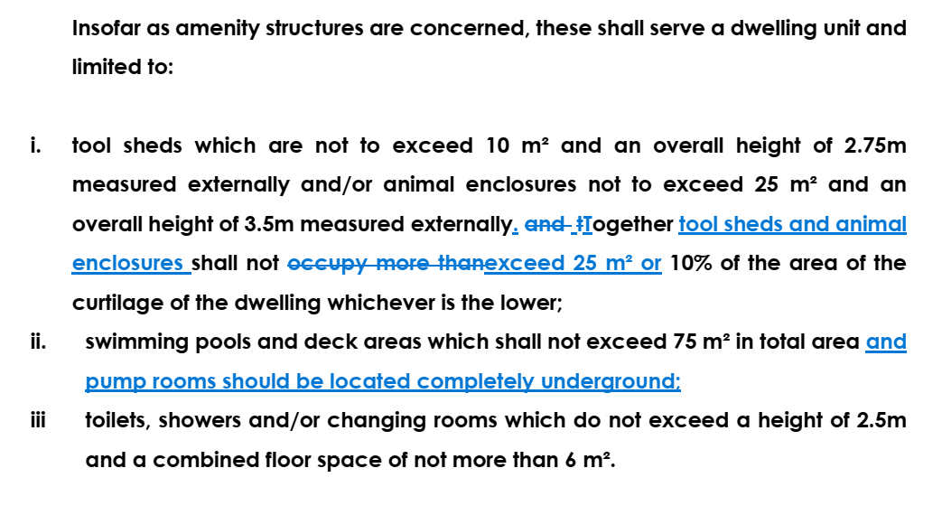
Policy Changes
Following consultation with the Designated Authorities, further safeguards were included to the respective policies

Slide 17
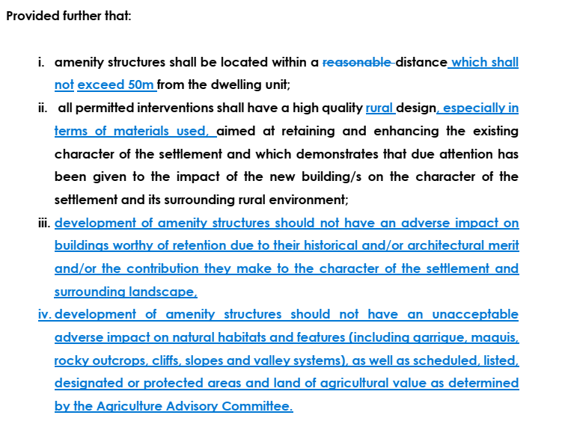
Policy Changes

Slide 18
Conclusion of SEA Screening
Considering that:
A smaller proportion of total settlements are located within sensitive areas for biodiversity and water,
The location of the settlements within the wider countryside of high landscape protection makes it of high value for landscape,
There are no envisaged risks to human health as the policy will not adversely affect the air, water quality and ambient noise of the rural settlements,
Category 2 and 3 rural settlements are small in nature, and the human population of these areas are small as well,
The additional safeguards introduced to the policy related to biodiversity, valley systems, rural environment, landscape, buildings which are scheduled, listed and/or worthy of retention due to their historical and/or architectural merit,
All this is considered to provide the assurance required so that the PP shall not generate significant negative environmental impacts.

Slide 19
Conclusion of partial review process
The SEA Screening concluded that this Partial Review is unlikely to have significant environmental impacts at a strategic level if additional provisions are included as part of its policy provisions. These policy provisions are included in this report.
The Executive Council on the 9th of September 2025, decided to amend the policy wording as described above. The amended partial review was referred to the SEA Focal Point on the 10th of September. In his reply of the 12th of September 2025, the SEA Focal Point, while taking note of the recommendation by the Planning Authority, did not determine that an SEA is required.
The Executive Council referred the Amended Final Draft following SEA Screening to the Minister on the 17th September 2025.
Minister referred Amended Final Draft following SEA Screening to the Standing Committee for its effective scrutiny in terms of Schedule III of the Act.

