Slide 1

Evaluating the role of the Malta film commission in promoting the Maltese film industry
November 2024

Slide 2
Contents
Background Information
Terms of Reference
Main findings of the Malta Film Week and the Malta Film Awards 2022
Corporate Governance
MFC’s promotion of the film industry in Malta
Overall conclusion
Recommendations

Slide 3
Background (1 of 2)
Comprised three separate but interrelated initiatives:
The NAO’s Annual Performance Audit Programme for 2022 included the review of the promotional activities undertaken by the MFC.
Prof Arnold Cassola requested an investigation into the expenditure and management of public finds related to the Malta Film Week and Awards held in January 2022.
Opposition members of the PAC and the Shadow Minister for National Heritage, Arts and Culture further requested an investigation into the internal procedures and controls as well as adherence to State Aid rules and good governance principles in relation to the MFC’s disbursement of financial aid through various incentives between September 2018 and August 2023.

Slide 4
Background (2 of 2)
The MFC was established by the Malta Film Commission Act in 2005
The Act establishes the Board and the Film Commissioner
The Film Commissioner is entrusted to adopt and implement measures for development, support, and promotion of the audio-visual and film servicing industry in Malta and in general, to implement Malta’s audio-visual policy
Between 2018 and 2023, the MFC operated three funding schemes:
  The Malta Film Commission Cash Rebate Scheme
  Creative Malta Fund / the Malta Film Fund
  Co-production fund

Slide 5
Terms of Reference (1 of 2)
This audit sought to determine whether the:
Commission’s work was based on documented strategies;
financial plans incorporated details of all of the main activities of the MFC;
financial and operational management of the Commission upheld accountability, transparency and good governance principles;
internal controls were in place to ensure that the MFC’s expenditure is contributing to the promotion and nurturing of the film industry in Malta.

Slide 6
Chapter 1: Terms of Reference – objectives (2 of 2)
Expenditure by the MFC for the marketing and promotion embraces the Ministry’s and Commission’s policies and resulted in tangible benefits for the Maltese film industry and to Malta’s economy;
State Aid schemes and incentives administered by the MFC complied with the regulatory framework;
MFC carried out due diligence exercises in relation to the beneficiaries’ claims for funds and their ability to deliver the projects in question; and
MFC provided access to schemes and financial initiatives to Maltese production companies.

Slide 7
Methodology
To attain the audit objectives, the following methodological approaches were adopted:
Adherence to ISSAIs and financial standards
Documentation review
Sampling undertaken to review the international and local productions that benefitted from financial incentives
Financial analysis
Semi-structured interviews
Value for Money considerations

Slide 8
Audit Limitations
Availability of MFC audited financial statements:
  MFC audited financial statements for 2021 and 2022 were concluded in October 2024
  MFC audited financial statement for 2020 were finalised in October 2023 and made available to this office in September 2024
  Last published audited financial statements date back to 2019
Specific events transactions are not classified in a separate cost centre:
  The Malta Film Awards was not treated as a cost centre.
  Its income and expenses were not treated separately from the rest of the MFW
Lack of audit trails:
  MFC did not document all decisions taken by the Management and the Ministry approvals concerning certain expenditures
Lack of KPIs:
  The absence of formally approved strategies, policies and plans also placed auditing constraints to the NAO

Slide 9
The 2022 Malta Film Week / Film Awards (1 of 2)
The Malta Film Week was a series of events spanning over six days, from 24 to 29 January 2022
The main objective of the MFW was to recognise 100 years of film servicing in Malta
The NAO was requested to investigate the extent to which expenditure incurred in conjunction with the MFA complied with:
  budgetary allocations,
  the regulatory framework and corporate governance principles
The Malta Film Week was assessed against a Project Management cycle (initial, planning, execution, monitoring and control as well as completion and results) benchmark

Slide 10
The 2022 Malta Film Week / Film Awards
(2 of 2)
MFC financed a third of MFW / MFA expenditure through a central government subvention
Documentation presented to the NAO shows that the cost of staging the Malta Film Week and the Malta Film Awards Events entailed an expenditure of around €1.3 million.
This analysis is excluding information of any non-financial agreements entered into by the Commission.
  Such a situation materialised as the MFC has not established and documented the fair-value of these arrangements.

Slide 11
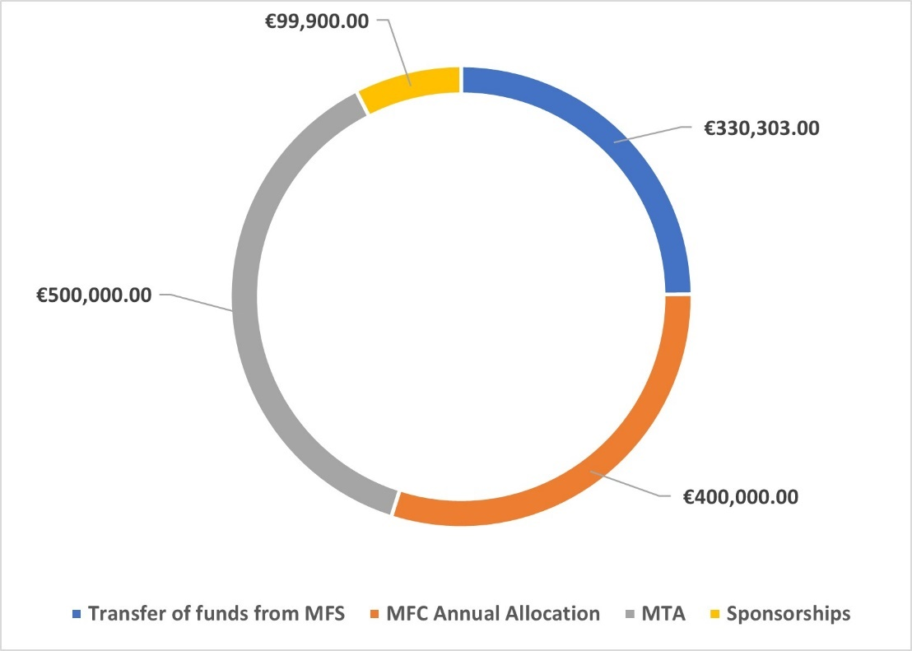
The 2022 Malta Film Week / Film Awards: Funding (1 of 2)

Slide 12
The 2022 Malta Film Week / Film Awards: Funding (2 of 2)
The Malta Film Studios had the financial capacity to back-up the MFW, as at the time the MFS had a profit of €915,589 (FDRS).
The transfer of €330,303 between MFS and MFC was driven by the availability of funds to the Commission.
NAO found no evidence that the above amount detracted from budgets allocated under the state aid funding (rebate schemes operated in conjunction with the production of films in Malta).
Moreover, Government allocated a separate budget line item to MFC for the MFW hence it did not affect support and financing of other activities

Slide 13
The 2022 Malta Film Week / Film Awards
The non-availability of MFC’s comprehensive accounting records to the NAO did not enable this Office to conclusively determine completeness of the costs involved in the MFW
The NAO requested a copy of all invoices relating to the MFW. Based on the documentation received, this evaluation resulted in the following:
  MFC did not have contracts in place covering all sponsorships and non-financial agreements entered into. Services including those provided from local artists, entertainers, make-up artists, hotels, hairdressers, PBS advertising slots and others.
  MFC did not always enter into documented agreements with suppliers
  MFC did not dedicate a specific line item to record financial transactions in conjunction with the MFW
  It could not be confirmed that some goods and services procured were used exclusively for the MFW or that other costs were charged to the MFW when they could have been utilsed for other purposes

Slide 14
Chapter 2: The 2022 Malta Film Week / Film Awards
MFC could not support its claim that the MFW constituted Value for Money
MFC did not provide a detailed account of the services and service providers, which were not directly paid for through invoices but through non-financial arrangements;
the description from the invoices was, in cases, somewhat limited as information presented did not attribute specific costs to particular events, such as specific master classes;
MFC did not provide this Office with the pre-determined outcomes and outputs, for example the cost per event against any set objectives; and
MFC was not in a position to determine the return on investment (ROI) over time resulting from such marketing efforts.

Slide 15
Corporate Governance
Certain MFC operations do not fulfil good corporate governance practices
Balance between executive and non-executive board members- Chapter 478 of the Laws of Malta stipulates that the MFC Board is to be composed of a Chairman, the Malta Film Commissioner and three non-executive members. With a few exceptions related to the endorsement of rebates, the MFC’s Board role is mainly advisory as the non-executive directors are not legally empowered to approve or veto initiatives. Within this context, corporate governance literature highlights the importance of a balance between executive and non-executive directors.
Staffing issues - As at end of 2022, the MFC had ten vacant positions out of the planned 23 employee workforce, when the Commissioner and his secretariat are excluded from the calculation. A similar situation prevailed in 2024.

Slide 16
Corporate Governance
The MFC lacks documented plans, which outline the resources required, initiatives to be implemented and their anticipated outputs and outcomes
In June 2023 the MFC published a draft strategy for public consultation. The draft sets out the MFC’s strategic goals for the period 2023 – 2030. This draft has been complemented by a number of speeches by the Malta Film Commissioner at key-note events which generally include high ranking government officials, industry stakeholders and other distinguished guests. Moreover, these speeches were often published in the MFC’s media platforms.
Matters were further exacerbated since the MFC’s business planning is not supported by a comprehensive marketing plan – where marketing constitutes one of the Commission’s major activities to promote Malta as a major film production destination.

Slide 17
Corporate Governance
The absence of a formally approved strategic document and supporting plans:
  could detract from a transparent process related to stakeholder involvement as well as evaluation of MFC’s vision and plans;
  minimises opportunities in connection with promoting Malta as a film production destination since the availability of an approved document illustrates and emphasises the MFC’s business intentions and direction;
  renders it more difficult for the MFC to present a case for additional resources in a robust manner; and
  hinders the compilation of a prolific business and marketing plan and activities to further promote the film production industry within Malta’s economic portfolio.

Slide 18
MFC’s promotion of the film industry in Malta
Substantial investment is required to further upgrade the film production facilities and to complement the world-class water tanks.
Over the past years, the facilities at the Malta Film Studios have been undergoing a programme of continuous upgrading.
In 2019, the MFC outlined its vision through three dimensional images of future infrastructural upgrades, which included the first soundstages in Malta.
Since 2018, a series of infrastructure works commenced at the Malta Film Studios, including a pumphouse, the creation of new spaces, maintenance of existing areas and building of new facilities.
The capital budget for the Film Studios infrastructural upgrading has been increasing through the annual government subvention
The capital allocation increased from €0 in 2018 to €3m in 2024

Slide 19
MFC’s promotion of the film industry in Malta
Substantial investment is required to further upgrade the film production facilities and to complement the world-class water tanks (cont.)
Between 2019 and 2022, central government has allocated €7.2 million to upgrade MFC infrastructures. However, based on the audited financial statements, this Office notes the following:
  € 4.8 million on this expenditure remained outstanding as deferred income on MFC accounts, and
  Current assets amounting to €1.2 million.

Slide 20
MFC’s promotion of the film industry in Malta
MFC’s marketing and promotion of Malta as a venue for film productions generally follows industry norms
Despite the absence of a comprehensive marketing plan, a qualitative analysis undertaken by the NAO showed that the MFC’s marketing and promotion approach embraces a range of industry best-practices. The following refers:
  Showcase Successful Productions:
  Offer Competitive Financial and Logistical Benefits:
  Develop a Strong Online Presence:
  Leverage Industry Trends and Innovations:
  Innovations:
  Create Strategic Partnerships:
  Focus on Networking and Industry Events:
  Market Unique Selling Points

Slide 21
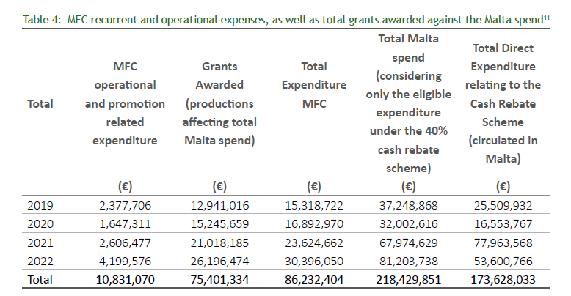
MFC’s promotion of the film industry in Malta
MFC recurrent and operations expenses, as well as total grants awarded against the Malta spend

Slide 22
MFC’s promotion of the film industry in Malta
Disbursement of cash rebate grants complied with state aid protocols
  Determining compliance with the state aid rules governing the cash rebate schemes operated by MFC entailed sampling 10 out of the 56 productions that were publicly listed on the European Commission State Aid Transparency website between 17 September 2018 and 8 August 2023.
  The sampled criteria related to the productions that were allocated the highest budgeted aid. The State Aid Board acts as the liaison office between the MFC and the European Commission with regards to the State Aid applications and when the European Commission carries out audits.
  Based on discussions held with State Aid Monitoring Board and a review of documentation pertaining to the sampled productions, the NAO is satisfied that the state aid protocols were adhered to.
  The prolonged finalisation of audit reports is hindering the timely disbursement of State Aid approved funds

Slide 23
MFC’s promotion of the film industry in Malta
The NAO reviewed the 2021 report, Economic Impact Assessment: Revised Cash Rebate Effect and the 2023 Report, Economic Impact Study on the Impact of the Film and Production Industry on Malta’s Economy
Both the 2021 and 2023 report mainly take into account:
  Economic value
  Employment
  Tax revenue generation
  The NAO’s analysis of the benefits reaped through the cash rebate scheme of film productions shot in Malta generally replicates the results portrayed in the MFC commissioned reports

Slide 24
Chapter 4: MFC’s promotion of the film industry in Malta
Difference in calculations between 2021 report and NAO computations
 | 2021 Report | NAO validation methodology
Average increase in expenditure in Malta by film productions (€) | 23.43 million | 21.8 million
Gross Value Added (€) | 16.6 million | 13.4 million
Tax (€) | 9.5 million | 8.8 million
Full time job equivalents sustained and created | 2,060 FTE jobs reported as a three-year total | 2,060 FTE jobs sustained over a three-year period

Slide 25
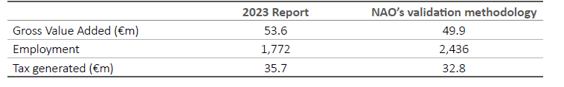
Chapter 4: MFC’s promotion of the film industry in Malta
A comparison between the MFC’s 2023 report and the NAO’s validation methodology

Slide 26
Overall conclusions
MFC works in a dynamic environment and highly competitive environment
The MFW was not supported by robust documentation such as feasibility studies. Nevertheless, the allocation of budgets from central government were approved and allocated for this event.
Outstanding strategic documents for the period up to 2030
The opportunity exists for MFC to strengthen its corporate government structure
Between 2018 and 2022, the MFC, mainly through the 40 per cent cash rebate scheme, was successful in attracting film productions to Malta. The total amount of money spent by international and national film makers amounted to over €231.5 million
In general, this review confirms MFC’s estimates on the impact of the cash rebate scheme on the Maltese economy in terms of expenditure by film productions in Malta, Gross Value Added, employment and tax revenue.
  Ultimately, it remains a matter for policy makers to decide the appropriate level of investment in film production, taking into account the opportunity cost of resources used, socio-economic priorities, as well as the potential for the industry to diversify and complement the overall make-up of economic activities in Malta.

Slide 27
Recommendations
Strengthen the human resources and infrastructure required
Develop and maintain robust internal processes and structures to ensure corporate governance especially transparency accountability and business continuity.
Explore different business models with private sector to support and expand MFCs operations

Slide 28
THANK YOU

