Slide 1
Presentation by the ECA Member of the Annual Report 2023 and the work at the ECA to the Malta parliamentary joint committee meeting
27 November 2024
George Hyzler

Slide 2
European Court of Auditors
The European Court of Auditors is the independent external auditor of the European Union.
Mission: Through our independent, professional and impactful audit work, assess the economy, effectiveness, efficiency, legality and regularity of EU action in order to improve accountability, transparency and financial management, thereby enhance citizens’ trust and respond effectively to current and future challenges facing the EU.
We are based in Luxembourg and employ around 950 audit, support and administrative staff of all EU nationalities.
Slide 2

Slide 3
Our statements of assurance
Every year, we audit the EU’s consolidated accounts and provide an opinion on three matters: whether the accounts are reliable, and whether EU revenue was received and payments were made in accordance with the relevant rules. These checks form the basis for our statement of assurance.
Our audit includes testing a statistically representative sample of transactions and evaluating supervisory and control systems to determine whether revenue and payments are calculated correctly and comply with the legal and regulatory framework.
The opinions in our statement of assurance are based on evidence obtained from audit testing in accordance with international auditing standards.
We consider that the estimated level of error is material when it exceeds the threshold of 2 %.
Slide 3

Slide 4
2023 annual report
European Court of Auditors
Overall results

Slide 5

2023 Annual Report figures
Figures for financial year 2023
EU budget spending per MFF heading: €191.2 billion
RRF Grants: €48 billion
Total payments: €239.2 billion
Revenue: €248.4 billion
Audit population
EU budget spending per MFF heading: €161.2 billion
RRF Grants: €53.5 billion (RRF grant payments €46,3bn plus cleared pre-financing expenditure ca €7,2bn)
Total payments: €214.7 billion
Revenue: €248.4 billion
Slide 5

Slide 6
2023 EU budget spending per MFF heading
de
Slide 6

Slide 7
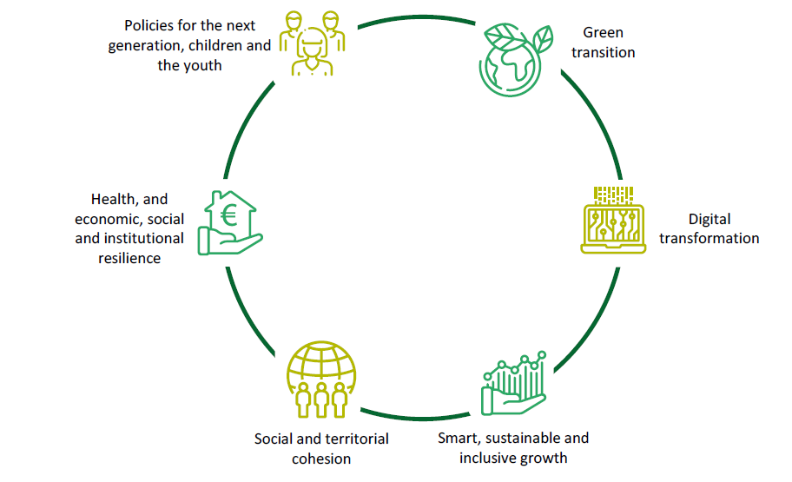
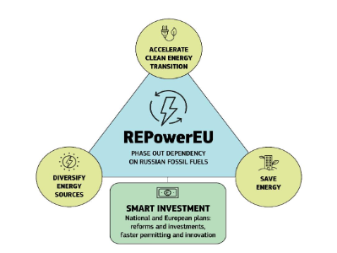
Recovery and Resilience Facility
RRF originally funded with €723 billion
Grants: €338 billion
Loans: €385 billion
Committed by 31.12.2023: €648 billion
Grants: €356.8 billion
Loans: €290.9 billion*
*Loans could be requested until August 2023. The remaining €94,5 billion are no longer available for loans
Repower EU chapter added in recovery and resilience plans – EUR 18.9 billion in February 2023.
Financed from emissions trading scheme (ETS) €17.3 bn and allocations from the Brexit adjustment reserve (BAR) €1.6 bn. Due to this additional financing, RRF grants, including REPower EU, could reach €356.8 bn, are 6% higher compared to the initial RRF grant allocation of €338 bn.
Slide 7

Slide 8
2023 annual report – Audit opinions
We issue a clean opinion on the reliability of the 2023 accounts of the EU.
We also issue a clean opinion on the legality and regularity of revenue transactions for 2023.
We provide two separate opinions on the legality and regularity of expenditure, as the RRF is a temporary instrument delivered and financed in a way that is fundamentally different to EU budget expenditure:
our opinion on the legality and regularity of EU budget expenditure is adverse;
our opinion on the legality and regularity of expenditure under the Recovery and Resilience Facility is qualified.
Slide 8

Slide 9
Estimated level of error in EU budget expenditure
Overall, the estimated level of error in EU budget expenditure was material at 5.6 % (2022: 4.2 %).
We estimate that the level of error in the high-risk expenditure is 7.9 %
(2022: 6.0 %). This level is material and pervasive, which is why we issue an adverse opinion on EU budget expenditure.
Slide 9

Slide 10
Estimated level of error: main MFF headings
Comparison of the estimated levels of error for MFF headings 1, 2 and 3 (2019‑2023)
Slide 10

Slide 11
RRF expenditure
For RRF expenditure, in 2023, the Commission made 23 grant payments to
17 member states and concerned 542 milestones and 135 targets.
16 out of 452 milestones and targets we examined did not comply with the payment and eligibility conditions. These concern seven payments in seven member states. Six of these payments were affected by material error, and we issue a qualified opinion on RRF expenditure.
We estimate the minimum financial impact of these findings to be above our materiality threshold. Given the nature of the RRF spending model, we do not provide an error rate comparable to other EU spending areas.
The Commission updated its ex-post audit strategy to include checks on reversal, but not on the substitution of recurring national budgetary expenditure.
We identified persistent weaknesses in the member states’ reporting and control systems which pose a risks to the protection of the EU’s financial interest.
Slide 11

Slide 12
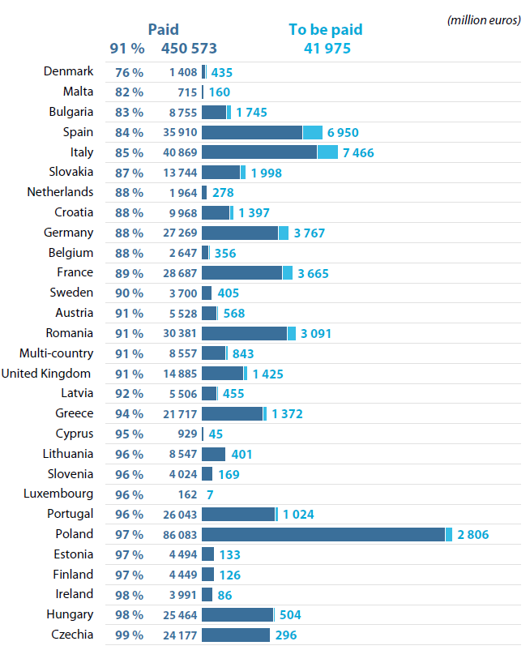
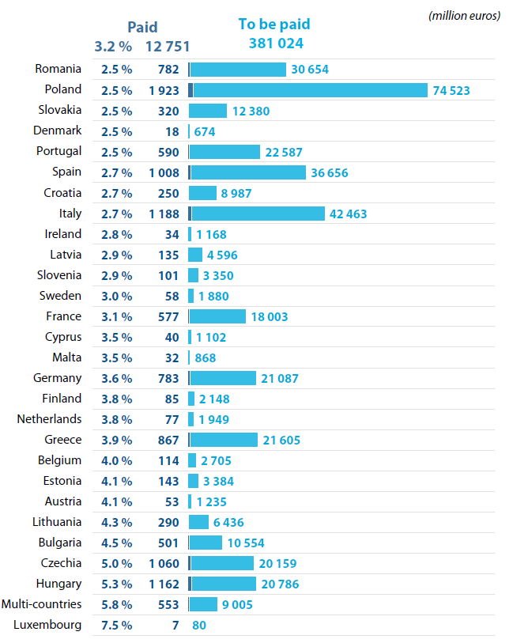
Member State absorption rates
2014-2020
2021 - 2027
Slide 12

Slide 13
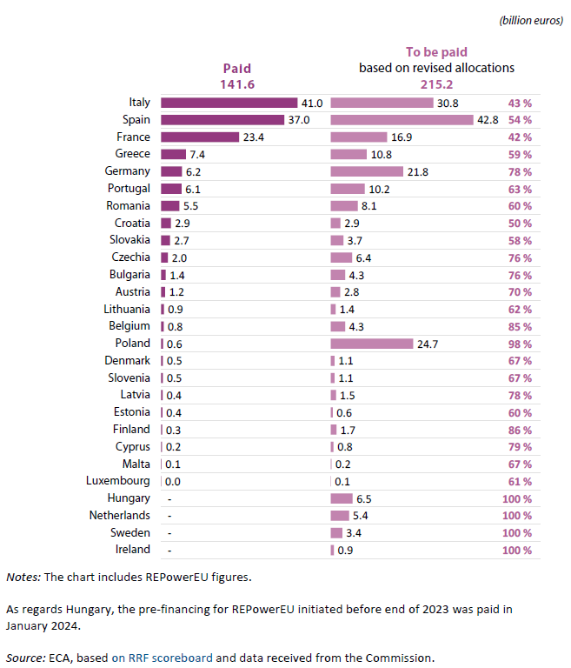
RRF grants paid and amounts to be paid based on revised allocations by member state, as at end of 2023
Slide 13

Slide 14
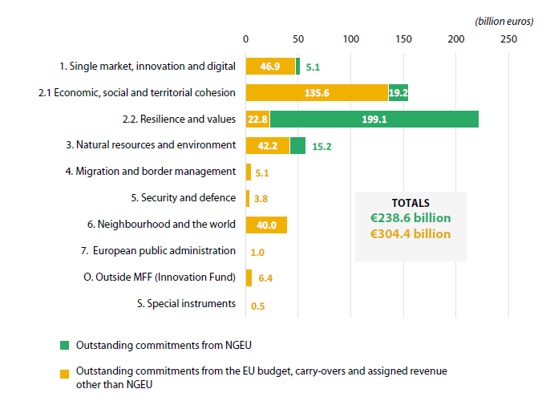
Outstanding commitments
Outstanding commitments from the EU budget and NGEU grant funding, which represent future financial obligations unless decommitted, reached a record level of €543.0 billion at the end of 2023 (2022: €452.8 billion). These were mainly related to the EU budget and carry-overs and NGEU grant funding.
Outstanding commitments by source and MFF heading
Slide 14

Slide 15
Risks and challenges
The risk of member states losing out on funding can materialise at the end of 2025. The Commission forecast decommitments for 2024-2027 period at €8.1 billion (of which €2.2 billion for the CF, ERDF, and ESF+ cohesion policy funds). When decommitments are high, the achievement of the EU objectives might be jeopardised.
Outstanding EU borrowing from the markets increased significantly in 2023 to €458.5 billion by year-end (2022: €348.0 billion), mainly due to borrowings for NGEU. While NGEU borrowing may more than double by 2026, the bulk of repayment is deferred to future MFFs. Furthermore, external assigned revenue from the NGEU debt has a significant negative impact on the economic result.
Potential changes in market conditions might result in higher borrowing costs that, for the NGEU debt relating to grants and NGEU top-ups, will have to be borne by the EU budget. The Commission estimated that the additional interest and coupon payments for NGEU borrowing within the current MFF might range between
€17.0 billion and €27.0 billion, compared to initial estimate of €15.0 billion.
In 2024, the Ukraine facility was set up to provide financial support for an additional amount of up to €33.0 billion in loans. There is no legal requirement for provisioning, which entails considerable risks for the EU budget.
Slide 15

Slide 16
Risks and challenges
EU budget exposure:
Increased to €298.0 billion (2022: €248.3 billion), mainly due to borrowings for additional RRF loans and MFA+ loans to Ukraine.
Is expected to rise in 2024 and 2025, mainly due to the RRF loans, as €211.7 billion of the signed RRF loan agreements had not yet been disbursed by the end of 2023.
In relation to Ukraine more than doubled in 2023 from €16.0 billion to €33.7 billion.
(*) European Fund for Sustainable Development (EFSD) guarantee: €0.5 billion, InvestEU guarantee: €1.4 billion, and European Fund for Sustainable Development Plus (EFSD+) guarantee: €0.6 billion; Euratom loans: €0.3 billion.
Slide 16

Slide 17
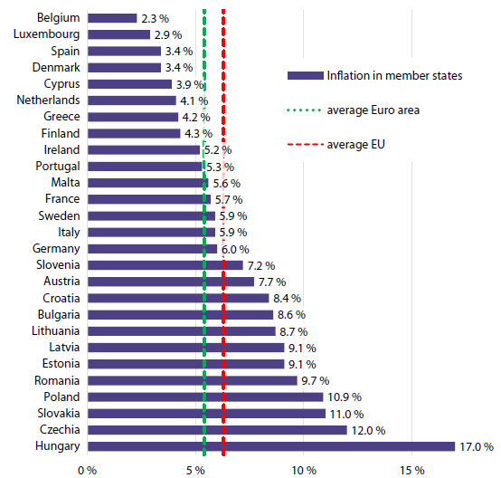
Risks and challenges
High inflation continues to affect the EU budget: Based on the Commission’s inflation forecast, we estimate the EU budget could lose nearly 13 % of its purchasing power by the end of 2025.
Inflation in member states in 2023
Changes in EU budget purchasing power
Source: ECA, based on Eurostat and Commission’s Spring 2024 Economic Forecast.
Slide 17

Slide 18
We contribute to fighting fraud
As the EU’s external auditor, the ECA does not have a mandate to investigate cases of suspected fraud against the EU’s financial interests.
Our estimate of the level of error in the EU budget is not a measure of fraud. In the vast majority of errors we come across in our work, we do not suspect indications of fraud.
When we suspect that we have come across illegal activity, we report it to the European Anti-Fraud Office (OLAF) and to the European Public Prosecutor’s Office (EPPO).
In 2023, we reported to OLAF 20 cases (2022: 14 cases) of suspected fraud. OLAF has already opened four investigations. In parallel, we reported 17 of these cases to the EPPO, which has opened nine investigations.
Slide 18

Slide 19
2023 annual report
References to Malta

Slide 20
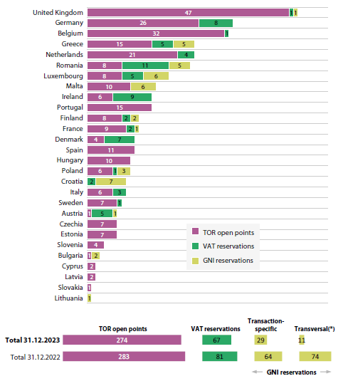
Revenue: Number of outstanding GNI reservations, VAT reservations and TOR open points by member state as at 31 December 2023
Slide 20

Slide 21
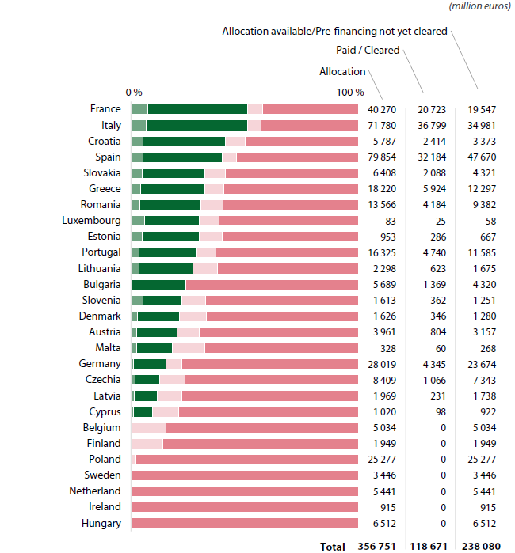

Progress of RRF grant payments as of 31.12.2023
Slide 21

Slide 22
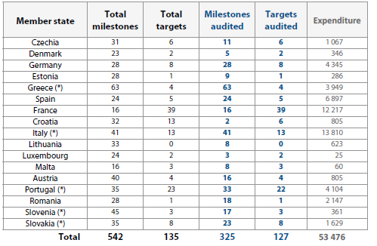
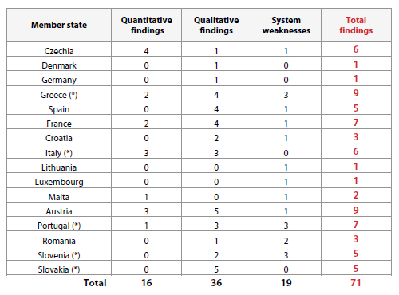
Recovery and Resilience Facility - Malta
Total and audited milestones and targets underpinning the 2023 RRF expenditure
Audit results
Slide 22

Slide 23
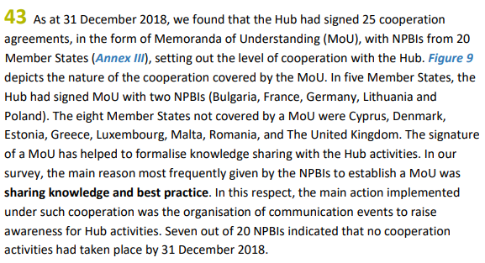
SR 12/2020 The European Investment Advisory Hub – Launched to boost investment in the EU, the Hub’s impact remains limited
In this Special Report, recommendation 4(iii) is relevant to Malta: to build on direct cooperation with NPBIs to improve geographical coverage of advisory services
Follow up: None of the member states without cooperation agreements as of 31 December 2018 (Denmark, Estonia, Greece, Cyprus, Luxembourg, Malta, Romania, and the United Kingdom) are covered by new agreements to improve the geographical coverage of advisory services in the European Union.
Slide 23

Slide 24
European Court of Auditors
Special Reports

Slide 25
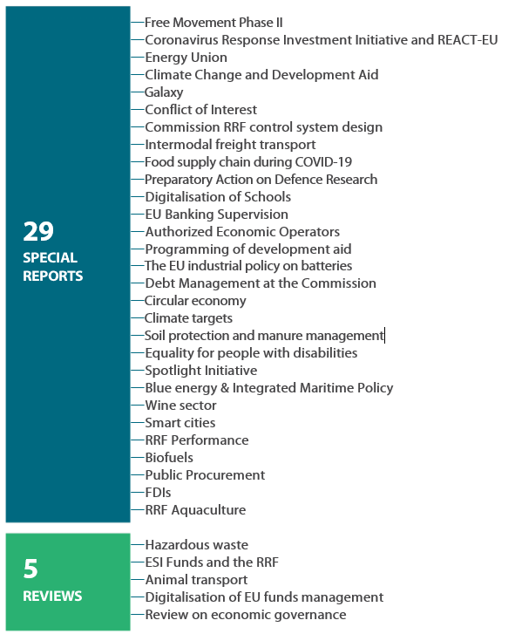
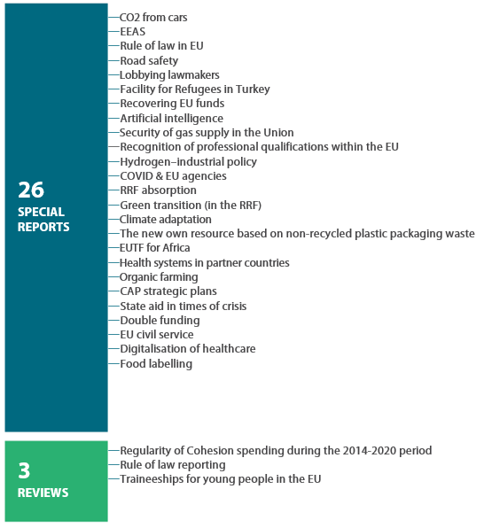
Publications of Special Reports and Reviews
2023
2024
Slide 25

Slide 26
European Court of Auditors
The Maltese private office

Slide 27
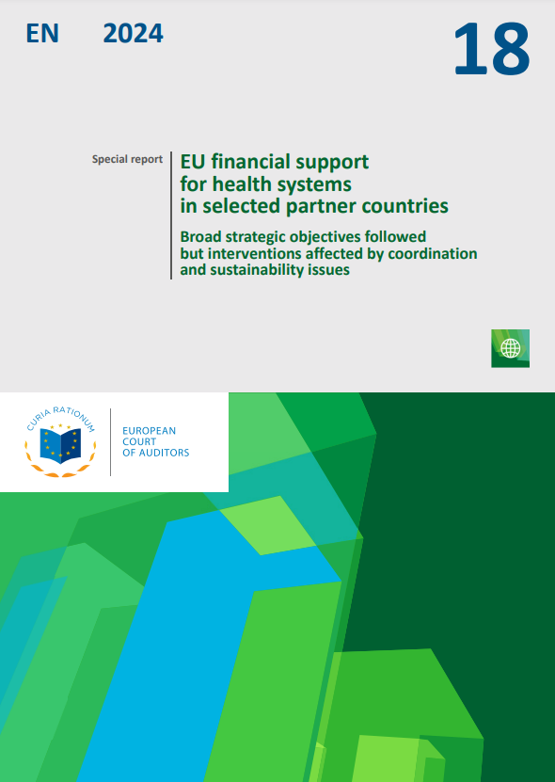
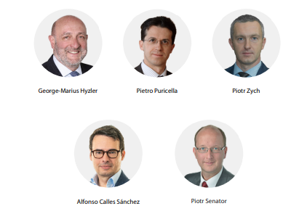
George Hyzler, Member of Chamber III, External Action, Security and Justice
Reporting Member for:
Task name | Product type | Objective of the task | Publication date
Health systems in partner countries | Special report | To assess the efficiency and effectiveness of EU support for health systems in developing countries, including the Commission’s financial and governance contribution to global health-related initiatives. | Oct 2024
Large-scale cyber-attacks | Special report | To assess whether the Commission, since its initial 2017 blueprint, has established clear and effective arrangements for a coordinated EU response in case of large-scale cybersecurity incidents and crises. | 2026
Union civil protection mechanism | Special report | To assess the economy, efficiency and effectiveness of EU support for emergency and natural disaster response through the Union Civil Protection Mechanism (UCPM). | 2026
Slide 28

Slide 28
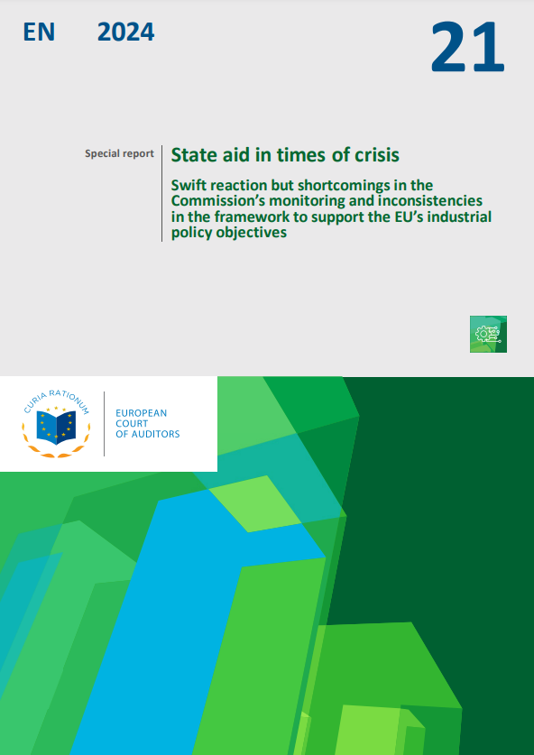
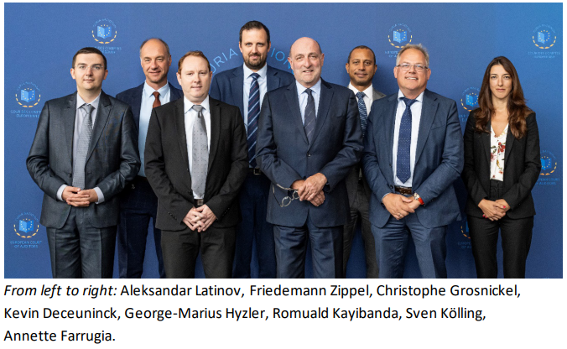
George Hyzler, Member of Chamber II, Investment for cohesion, growth and inclusion
Reporting Member for:
Task name | Product type | Objective of the task | Publication date
Cohesion’s Action for Refugees in Europe (CARE) | Special report | To examine whether member states deployed EU CARE/FAST Cohesion policy funds effectively, efficiently and economically to support refugees fleeing from Russia’s invasion of Ukraine. | Jan 2025
State aid in times of crisis | Special report | To assess how the Commission adjusted state aid rules to ensure their effective application following COVID-19 and the invasion of Ukraine, and to examine how member states applied these rules. | Oct 2024
Slide 27

Slide 29
November 2024
Special Report N°21/2024:
State aid in times of crisis
Swift reaction but shortcomings in the Commission’s monitoring and inconsistencies in the framework to support the EU’s industrial policy objectives

Slide 30

Why did we do this audit?
Unprecedented amounts of state aid, which the Commission approved to remedy the economic disturbance from COVID 19 and Russia’s invasion of Ukraine
Importance of state aid rules for supporting the achievement of the Green Deal and the EU’s industrial policy objectives
Many member states chose to use significant amounts of state aid to support economic recovery, strategic autonomy and the transition towards net-zero emission industry

Slide 31
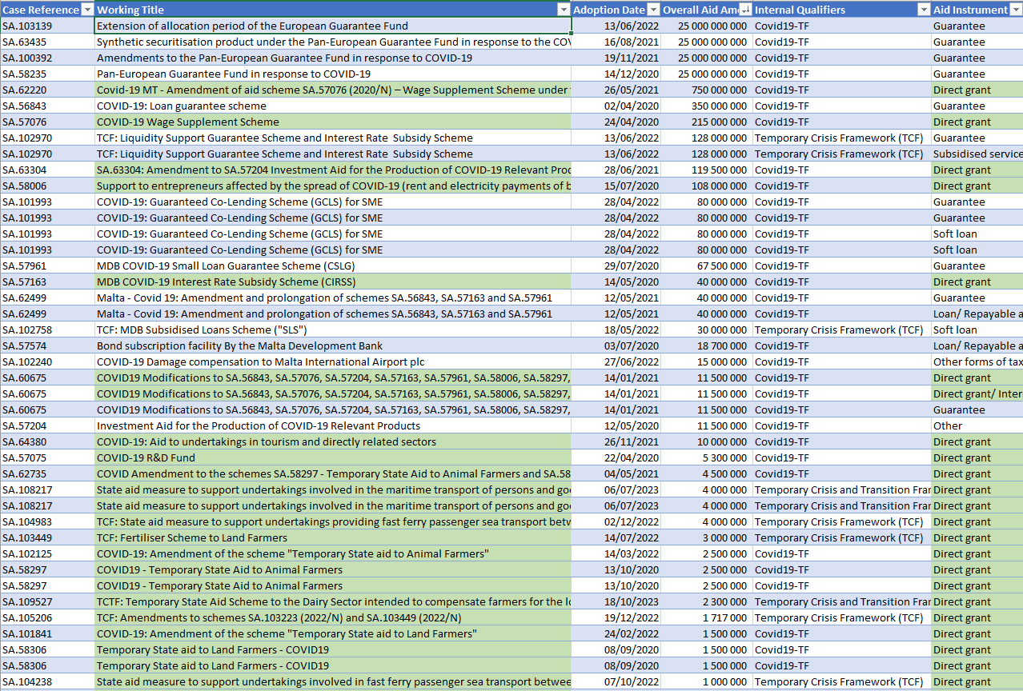
Why did we do this audit? (Malta)

Slide 32

What did we look at?
We reviewed the relevant temporary crisis frameworks that the Commission had established for approving national state aid measures since the outbreak of the COVID‑19 pandemic in 2020 and the Russian invasion of Ukraine in 2022;
We analysed a sample of 30 crisis‑related state aid notifications approved by the Commission from March 2020 to June 2023; and
We examined the information and resources available to the Commission to identify and follow‑up infringements of crisis‑related state aid rules.
We visited Germany, France, the Netherlands and Poland.

Slide 33

What did we find? (1/2)
The Commission adopted temporary frameworks swiftly and reviewed state aid cases , but conditions for targeting of state aid were not always well defined
1
2
The Commission’s review of crisis related state aid cases was rapid but often based on limited information on measures adopted by member states
3
The Commission reduced its monitoring of state aid schemes during the crises and has not yet evaluated the impact of temporary frameworks on competition

Slide 34
What did we find? (2/2)
Member states granted aid under the temporary frameworks below the amounts approved, but reporting is unreliable
4
Inconsistencies in the different frameworks and guidelines for state aid currently supporting the European Green Deal and other industrial policy objectives
5

Slide 35
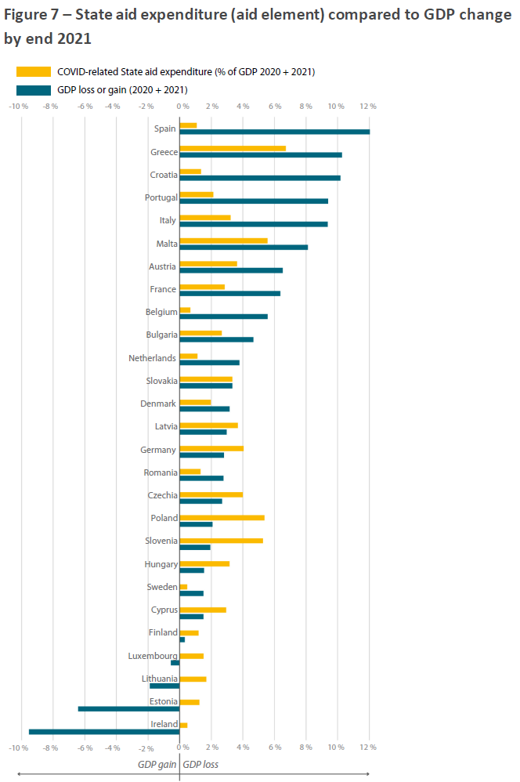
State aid expenditure compared to GDP change

Slide 36

What do we recommend?
1
Strengthen the assessment and monitoring of state aid schemes
2
Evaluate the impact of crisis related state aid on competition
3
Enhance the transparency of state aid and improve state aid reporting for evidence based policy making
4
Improve analysis of the need for state aid to support EU industrial policy objectives

Slide 37
European Court of Auditors
Work related to ethics

Slide 38
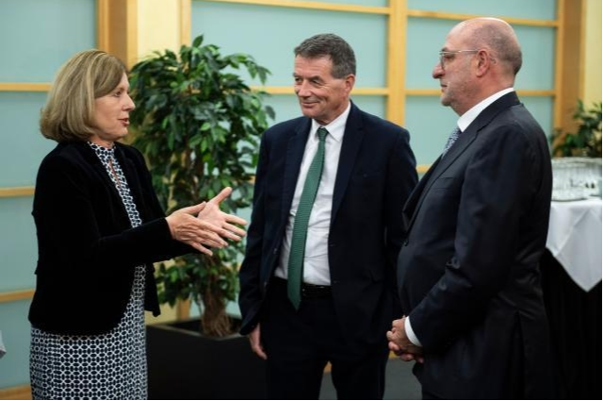
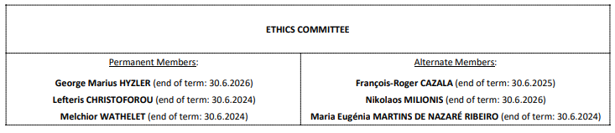
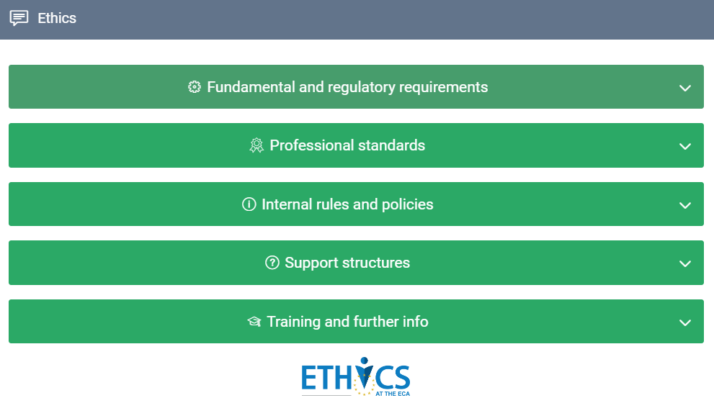
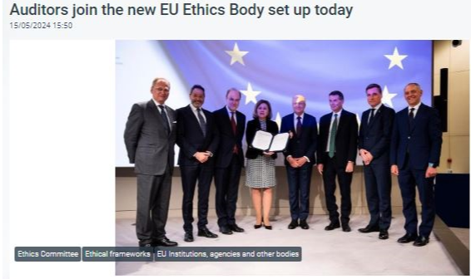
ECA Representative to the EU Inter-institutional ethics body
Chairperson of the Ethics Committee
Slide 38

Slide 39
European Court of Auditors
Questions?

Slide 40
Contact Details
George Hyzler
Member
+352 4398 47467
georgemarius.hyzler@eca.europa.eu
European Court of Auditors
12, Alcide de Gasperi
1615 Luxembourg
eca.europa.eu
eca-info@eca.europa.eu
@EUAuditorsECA

