Slide 1

25-06-2024

Slide 4
TEN YEARS OF SPORT MALTA
REACHING THE MISSION, SHOWING THE VISION

Slide 12
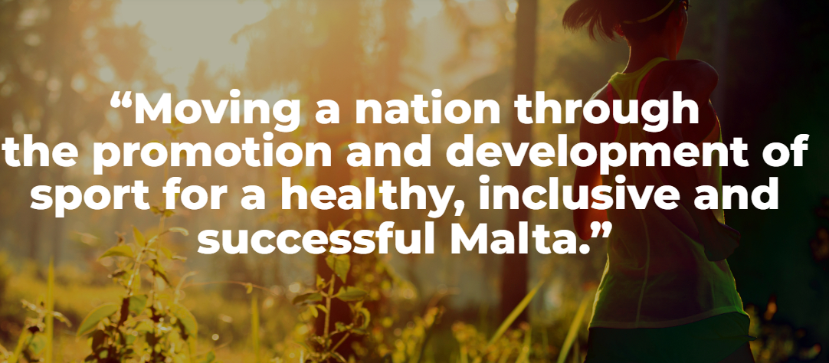

Slide 13
FINANCE

Slide 14
FINANCE

Slide 15
FINANCE

Slide 16
ASSISTANCES TO SPORT ASSOCIATIONS

Slide 17
FACILITIES

Slide 18
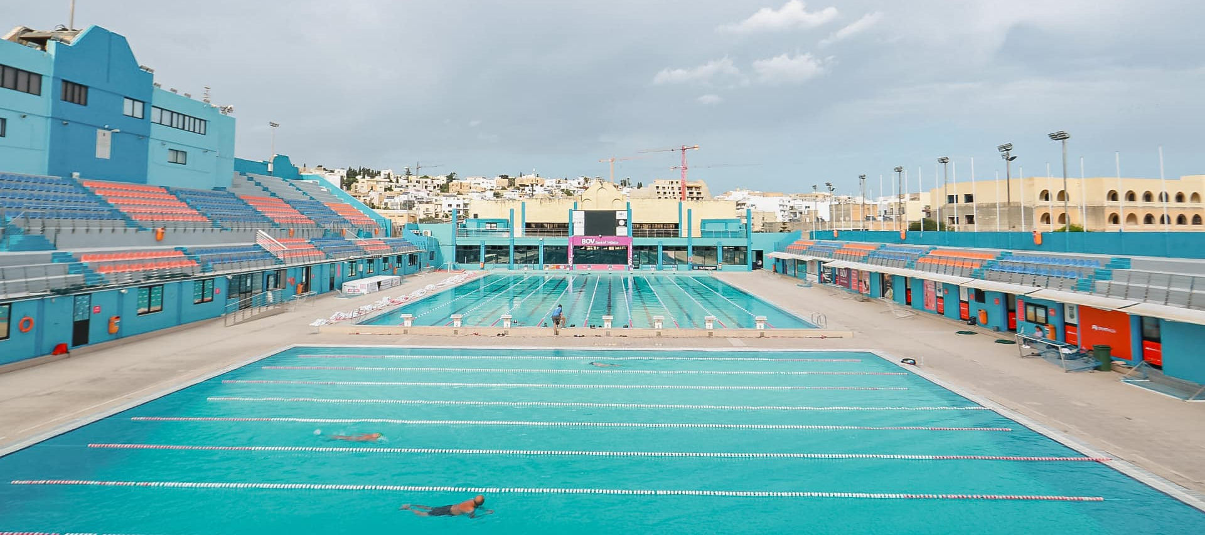
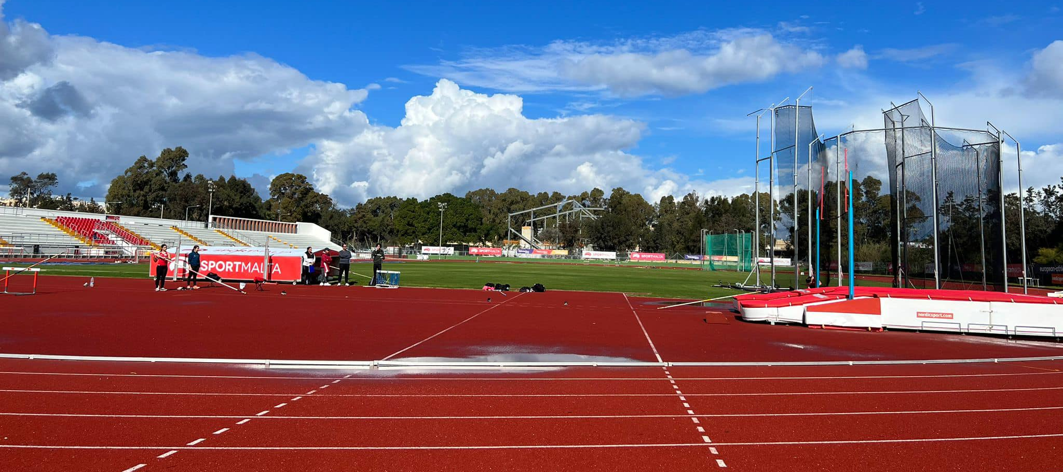
FACILITIES
National Pool Upgrade
Marsa Athletics Track Resurfacing / Stadium / Warm-up track

Slide 19
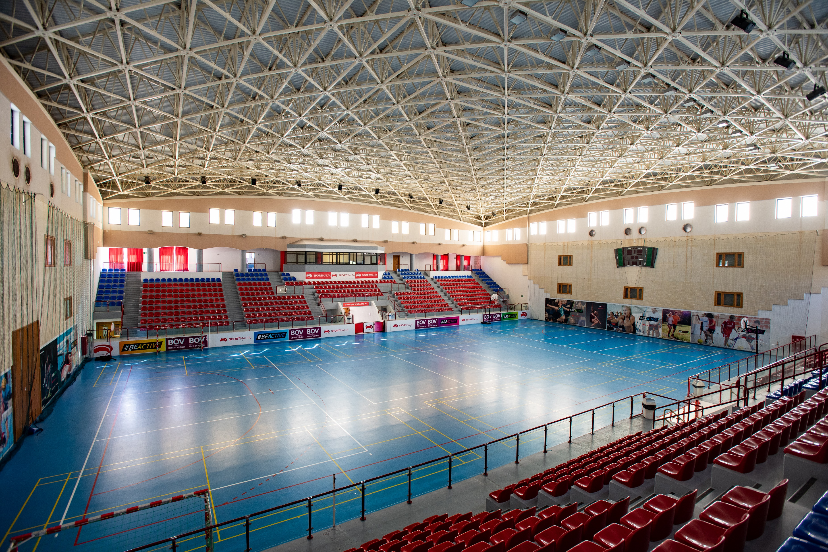
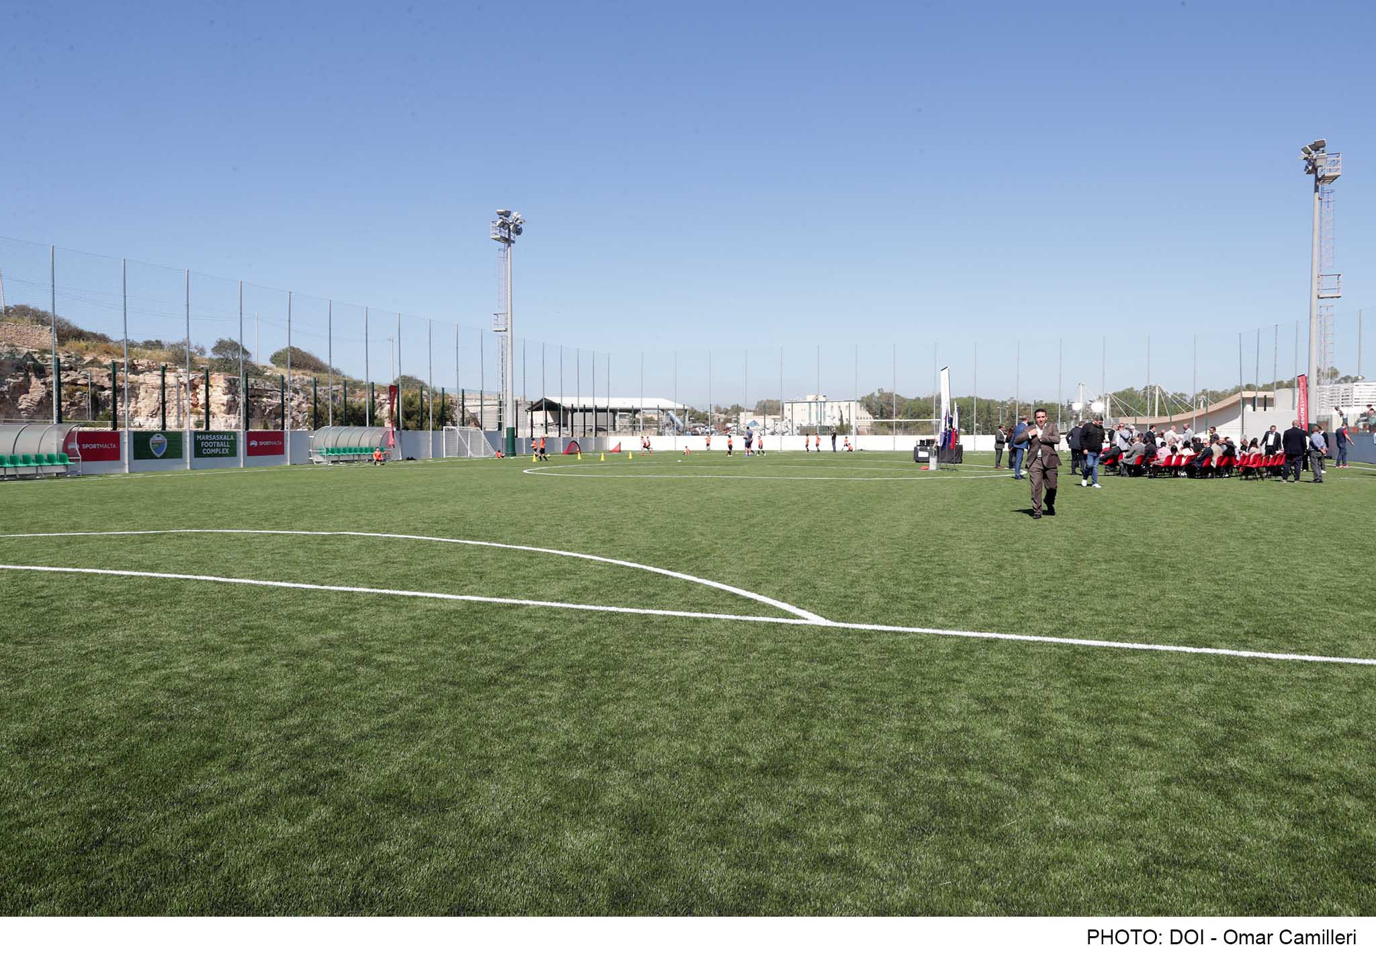
Flooring at Cottonera Sports Complex
Marsascala Football Stadium

Slide 20
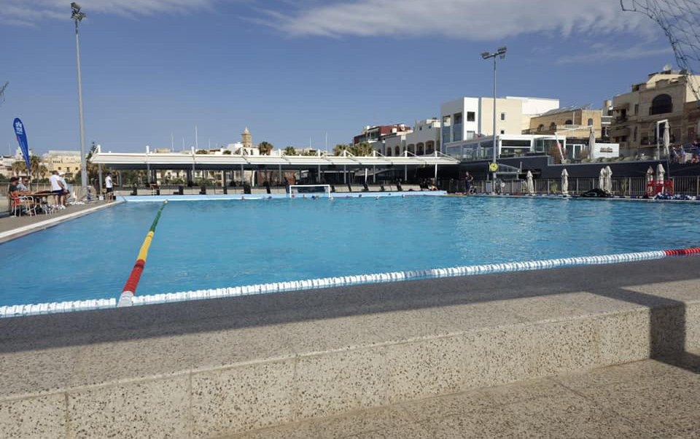
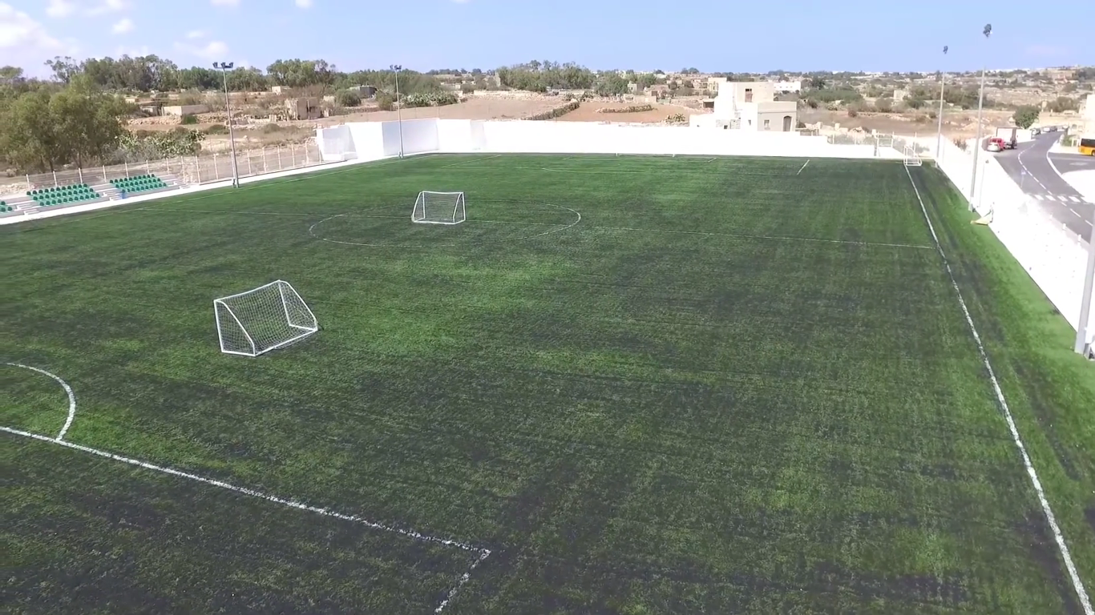
Birżebbuġa Waterpolo Pitch Birżebbuġa Football Stadium

Slide 21
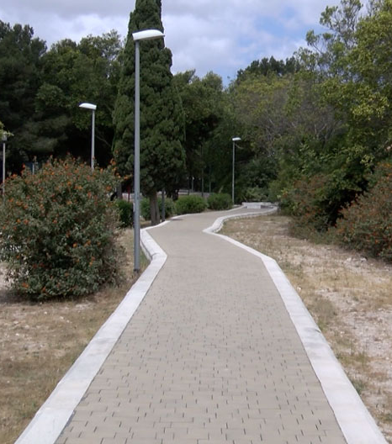
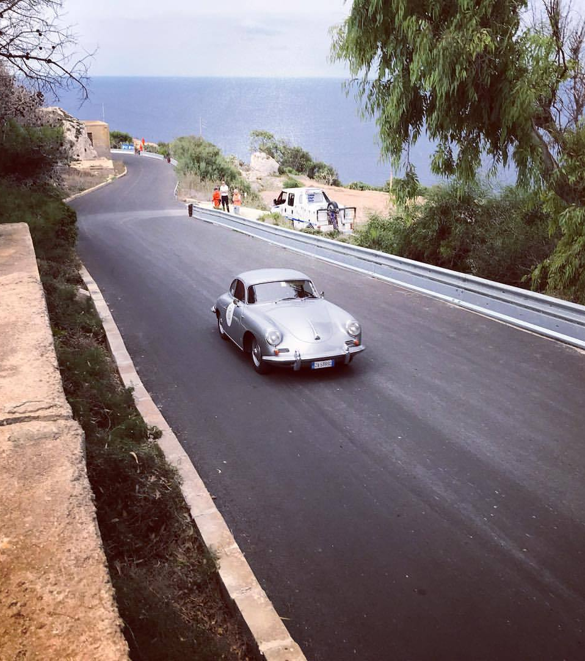
Resurfacing Mtaħleb Hill Climb
Santa Lucia Jogging Track

Slide 22
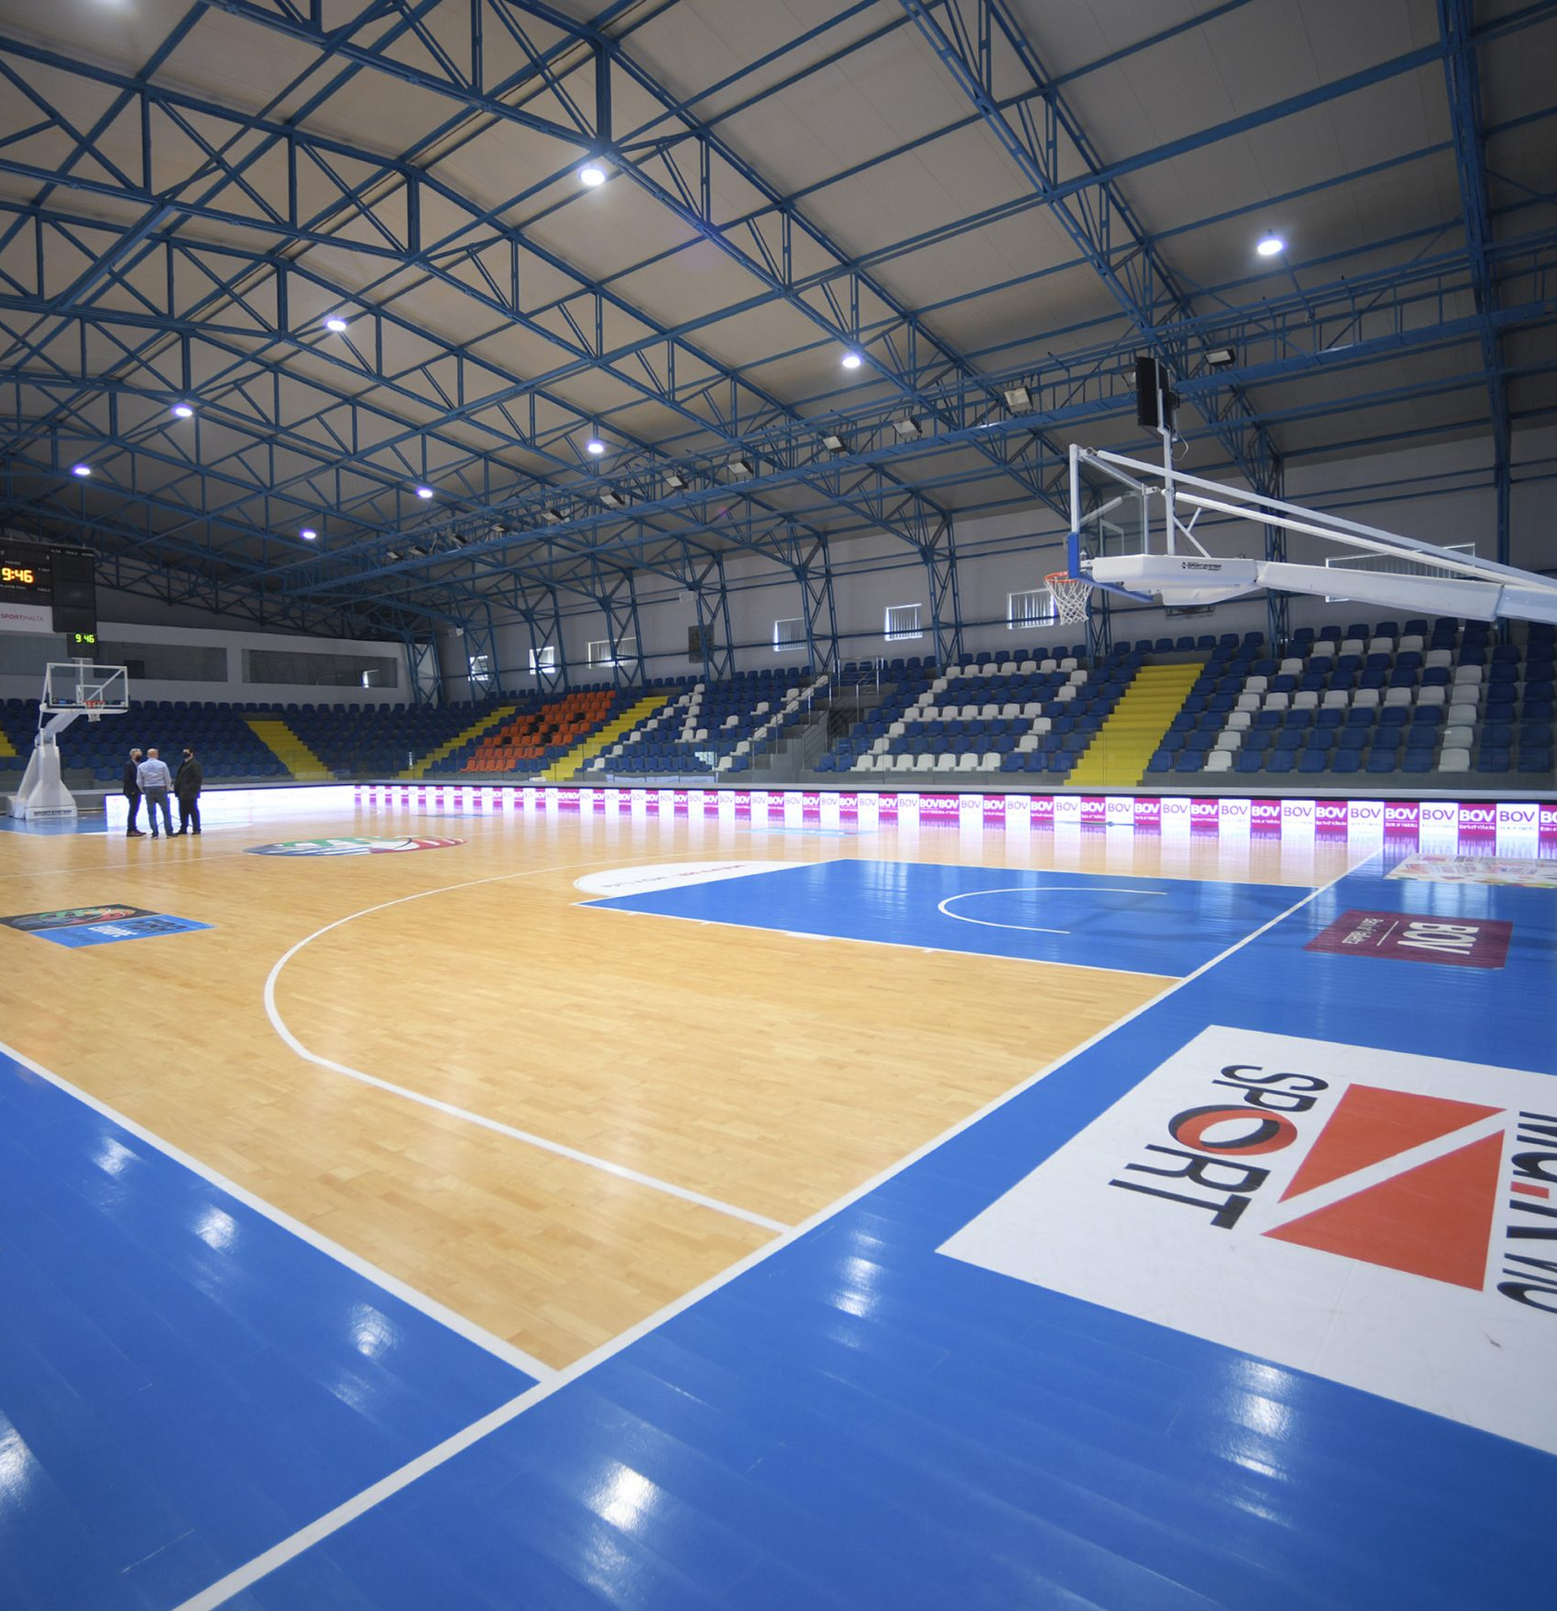
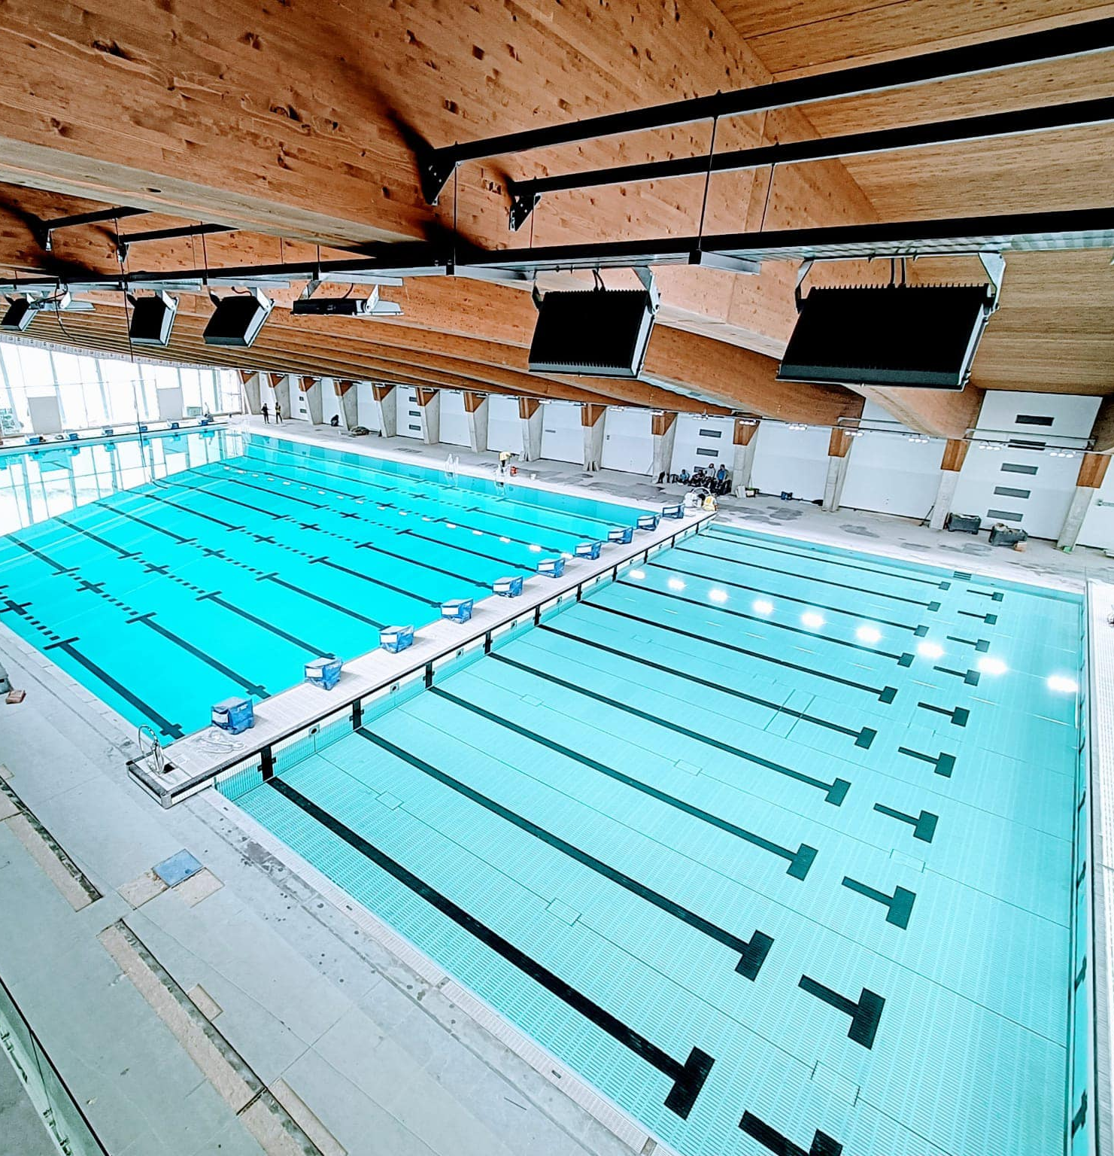
Refurbishment MBA Pavilion
Indoor Pool Cottonera

Slide 23
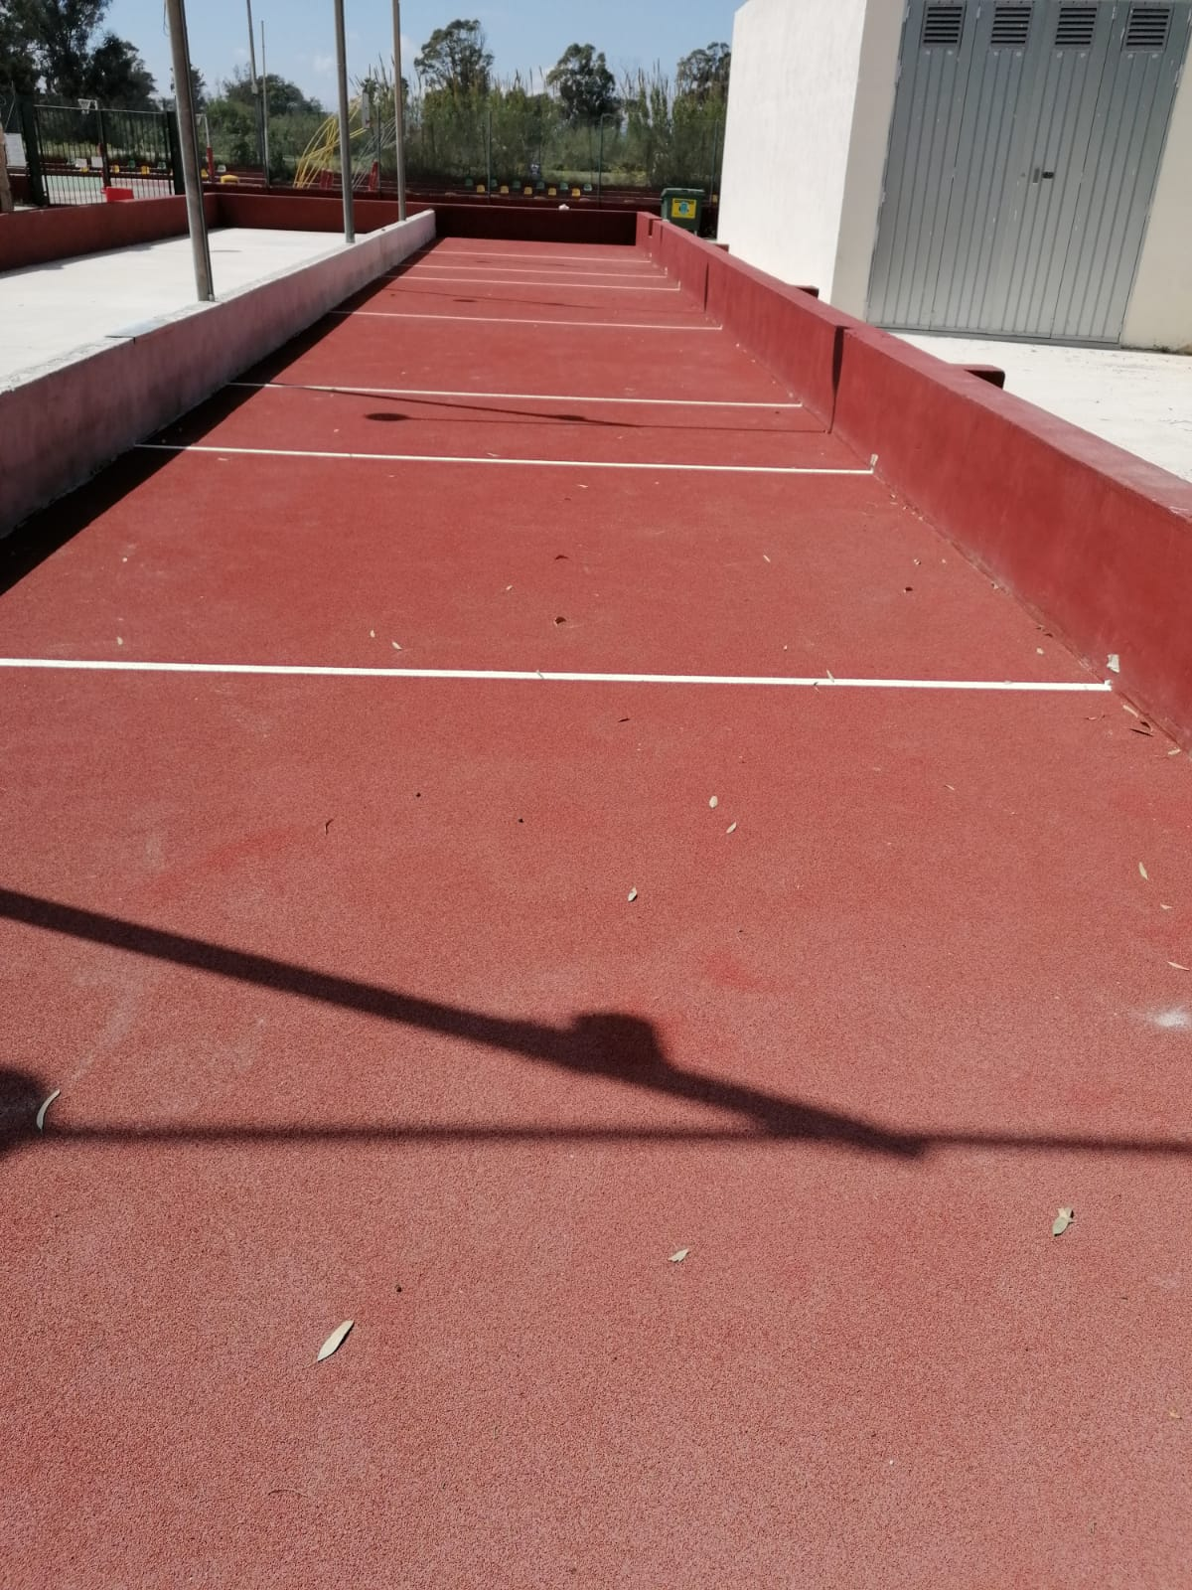
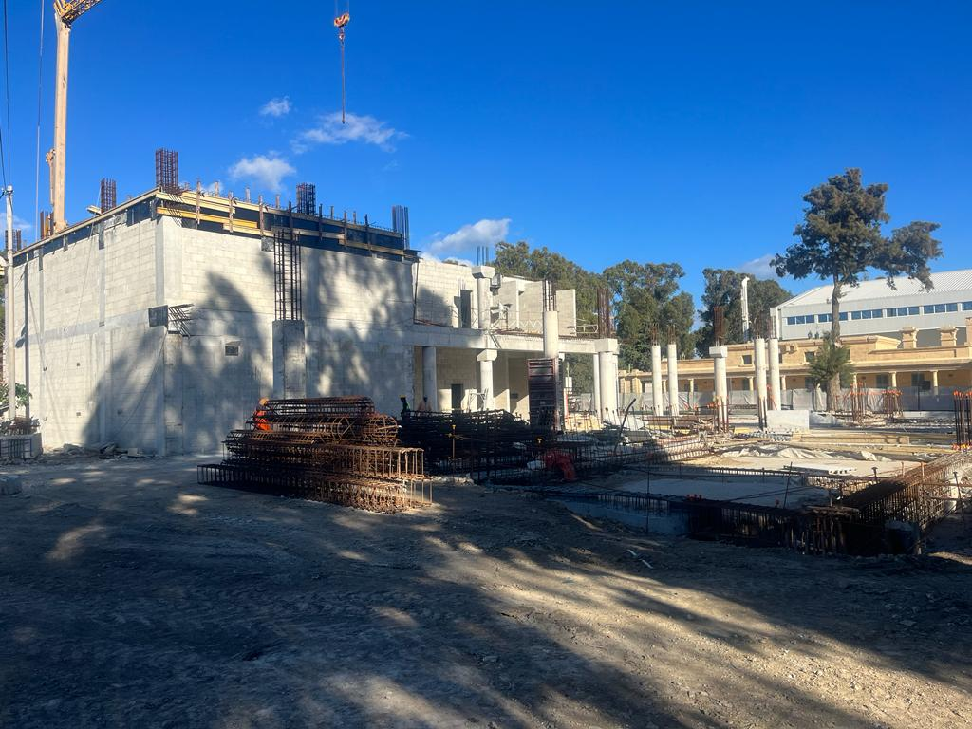
Marsa Squash / Weightlifting / Netball Centre
Raffa Boċċi Marsa

Slide 24
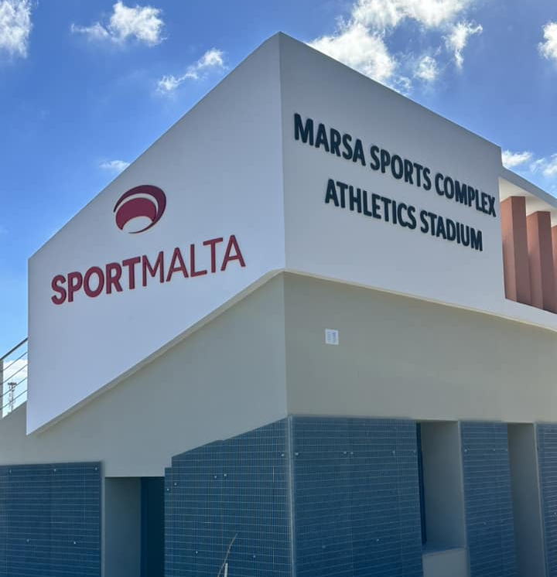
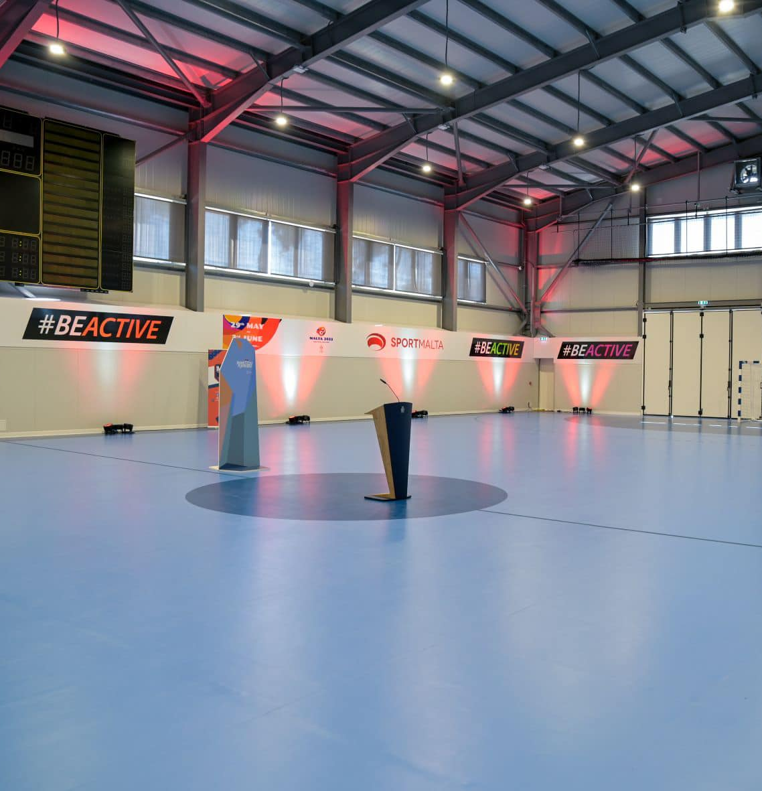
Marsa Sports Complex
Handball Pavilion Maria Assunta

Slide 25
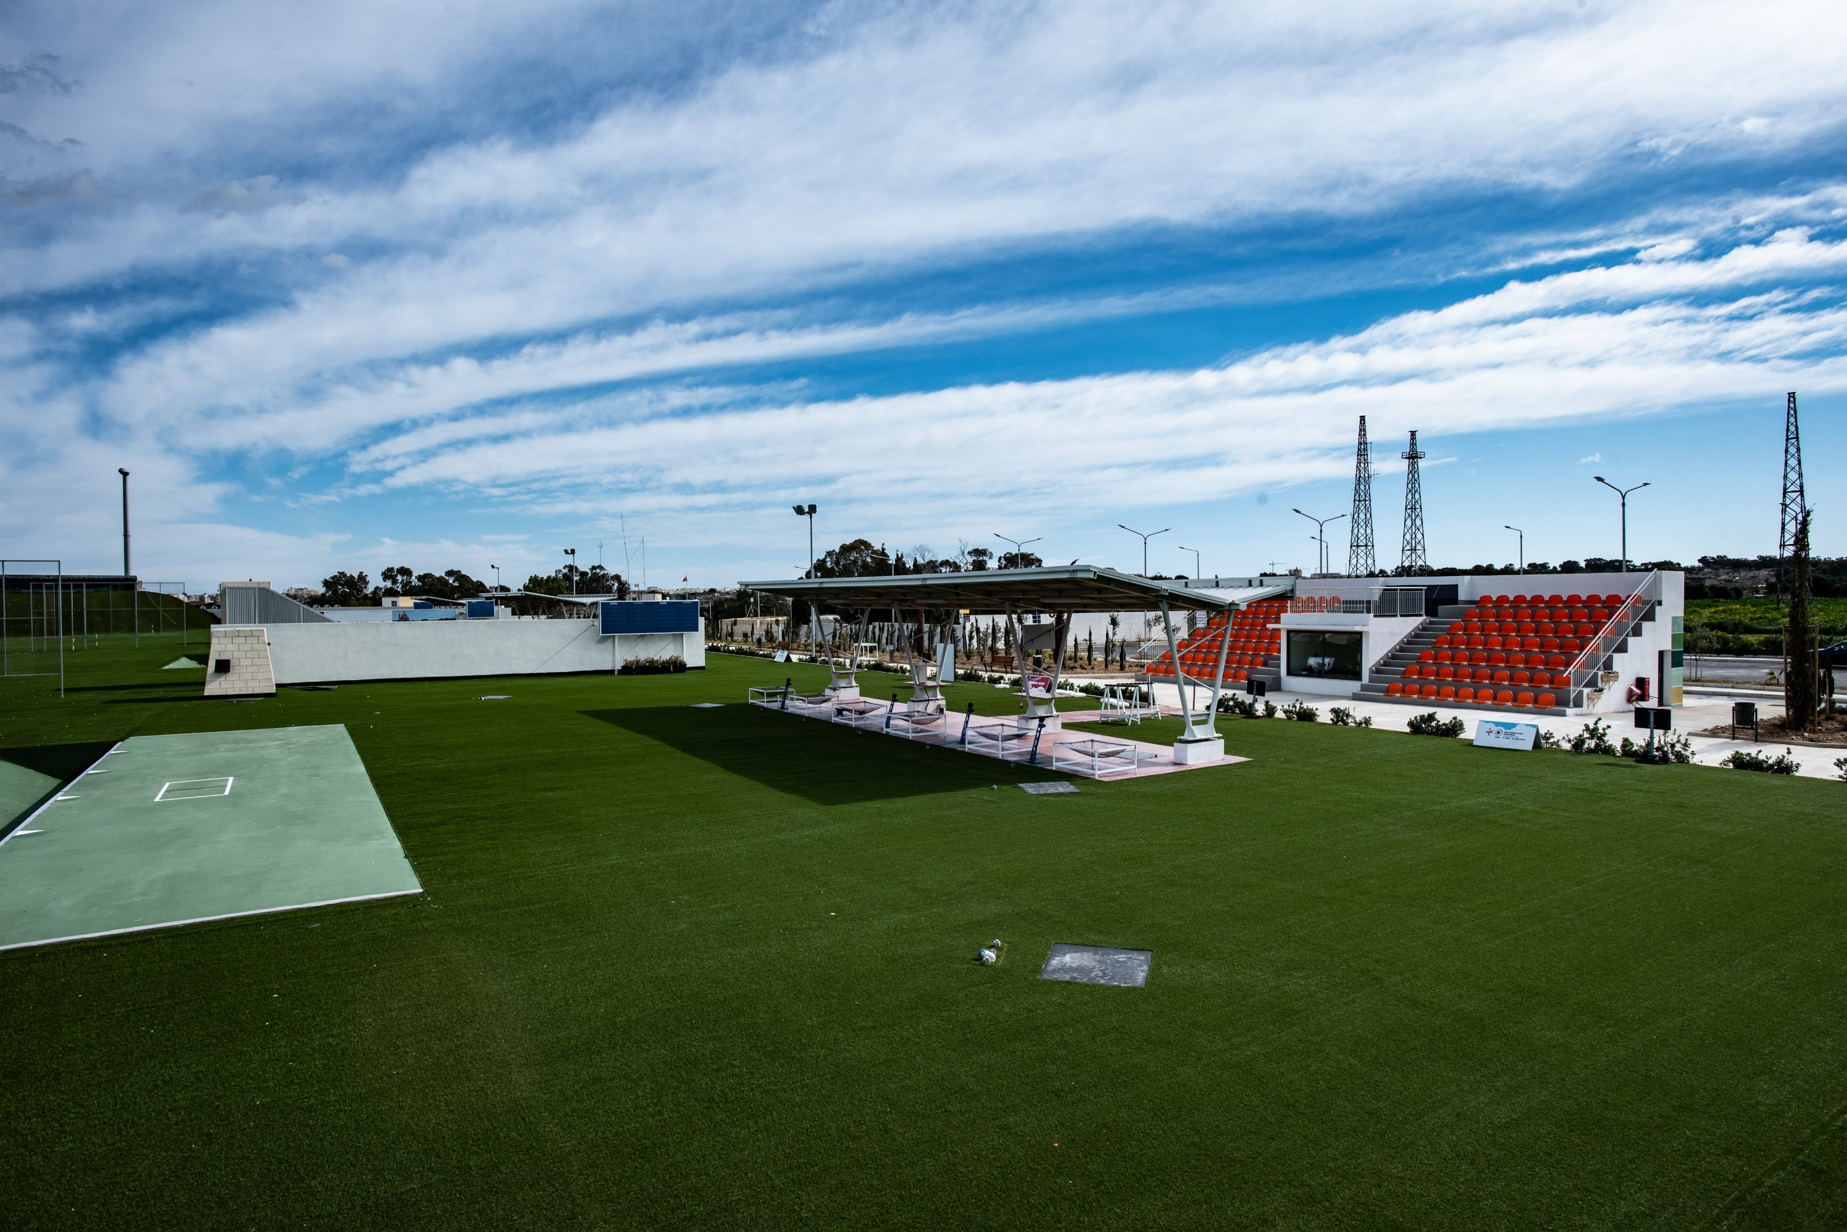
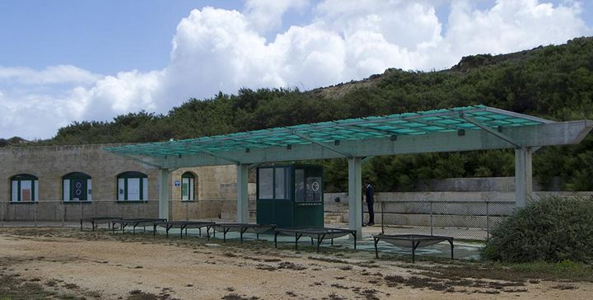
Ta’Kandja Shooting Range
Shooting Range, Gozo

Slide 26
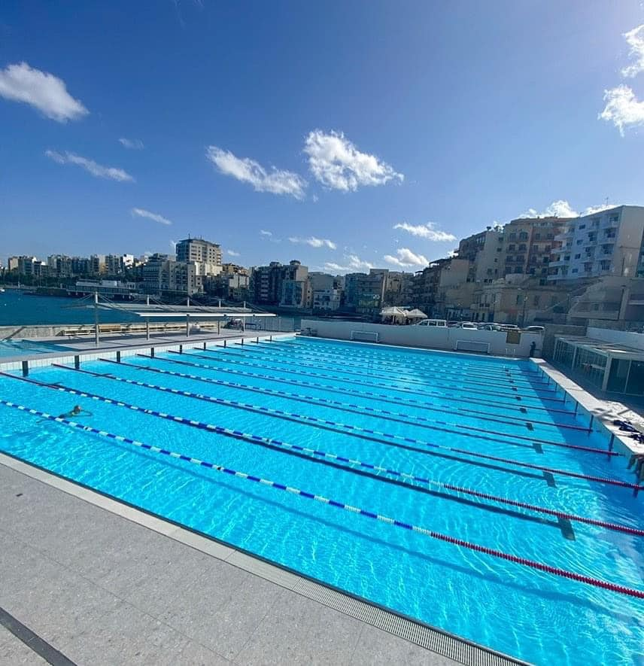
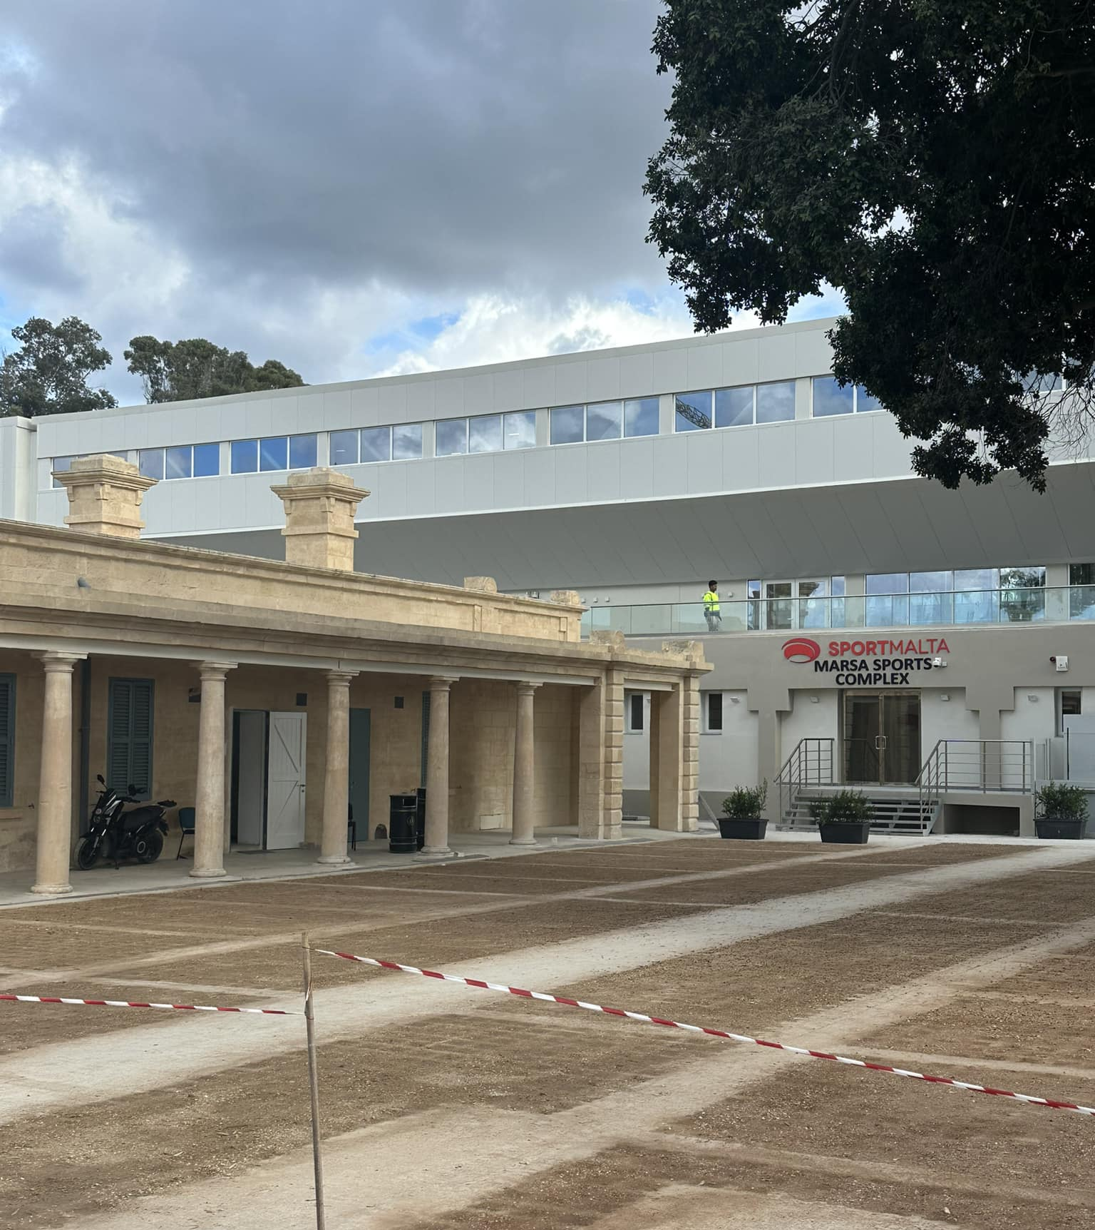
Refurbishment & New Multi-Purpose Facility, Marsa
Sirens Waterpolo Pitch

Slide 27
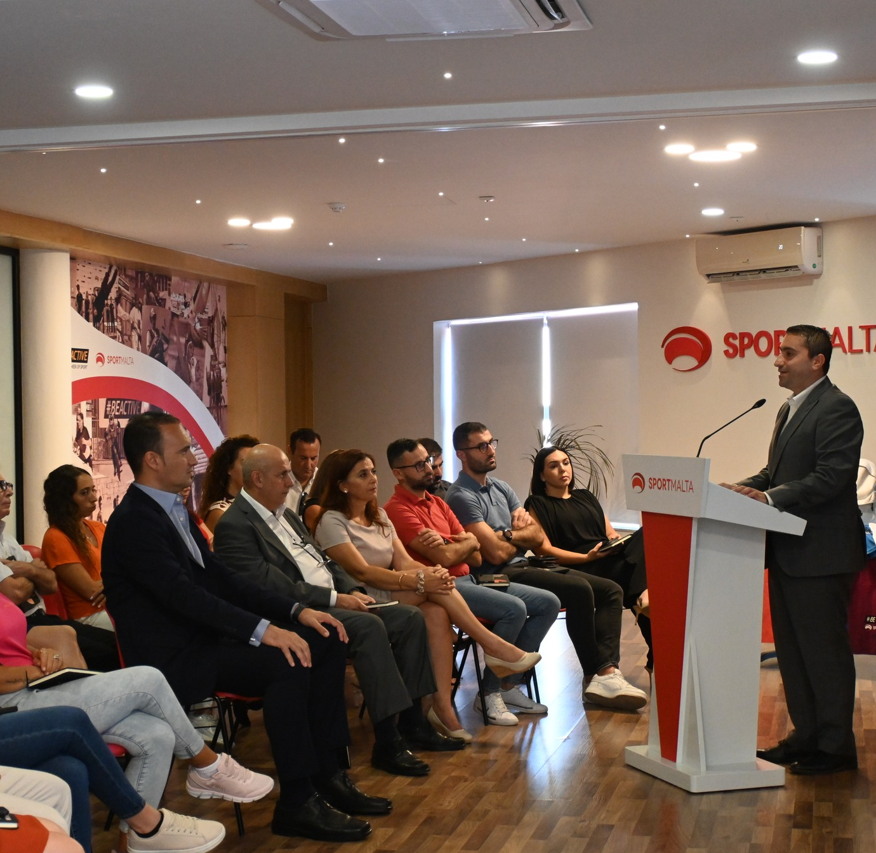
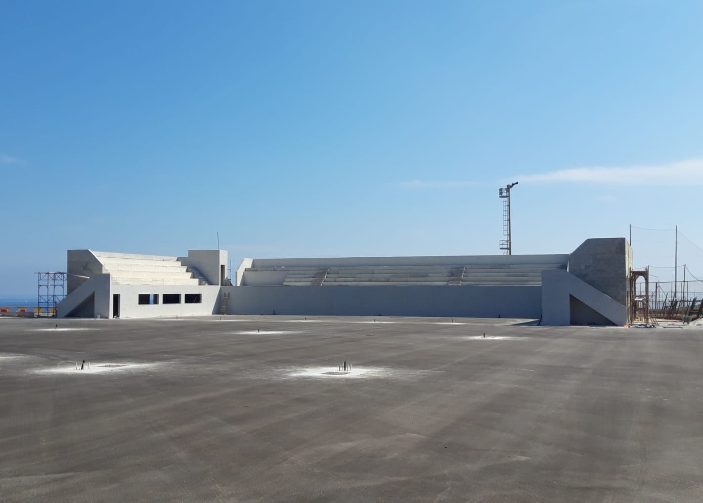
Pembroke Tennis Centre
Sala Teddy Borg

Slide 28
EMPLOYEES

Slide 29
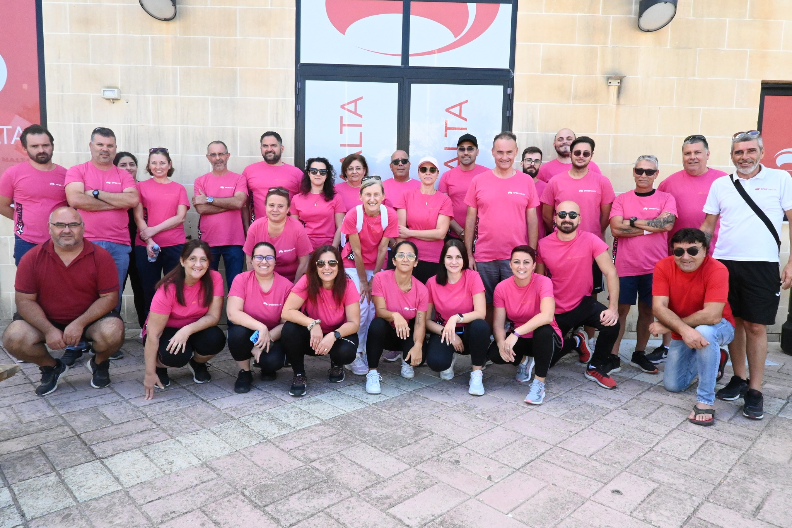
EMPLOYEES
2014: 60 Full Time
2018: 91 Full Time
2024: 107 Full Time

Slide 30
GROWTH OF EUROPEAN WEEK OF SPORT

Slide 31
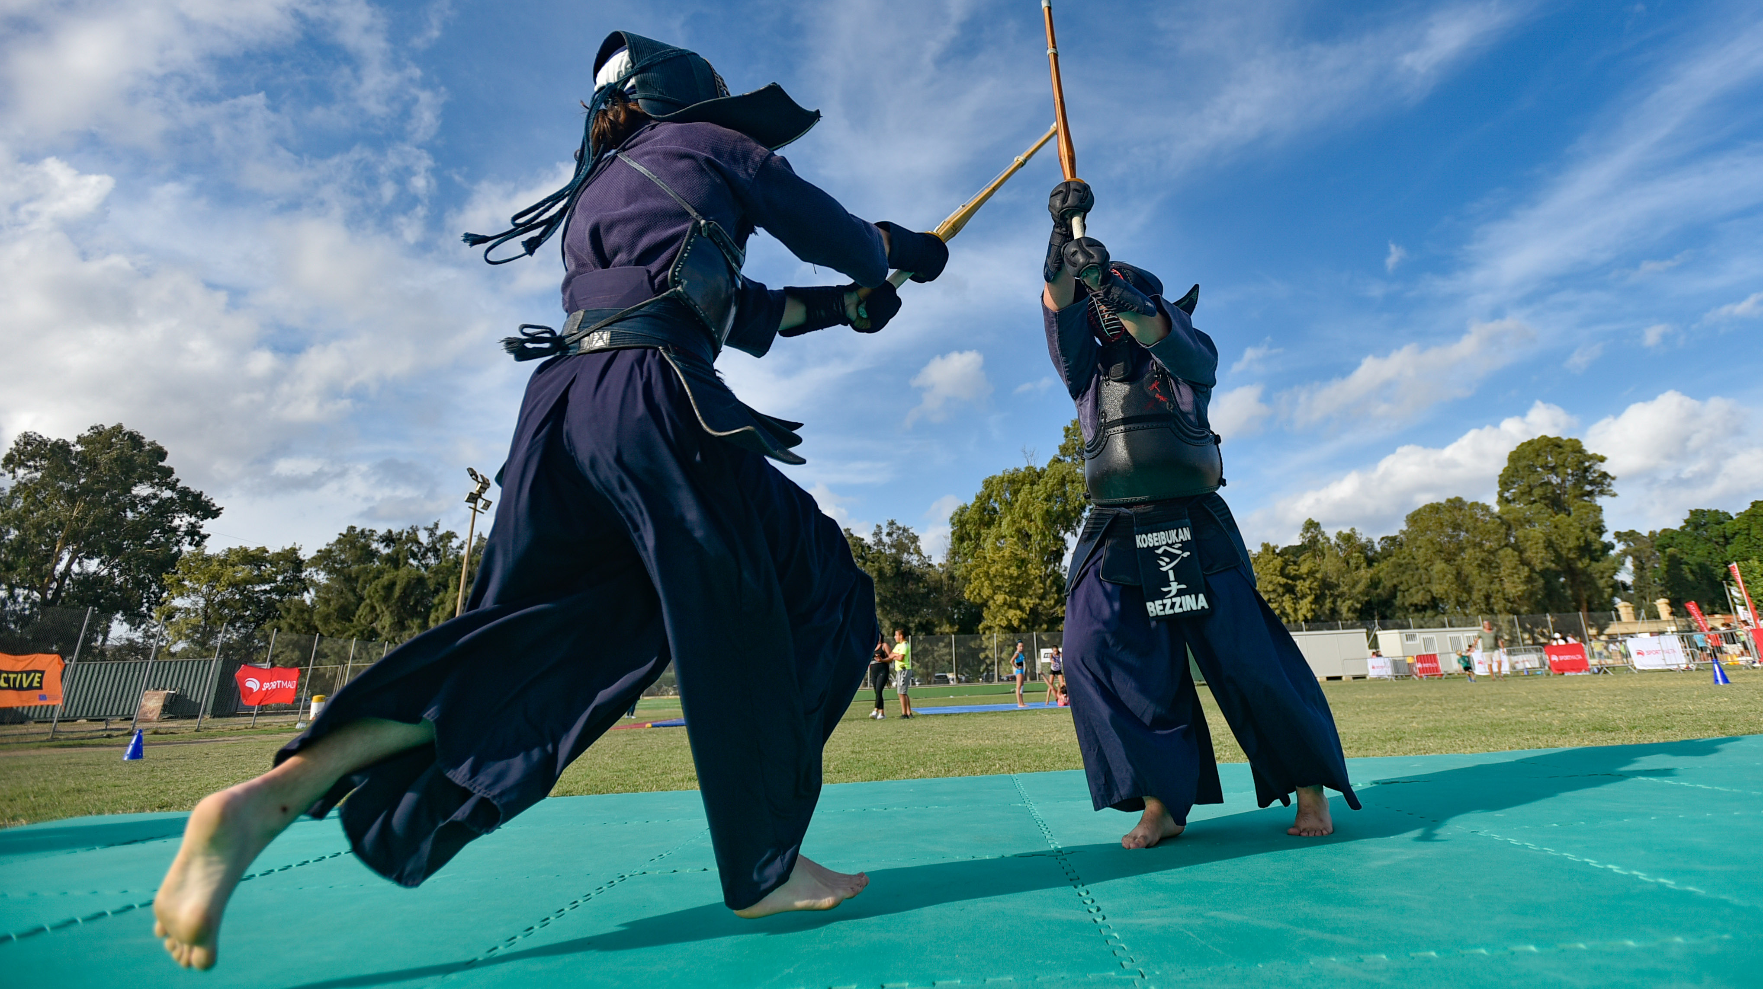
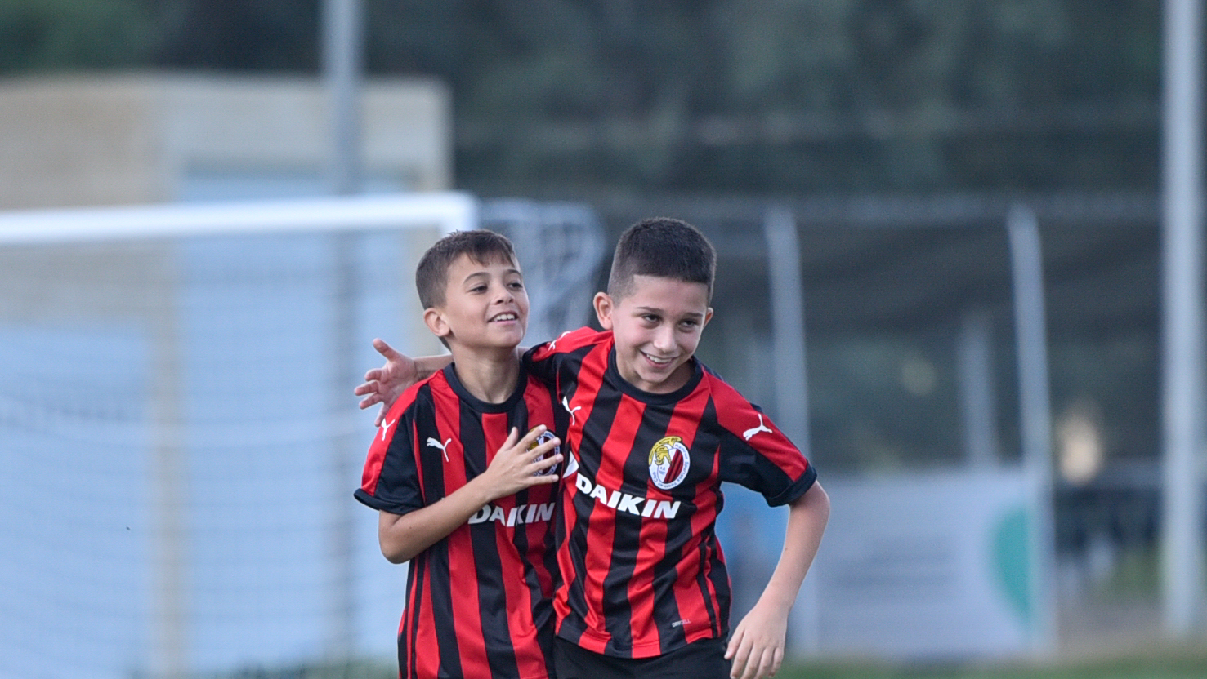
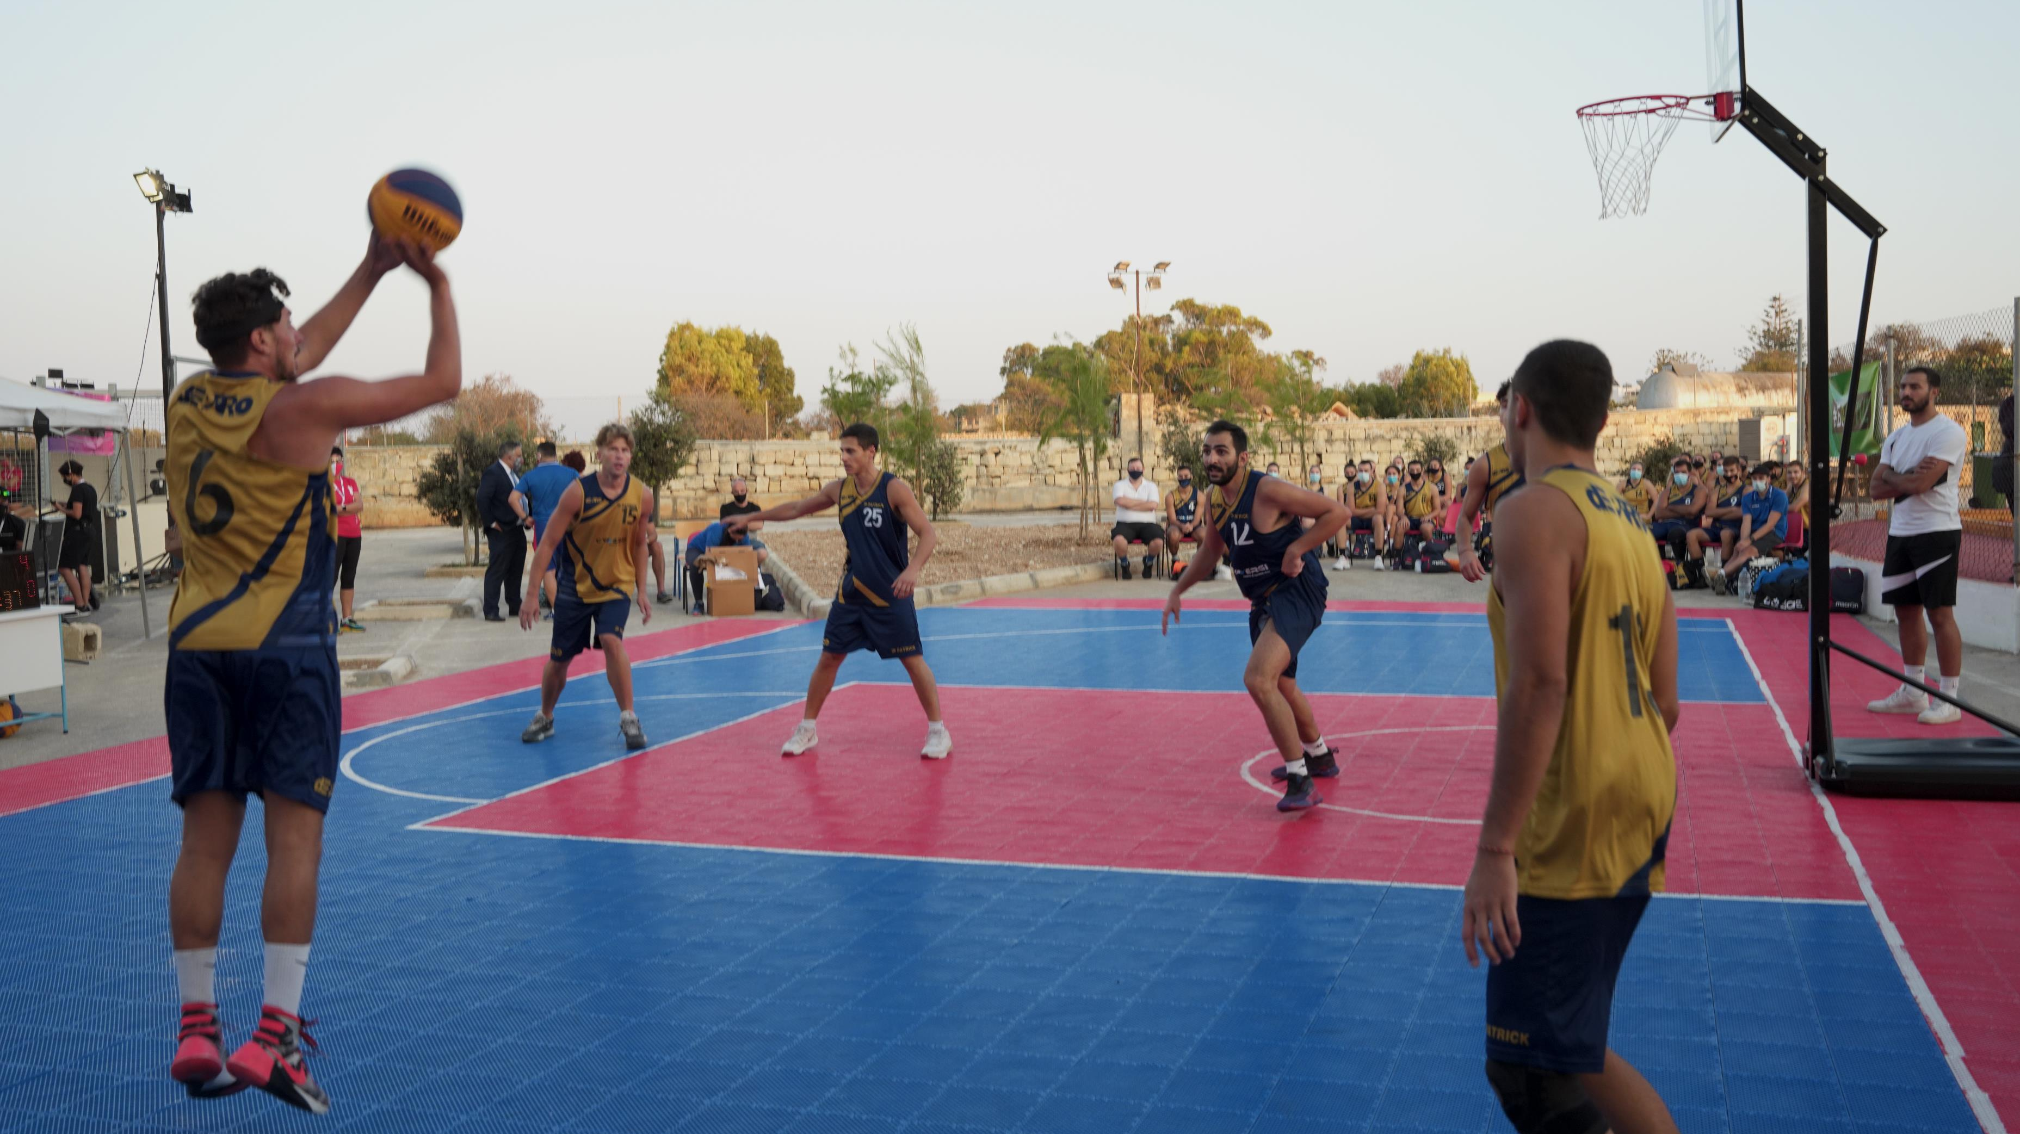
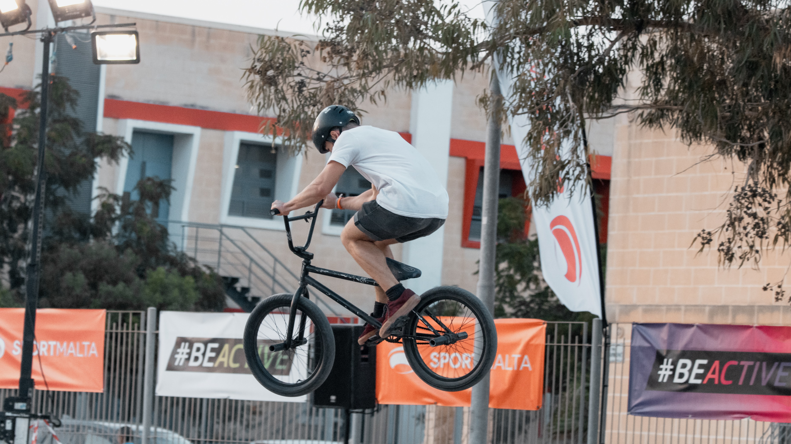
GROWTH OF EWOS
2014 – 2024
- Starting Budget: €60,000 per year
- Budget now: €160,000 per year

Slide 32
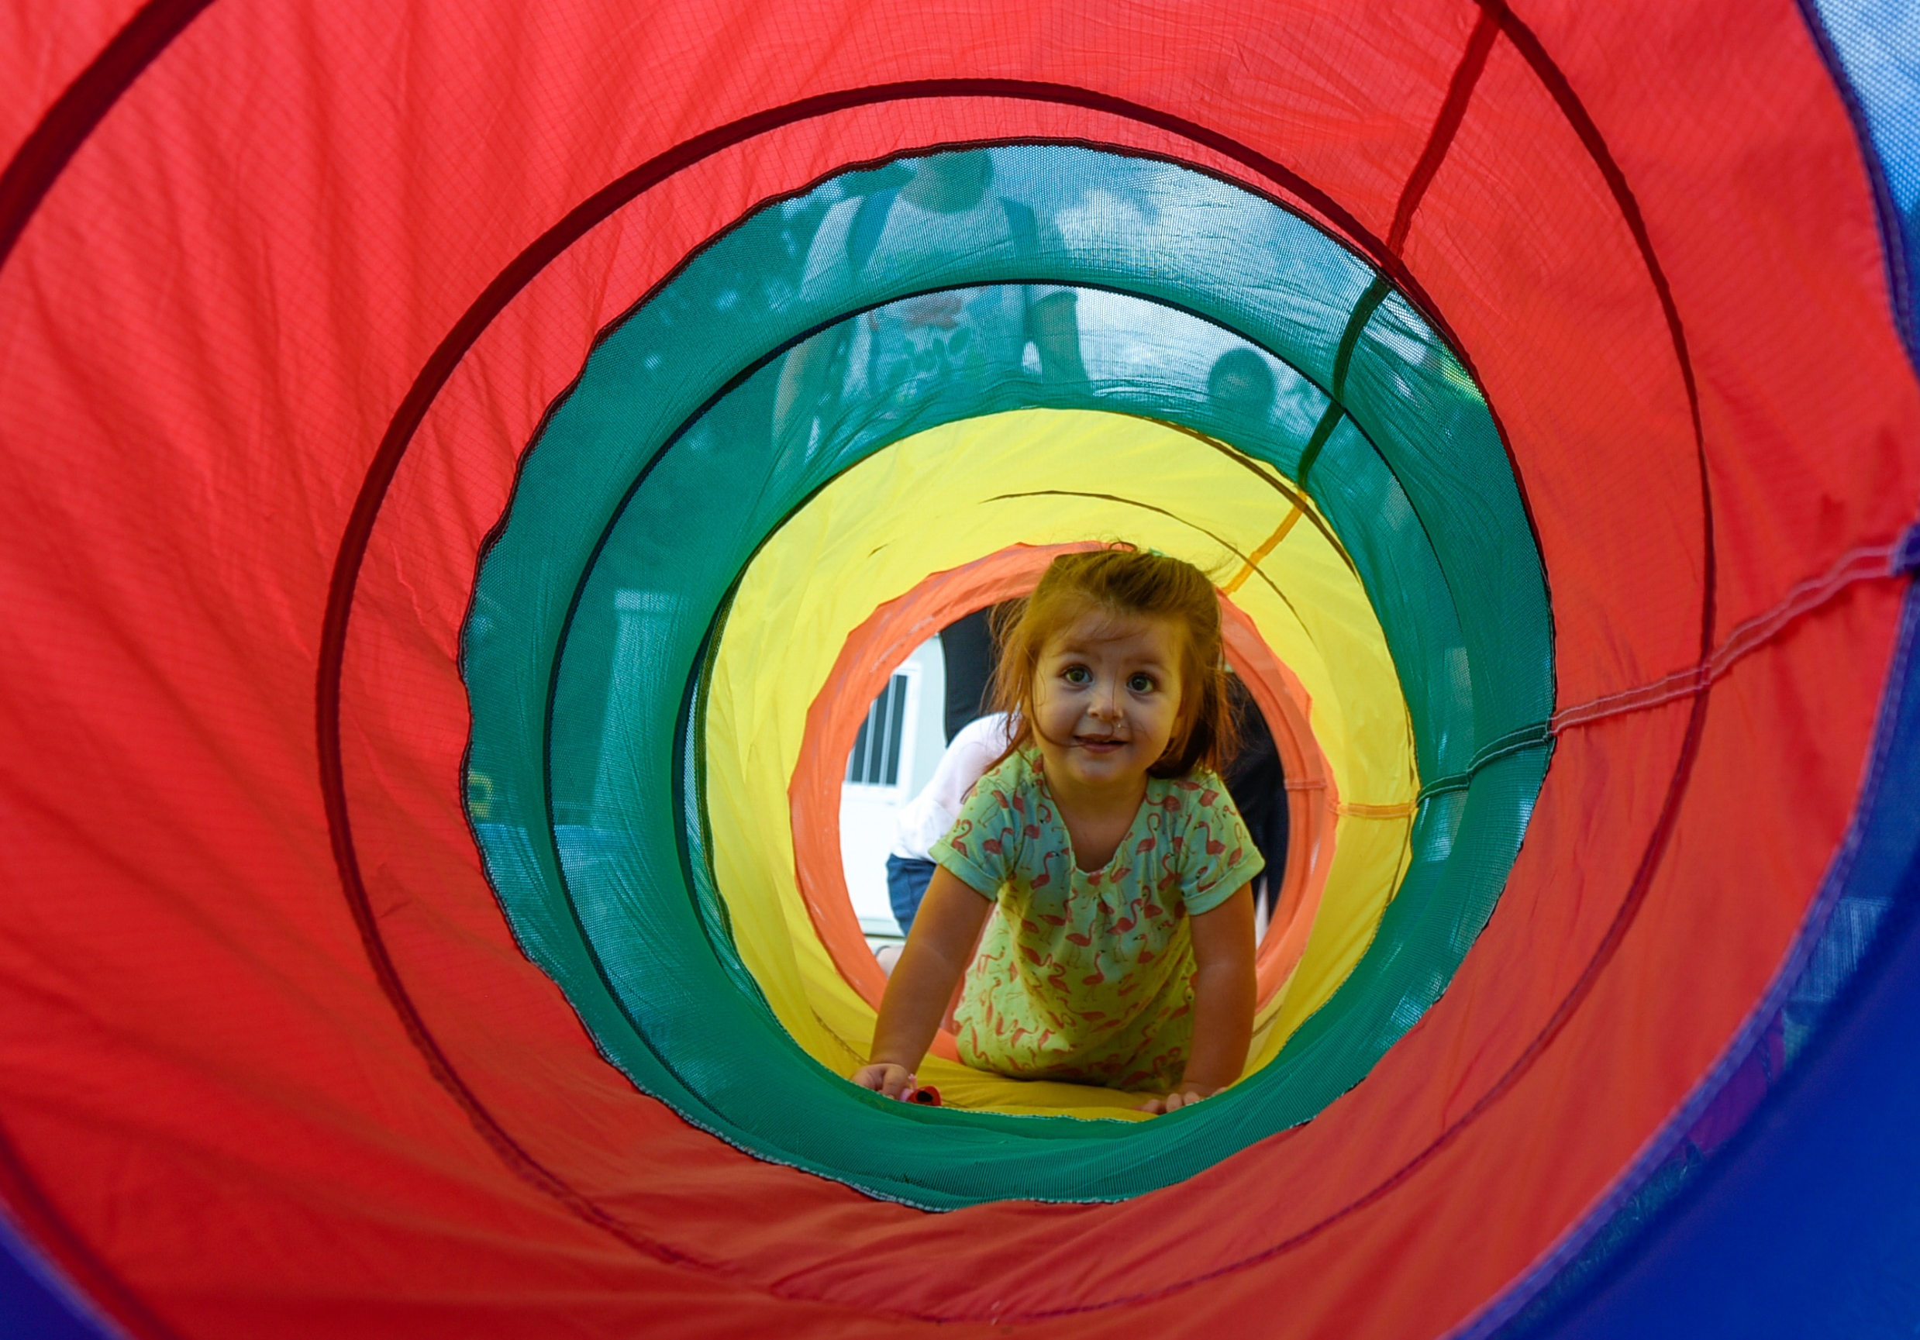
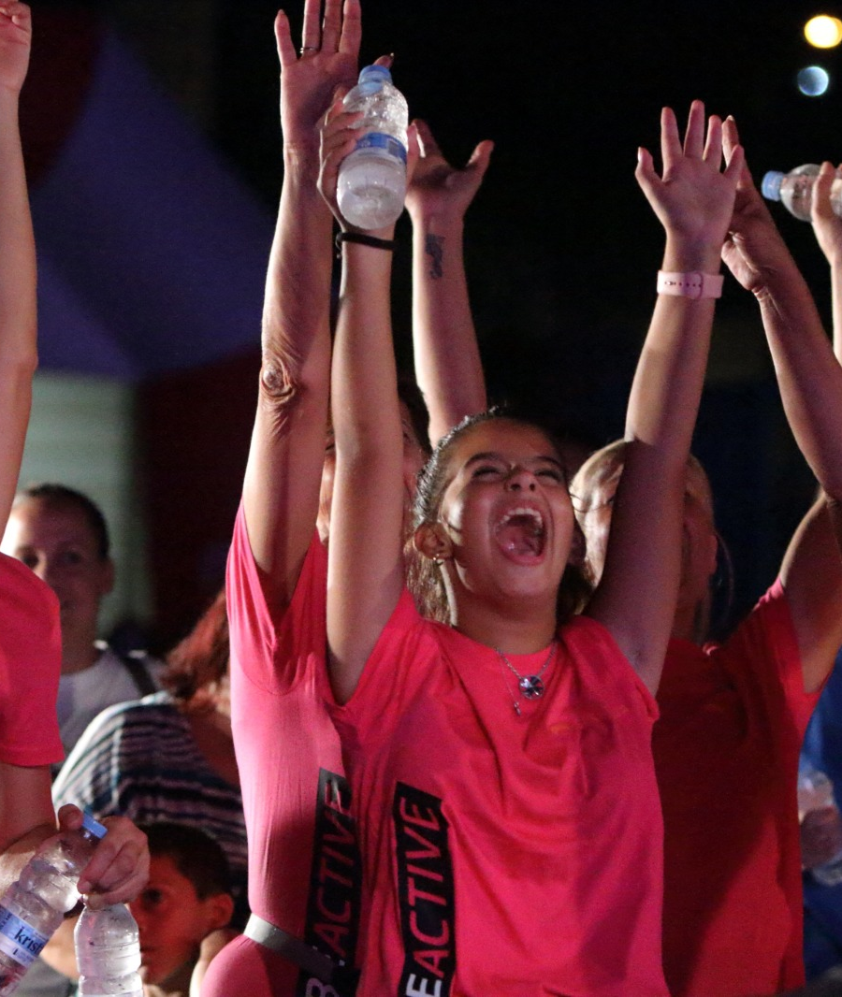
Inactivity Rate: 2014 - 75%
Inactivity Rate: 2018 - 56%
Inactivity Rate: 2022 - 31%

Slide 33
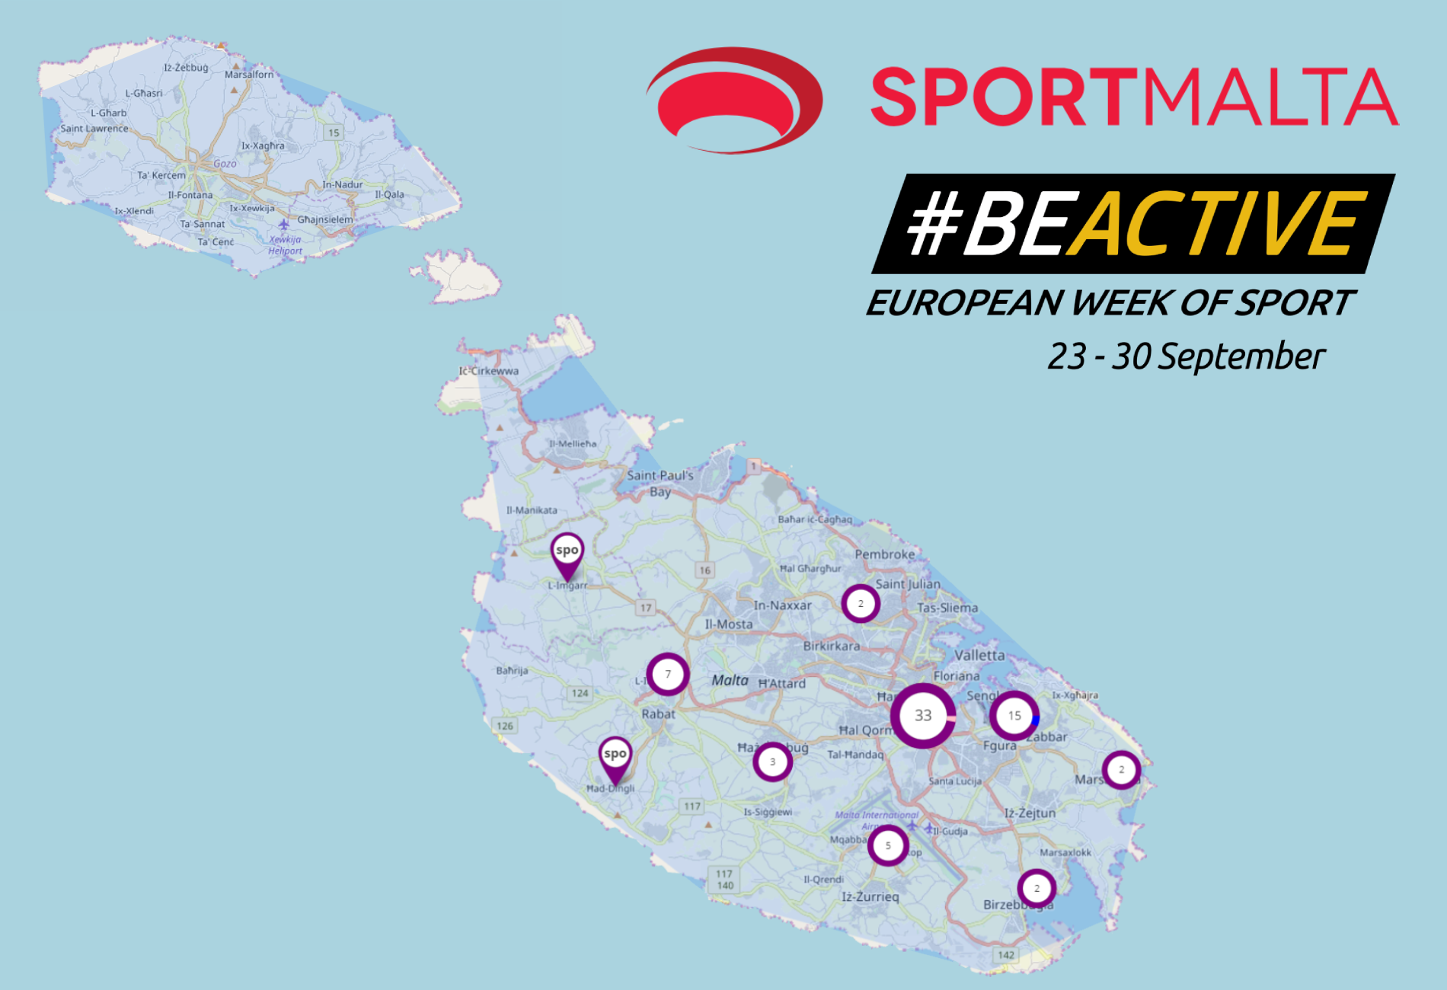
2023 – 125 events around Malta & Gozo

Slide 34
#OnTheMove

Slide 35
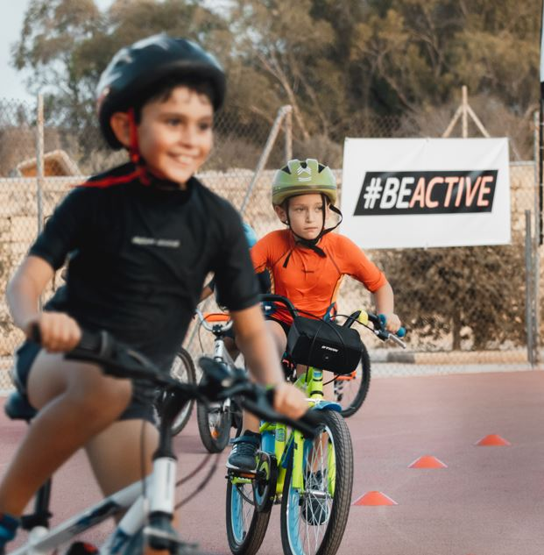
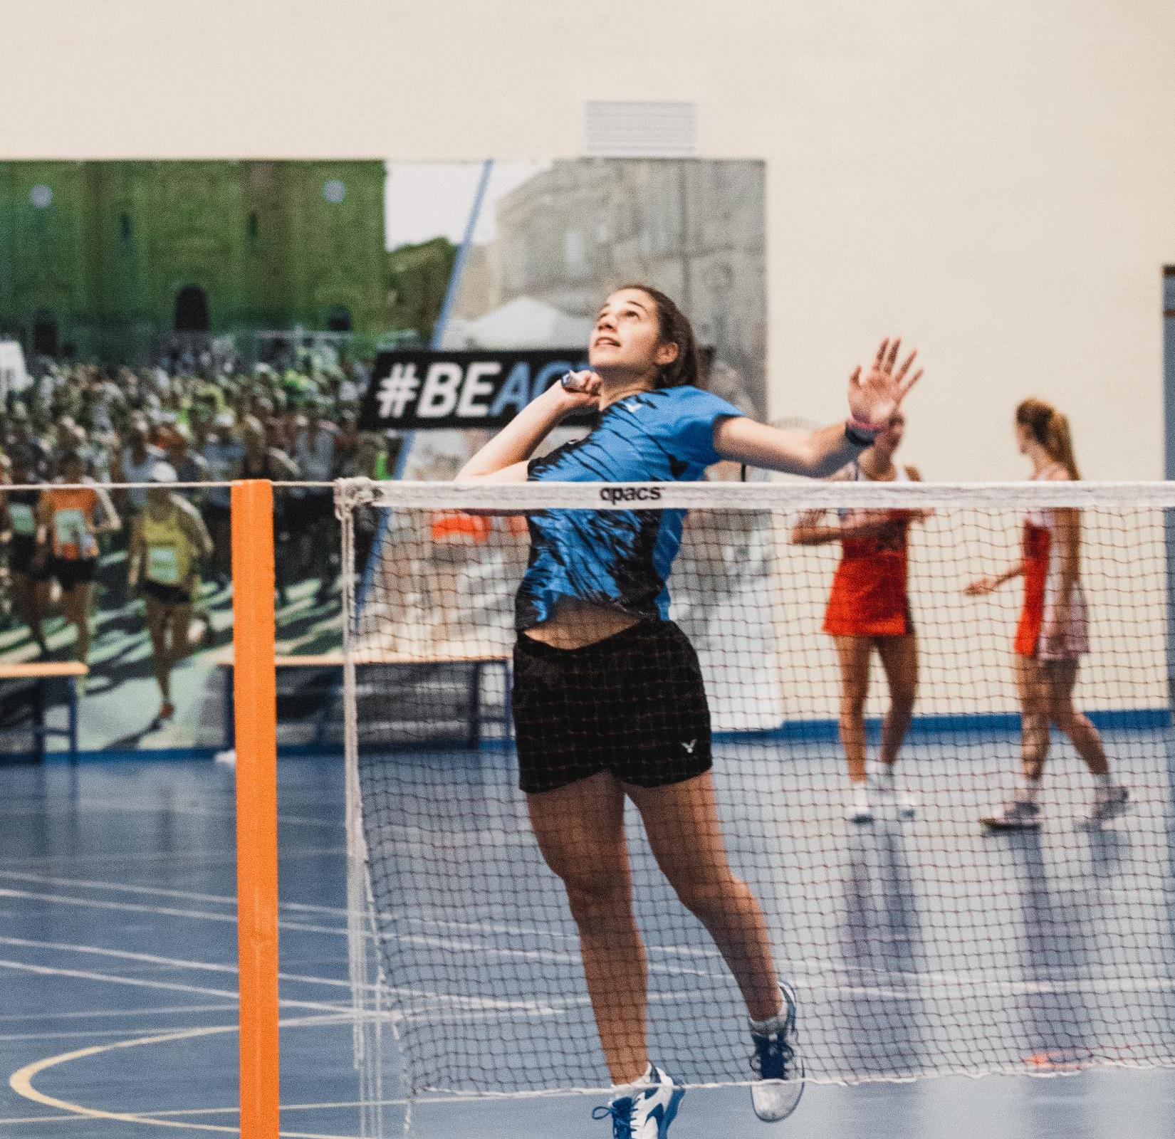
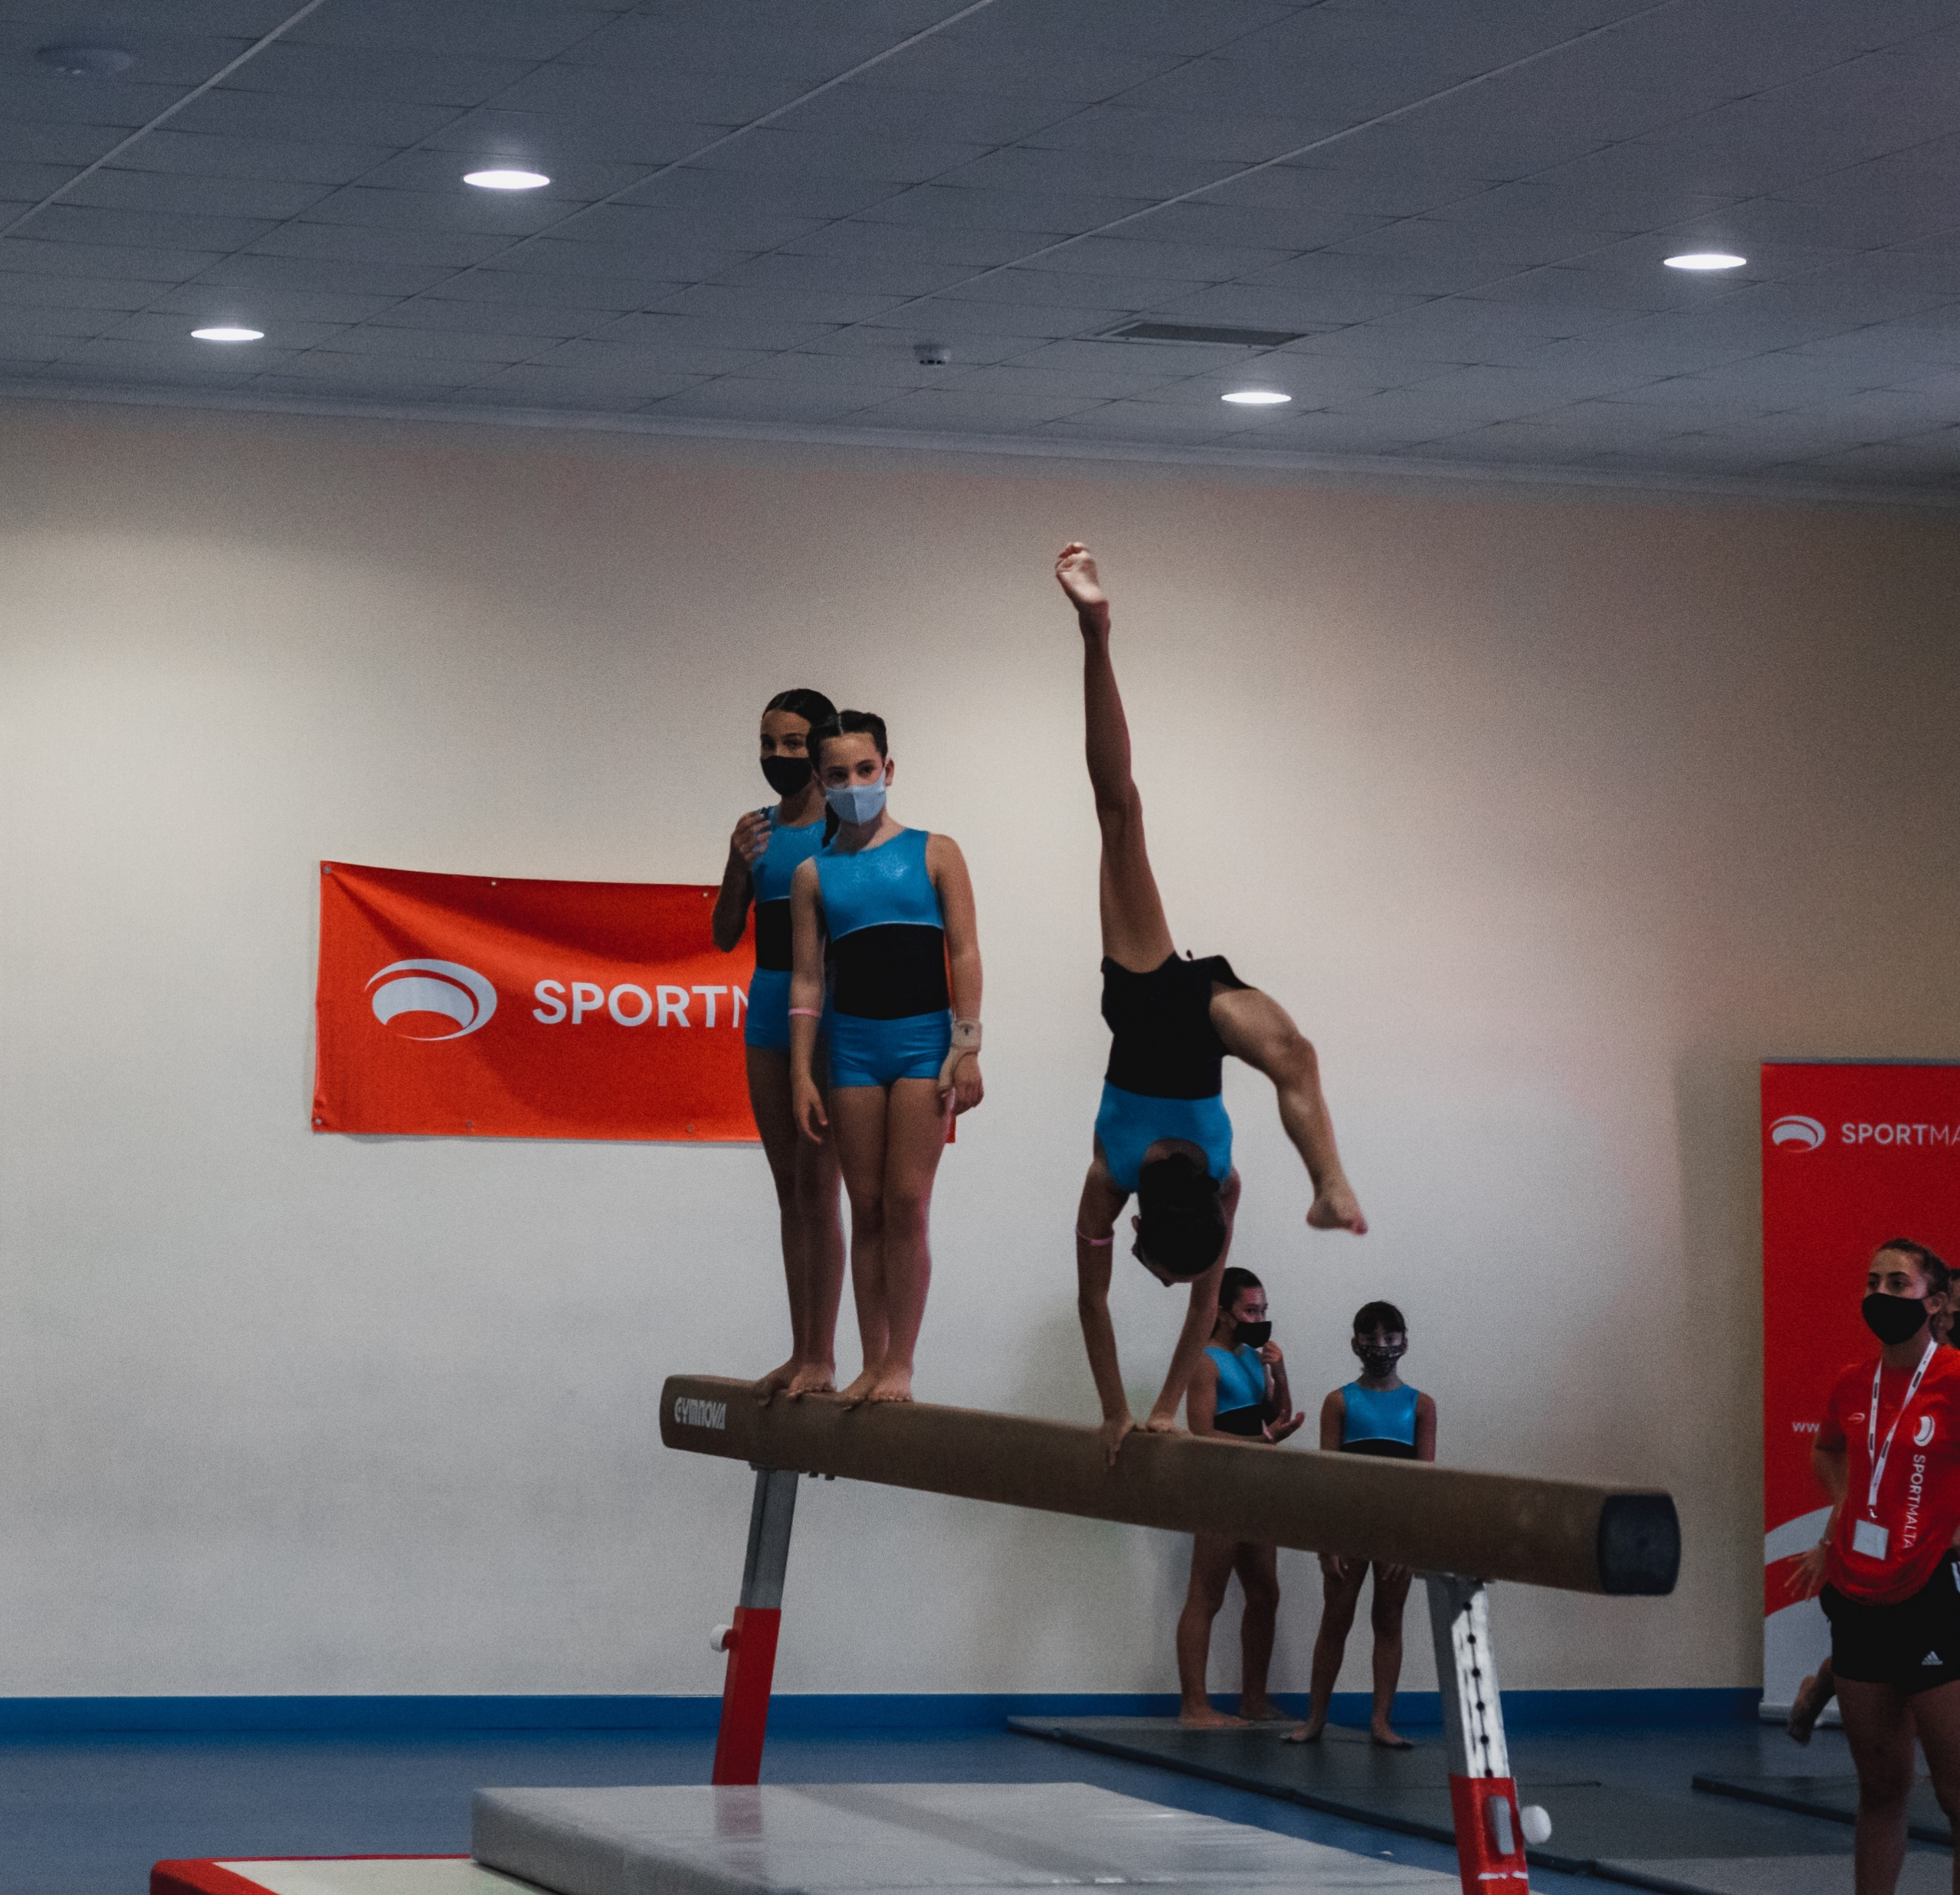
ON THE MOVE
TRIATHLON
BADMINTON
2015 – First Academy
2024 – 3 Academies
Success through:
-International participation
- Medals
- Rising number of participants
GYMNASTICS

Slide 36
PRESIDENCY – EU2017

Slide 37
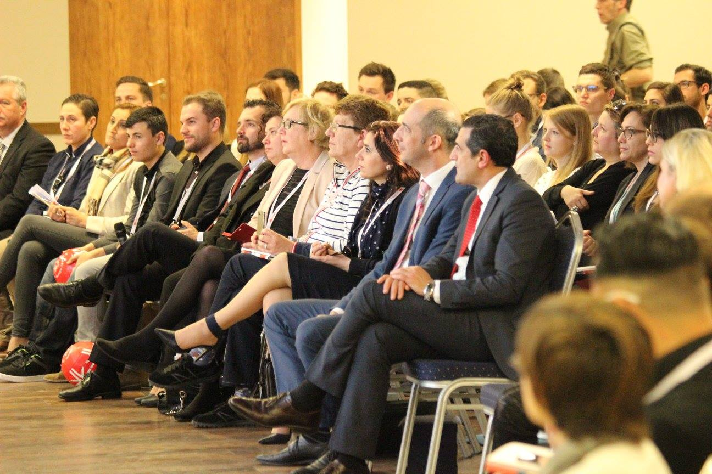

PRESIDENCY – EU2017
European Youth Sport Forum: 350 delegates from all over Europe
450 participants in the EU Sport Forum
European Work Plan for Sport
Council conclusion on Inclusion & Sport Volunteering

Slide 38
SPECIAL OLYMPICS INVITATIONAL GAMES 2022

Slide 39
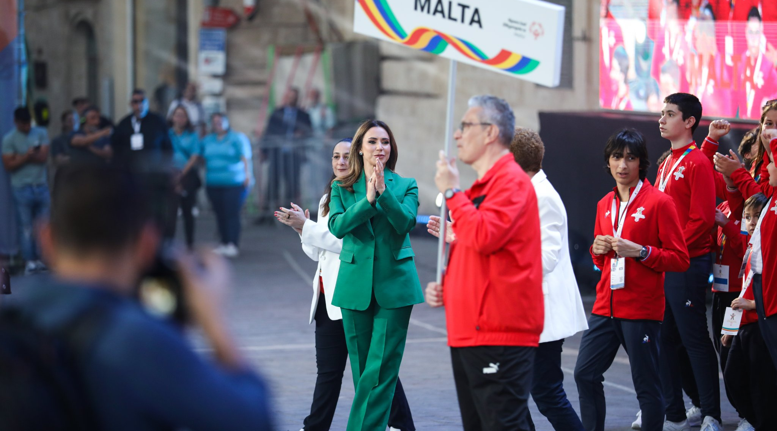
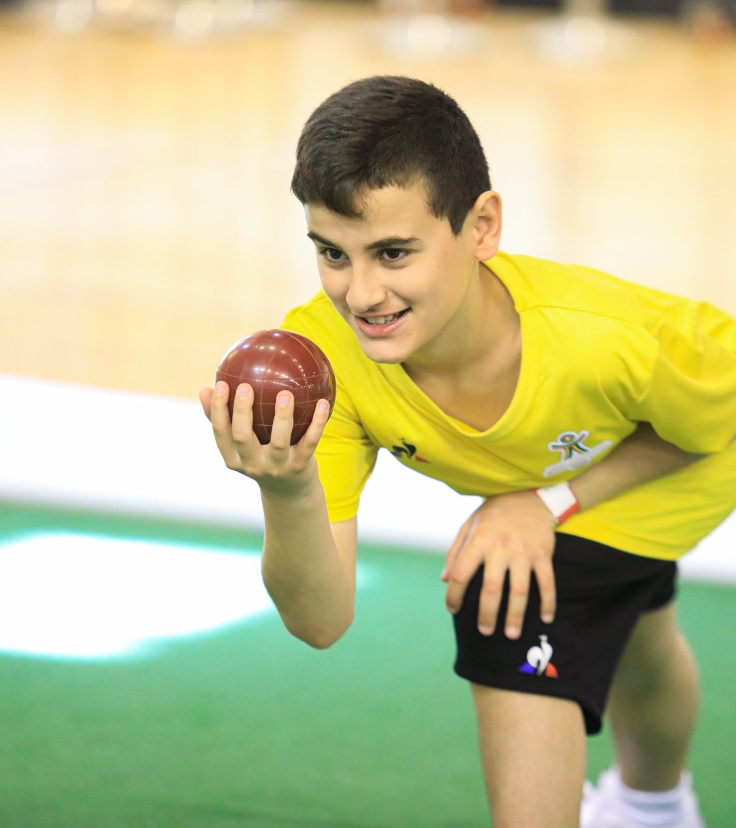
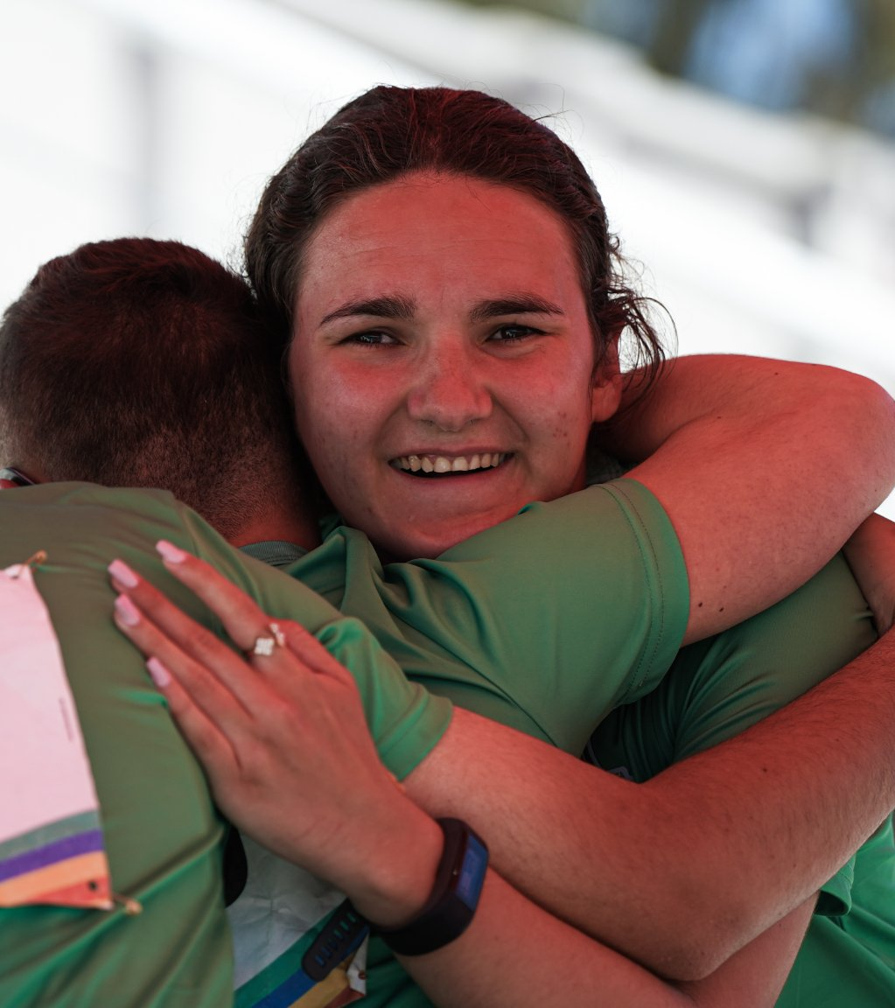
SPECIAL OLYMPICS INVITATIONAL GAMES
2022
Brought together close to 1,000 athletes from 23 countries
Facilities: National Pool Complex, Marsa Sports Complex, University Sports Hall
6 different sports – Athletics, Swimming, 5-a-side Football, Bocce, Table Tennis, Ten Pin Bowling
65 gold medals, 60 silver, and 67 bronze

Slide 40
GAMES OF THE SMALL STATES OF EUROPE 2023

Slide 41
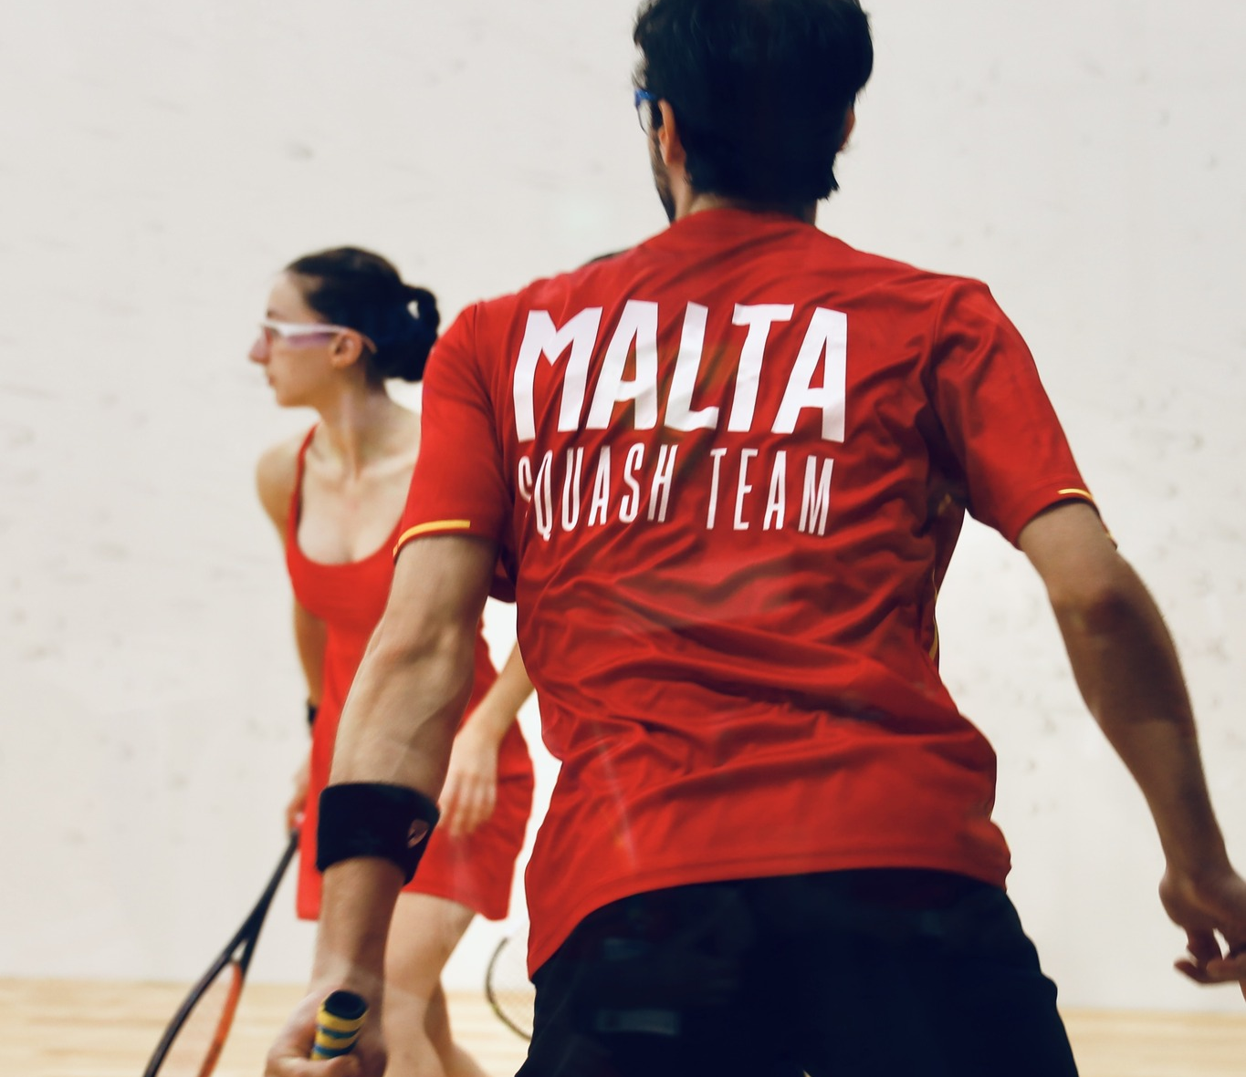
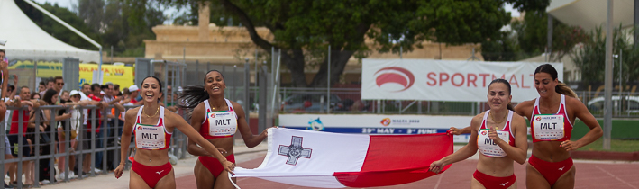
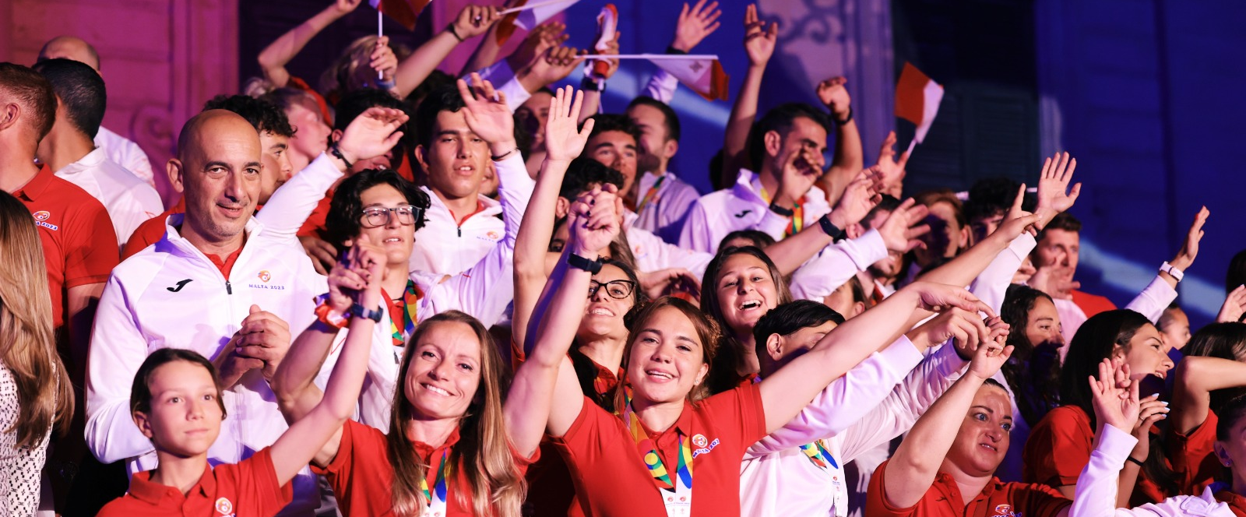
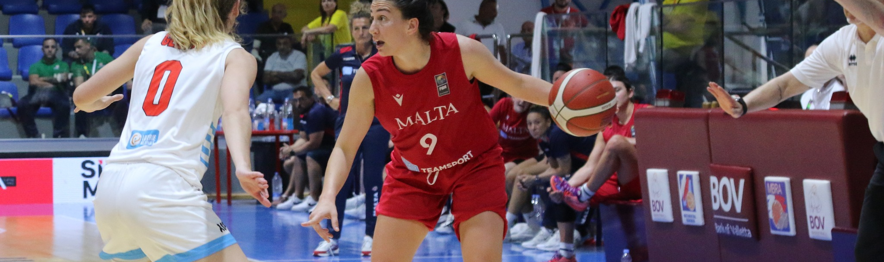
GSSE
MALTA - 38 Gold, 30 Silver & 29 Bronze medals
Over 900 athletes
Record number of medals won by Team Malta
9 Countries – Andorra, Cyprus, Iceland, Liechtenstein, Luxembourg, Malta, Monaco, Montenegro, San Marino

Slide 42
EUROPEAN AQUATICS CHAMPIONS LEAGUE MEN FINAL 4 MALTA 2024

Slide 43
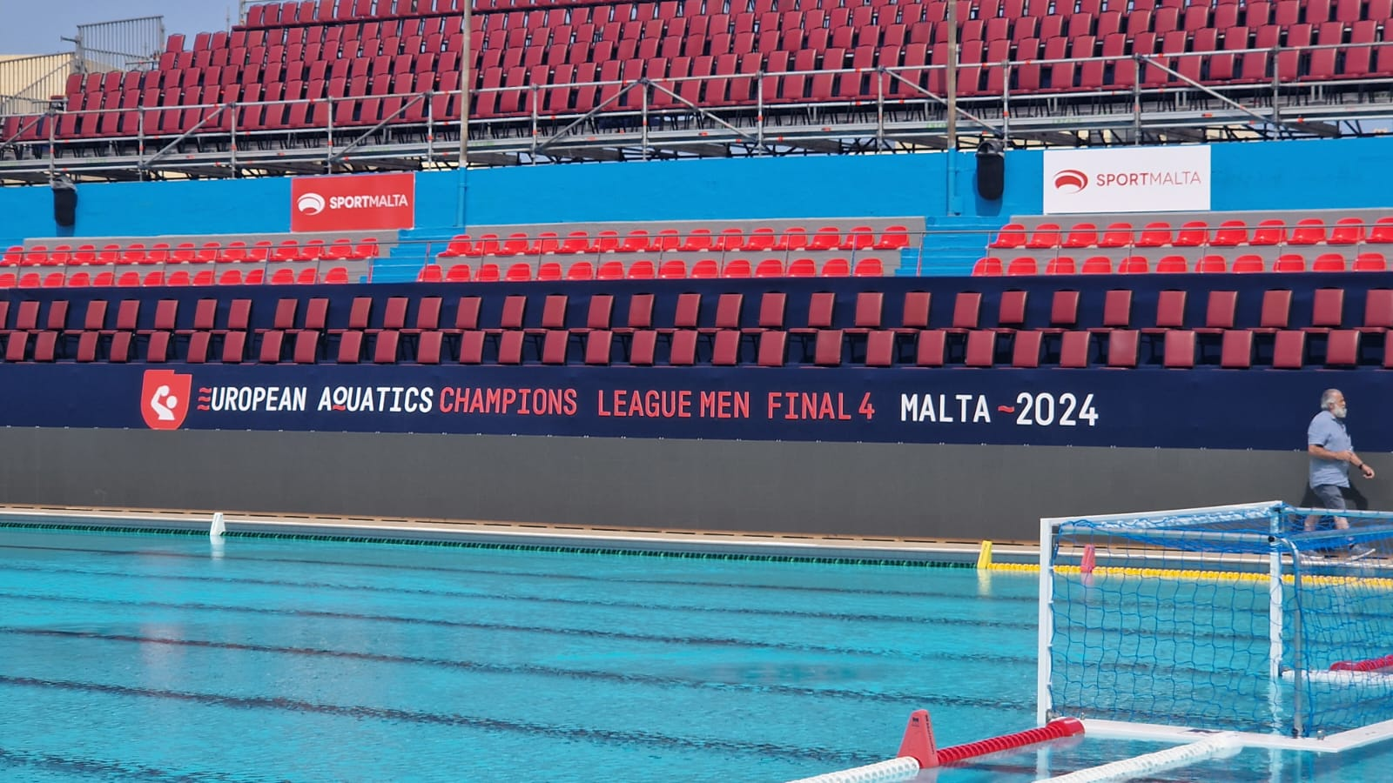
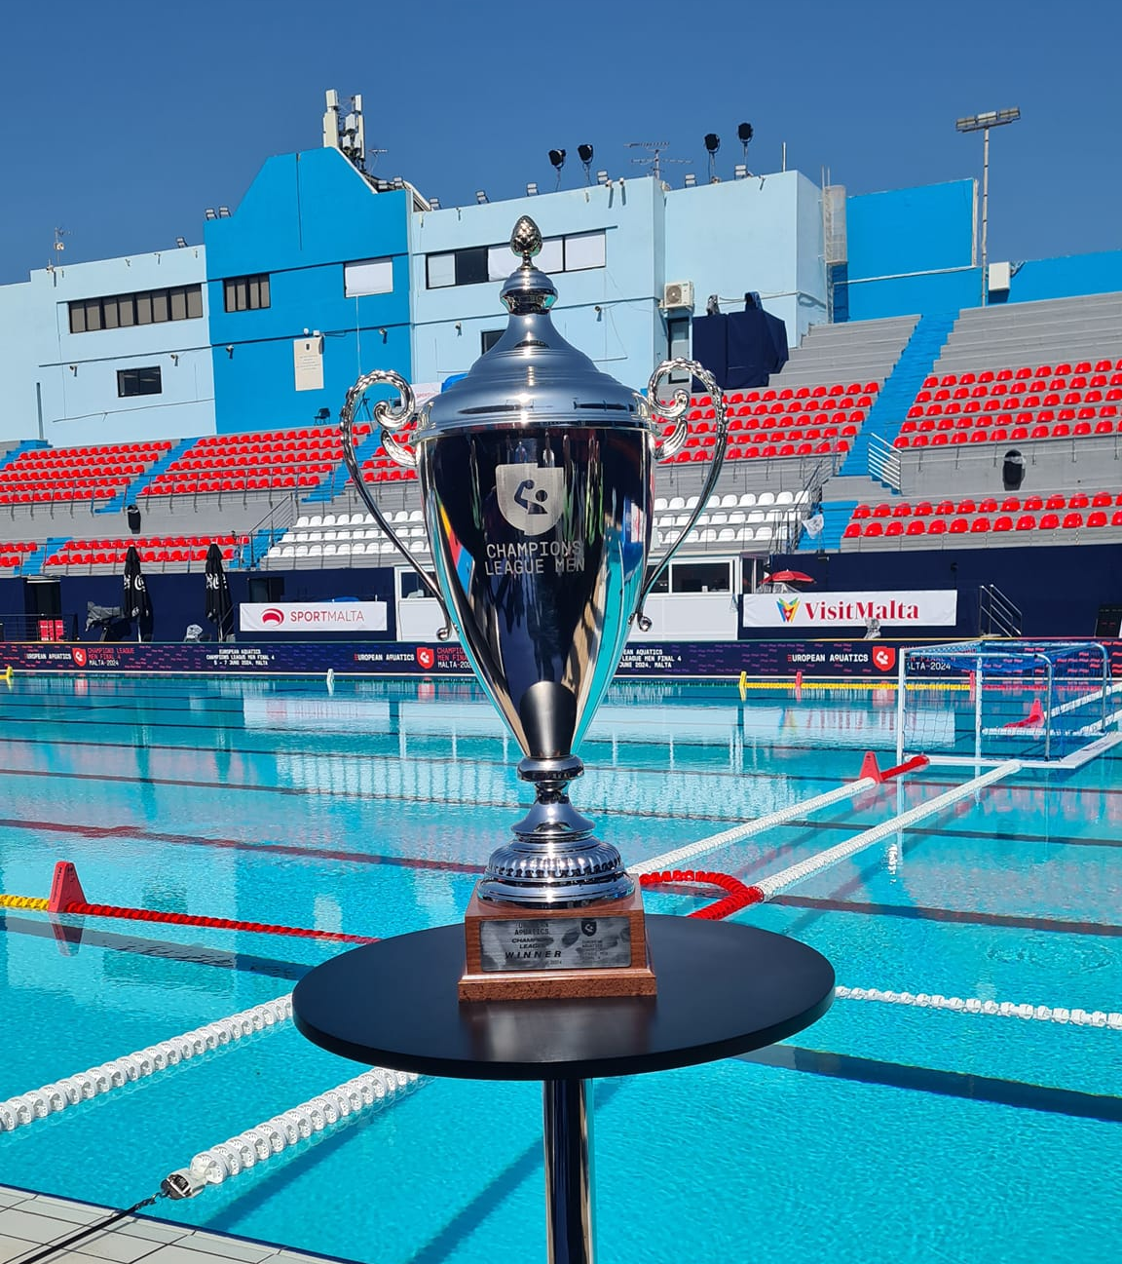
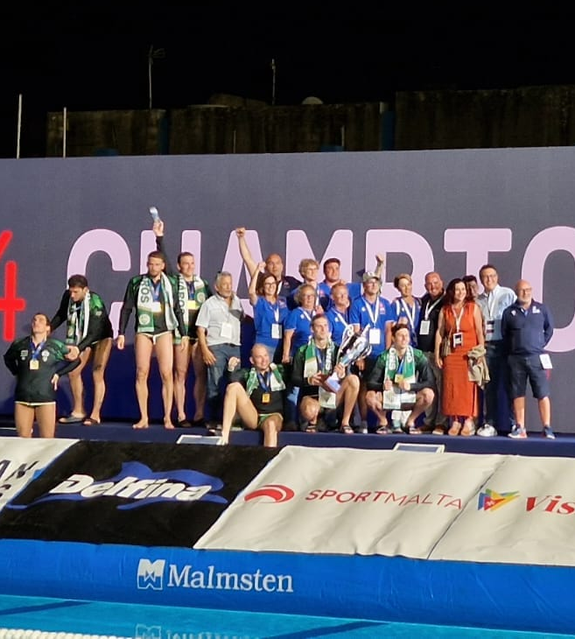
CHAMPIONS LEAGUE MEN FINAL 4
Held at the National Pool Complex Tal-Qroqq
Top 4 European Teams competed
Agreement to be organised in Malta for 3 Years
Teams from Serbia, Hungary, Italy and Greece
SportMalta Cup was organised between days off

Slide 44
NATIONAL WEEK OF SPORT

Slide 45
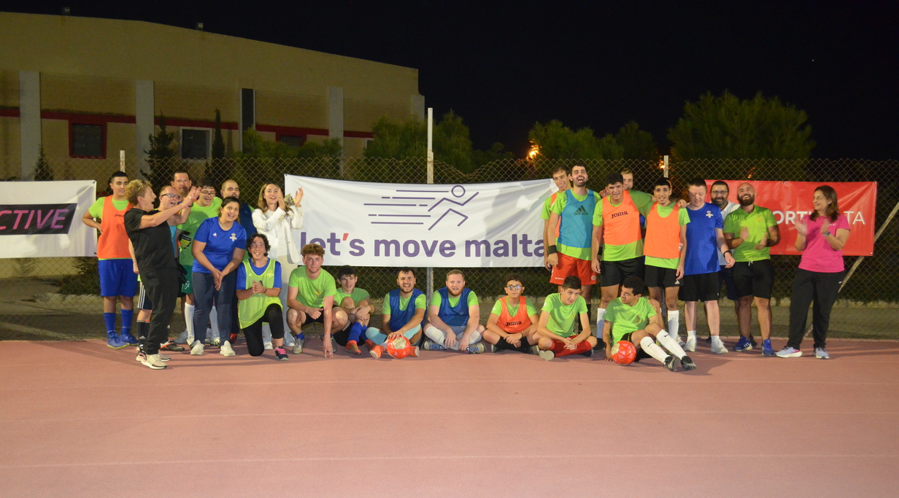
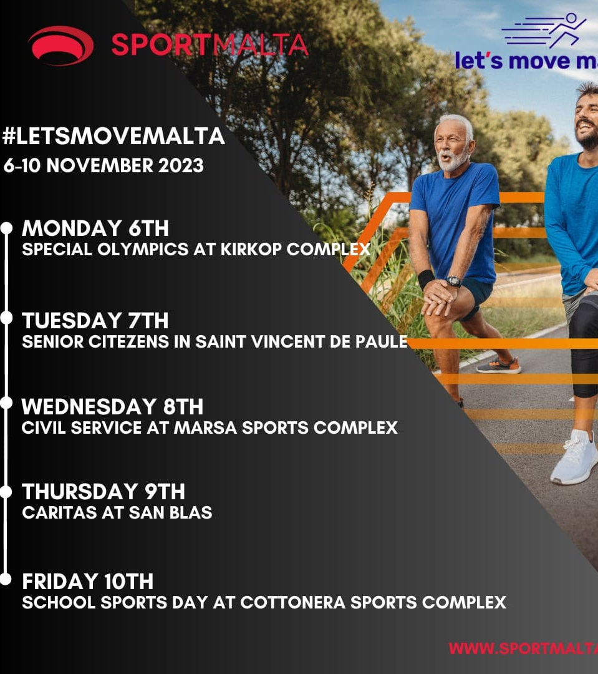
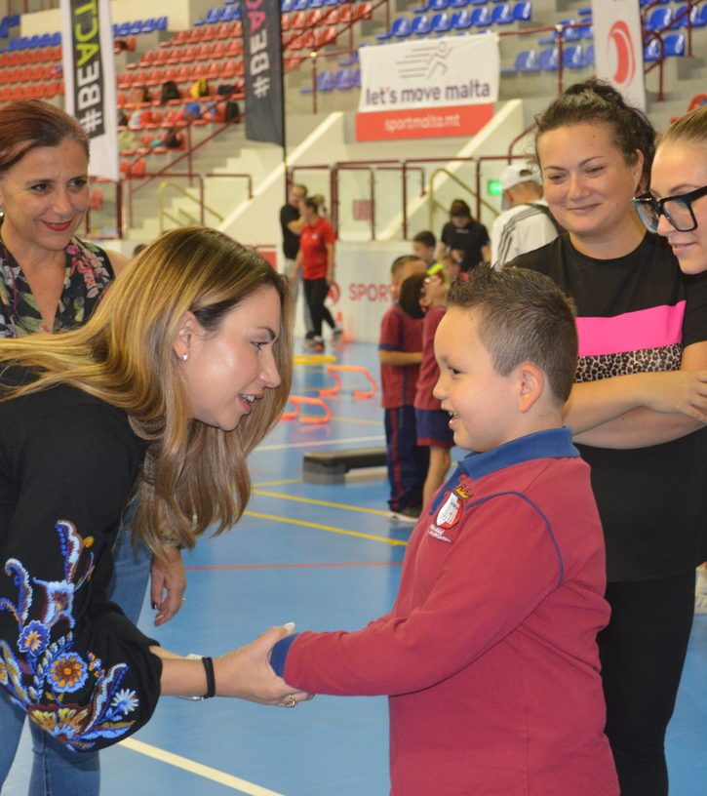
NATIONAL WEEK OF SPORT
Let’s Move Malta – Inclusivity, Active Citizenship, Workplace, Marginalisation, Education
5 different venues – Kirkop Sports Complex, Sain Vincent De Paule, Marsa Sports Complex, San Blas, Cottonera Sport Complex
Organisations involved: Saint Vincent De Paule, MESA, Civil Service, Caritas, School Sports Day

Slide 46
CORPORATE SOCIAL RESPONSABILITY

Slide 47
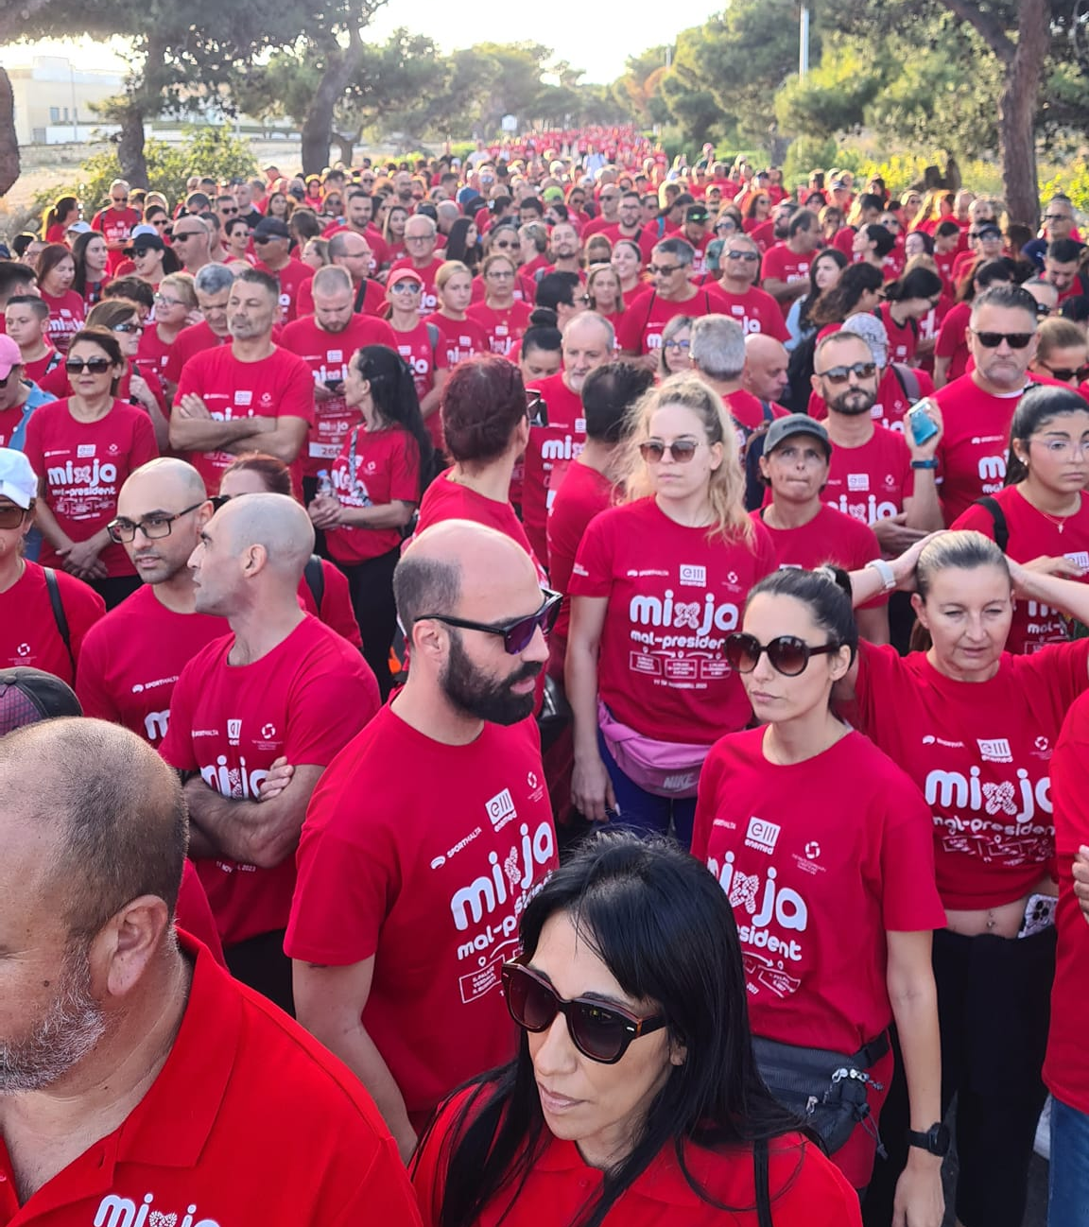
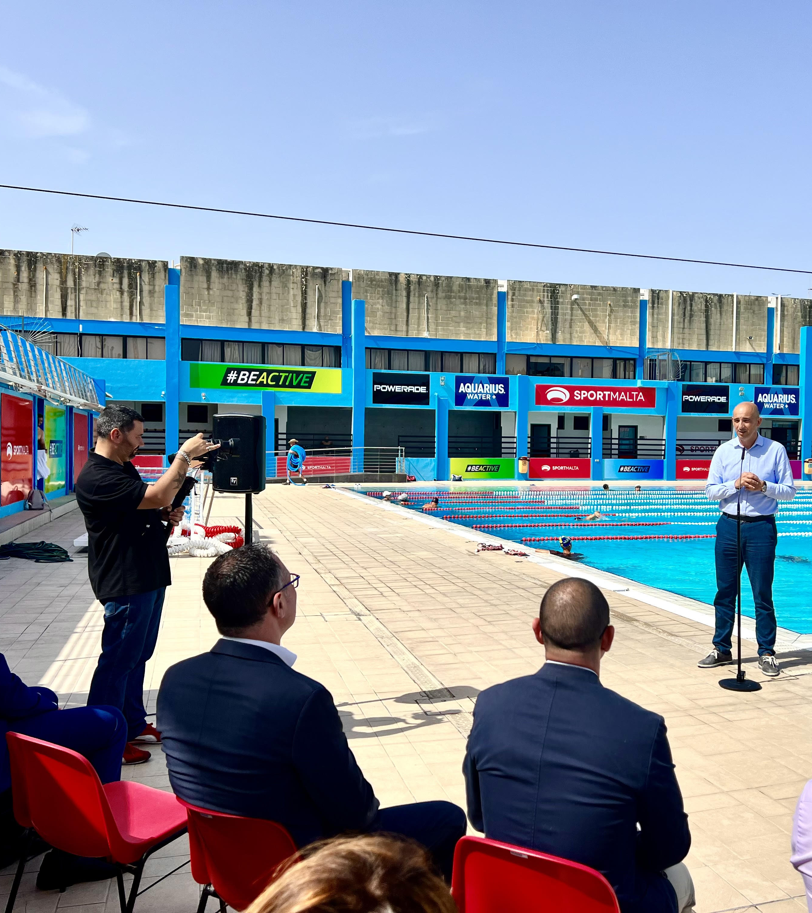
CORPORATE SOCIAL RESPONSABILITY
President’s Fun Run
Caritas
Istrina
Puttinu Cares
Pink October
Hospice
Blood Donation

Slide 48


