Slide 1
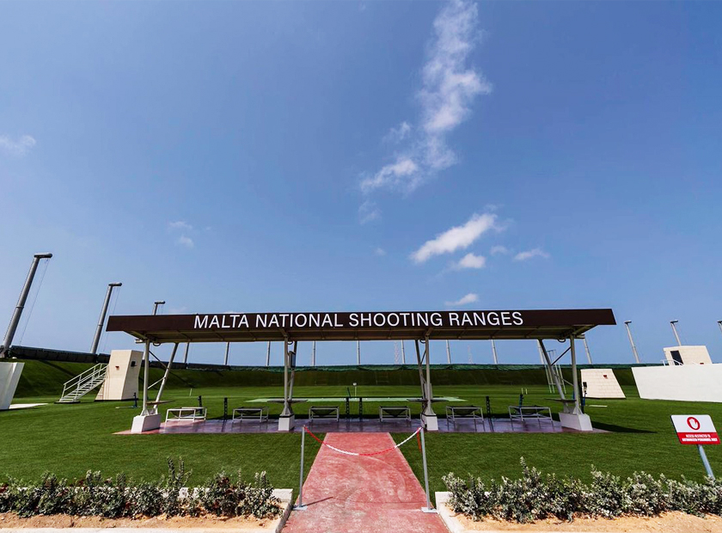
Annual Audit Report 2019
National Audit Office

Slide 2
Background - Malta National Shooting Range
Situated in Ta’ Kandja, limits of Siġġiewi.
Built on an Olympic size model and is certified by the International Shooting Sport Federation.
Site was managed by SportMalta.
The construction and administration of this project fell under SportMalta’s responsibility in June 2017.
Information provided by SportMalta indicated that, as at December 2019, the total contracted amounts for various goods and services relating to the Shooting Range project totalled €11.3 million.

Slide 3

Scope of the Audit
To verify whether procurement procedures adopted by SportMalta were in compliance with the Public Procurement Regulations.
The National Audit Office (NAO) also sought to determine the level of existing internal controls over this project, including the adequacy of certification prior to effecting the respective payments.

Slide 4
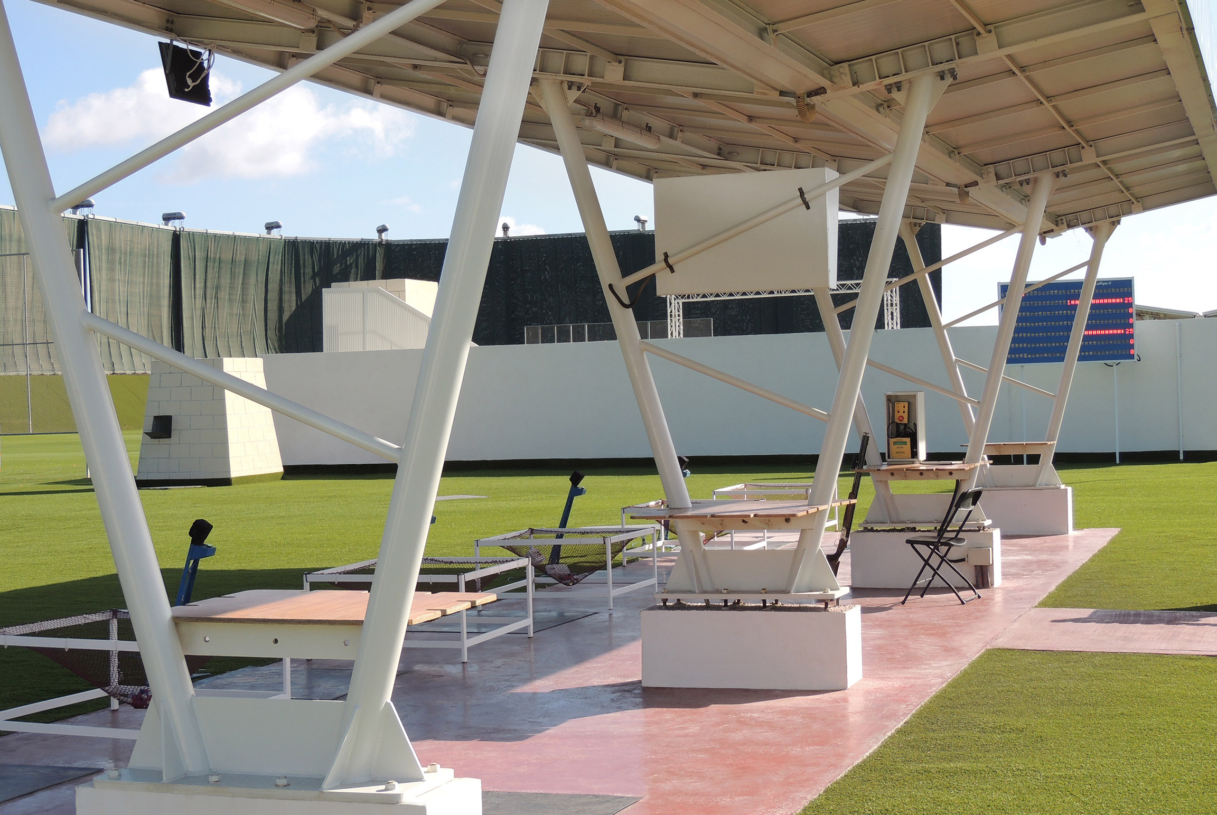
Key Issues

Slide 5
Lack of Ownership over the Shooting Range Project
SportMalta was not in a position to provide NAO with basic information.
Requests for documentation were forwarded to other individuals involved in the project.
At times, NAO received conflicting information.
Total reliance on third parties for retrieval of information indicated lack of ownership over the project.
NAO did not have the comfort that the information and documentation made available for audit purposes was complete and accurate.

Slide 6
Weak Internal Controls
Works for a value of almost €4 million were not covered by performance guarantees or single bond.
No approval from the Department of Contracts was obtained for variations emanating from extra works carried out or additional quantities utilised by the contractors, which in aggregate totalled over €0.4 million.
The percentage pre-established capping of 15% for modifications carried out on the spectators’ stand contract was exceeded.
The agreement for the Construction of Berm Wall and Foundations, Shooting Tunnel and Foundations of Shooting Range, at a total contract value of €2,371,534 (VAT excl.), was signed after the commencement of works.

Slide 7
Shortcomings related to Procurement Procedures
Although above the threshold applicable for a tender through the Department of Contracts, the contract for the construction and finishing of the spectators’ stand, for the value of €262,990 (VAT excl.), was awarded following a call for quotations issued through the Electronic Public Procurement System.
In the case of the construction of the berm wall (€2,371,534 VAT excl.), as well as alterations and finishes to the clubhouse building (€160,231 VAT excl.), SportMalta contacted three contractors for each task and asked them to submit their bids.
The quotes for the negotiated procedure contracts were not negotiated further with the contractors.
Contract prices matched exactly the bid amounts, even when these were higher than the estimate prepared by the Quantity Surveyors.

Slide 8
Control Issue

Slide 9
Conflicting or Inconclusive Information on
Timeline of Project Works
Files made available for audit review provided insufficient information on project timelines.
NAO specifically requested SportMalta to indicate the commencement date for works relating to different parts of the project and the period of execution.
Unfortunately, practically no information was forthcoming.
Upon further enquiry by NAO, information on the sampled contracts was obtained from the Projects Manager. However, this was either conflicting or inconclusive.
Since acceptance certificates were not made available for audit purposes, the completion date of each task was unknown to NAO. This hindered this Office from verifying whether the periods of execution stipulated in the sampled contracts were respected, and if penalties were to be imposed in case of delays.

Slide 10



