Slide 1

Childcare Provision in Malta and Gozo 2023
Denise Gatt
Director
Directorate for Quality and Standards in education

Slide 2
Structure of Presentation :
Facts and Figures
Monitoring and Evaluation
Areas of Concern

Slide 3
Facts and Figures
Information related to CCCs in Malta and Gozo

Slide 4
Childcare Centres in operation – 2023
Data obtained from DQSE records
Centres in operation | 195 (3 of which are in Gozo)
Privately owner centres | 175
Foundation for Educational services | 12
Public Private Partnership | 5
Childcare for Entities/Authorities (Mater Dei, Jobsplus, Water Services | 3
Childcare Night Service | 0

Slide 5
Childcare increase from 2016-2023
Data obtained from DQSE records
Year | Number of Childcare Centres | New licenses | % increase
2016 | 98 | NA
2017 | 109 | 11 | 11%
2018 | 123 | 14 | 13%
2019 | 135 | 12 | 10%
2020 | 152 | 17 | 12.5%
2021 | 165 | 13 | 8.5%
2022 | 177 | 12 | 7%
2023 | 195 | 18 (Nov 2023 – 5 applications still being processed) | 10%

Slide 6
Staff approved to work in childcare centres
Unofficial data obtained from DQSE internal documentation
Designation | Number of staff approved to work within CCEs
Childcare Centre Manager | 231
Childcare Centre Managers in Training | 24
Qualified Childcare Centre Educators | 1179
Childcare educators in training or waiting to start their training – currently employed as childcare assistants or helpers. | 468
Total population of staff | 1902

Slide 7
Number of children currently benefitting from Free childcare Scheme and attending Childcare Centres
Data obtained from Jobsplus reports
Year | Number of unique participants who made use of the Free childcare scheme at any point in time during the respective year. | Number of unique participants who started making use of the free childcare scheme during the respective year.
2019 | 7,341 | 3,579
2020 | 6,702 | 2,544
2021 | 7,509 | 3,868
2022 | 8,437 | 4,029
Administrative data of registered participants/beneficiaries of the Free Childcare Scheme

Slide 8
Monitoring and evaluation
External QA carried out by the DQSE

Slide 9
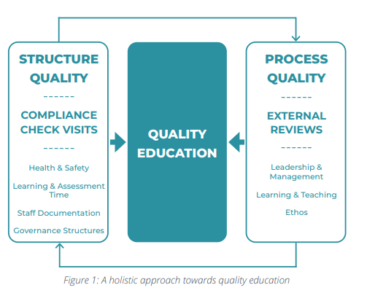
National Framework for Quality Assurance – 2023

Slide 10


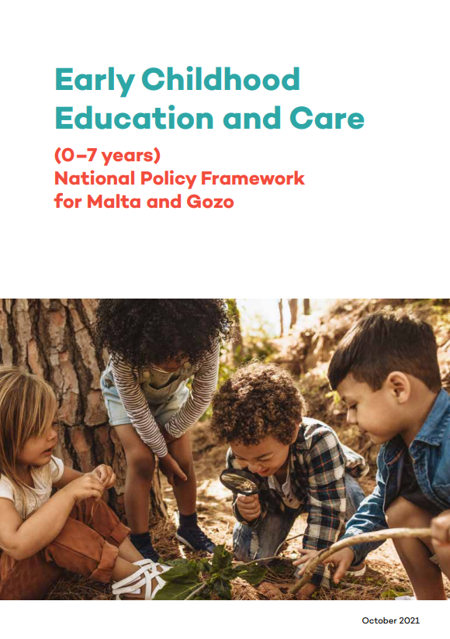
National Standards, Regulation Criteria and ECEC Policy

Slide 11
National Standards and Regulation Criteria
Quality Area 1 The Quality of the Learning Environment Details expanded in Regulation Criteria | Quality Area 2 The Quality of Learning and Care
Standard 1.1 – Suitability of staff (manager/Childcare educator ) Standard 1.2 –POMA clearance for all employees working with children Standard 1.3 – Appropriate Ratios Standard 1.4 – The premises are suitable for the service provided Standard 1.5 – The premises and equipment are safe Standard 1.6 – The child’s wellbeing | Standard 2.1 – Leadership skills – Centre Manager Standard 2.2 – Focus on developing child-friendly and play-based environment – nurtures learning and development. Standard 2.3 – The curriculum helps children to progress towards achieving desired learning outcomes. Standard 2.4 – Environment and Resources support child’s play, learning and development. Standard 2.5 – Childcare educators nurture meaningful relationships and engage in high quality education. Standard 2.6 – The centre welcomes parents and fosters collaborative partnerships.

Slide 12
ECEC – National Policy Framework for Malta and Gozo (0-7)
Goal 1 – Accessibility
Goal 2 – Workforce
Goal 3 – Curriculum
Goal 4 – Monitoring and Evaluation
Goal 5 – Governance and Financing

Slide 13
Monitoring and Evaluation in Practice - DQSE
All Childcare Centres in Malta and Gozo are to be licenced (Education Act Cap 605 – 2021).
Long term plan is to have licenses issued every 3 years. Currently the DQSE is following a two-year cycle. As per legislation, the DQSE reserves the right to withdraw a license where necessary.
  In 2022/2023 – 3 licenses were withdrawn.
The DQSE carries out regular evaluation:
  Structure – Compliance review a yearly basis
  Process – on a 2-year basis – 1st year visit / 2nd year follow up on actions.
  A report is given following every visit with specific recommendations which are followed by the DQSE officials.
Since 2022 visits are completely unannounced.
Complaints on CCC are received by the DQSE and are followed up with a visit/ phone call depending on the nature of the complaint.

Slide 14
Monitoring and Evaluation in Practice – Business Inspections
Business inspections (BI) model (OPM) started being implemented by the DQSE during childcare centre visits in January 2022.
83 centres have been visited using the BI model and 4 centres have obtained the quality mark.
BI model follows the National Standards for Childcare and collects data for Jobsplus, CRPD and DIER.

Slide 15
Areas of concern
Emerging from Evaluation exercise carried out by the DQSE

Slide 16
Areas of Concern
The shift from a ‘babysitting’ service to an educational sector.
The lack of strategic management/planning.
Supply and demand – Not enough qualified childcare educators/managers to cater for demand.
Resistance to the requirements related to opening a childcare centre – space allowance etc.
Centres consistently in breach of specific standards – Child to carer ratio (70% of centres visited during 2023 had recommendations linked to ratios).
Understanding that child’s life and wellbeing is put at risk if standards are not adhered to – Ratios, health and safety, POMA etc.
Sector growth – Looking into the allocation of more resources.

Slide 17
Thank You

