Slide 1

INFLATION
Presentation to the Family Affairs Committee
10.05.2023

Slide 2
INFLATION – Family Affairs Committee 10.05.2023
Type of Inflation
IMPORTED
Transport Cost
Energy Cost
LOCAL
Labour Cost
Labour Cost
Other Factors

Slide 3
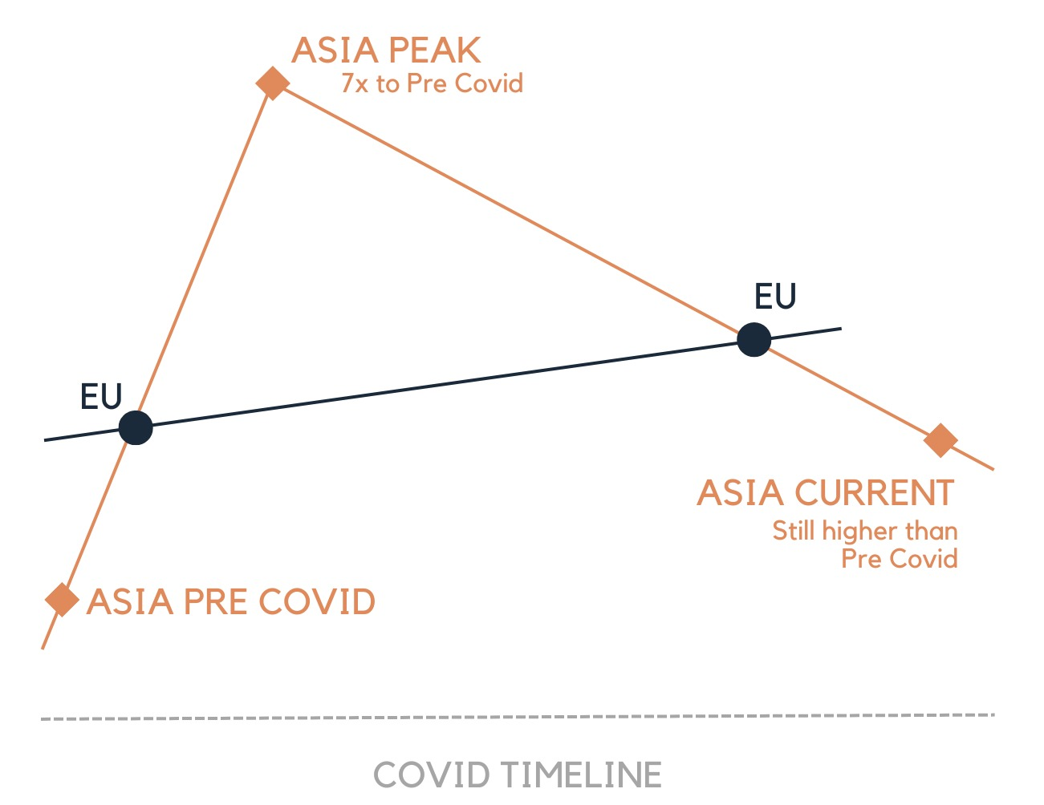
INFLATION – Family Affairs Committee 10.05.2023
Transport Costs – Imports from Asia & EU (1)
to date costs from Asia are still not where they used to be pre-COVID
it not clear whether they will ever actually return to pre-COVID levels

Slide 4

INFLATION – Family Affairs Committee 10.05.2023
Transport Costs – Imports from Asia & EU (2)
Container Cost from ASIA:
decreased over the last months but are still above pre-COVID levels
at peak 7x what it used to be before
forced importers to source products from Europe which is more expensive than pre-COVID cost from Asia but works out cheaper than exorbitant price from Asia
reasons why product prices increased on the local market
albeit, not as much as they would have, had importers not sought alternative sources

Slide 5
INFLATION – Family Affairs Committee 10.05.2023
Transport Costs – Imports from Asia & EU (3)
Trailer Cost from EUROPE:
fuel prices in Europe are very high
reflected in higher road transport charges and higher fuel charges for shipping leg
those who have always imported products using trailers from Europe are facing the highest cost of importation that they have ever faced
To Note: Most Foodstuffs Come From Europe By Trailer

Slide 6
INFLATION – Family Affairs Committee 10.05.2023
Labour Costs
Trailer Cost from EUROPE:
fuel prices in Europe are very high
reflected in higher road transport charges and higher fuel charges for shipping leg
those who have always imported products using trailers from Europe are facing the highest cost of importation that they have ever faced
To Note: Most Foodstuffs Come From Europe By Trailer

Slide 7
INFLATION – Family Affairs Committee 10.05.2023
Local Inflation
Labour Cost
wages and salaries in services have risen substantially due to hr shortages
inflation in the cost of services is among the highest in Europe and is the major driver of local inflation
Other Factors
interest rates
near full employment + supplementary income from rents etc
spending patterns and lifestyle

Slide 8
INFLATION – Family Affairs Committee 10.05.2023
To Note
while imported inflation is expected to abate over time,
wage inflation will continue growing
UNLESS shortages are addressed through:
smarter human resource allocation
a more efficient and attractive system for importing qualified labour

Slide 9
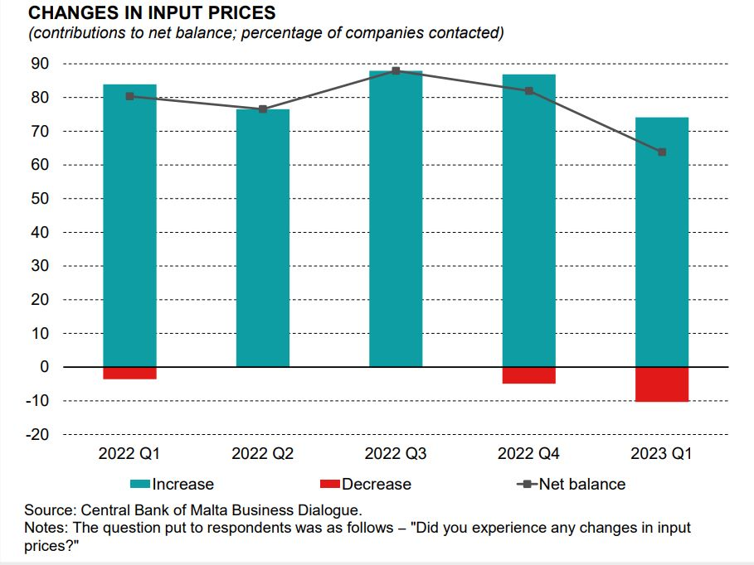
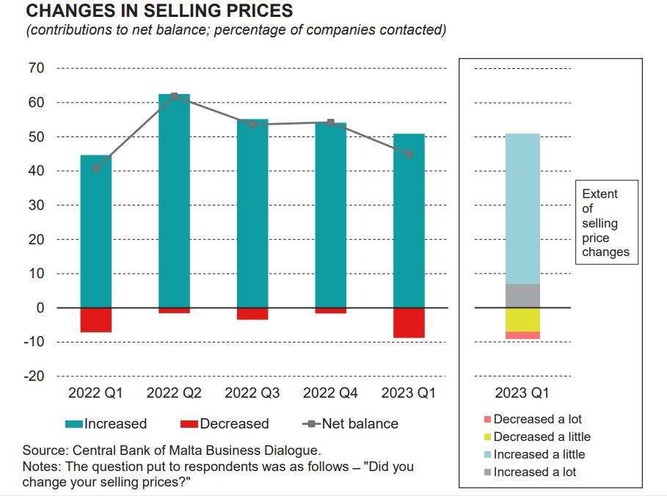
INFLATION – Family Affairs Committee 10.05.2023
Input Prices & Selling Prices

Slide 10
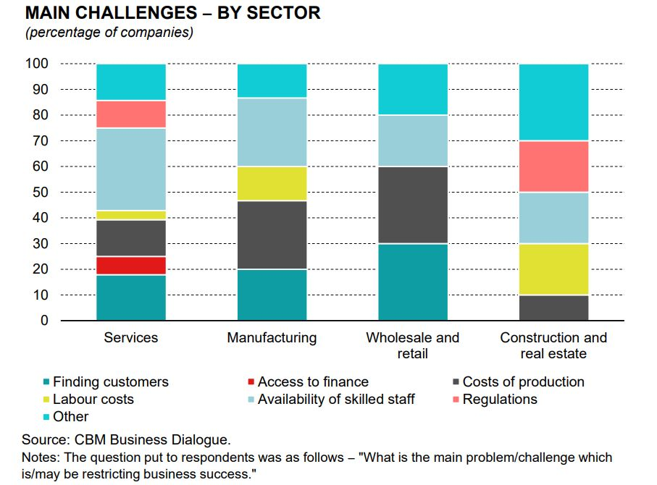
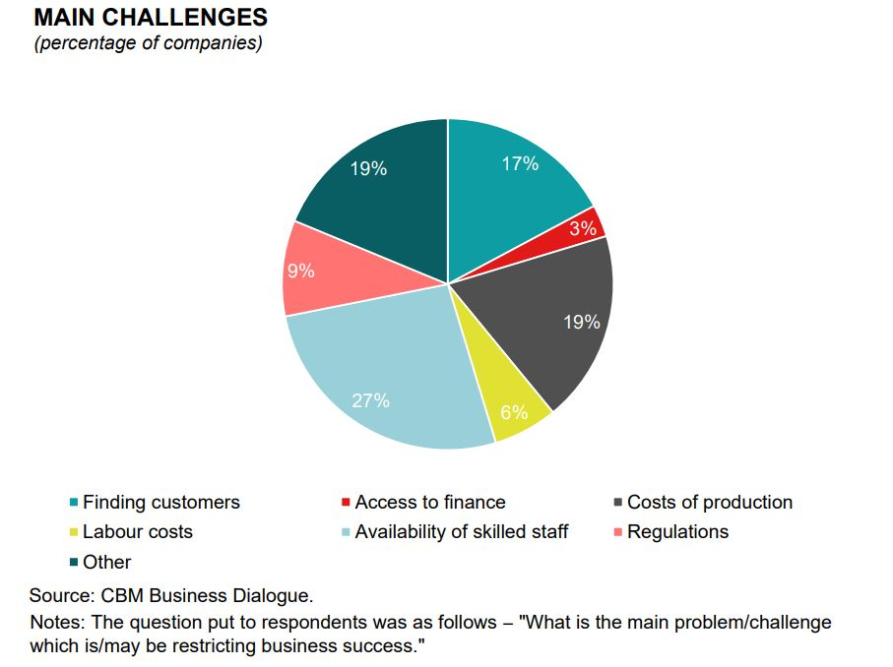
INFLATION – Family Affairs Committee 10.05.2023
Main Challenges

Slide 11
INFLATION – Family Affairs Committee 10.05.2023
Current Scenario – Our Competitiveness
Manufacturing
Net Balance of Improved Business Performance from Previous Quarter
18% to 13%
had the least +ve score
most export oriented & first to feel impact of slowdown in Europe, or reduction in competitiveness vis-à-vis other European manufacturing locations
Wholesale & Retail
Net Balance of Improved Business Performance from Previous Quarter
55% to 50%
similar trend to manufacturing
Services
Net Balance of Improved Business Performance from Previous Quarter
43% to 46%
still upbeat (due to tourism not yet fully recovered to pre-COVID levels); +ve assessment mainly noticed in related areas
to note service firms that reported worse conditions increased from 14% to 18%

Slide 12
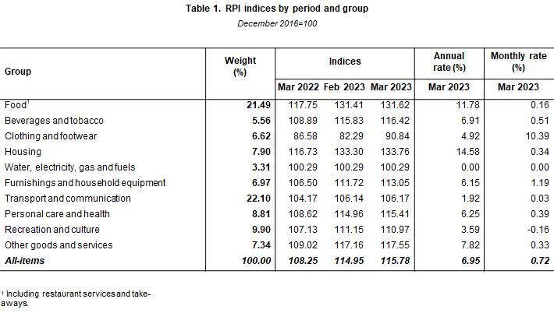




INFLATION – Family Affairs Committee 10.05.2023
Retail Price Index

Slide 13
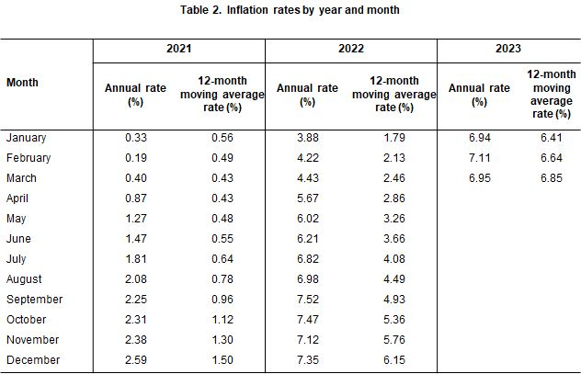
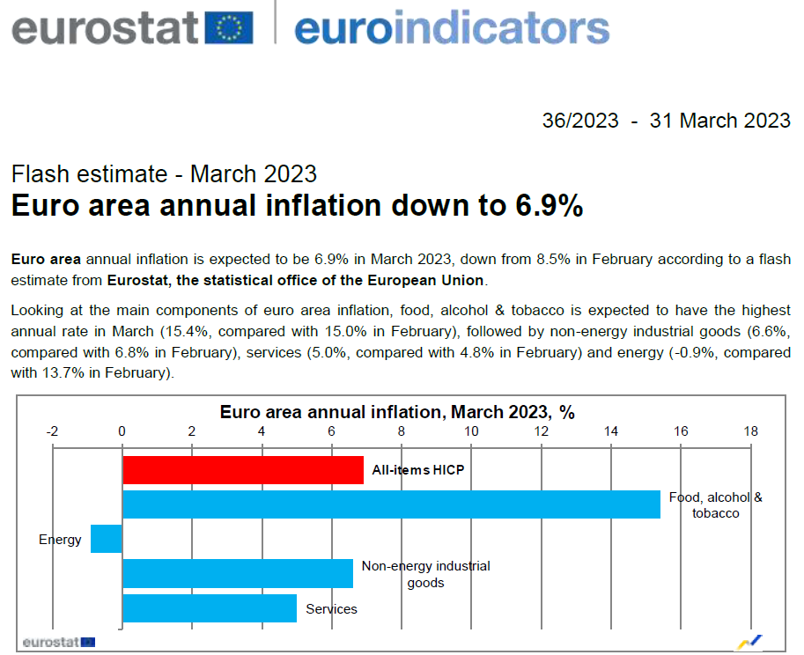




INFLATION – Family Affairs Committee 10.05.2023
Current Trend - Inflation (Malta & EU)
Malta
EU

Slide 14
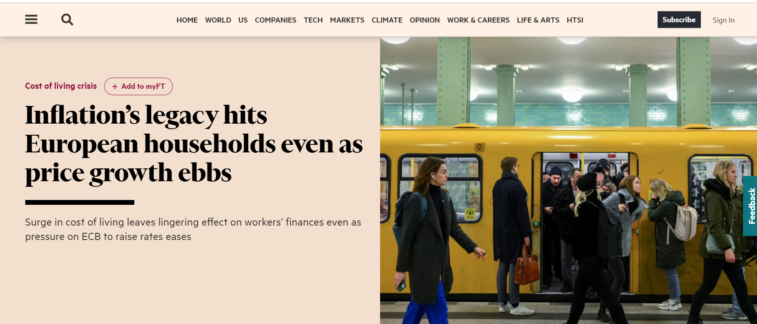
INFLATION – Family Affairs Committee 10.05.2023
Extract from the Financial Times
Households across Europe are facing a persistent pinch from one of the worst cost of living crises since the second world war. Even by late next year, real incomes will not have regained the levels they reached before the surge in price growth.
Real incomes fell by 6.5 per cent between 2020 and 2022 in the eurozone due to surges in energy and food costs. By the end of 2024 they will remain 6 per cent below 2020 levels.
In the EU, food costs rose by 19.5 per cent in the year to March, the highest rate since Eurostat started collecting such data in 1997. In some member countries — including Poland, Portugal and the Baltic states — costs have surged even more. The prices of some staples such as cooking oil and eggs have risen more than 30 per cent within the bloc in the year to March.
The headline rate of price growth in both the eurozone and the UK is not expected to return to the 2 per cent level the ECB and the Bank of England target until next year, according to Consensus Economics forecasts.
https://www.ft.com/content/784156df-ca03-4d5b-a61f-62ea57c3b911 29.04.2023
“For families to feel better off, the government must reward work instead of wealth.”
“The headline rate of price growth in both the eurozone and the UK is not expected to return to the 2 per cent level the ECB and the Bank of England target until next year, according to Consensus Economics forecasts.”

Slide 15

Dr Marthese Portelli
CEO
10.05.2023
marthese.portelli@maltachamber.org.mt
Thank you

