Slide 1

The Price Increase in the Logistics Industry
ATTO – The Association of Tractor & Trailer Operators
Founded in 2004 by the main players in the Industry
Number of employees in our industry exceed 1000 in number with approx. 3000 trailers registered in Malta and more than 200 trucks.
Its first objective is to protect its members and be their voice in all discussions affecting their industry.
Another objective in our statute is establish, promote, cooperate or affiliate with entities, associations and institutions. Today we are here at the Permanent Committee about family matters.

Slide 2
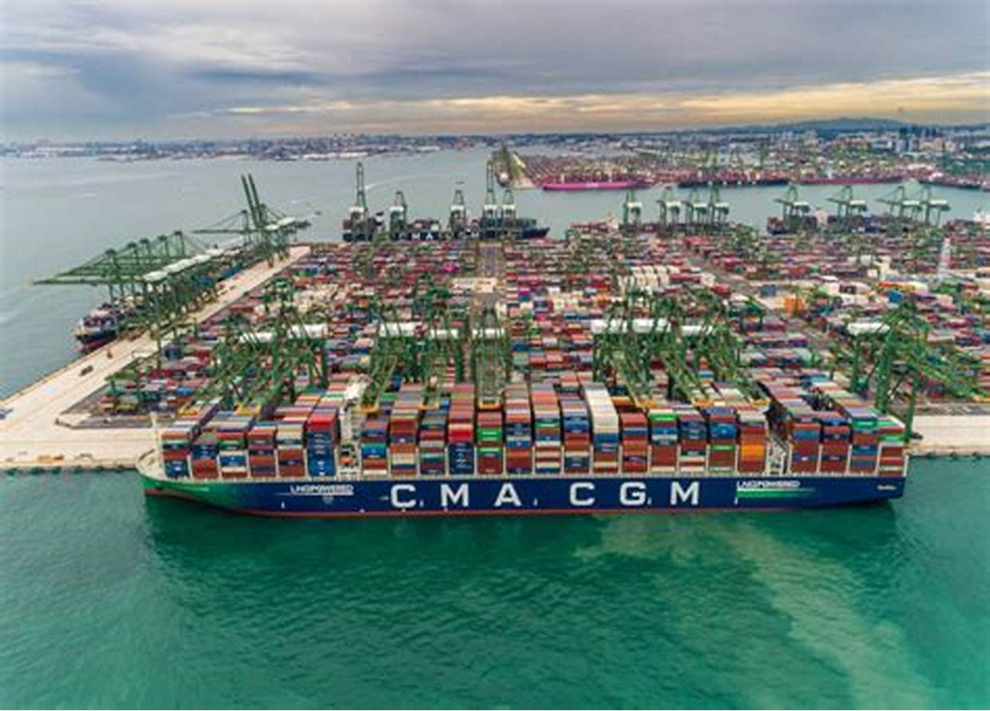
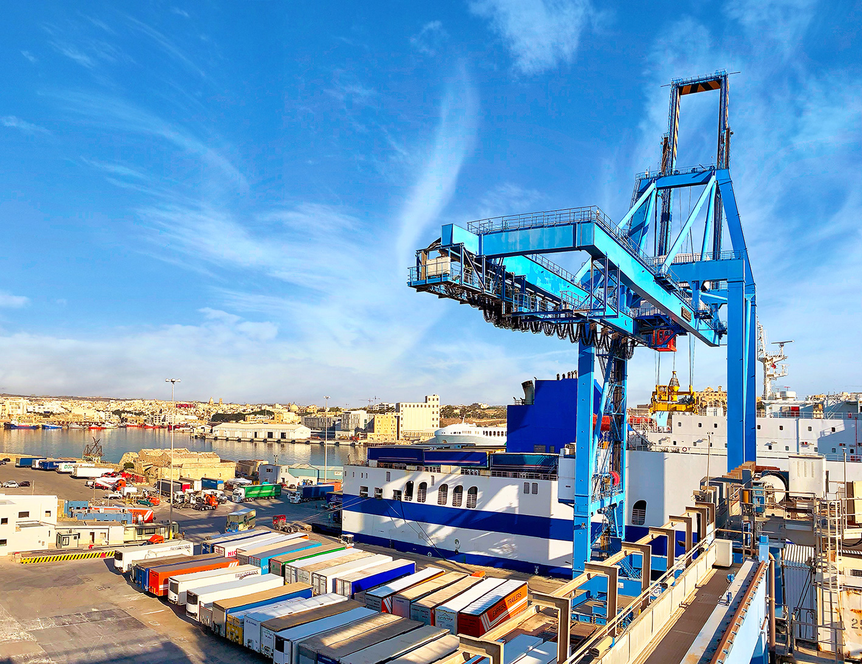
The Price Increase in the Logistics Industry
Malta Freeport
Valletta Gateway Terminal

Slide 3
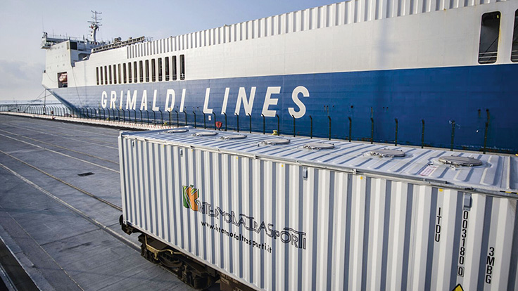
The Price Increase in the Logistics Industry
Service Offered by ATTO members : Import/Export service on land mostly to/from Mainland Europe – IT-GB-DE-ES-FR.
Approx 65% of our goods are imported/exported by this mode –Ferry-Land: main ports Italy (GOA – NAP – CTA) then by road.

Slide 4

The Price Increase in the Logistics Industry
number of Trucks(horses) 200 owned by Maltese Operators.
Number of Trailers: 3000 owned by Maltese Operators.
Consumption of diesel in a week per truck 1000 Ltrs/3000km approx
Departure/Arrival From Corradino or Marsa

Slide 5
The Price Increase in the Logistics Industry
Historical events 2020-2023 – Brexit – Covid and Invasion of Ukraine
Brexit - disruptions into our operations due to new customs processes causing delays and extra costs at entry/exit points in UK/EU.
Covid 19 – complete limitations of movement and operational challenges
Lack of drivers in the industry causing spikes in drivers’ salaries
Increase of cost of fuel resulted in increase of rates

Slide 6
The Price Increase in the Logistics Industry
Rates are based on following factors:
Cost of Fuel on Land – FAF – Fuel Adjustment Factor
Cost of Bunkering Adjustment Factor on the Ferry sector MT-IT – fuel based on very low Sulphur oil and High Sulphur Fuel oil
Cost increase due to adverse conditions in the EU mobility package
Cost of wages and salaries – including COLA
Other costs – warehousing charges in Malta and outside – Terminal costs – spike in drivers’ salaries due to lack of drivers - Brexit effect – Ukraine war.

Slide 7
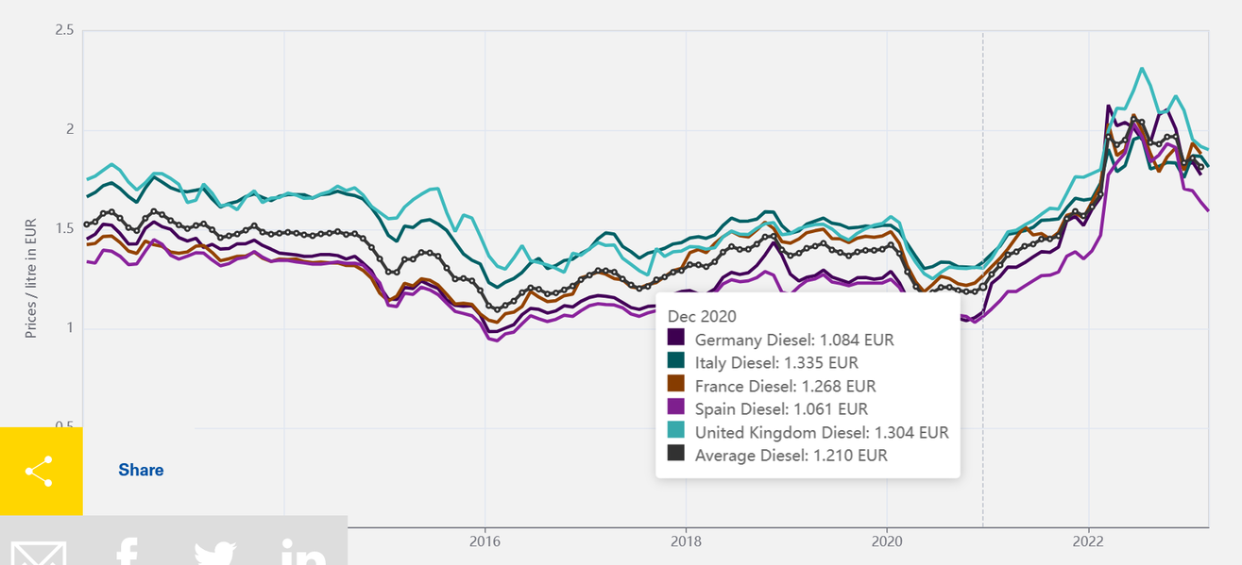
Average Diesel Price in 2020: EUR 1.21/Ltr ex VAT (SRC IRU)

Slide 8
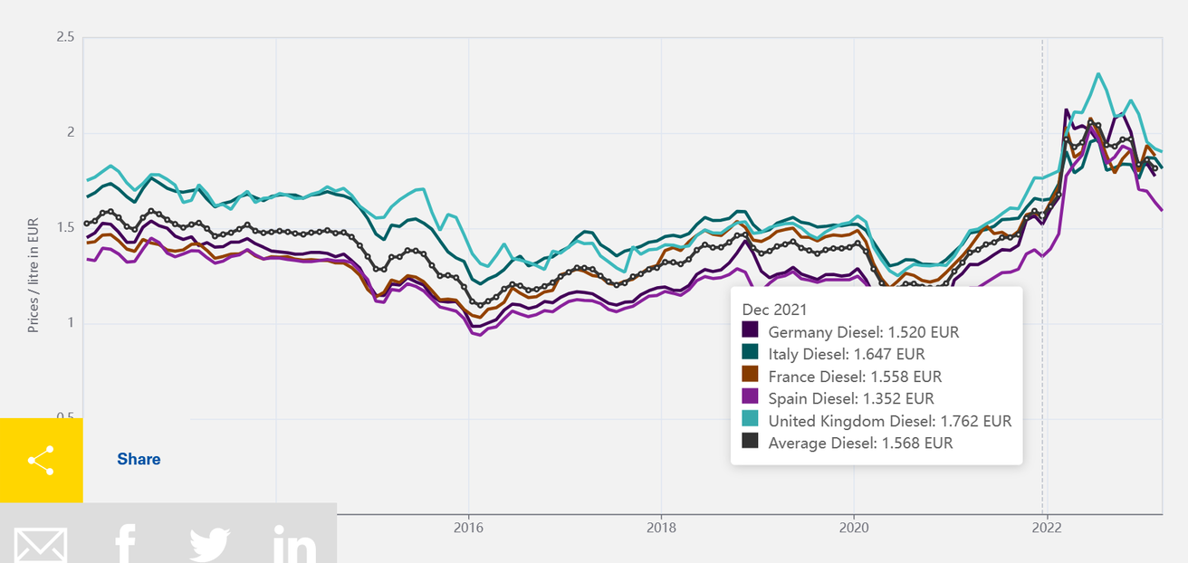
Average Diesel Price in 2021: EUR 1.56/Ltr ex VAT (SRC IRU)

Slide 9
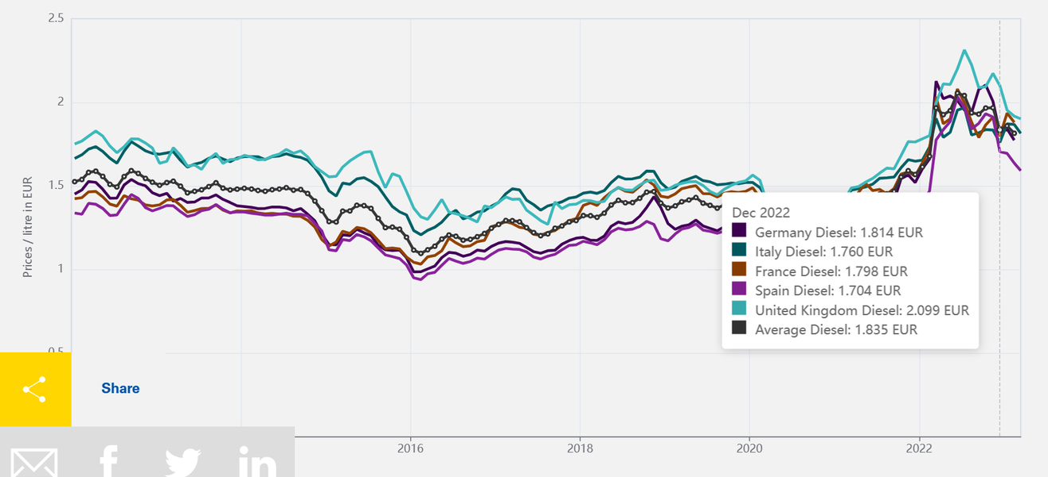
Average Diesel Price in 2022: EUR 1.84/Ltr ex VAT (SRC IRU)

Slide 10
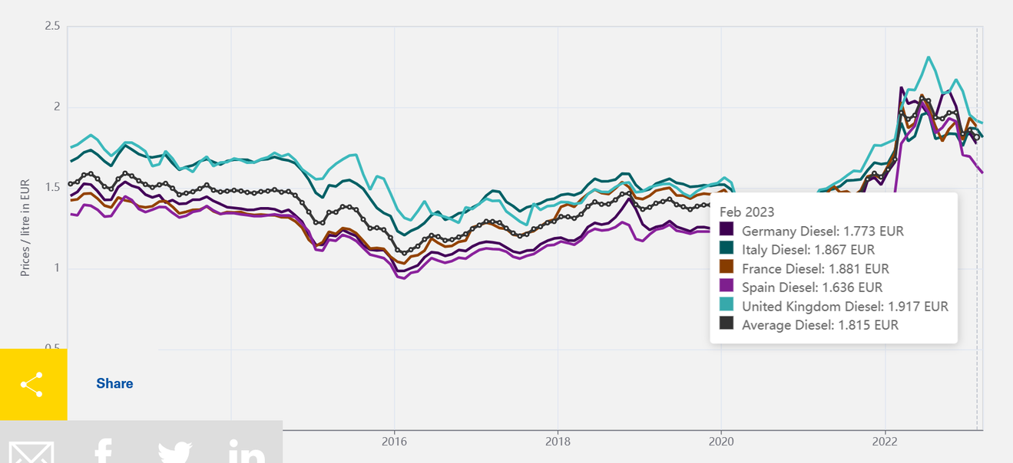
Average Diesel Price in FEB/2023: EUR 1.82/Ltr ex VAT (SRC IRU)
Notes:
30% increase from 2019

Slide 11
The Price Increase in the Logistics Industry
2020 – FEB2023 the increase in diesel was 50% more.
2020 – Feb2023 – Increased Cost of Bunkering Adjustment Factor on the Ferry sector from Malta to Italy approx. 33% more than 2020.
200 trucks x 1000 litres of diesel(average weekly) + plus 50% more in diesel and 33% more in cost of ferry journey between Malta and Italy

