Slide 1
    Presentation given to the Parliament Family Affairs Committee by the Central Bank Governor Prof. Edward Scicluna and Chief Economist Dr. Aaron Grech
Graphs prepared by the Economic Analysis Department - March 2023
Notes:
1

Slide 2
Inflation Developments

Slide 3
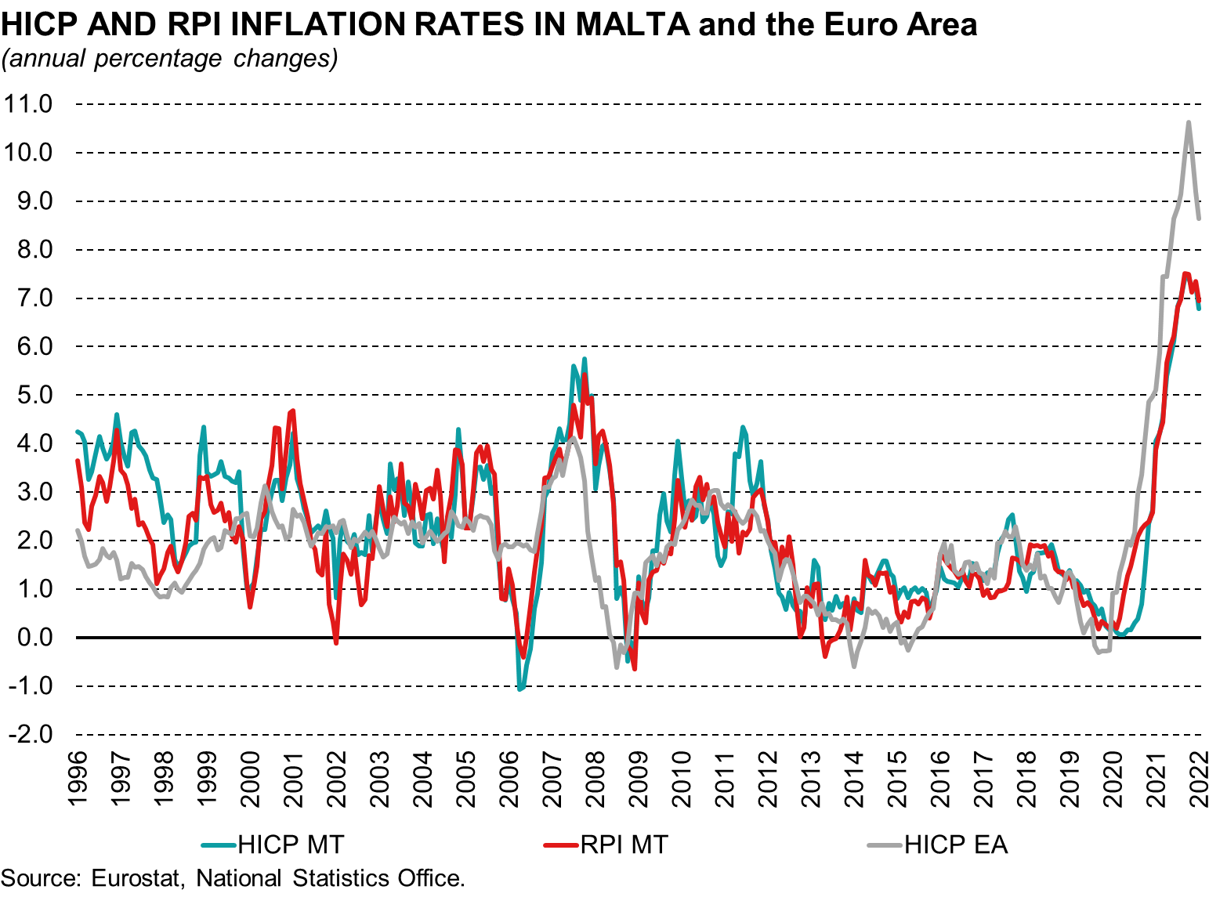
Inflation measures since 1997

Slide 4
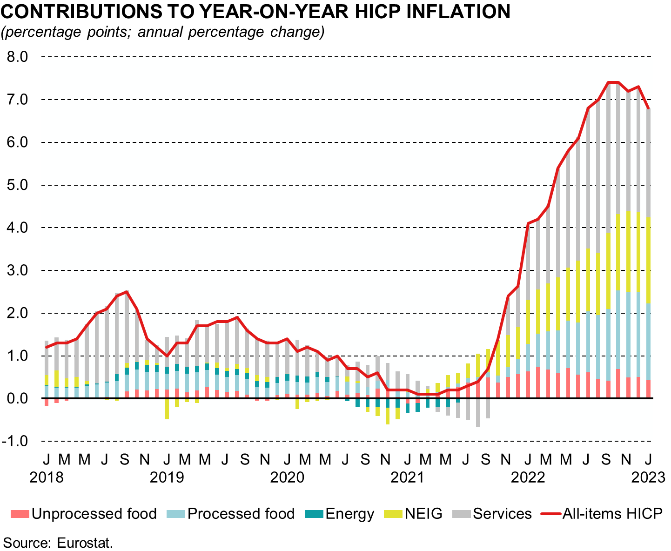
Main drivers of HICP inflation

Slide 5
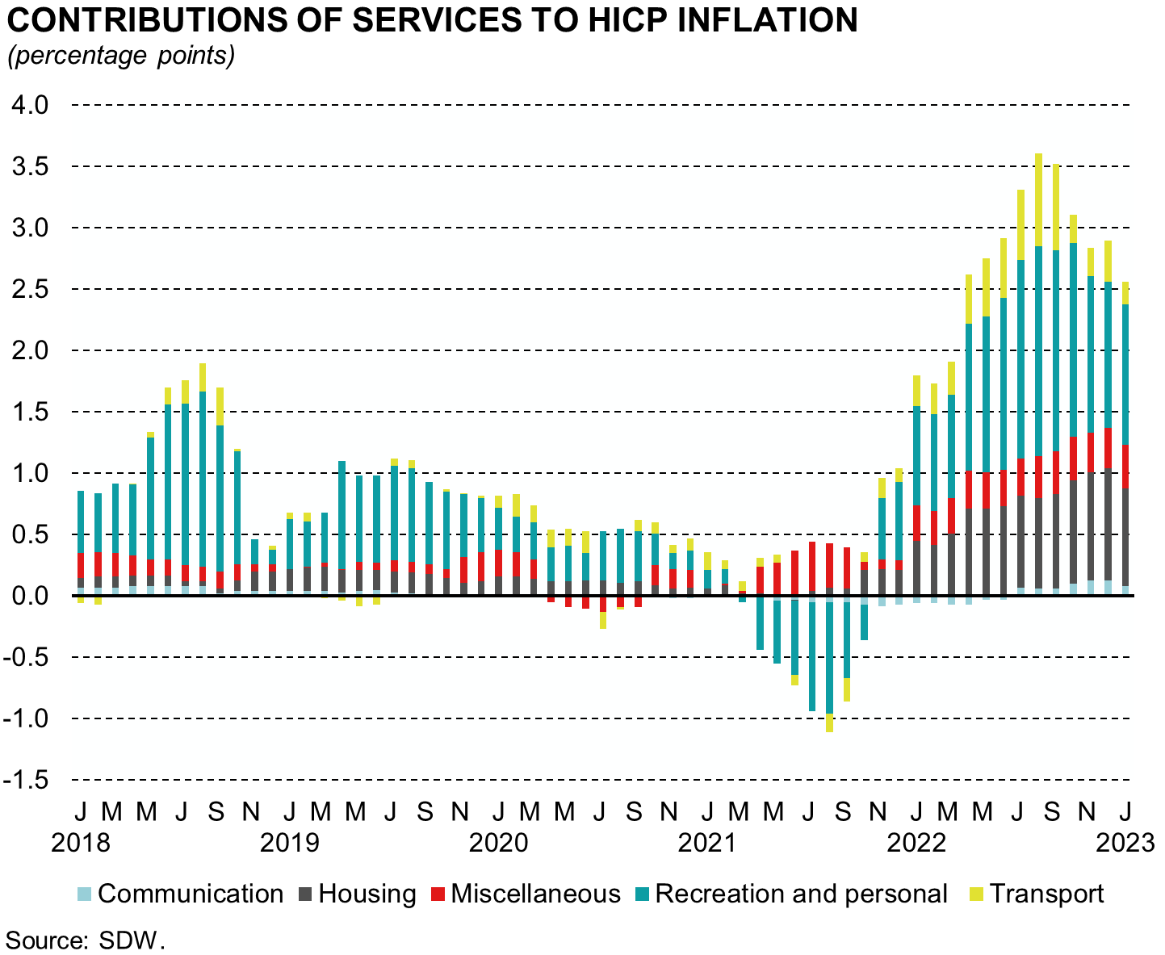
Main drivers of HICP inflation - Services

Slide 6
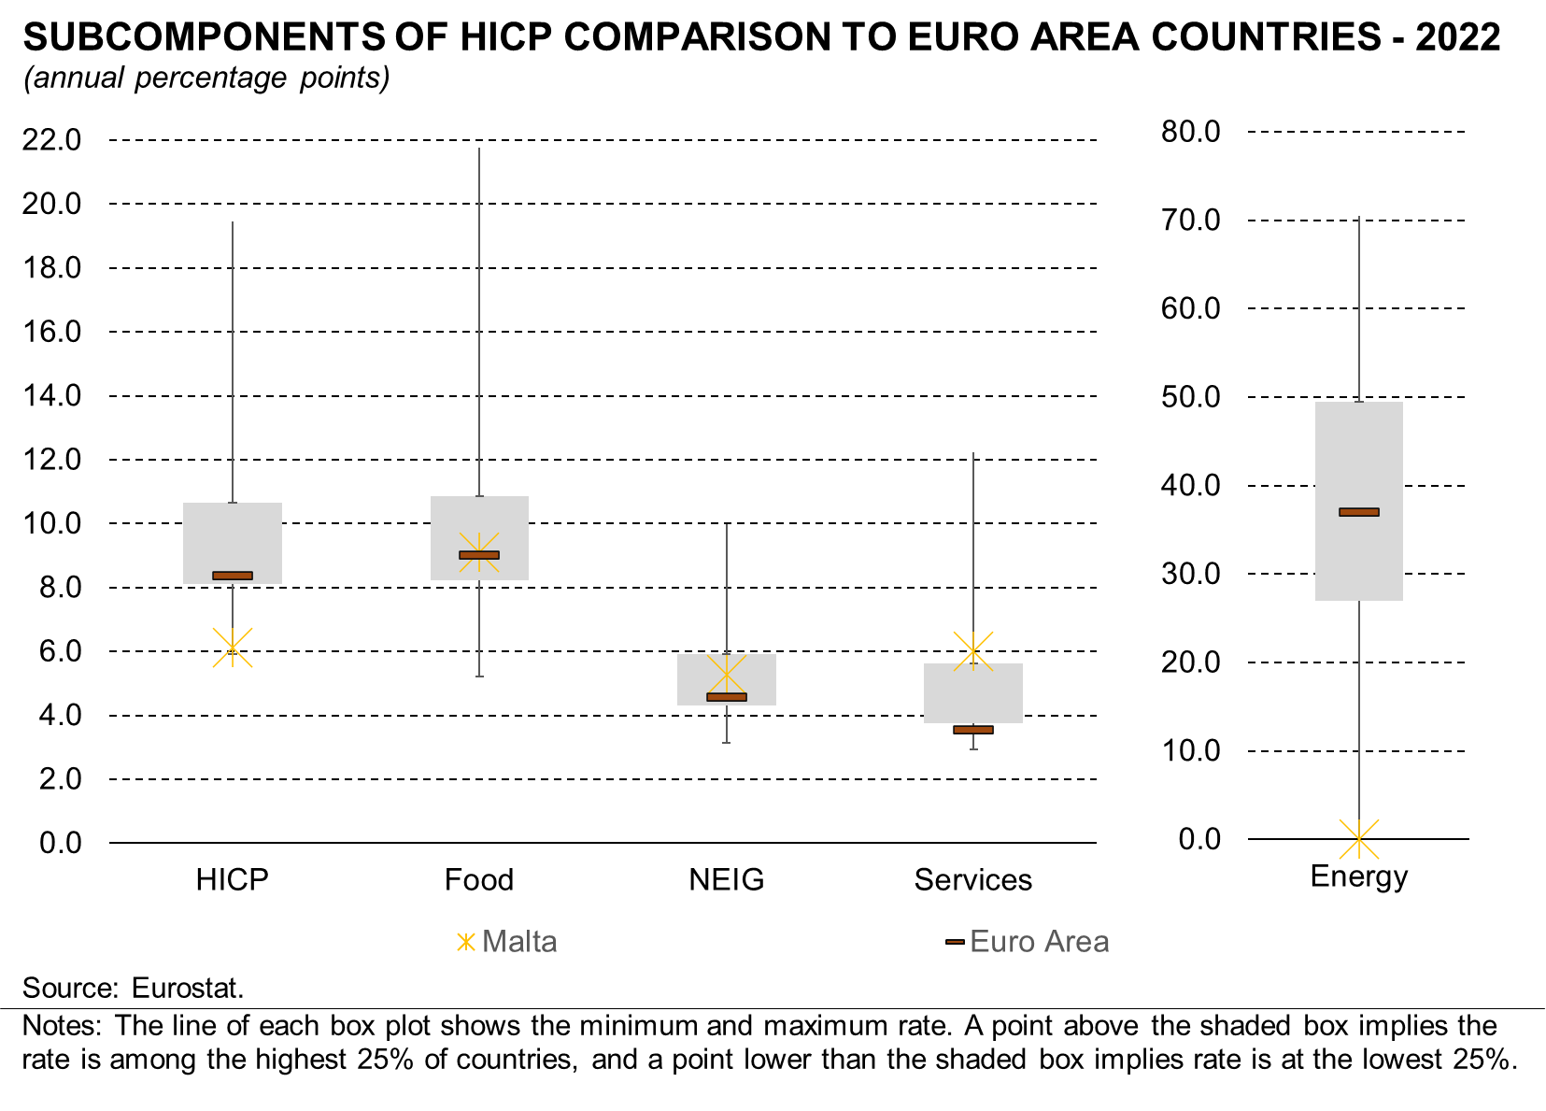
Comparison with euro area average and its member countries

Slide 7
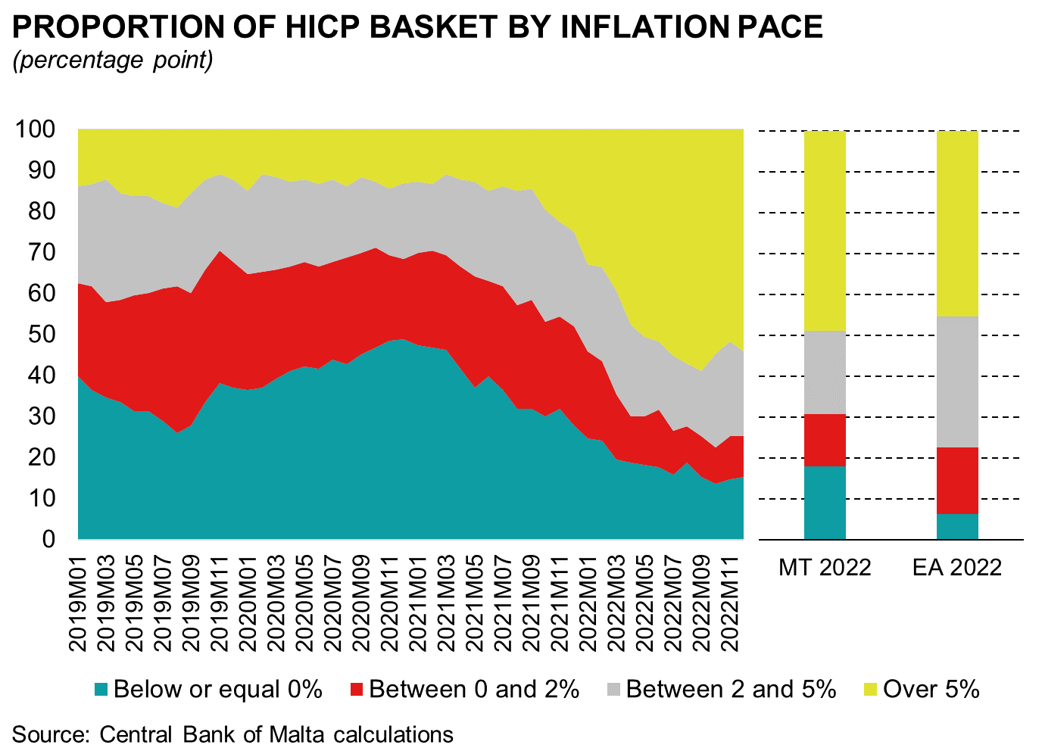
Analysis of HICP basket by inflation rate suggests that inflation may have peaked

Slide 8
The heterogeneous effect of inflation on different household groups

Slide 9
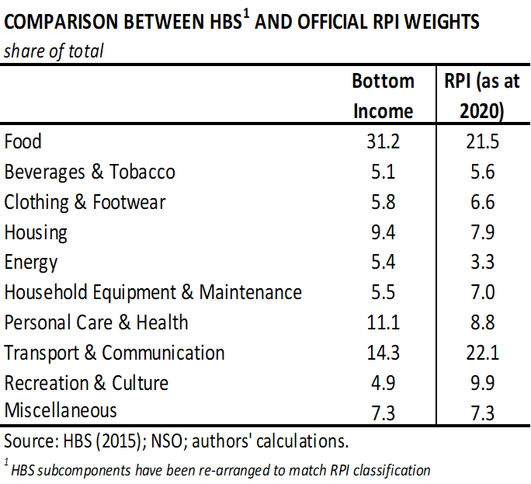
Analysis of households’ expenditure patterns

Slide 10
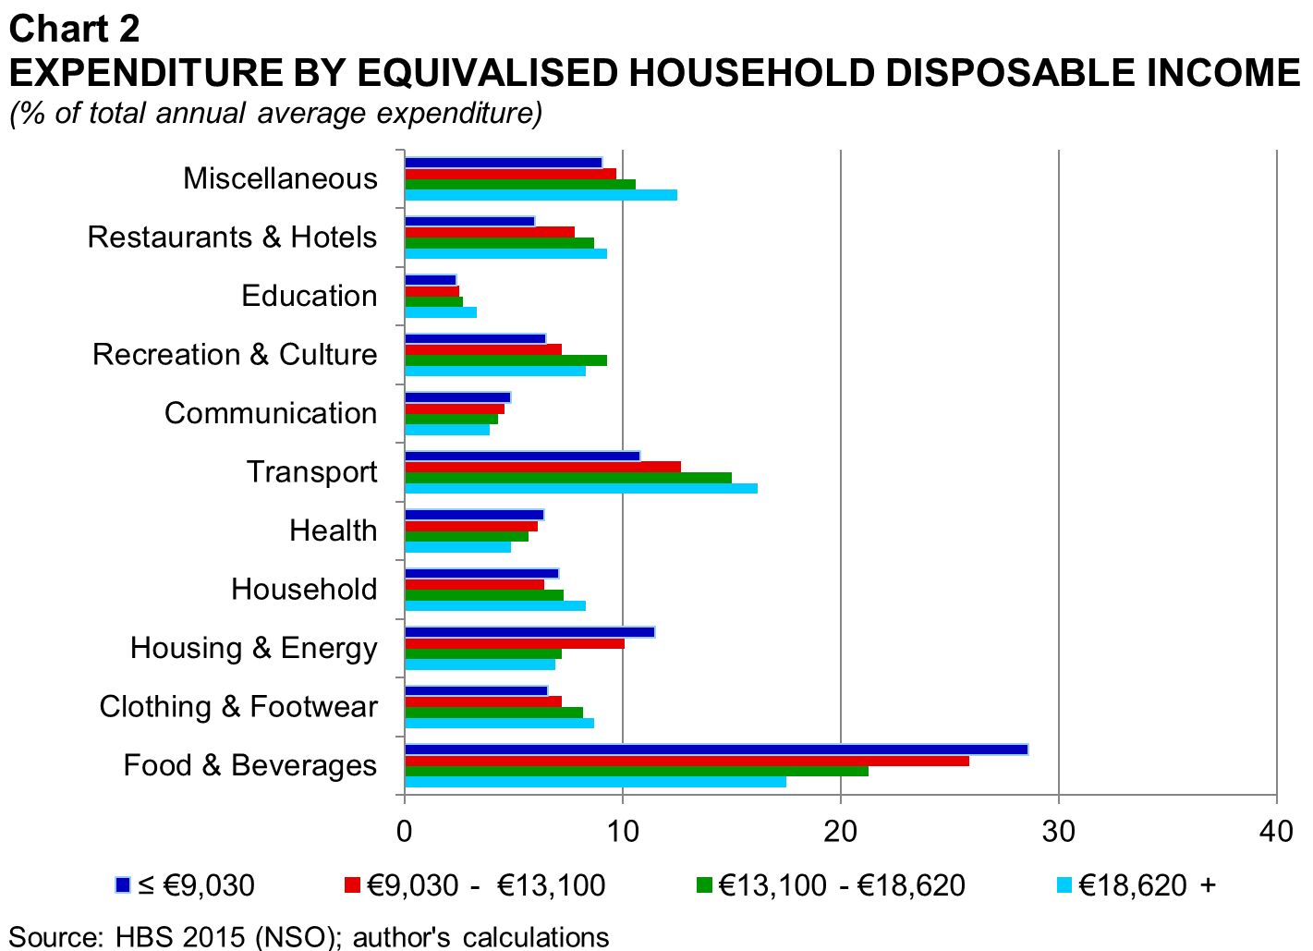
Analysis of households’ expenditure patterns

Slide 11
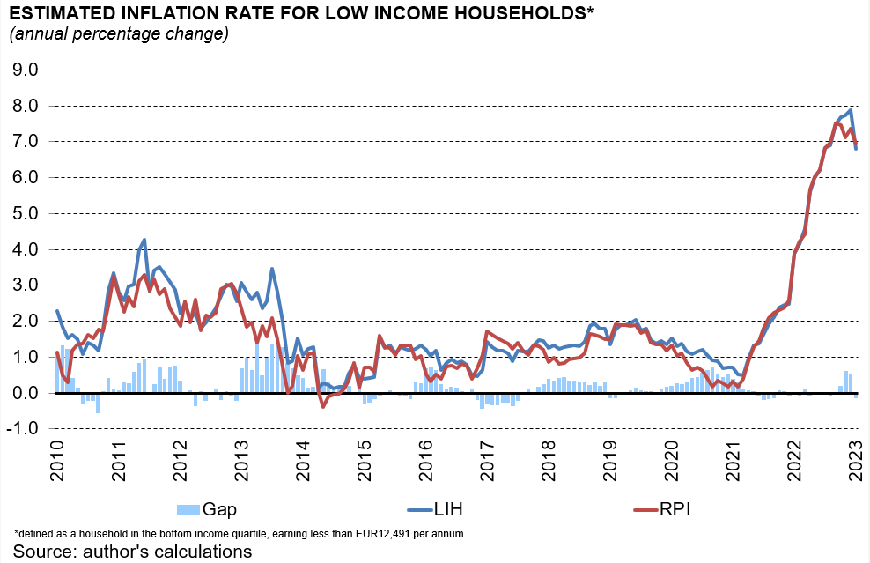
Inflation rate for low income households

Slide 12
2nd COLA mechanism
In the 2023 Budget, the Finance Minister unveiled a second Cost of Living Allowance mechanism directed towards low-income and vulnerable households. This mechanism is activated whenever the following two conditions are met:
The first condition relates to whether the overall inflation (i.e. 12-MA, as of September) is higher than 2% (as per inflation target of the ECB);
The second condition focuses on five out of the ten RPI components which are deemed to be of utmost primacy. The five sub-indices include “Food”, “Housing”, “Water, electricity, gas and fuels”, “Household equipment and house maintenance cost”, and “Personal health care”. In terms of the trigger, if the individual (12-MA) inflation rates of three out five sub-index components exceed their five-year rolling average, the mechanism is activated.
Around 80,000 vulnerable people (making up around 37,000 household) are expected to be beneficiaries of this new mechanism. The term ‘vulnerable’ refers to individuals who are receiving social benefits and have earned less than an average income of €17,796. Furthermore, the expected pay-out per household will be based on several household specific characteristics including net (and equivalized) disposable income, the household’s composition, type of beneficiary and employment status.

Slide 13
Inflation outlook

Slide 14
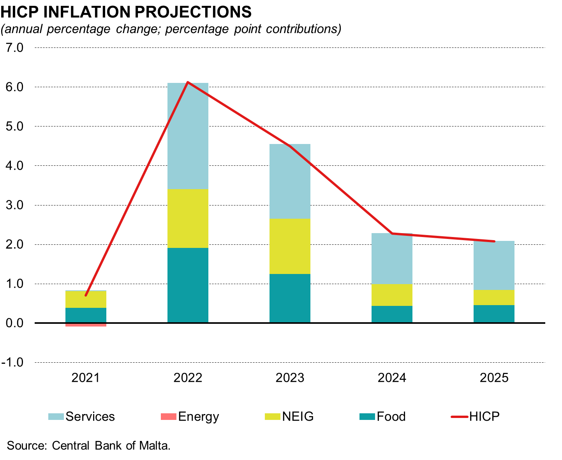
Inflation projections

Slide 15
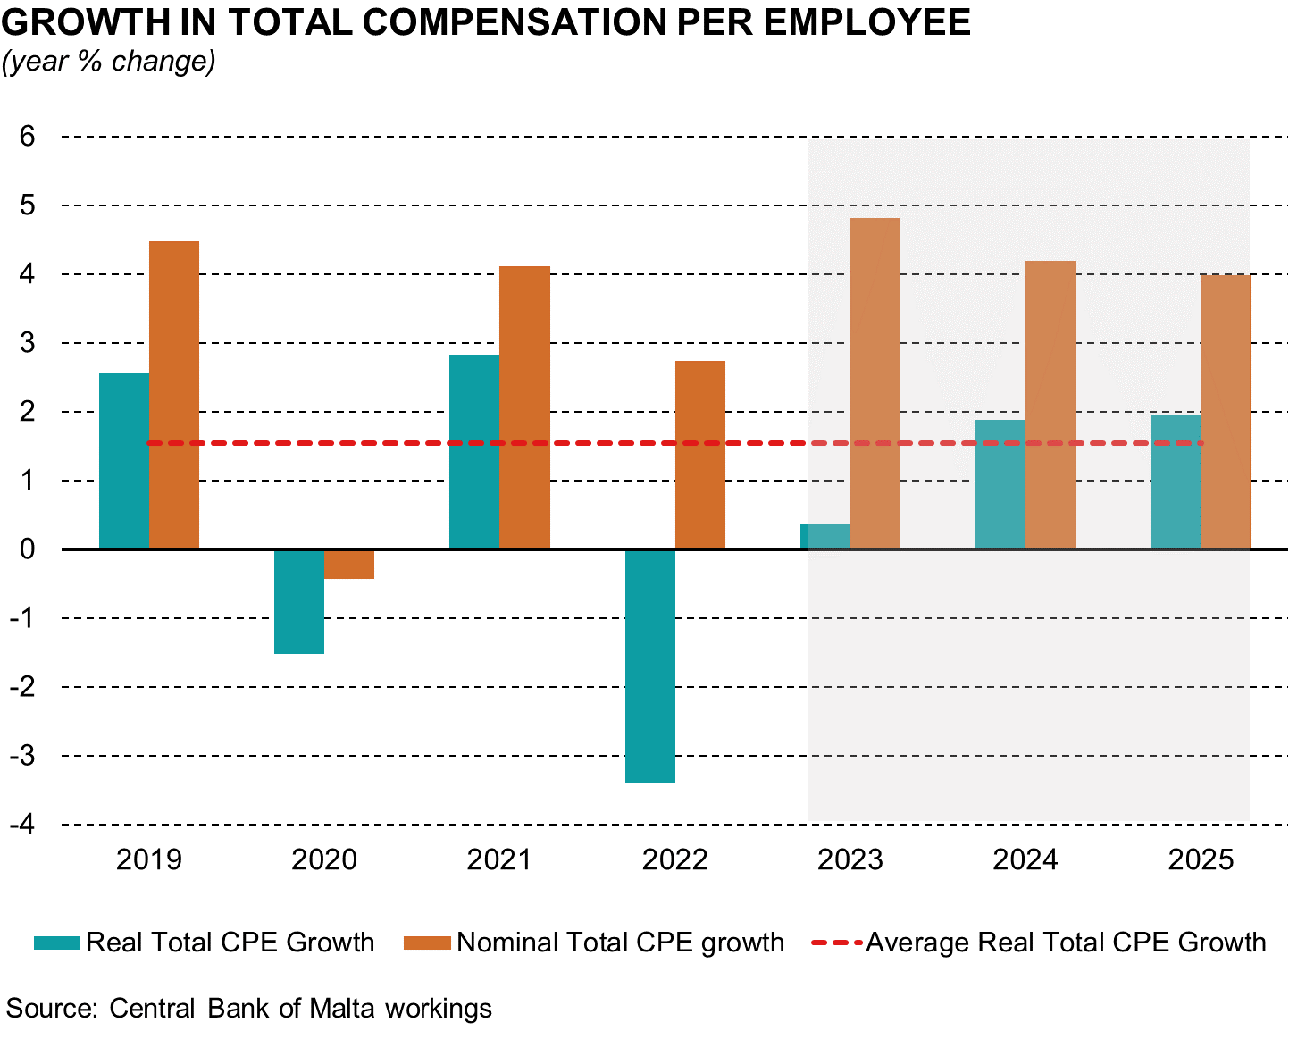
Wage developments and projections

Slide 16
MONETARY POLICY RESPONSE

Slide 17
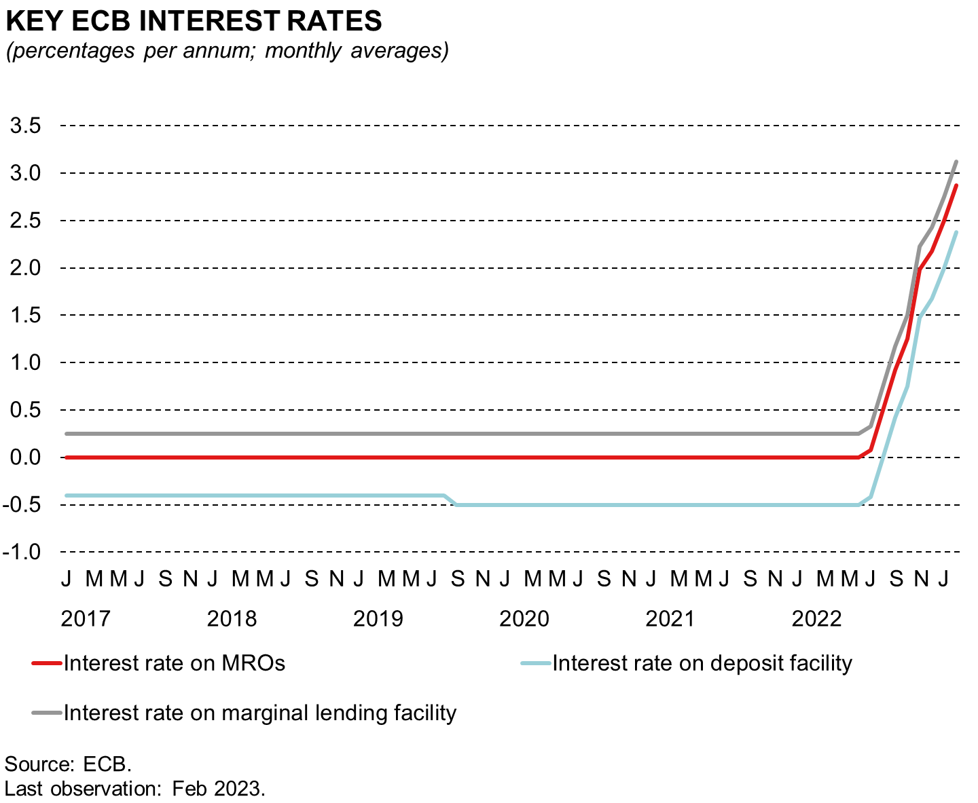
THE HIGH INFLATION ENVIRONMENT HAS PROMPTED THE ECB TO START NORMALISING ITS MONETARY POLICY

Slide 18
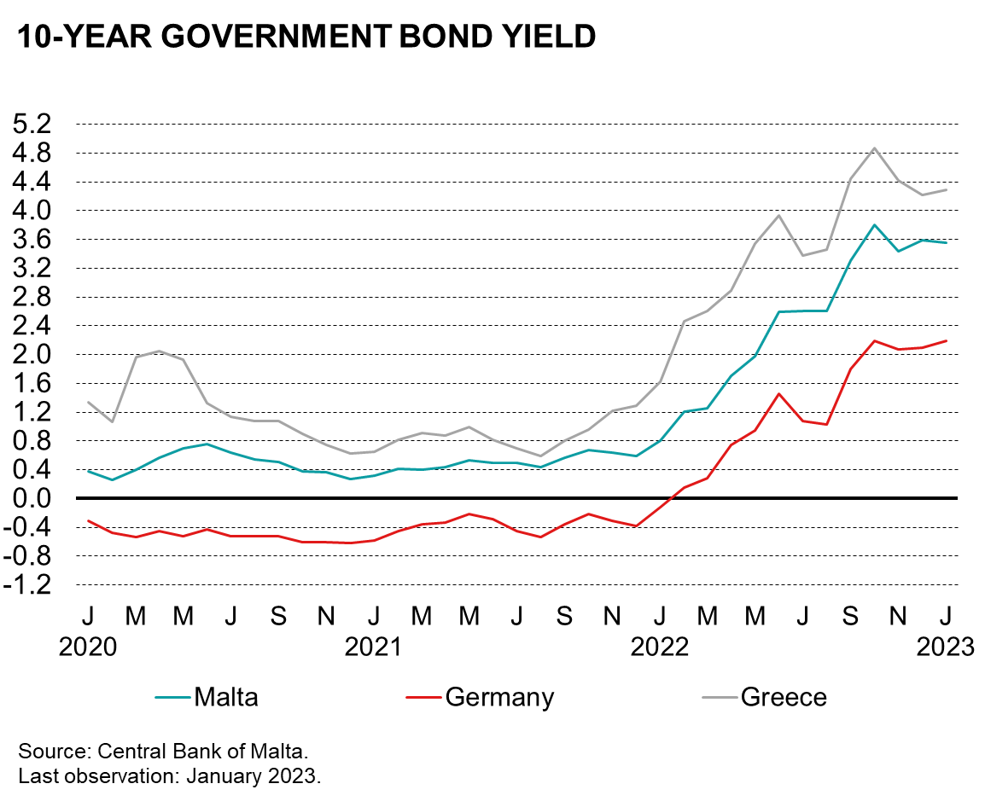
ECB RATE HIKES HAVE TRANSMITTED TO
MONEY MARKET RATES AND SOVEREIGN YIELDS

Slide 19
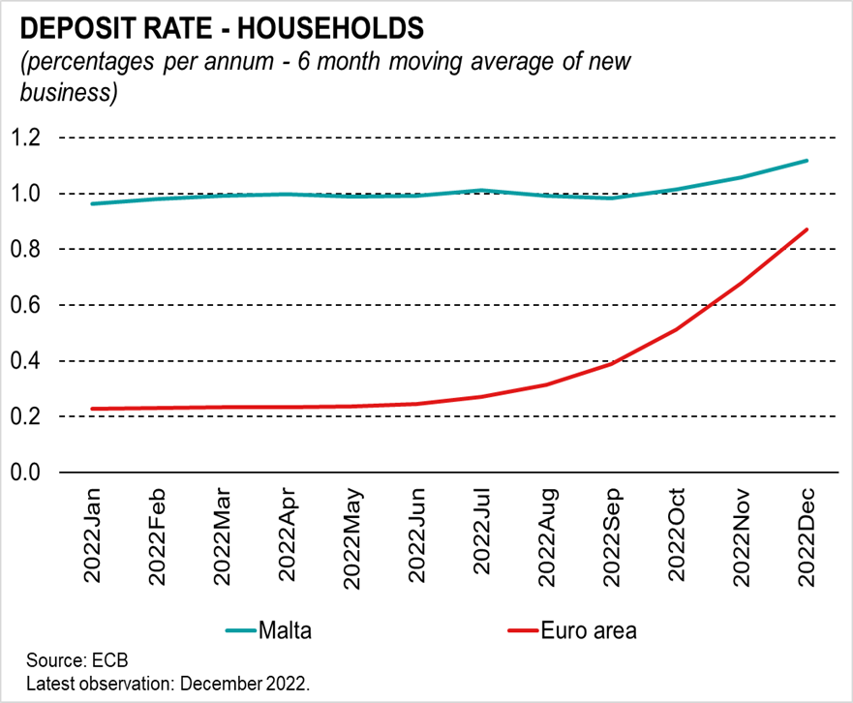
ECB RATE HIKES ARE ALSO AFFECTING RETAIL DEPOSIT AND LENDING RATES, THOUGH PASSTHROUGH HAS BEEN MORE LIMITED IN MALTA

Slide 20
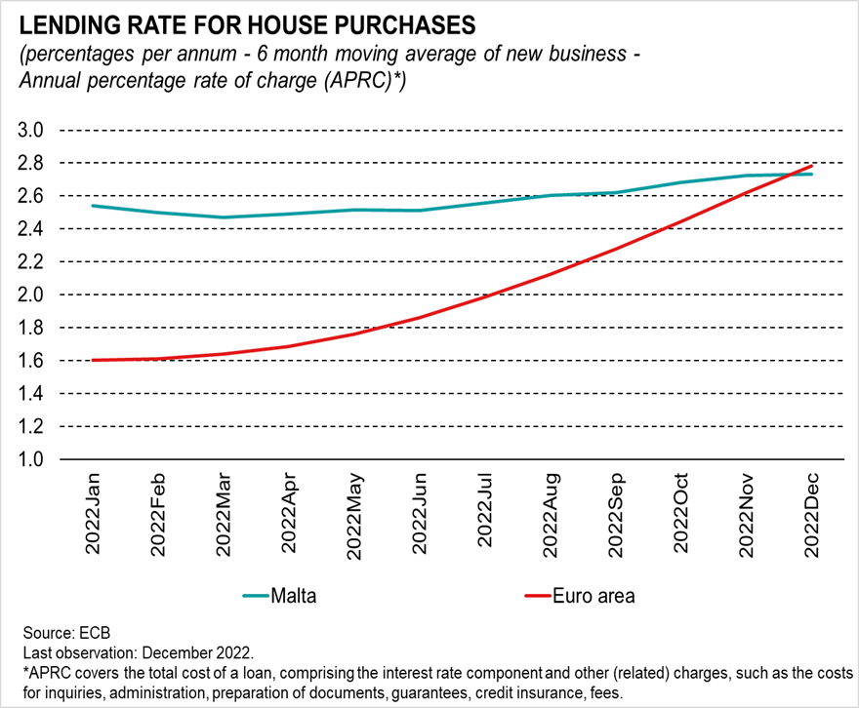
ECB RATE HIKES ARE ALSO AFFECTING RETAIL DEPOSIT AND LENDING RATES, THOUGH PASSTHROUGH HAS BEEN MORE LIMITED IN MALTA

Slide 21
TIGHTER MONETARY POLICY IS ESSENTIAL FOR INFLATION TO RETURN TOWARDS THE POLICY AIM OF 2%
While nominal interest rates have increased significantly since July 2022, they may need to increase further as long as euro area HICP inflation continues to exceed the ECB’s policy target of 2%.
This implies higher borrowing costs for government and the private sector and all else equal, (s)lower growth.
However, failing to act decisively can be more costly. If inflation persists, markets and the general public would lose confidence in the central bank’s commitment to fight inflation, potentially propagating into unanchored inflation expectations, stronger wage demands and new cost/price pressures. Financial costs could also increase further, as investors seek compensation for another round of price increases.
It is essential that fiscal policy pulls the same rope.
  Inflation mitigating measures have been instrumental in limiting inflationary pressures in Malta, by breaking the link between international energy prices and domestic consumer prices for energy.
  Nevertheless, inflation for non-energy items has been close/above corresponding euro area figures, partly reflecting the healthy balance sheet position of households and very favourable labour market conditions, which support demand.
  Untargeted fiscal support measures could be lifting demand further at a time when monetary policy is trying to bring it down, possibly undermining efforts to appease the lowest income groups.

Slide 22
Reserve Slides

Slide 23
Comparison with euro area average and its member countries

Slide 24
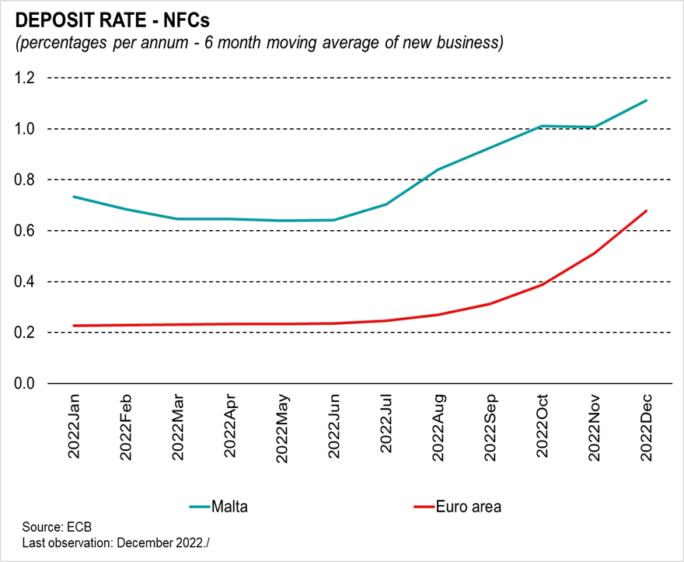
ECB RATE HIKES ARE ALSO AFFECTING RETAIL DEPOSIT AND LENDING RATES, THOUGH PASSTHROUGH HAS BEEN MORE LIMITED IN MALTA

Slide 25
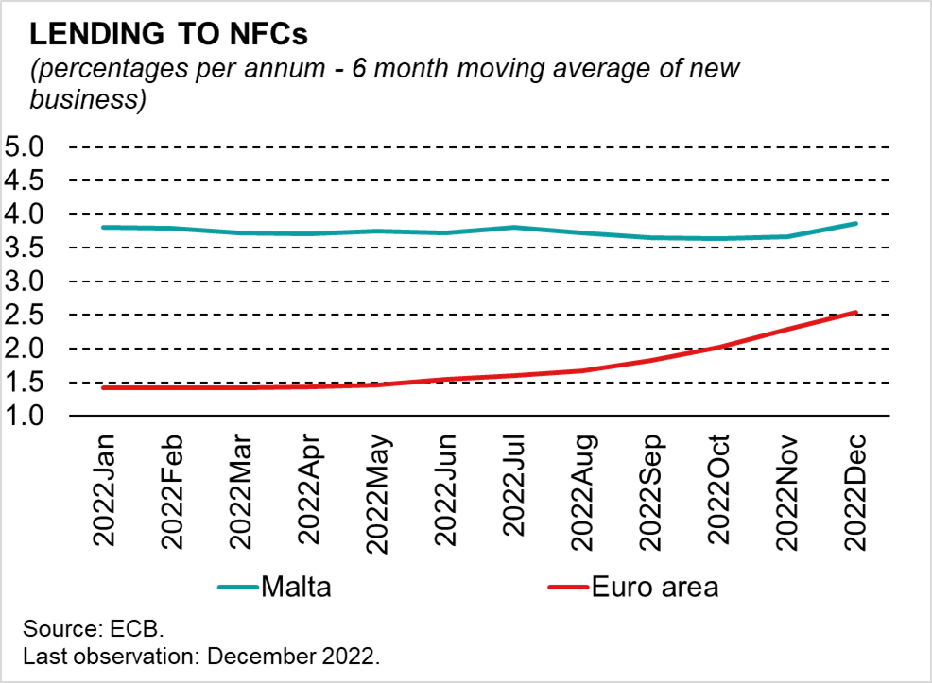
ECB RATE HIKES ARE ALSO AFFECTING RETAIL DEPOSIT AND LENDING RATES, THOUGH PASSTHROUGH HAS BEEN MORE LIMITED IN MALTA

