Slide 1
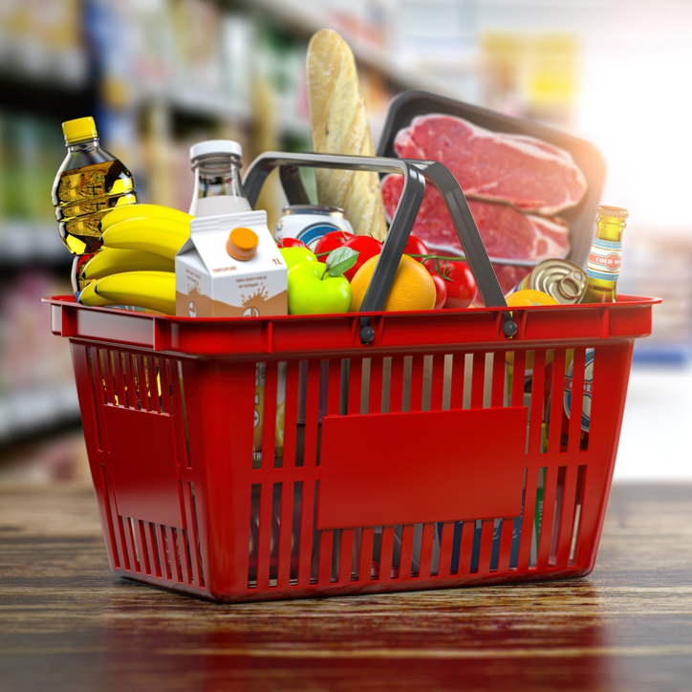
Shopping basket survey

Slide 2
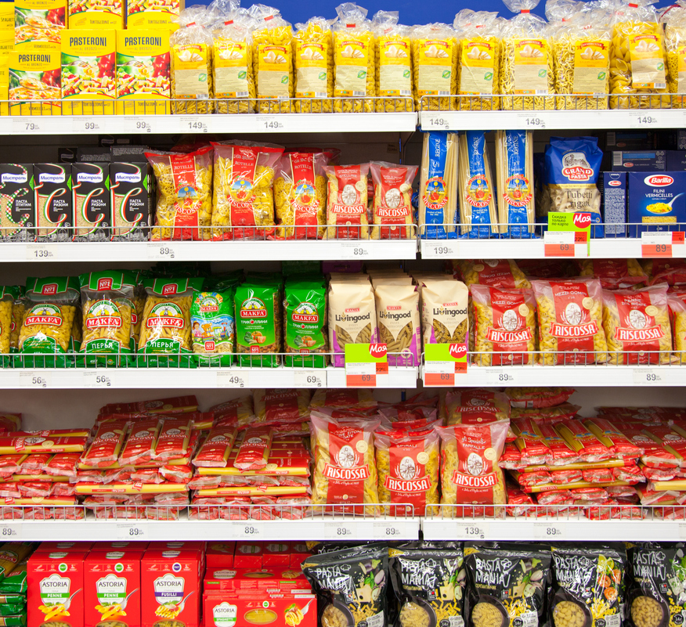
Objectives
To look into claims that prices of essential items such as groceries are increasing sharply
To identify which particular products are becoming more expensive
To identify by how much essential products are rising
To establish if there are particular trends or patterns behind these sharp rises

Slide 3
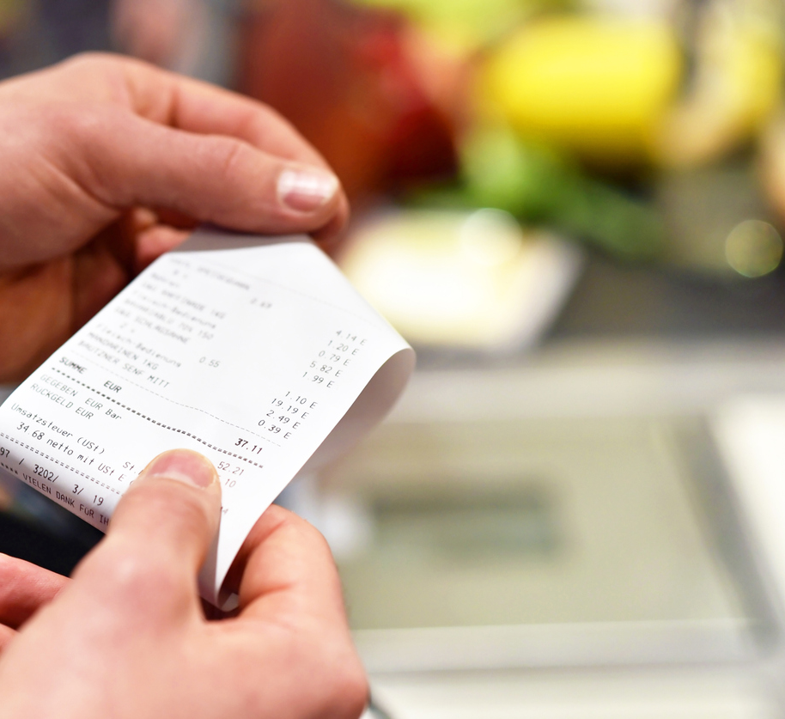
Methodology
A list of essential items covering basic types of food, detergents and some toileteries for a family of four was drawn up
The prices of each item was researched from the websites of three main supermarket chains in Malta which will be identified as A, B and C
The exercise was repeated every month as from January 2022
The variations in prices were mapped on an excel sheet

Slide 4
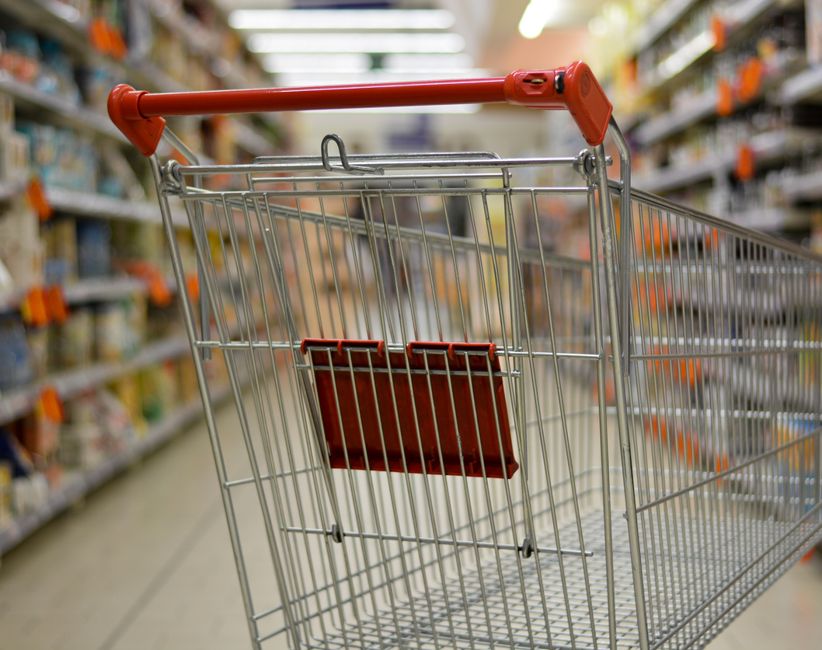
How was the list of items chosen?
The items were based on the typical lifestyle of a family of four with two children
The list contains dairy products, pasta, bread, toiletries, canned food, fruit and vegetables cereals, chicken and beef, detergents and frozen food.
Certain items such as sweets, soft drinks and alcohol are not included.
The list of items is estimated to cover between one or two weeks depending on the levels of consumption. In general, we opted for very modest quantities, meaning the expense is on the conservative side.

Slide 5
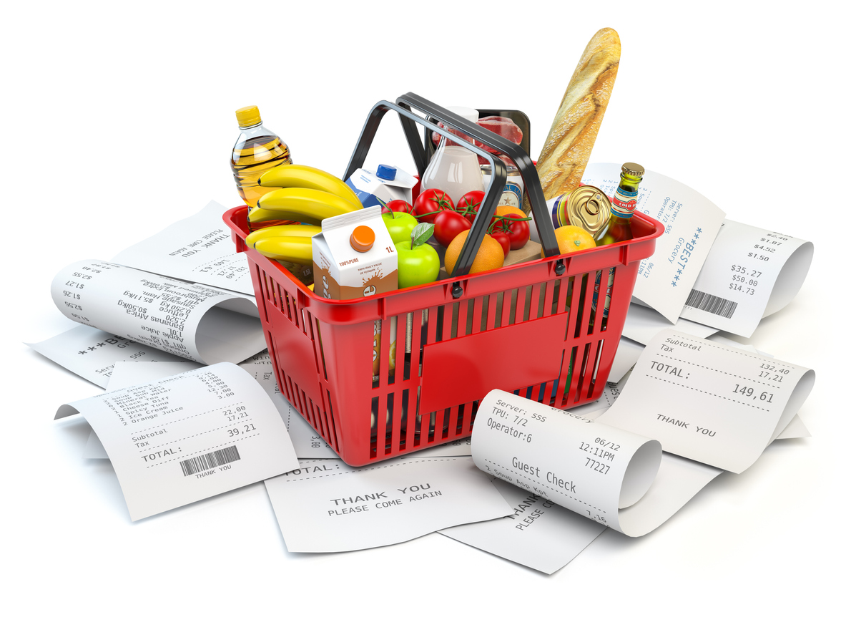

The detailed list
Sugar, toilet paper, potatoes, carrots, onions, bananas, tomatoes, oranges, apples, chicken drumsticks, chicken breast, fresh minced beef, frozen minced beef, ham, grated cheese, cheddar cheese, butter, buns, Maltese bread, white loaf, whole meal loaf, flour, fresh milk, mozzarella, yoghurt, ricotta, coffee, tea, pasta, tortellini, ravioli, polpa, kunserva, olives, caponata, pesto, kunserva, couscous, cereal, oven fries, canned tuna, toilet paper, floor detergent, sanitizer, fabric conditioner, laundry detergent.

Slide 6
How did the bills compare?
Month | A | B | C
January | €138.64 | €133.05 | €137.37
May | €149.46 | €139.04 | €142.57
September | €153.67 | €145.70 | €149.73
December | €151.76 | €144.65 | €147.64
Diff (Jan-Dec) | €13.12 | €11.60 | €10.27
Diff (Jan-Dec) % | +9.5% | +8.7% | +%7.5
Average Difference % | 8.6%
Average increase (€) | €11.67

Slide 7
How Did we cope in 2022 with the 2021 €1.75 cola increase*?
In/Out | A | B | C
Actual increase in annual expenditure for 2022 | -€332.34 | -€241.56 | -€223.11
COLA (not taxable) | +€91 | +€91 | +€91
Out of pocket | -€241.34 | -€150.56 | -€132.11
COLA (@15% tax) | +€77.35 | +€77.35 | +€77.35
Out of pocket | -€254.99 | -€164.21 | -€145.76
COLA (@25% tax) | +€68.25 | +€68.25 | +€68.25
Out of pocket | -€264.09 | -€173.31 | -€154.86
In each case increase in cost was overwhelmingly above the COLA increase for 2022
*Based on 3 shopping visits every month which equate to 36 shopping baskets per year

Slide 8
Assuming a price freeze in 2023 what would be the effect of the 2022 €9.90 cola increase*?
In/Out | A | B | C
Forecasted additional cost for 2023 | -€472.32 | -€417.60 | -€369.72
COLA (not taxable) | +€514 | +€514 | +€514
Out of pocket | 0 (€41.68) | 0 (€96.40) | 0 (€144.28)
COLA (@15% tax) | +€436.90 | +€436.90 | +€436.90
Out of pocket | -€35.42 | 0 (€19.30) | -€67.18
COLA (@25% tax) | +€385.50 | +€385.50 | +€385.50
Out of pocket | -€86.82 | -€32.1 | 0 (€15.78)
These figures raise questions on the COLA mechanism itself as even when it reached record level it was not be enough to cover increase in costs of supermarket items, let alone other sectors like clothes, medicines, transport, house maintenance, personal care, education etc.
*Based on 3 shopping visits every month which equate to 36 shopping baskets per year

Slide 9
The Cola anomaly should be removed
As long as the compensation being awarded through the COLA mechanism will remain taxable, this system will remain flawed as a significant chunk of this increase is being deducted as tax, and hence is never reaching the employee.
The same anomaly is also happening for the Social Security Contribution whereby this amount is taxable when in actual fact it is not reaching the employees’ pockets. Hence, this is a case of double taxation.

Slide 10
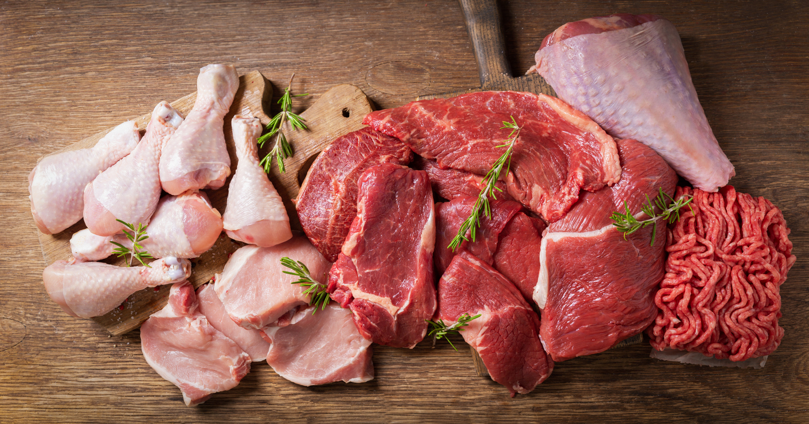



Which products increased most?
Beef and Chicken
Cheese and Tomato Paste
Detergents and toilet paper
pasta, Cereals and Sugar
Minced beef increased in two supermarkets by up to 34%
Chicken breast and drumsticks increased by up to 52%
Cheddar cheese increased in two supermarkets by up to 32%
Tomato paste increased by up to 46% in one supermarket
Laundry detergent increased in one supermarket by up to 14%
Floor detergent increase in two supermarkets by up to 20%
Toilet paper increase in all supermarkets by up to 41%
Sugar increased by 48% in one supermarket
Flour increase by up to 34%
Other pasta products increased by up 29% in one supermarket
The average increase of these essential items was of 35%

Slide 11
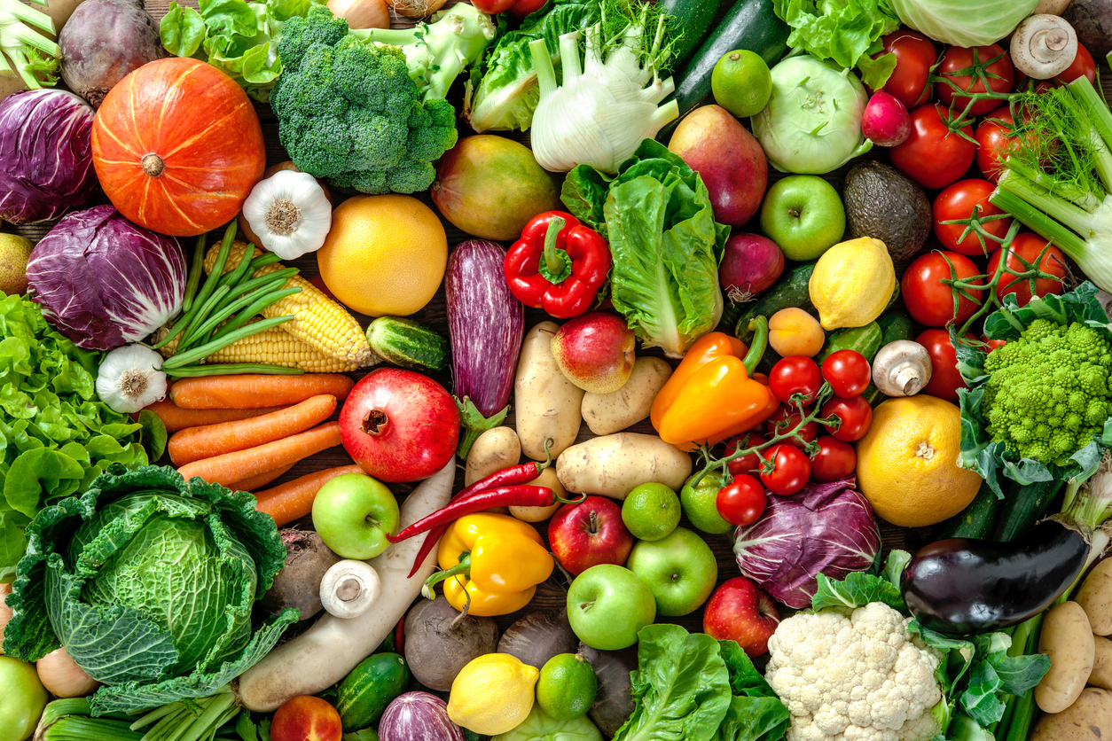


Any products which became cheaper?
Seasonal fruit and Vegetables
Limited special offers
There were some fluctuations in the prices of fruit and vegetables, but these were mainly due to seasonality.
Some products were sold at reduced prices for limited time mainly due to special offers

Slide 12
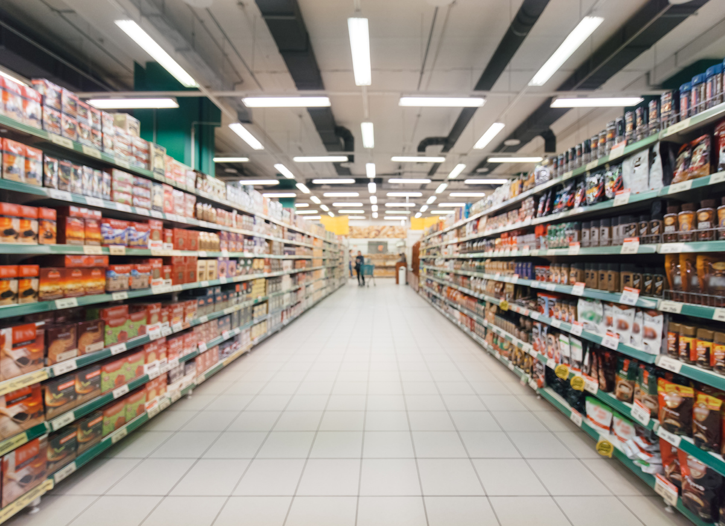
Other trends observed
Products which are out of stock for a period of time could indicate that an increase in price is on the way
Different supermarket chains may opt for different strategies when forced to increase prices due to external factors such as the war in Ukraine, meaning it will not have the same impact and necessarily happen at the same time.
Even at the cheapest supermarket there might be some items which cost more than elsewhere.
Customers are switching brands in an attempt to save money but at the risk of buying lower quality products

Slide 13

Thank you
pa@uhm.mt
http://www.uhm.mt

