Slide 1


The Pandemic and Education: What did we find?
What did we learn? How can we reach every learner?
_________________
Il-Pandemija u l-Edukazzjoni: X’sibna? X’tgħallimna? Kif nistgħu nilħqu lil kulħadd?
Prof Carmel Borg
and
The Early Childhood and Primary Education (ECPE) Research Group
Dr Charmaine Bonello, Dr Rosienne Camilleri, Dr Josephine Deguara, Dr Josephine Milton, Dr Tania Muscat
13th March, 2023

Slide 2

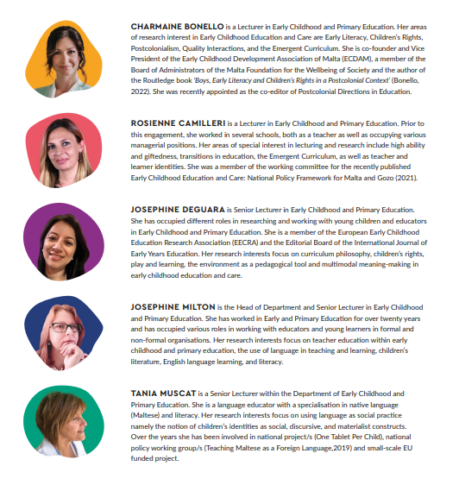
ECPE Research Group
The Early Childhood and Primary Education (ECPE) Research Group
A group of 5 research academics from the Department of Early Childhood and Primary Education (2020)
Our web-page: https://www.um.edu.mt/educ/ourresearch/researchprojects/ecperesearchgroupthecovid-19andeducationinmaltacov-emstudy/

Slide 3
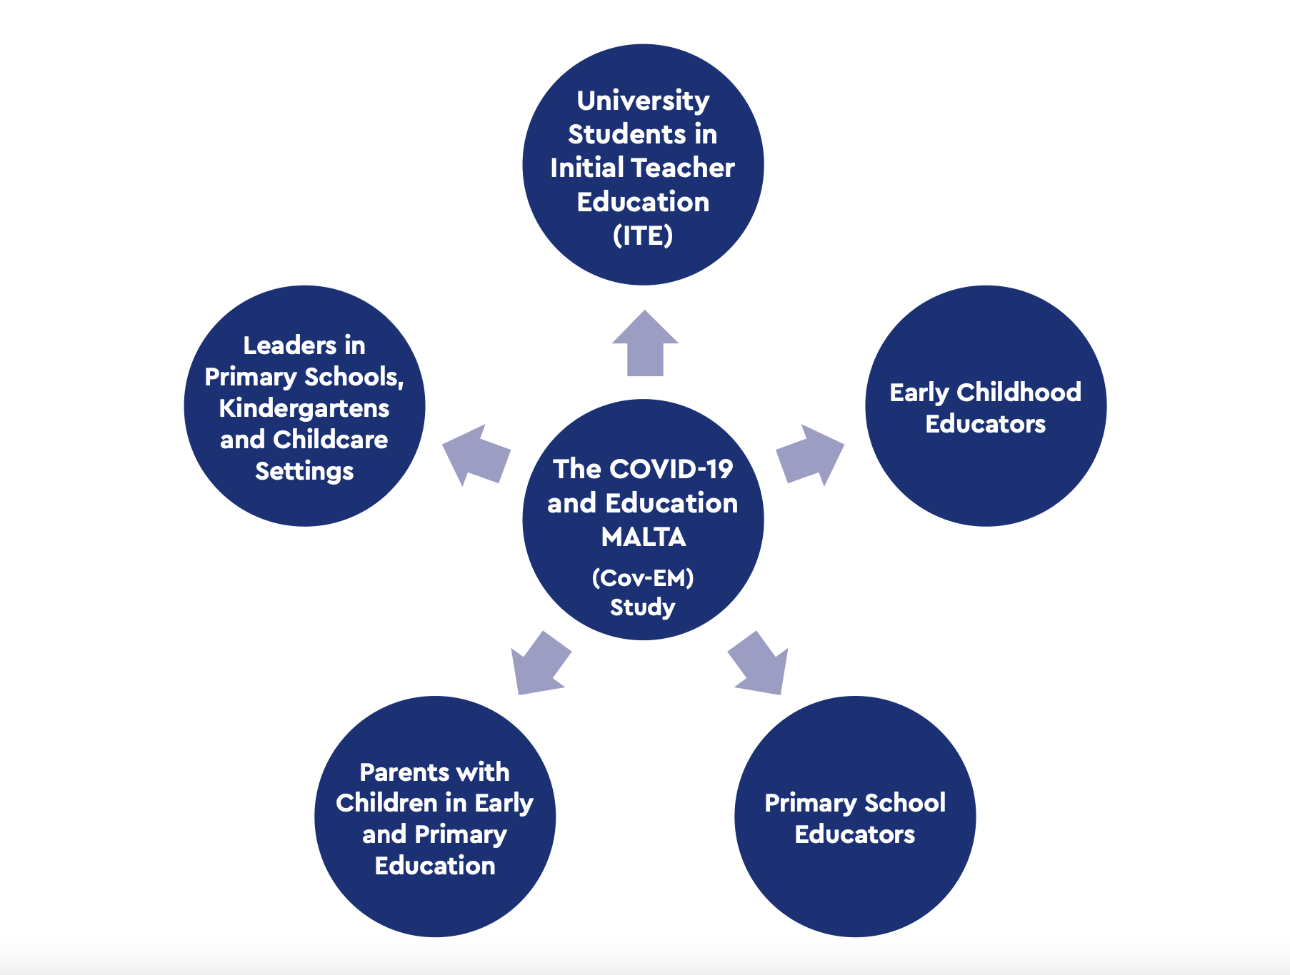

The Cov-EM study was conducted with 5 main stakeholders in education to explore how the pandemic impacted their personal and professional lives
The Cov-EM
Study:
The COVID-19 and Education in Malta -
a 2-year study

Slide 4
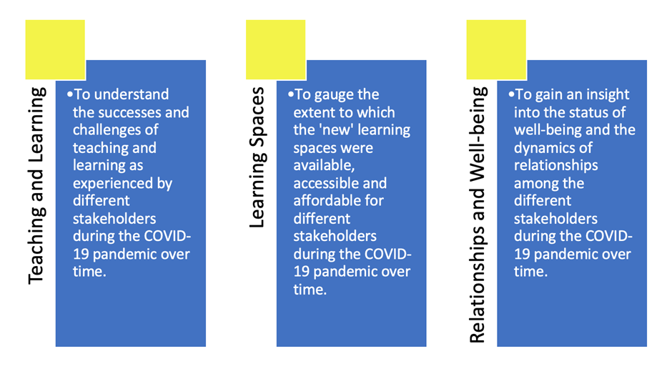
Aims of the study
Research Question:
What lessons can we learn from the perspectives of different stakeholders in Early, Primary and Higher Education during the COVID-19 pandemic in Malta?

Slide 5

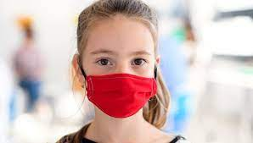
Methods
Quantitative methodology: Online survey (closed and open-ended questions)
Two phases:
i) Phase One (September 2020)
ii) Phase Two (September 2021 – using a modified version of the questionnaire)

Slide 6

Survey Respondents
Stakeholders | Run 1: 2019/2020 |  | Run 2: 2020/2021
 | N | % | N | %
University Students (ITE) | 127 | 100 | 68 | 100
Early Childhood Educators | 263 | 100 | 79 | 100
Primary School Educators | 207 | 100 | 126 | 100
Parents of Children in Early Childhood & Primary Education | 815 | 100 | 411 | 100
Leaders in Primary Schools, Kindergartens & Childcare Centres | 126 | 100 | 40 | 100
Total | 1,538 | 100 | 724 | 100

Slide 7

Teaching and
Learning

Slide 8
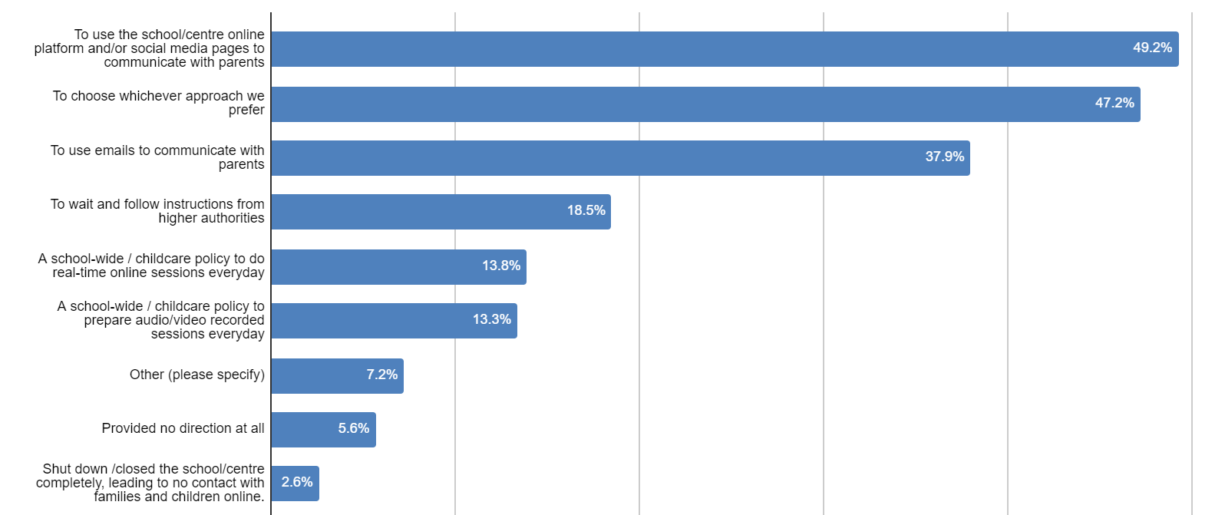
No clear protocol for schools lead to an uneven start
Early Childhood Educators

Slide 9
An asymmetric provision
Due to a lack of clear protocol:
Schools from different sectors provided different provisions and support with some parents indicating that church and independent schools were more prepared than state schools to transition to remote modes and to provide continued support to children
Church and independent schools seemed to have had more provisions in place, supported and prompted their teachers more to shift to online teaching
For example, children attending state schools were more likely to be offered asynchronousus modes of learning (supported by Vassallo et al, 2021).

Slide 10
The difference in the quality of teaching not only resulted in the differences between the school sectors but also between teachers in the same schools.
Some state schools, guided by a strong leadership team, were able to shift quickly to online modes and managed to support teachers, parents and children very well; others did not.
“There were teachers in state schools who did very little, whereas church schools prompt their teachers more. The difference is evident.”
“My son's school, which is a church school, was well prepared and continued supporting my child remotely. My niece, however, who attends a state school, was left on her own and didn't have support from school. She stayed home for the whole year and did not follow any online lessons nor was the parent provided with material / guidance. Thus, the child, who is in year 5, missed a lot academically.”

Slide 11
2020
2021

Slide 12

Synchronous vs Asynchronous modes
Synchronous modes of learning were the most common and most used mode of remote learning for all stakeholders in the first school closure (Survey 1 - March – June 2020)
An increase in the use of synchronous sessions was reported in Survey 2 (March – April 2021).
In both surveys higher levels of motivation and engagement were indicated for synchronous online experiences.
Satisfaction with overall quality of online learning was generally higher in the second survey (e.g. 82% for ITE University students).

Slide 13
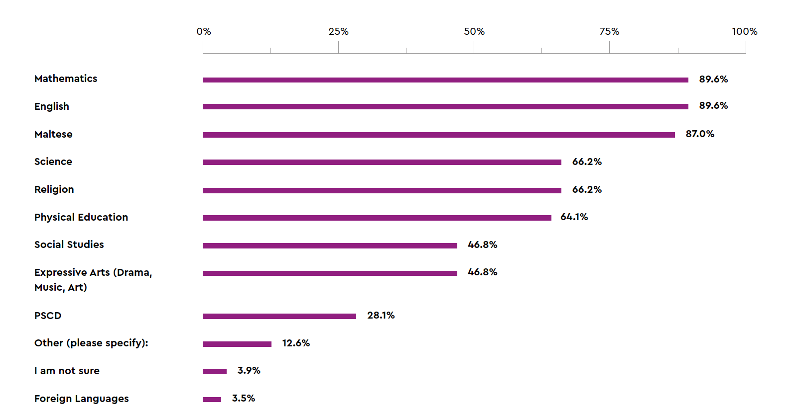

Online activities/lessons were more frequent for the main subject areas (Mathematics, English & Maltese) – and very rare / totally absent for subjects considered ‘less’ important(arts, social studies, PSCD) – confirming the hierarchical structure of curriculum content.
A traditional approach was mainly adopted teaching.
Some stakeholders indicated the absence of assessment practice in early and primary education.
Type and frequency of activities & lessons: focus on the core subjects
Primary educators resorted to formal and traditional teaching
emphasised by the use of
templates and worksheets

Slide 14
Type and level of support provided by schools
2020
2021
There was an increase in all levels of support by schools to parents from 2020 – 2021

Slide 15
Type and frequency of modalities used by teachers in 2020 (Survey 1)
The most popular modalities in 2020: List of exercises and list of worksheets.
Least popular modalities in 2020: Recorded video clips with explanations and real-time sessions with a small group at a time.

Slide 16
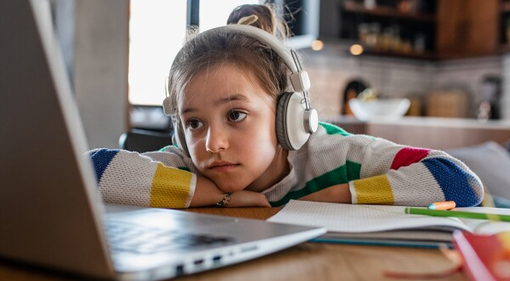
A traditional approach does not suit all learners
“We struggled greatly as my children had zero interest in following the lessons without being able to physically interact with their teachers and friends.”
“It was extremely hard to get a 4-year old to sit still and look at the screen for more than a few minutes at a time.”
“Online experience was inadequate for a 7/8 year old child. Children were restless. There was no control over who spoke in class. Certain children were constantly interfering and parents had their volume on, thus disturbing the whole class.”
“Online lessons were so boring that my son used to sleep.”
(Parents’ report)

Slide 17
Type and frequency of parental support in 2020 (Survey 1)
Parents supported their children mainly with working activities and tasks while they provided the least support in correcting their child’s work.

Slide 18

Learning
Spaces

Slide 19
Access to digital equipment between 2020 and 2021
Use of desktop and no technological device available, remained the same.
Use of own laptop increased.
Use of tablet provided by the school, mobile device, and shared equipment decreased (Parents)

Slide 20
Challenges of learning remotely
Space did not seem to be a major issue in Maltese households
Distractions were frequent
Difficult to find a balance between supporting children, work and life
(Parents’ Report)

Slide 21
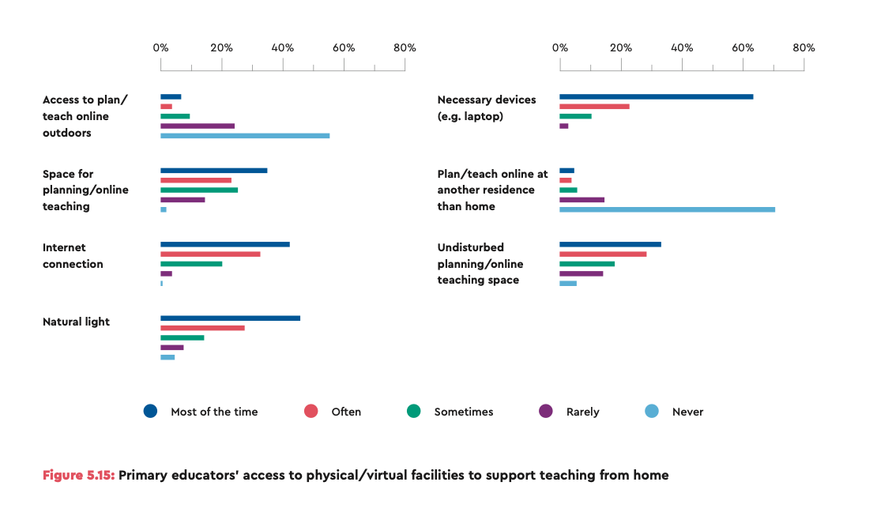
Shared learning spaces led to logistical difficulties and stress for adults and children
Digital divide between those who could afford to pay for technological devices and connectivity and those who did not. This was evident across the reports.
Primary Educators
(2020)

Slide 22
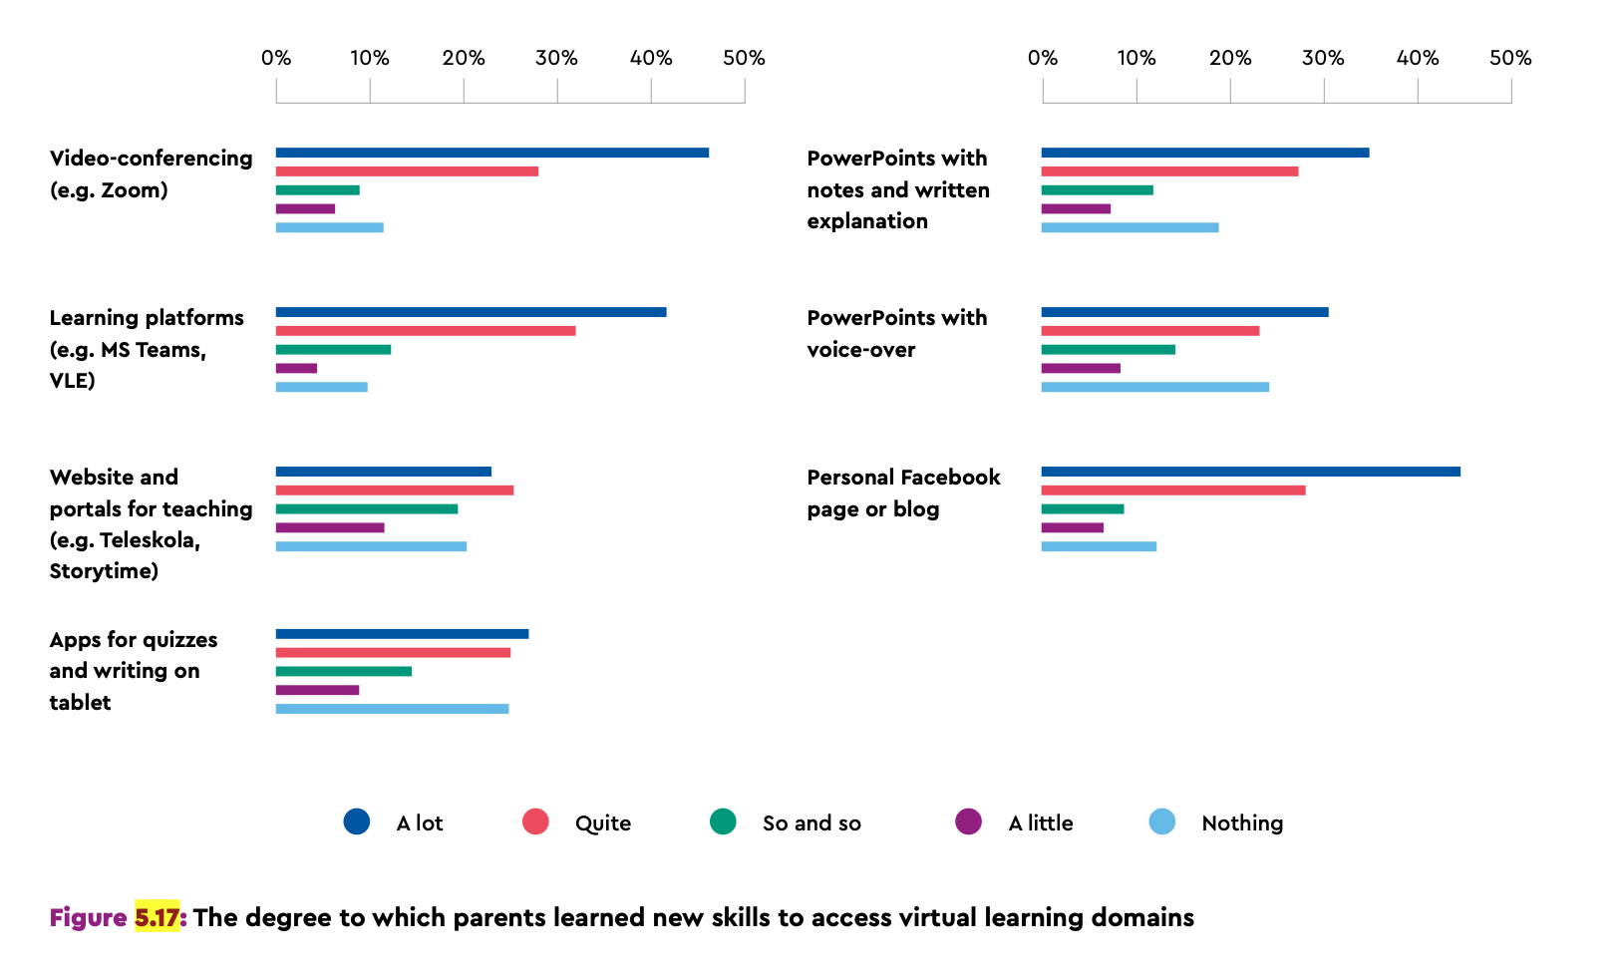
Parents: Survey 1
Leaders, educators, parents and students acquired new digital skills and came up with innovative solutions.

Slide 23
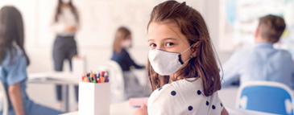
Relationships and Well-Being

Slide 24
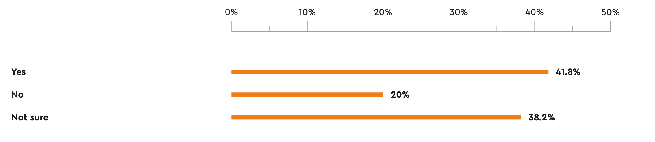
The well-being of children according to early years’ educators
Early years’ educators’ perspectives on whether young children benefited from remote teaching and learning 2021

Slide 25
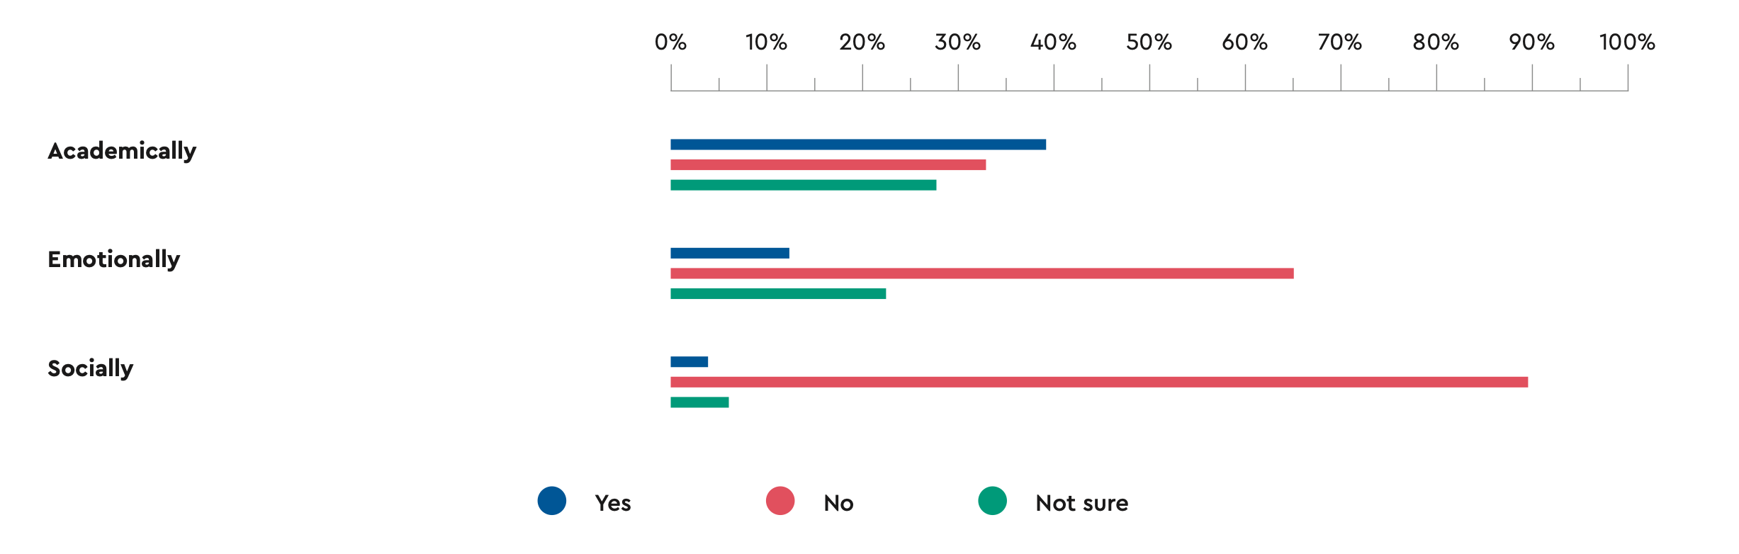
The well-being of children according to primary teachers
Teachers’ perspectives on whether children benefited from remote teaching and learning in relation to their academic development and emotional and social well-being in 2021
Losses identified in terms of outcomes for learners: Generally, the social and emotional losses for students were considerable and far outweighed any gains (according to teachers in 2021)

Slide 26
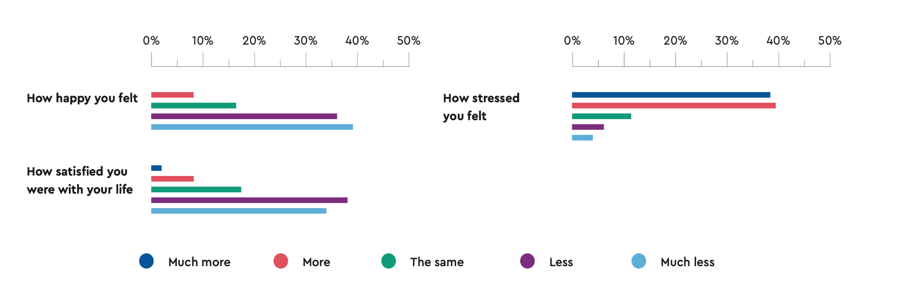
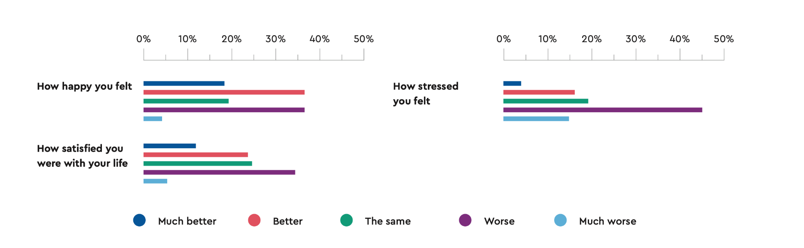

The well-being of primary educators in 2020 and 2021
For most primary educators, the pandemic negatively affected their happiness and satisfaction.
However, when compared to 2020, in 2021 they felt:
Happier
More satisfied
Less stressed
2020
2021

Slide 27
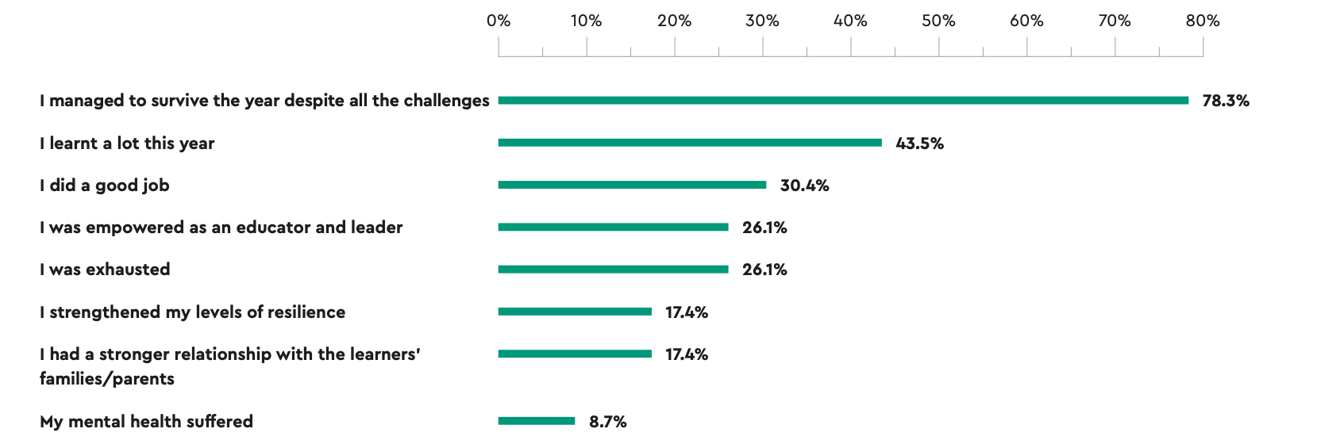

The well-being of school leaders in 2021
The majority of leaders felt satisfied and empowered that they managed to survive the pandemic despite the challenges
Benefits:
- Strengthened their levels of resilience
- Developed a stronger relationship with parents
Drawbacks:
- Feeling exhausted
- Mental health suffered

Slide 28
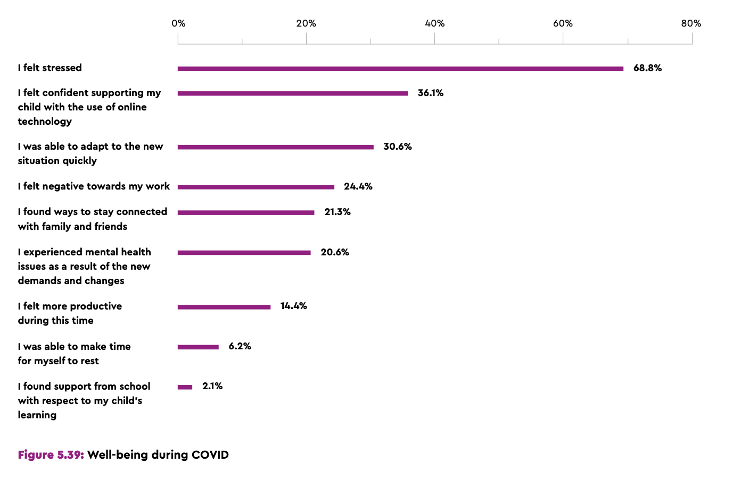
The well-being of parents in 2021
Negative feelings:
Felt stressed
Negative toward work
Felt isolated
Adjusting to a ‘new normal’ revealed several stakeholders’ resilience.

Slide 29
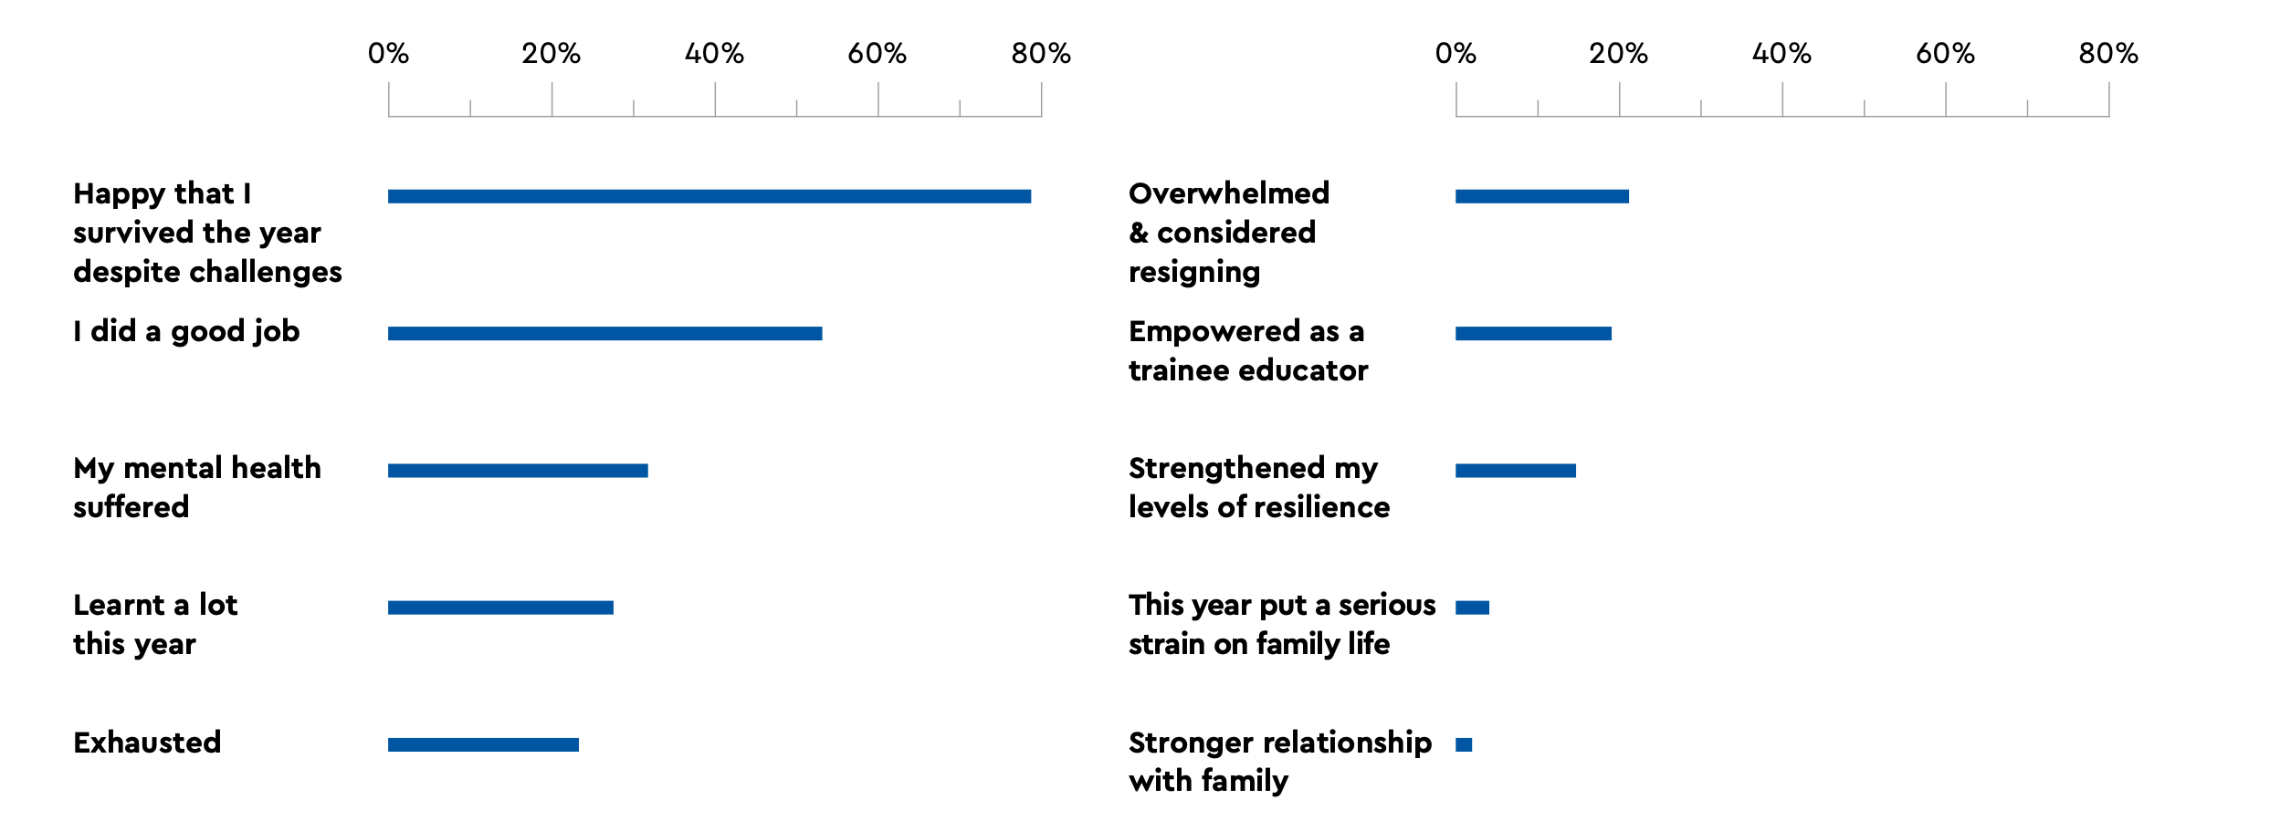

The well-being of pre-service educators in 2021
Positive feelings:
Survived/resilience
Empowerment (good job)
Negative feelings:
Mental health issues
Exhuastion
Overwhelmed

Slide 30

Learning
Spaces
Beyond the pandemic: Reconceptualising education
in a post-COVID world

Slide 31
It is time to move beyond the ‘lessons learnt’ and take individual and collective ‘action’
Towards a systemic approach
Required policy infrastructure
Capacity building - technological preparedness
Tapping on the best of both online and offline worlds
Higher Education - Flexible and blended modes
Increase monitoring and support

Slide 32
It is time to move beyond the ‘lessons learnt’ and take individual and collective ‘action’
Address Digital Divides
Opportunities for ongoing dialogue
A plan of action for vulnerable children and their families and any identified learning loss
Centrality of relationships & partnership with parents
Towards valuing and recognising the teaching profession
Sustainable well-being support programmes for all stakeholders in education

Slide 33
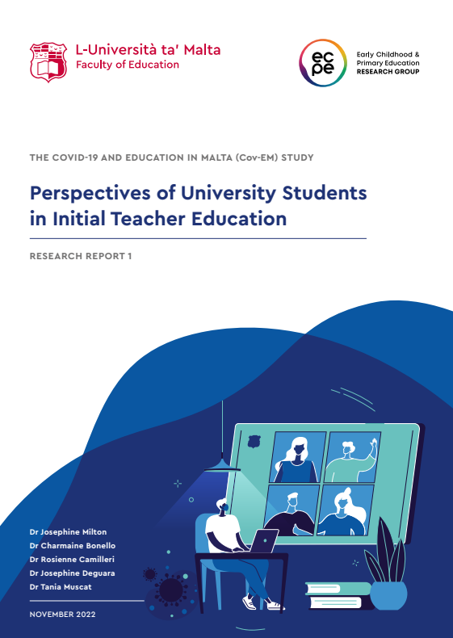
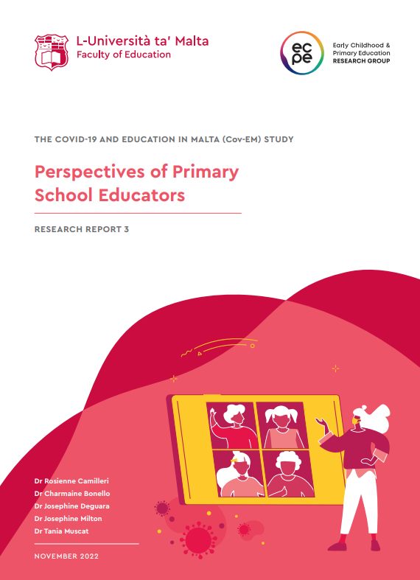
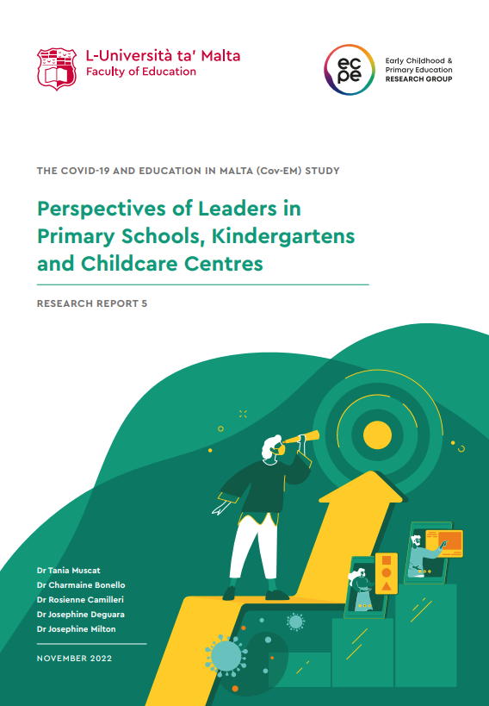
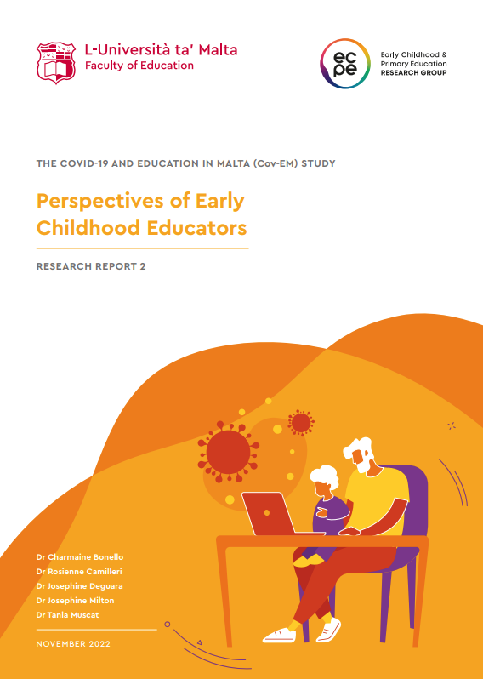
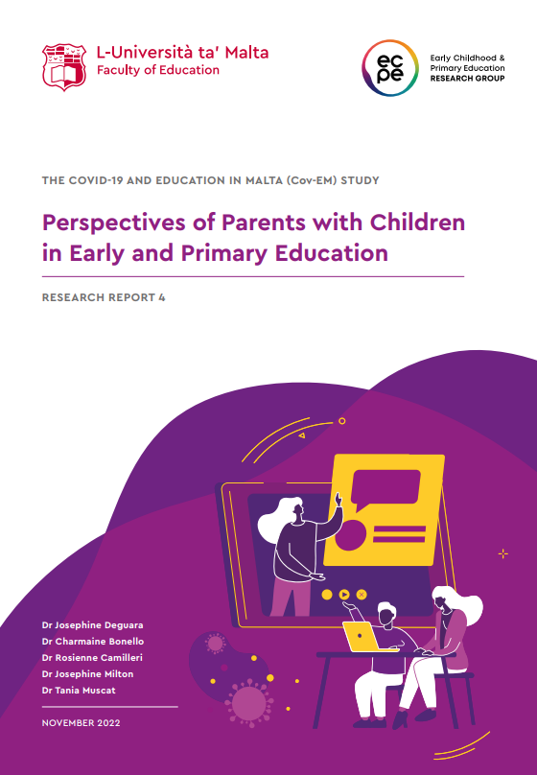
The reports can be accessed online through our webpage:
https://www.um.edu.mt/media/um/docs/faculties/educ/research/R1112_ECPE_Report1_USITE_DIGITAL_updated.pdf
https://www.um.edu.mt/media/um/docs/faculties/educ/research/R1112_ECPE_Report3_PSE_DIGITAL.pdf
https://www.um.edu.mt/media/um/docs/faculties/educ/research/R1112_ECPE_Report5_Leaders_DIGITAL.pdf
https://www.um.edu.mt/media/um/docs/faculties/educ/research/R1112_ECPE_Report2_ESE_DIGITAL.pdf
https://www.um.edu.mt/media/um/docs/faculties/educ/research/R1112_ECPE_Report4_PCEPE_DIGITAL.pdf
https://www.um.edu.mt/educ/ourresearch/researchprojects/ecperesearchgroupthecovid-19andeducationinmaltacov-emstudy/

Slide 34
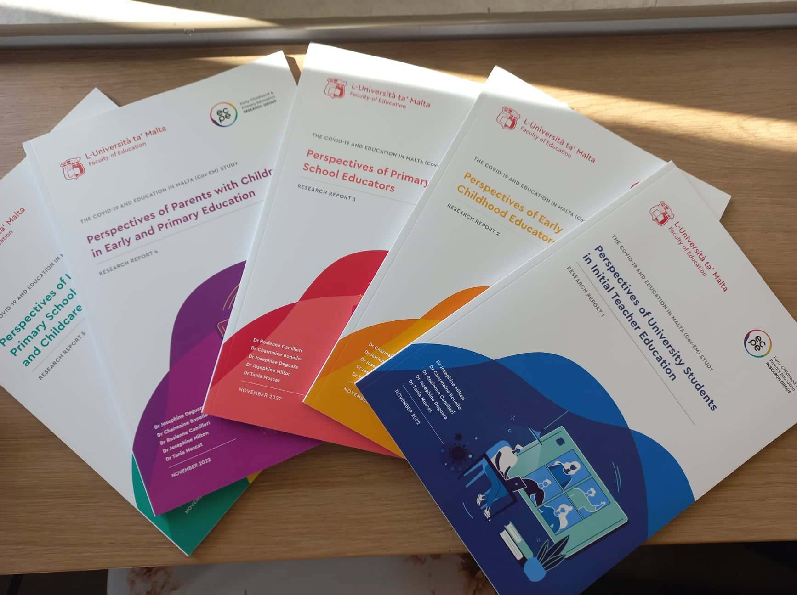
Grazzi - Thank you

