Slide 1




Slide 2
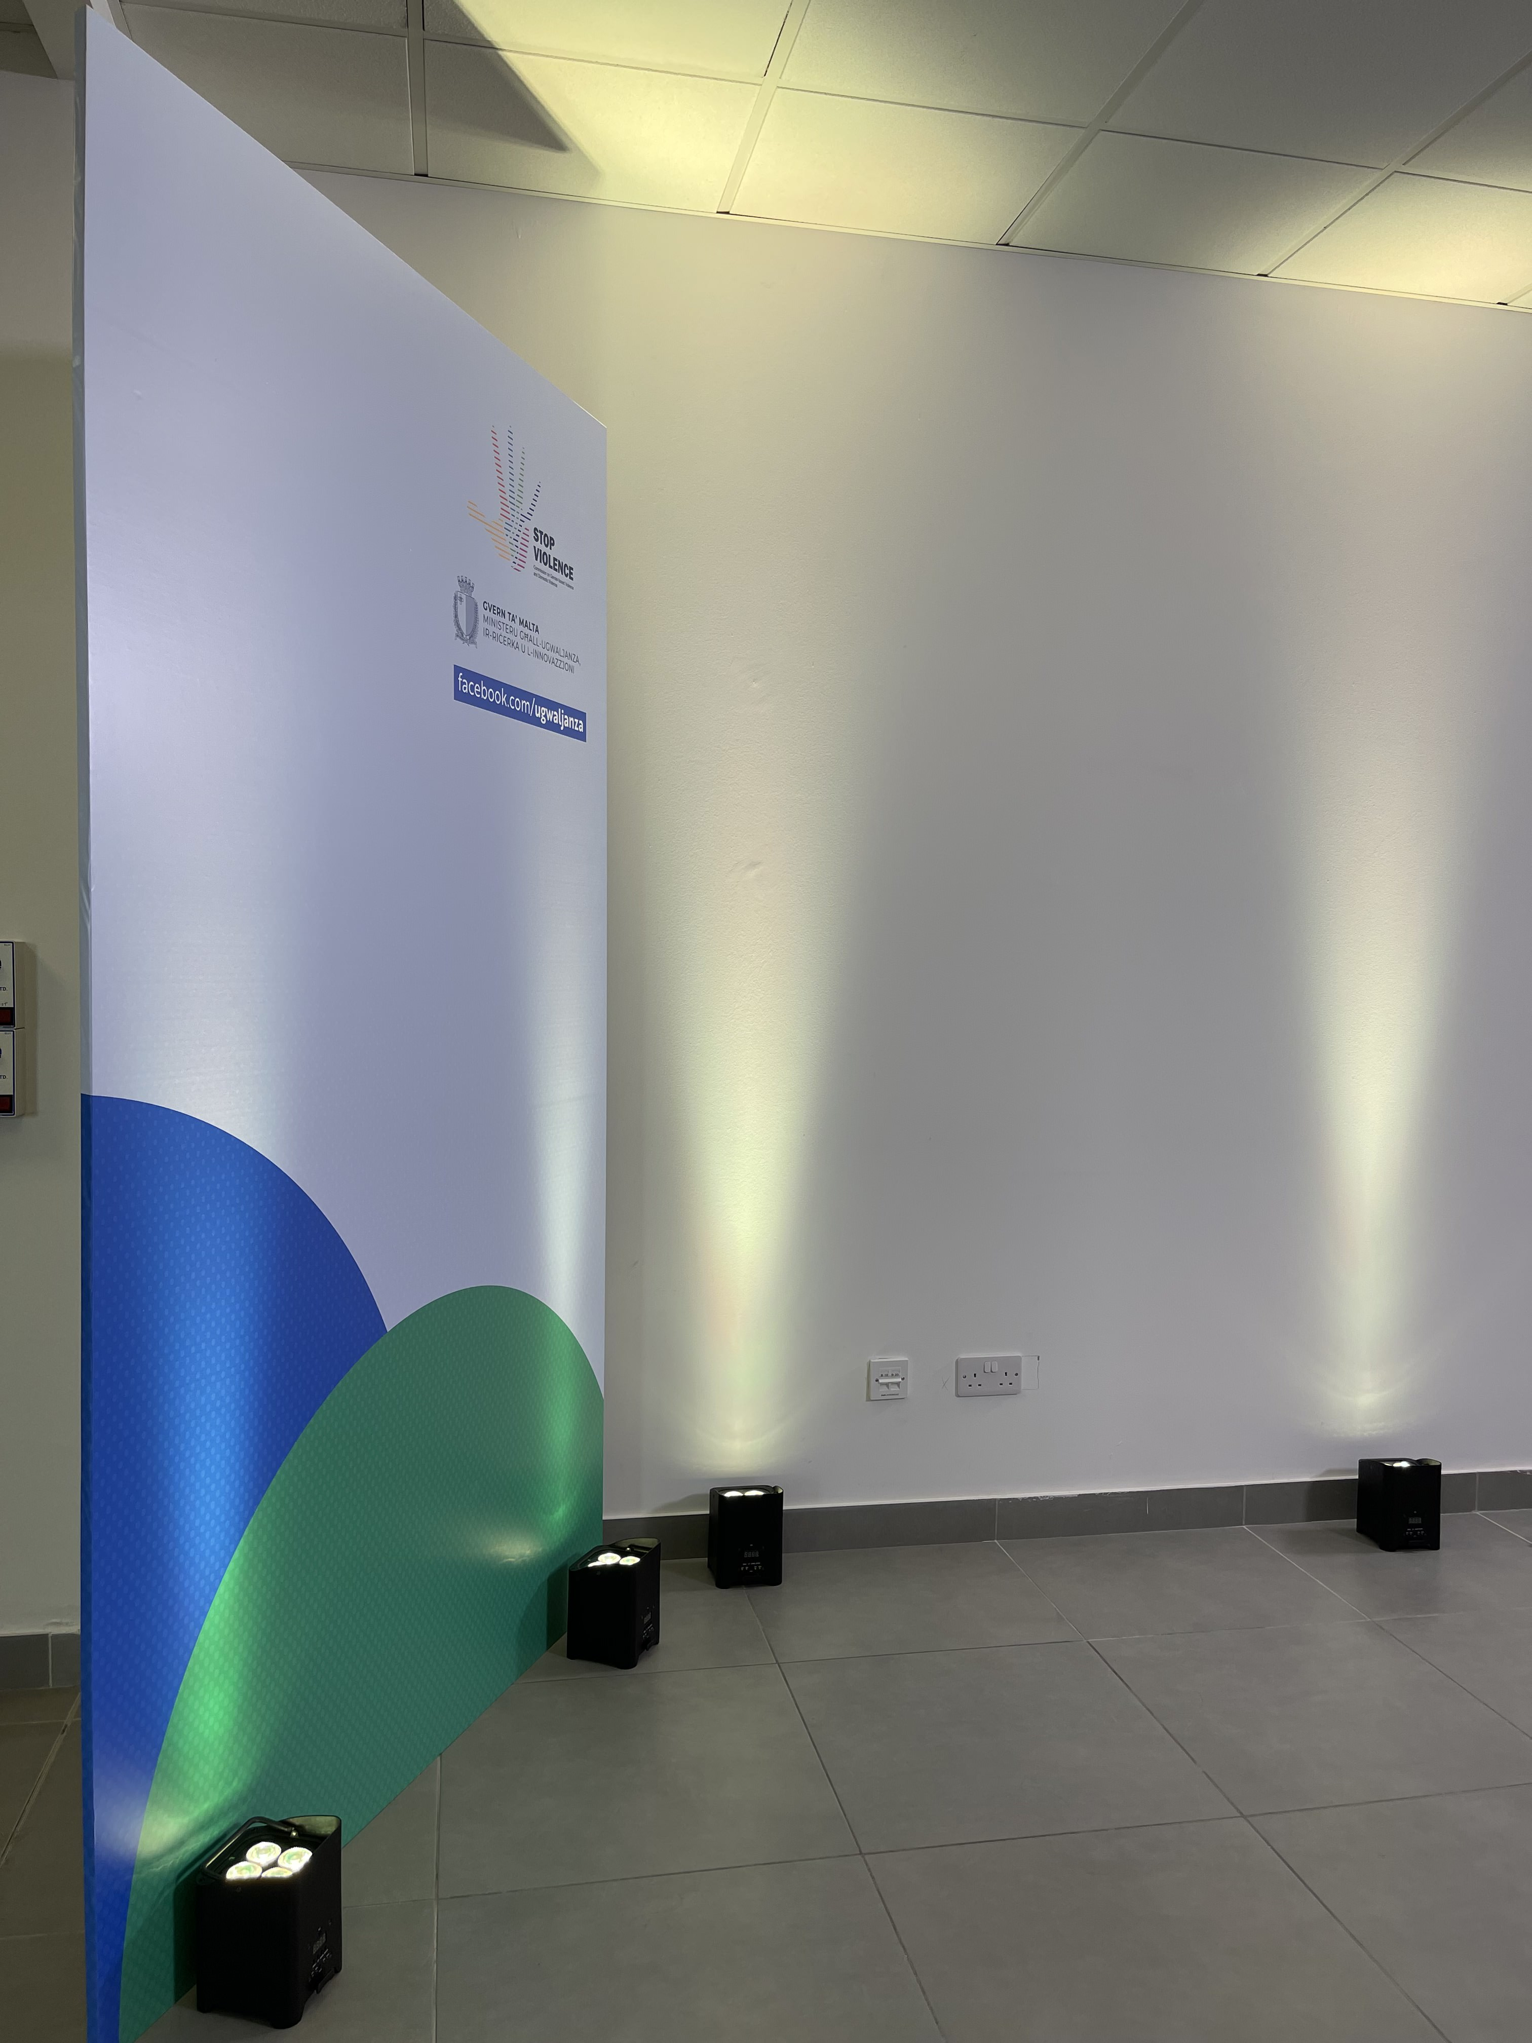
The Commission
In 2018, Article 10 of the Istanbul Convention was legally transposed in full to the Gender-Based Violence and Domestic Violence Act (Cap. 581) and the Commission on Gender-Based Violence and Domestic Violence was set up as coordinating body.

Slide 3

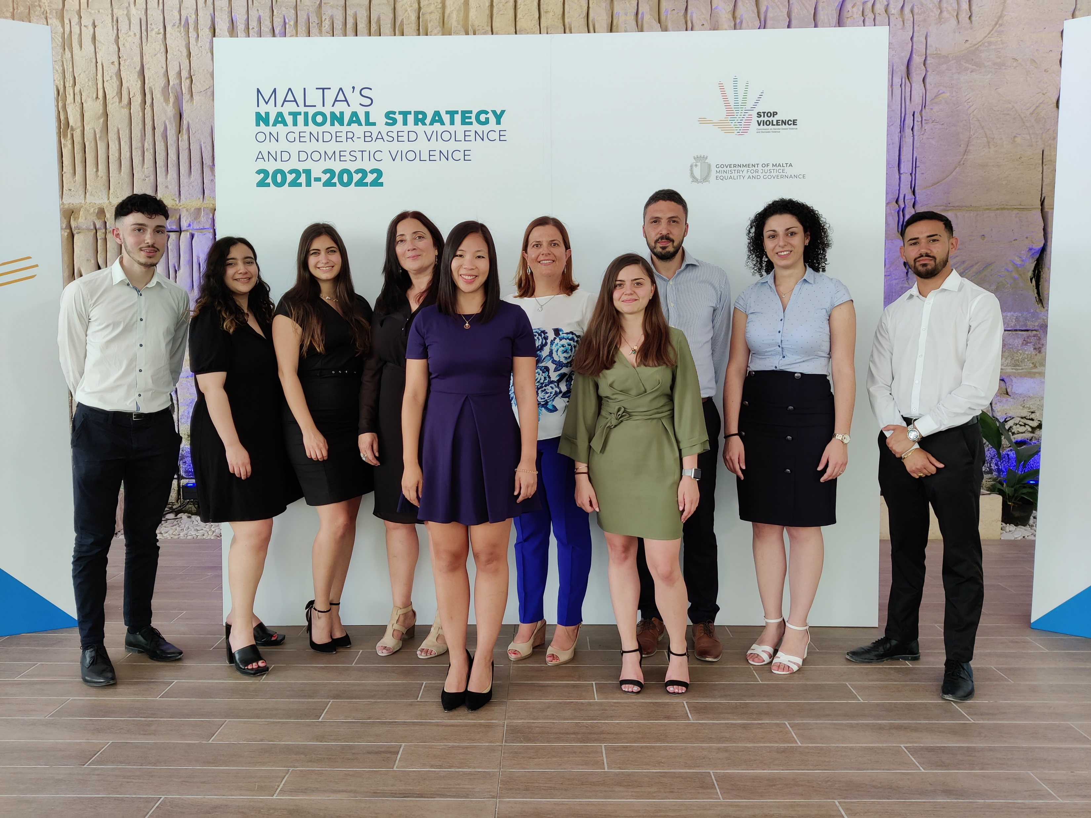
Commission Members
Commissioner: Ms. Audrey Friġġieri
Employees of the Commission:
• Ms. Katya Unah (Assistant Director)
• Ms. Sasha Na Jeong Farrugia (Senior Manager)
• Mr. Ivan Edward Scicluna (Project Manager)
• Ms. Maria Farrugia (Project Manager)
• Mr. Nicholas Saliba (ICT Manager)
• Ms. Therese Caruana (Research Manager)
• Ms. Maria Borg (Research Manager)

Slide 4






Research and
Statistical Reporting
Every year, the Commission collects data on gender-based violence and domestic violence from the various governmental and non-governmental service providers. This data is then harmonized by the National Statistics Office.

Slide 5
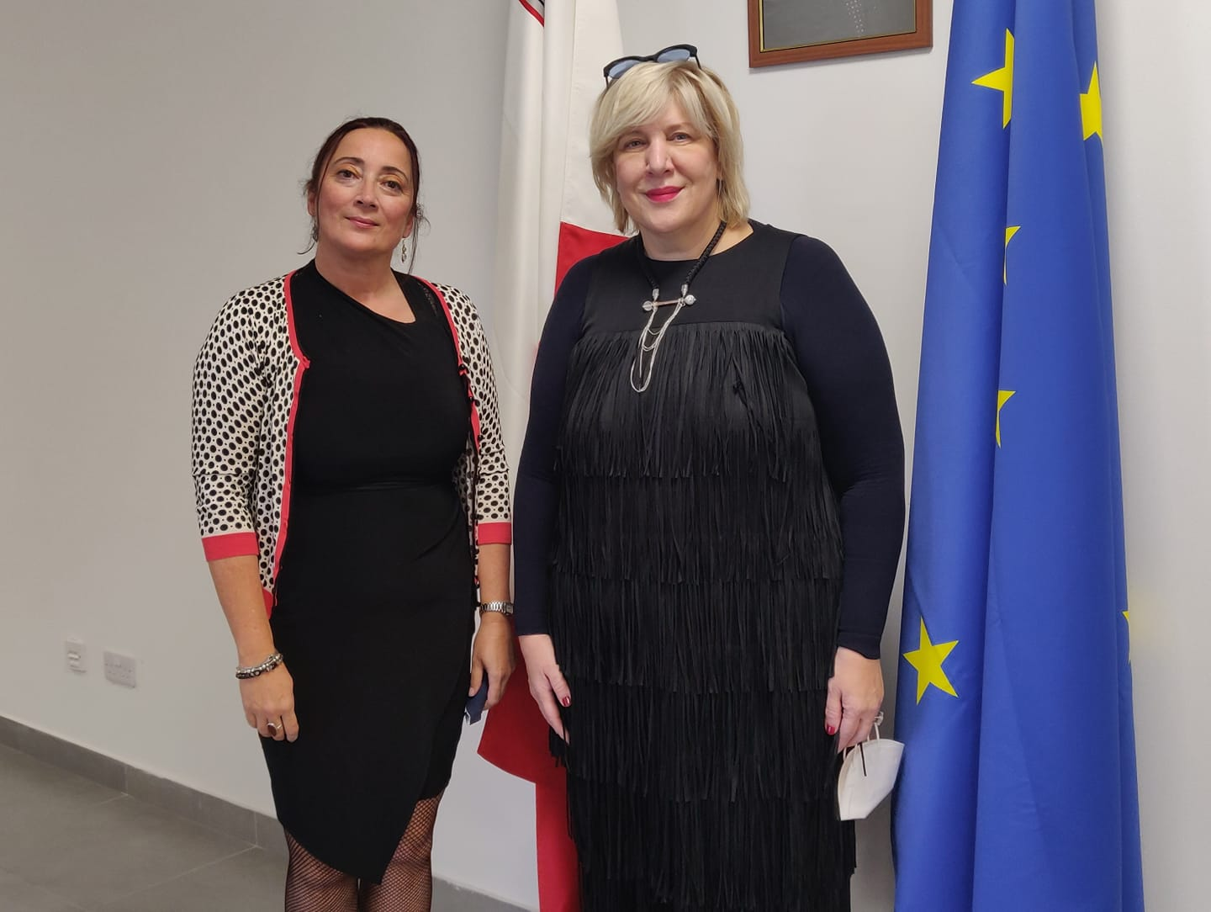
Meeting with
EU Commissioner for Human Rights
Ms. Dunja Mijatovic, the Human Rights
Commissioner of the Council of Europe met
with the Commissioner on Gender-based
Violence and Domestic Violence, Ms. Audrey
Friggieri at the Commission’s offices on the
15th October 2021.

Slide 6
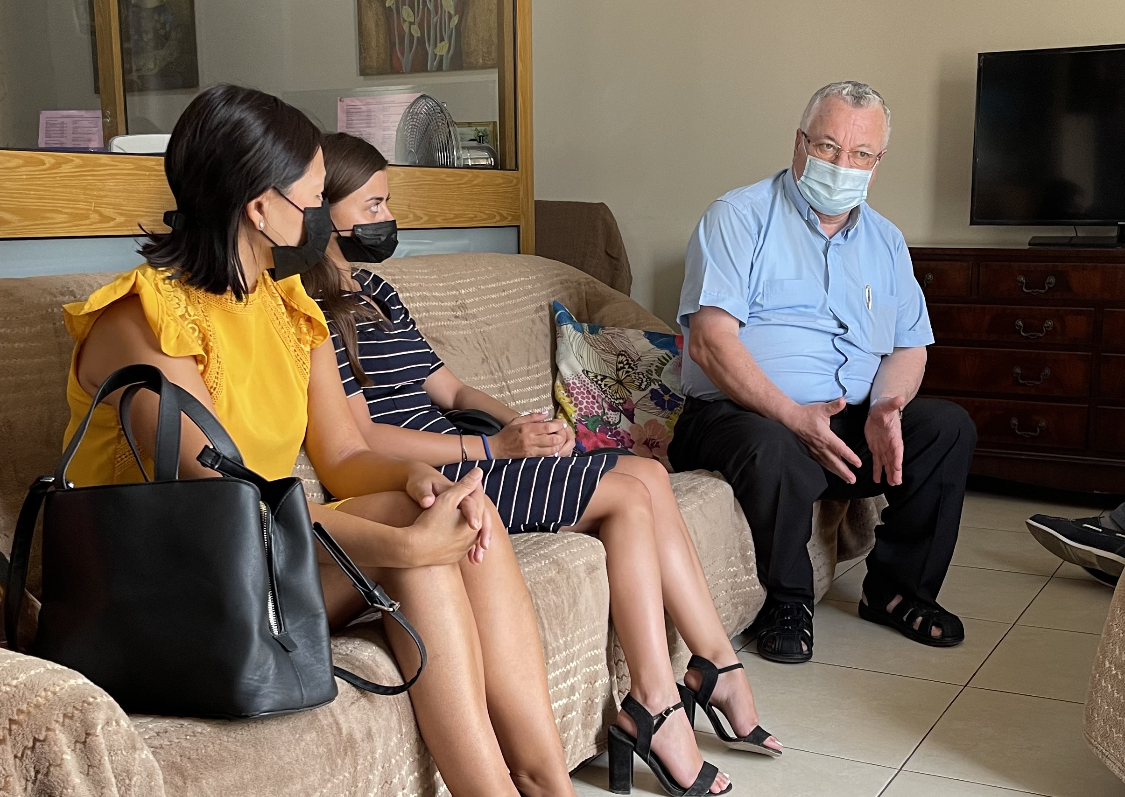
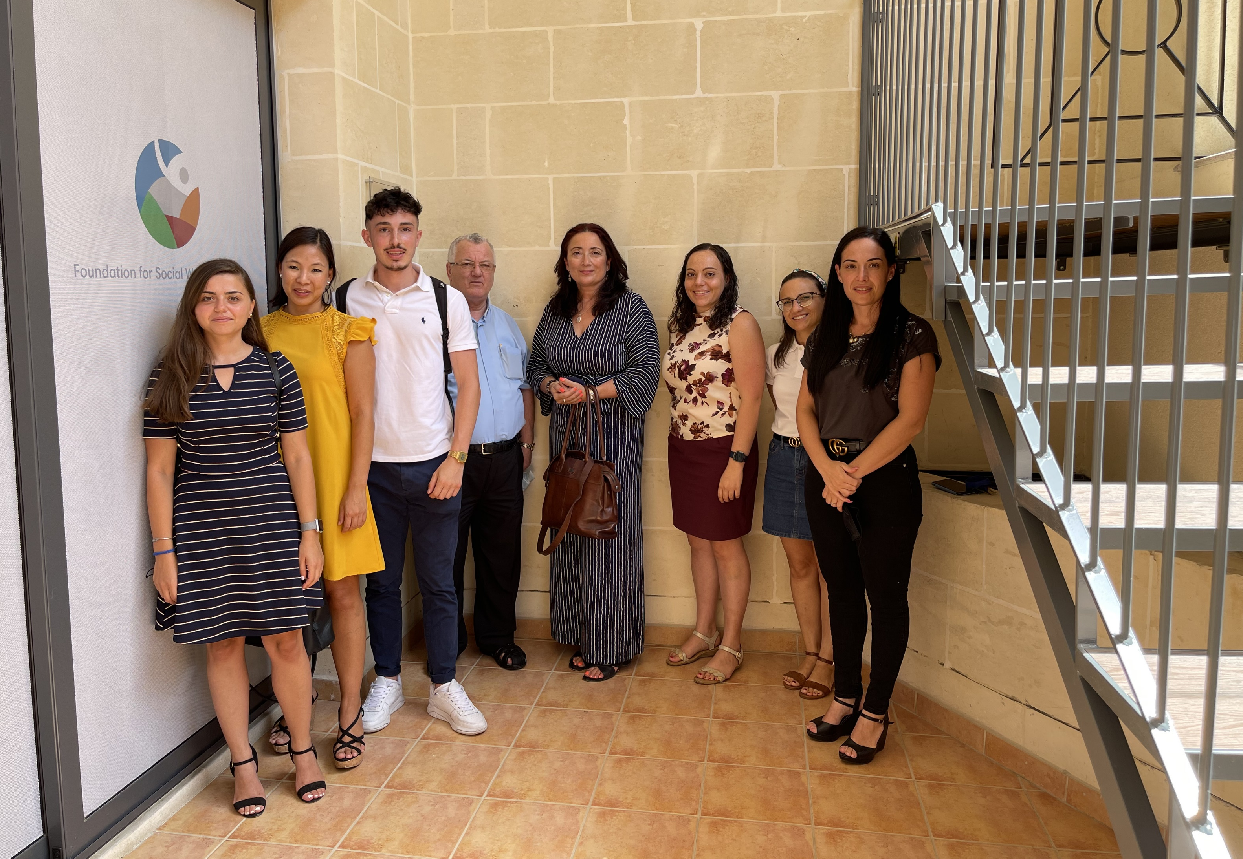
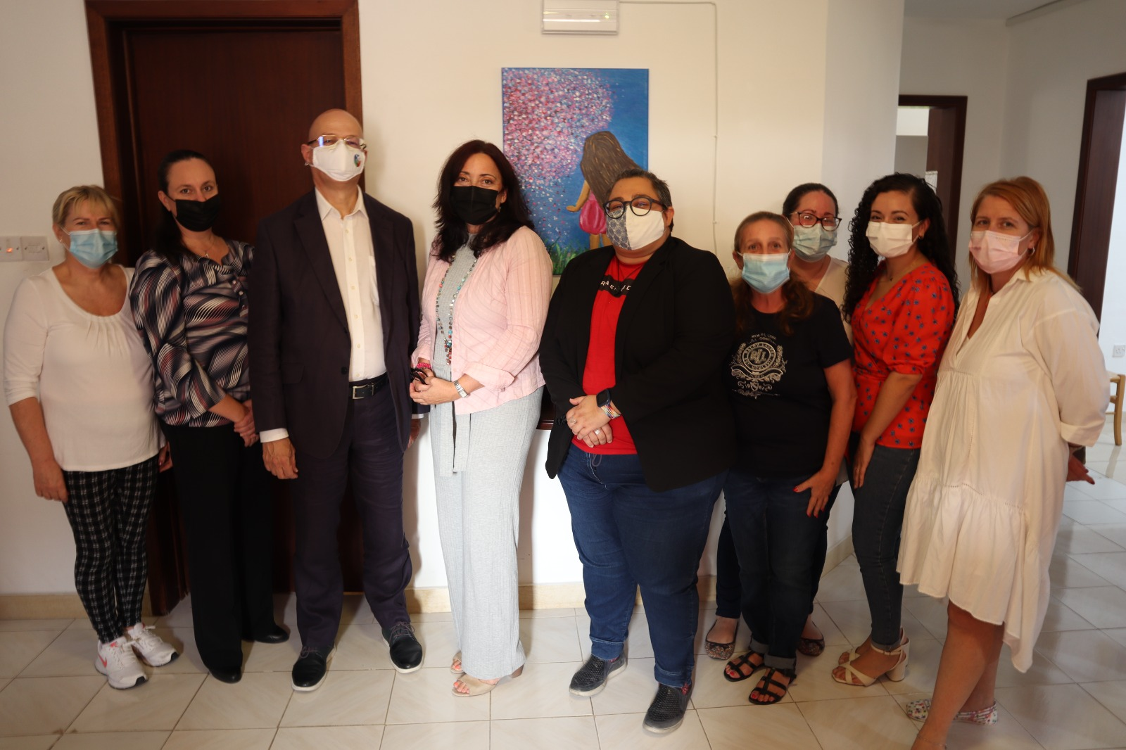
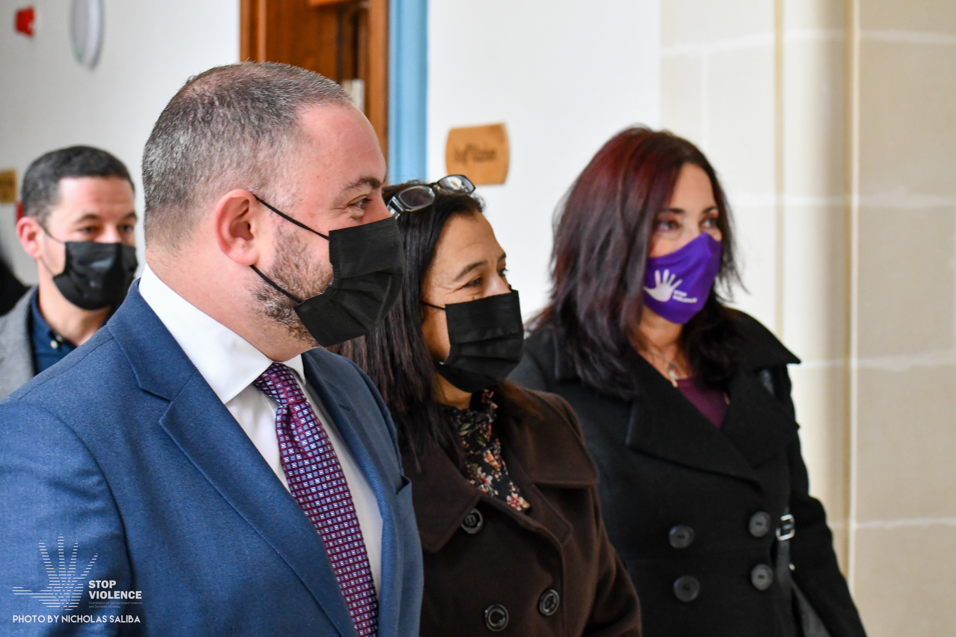
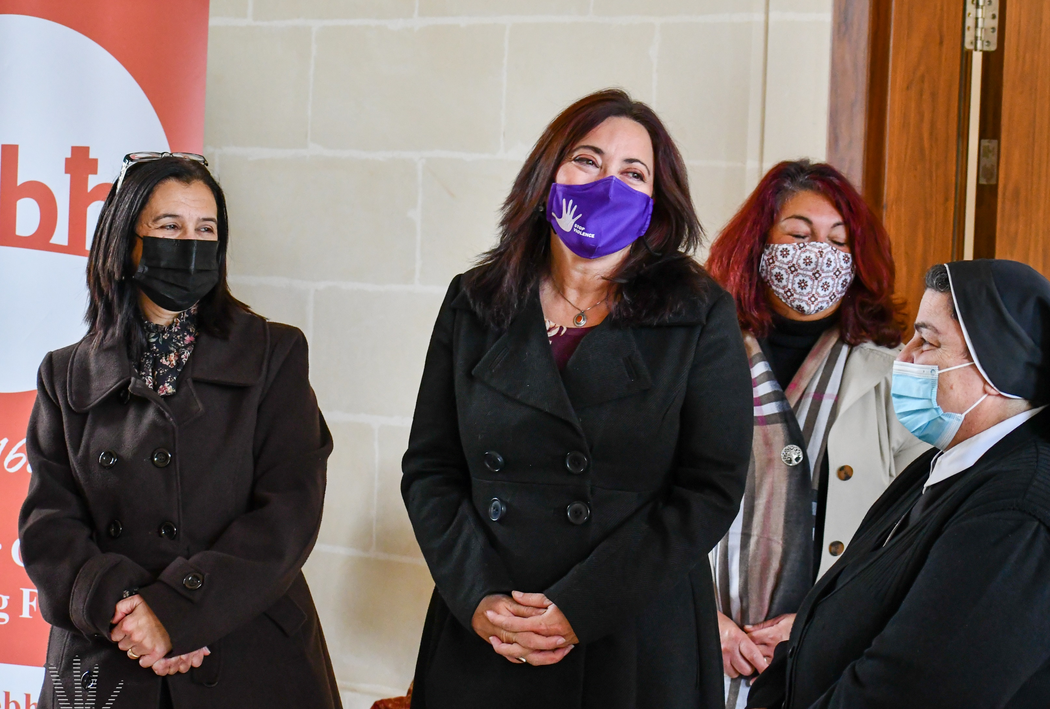
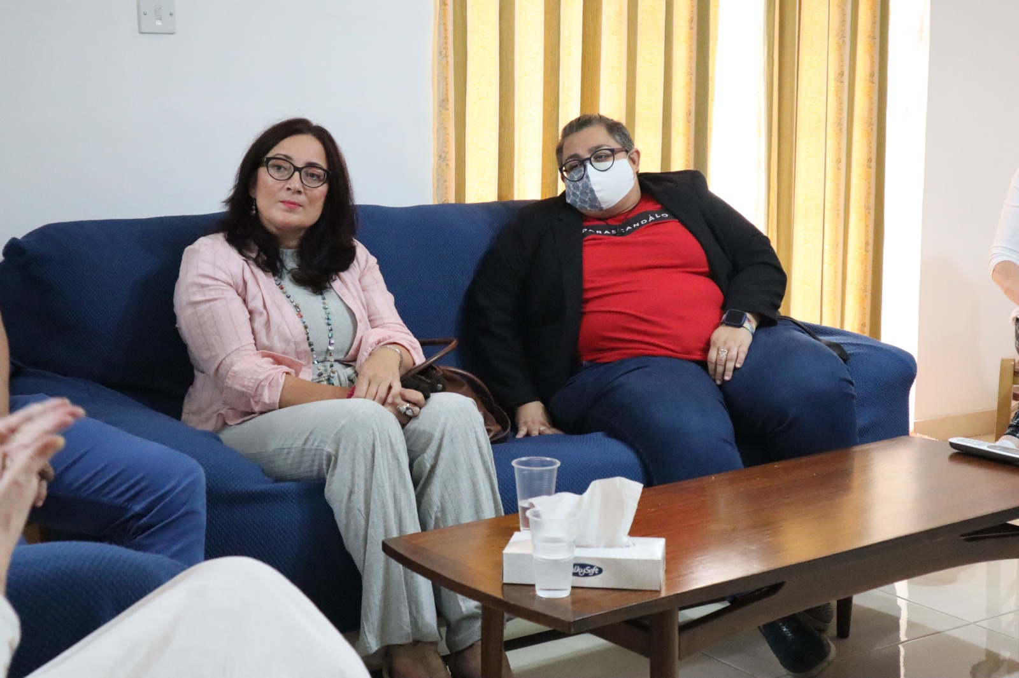
Courtesy Visits
The Commissioner and team members visited Dar Emmaus (18th August), Dar Hosea (17th September), Għabex (8th October), and Dar il-Milja (15th December), in recognition of their invaluable work with victims, both adults and children, of gender-based and domestic violence

Slide 7
Training for Professionals
During 2021, the Commission coordinated and delivered three multi-agency training programmes for professionals following a training needs analysis conducted with the Inter-Ministerial Committee at the beginning of the year.
 | Training on DASH risk assessment | Training on SARA risk assessment | Training on child to parent Violence
Date | May 2021 | July 2021 | November/December 2021
Trainer | Ms. Beverley Gilbert and Ms. Rachel Wilde | Dr. Ruth Tully | Dr. Ceryl Davies
Location | Online | Online | Online
Participants | 80 | 46 | 84
Professionals who participated included social workers, risk assessors, counsellors, psychologists, probation officers, police from the GBDV Unit, lawyers, doctors, nurses and representatives from domestic violence shelters and NGOs.

Slide 8

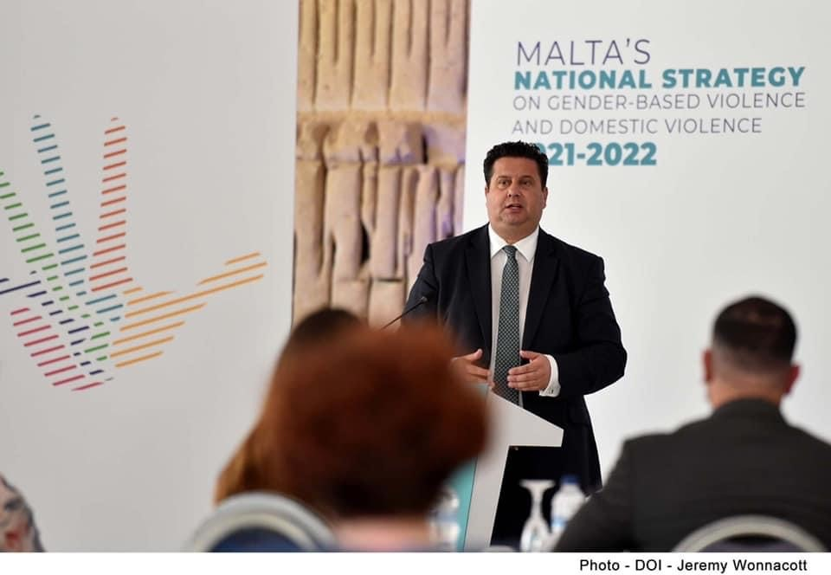
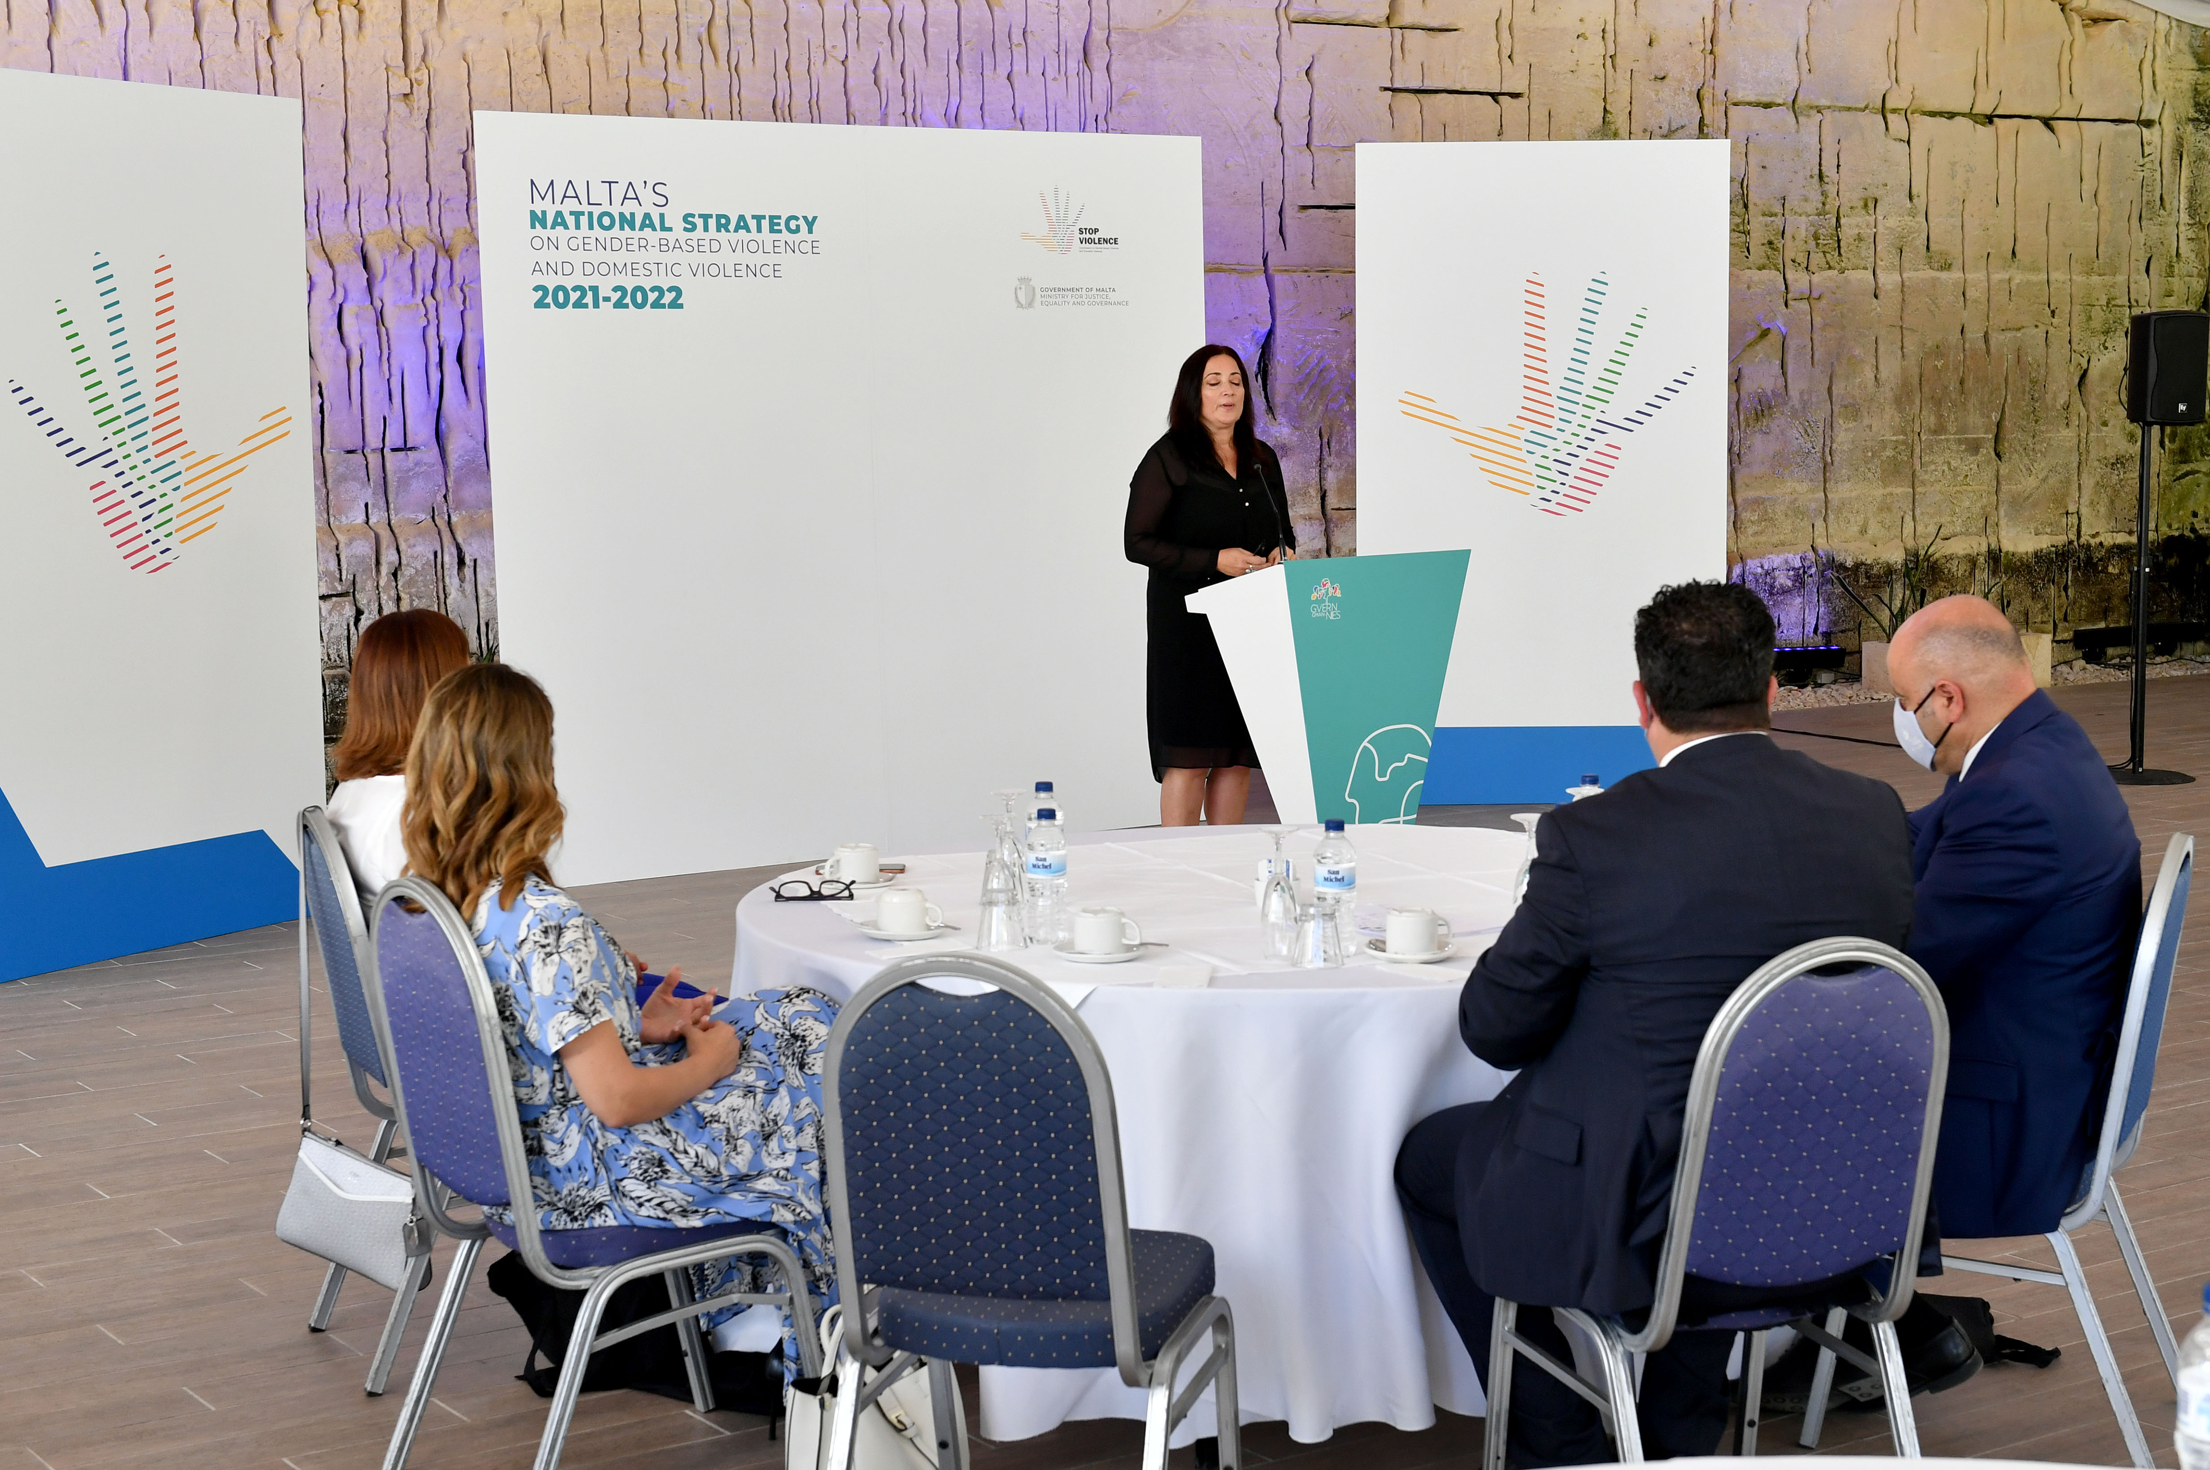
Launch of
Second National Strategy
On the 17th of June, Malta’s second national strategy on gender-based violence and domestic violence was launched, which is a continuation of Malta’s previous strategy to address gender-based violence and domestic violence.

Slide 9
Implementation of the
National Action Plan
As a coordinating body, the Commission is responsible for coordinating and monitoring the implementation of the national strategy. This is done through the Inter-Ministerial Committee which is made up of representatives from the various Ministries and entities. In 2021, the Commission chaired a total of nine Inter-Ministerial Committee meetings, three of which were held with NGOs.
The Commission is also tasked with monitoring the implementation of the GREVIO recommendations and requested updates from the stakeholders in May and December.

Slide 10
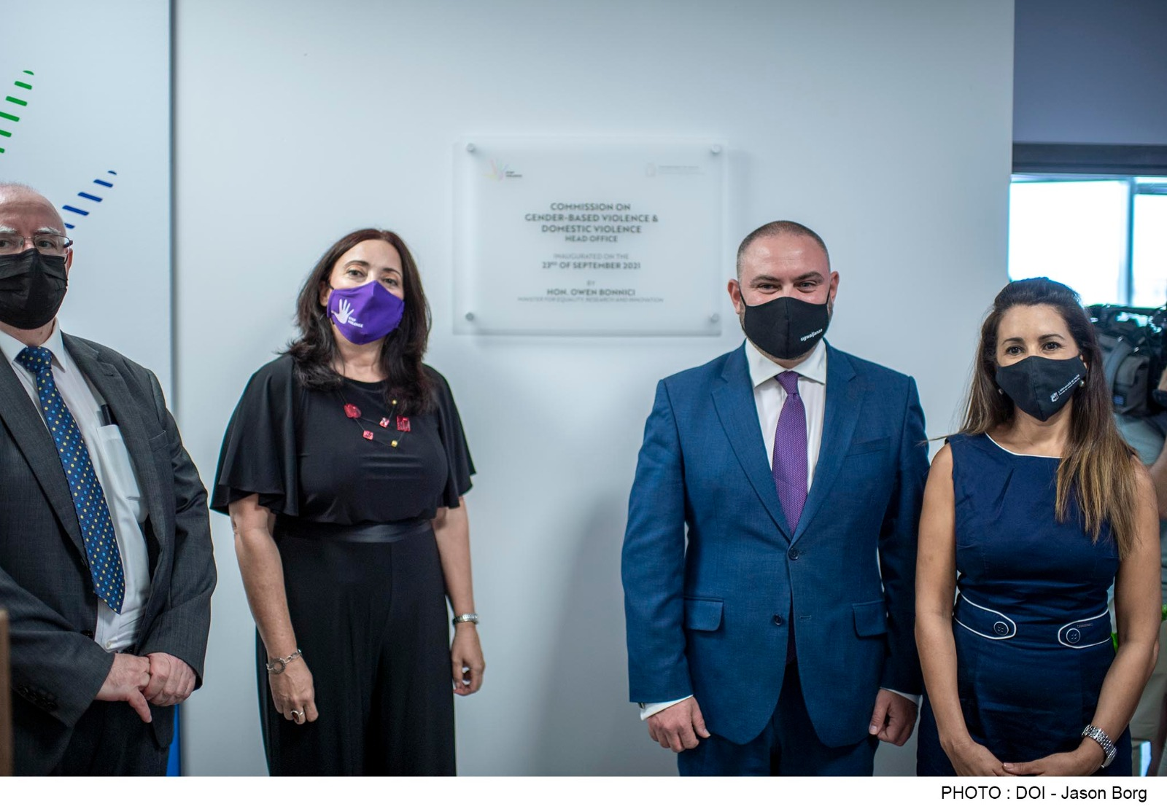
Inauguration of New Offices
On the 23rd of September, Minister Owen Bonnici inaugurated the new Commission offices at the Zentrum Business Center, Triq l-Imdina, Qormi. Various stakeholders working in the sector were invited to attend the inauguration ceremony.

Slide 11
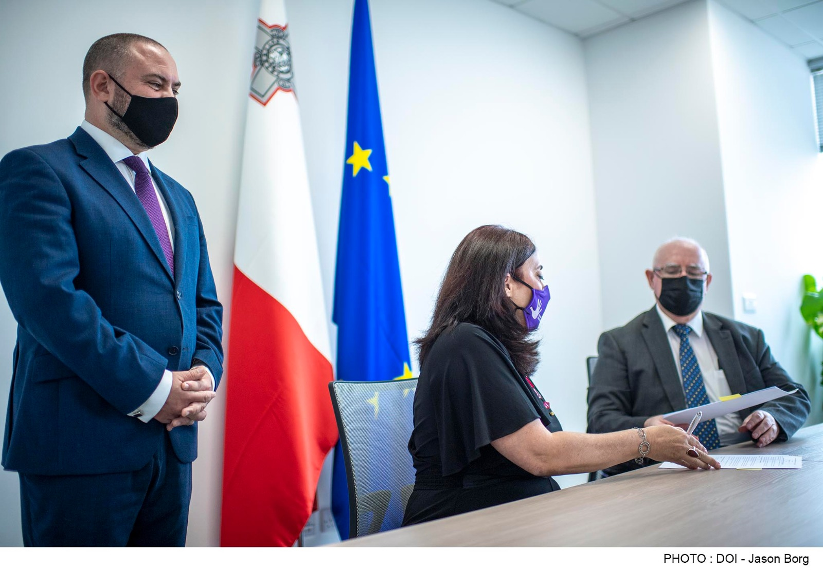
Memorandum of Understanding with the Faculty for Social Wellbeing
On 23rd September 2021, the Commission and the Faculty for Social Wellbeing signed a Memorandum of Understanding, which was immediately put into effect with the commissioning of a prevalence study on children’s experiences of abuse and witnessing violence.

Slide 12


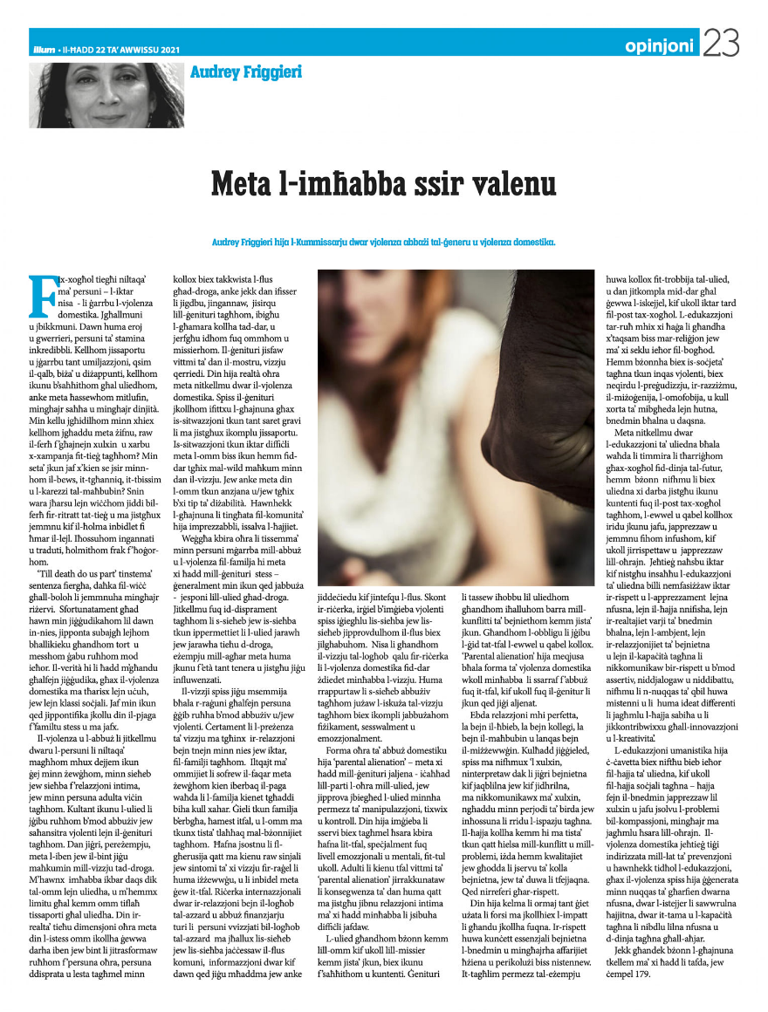
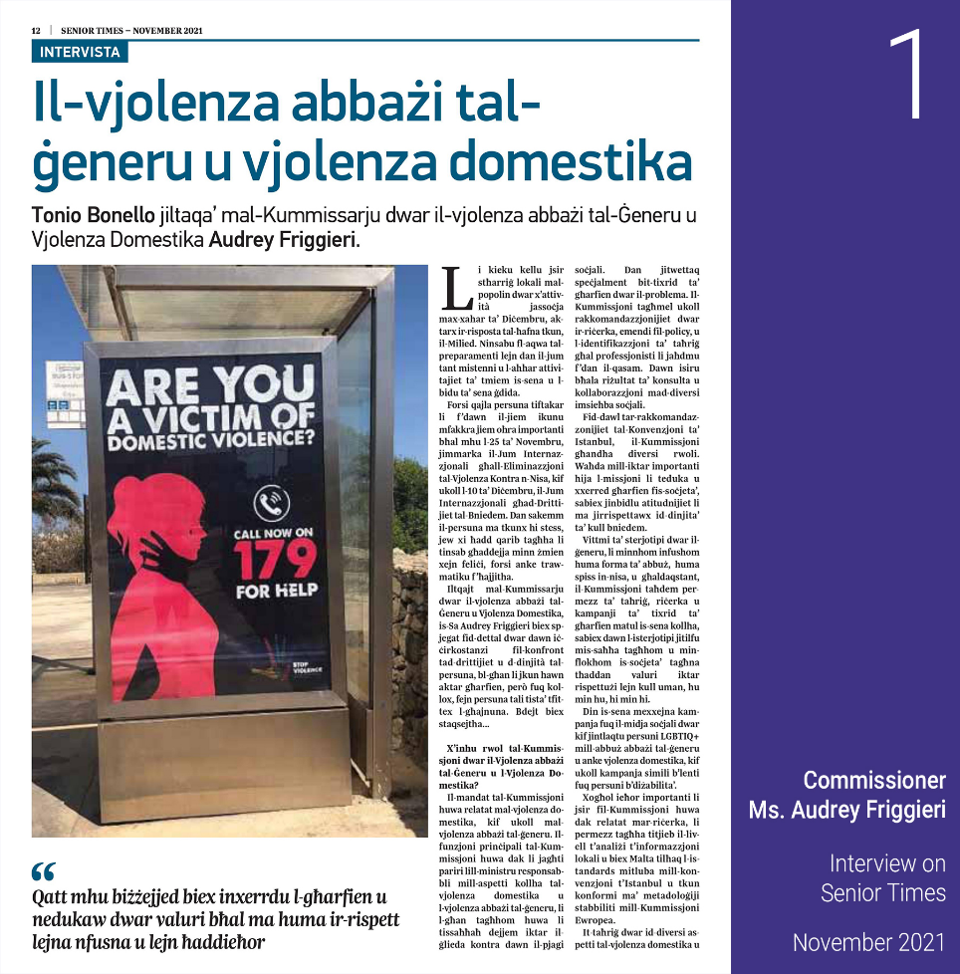
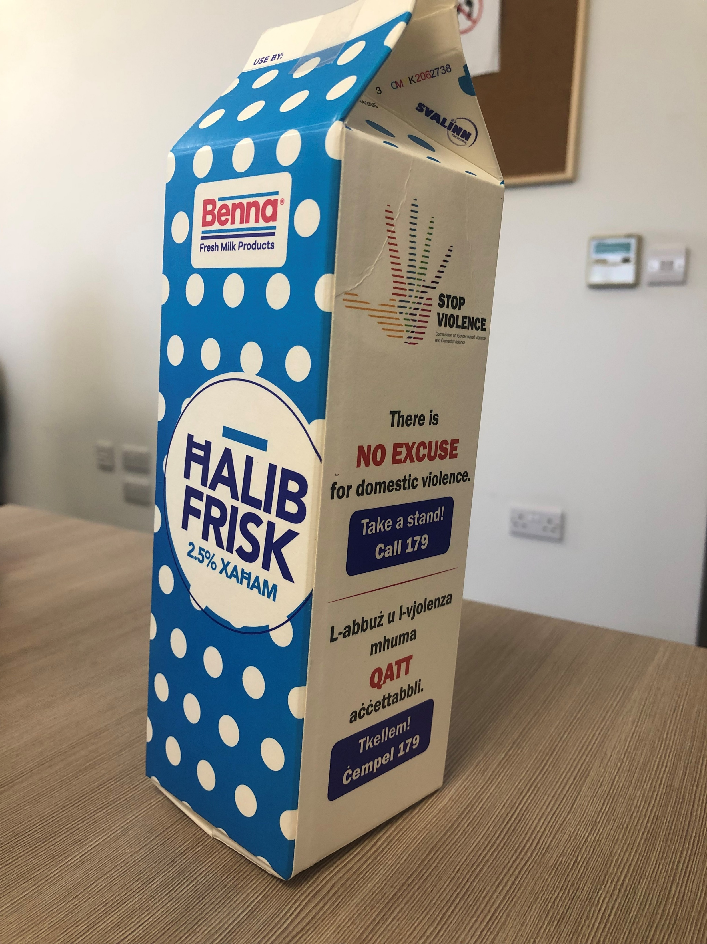
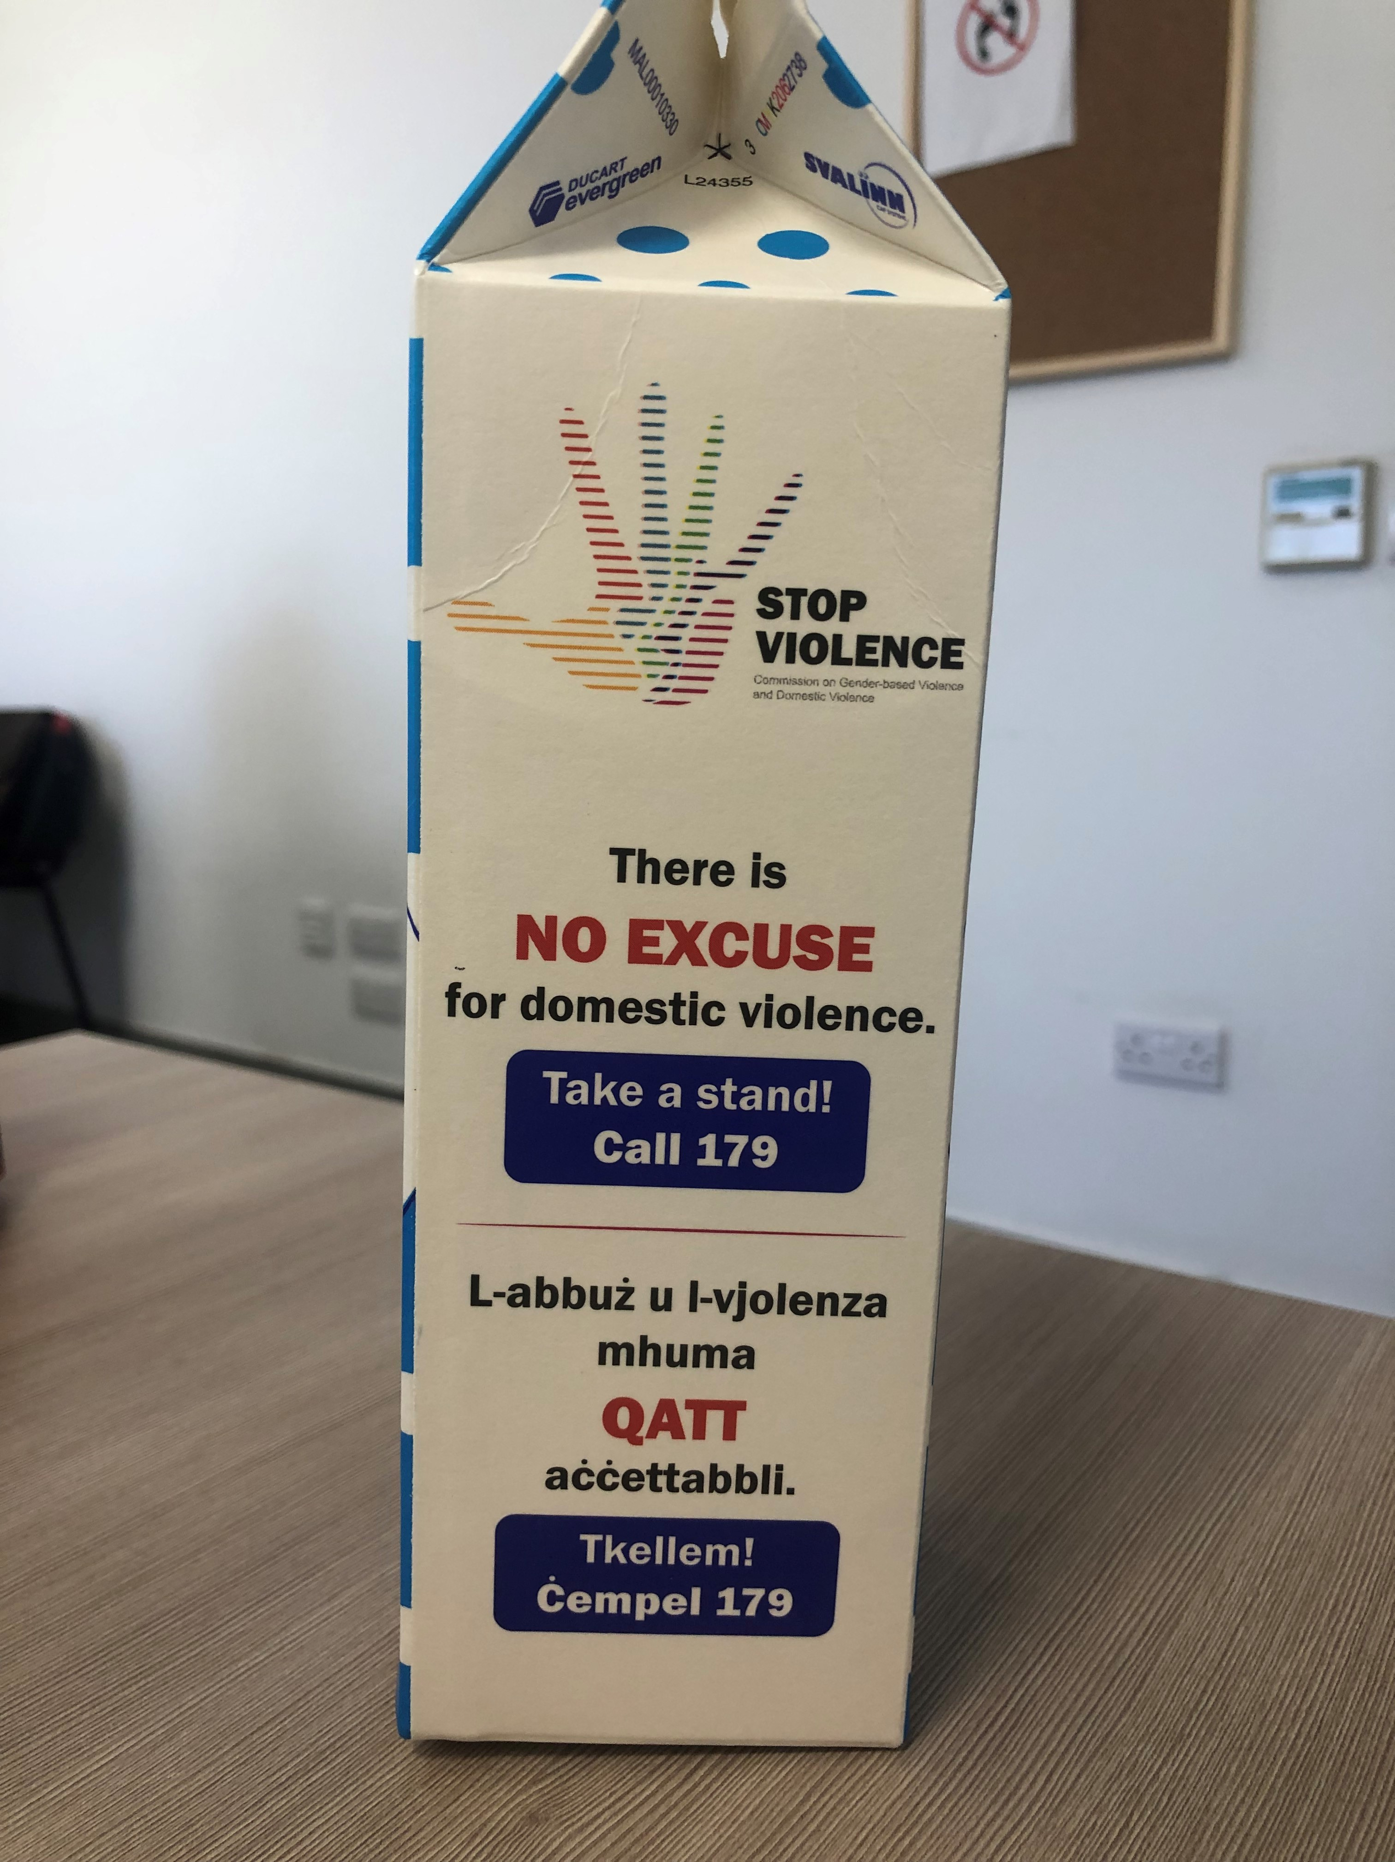
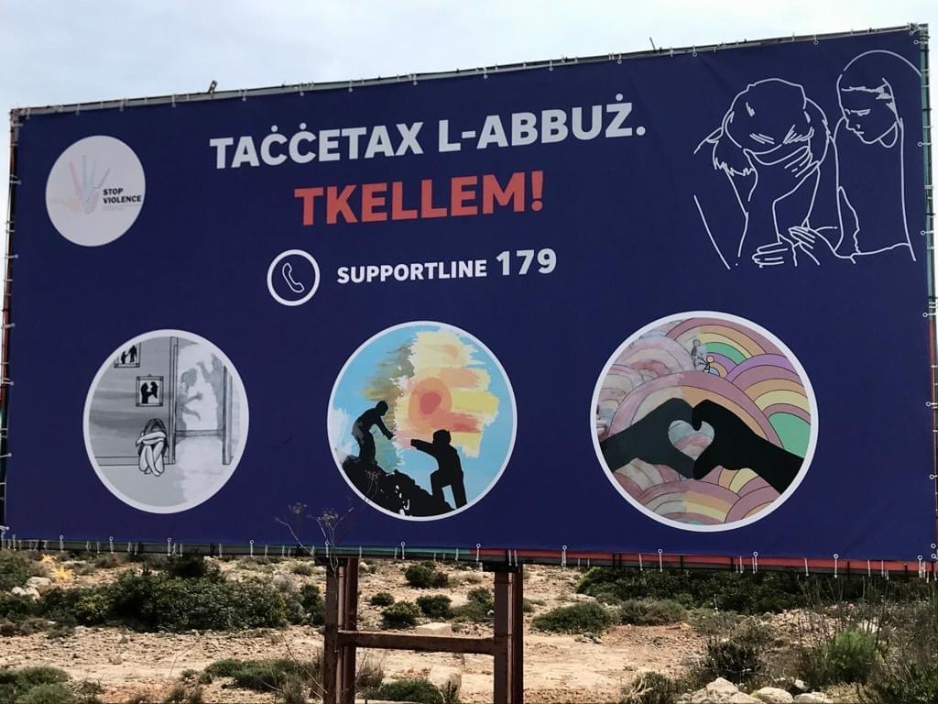
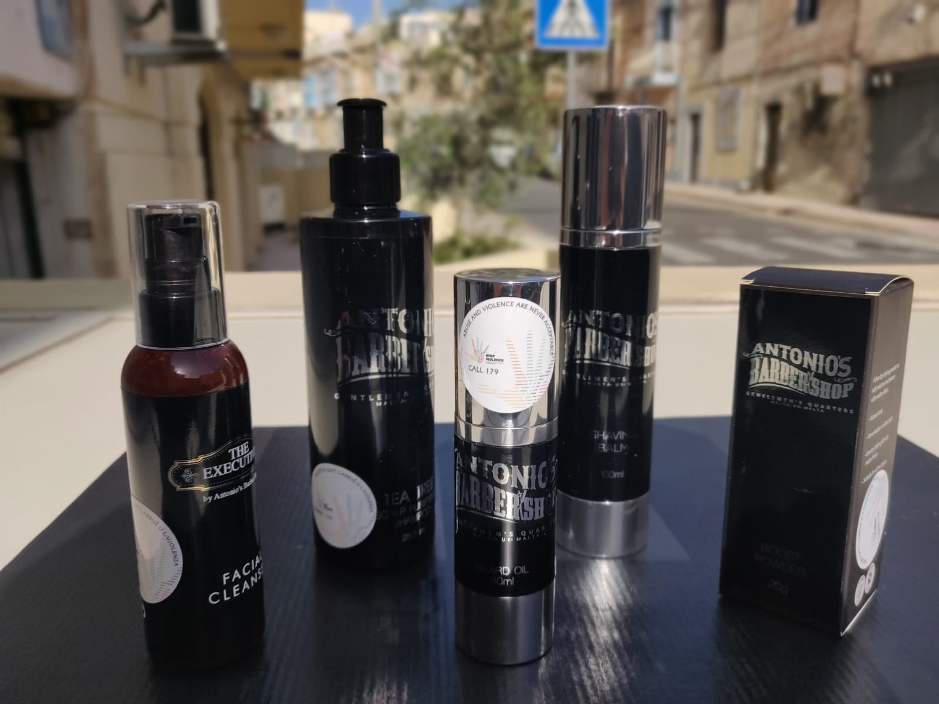
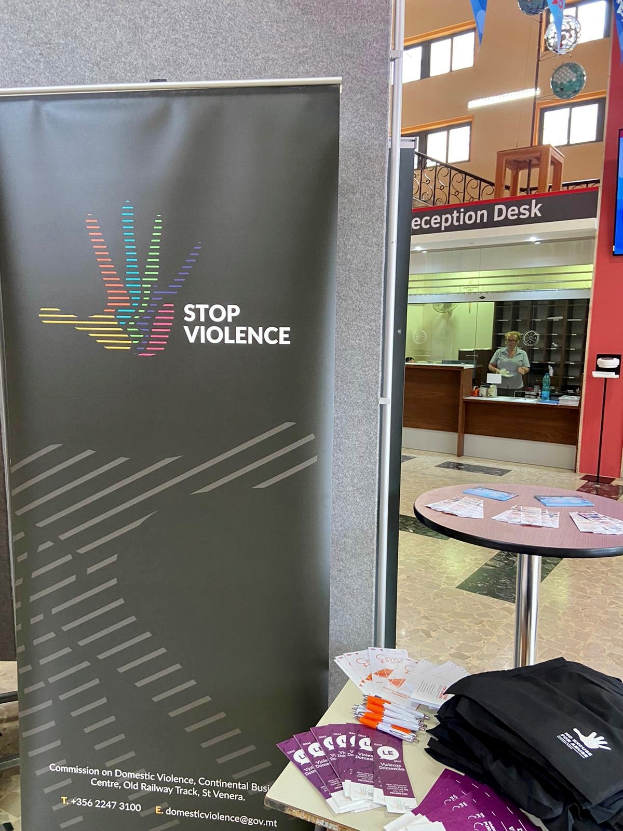
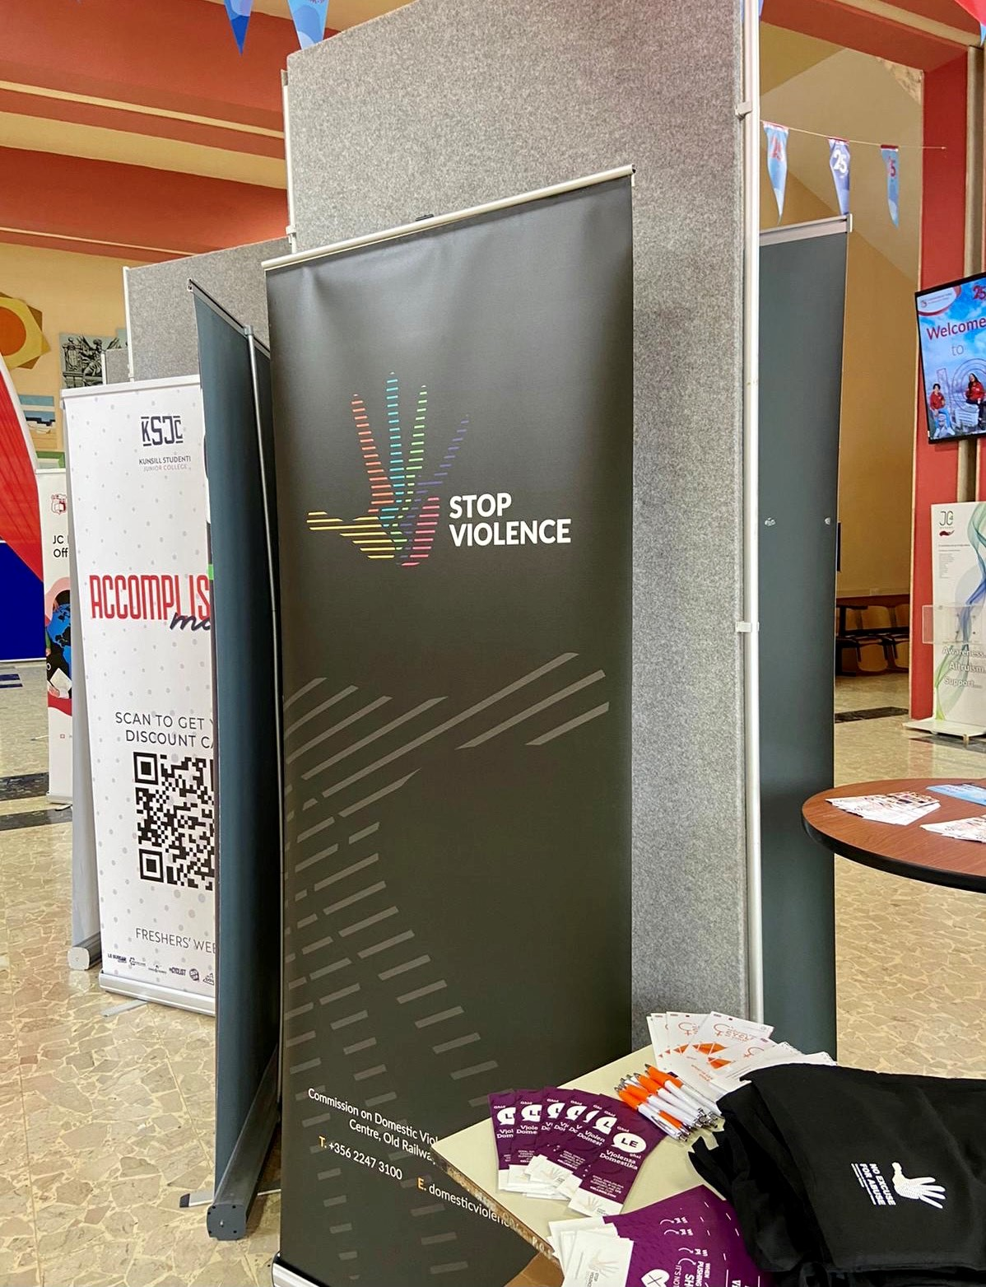
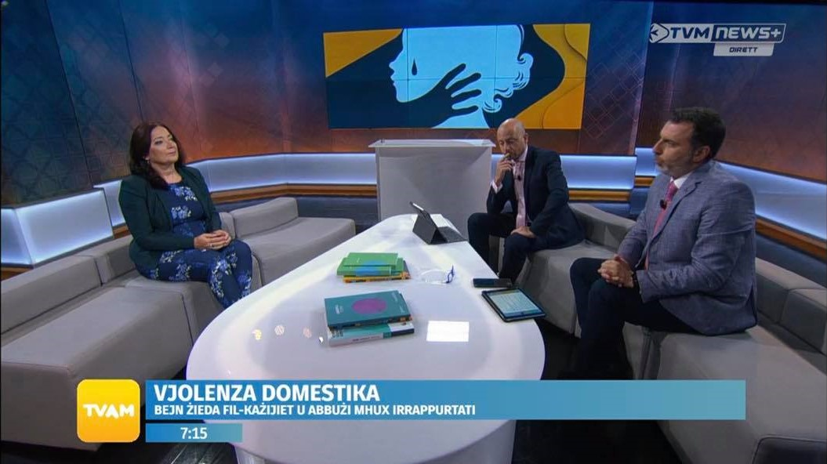
Awareness-raising Campaigns
Campaign with Benna
International Days
Women’s Day
Newspaper Articles
Junior College
Fresher Month
Billboard Campaign
Sticker Campaign
Discussions on Television
and Radio programs

Slide 13
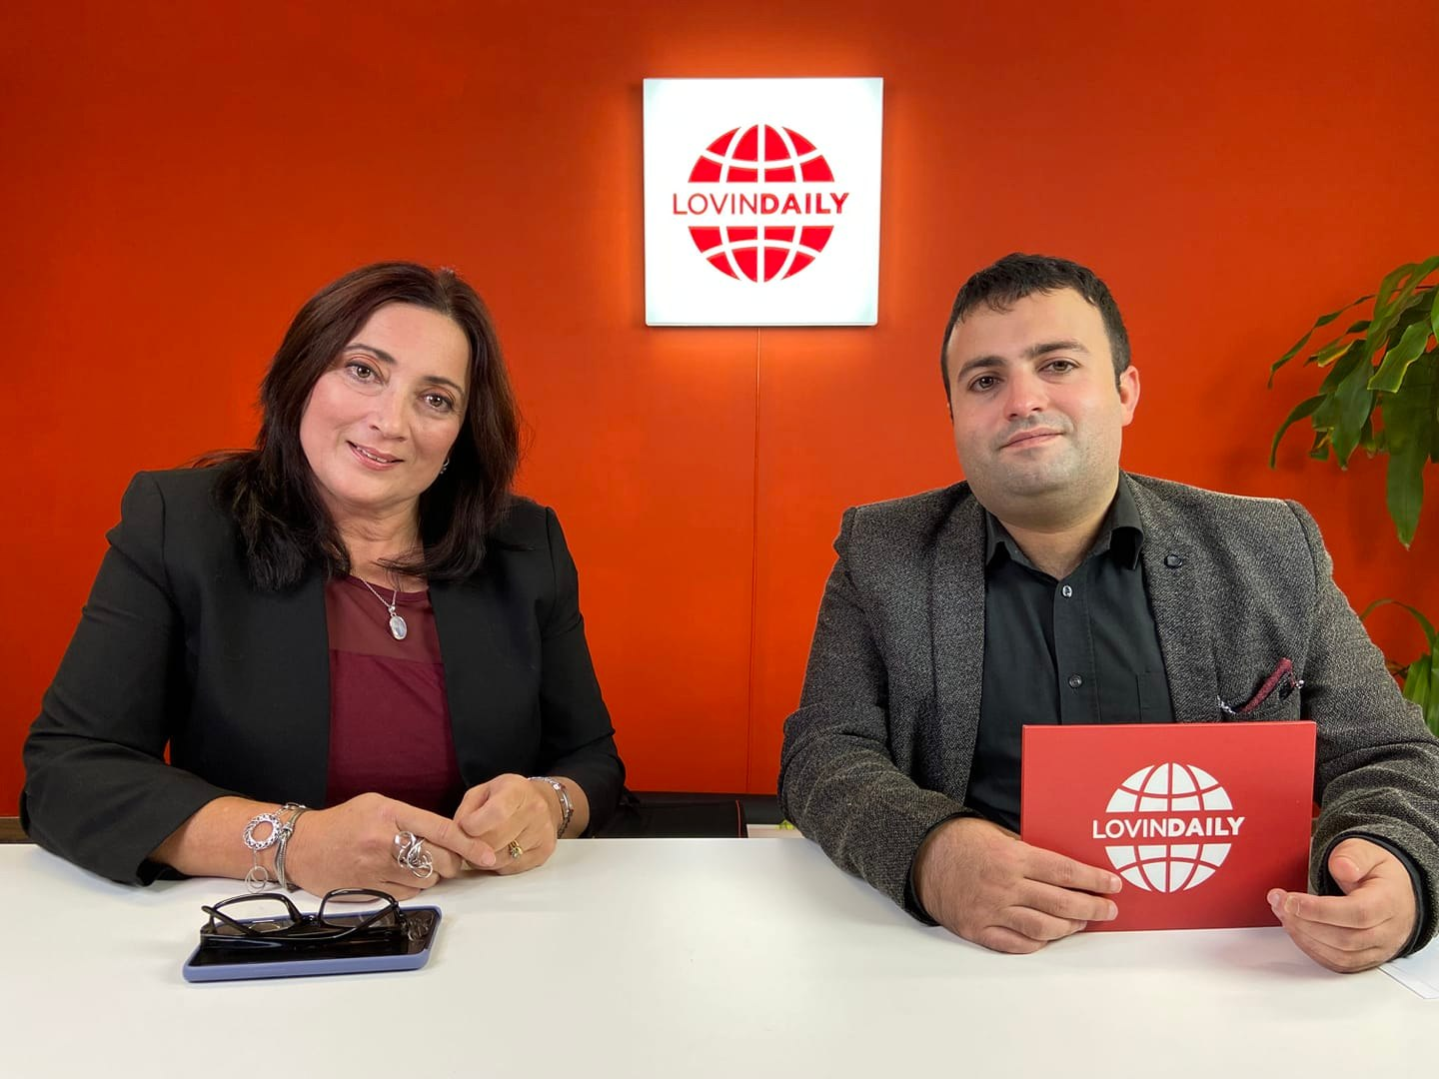
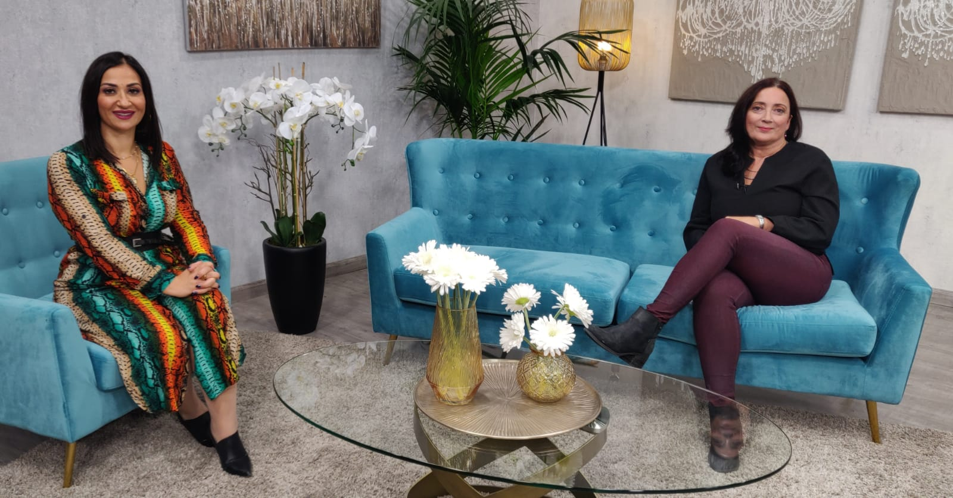
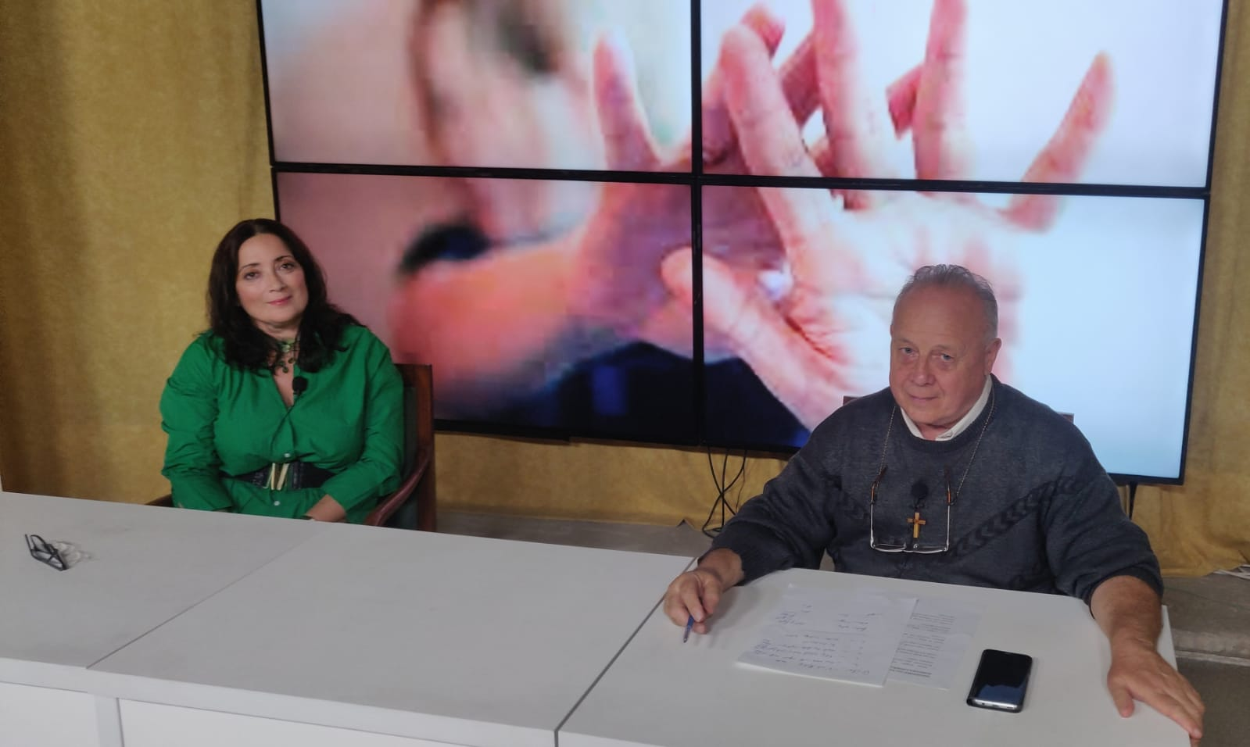
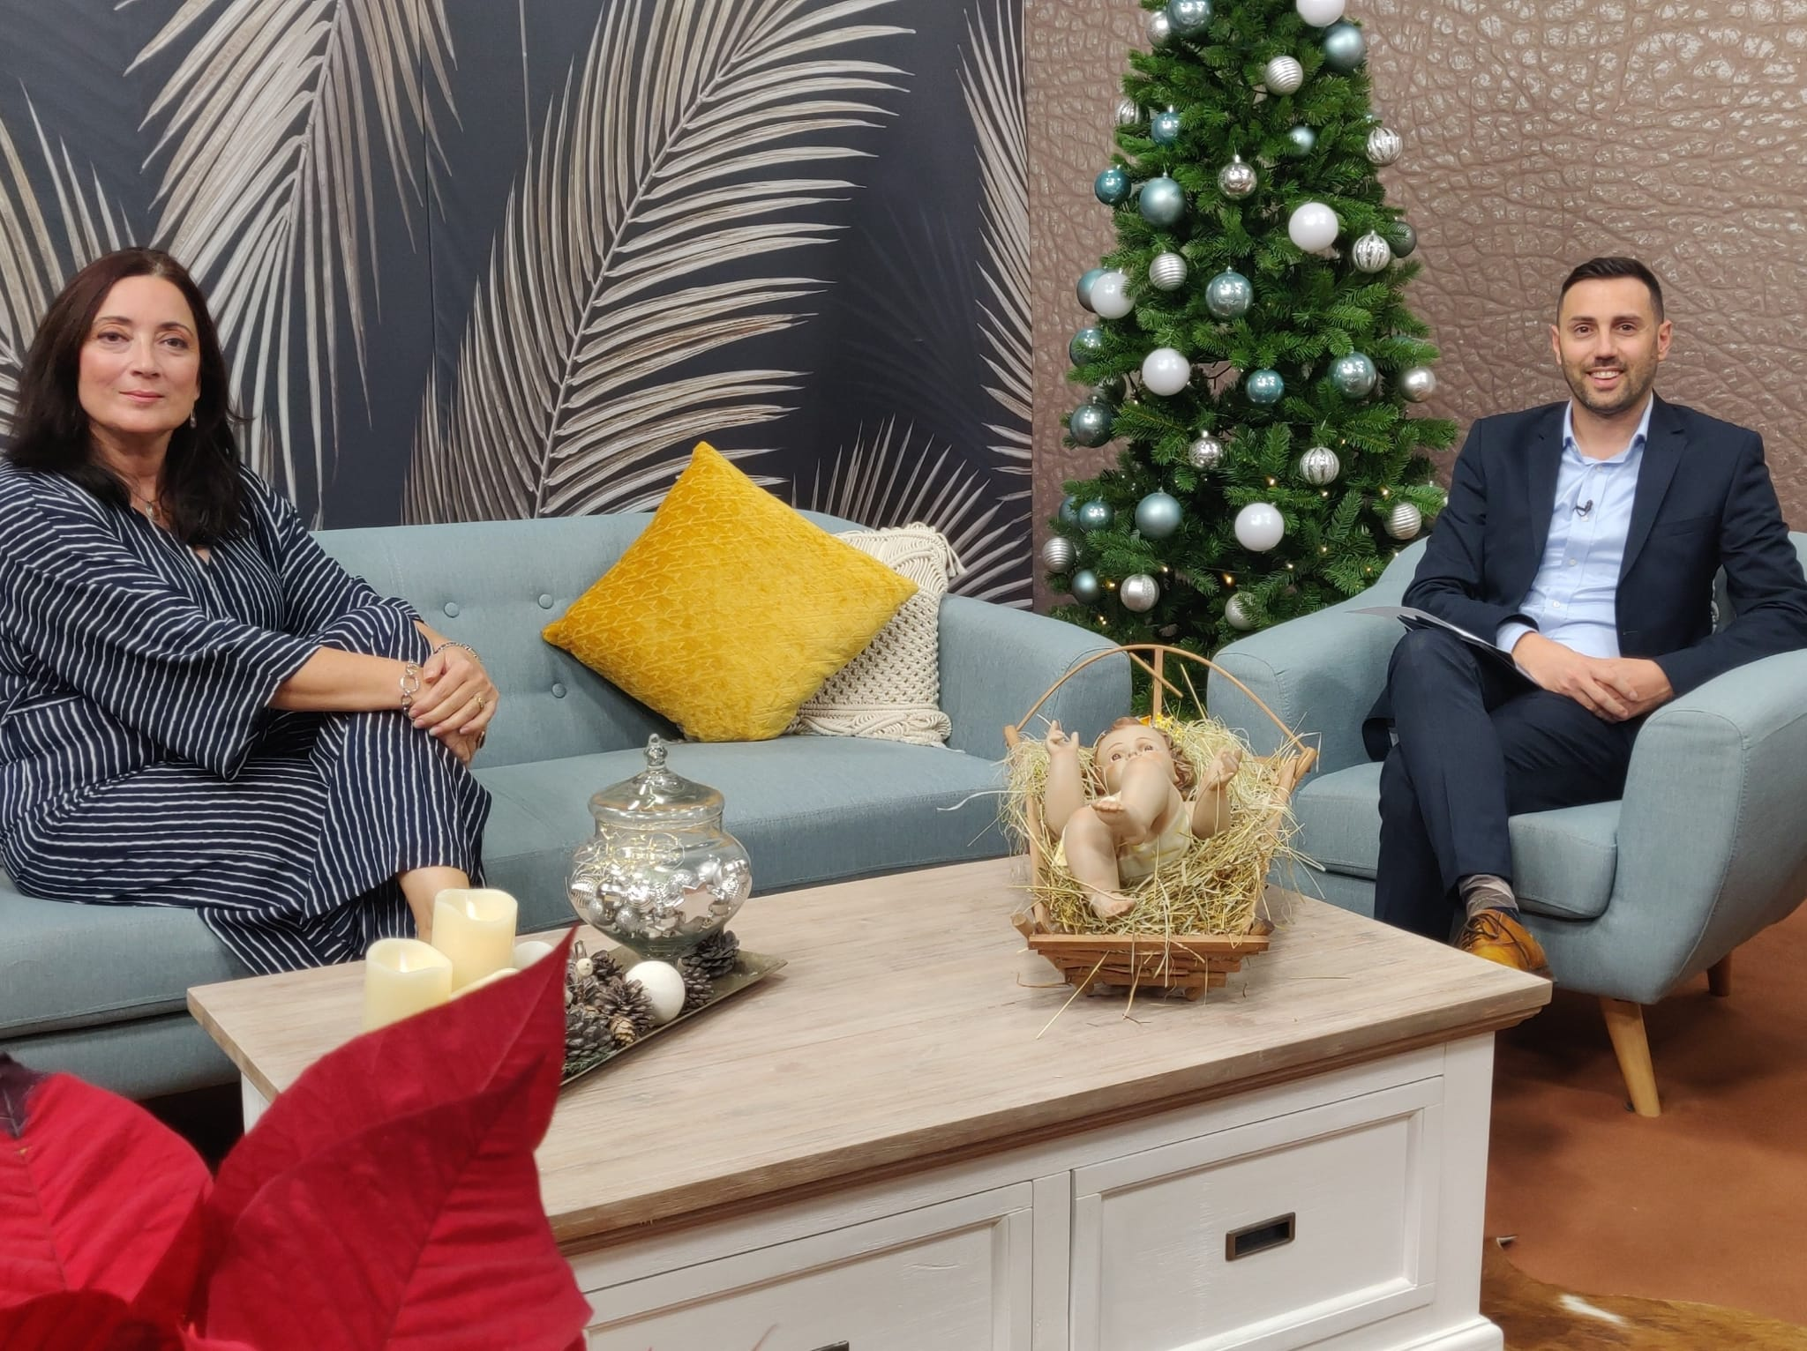
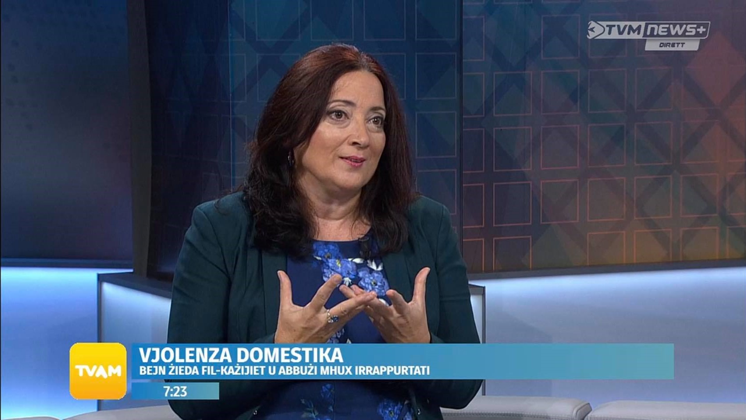
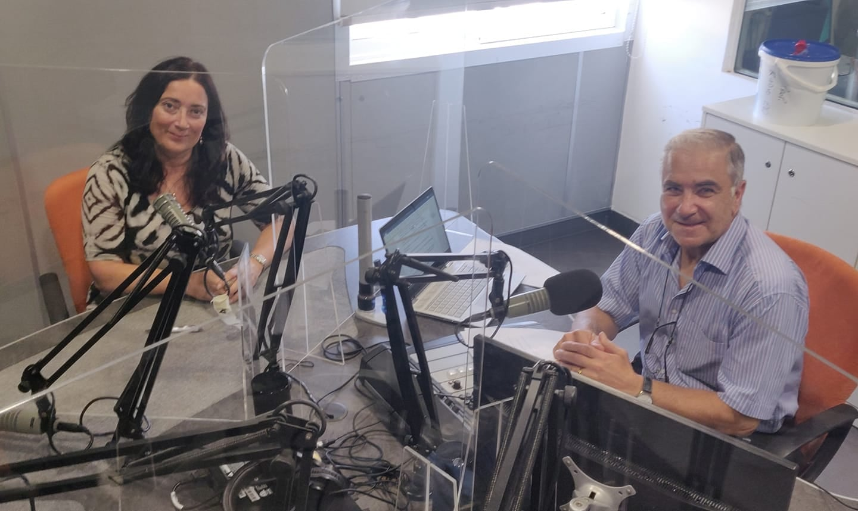
Discussions on
Television and Radio
Lovin Daily - Facebook
Kalamita – ONE TV
Attwalita – Xejk TV
Espresso – ONE TV
TVAM – TVM News+
Newsline – Radju Malta

Slide 14
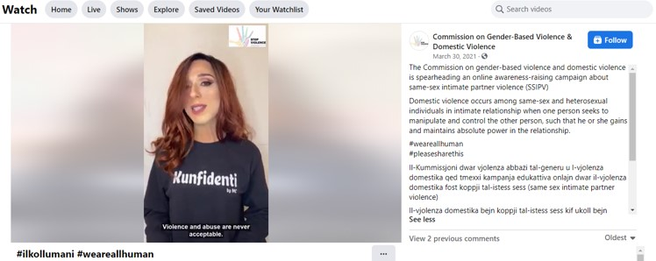

Social Media Campaigns
‘My Disability Does Not Mean Consent for Abuse’ in collaboration with the Commission for the Rights of Persons with Disability – an awareness-raising campaign on violence against people with disabilities.
‘We Are All Human’ (‘Ilkoll Umani’) awareness-raising campaign on same-sex intimate partner violence

Slide 15

16 Days of Activism
Every year, the Commission coordinates the 16 days of activism international awareness campaign which spans between the 25th of November (the International Day for the Elimination of Violence against Women) and the 10th of December (Human Rights Day). The theme chosen for 2021 was ‘Your voice can set you free – Il-vuċi tiegħek tista’ teħilsek’.

Slide 16
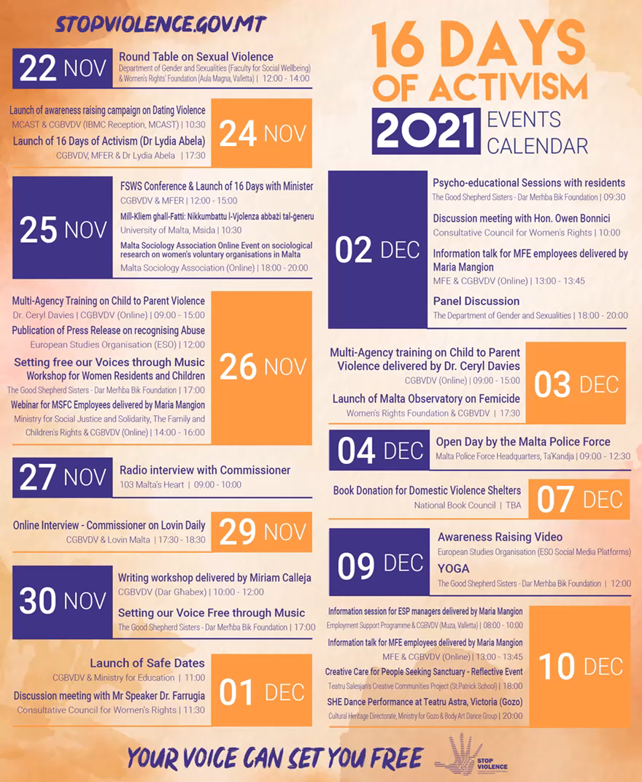
Initiatives and activities held during the 16 days included:
Social media campaign
Television adverts
Awareness-raising stand in collaboration with MSFC
Collaboration with Lovin Malta
Writing workshop with residents of Dar Għabex
Drawing and writing competition in primary and secondary schools
Launch of Safe Dates pilot project in secondary schools
Launch of Malta’s Observatory on Femicide
Book donation to domestic violence shelters by the National Book Council
Training for professionals
  Training seminar for health professionals addressing the legal aspects of sexual assault management
  Multi-agency training on child-to-parent violence
  Information sessions for employees within MSFC and MFE
  Information session in collaboration with ESP
Commissioner’s participation in the media

