Slide 1

ANNUAL REPORT 2020
^{9th} year of Operation
The Covid-19 Pandemic

Slide 2
Impact of Covid-19 pandemic
Population mental health, service use and service provision has been impacted
The Office:
  Continued to promote & protect Mental Health patients’ rights
  Was instrumental for Richmond Foundation helpline 1770 → 24 x 7
  Instead of the annual visitations, e-mails, phone calls & case reviews were used to address the obligations of monitoring
  Supported the Covid-19 Public Health Response Team

Slide 3
2020 OBSERVED TRENDS - 1
30% ↑ in service requests compared to pre-pandemic levels
16% ↑ in the number of NEW pts for involuntary care .
  During 2016-2018, there was a ↓ 5-7%
  In 2019 ↑ 2%
64.7% of involuntary admissions were <45 years (high burden in younger generations)
30% of involuntary admissions were adolescents & youth aged <30 yrs (also reported in 2017-2019)
↑ 15% among persons being actively followed up on CTO

Slide 4
2020 OBSERVED TRENDS - 2
↓ in length of stay in involuntary care (seen also in 2017-2019)
Community involuntary care is now the preferred option for following up difficult cases ( ↑ seen in 2015-2020)
29.6% of all acute involuntary admissions were foreigners
↑ mental health needs of foreign workers, persons in residential care & detention facilities and migrants

Slide 5
2020 OBSERVED TRENDS - 3
A sustained ↑ of 16.7% in incident reports from 2019 filed by Nursing Staff
  Aggressive behaviour (56%);
  Falls (14%),
  Self-harm (12%);
  Substance Abuse (7%) and
  Abscondment (5%).
  Others (6%)
29% of patients were involved in 58% of all incidents (same as in 2019)

Slide 6
Data from POYC Schedule V applications show:

Slide 7
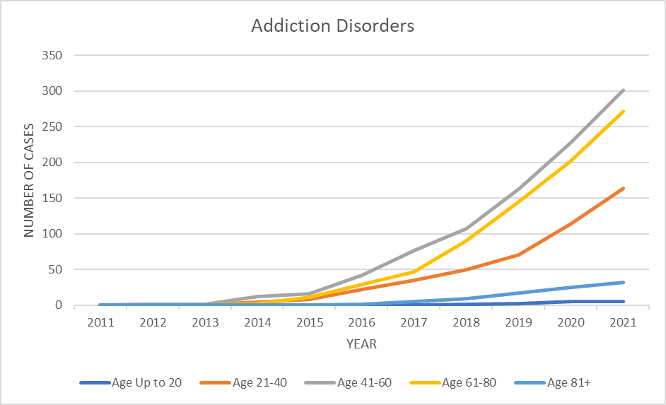
Addiction Disorders over the Past Ten Years

Slide 8
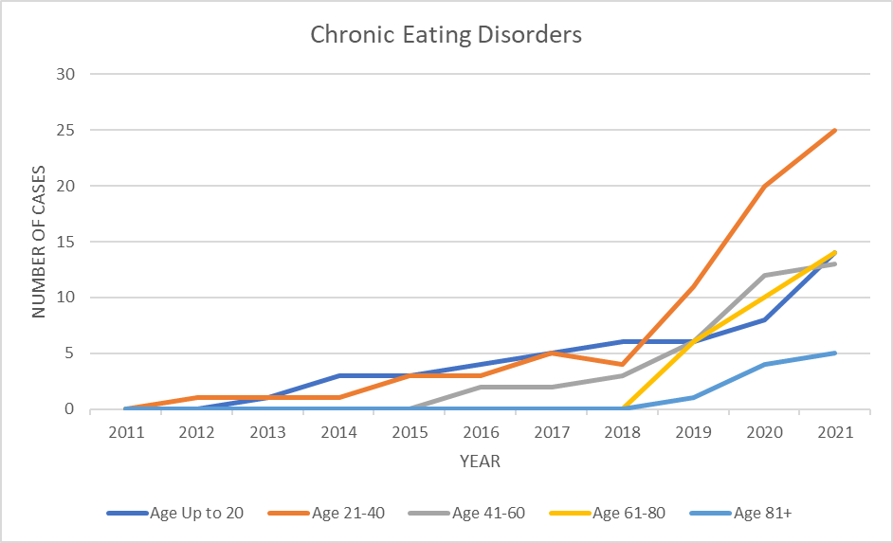
Chronic Eating Disorders over the Past Ten Years

Slide 9
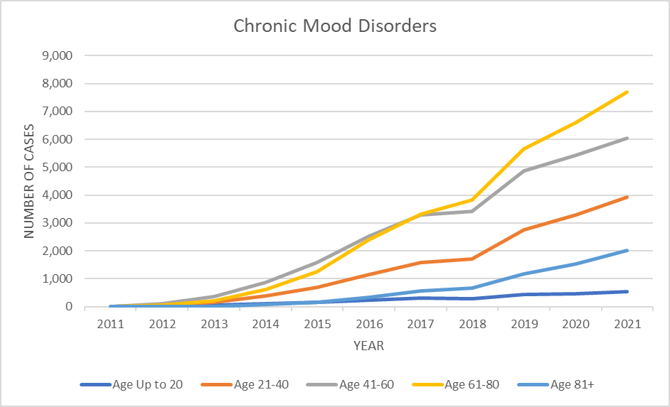
Chronic Mood Disorders over the Past Ten Years

Slide 10
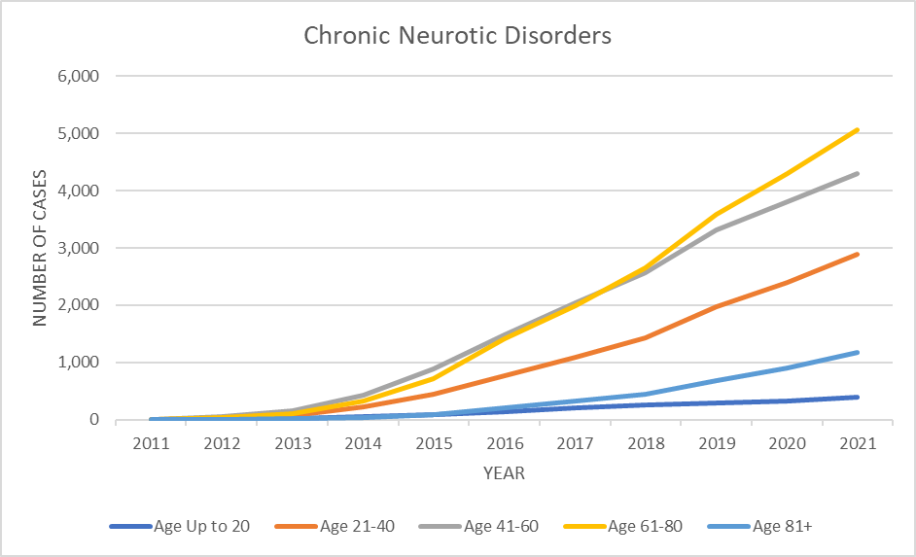
Chronic Neurotic Disorders over the
Past Ten Years

Slide 11
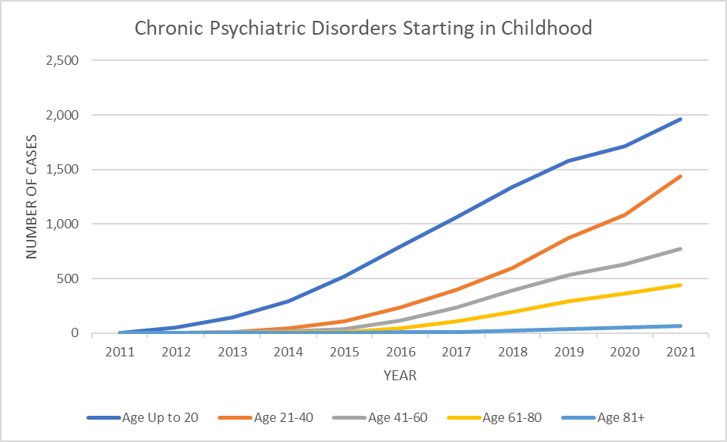
Chronic Psychiatric Disorders Starting in Childhood over the Past Ten Years

Slide 12
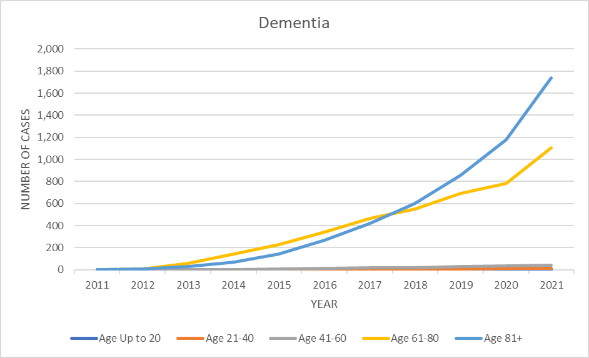
Dementia over the Past Ten Years

Slide 13
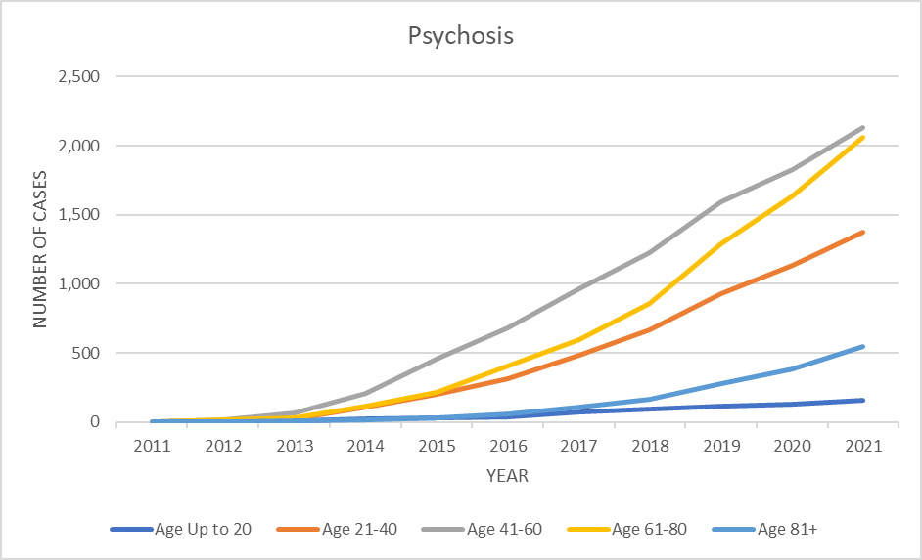
Psychosis over the Past Ten Years

Slide 14
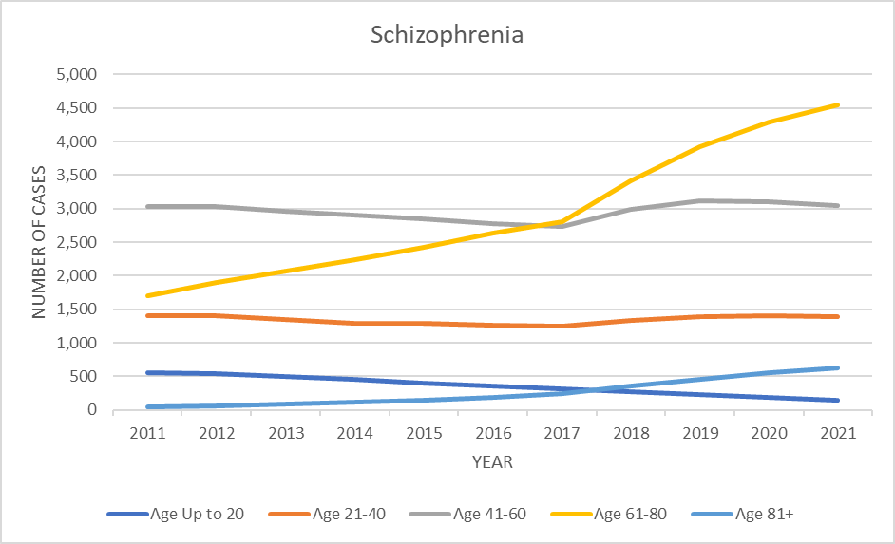
Schizophrenia over the Past
Ten Years

Slide 15
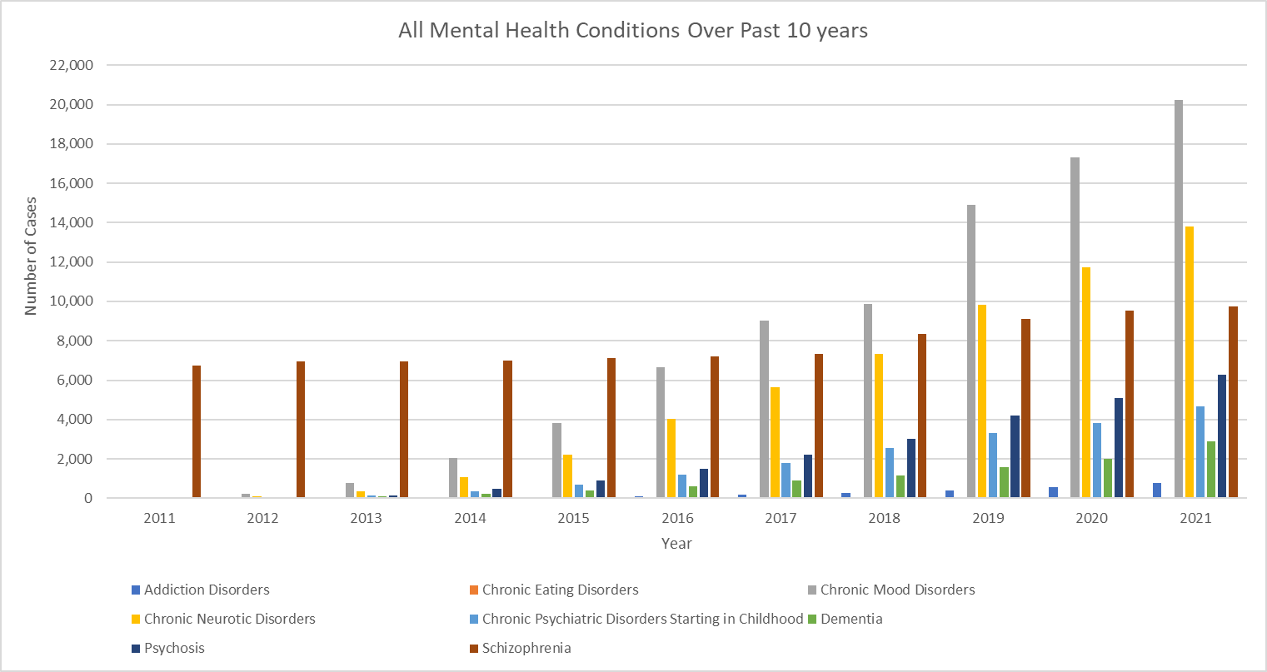
All Mental Conditions over the
Past Ten Years
Notes:
Overall increase over last five years

Slide 16
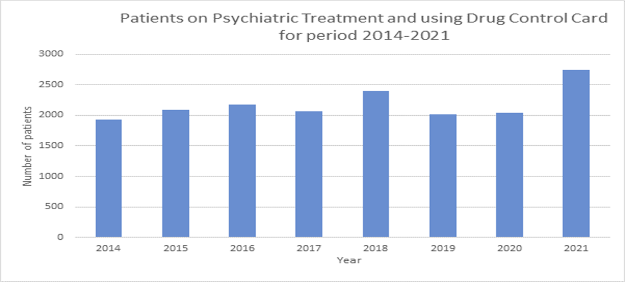
All Mental Conditions over the
Past Ten Years
Notes:
Includes patients on DDA medicines in public and private

Slide 17
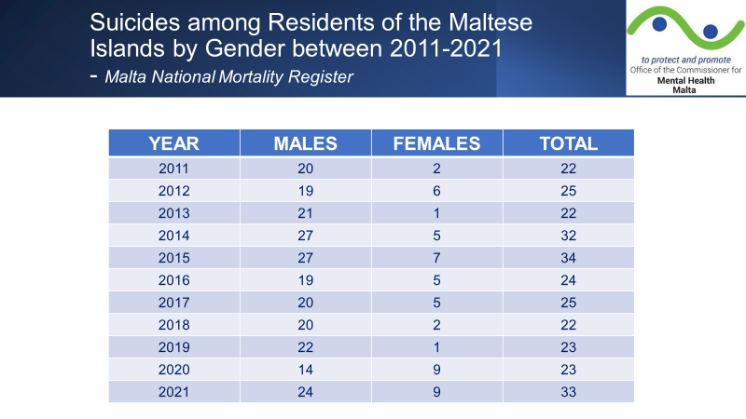
Notes:
Peaks in 2014-2015, 2021

Slide 18
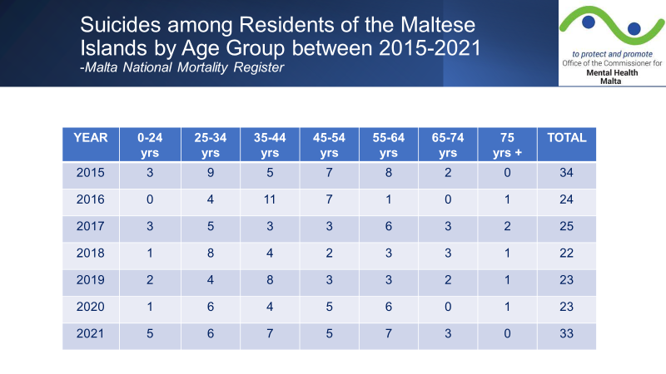
Notes:
Affecting young and middle aged – economically active

Slide 19
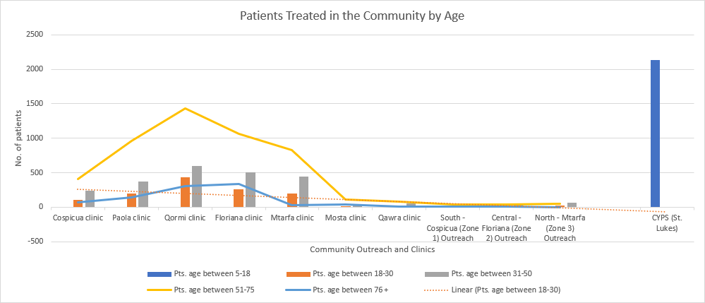
Notes:
Year 2020

Slide 20
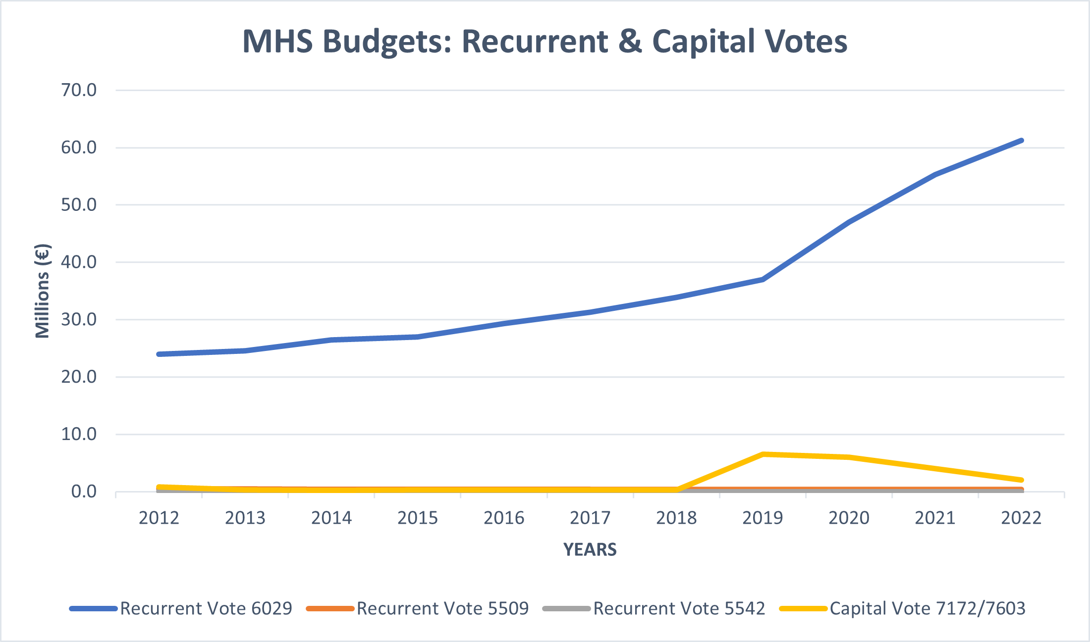
MHS Budget allocations (Recurrent and Capital)
Notes:
Does not include EU funds
No mention of unutilized funds

Slide 21
IN SUMMARY
2020 was 6th year of full implementation of the new MHA
Involuntary Care Process still being closely monitored
Patients are being followed up on regular basis
Length of Involuntary care – drastically diminished
Community Involuntary care preferred option for difficult cases

Slide 22
Challenges -1
Analyze and address Burden of Mental Health problems esp amongst younger generations
Inter-Ministerial, Inter-Organizational Commitment and Collaboration in the field of Prevention, Treatment and Rehabilitation
Increased Recruitment and Training of Health Care Professionals in Mental Health – Drs, Nurses, Clinical Pharmacists, OTs, SW, Psychologists, Youth Workers, Physiotherapists, Carers, Sports Therapists, Activity Co-ordinators, Counsellors, Cultural Mediators and Interpreters, etc
Work to increase Mental Health Literacy esp amongst younger generations and vulnerable groups
Prioritize and accelerate Procurement procedures in this sector including the introduction of new Psychiatric Medicines
Notes:
Drs = Psychiatry specialists and GPs

Slide 23
Challenges -2 Mental Health Capital Projects
Concretize building of New Psychiatric Hospital
Re-establish a dedicated Psychiatric Unit in MDH
License sections within MDH as Mental Health Facilities
Speed up Refurbishment and Maintenance of MCH
Open up new purposely built Community Mental Health Clinics
Urgently relocate CYPS to a new dedicated facility
Open up dedicated facilities in the community for persons with Neurodevelopmental Disorders, Challenging Behaviours, Addictions, etc

Slide 24
Challenges - 3
Enhance support (financial and HR) to NGOs working in this sector, ensuring collaboration between all and avoiding duplication
A Mental Health Research Repository accessible to all stakeholders
Medical records – speed up digitalization to ensure a seamless care
Protection of the Mental Health of our HCW
Proactively address Stress at places of work
Incongruency between declared Patient Rights and the actual situation on the ground
Consider amendments of the current Mental Health Act – strengthening the Office of the CMH
Notes:
Consent forms
Responsible Carers

Slide 25
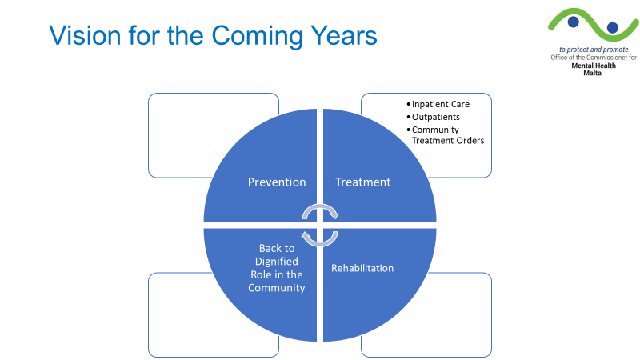

Slide 26
Words of Appreciation
Previous Mental Health Commissioner – Dr. John Cachia
All staff at the Office of the Commissioner
All Health Care professionals and Support staff working within the Mental Health Facilities and elsewhere for their continued dedication at their respective place of work

Slide 27
THANK YOU

