Slide 1

A review of the implementation of Sustainable Development Goal 2: Addressing pre-obesity and obesity
National Audit Office
January 2024

Slide 2
Presentation Outline
1. | Introduction & methodology | Why and how are we focusing on overweight?
2. | The local framework | What are the governance structure, local targets and the measurement frameworks?
3. | Government’s address of overweight | What are the measures being taken by Government?
4. | Statistics | How does Malta rate on various indicators of overweight?
5. | Stakeholder views | What are the views of stakeholders on Government’s efforts and progress achieved?
6. | Analysis and conclusions | Were Government’s efforts comprehensive, effective and inclusive? Has sufficient progress been achieved?

Slide 3
Part 1
Introduction and methodology

Slide 4
Introduction
SDG Target 2.2 – which aims to ‘end all forms of malnutrition by 2030’
The prominent nutritional issue within the EU is overweight
Excess weight is linked to an increased risk of various noncommunicable diseases, worsening quality of life and life expectancy, mortality, increased risk of disability
Huge economic burden of overweight
Obesity is presented as a major challenge with worsening trend for Malta according to the 2022 SDG Index and Dashboard Report
These factors motivated focus on overweight

Slide 5
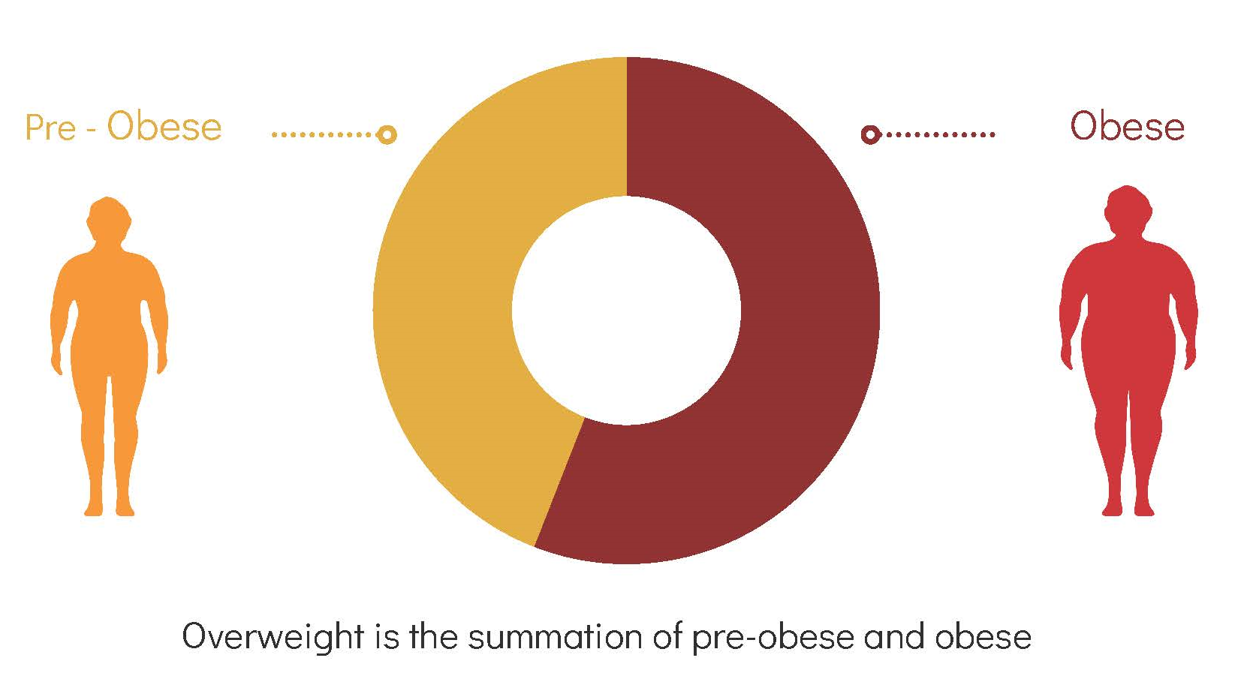
Defining overweight

Slide 6
The NAO enquired whether:
progress has been achieved in addressing overweight
Government’s efforts are sufficient, effective and address all vulnerable groups in addressing overweight
there is sufficient communication, coordination and cooperation within Government to address overweight
Government is providing an enabling and positive environment for other actors to contribute to the address of overweight

Slide 7
Engagement with stakeholders
Information relating to work undertaken
Analysis of data
Review
The four main components of our fieldwork

Slide 8
Engagement with stakeholders
Ministry for Health officials, including members of the Advisory Council,
other Ministries & public sector entities officials,
NGOs,
professional associations,
service providers, academics,
governmental officially appointed bodies,
business stakeholders,
WHO expert
Interviews, written contributions & focus groups
Thematic analysis
Engagement with stakeholders
Information relating to work undertaken
Analysis of data
Review

Slide 9
Sourcing and analysis of information relating to work undertaken by Government to address overweight:
Minutes of the 2016-2021 Advisory Council meetings
Thematic analysis
Operational dynamics, areas of action, achieved output and factors influencing the work of the Council
Information regarding Strategy implementation
2012-2020 implementation period
89 areas for action
NAO opinion on the validity and comprehensiveness of the identified implemented actions and the assessment of implementation progress
Engagement with stakeholders
Information relating to work undertaken
Analysis of data
Review

Slide 10
Analysis of data:
Analysis of prevalence rates across countries
Analysis of local prevalence rates over time
Salient indicators disaggregated by demographic characteristics
Statistics for health determinant behaviours
Assessment of target achievement
Engagement with stakeholders
Information relating to work undertaken
Analysis of data
Review

Slide 11
Review:
Ministry for Health feedback at report review stage
Engagement with stakeholders
Information relating to work undertaken
Analysis of data
Review

Slide 12
Part 2
The local context

Slide 13
Local context
Main policy: The Healthy Weight for Life: A National Strategy for Malta 2012-2020
Local 2020 targets:
reduction in the self-reported proportion of the adult population who are pre-obese from 36 per cent to at least 33 per cent
reduction in the self-reported proportion of the adult population who are obese from 22 per cent to at least 18 per cent
reduction in the proportion (measured by anthropometric studies) of 7-year-olds who are overweight from 32 per cent to 27 per cent
maintenance of the proportion of 13-year-olds who are obese below 15 per cent

Slide 14
Local context
Governance structure: implementation supported by the Advisory Council on Healthy Lifestyles
Legal framework: The Healthy Lifestyle Promotion and Care of Non-Communicable Diseases Act
Measurement framework: the WHO European Childhood Obesity Surveillance Initiative (COSI) – 6- to 9-year-olds; the Health Behaviour in School-aged Children (HBSC) –11-, 13- and 15-year-olds; European Health Interview Survey (EHIS) – 15+-year-olds

Slide 15
Part 3
Government’s address of overweight

Slide 16
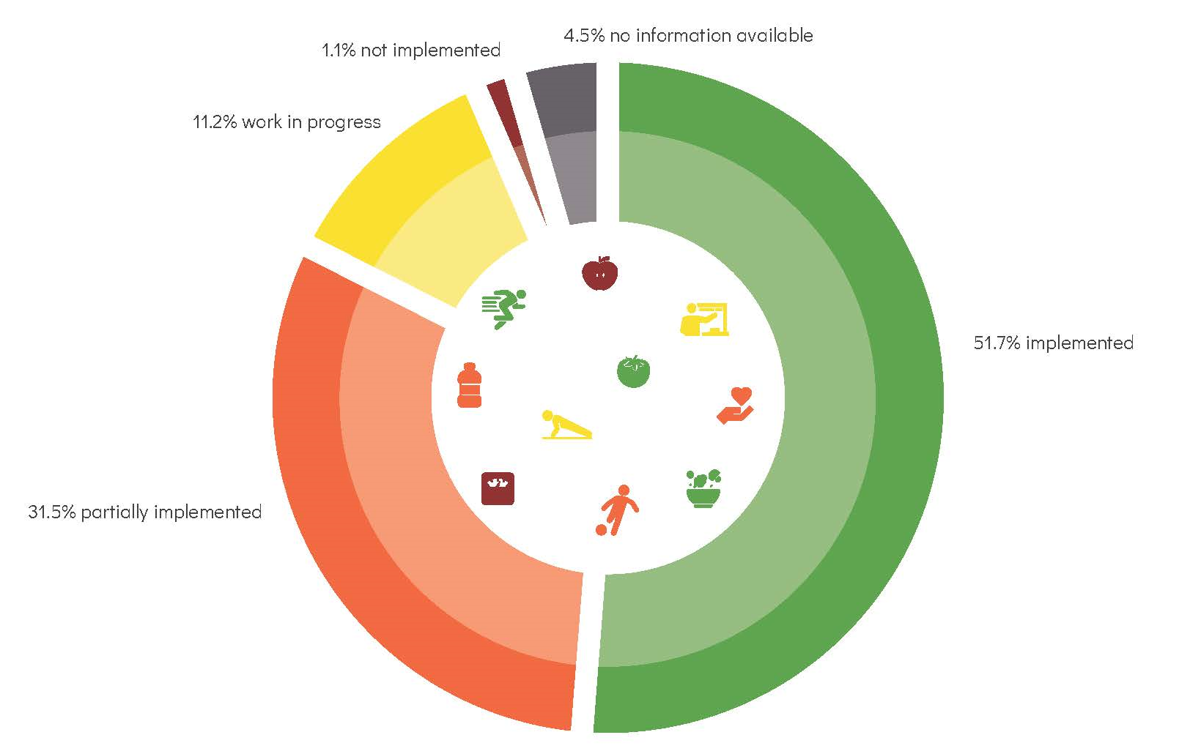
Strategy implementation progress
Information collected by the Strategy Development and Implementation Unit, MFH from various stakeholders across Government
Implementation progress of 89 areas for action included in the Healthy Weight for Life Strategy
Mixed results noted
NAO assessment of log of implementation efforts – some identified implementation actions at best tokenistic, tangential, limited in scope, unrelated

Slide 17
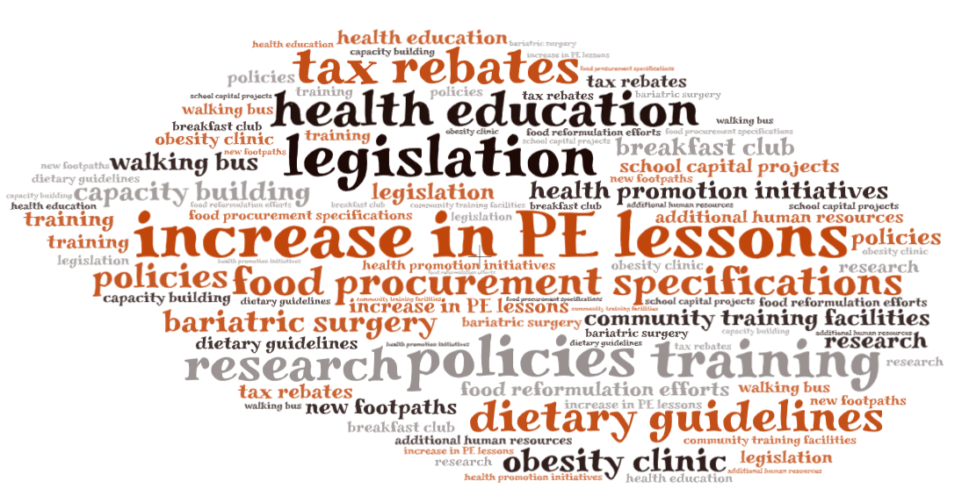
Strategy implementation progress

Slide 18
Efforts undertaken by the Advisory Council
Identifying, consulting and securing cooperation with stakeholders
Planning educational campaigns
Considerations of policy coherence
Spurring legislative change
Identifying and sourcing budgetary allocations
Exploring different fiscal measures
Monitoring developments at EU level
Focus on addressing overweight in children

Slide 19
Part 4
Statistics

Slide 20
Latest statistics
Population group | Data source | Pre-obese (%) | Obese (%) | Overweight (%)
7-year-olds | COSI, 2022 (preliminary figures) | 18.3 | 17.1 | 35.4
11-, 13-, 15-year-olds | HBSC, 2018 | 22.4 | 8.9 | 31.2
15-year-olds and over | EHIS, 2019 | 35.7 | 28.1 | 63.8

Slide 21
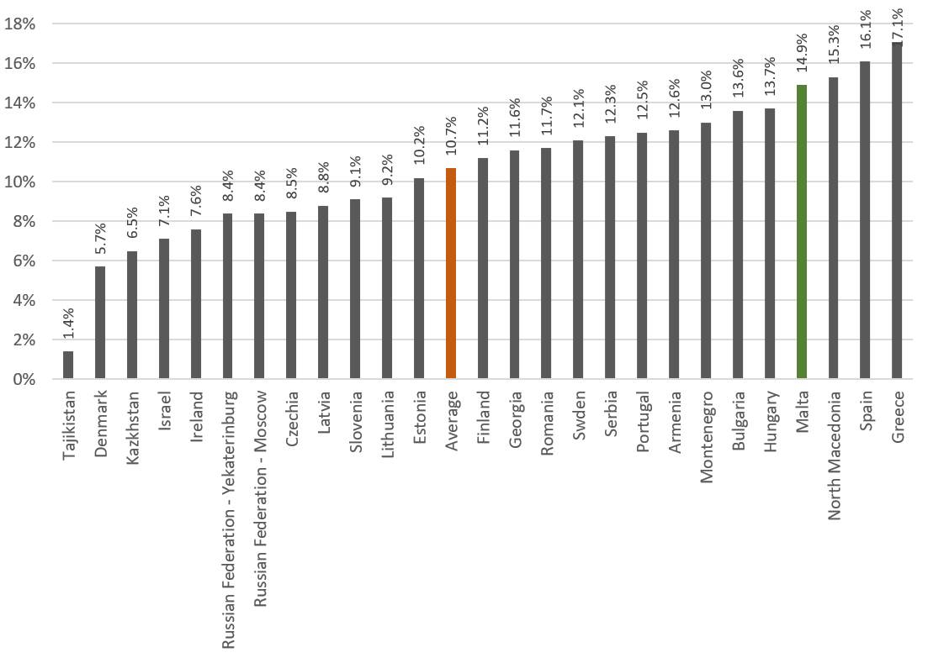
Child obese prevalence rates, COSI round five (2018-2020)

Slide 22
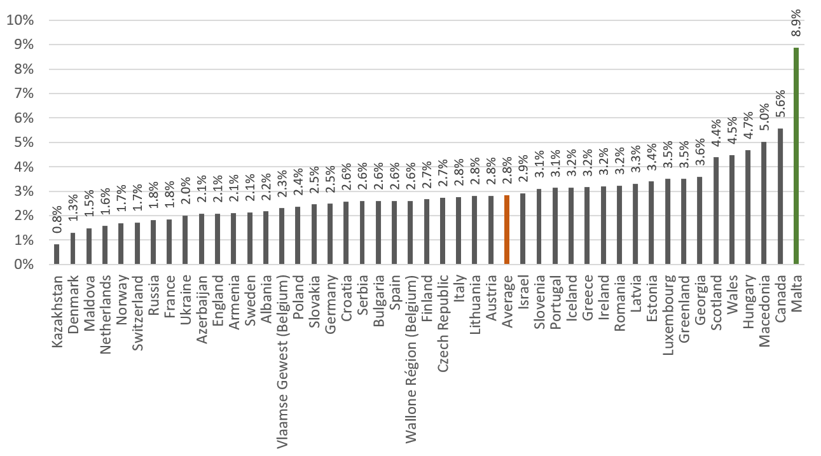
Adolescent obese prevalence rates, HBSC 2018

Slide 23
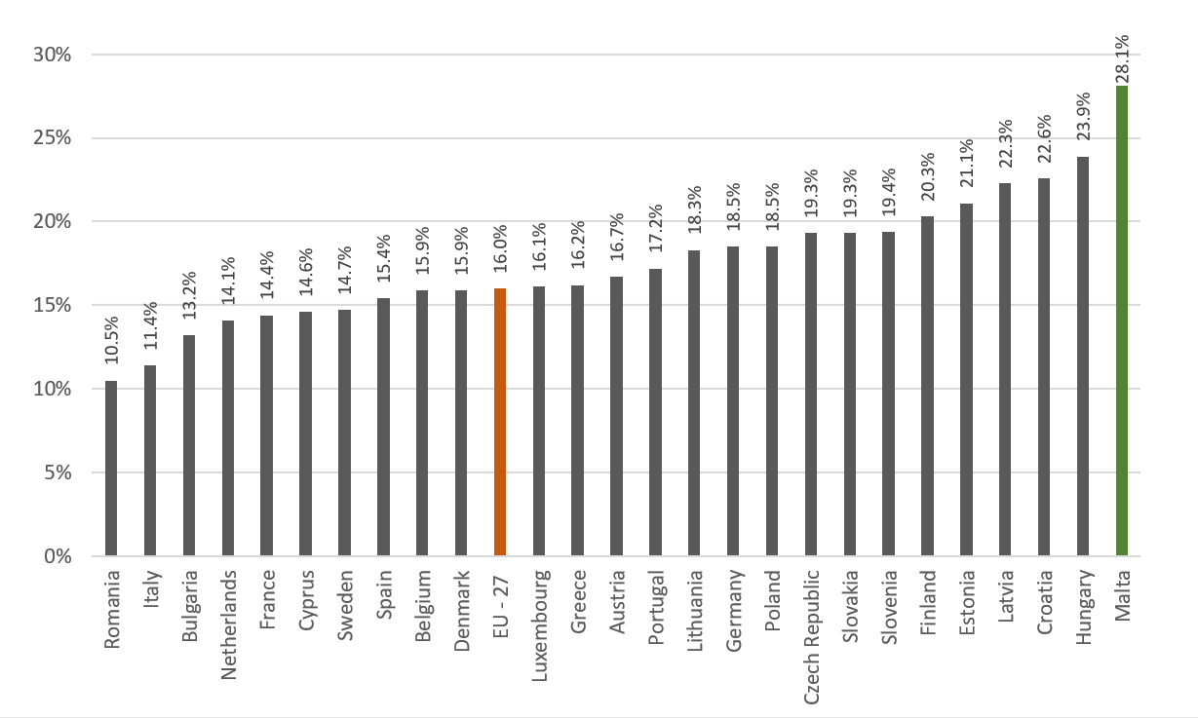
Adult obese prevalence rates, EHIS 2019

Slide 24
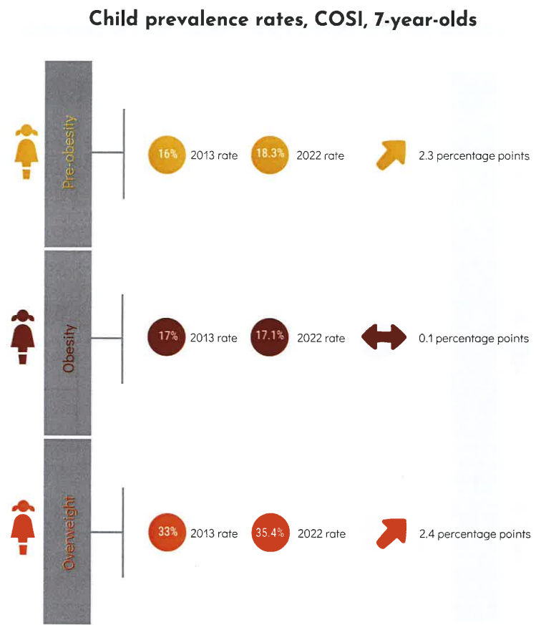
Child prevalence rates, COSI, 7-year-olds

Slide 25
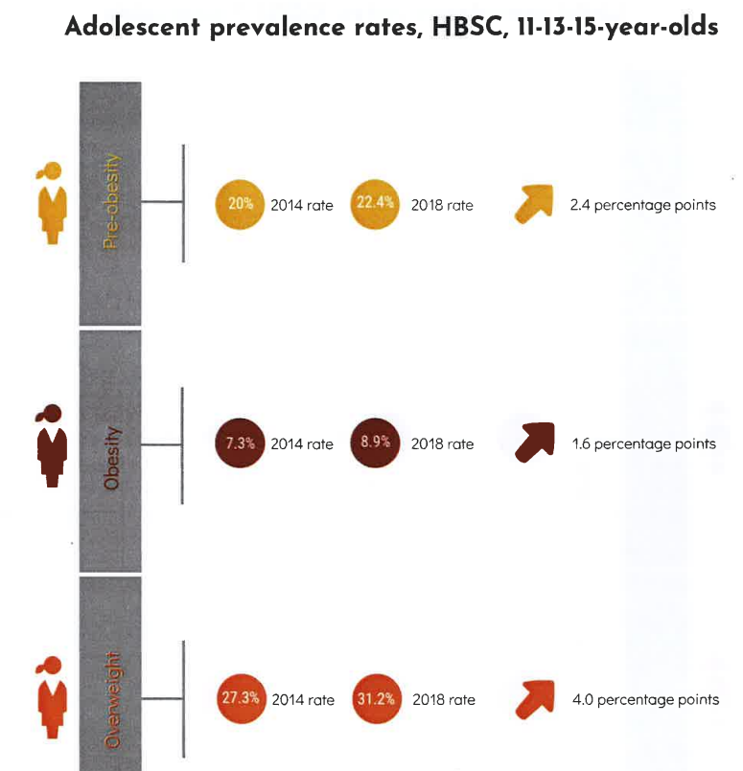
Adolescent prevalence rates, HBSC, 11-13-15-year-olds

Slide 26
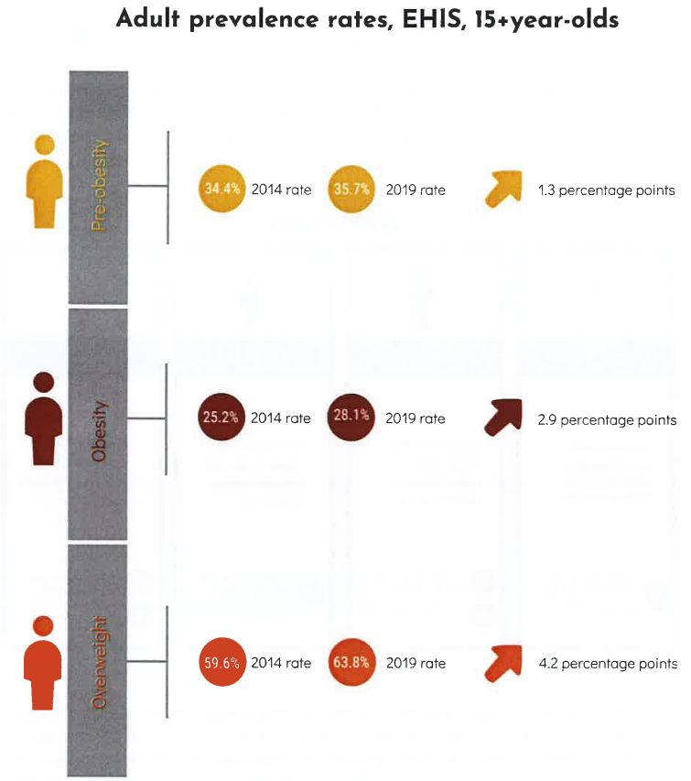
Adult prevalence rates, EHIS, 15+year-olds

Slide 27
Disaggregated salient indicators
Pre-obesity, obesity and overweight prevalence rates disaggregated by important demographic variables
Higher prevalence rates for males compared to females
Mixed results for wealth – general pattern of higher prevalence rates for lower income groups
Inverse association between education level and excess weight

Slide 28
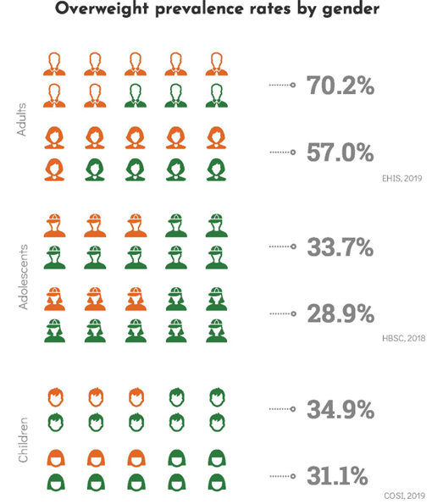
Overweight prevalence rates by gender

Slide 29
Health determinant behaviour
Analysis of food consumption patterns and uptake of physical activity data
High prevalence of behaviours that contribute to overweight
Sub-optimal consumption of fruit and vegetables
Most adolescents and adults do not partake in the minimum level of recommended weekly physical activity; Statistics for children are more encouraging

Slide 30
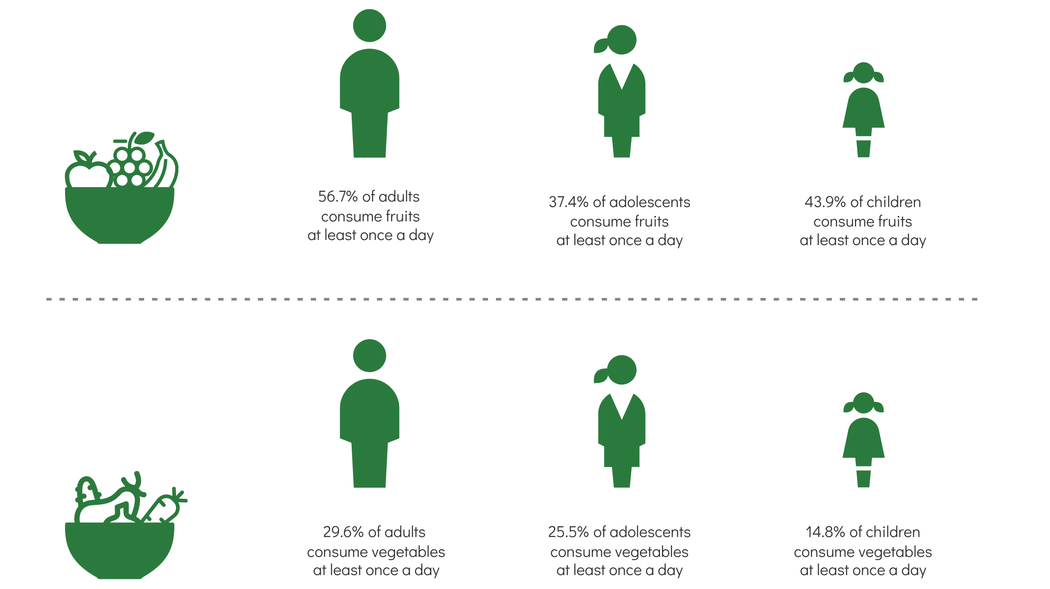
Fruit and vegetable daily consumption
EHIS, 2019; HBSC, 2018; COSI, 2019

Slide 31
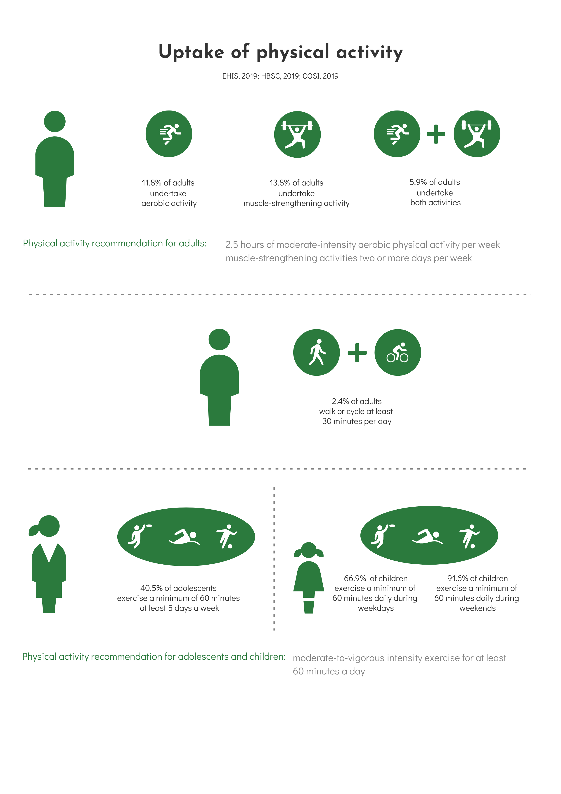
Uptake of physical activity (adults)
EHIS, 2019; HBSC, 2018; COSI, 2019

Slide 32
Uptake of physical activity (children & adolescents)
EHIS, 2019; HBSC, 2018; COSI, 2019

Slide 33
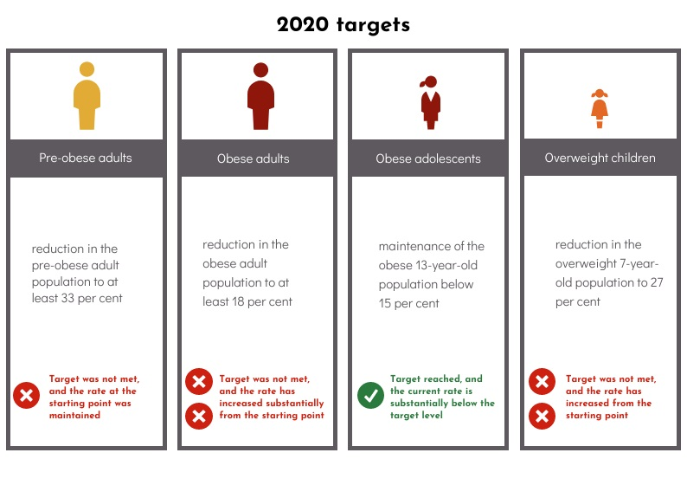
Target achievement assessment

Slide 34
Part 5
Stakeholder views

Slide 35
Stakeholder feedback sought on various matters relating to Government efforts
Legal and policy framework
Institutional set-up
Plans and budgets
Implemented measures, projects and initiatives
Engagement of multiple stakeholders
Planned progress

Slide 36
Salient themes
The measurement of progress | Unmet needs and vulnerable groups | Market and political considerations | Legislation and policies
Enabling environment | Spatial planning | Physical activity | Funding and resources
Food considerations | Lifestyle and culture | Collaboration and coordination | Enabling environment
Institutional set-up | Weight management | Fiscal measures | Health education and promotion

Slide 37
Stakeholder views
Enabling environment
Spatial planning
Health education essential but insufficient to motivate change
Must be supplemented with an enabling environment
Making the healthy choice the easy one
Policy and legislative changes, fiscal measures, efforts relating to food labelling, food reformulation, portion size regulation, aisle placement changes, pesticide use control, spatial planning
Need for greater investment and political goodwill
Built environment – an important yet often overlooked element
Current infrastructure does not encourage active transportation or physical activity within locality
Including health considerations in spatial planning, built environment and transport policies
Implementing policies
Ensuring major projects are consistent with policies

Slide 38
Stakeholder views
Weight management services
Food accessibility
Dwindling communication between service providers
Service overlap
Service evaluation – need for follow-up studies
To consider including GLP-1 analogues in Government formulary list
Proposals put forward for improving food accessibility and affordability
Fiscal measures aimed at the consumer, farmer, producer/manufacturer, restauranteur
Improving accessibility to farmers markets
Water fountains in localities
Availability of healthy options in vending machines and canteens
Guidelines or legislation regulation food procurement or preparation in specific settings

Slide 39
Part 6
Analysis and conclusion

Slide 40
Has progress been achieved?
Analysis of trends in prevalence rates
No progress. regression in recent years
Assessment of 2020 target achievement
Overall negative assessment, only one of four targets met
Lack of progress
Not unique to Malta

Slide 41
Are Government’s efforts sufficient and effective? Do they address the needs of all vulnerable groups?
Sufficiency & effectiveness
NAO acknowledges investment and efforts undertaken
High prevalence rates raise concerns re Government’s acknowledgement of the
scale of the problem and whether sufficient action is being taken
Gaps in funding, human resources and service provision & issues related to lack of policy coherence highlighted by stakeholders
Limited legislative changes
Strengthened political will, allocation of appropriate resources and funding & undertaking of sufficient efforts required
Address the needs of vulnerable groups
Several measures taken addressing the vulnerabilities of particular groups
Statistical analysis and stakeholder feedback provide insight into systemic disadvantages
Need for varied and targeted efforts

Slide 42
Is there sufficient communication, coordination and cooperation within Government?
The Advisory Council provides an adequate framework to promoting a whole-of-government approach to addressing overweight
Need to strengthen the Council
Widen consultative processes
Introduce a more robust monitoring and implementation framework
Elements of policy incoherence
Shortcomings in policy implementation
Inconsistencies between policy frameworks and major project design
Weight management services – Dwindling communication and cooperation as well as service overlap
Further cooperation at the level of policy implementation and service provision required
Overweight is not solely the responsibility of the MFH
Creation of enabling environment requires coordinated efforts across Government

Slide 43
Is Government providing an enabling positive environment for other actors to contribute in the address of overweight?
Government’s consideration of non-governmental stakeholders when designing policy and action
Efforts by the Advisory Council to consult and foster cooperation
Scope for more impactful consultative practices
Areas of cooperation for implemented action – limited progress registered
Scope for further collaboration
Capitalise on available resources, overcome capacity shortages and ensure a holistic, effective and sustainable approach to tackling overweight
Specifically, businesses to be involved as stakeholders through consultation, incentive and support schemes

Slide 44

Thank you
Rebecca Vassallo
Principal Auditor, National Audit Office
Keith Mercieca
Assistant Auditor General, National Audit Office

