Slide 1
2021 annual report of the EU auditors
November 2022
George Hyzler

Slide 2
European Court of Auditors
The European Court of Auditors is the independent external auditor of the European Union.
Mission: Through our independent, professional and impactful audit work, assess the economy, effectiveness, efficiency, legality and regularity of EU action to improve accountability, transparency and financial management, thereby enhance citizens’ trust and respond effectively to current and future challenges facing the EU.
We are based in Luxembourg and employ around 900 audit, support and administrative staff of all EU nationalities.
Slide 2

Slide 3
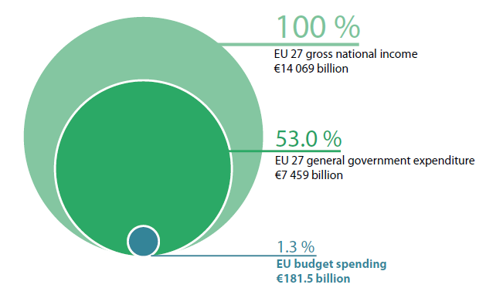
What were the 2021 figures?
EU budget spending €181.5 billion
+
RRF grants €46.5 billion
=
EU total spend of €228 billion
Slide 3

Slide 4
Audit population 2021 amounts to 154.3 billion euro
Slide 4

Slide 5
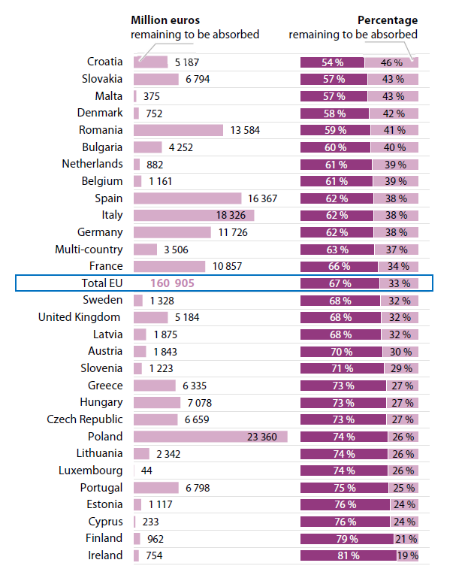
Overall findings: Budgetary and financial management
2014-2020 ESIF absorption levels (excluding NGEU resources)
Slide 5

Slide 6
Overall findings: Budgetary and financial management
Outstanding commitments reached a record amount of €341.6 billion
€251.7 billion related to the EU budget from 2021 and previous years (decreased significantly from a historic high of €303.2 billion at the end of 2020)
€89.9 billion related to NGEU
Outstanding commitments as at the end of 2021 by year of origin
Slide 6

Slide 7
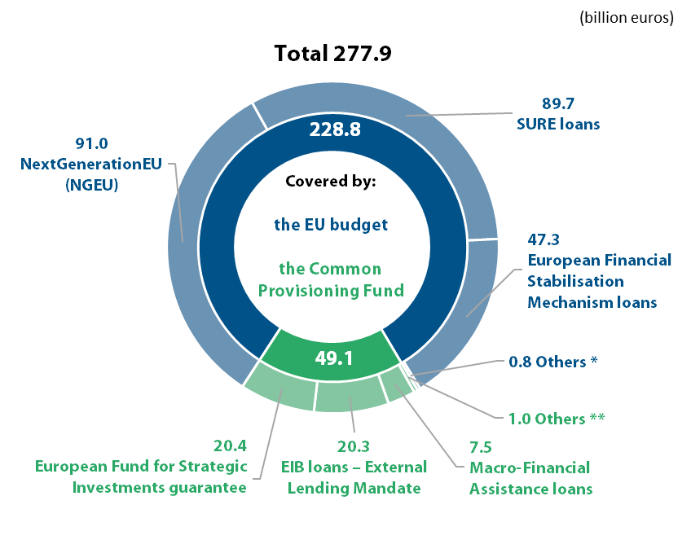
Main risks and challenges for the EU budget in the coming years
Overall findings: Budgetary and financial management
The total exposure of the EU budget increased in 2021 from €131.9 billion in 2020 to €277.9 billion in 2021, due to
introduction of NGEU
increase in the amount of loans provided under the SURE
(*) EIB loans – Member States €0.6 billion, Balance of Payments loans €0.2 billion, Euratom loans – Member States €0.1 billion, difference from the total is due to rounding.
(**) European Fund for Sustainable Development (EFSD) guarantee €0.5 billion, Euratom loans – non-member countries €0.3 billion and NDICI-European Fund for Sustainable Development Plus (EFSD+) €0.2 billion.
Slide 7

Slide 8
Main risks and challenges for the EU budget in the coming years
Overall findings: Budgetary and financial management
Russia’s war of aggression against Ukraine increases risks to the EU budget
The EU is mobilising its budget and adding additional flexibility to react to Russia’s war of aggression against Ukraine. This will increase the EU’s budgetary needs and lead to a higher risk of contingent liabilities to the EU budget being triggered. At the end of 2021, Ukraine had outstanding loans with a nominal value of €4.7 billion under the Macro-Financial Assistance and Euratom programmes. In addition, the European Investment Bank (EIB) has granted loans to the value of €2.1 billion to Ukraine, loans which are supported by EU guarantees.
Slide 8

Slide 9
Our statement of assurance for 2021
a clean opinion on the reliability of the accounts of the EU
a clean opinion on the legality and regularity of revenue
an adverse opinion on the legality and regularity of EU budget expenditure
a clean opinion on the legality and regularity of RRF expenditure
P
P
O
P
Slide 9

Slide 10
Estimated level of error for EU budget spending
(2017-2021)
Slide 10

Slide 11
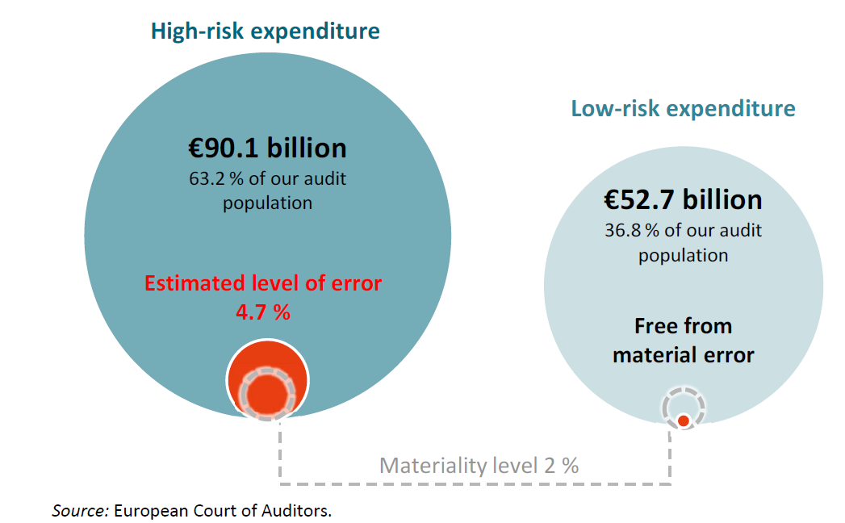
Error rates reflect the level of risk
Slide 11

Slide 12
Overall findings: transactions
The most common errors we found in high-risk expenditure in the main MFF headings were:
ineligible costs and projects, infringements of internal market rules (in particular non-compliance with state aid rules), absence of essential supporting documents, and non-compliance with public procurement rules in ‘Cohesion, resilience and values’;
ineligible beneficiaries, projects or expenditure, administrative errors and failure to meet agri-environmental commitments are the most common errors found in the rural development, market measures, environment, climate action and fisheries spending areas, which together make up around 33 % of total spending in ‘Natural resources and environment’;
ineligible direct personnel and direct other costs are the main sources of error in research expenditure (Horizon 2020 and the Seventh Framework Programme under ‘Single, market, innovation and digital’).
serious non-compliance with public procurement rules and ineligible other direct costs are the most common errors found in other programmes and activities (mainly the Connecting Europe Facility);
expenditure not incurred, ineligible costs, absence of supporting documents and public procurement in ‘Neighbourhood and the world’.
Slide 12

Slide 13
We report suspected fraud to OLAF and the EPPO
In the course of our audit work, we reported to the European Anti-Fraud Office (OLAF): 15 cases (2020: six cases) of suspected fraud that we had identified in 2021, from which OLAF has already opened five investigations.
We reported one of these cases in parallel to the European Public Prosecutor’s Office (EPPO), along with an additional case that we had identified in 2021.
Slide 13

Slide 14
References to Malta
For the financial year 31 December 2021

Slide 15
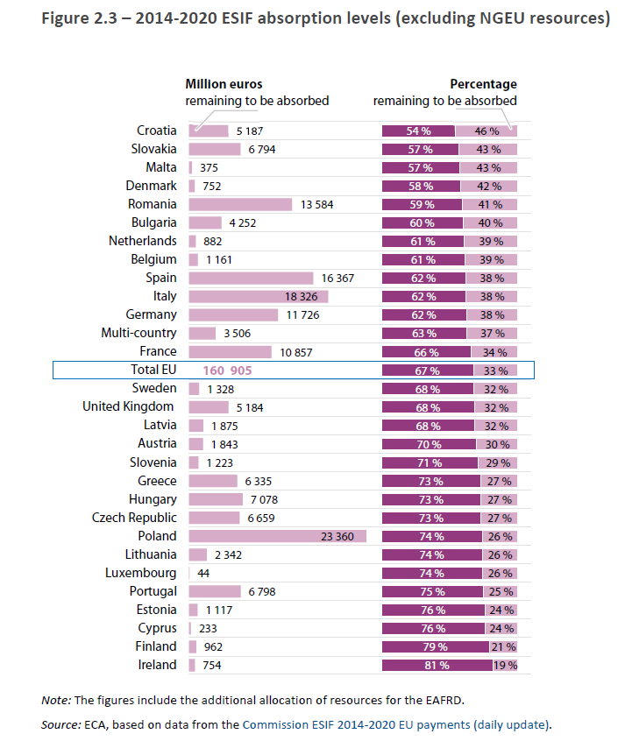
Figure 2.3 - 2014-2020 ESIF absorption levels (excluding NGEU resources)
Slide 15

Slide 16
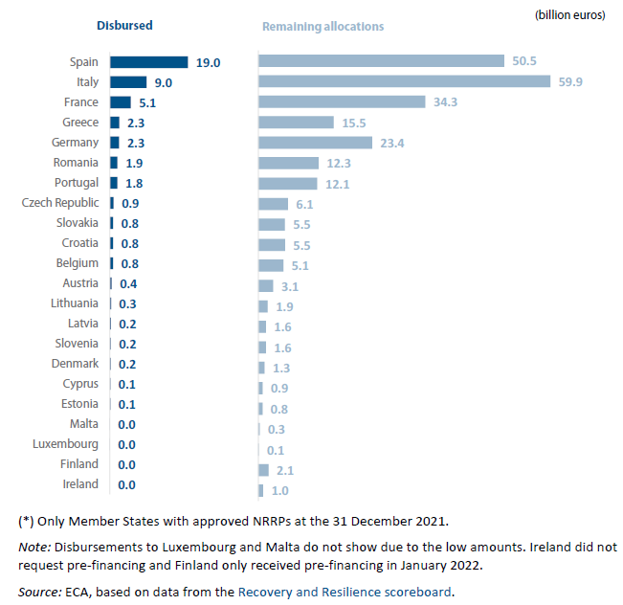
Figure 2.6 – RRF grants per Member State: 2021 disbursements and remaining allocations*
Slide 16

Slide 17
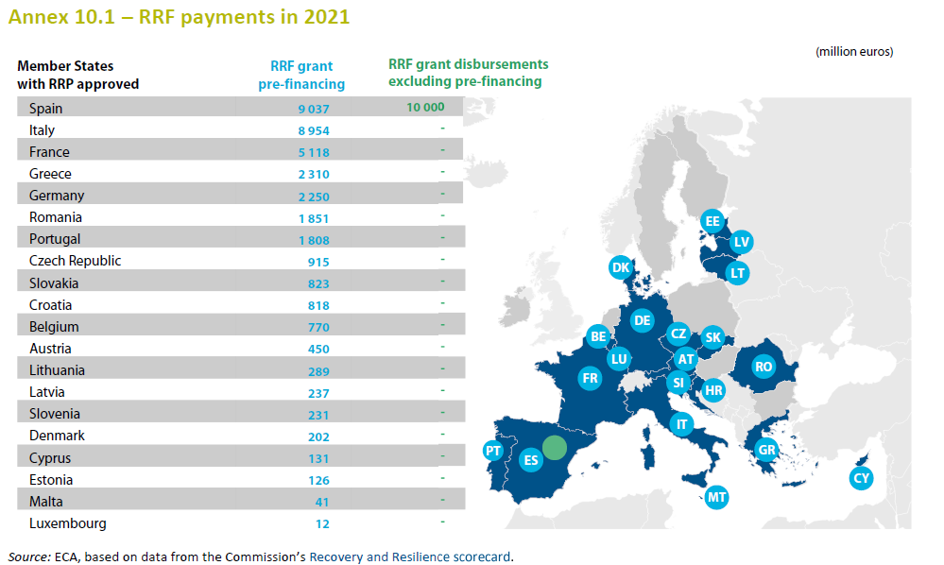
Chapter 10 – Recovery and Resilience Facility
Slide 17
Notes:
Grant payments based on milestones and targets to Spain: 10.0 and 1.5 billion clearing of pre-financing. The annex above excludes the 1.5 bn of pre-financing in the 10 bn.

Slide 18
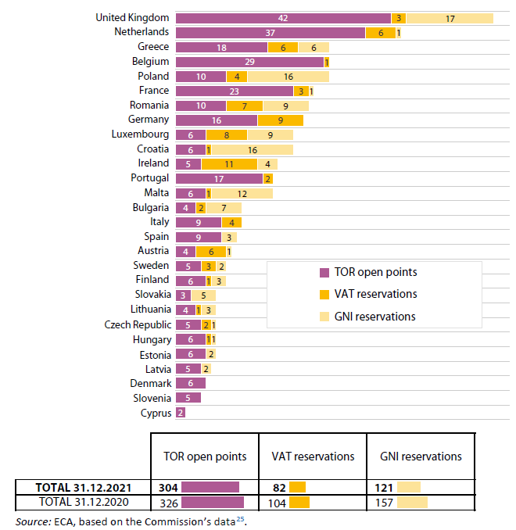
Chapter 3 Revenue
Annex 3.2 – Number of outstanding GNI reservations, VAT reservations and TOR open points by Member State at 31.12.2021
Slide 18

Slide 19
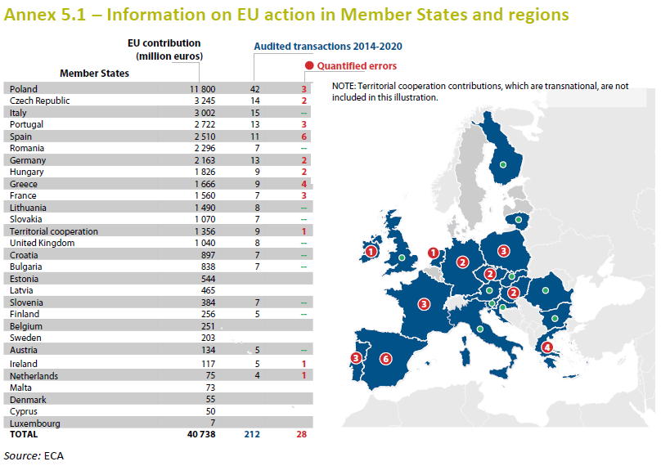
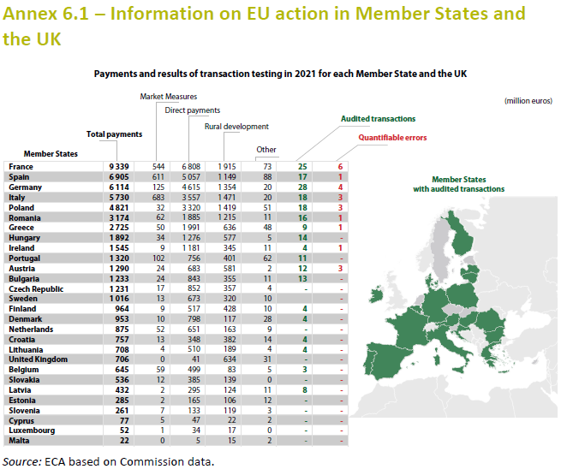
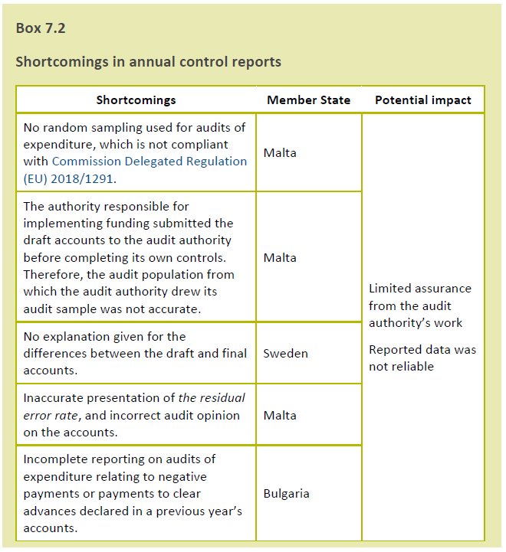
No audited transactions for Malta
Chapter 5
Chapter 6
Chapter 7
Slide 19

Slide 20
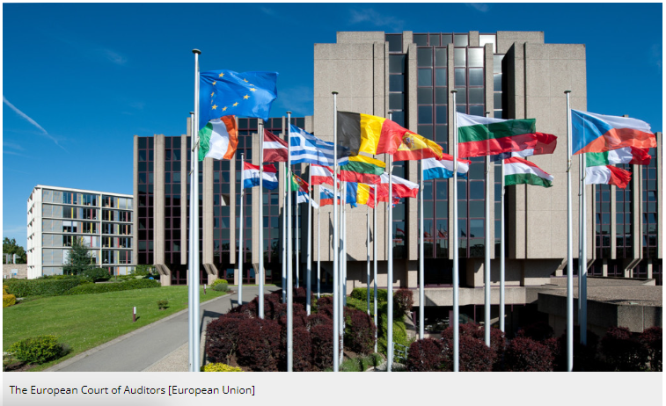



ECA’s audit fieldwork

Slide 21
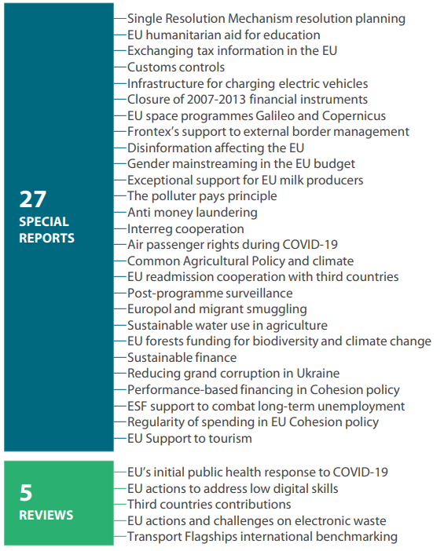
Publications for 2021
Slide 21

Slide 22
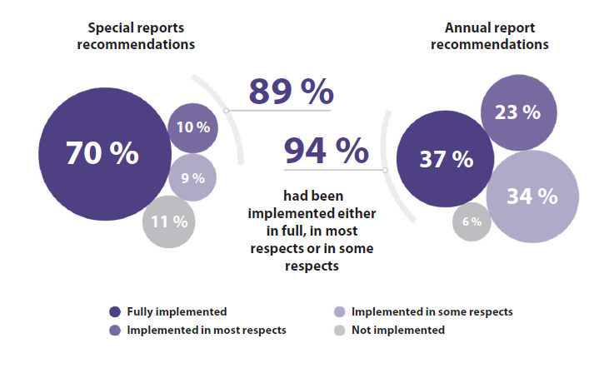
Implementation of audit recommendations
Slide 22

Slide 23
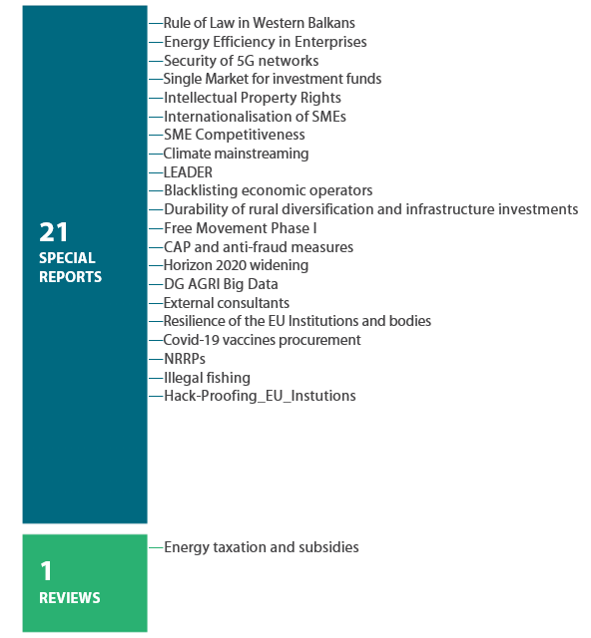
Publications for 2022
Slide 23

Slide 24
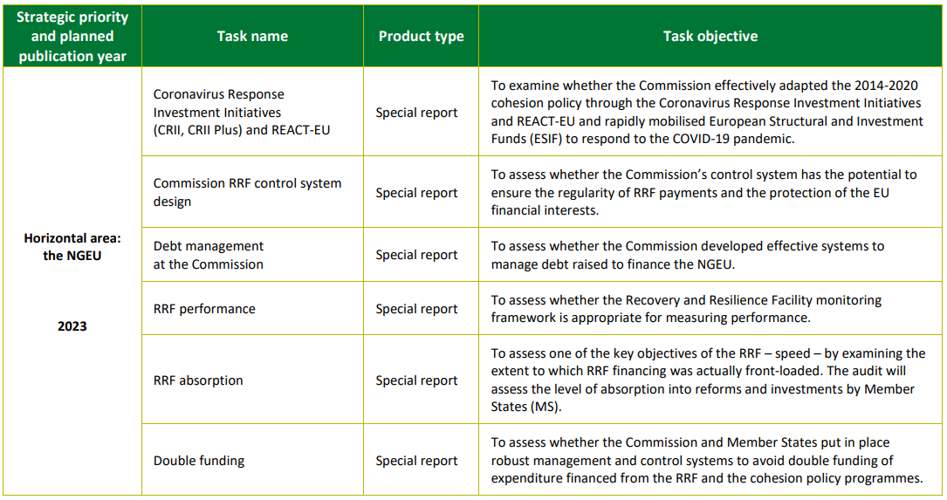
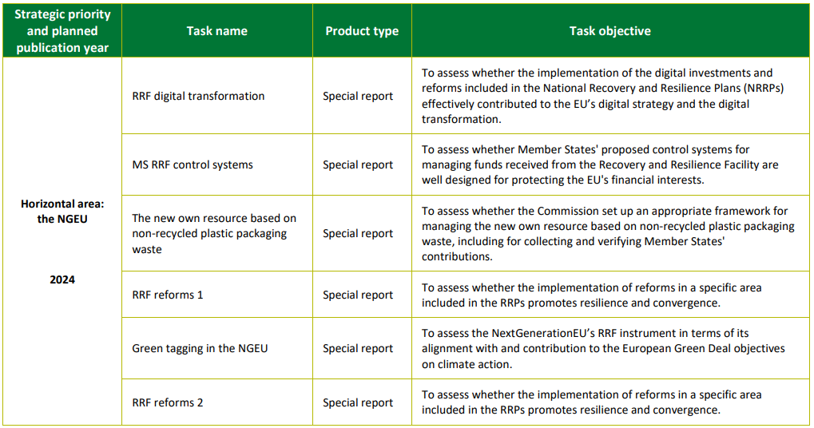
2023+ Work Programme
Slide 24

Slide 25
European Court of Auditors

Slide 26
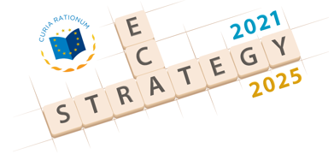
The 2021-25 strategy of the European Court of Auditors
Goal 1: Improving accountability, transparency and audit arrangements across all types of EU action
Goal 2: Targeting our performance audits on the areas and topics where we can add most value
          The Union’s economic competitiveness;
          The resilience to threats to the Union’s security, and respect for the European values of freedom, democracy and the rule of law;
          The climate change, the environment and natural resources and
          The fiscal policies and public finances in the Union.
Goal 3: Providing strong audit assurance in a challenging and changing environment
33
Slide 26

Slide 27
Organisation of ECA
5 Audit Chambers
27 Members
PRESIDENCY
SECRETARIAT
GENERAL
AUDIT CHAMBERS
Corporate Strategy, Planning and Performance Management
Human resources, finance and general services
Institutional Liaison
Chamber I (Sustainable use of natural resources)
Information, workplace and innovation
Communication and Media Relations
Chamber II (Investment for cohesion, growth and inclusion)
Legal matters
Chamber III (External action, security and justice)
Translation and language services
Internal audit
Chamber IV (Regulation of markets and competitive economy)
ETHICS COMMITTEE
Chamber V (Financing and administering the Union)
ADMINISTRATIVE COMMITTEE
AUDIT QUALITY CONTROL COMMITTEE
Slide 27

Slide 28
European Court of Auditors
Questions?

Slide 29
Contact Details
George Hyzler
Member of the European Court of Auditors
+352 4398 47467
georgemarius.hyzler@eca.europa.eu
European Court of Auditors
12, Alcide de Gasperi
1615 Luxembourg

