Slide 1



Safety of Cannabis|Regulation
Regulatory changes and their impact on public health and safety
Dr. Fabian Pitter Steinmetz
Dipl.-Ing. (FH), MSc, PhD, CBiol, MRSB, MRSC, AFHEA, ERT

Slide 2
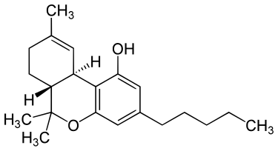
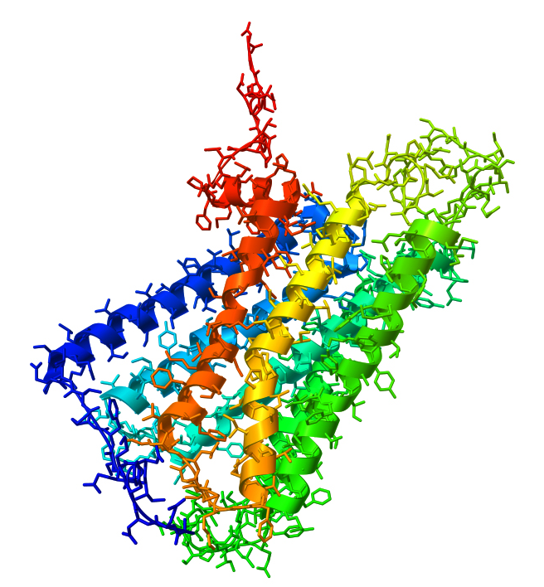
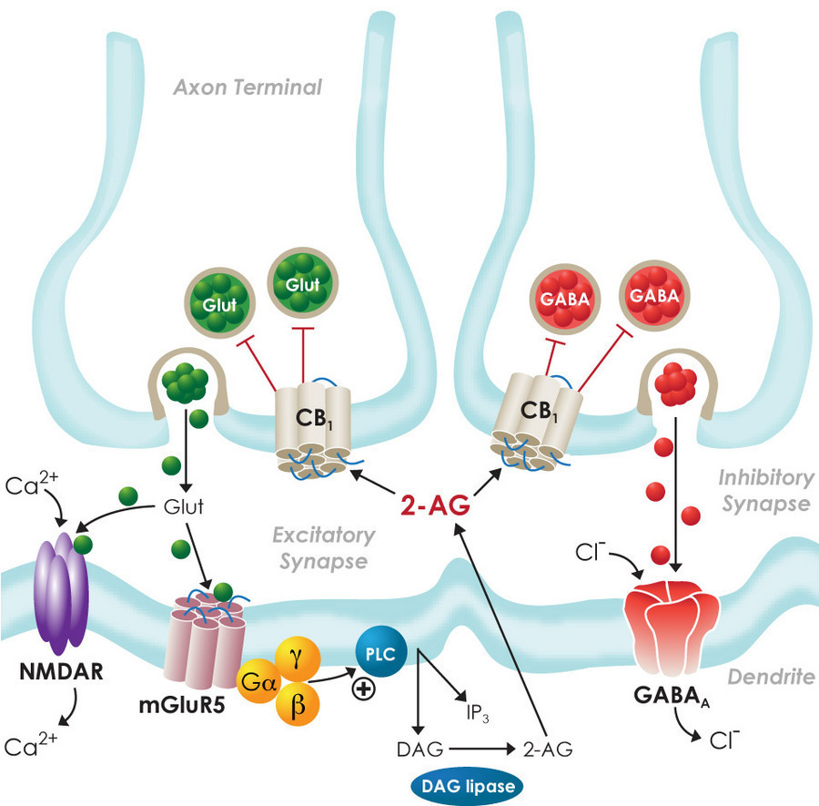
Safety of Cannabis

Slide 3
Safety of Cannabis|Regulation

Slide 4
Safety of Cannabis|Regulation
Greatest safety concern resulting from cannabis use is a substance use disorder, which is as likely as that from alcohol use, however health consequences are less severe.^{1,2}
Based on experiences of countries/states with more liberal cannabis regulations, we know that use prevalence does not change significantly and that use prevalence is generally rather independent from regulations/penalties.^{3,4,5}
1. GCDP (2017). Global Commission on Drug Policy. Report 2017. 4. EMCDDA (2011). Cannabis legislation in Europe: An overview.
2. Nutt DJ et al. (2010). Lancet (2010) 376: 1558-1565. 5. Stevens A (2019). Int J Drug Policy 66: 94-99.
3. Laqueur H et al. (2020). Int J Drug Policy 80: 102748.

Slide 5
Safety of Cannabis|Regulation
Greatest safety concern resulting from cannabis use is a substance use disorder, which is as likely as that from alcohol use, however health consequences are less severe.^{1,2}
Based on experiences of countries/states with more liberal cannabis regulations, we know that use prevalence does not change significantly and that use prevalence is generally rather independent from regulations/penalties.^{3,4,5}
Hence, it comes down to the questions:
Is regulated cannabis safer than unregulated cannabis?
Is less money in the hands of organised crime groups better?
Are evidence-based regulations for driving/working improving justice?
1. GCDP (2017). Global Commission on Drug Policy. Report 2017. 4. EMCDDA (2011). Cannabis legislation in Europe: An overview.
2. Nutt DJ et al. (2010). Lancet (2010) 376: 1558-1565. 5. Stevens A (2019). Int J Drug Policy 66: 94-99.
3. Laqueur H et al. (2020). Int J Drug Policy 80: 102748.

Slide 6
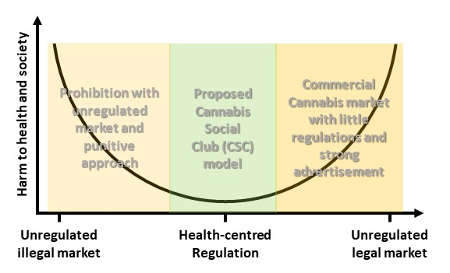
Cannabis and Harm Reduction
„The paradox of prohibition“ adapted from Dr. John Marks (1984)

Slide 7
Cannabis and Harm Reduction
Direct harms:
Criminalisation/stigmatisation
People in need not seeking help
Indirect harms:
Organised Crime (tax loss, violence etc.)
Adulterants/impurities
  Mycotoxins
  Heavy metals
  Synthetic cannabinoids
„The paradox of prohibition“ adapted from Dr. John Marks (1984)

Slide 8
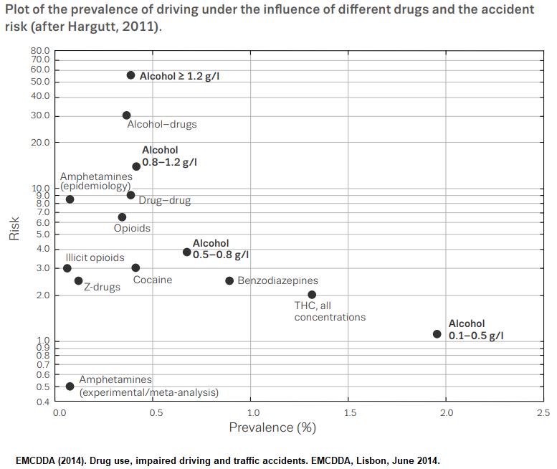
Cannabis and Driving
“(…) amount of THC in blood (…) is not as strongly related to driver impairment as BAC is to alcohol-impaired driving” was a finding in European/Canadian meta-analysis and confirmed by recent Australian study.
EMCDDA & CCSA (2018). Cannabis and driving: Questions and answers for policymaking. Lisbon, May 2018.
Arkell TR et al. (2021). The failings of per se limits to detect cannabis-induced driving impairment: Results from a simulated driving study. Traffic Inj Prev 22(2): 102-107.

Slide 9
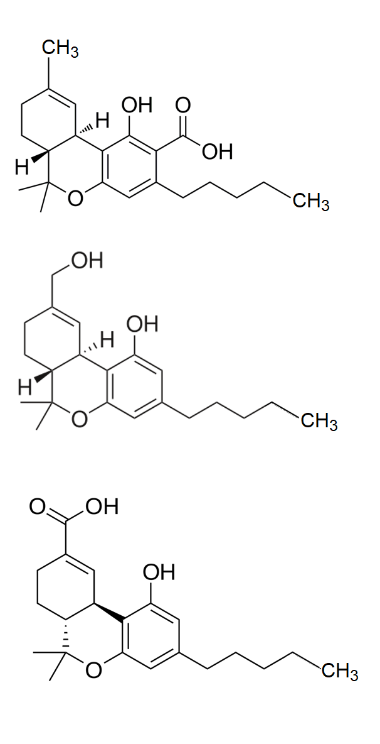
Cannabis and Driving
THCA
Decarboxylation
THC-OH
Metabolic Step 1
Metabolic Step 2
THC
THC or (–)-Δ9-trans-Tetrahydrocannabinol is the main cannabinoid in Cannabis associated with impairment. In edibles the metabolite THC-OH is also considered as impairing.
THC-COOH

Slide 10
Cannabis and Driving
THCA
Decarboxylation
THC-OH
Metabolic Step 1
Metabolic Step 2
THC
THC or (–)-Δ9-trans-Tetrahydrocannabinol is the main cannabinoid in Cannabis associated with impairment. In edibles the metabolite THC-OH is also considered as impairing.
THC-COOH
THC-COOH immunoassays for urine are common practice for roadside/occupational testing, but they can be positive even if last used days/weeks ago.

Slide 11
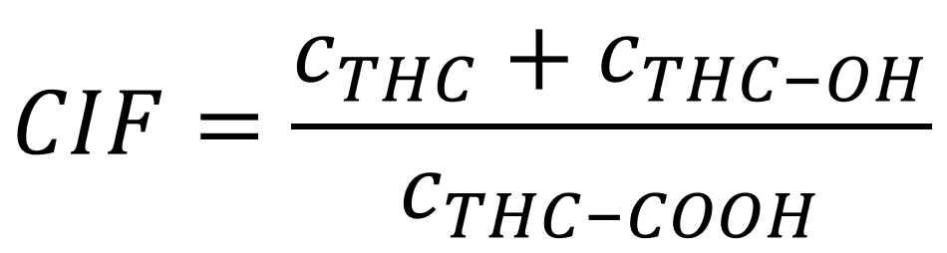
Cannabis and Driving - Suggestions
1) No standard testing at all.
Clinically determined impairment alone shall lead to penalties. Forensic data would only support narratives. This is common practice for many psychoactive substances (e.g. caffeine, nicotine, valerian root, kava-kava, antihistamines) and other factors (e.g. sickness, tiredness, age) potentially impairing driving.
2) Staggered limits, e.g.
3) Research on cannabis influcence factor (CIF) using ratio of molar concentrations.
THC limits (whole blood) | Consequences
< 1.5 ng/mL | Considered sober
1.5 ng/mL < c_{wb} < 5 ng/mL | Considered sober if no clinical symptoms, otherwise impaired
> 5 ng/mL | Considered impaired
Daldrup T & Meininger I (1998). Begutachtung der Fahrtüchtigkeit unter Cannabis im Straßenverkehr. [Buchverf.] Krüger H-P Berghaus G. Cannabis im Straßenverkehr. Stuttgart: Gustav Fischer Verlag, 1998, p.181-202.

Slide 12
Cannabis and Driving - Suggestions
1) No standard testing at all.
Clinically determined impairment alone shall lead to penalties. Forensic data would only support narratives. This is common practice for many psychoactive substances (e.g. caffeine, nicotine, valerian root, kava-kava, antihistamines) and other factors (e.g. sickness, tiredness, age) potentially impairing driving.
2) Staggered limits, e.g.
3) Research on cannabis influcence factor (CIF) using ratio of molar concentrations.
THC limits (whole blood) | Consequences
< 1.5 ng/mL | Considered sober
1.5 ng/mL < c_{wb} < 5 ng/mL | Considered sober if no clinical symptoms, otherwise impaired
> 5 ng/mL | Considered impaired
Daldrup T & Meininger I (1998). Begutachtung der Fahrtüchtigkeit unter Cannabis im Straßenverkehr. [Buchverf.] Krüger H-P Berghaus G. Cannabis im Straßenverkehr. Stuttgart: Gustav Fischer Verlag, 1998, p.181-202.

Slide 13
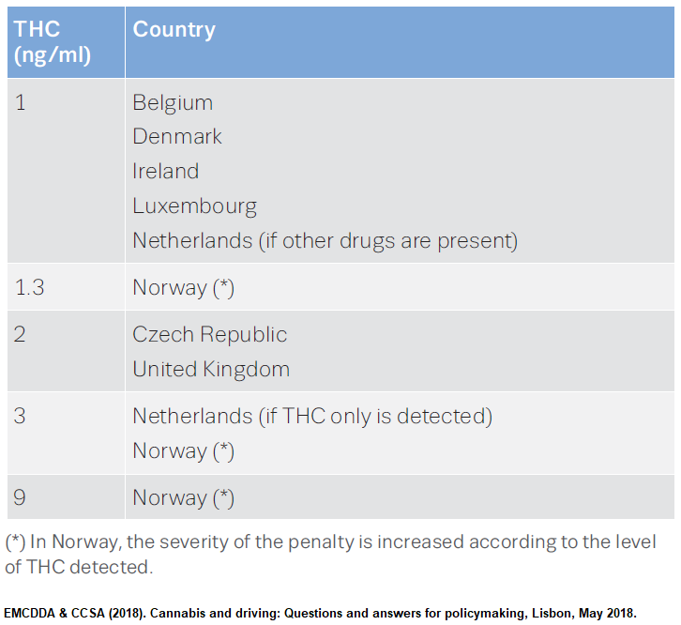
Suitable for becoming new EU standard
Cannabis and Driving - Suggestions
1) No standard testing at all.
Clinically determined impairment alone shall lead to penalties. Forensic data would only support narratives. This is common practice for many psychoactive substances (e.g. caffeine, nicotine, valerian root, kava-kava, antihistamines) and other factors (e.g. sickness, tiredness, age) potentially impairing driving.
2) Staggered limits, e.g.
3) Research on cannabis influcence factor (CIF) using ratio of molar concentrations.
THC limits (whole blood) | Consequences
< 1.5 ng/mL | Considered sober
1.5 ng/mL < c_{wb} < 5 ng/mL | Considered sober if no clinical symptoms, otherwise impaired
> 5 ng/mL | Considered impaired
Daldrup T & Meininger I (1998). Begutachtung der Fahrtüchtigkeit unter Cannabis im Straßenverkehr. [Buchverf.] Krüger H-P Berghaus G. Cannabis im Straßenverkehr. Stuttgart: Gustav Fischer Verlag, 1998, p.181-202.
…and suitable to tackle occupational drug use.

Slide 14
Thank you for your attention

