Slide 1

ME, CFS & FIBROMYALGIA ALLIANCE MALTA

Slide 2
Contents:
Fibromyalgia
Myalgic Encephalomyelitis
Getting a diagnosis
Trial and Error Treatment
Comorbidities- Are they the same?
What is a dis-ability?
Proposals – NGO requests

Slide 3
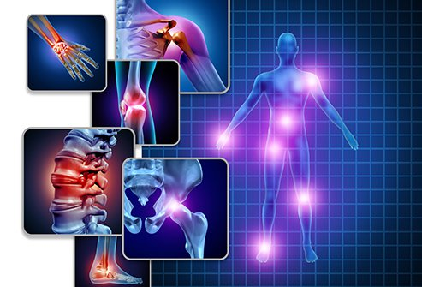
FIBROMYALGIA
MG30.01 Chronic widespread pain (Fibromyalgia)

Slide 4
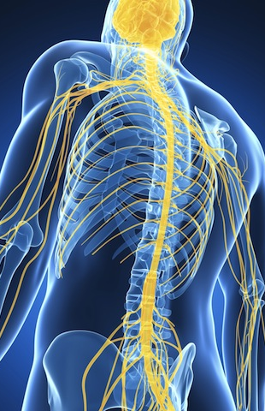
What is fibromyalgia?
Fibromyalgia is a condition characterized by widespread pain
Accompanied by tiredness, sleep, memory lapses, and mood issues.
Symptoms may start after specific events called triggers:
  physical assault
  emotional trauma
  pregnancy
  surgery
  serious illness
  Sometimes, there may be no identifiable trigger.
Fibromyalgia is more common in women than in men.
IMAGINE LIVING WITH ALL THESE SYMPTOMS
EVERY DAY OF YOUR LIFE

Slide 5
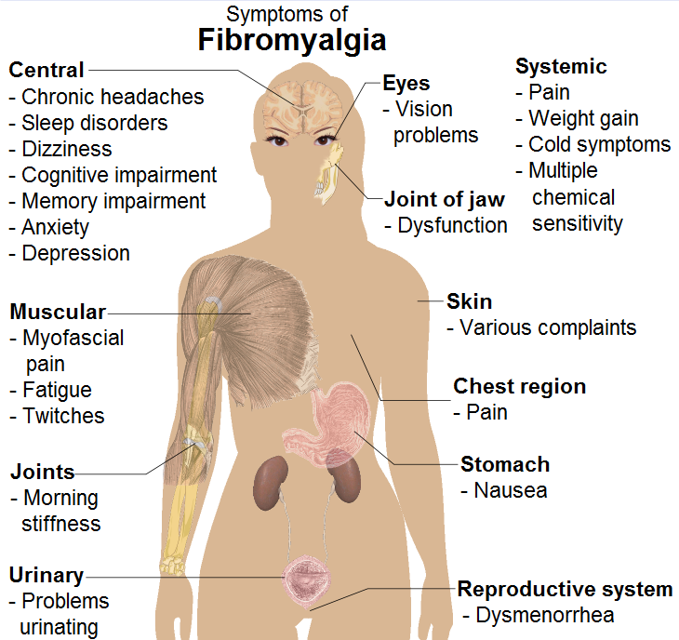
Fibromyalgia Symptoms Summary
EACH SEPARATE SYMPTOM IS DISABLING ON ITS OWN

Slide 6
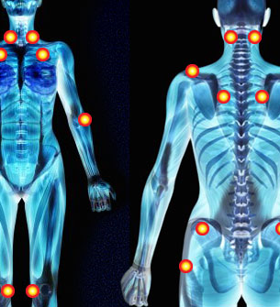
What causes fibromyalgia?
The exact cause of fibromyalgia is unknown
Chemical imbalance in the brain may cause the person to perceive even “touch” or “poke” as pain.
The factors that make you likely for fibromyalgia may include the following:
Genetics
Infections
Physical or emotional trauma
Acute psychological stress
Physical trauma such as an accident.
FIBROMYALGIA CAN HAPPEN TO ANYONE

Slide 7
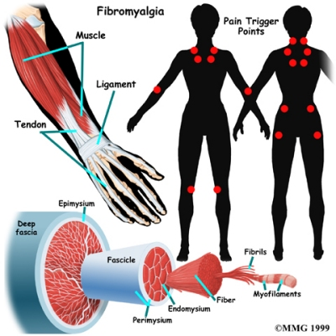
Is Fibromyalgia Real?
Fibromyalgia is very real
No specific diagnostic tests for fibromyalgia,
Misdiagnosis -Similar to other conditions
Risk factors for fibromyalgia are as follows:
Female sex
Family history
Other disorders:
  osteoarthritis
  rheumatoid arthritis
  lupus can increase the risk.
IT’S NOT ALL IN THE HEAD!

Slide 8
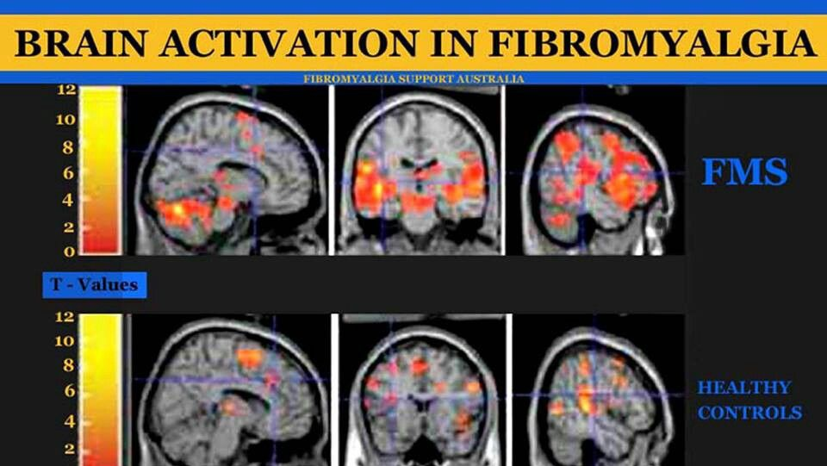
https://fibromyalgiaresources.com/pet-scans-fibromyalgia-patients/

Slide 9
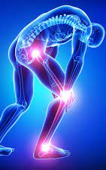
Some statistics: https://disturbmenot.co/fibromyalgia-statistics/
1. 2.7% - 6% of the world’s population has fibromyalgia. This varies form one country to another sometimes even up to 6%.
2. Two-thirds of cases with fibromyalgia are misdiagnosed.
3. Almost 28% of physicians who treat fibromyalgia patients don’t take it as a legitimate disease.
4. 74% of fibromyalgia patients spend more than €100 per month on OTC medications.
5. More than 12 medical visits are made annually by 13% of the entire fibromyalgia population.
6. Fibromyalgia patients have a higher chance of becoming overweight than their healthy counterparts.
7. Fibromyalgia patients are 10 times more likely to commit suicide.
8. 20–36% of patients with migraines also suffer from fibromyalgia.
9. Fibromyalgia can be the underlying cause of non-allergic rhinitis.
10. High levels of the stress hormone cortisol increase chronic pain in women suffering from fibromyalgia.
WITH PROPER PROTOCOLS DIAGNOSING CAN BE EASIER
AND FASTER TO THE BENEFIT OF THE SUFFERER

Slide 10
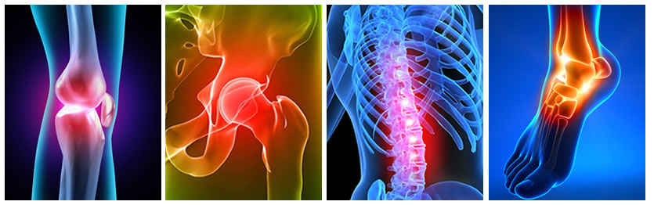
Fibromyalgia Diagnosis
Your doctor must rely solely on your group of symptoms to make a diagnosis.
Physical assessment by the physician for “tender points”
Complete blood analysis to rule out other causes of muscle pain

Slide 11
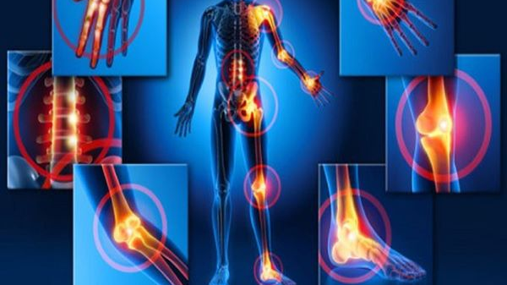
How is fibromyalgia treated?
Treatment options for fibromyalgia are as follows:
Pain killers:
  Over-the-counter pain relievers
  Prescription painkillers can help reduce symptoms.
Antiseizure medication:
Lyrica (pregabalin) used to treat epilepsy
Antidepressants:
  Cymbalta (duloxetine)
  Savella (milnacipran)
  muscle relaxants
CURRENTLY ONLY TWO TYPES OF MEDICATION ARE GIVEN BY THE GOVERNMENT ON POYC

Slide 12
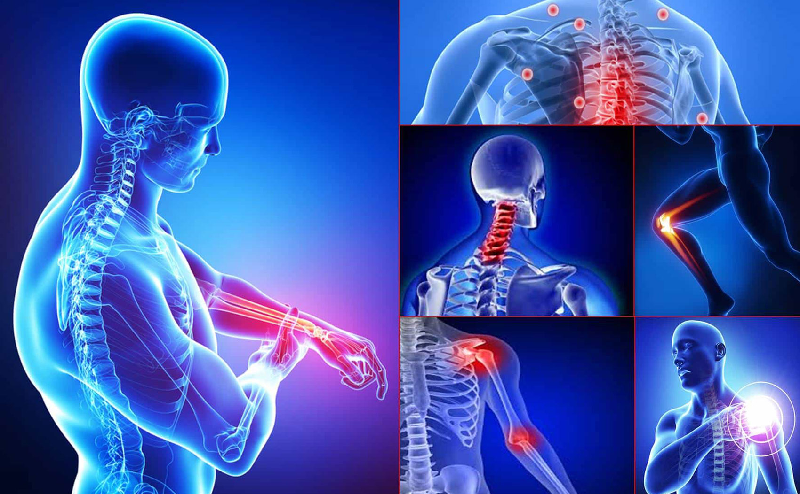
Physical therapy
Hydrotherapy
Occupational therapy
Stress management deep-breathing exercises, yoga pilates meditation
Adequate sleep
ALL THESE TREATMENTS COME AT A GREAT COST FOR THE PATIENT!

Slide 13
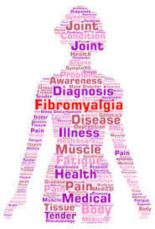
Exercise and Diet
Exercise and diet: Initially, exercise can increase pain, but exercising regularly reduces pain gradually. Exercises may include walking, swimming, biking, water aerobics, yoga, or dance.
A physical therapist can help develop an exercise regimen. Eating a healthy, balanced diet and limiting caffeine intake are important in the management of fibromyalgia.
LIVING A HEALTHY LIFE HAS A COST OF ITS OWN.
MANY SUFFERERS DO NOT WORK AND THEREFORE NEED ASSISTANCE TO KEEP A HEALTHY BALANCED DIET & THERAPY OR EXERCISE REGIME

Slide 14
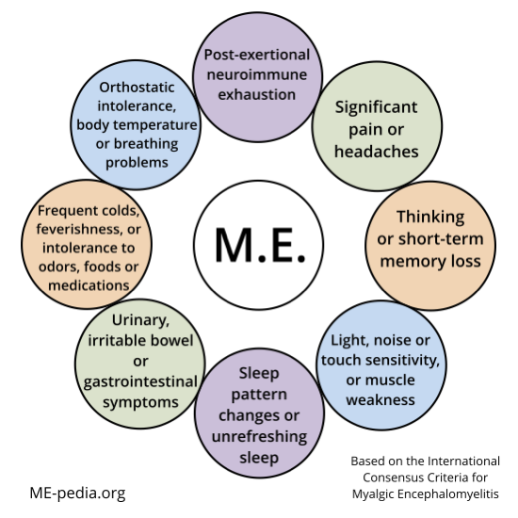
Myalgic Encephalomyelitis
8E49 Post viral fatigue syndrome
(Myalgic Encephalomyelitis )

Slide 15
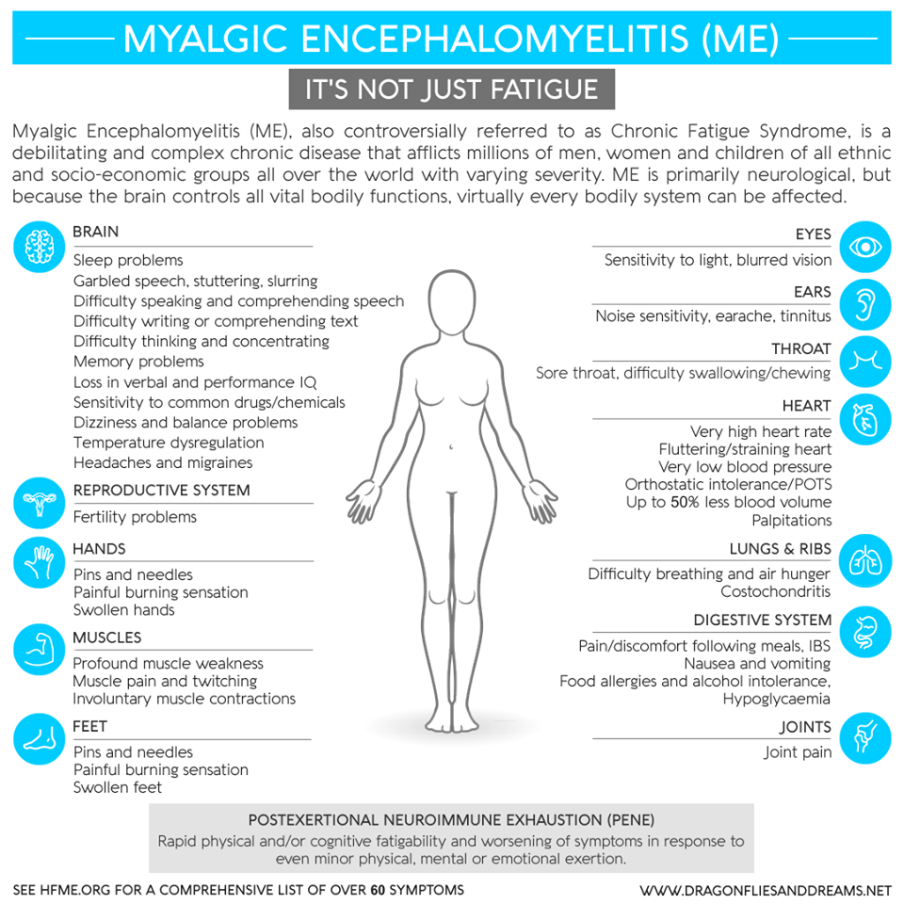

Slide 16
“The diagnosis of ME/CFS should be questioned if patients do not have these symptoms at least half of the time with moderate, substantial, or severe intensity.” https://solvecfs.org/about-the-disease/
Extreme exhaustion, which is made worse by effort (either physical or mental). This symptom, called post exertional malaise (PEM) is unique the ME/CFS.
Non-restorative sleep
Brain fog/cognitive impairment
Joint pain
Inflamed lymph nodes
Persistent sore throat
Severe headache
Neurological abnormalities
Complete organ system shutdown
Sensitivity to light, sound, odours, chemicals, foods, and medications
ALL THE ABOVE SYMPTOMS ARE DISABLING AND REDUCES LIFE’S PERFORMANCE

Slide 17

Myalgic Encephalomyelitis Statistics https://me-pedia.org/wiki/Epidemiology_of_myalgic_encephalomyelitis_and_chronic_fatigue_syndrome
Epidemiology of myalgic encephalomyelitis and chronic fatigue syndrome:
17-24 million people worldwide have ME/CFS.^{[1]}
90% of patients are not diagnosed.^{[5][4]}
The CDC estimates that one million people in the US have ME/CFS
The Institute of Medicine Report estimates: between 836,000 and 2.5 million in the US. ^{[3][4]}
A recent UK biobank study places that estimate at 30 million.^{[2]} In 2015
25% of ME/CFS patients have a very severe form of it.^{[6][7]}
ME/CFS is more prevalent in women than men, can affect children or adults
In 72% of causes: the onset follows an acute infection,^{[12]}
HOW LONG DO WE HAVE TO WAIT TILL RECOGNITION IS APPROVED?

Slide 18
Getting a diagnosis for ME https://www.cdc.gov/me-cfs/healthcare-providers/diagnosis/iom-2015-diagnostic-criteria.html
The 2015 IOM diagnostic criteria for ME/CFS in adults and children states that three symptoms are required:
A substantial reduction or impairment in the ability to engage in pre-illness levels of activity
(occupational, educational, social or personal life)

Slide 19
At least one of the following two additional manifestations must be present:
Cognitive impairment*
Orthostatic intolerance
BOTH COGNITIVE IMPAIREMENT & ORTHOSTATIC INTOLERANCE
ARE DISABLING SYMPTOMS

Slide 20


POST EXERTIONAL MALAISE (PEM)
- worsening of after physical, mental or emotional exertion - puts the patient in relapse that may last days, weeks, or even longer.
- Sensory overload (light and sound) can induce PEM
- The symptoms typically get worse 12 to 48 hours after the activity or exposure
- Unrefreshing sleep

Slide 21
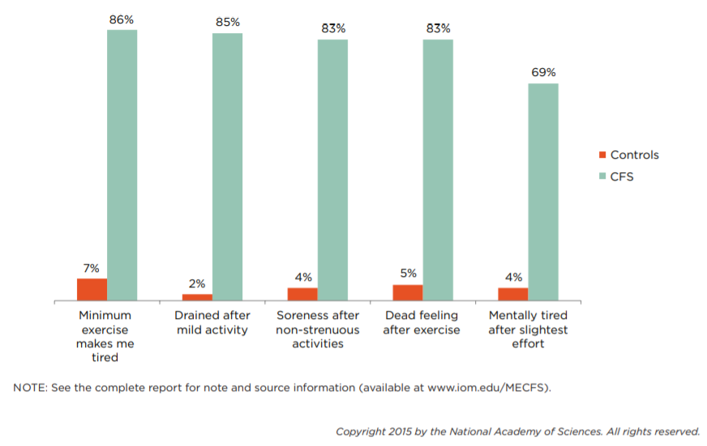
Percentage of ME/CFS patients and healthy controls reporting post-exertional malaise symptoms of at least moderate severity that occurred at least half of the time during the past 6 months.

Slide 22

Most Common Symptoms and how to diagnose https://www.omf.ngo/what-is-mecfs/
Main Diagnostic Symptoms
Post-exertional malaise (PEM) - symptoms worsen after exertion
Reduction or impairment in ability to carry out normal daily activities, accompanied by Profound Fatigue
Unrefreshing sleep
Cognitive Impairment
Orthostatic intolerance (symptoms worsen when sitting or standing upright)
Severe body pain and worsening headaches
Neurological or Cognitive Symptoms
Brain Fog
Confusion & Disorientation
Difficulty concentrating
Short-term memory issues
Ataxia and muscle weakness
Hypersensitivity to noise and light
IMAGINE LIVING WITH MORE THAN 3 OF THE ABOVE SYMPTOMS DAILY

Slide 23
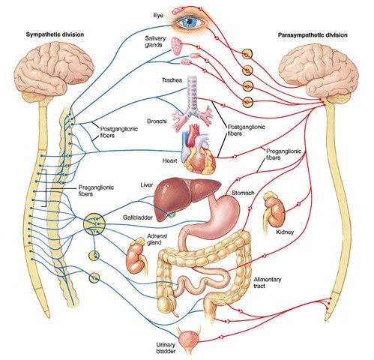
Autonomic, Immune & Digestive Symptoms: How to diagnose
Orthostatic intolerance
Postural Orthostatic Tachycardia Syndrome (POTS)
Dysautonomia
Irregular heartbeat
Increased heart rate on standing
Recurrent flu-like symptoms
Sweating, fever, chills and night sweats
Nausea & Irritable Bowel Syndrome
New sensitivities to food, medication, chemicals
Recurring sore throat
Joint pain without swelling or redness
Tender lymph nodes
Light-headedness
Shortness of breath
Change in body weight
Temperature instability
Change in appetite
HOW CAN THESE SYMPTOMS NOT BE CONSIDERED DISABLING?

Slide 24
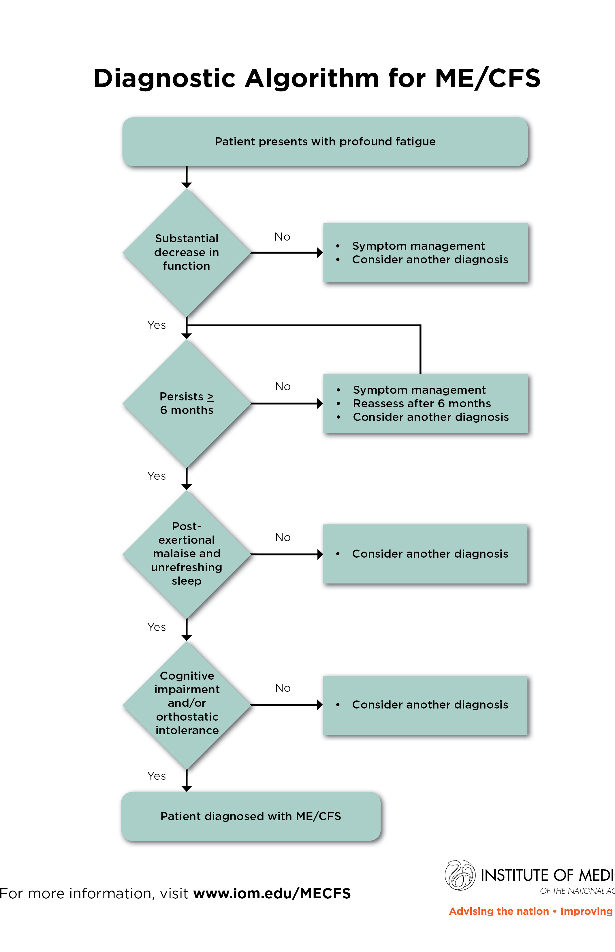
What are the challenges in improving diagnosis and care for ME/CFS?
The cause of ME/CFS remains unknown,
May be triggered by certain infections.
There is no existing cure for ME/CFS.
There is an urgent need for more research to discover what causes ME/CFS,
  understand the mechanisms associated with the development and progression of the disease,
  develop effective diagnostic markers and treatments.
OUR MEDICAL STUDENTS NEED MORE THAN 1 HOUR TO LEARN ABOUT THESE CHRONIC ILLNESSES

Slide 25
Drug Therapies for ME/CFS https://www.stlukes-stl.com/health-content/medicine/33/000035.htm
Antidepressants:
Tricyclics
Selective serotonin reuptake inhibitors (SSRIs)
Anti-anxiety medications (benzodiazepines).
Antihistamines
Relieve allergy like symptoms.
Side effects include drowsiness and headache.
Nonsteroidal anti-inflammatory drugs (NSAIDs). NSAIDs help relieve pain
Acetaminophen (Tylenol).
Another pain reliever. Side effects can include kidney and liver damage when taken in large doses.
Stimulants
Improve fatigue and concentration.
DOCTOR’S VISITS, THERAPIES & MEDICATIONS HAVE A LARGE COST WITH NO COMPENSATION

Slide 26
Alternative Therapies: https://www.prohealth.com/library/evergreen_pages/alternative-treatments-and-complementary-approaches-for-chronic-fatigue-syndrome-myalgic-encephalomyelitis
CFIDS Association of America in 2013 found that:
  70% take nutritional supplements
  employ non-drug therapies such as diet modifications,
  rest, taking naps and activity modification
  50% used alternative therapies such as massage therapy, yoga, acupuncture and meditation
Allergies: Provocation-Neutralization
Pain Relief: Acupressure and Acupuncture, Chiropractic, Massage, TENS, reflexology
Anxiety and Stress Reduction: Biofeedback, Meditation, Hypnosis, Yoga, Visualization and Guided Imagery
Detox Techniques: Perrin Technique, Chelation, Coffee Enemas
Immune Support: Transfer Factor, Live Cell Therapy
Global Support: Hydrotherapy, Hyperbaric oxygen, Ayurveda
ALTERNATIVE THERAPIES COME AT A COSTLY PRICE PER MONTH AS WELL!

Slide 27
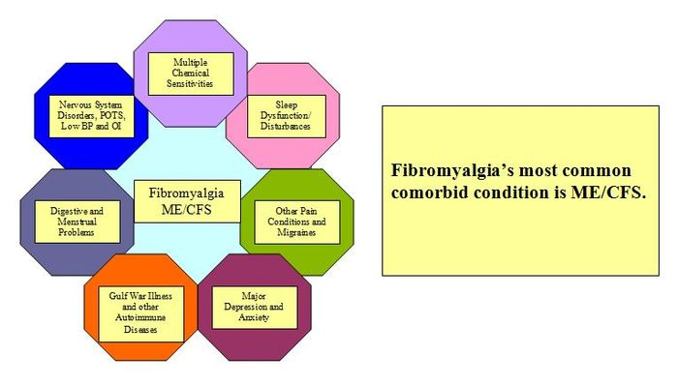

Slide 28
Comorbidities: The Canadian Consensus Criteria recognizes the following comorbidities for ME/CFS: https://me-pedia.org/wiki/Comorbidities_of_Myalgic_Encephalomyelitis
Fibromyalgia,
Myofascial pain syndrome (MPS),
Temporomandibular joint syndrome (TMJ),
Irritable bowel syndrome (IBS),
Interstitial cystitis,
Irritable bladder syndrome,
Raynaud's phenomenon,
Prolapsed mitral valve, depression,
Migraine,
Allergies,
Multiple chemical sensitivities (MCS),
Hashimoto's thyroiditis,
Sicca syndrome (Sjögren's syndrome).^{[2]}

Slide 29
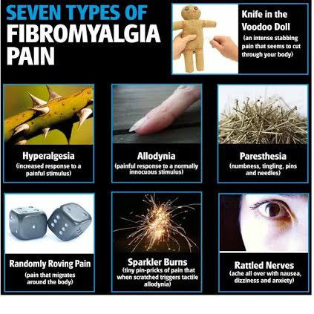
Fibromyalgia & Myalgic Encephalomyelitis are not the same illness?
70% of me patients have *comorbid* fibromyalgia.
Some have fibromyalgia initially but go on to develop ME/CFS later.
They are not, however, the same condition.
Fibromyalgia is dominantly pain, whereas people can have ME/CFS without pain being a dominant symptom.
An infection usually triggers ME/CFS, whereas fibromyalgia is usually related to trauma.

Slide 30

Brain: Fibro (and conditions like depression) show overactivity in certain areas of the brain whereas CFS doesn’t and is dominantly low blood flow. Reduced midbrain and cortical blood flow may be found in both.
Immunity: They have different immune signatures. Flu-like Sore throats and swollen glands are a symptom of ME/CFS but not fibromyalgia.
Nerves. Biopsy of small nerve fibres shows an increased density in fibromyalgia. Small fibre peripheral neuropathy is being investigated in relation to both.
Exercise: ME/CFS is worse from progressive exercise with PEM (brain fog, flu symptoms) with documented aerobic dysfunction which doesn’t improve as it should. Fibromyalgic well-being and endurance will usually improve with the same exercise regime.
Antidepressants: Antidepressants help fibromyalgia. There is no proof of efficacy for ME/CFS.
Depression is shown to worsen pain perception and coping, and catastrophising is an exacerbating factor in fibromyalgia. Depression is also common in ME/CFS but often follows the onset of PEM from pleasurable activities, rather than preceding it.
Substance P, a neurotransmitter responsible for the transmission of pain is elevated in the spinal cord in FM but not CFS
RNaseL, a cellular antiviral enzyme is elevated in CFS but not in FM. This may account for pain vs PEM differences.
Sympathetic dominance is found in ME/CFS, whereas nervous system sensitisation is emphasised in fibromyalgia, though both show disturbed Stage 4 sleep.
Deaths. As to today, no Fibromyalgia relates deaths have been recorded.
FM & ME ARE NOT THE SAME!

Slide 31
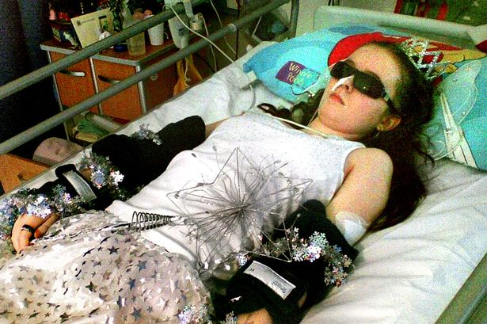
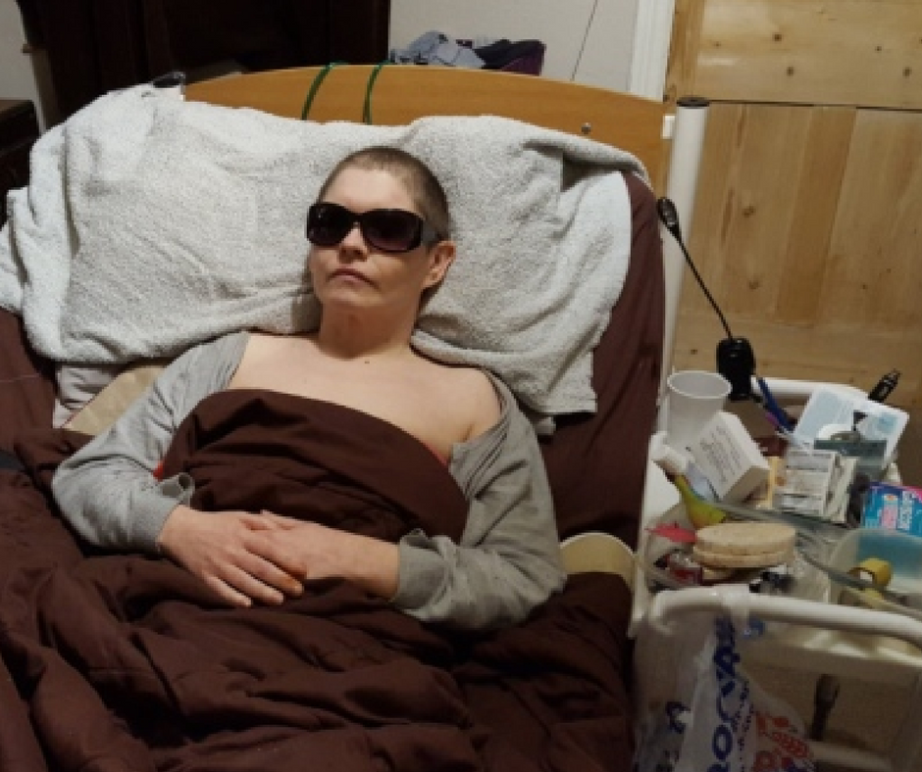
People with Fibromyalgia and ME in Malta are still fighting for their right to be considered as disabled, hence to fall under the social security act, and eventually benefit from invalidity or disability pensions. This is still strictly done on a one to one basis many times with great difficulty and refusal.
THE REALITY OF ME/CFS & SEVERE FIBROMYALGIA
MULTISENSORY HYPERSENSITIVITY

Slide 32

Hope
Training
Human Rights
Survivors

Slide 33

WHO | Disabilities - World Health Organization
An impairment is a problem in body function or structure; an activity limitation is a difficulty encountered by an individual in executing a task or action; while a participation restriction is a problem experienced by an individual in involvement in life situations.
Disability is thus not just a health problem.
Definition of disability discrimination
Disability discrimination is the act of treating someone with a disability less favorably than someone without a disability.

Slide 34
World Report on Disability 2017
More than one billion people in the world live with some form of disability, of whom nearly 200 million experience considerable difficulties in functioning.
In the years ahead, disability will be an even greater concern because its prevalence is on the rise.
This is due to ageing populations and the higher risk of disability in older people as well as the global increase in chronic health conditions
such as fibromyalgia, ME (Myalgic Encephalomyelitis), diabetes, cardiovascular disease, cancer and mental health disorders.

Slide 35

Across the world, people with disabilities have
poorer health outcomes,
lower education achievements,
less economic participation and
higher rates of poverty
than people without disabilities.
People with disabilities experience barriers in accessing services;
health, education, employment,
transport information.
WE TOO FORM PART OF SOCIETY INCLUSION AND EMPATHY IS KEY TO MOVE FORWARD

Slide 36
To achieve the long-lasting, vastly better development prospects that lie at the heart of the 2015 Millennium Development Goals and beyond;
We must empower people living with disabilities and remove the barriers which prevent them participating in their communities; getting a quality education, finding decent work, and having their voices heard.
UNCRPD CLEARLY STATES THAT INNOVATIVE POLICIES AND PROGRAMS MUST BE MADE TO IMPROVE THE LIVES OF PEOPLE WITH DISABILITIES

Slide 37

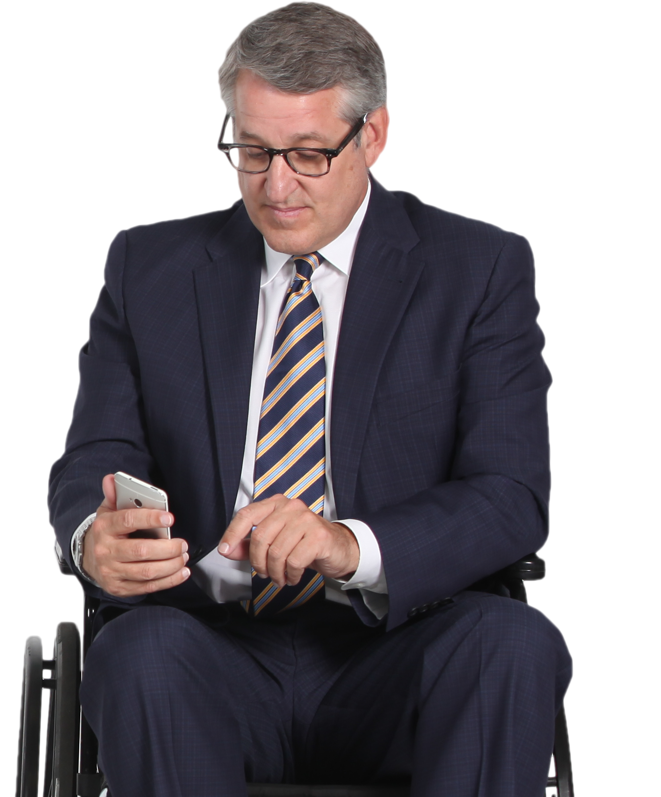
PEOPLE WITH DISABILITIES SHOULD BE CENTRAL TO THESE ENDEAVOURS
The World Report on Disability suggests steps
for all stakeholders – including governments,
civil society organizations and
disabled people’s organizations –
> to create enabling environments,
> develop rehabilitation and support services,
> ensure adequate social protection,
> create inclusive policies and programs,
> enforce new and existing standards and legislation, to the benefit of people with disabilities and the wider community.

Slide 38
The Preamble to the CRPD acknowledges that disability is “an evolving concept”,
but also stresses that
“disability results from the interaction between persons with impairments and attitudinal and environmental barriers that hinder their full and effective participation in society on an equal basis with others”.
NOT ALL DISABILITIES ARE VISIBLE!

Slide 39

Invisible Disability definition:
https://www.umass.edu/studentlife/sites/default/files/documents/pdf/Invisible%20Disabilities%20List%20%26%20Information.pdf
It is a physical, mental or neurological condition that limits a person’s movements, senses, or activities that is invisible to the onlooker.
Invisible disabilities lead to:
misunderstandings,
false perceptions
judgments.
THIS IS THE SAME PERSON ON DIFFERENT DAYS

Slide 40
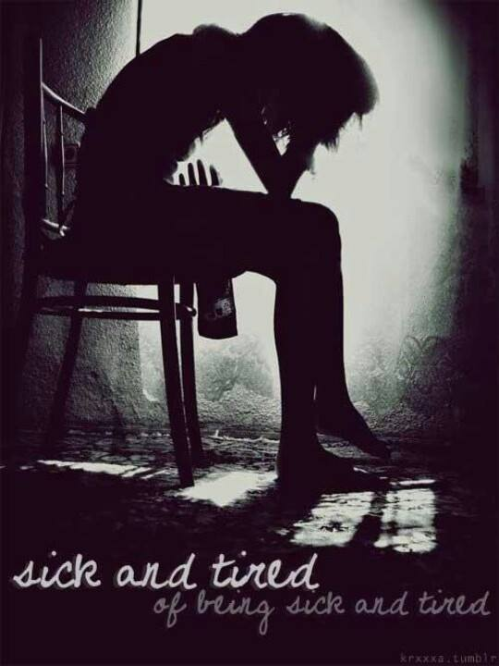
Challenges we need to face
We have difficulty to walk long distances
We need Blue Badge Parking ID
We have difficulty standing in queues
Ability to work from home
Financial help for medicines
We need home help
We need disability – invalidity pension

Slide 41

Physical -Emotional - Spiritual - Financial Traumas
How the body manifests in stressful situations:
Emotional stress increases the pain and brings on a flare up.
Sufferers are misjudged, misunderstood by their family and friends
  They are called lazy and attention seekers.
  Doctors are not always as considerate and understanding
  You start feeling alone in your own world of pain and fatigue
  They wish they can work but their health will not allow it
  We rely on doctors to provide us with a diagnosis and a solution to our pain.
  .Current allowances are means tested
  POYC does not cover all medications
WE NEED FINANCIAL / MEDICAL HELP
TO TRY AND LIVE “NORMALLY”

Slide 42

Persons with invisible disabilities who work are often judged by others as cheaters of the system
Those persons men and women who cannot afford not to work as their families depend on them, must ignore their ill health and continue to work. Obstacles at work are:
Commuting
Misunderstanding
Total mental & Physical exhaustion
Imposter Syndrome
Criminal
Shame
Cheater
Blame
Many people with a disability or illness are made to fight for any real support leaving them with feelings of doubt questioning if they really deserve the accommodations in the first place.

Slide 43

Invisible Disability
is not immediately apparent or obvious
“types of disability” are defined using only one aspect of disability, such as impairments – sensory, physical, mental, intellectual – and at other times they conflate health conditions with disability.
People with chronic health conditions, communication difficulties, and other impairments may not be included as disabled despite encountering difficulties in everyday life.
ALTHOUGH SOME STILL MANAGE TO WORK IT IS WITH GREAT DIFFICULTY

Slide 44


What can be done to aid those who want to work?
COMPLIMENTARY BENEFITS
BENEFITS
Provide monetary refund against receipts of supplements needed to maintain a healthy balance life
Occupational therapy to help with coping skills
Encourage a healthy diet
Encourage therapy sessions like Hydropool, acupuncture, Oxygen Tank Therapy,
Use of Medical Cannabis for free
Provide Home help
Provide all the medications prescribed by consultant on POYC Scheme
Improve the sickness benefits
Improve the Sick days scheme
Allowing work from home
Government to pay Stamps for employee as well as for employer when employed as disabled
Reduce bureaucracy when applying for the Blue Badge

Slide 45

What can be done to aid those who do not work?
BENEFITS
COMPLIMENTARY BENEFITS
Provide all the medications prescribed by consultant on POYC Scheme
Allowing work from home
Government to pay Stamps for employee as well as for employer when employed as disabled
Reduce bureaucracy when applying for the Blue Badge
Provide monetary refund against receipts of supplements needed to maintain a healthy balance life
Occupational therapy to help with coping skills
Encourage a healthy diet
Encourage therapy sessions like hydropool, acupuncture, Oxygen Tank Therapy,
Use of Medical Cannabis for free
Provide Home help

Slide 46

What can we do to aid those children/youths who are still studying?
BENEFITS
COMPLIMENTARY BENEFITS
Provide parents/carer with extra days off work to aid their sick child
Allow parent/carer to work from home
Allow more sick days from school/home schooling when necessary
Availability of online lessons
Allow for extra time in assignments
Exams not written but in verbal or on computer
Allow use of lift at school premises
Awareness at schools for inclusions
Provide monetary refund against receipts of supplements needed to maintain a healthy balance life
Encourage a healthy diet
Provide Home help
Occupational therapy to help with coping skills

Slide 47
We are not asking for the world but for our basic human rights!
RECOGNITION AS A DISABILITY
SOCIAL INCLUSION & BENEFITS

Slide 48
Bibliographies
https://www.medicinenet.com/the_most_severe_symptoms_of_fibromyalgia/article.htm
https://disturbmenot.co/fibromyalgia-statistics/
https://me-pedia.org/wiki/Epidemiology_of_myalgic_encephalomyelitis_and_chronic_fatigue_syndrome
https://www.cdc.gov/me-cfs/healthcare-providers/diagnosis/iom-2015-diagnostic-criteria.html
https://www.omf.ngo/what-is-mecfs/
https://www.stlukes-stl.com/health-content/medicine/33/000035.htm
https://www.prohealth.com/library/evergreen_pages/alternative-treatments-and-complementary-approaches-for-chronic-fatigue-syndrome-myalgic-encephalomyelitis
https://me-pedia.org/wiki/Comorbidities_of_Myalgic_Encephalomyelitis
https://www.ncbi.nlm.nih.gov/pmc/articles/PMC3527744/
http://uis.unesco.org/en/glossary-term/disabilities
https://www.equalityhumanrights.com/en/advice-and-guidance/disability-discrimination
https://www.who.int/disabilities/world_report/2011/report.pdf
https://www.umass.edu/studentlife/sites/default/files/documents/pdf/Invisible%20Disabilities%20List%20%26%20Information.pdf

Slide 49
Further Reading:
ME and FM proposal 2019 (1).pdf
ME-FM Canadian Disadvantage I
Fibromyalgia-Clinical-review2021.pdf nfo2021.pdf
Fibromyalgia and Related conditions.pdf
Canadian Consensus Criteria for ME.pdf
International Consensus Primer for Medical Pratitioners.pdf
-

