Slide 1


Slide 2

Timeline
2020
2002
2007
2018
Learning and Development Unit estabilished
1770 Helpline available 24/7
Moved to new Head Offices in Qormi
Home Support Service
Later renamed to Community Support Services
Offices estabilished in Santa Venera
Launched Youth Mental Health First Aid
Certified as training centre
KIDs in Development programme estabilished
2016
1993
1999
Setting up of Richmond Foundation
Supportive Housing Scheme
Attard Hostel opened
1996
2001
2006
2015
2017
2019
Supported Employment Programme estabilished
Opened Qormi Hostel
Launched Mental Health First Aid
Villa Chelsea Rehabilitation Programme
Floriana Hostel
Later moved to Paola Hostel
Psychological Support Services estabilished
Mosta Hostel and
Kappara Hostel opened
Certified as CPI training provider
Brief Intervention Support
Estabilished
Staff and Organisation Support Programme
launched

Slide 3
Organisational Structure
7
31
95
120
144
group residences
apartments
corporate clients
EMPLOYEE ASSISTANCE PROGRAMME
employees
residents
4500
€3 million
Individuals supported
c.a. costs per annum

Slide 4
RESIDENTIAL SERVICES
All licensed Mental Health Facilities
Notes:
Residential Services: All licensed as mental health facilities

Slide 5
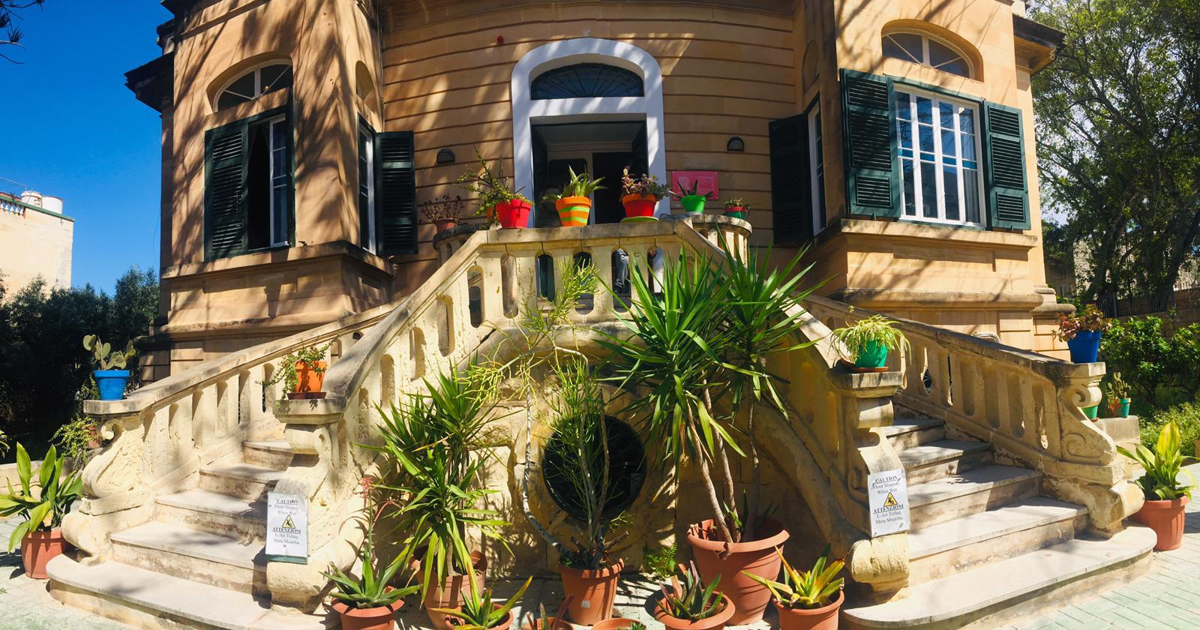
REHABILITATION
Residential l Day Care l Respite
A one-year programme, providing a therapeutic and supportive environment to our service users as well as hands-on support that is related to the activities of daily living.
Notes:
Ministeru għas-Solidarjetà u l-Ġustizzja Soċjali, il-Familja u d-Drittijiet tat-Tfal

Slide 6
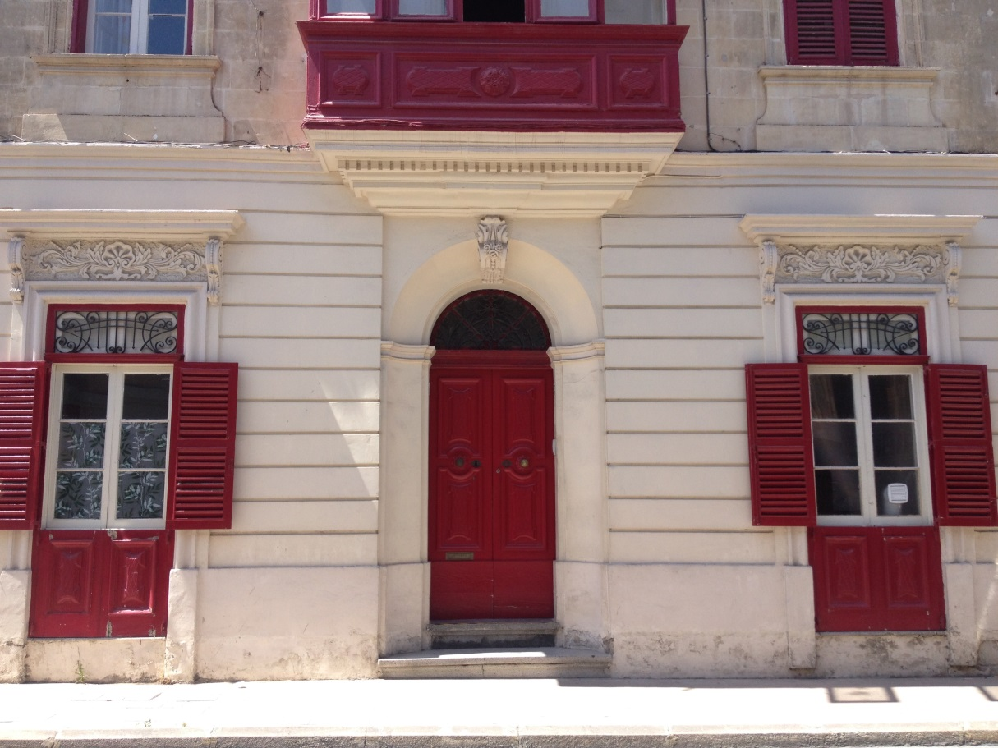

ASSISTED LIVING
Long-term l 24/7 staff support
Individuals who previously resided at Mount Carmel Hospital provided with accommodation and professional support to lead a good quality of life in the community.

Slide 7
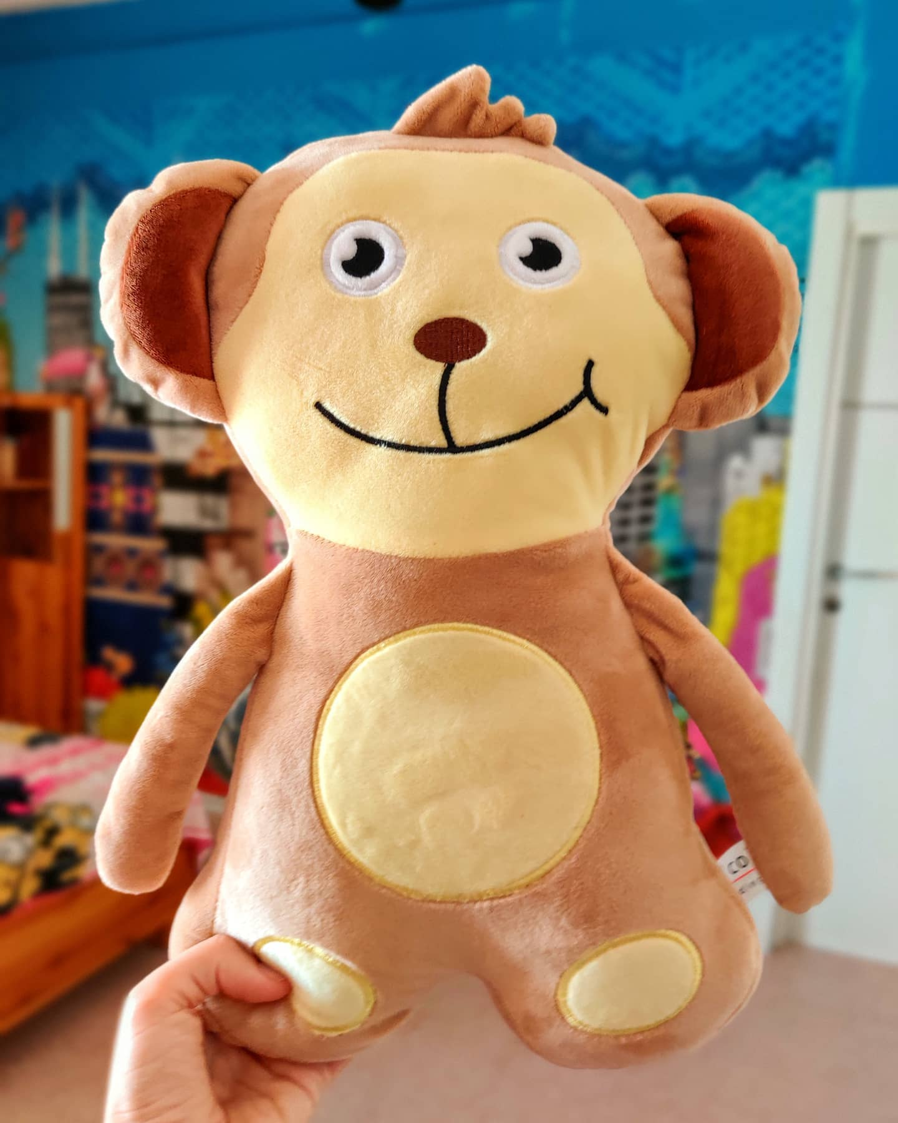
KIDs IN DEVELOPMENT
Residential l 3-year programme
Tailored for children aged 7 – 13, who experience severe emotional difficulties and challenging behaviour.
The focus is on developing healthy attachments and a sense of self-worth in a safe environment.
Notes:
Ministeru għas-Solidarjetà u l-Ġustizzja Soċjali, il-Familja u d-Drittijiet tat-Tfal

Slide 8

COMMUNITY SUPPORT
SERVICES
Housing l Therapeutic Support
Supporting more than 140 individuals with mental health problems and their carers in the comfort of their own home.

Slide 9

LEARNING & DEVELOPMENT
Training l Support l Consultation
Offering a variety of services to corporate entities to enhance employee wellbeing.

Slide 10
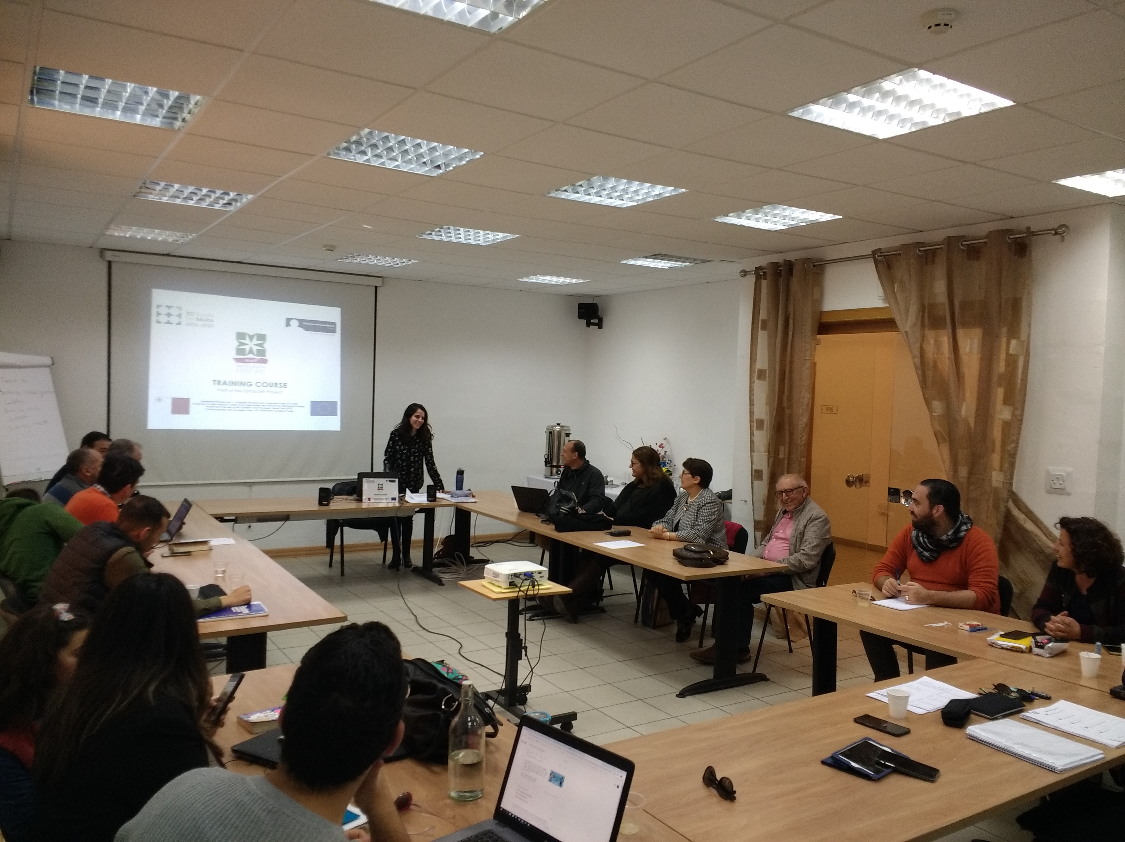
MENTAL HEALTH FIRST AID
NEW
Standard l Youth l Teen l Blended
Learning knowledge and skills required to support individuals facing mental health challenges and crises.
Topics include depression, anxiety, suicide and self-harm.

Slide 11

PSYCHOLOGICAL SUPPORT
Helpline l Brief Intervention l Therapy
Qualified psychologists, counsellors and psychotherapists offering psychological support to individuals, couples and families.
Offering paid, subsidised and free therapy.
Providing psychotherapy sessions to employees of corporate entities.

Slide 12

1770 HELPLINE
Freephone l Available 24/7
Providing emotional and psychological support to the general public.
The helpline is the country’s national support line for mental wellbeing during COVID-19.

Slide 13
Mental Health during COVID-19: 2020
Comparing data to 2019
400%
280%
increase in calls to our helpline
increase in follow-ups
Richmond received more than 3600 calls throughout the year, with more people requiring urgent support.

Slide 14
Mental Health during COVID-19: 2020
4289 hours
800
of therapy provided
clients were provided with psychotherapy
Notes:
This was despite a dip in March and April when people were adjusting to online therapy.

Slide 15
Current Challenges
Upcoming projects
Dar Tereża
A three-year residential programme for mothers with mental health
problems and their children
Alternative premises for KIDs
Finding alternative accommodation whilst carrying out works on current
premises

Slide 16
Future Challenges
Completing new premises for KIDs
Setting up of Residential Programme for Youth
Early Intervention Service for young people
Increase of Independent Living Capabilities

Slide 17
Thank you.

