Slide 1

N. Xerri
28/04/2021

Slide 2
Mission Statement
The OASI Foundation promises a commitment to assist people in their continuous life-long education to enhance their self awareness, mature growth and happy life, to accompany them in personal distress from desperation into hope and eventually to treat and lead those with the disease of addiction or alcoholism towards a recovery touched with a serene future.

Slide 3
OASI Foundation
Founded 26th June 1991 (World Day against Drug Abuse and Trafficking)
NGO
Autonomous
Prevention, Intervention and Treatment & Rehabilitation
Full-Time | Part-Time | Volunteers
12 | 15 | 55

Slide 4
Social Awareness (Prevention)
We believe prevention is better than cure!
We seeks to enhance in people self awareness and self respect, to proudly identify themselves with measures which will improve their health, and consequently to reject those actions that will have adverse effects on their life.
Mainly the primary prevention unit gives its teaching through edutainment (entertainment combined with education).
1 Full-timer & 1 Part-Timer

Slide 5
Social Awareness (Cont)
Our action plan targets:
Families
Schools
Workplaces
Youths
Media

Slide 6
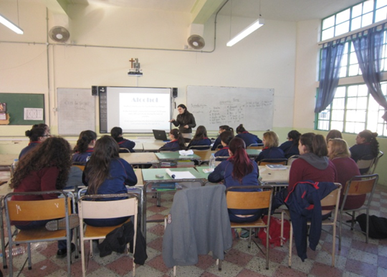
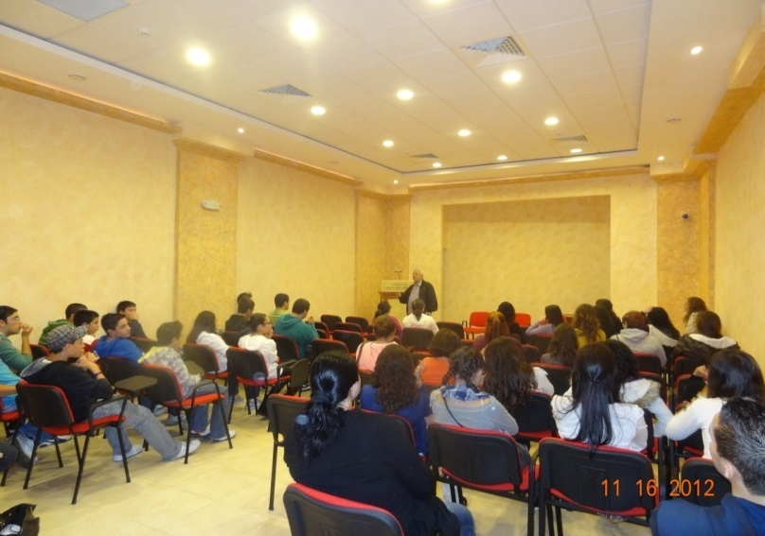
Schools Awareness
Parents sessions and talks are organized in collaboration with parishes and local councils.
Various sessions are held in different localities around Gozo with youths such as in schools.
All schools in Gozo are targeted and different subjects are discussed according to the age (but stopped from Secondary Schools in 2015)
Year 1 - Ghandi habib
Year 2 - L-effetti tat-teknologija
Year 3 - Il-Hbiberija u t-teknologija
Year 4 - Il-Pressjoni mill-Hbieb u l-effetti tat-teknologija
Year 5 - Time Management
Year 6 – Dependence – Sugar, Caffeine, Nicotine, Alcohol.

Slide 7
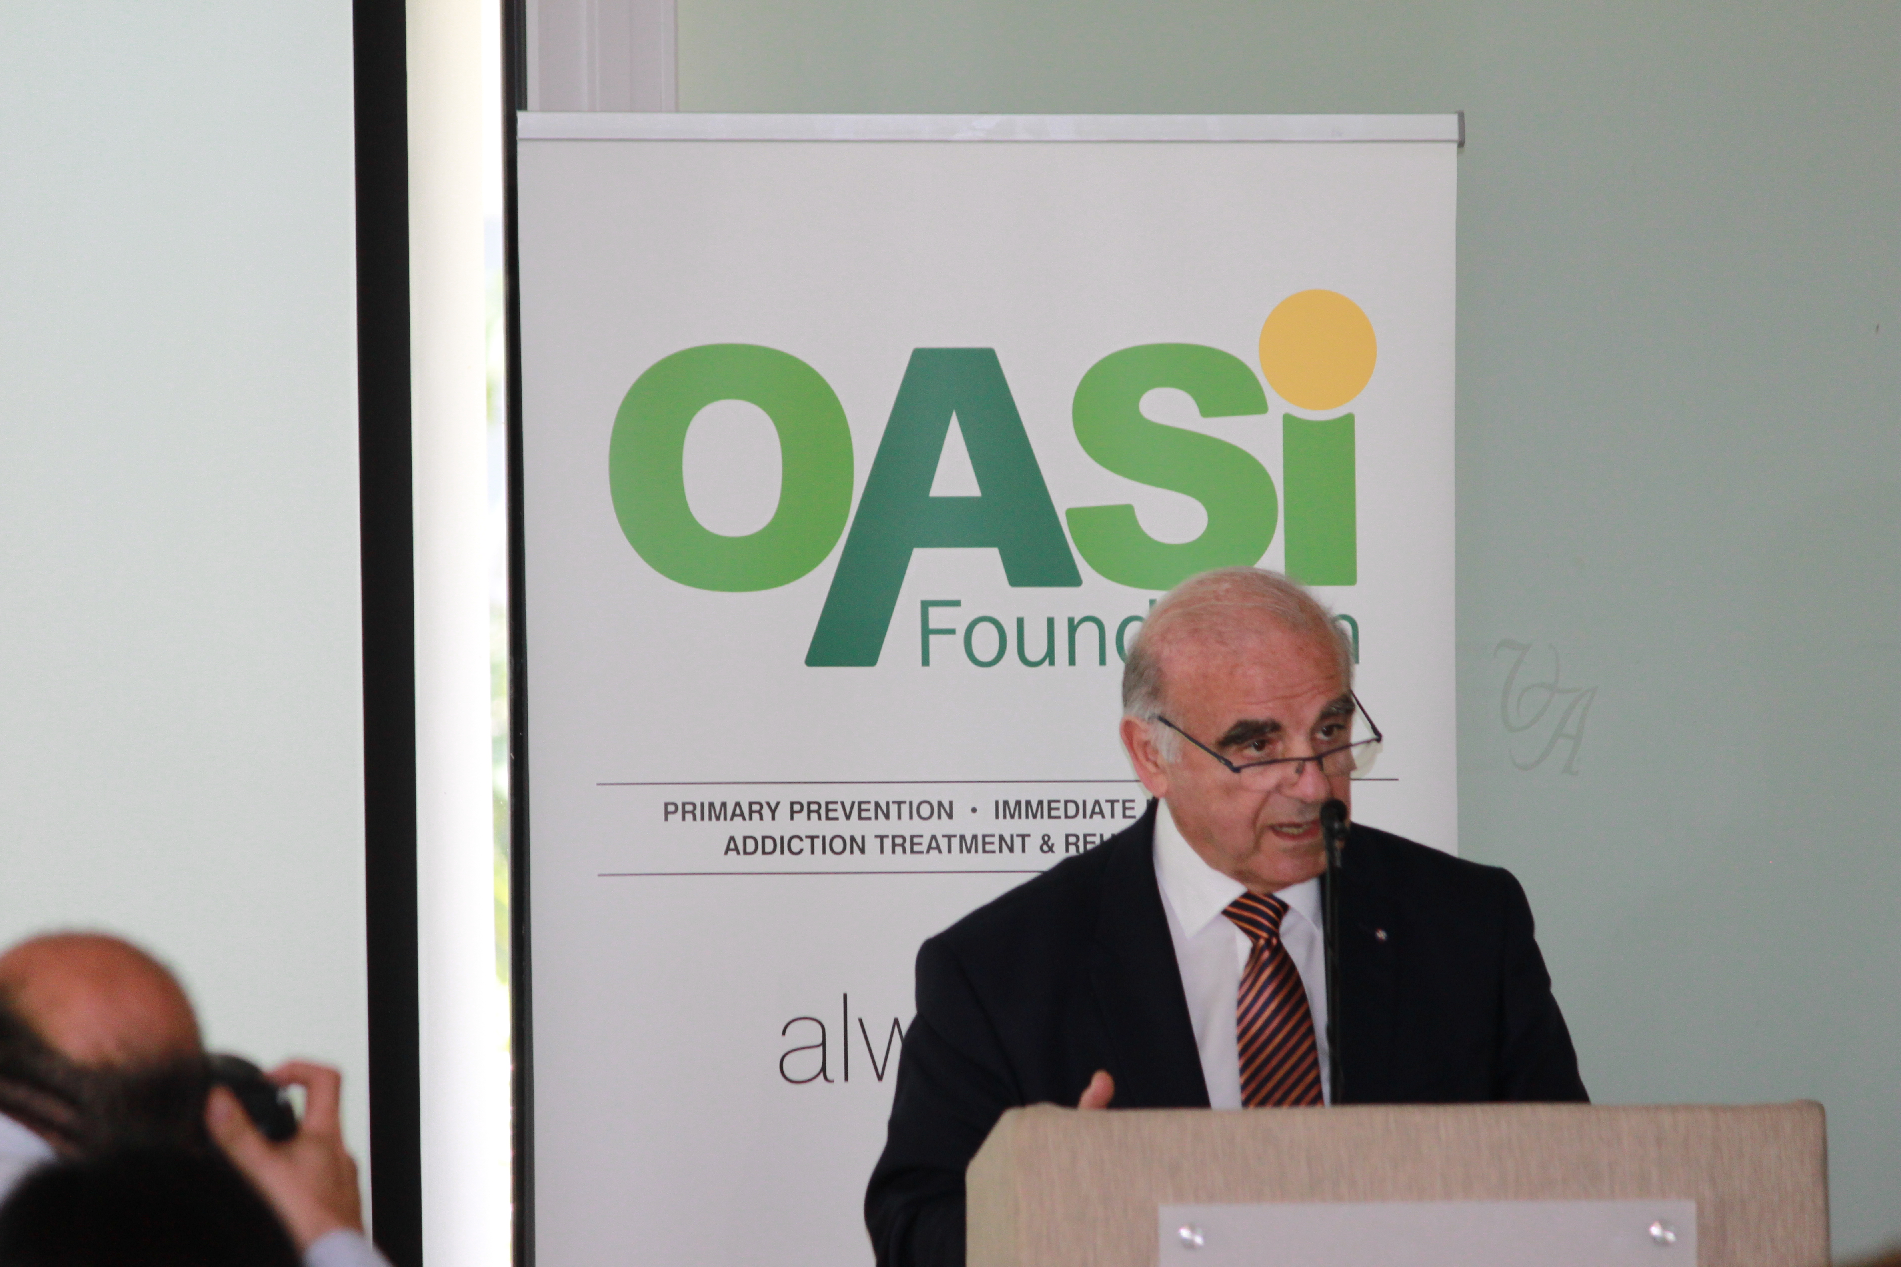
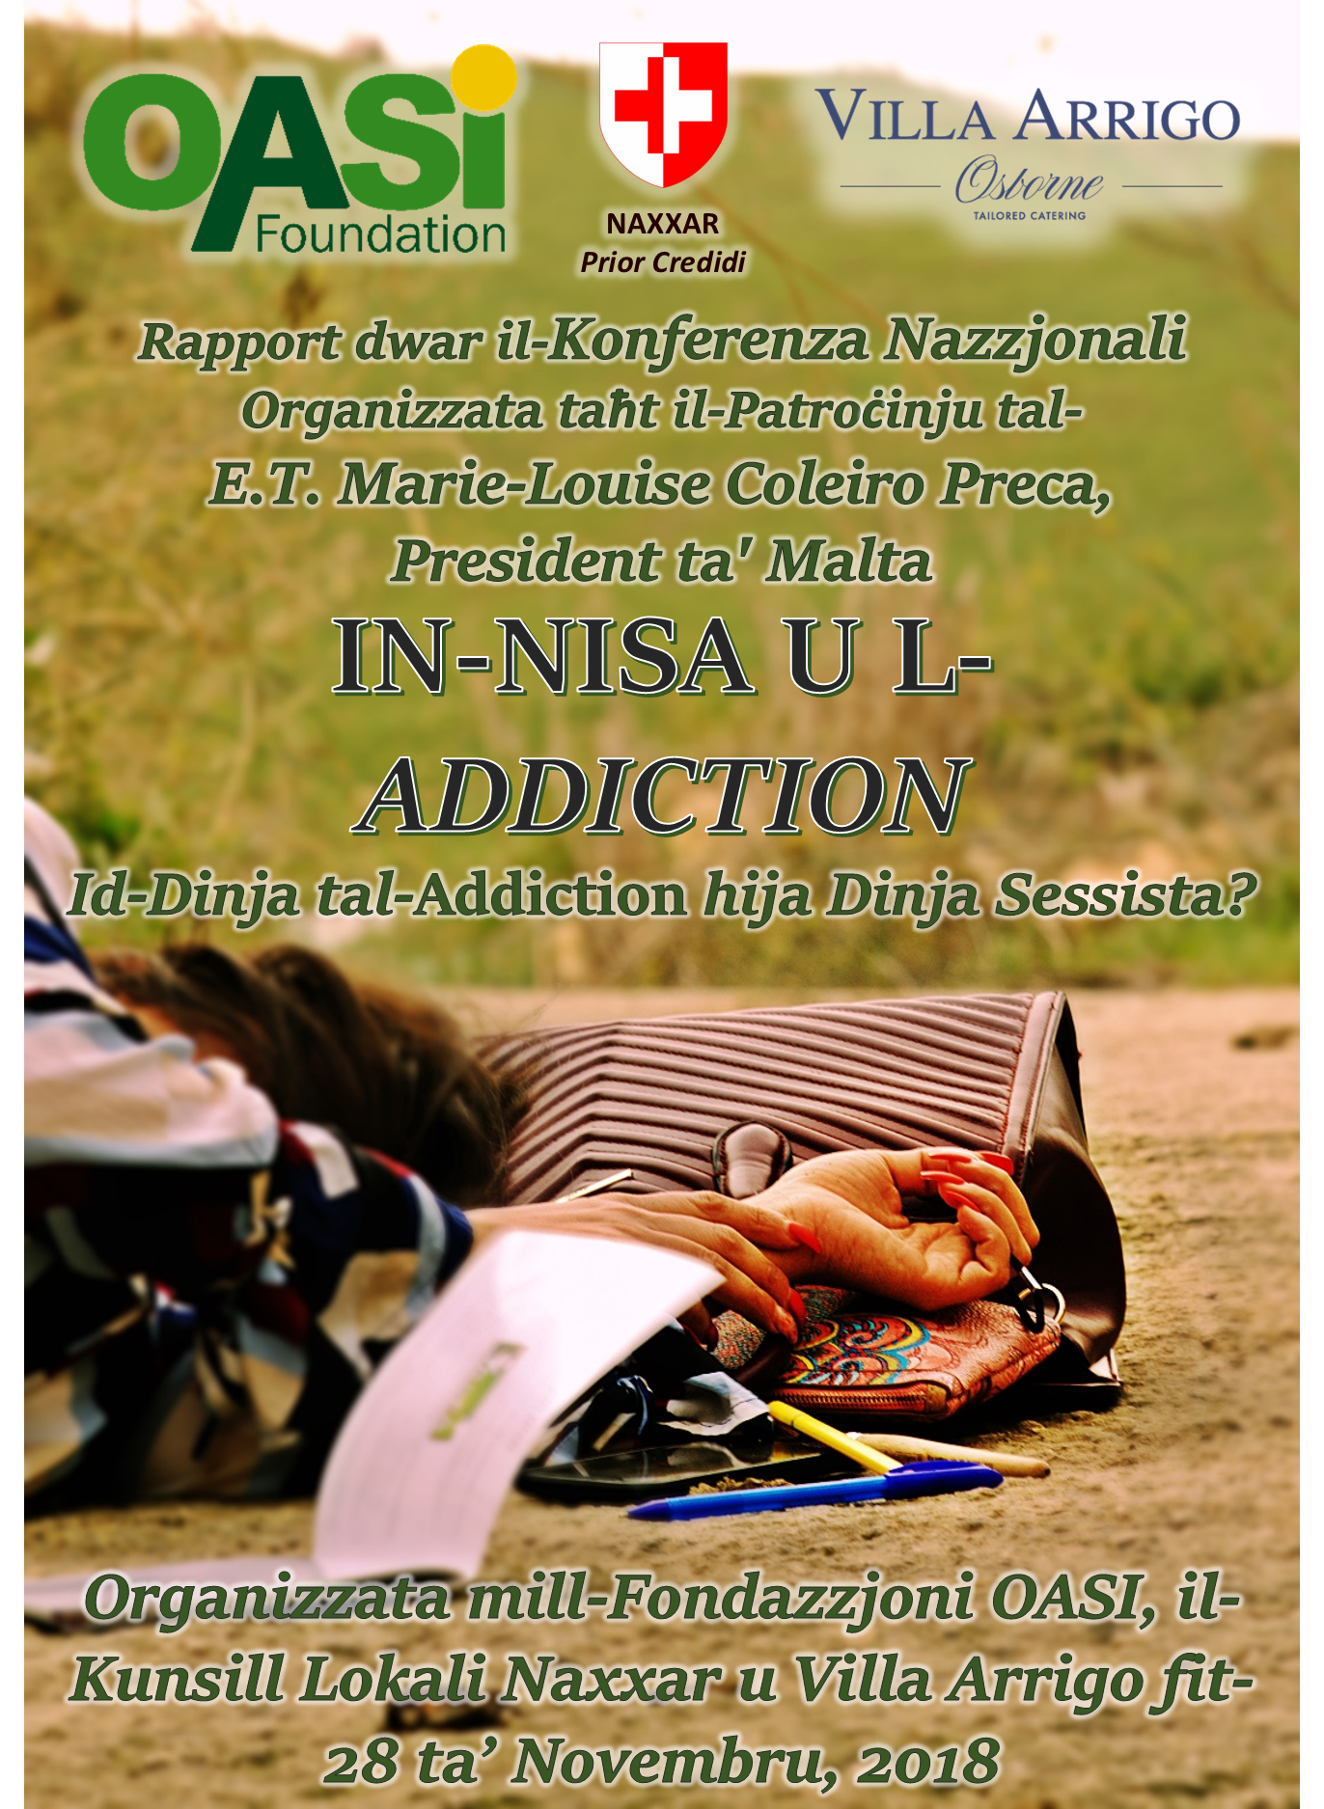
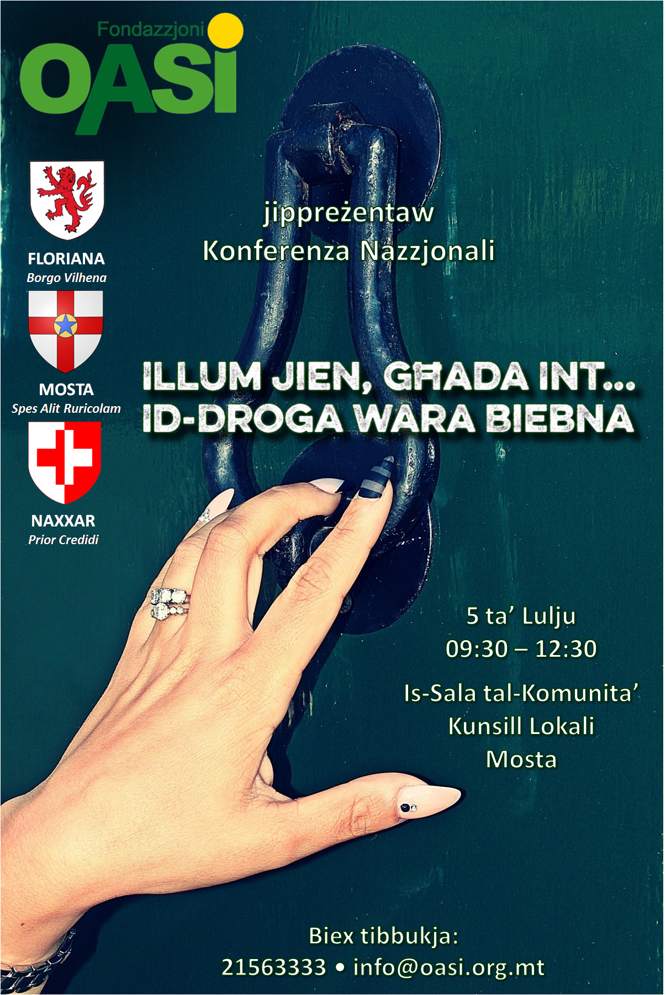
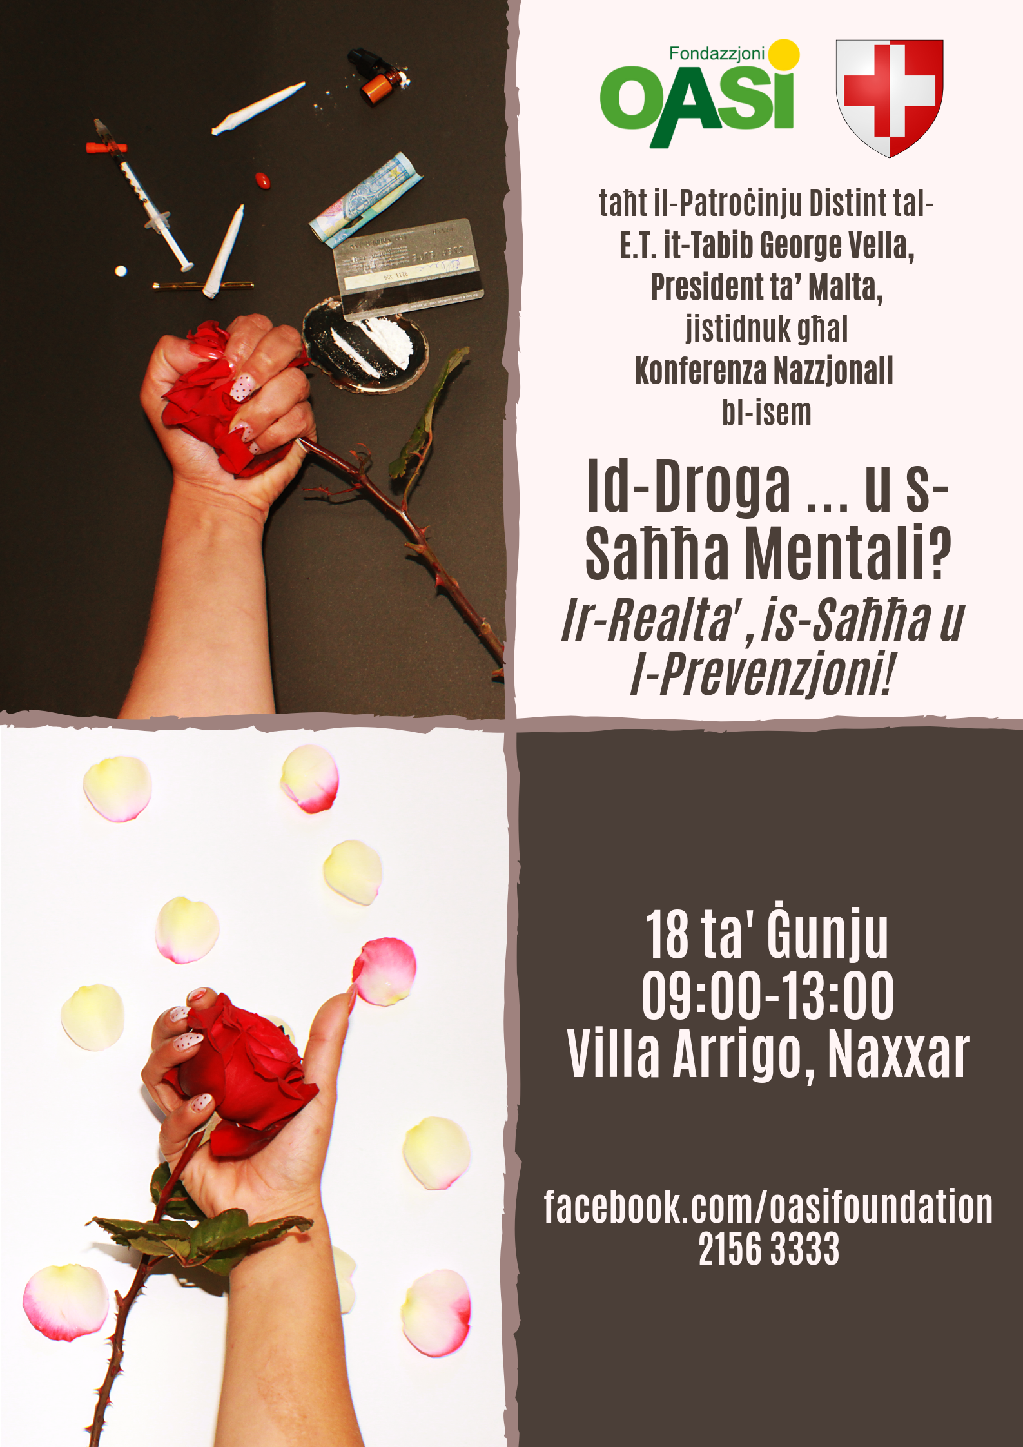
Conferences
WE COME UP WITH A NEW AND CURRENT TITLE FOR A CONFERENCE annually.
Invite professionals.
Create a debate – the idea is to increase awareness and consequently
make a change!
2016 – Drugs reform law – one year after
2017 – Illum Jien Ghada Int … Id-Droga Wara Biebna
2018 – Addiction and Women – Is the World of Addiction a Sexist One?
2019 - Drugs...and Mental Health? Reality, Health and Prevention.

Slide 8
Media
Media is a good source to divulge teaching and awareness. The OASI Foundation tries to appear on local media as frequently as possible.
Radio Stations
T.V.
Newspapers
Internet: Website, Facebook, Instagram

Slide 9

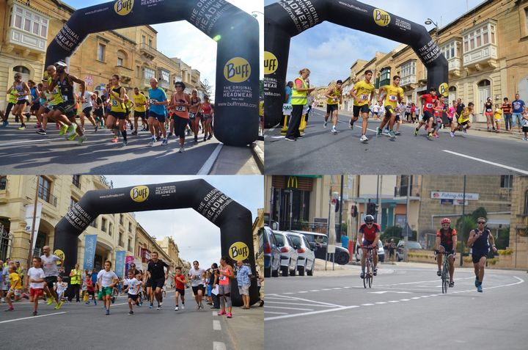
OASI CUP RUN
A run and a walk for various ages with the aim to promote exercise and include it in our lives.
We believe that sports in general has the ability to deter addictions.

Slide 10

Aqua Fun Day
New activity happening for the first time on the 30th of June.
Idea is to make use of the sea around us as a means of substance prevention.
Various activities such as keeping fit, water polo, chess games, sailing, water races.

Slide 11
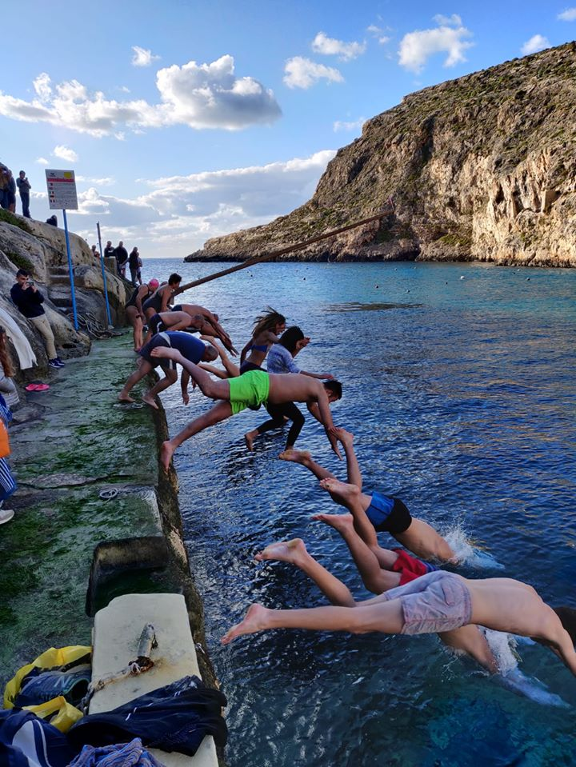
Jump for Life
Greasy pole (Gostra) competition and a jump in the sea in December.
A sign of support and encouragement to those who need to make that jump to improve their life by asking for help regarding their substance abuse – hence the name of the activity – Jump for Life.
This activity also serves to promote water sports – an effective preventive means of staying away from substance abuse and addictive behaviours.

Slide 12
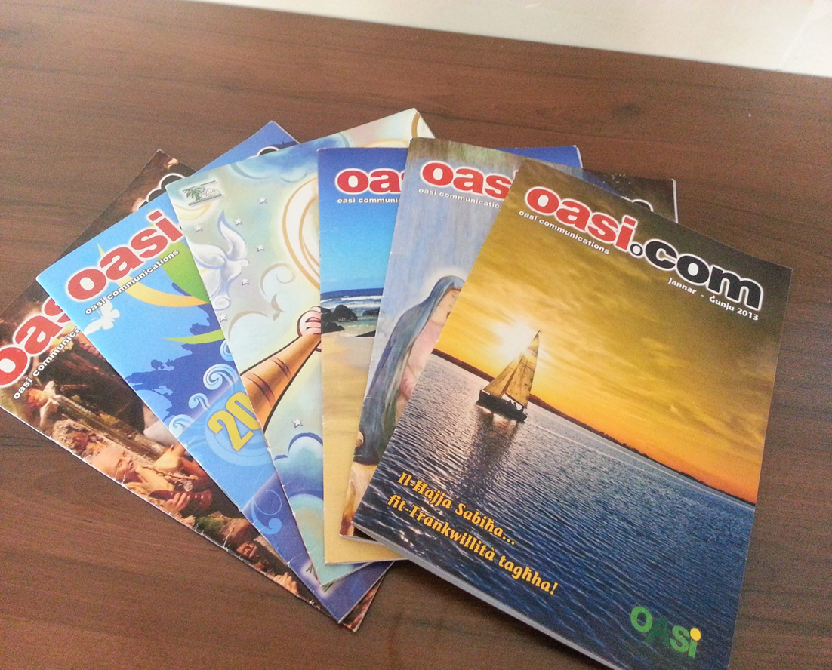
OASI.kom
It is a periodic magazine that is published every 6 months and delivered to all Gozitan residents and some places in Malta too. It contains educational information that targets both children and adults and news about the Foundation.

Slide 13
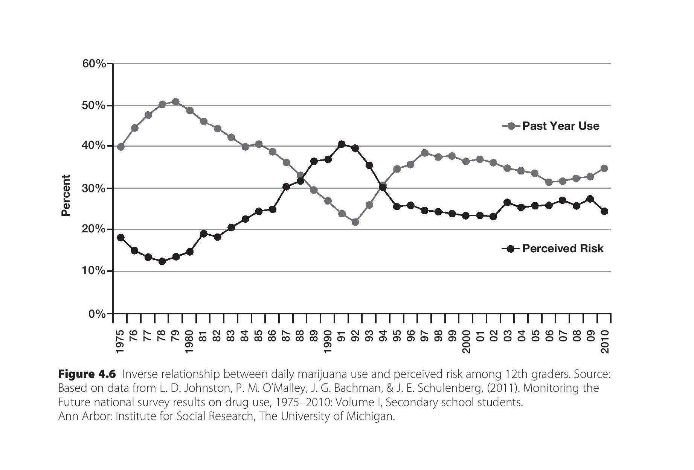
Daily Use and Perceived Risk Inverse Relationship

Slide 14
Immediate Intervention
Immediate Intervention is an attempt by OASI Foundation to prevent individuals in distress from reverting to alcohol or drugs as a means to ‘solve’ their life’s ordinary troubles.
Anyone can seek this remedial therapy at OASI Immediate Intervention Programme. This therapeutic remedy opens up in clients a process of honesty, release and change and in due time develops a support therapy that assists them in the recovery of their self-esteem, self-confidence and the gaining of a positive attitude towards life.
Immediate intervention deals with issues such as inner-conflicts, inter-personal relations, family problems, “different” lifestyles, emotional pain and difficulties related to stress. Through therapeutic sessions people are facilitated to regain trust and communication with their significant others.
Tackling the problem before it becomes bigger!
Shared Staff

Slide 15
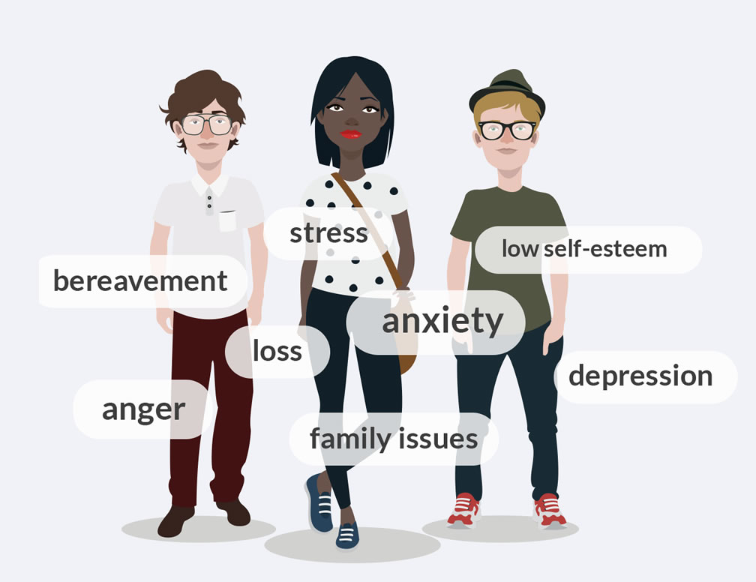
What happens in immediate intervention?
Meetings are held between the therapist and client, were clients are assisted to explore various life coping skills and encourage alternative and healthier life styles.
Besides individual sessions, the therapist or the client may request a therapy session in a group. Group Therapy often contributes to a speedy solution and a better result because of the valuable input of all those involved in the matter.
Certain people may need assistance to facilitate their liaison with other agencies, social services or professionals. Often people may only need immediate intervention in this particular way just to get rid of their tensions or conflicts.

Slide 16
Addiction Treatment & Rehab
Treat the dependent person
Treat with Dignity
Treat as whole – Body, Mind and Spirit
Community Based Services
Residential Based Services
7 Full-timers, 11 Part-Timers, 11 Volunteers

Slide 17
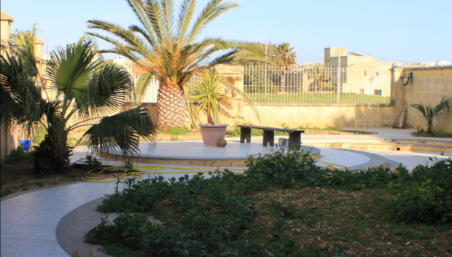
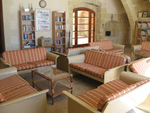
Treatment & Rehab
The Aims
Safe Place
Supportive Environment
Gain Strength – Physically, Emotionally and Spiritually
Self-Awareness
Encourage Change and Improve Life
Plan for the Future & Work the Plan
This offers our beneficiaries the possibility to work on themselves.

Slide 18
During the time spent with us, beneficiaries have a busy Schedule…
Group Therapy sessions
Individual Therapy sessions
Lectures on Addiction Related Areas
Daily Living Skills
Yoga
Walks in Nature
Gym and physical exercise
Self-Help Groups
CBT, DBT, Bibliotherapy, etc
Reflective methods such as assignments
Discuss behaviours and triggers which might lead to relapse.
Notes:
Read, understand and write the pamphlet.
Some people advanced through the stages of physical growth without shedding this so-called “King Baby” attitude.
When addicts suffer from “King Baby Syndrome” they want the same level of self-centred gratification that babies and young children need. Addicts must be especially aware of King Baby drives and characteristics, for these attitudes and behaviours can continue to show up after we achieve abstinence.

Slide 19
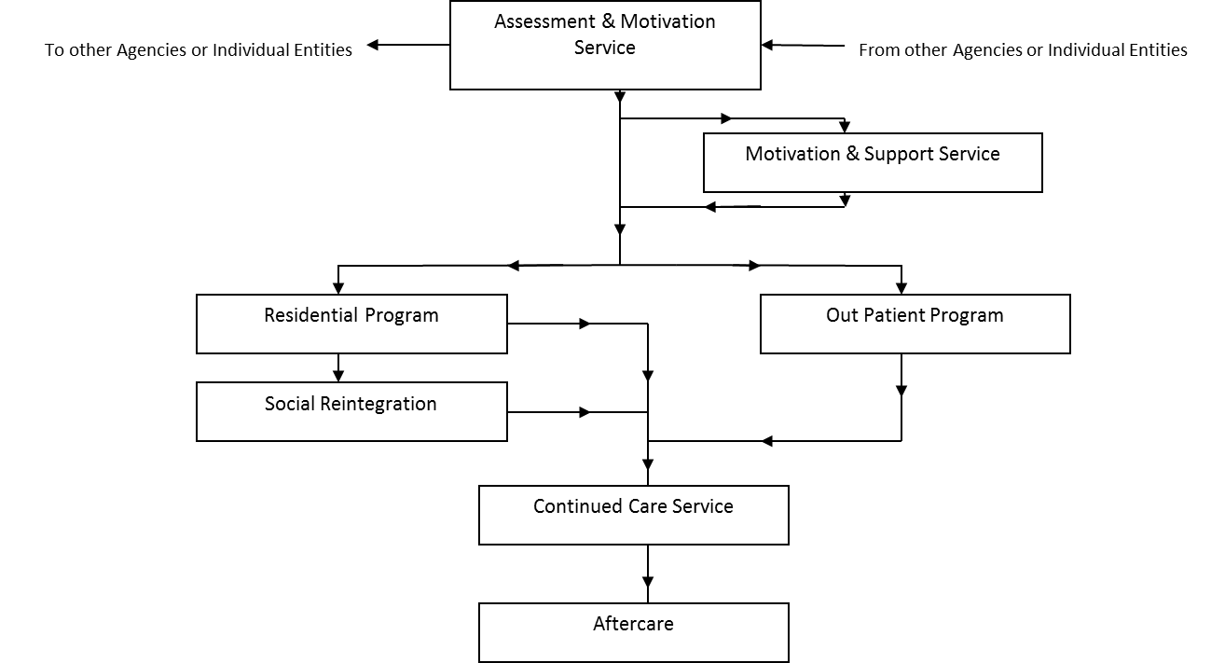
A Multidisciplinary Team approach

Slide 26
Depenalisation
Depenalisation refers to the introduction of the possibility or policy of closing a criminal case without imposing punishment, for example because the case is considered ‘minor’ or prosecution of it is ‘not in the public interest’.
Cannabis Legislation in Europe – an overview, EMDDA, 2017

Slide 27
Decriminalisation
Decriminalisation refers to the removal of criminal status from a certain behaviour or action. This does not mean that the behaviour is legal, as drugs can be confiscated and non-criminal penalties may still be applied. In the drug debate, this term is usually used to describe laws related to personal possession or use rather than drug supply.
Cannabis Legislation in Europe – an overview, EMDDA, 2017

Slide 28
Legalisation
Legalisation refers to making an act lawful that was previously prohibited. In the context of the drug debate, this usually refers to removing all criminal and non-criminal sanctions, although regulations may limit the extent of the permission, as is the case for alcohol and tobacco. Penalties for breaching these regulations may be criminal or non-criminal.
Cannabis Legislation in Europe – an overview, EMDDA, 2017

Slide 29
Questions
Thank you
E: ce@oasi.org.mt
T: 21563333
M: 99877139
W: www.oasi.g.mt

