Slide 1
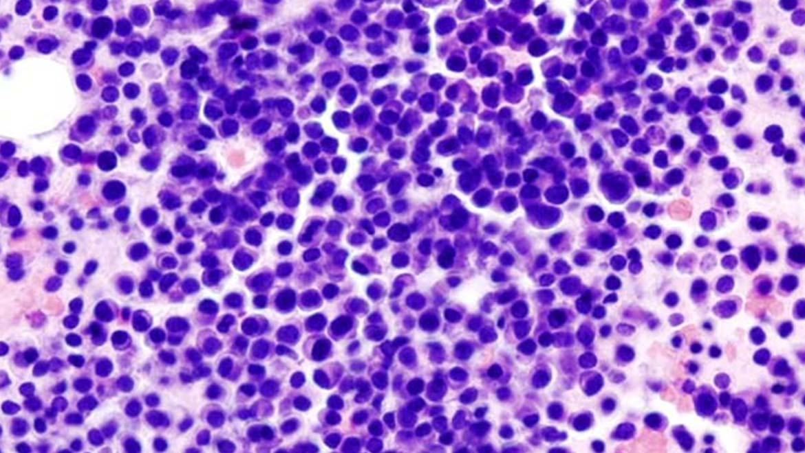
Enabling survival
Thank you
Hon. Silvio Parnis
Hon. Ivan Bartolo
Then in alphabetical order
Hon. David Agius
Hon. Justyne Caruana
Hon. Rosienne Cutajar
Hon. Maria Deguara
Hon. Silvio Grixti
Presentation to the Social Affairs Committee, Parliament of Malta, Wednesday, 17th March, 2021
Request for the inclusion of Daratumumab as part of the formulary for free medicinals
by Lara Said

Slide 2
WHAT IS MULTIPLE MYELOMA?
Multiple myeloma (MM) is a type of bone marrow cancer.
MM affects several areas such as the spine, skull, pelvis and ribs.
Significant variation in life expectancy:
nature of the disease,
quality of care,
timely and consistent access to best treatment; and
patient involvement.

Slide 3
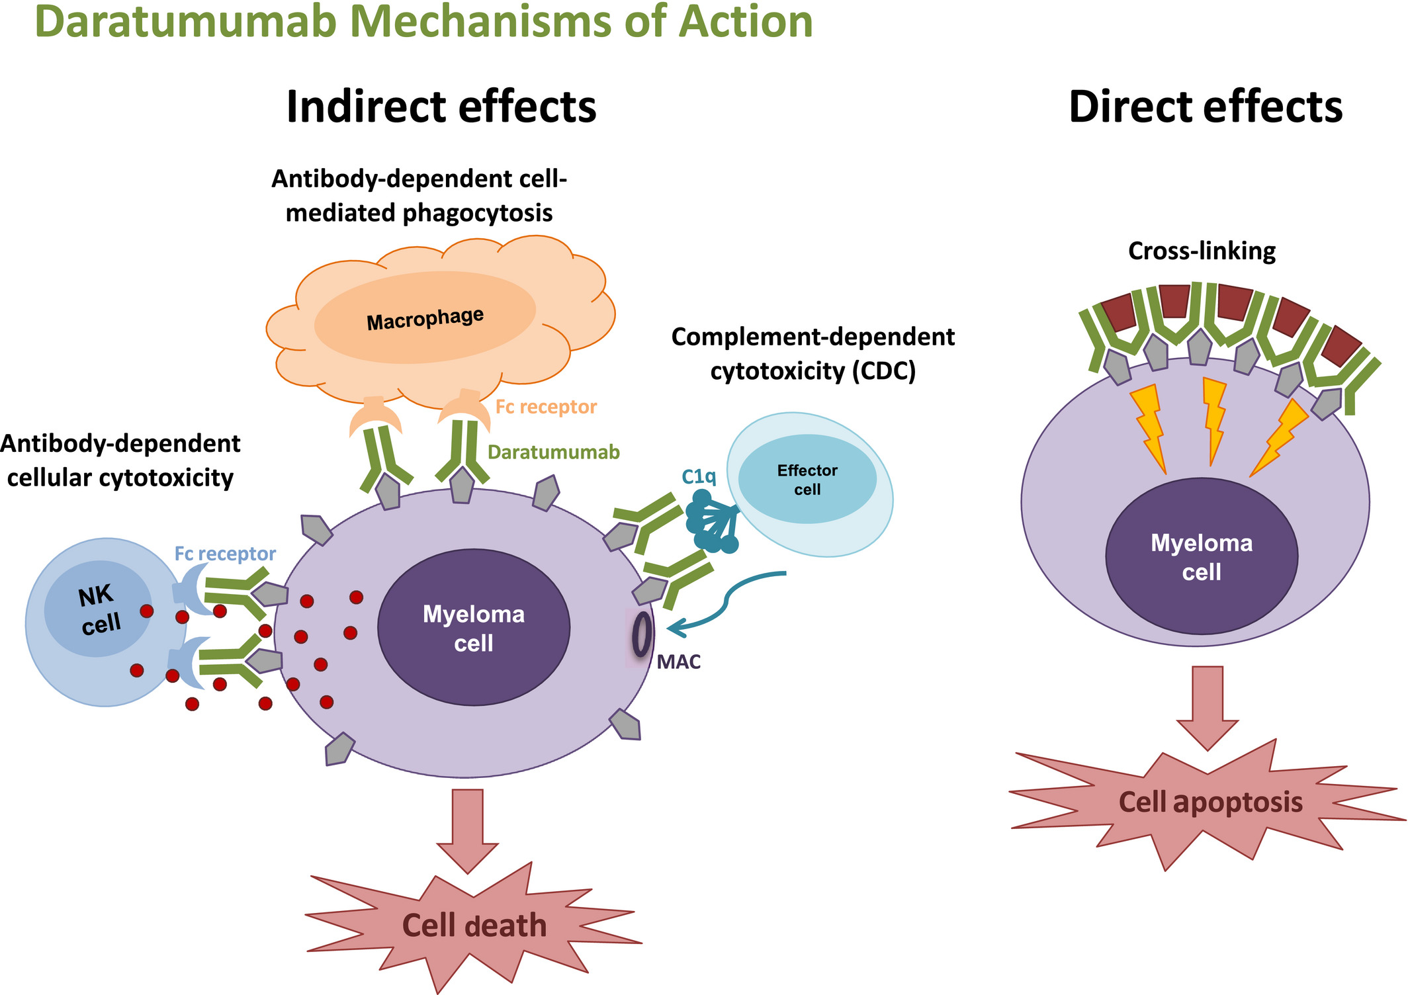
why is dara social?
Daratumumab is increasingly the second line of treatment in EU member states.
An EU mission to ‘conquer cancer’ by 2030 (1st plan June, 2020; ENVI policy July 2020). Focus on prevention, diagnosis, treatment, quality of life and equitable access.
Increasingly ‘replacing’/‘delaying’ autologous stem cell transplantation.
Keeps people as active and gainfully occupied members of society for longer.

Slide 4
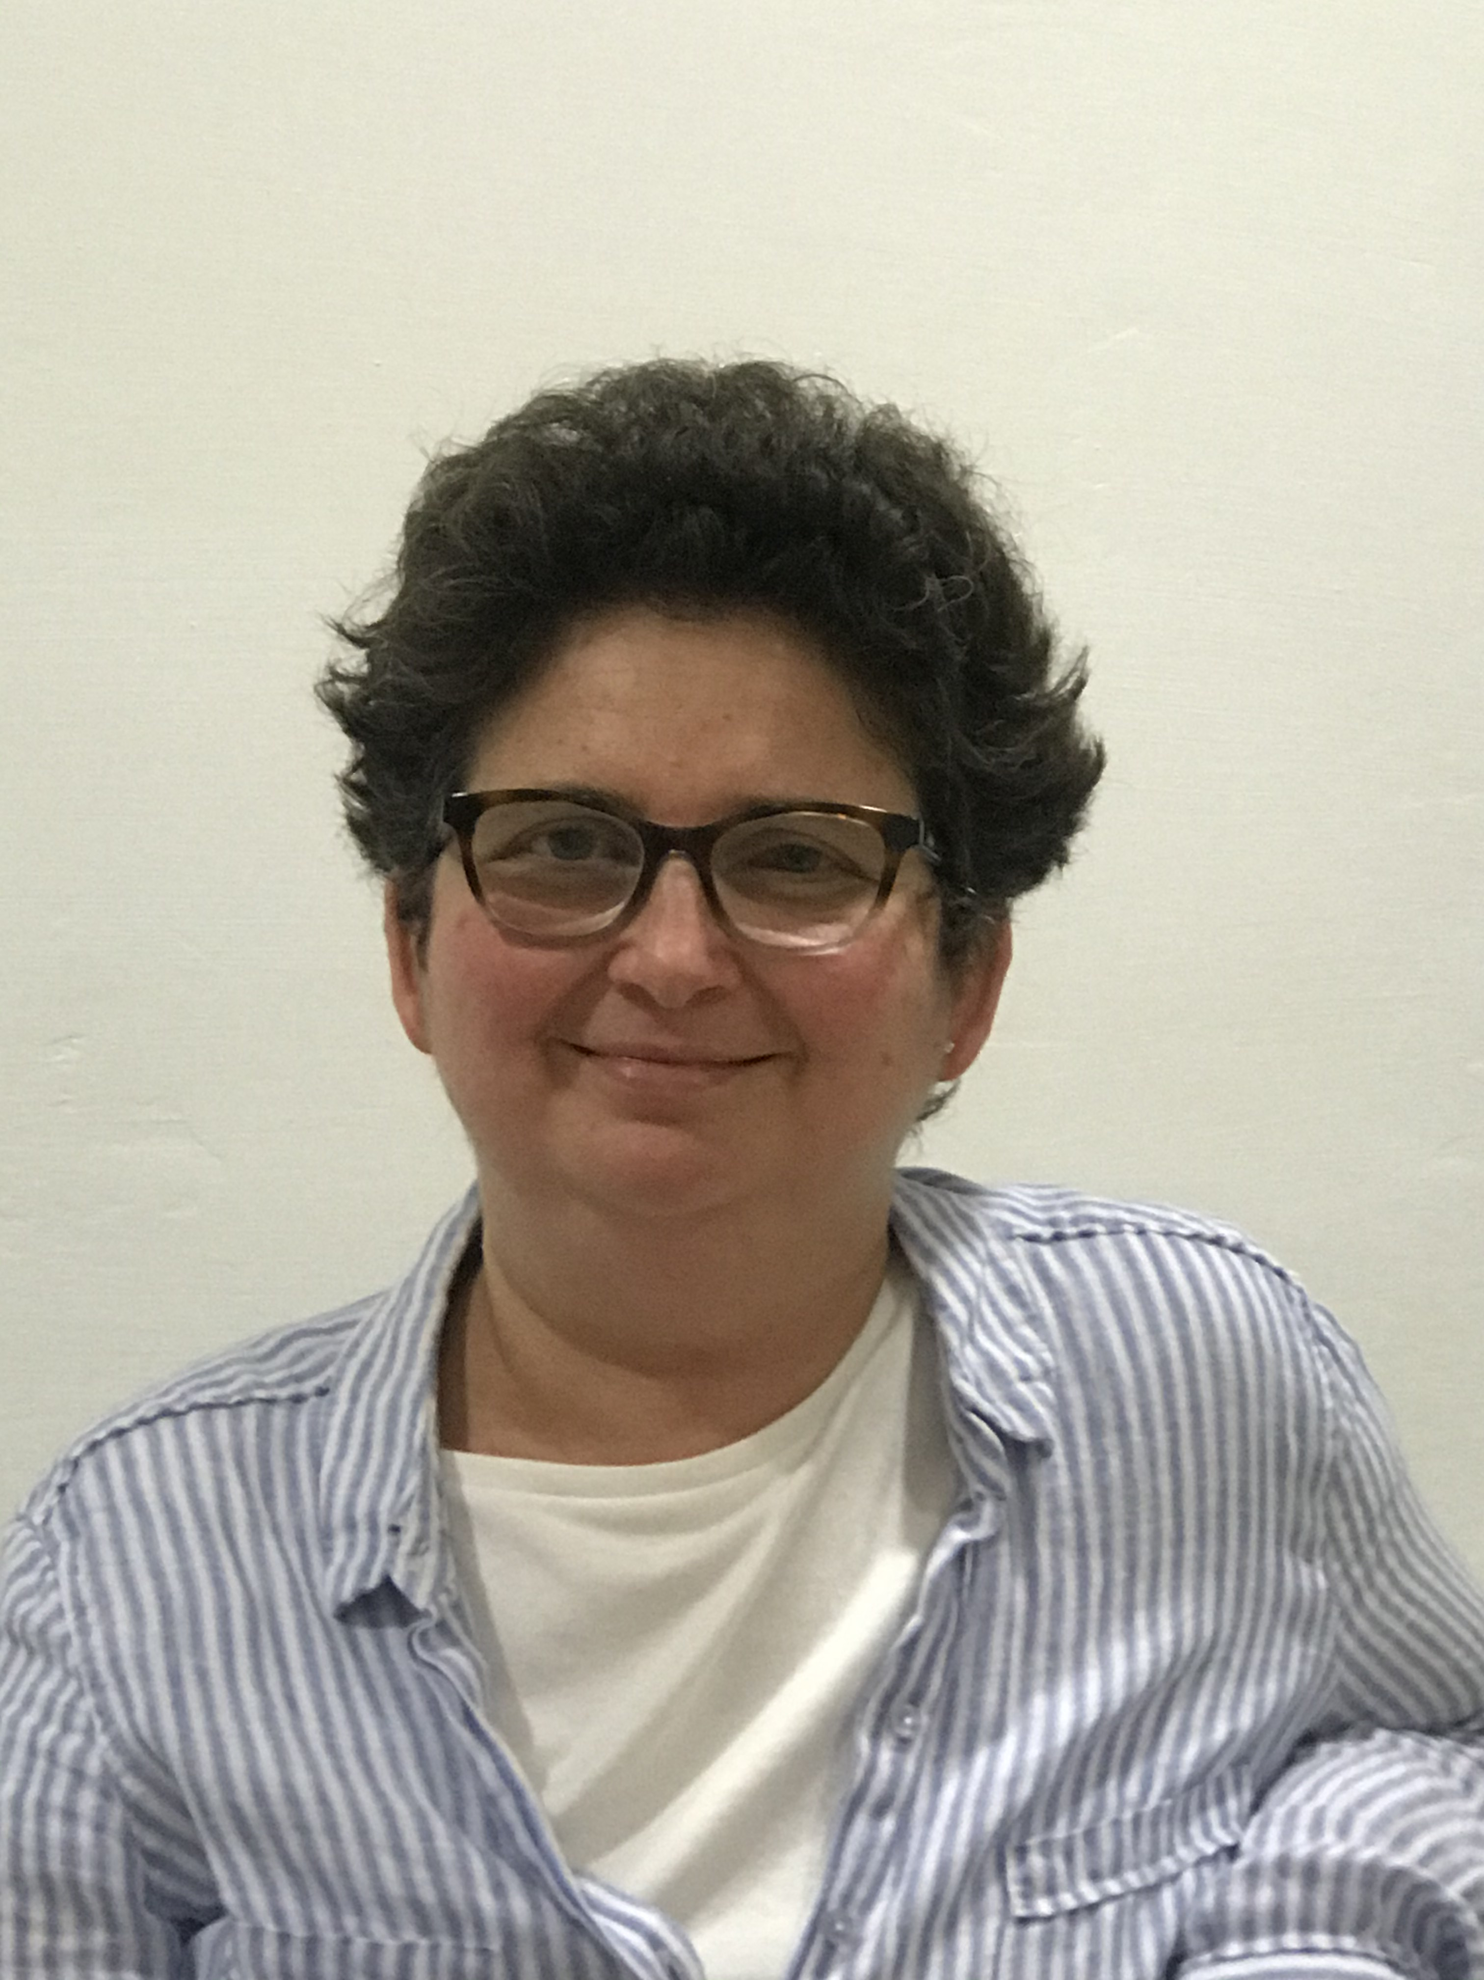
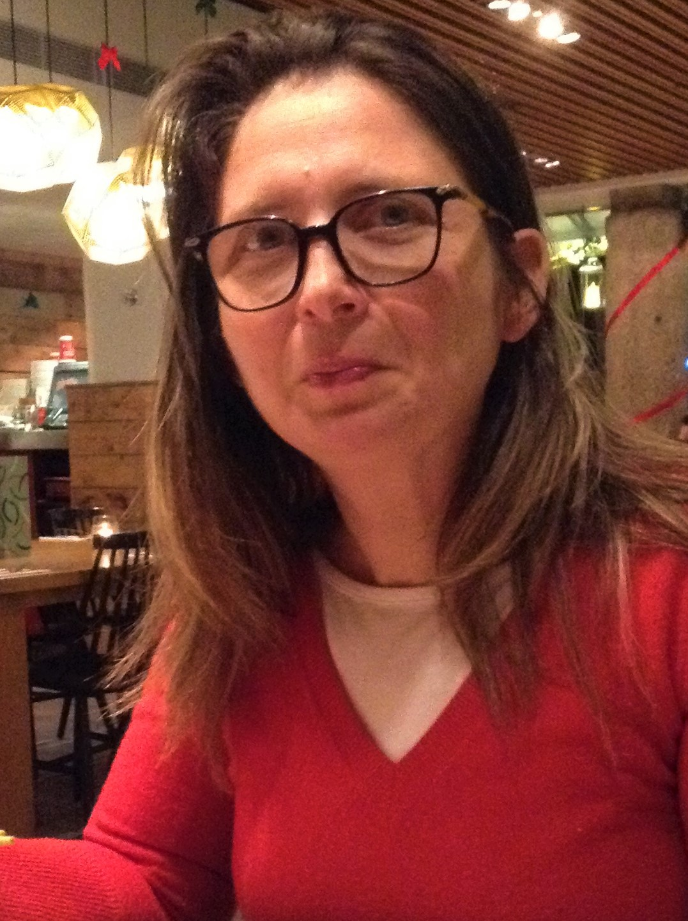
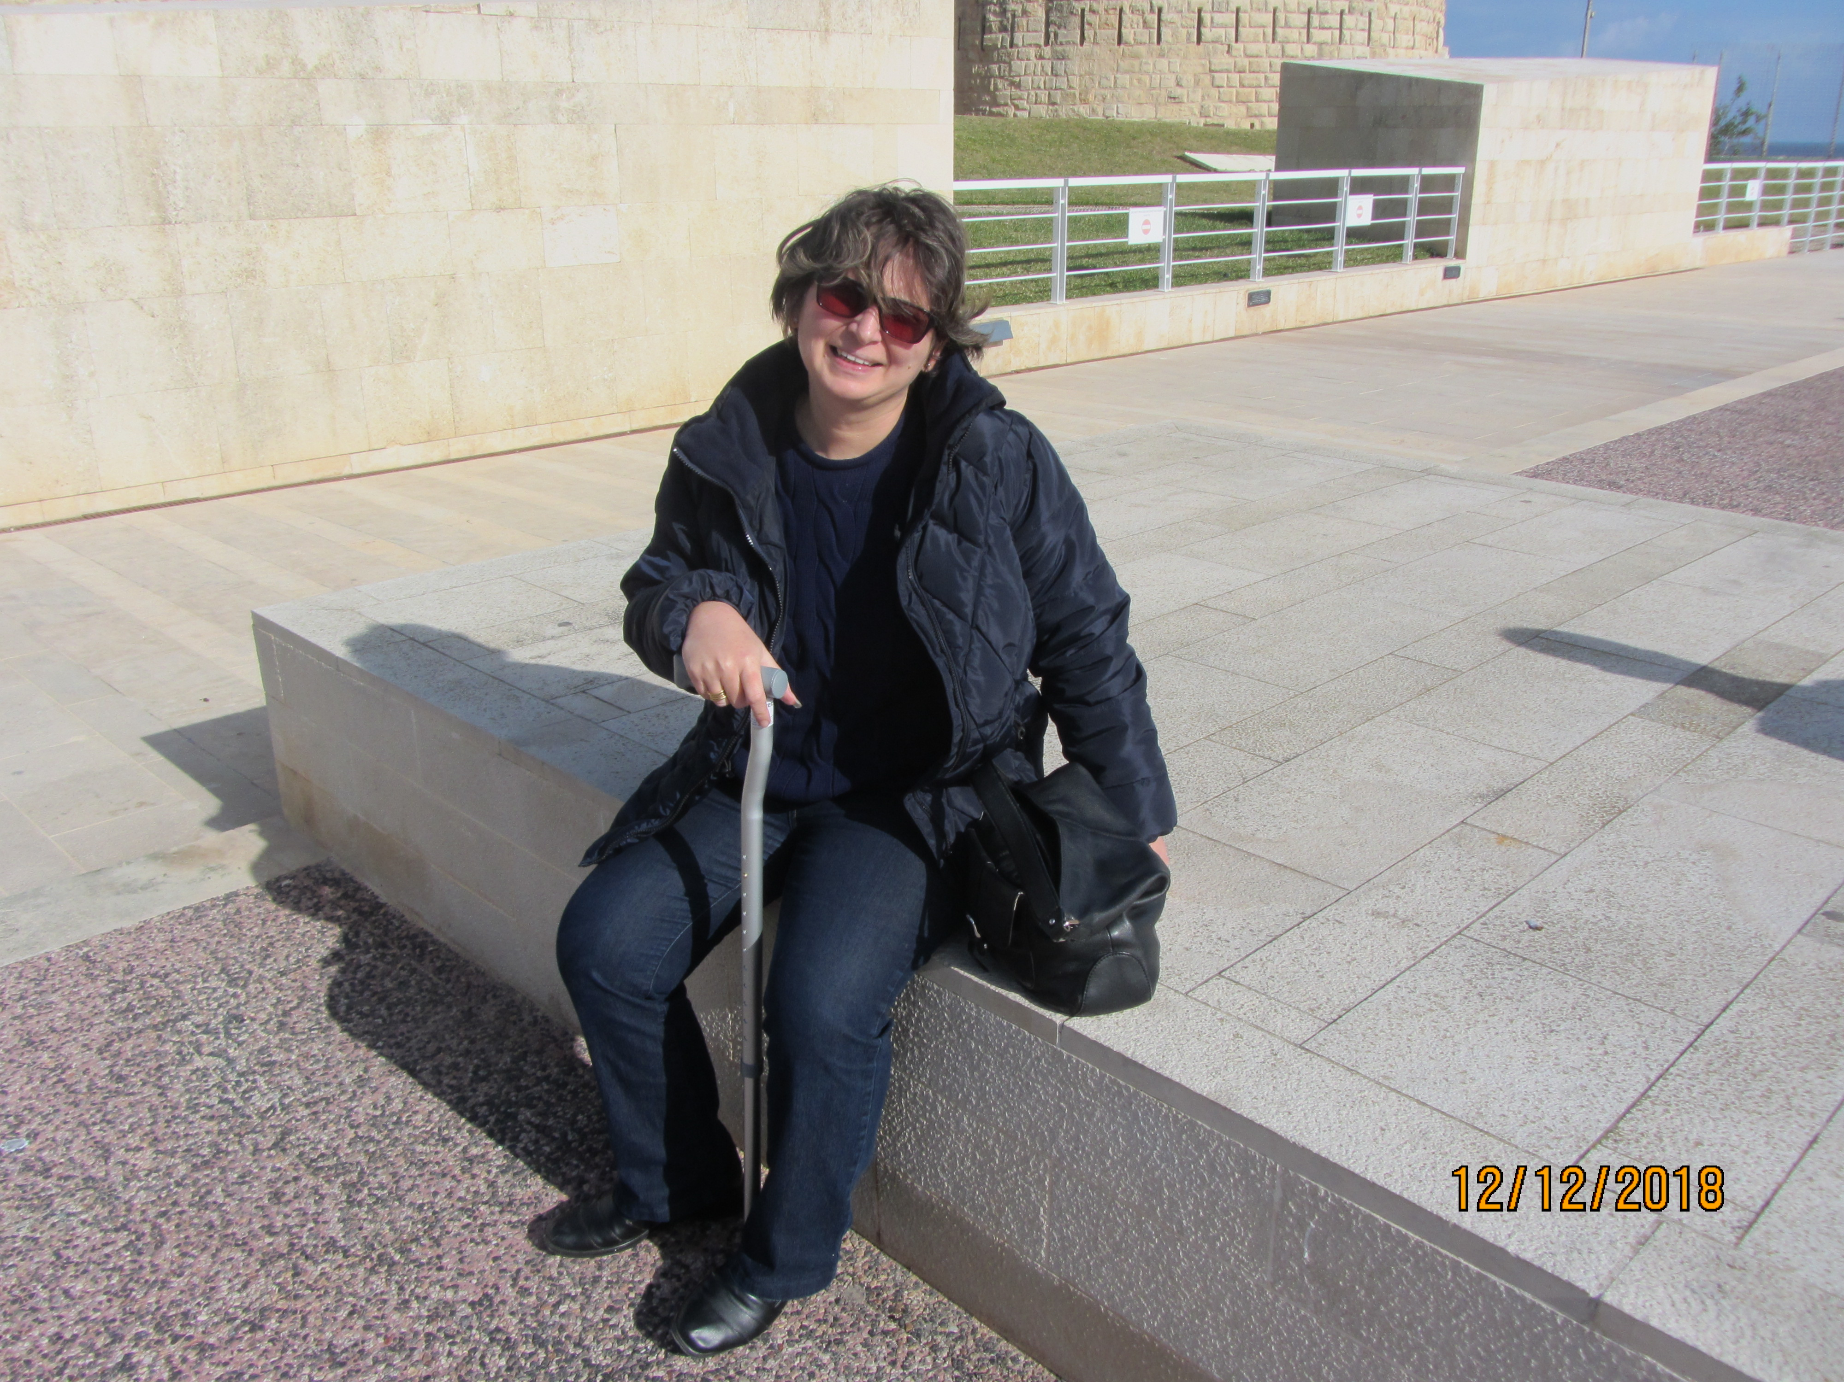
why is access to dara CURRENTLY unjust?
CLONE 1
ITALIAN - RECEIVES ‘NHS’ DARA
CLONE 2
MALTESE - PAID FOR THROUGH PRIVATE INSURANCE
CLONE 3
MALTESE - CHARITY FUNDED TREATMENT UNTIL JUNE 21

Slide 5
why is access to dara CURRENTLY ‘UNSOCIAL’?
CLONE 1
RECEIVES DARA MONTHLY.
CASE REVIEWED EVERY THREE MONTHS.
CLONE 2
UNABLE TO WORK/PAY PREMIUM
TOO FRAIL FOR CHARITY FUNDING
SELLING HER HOME
CLONE 3
STILL MAKING A BIG FUSS EVEN IF IT FEELS LIKE SPEAKING OUT TO ONESELF!
LARA WANTS FAIRER ACCESS TO DARA FOR ALL!

Slide 6
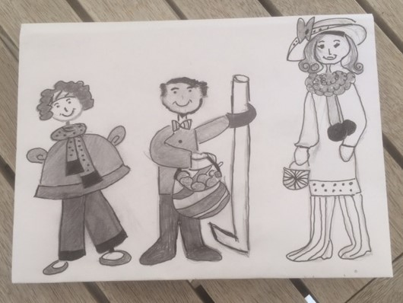
…and I am not highlighting differences in: AGE, GENDER, EDUCATION, iNCOME, MOTIVATION, family background, support…

Slide 7
MY POM, DEX, DARA PROTOCOL AND COST
Am on Pomalidomide, Dexamethsome and Daratumumab and other medication.
Pomalidomide is ‘free’ but not yet on the Government formulary.
DARATUMUMAB costs 633 euros per vial; VAT included.
Weekly first 8 weeks - between 6,200 to 6,500 per week.
Every two weeks, weeks 9 up to 24 - 6,500 to 8,200 per Dara treatment.
Monthly – from week 24 onwards or on a complete response (for me this was at week 18) – from June 2021 onwards my cost per session is around 8,200 and possibly up to 10,000 due to my increased body weight; a Dexamethsome side-effect.

Slide 8
I qualify FOR ‘nhs’ funding for daratumumab…
if I were residing in EU member states Spain, Italy, France, Germany, Portugal; besides non-EU countries such as the UK and Turkey.
YET I AM UNABLE TO ACCESS DARA UNDER THE CROSS-BORDER TREATMENT PROTOCOL…
because of inequality of access to treatment within Malta in relation to some other EU member states.

Slide 9
CHARITIES ARE LESS LIKELY TO HAVE THE ORGANISATIONAL RESOURCES AND INTER-DISCIPLINARY EXPERTISE TO SAFEGUARD, INSTEAD OF GOVERNMENT, CONSISTENCY OF critical TREATMENT
Charities/Associations/Foundations are a plausible additional source of funding for critical treatment.
Charities cannot solely offer primary critical care provision; the responsibility of Government.

Slide 10
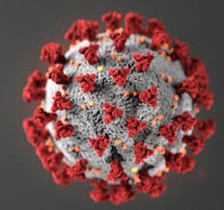
CANCER WILL KILL MORE THAN COVID
Malta’s healthcare system ranks 5th worldwide.
EU average of GDP spending on healthcare was 9.8% (2,940 euros) per capita for 2019.
Malta’s spending stood at an average 9.3% (2,930 euros) per capita of GDP for 2019. Income stood at 14.9 billion.
COVID impacted on cancer funding; est. 100 million spent by June 2020? On virus
Approximately 66% of ‘relapsed’ people on the POM. DEX, DARA protocol are still alive a year later.

Slide 11
inclusion, CONSISTENCY, REGULATION & values
Inclusion of Daratumumab as part of the Government formulary for free medicinals.
Consistent and accessible funding for critical treatment including novel and/or orphan drugs; as these increasingly gain EU approval.
Independent regulation about the funding/provision of free medicinals; as led by science/inter-disciplinary expertise and open to public scrutiny.
Positive, principled and ethical values about the right of each individual for a chance at extended overall survival.

Slide 12
LET ME SPEAK FINANCIALLY STRAIGHT!
Inclusion of Daratumumab is likely to increase expenditure and ‘my cost burden’.
Consistent organization/management is likely to identify financial paths and mechanisms to break financially even, at worst, or offer, value-added at best.
Independent regulation is likely to follow best value for money approaches and empower government to negotiate with pharmaceutical companies for the best price.
Societal values means that the lives of everyone matters; even if this comes at an added cost.

Slide 13
WHY should I EXPECT YOU TO LISTEN TO ME?
Fulfillment of 4:55 of the 2017-2021 National Cancer Plan.
Parliament to safeguard the health of Maltese citizens and consider this in a value-added manner
‘All patients should have access to a uniformly high quality of care in the community or hospital wherever they may live to ensure the maximum possible cure rates and best quality of life…Calman-Hine report, 1995).’

Slide 14
MAKING LIFE BETTER
Thank you for your time and attention
My life depends on Dara! (short-term)
Action: inclusion of Daratumumab in the Government formulary for free medicinals.
The lives of others equally matter too! (medium-term)
Action: all patients need more than one source of funding for their treatment.
Future generations matter! (long-term)
Action: Malta and Gozo need independent regulation, ongoing monitoring, the maintenance of key figures and research about the implementation of healthcare standards, regulation and policy.
Together we can make a difference!

