Slide 1



Slide 2
About APA
Founded in 2008 by parents for parents
Currently over 300 official family members - over 900 closed facebook members
Website – www.autismparentsassociation.com
Our mission is to facilitate the journey of parents whose child is diagnosed with Autism
To support and guide parents and individuals with Autism Spectrum Disorder (ASD)
To break barriers in the community, educational settings and place of work
To create opportunities for people on the Spectrum in line with their potential
To be a point of reference on any new interventions or research
To ensure that people on the Autism Spectrum are not deprived of their rights
To identify gaps in service provision and lobby with the respective stakeholders

Slide 3
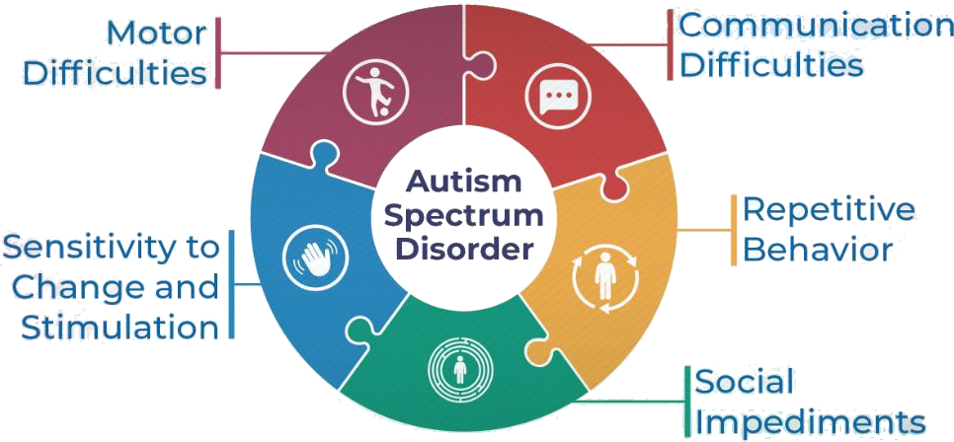
What is Autism ?

Slide 4
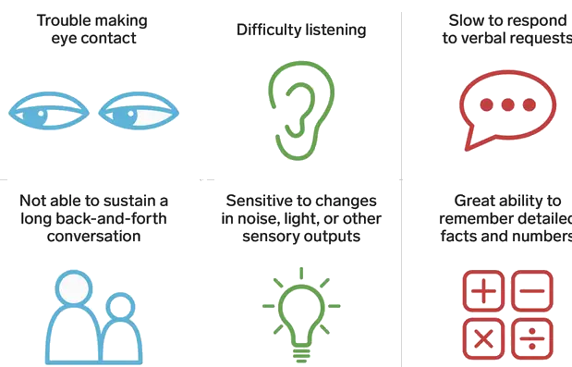
Symptoms of Autism

Slide 5
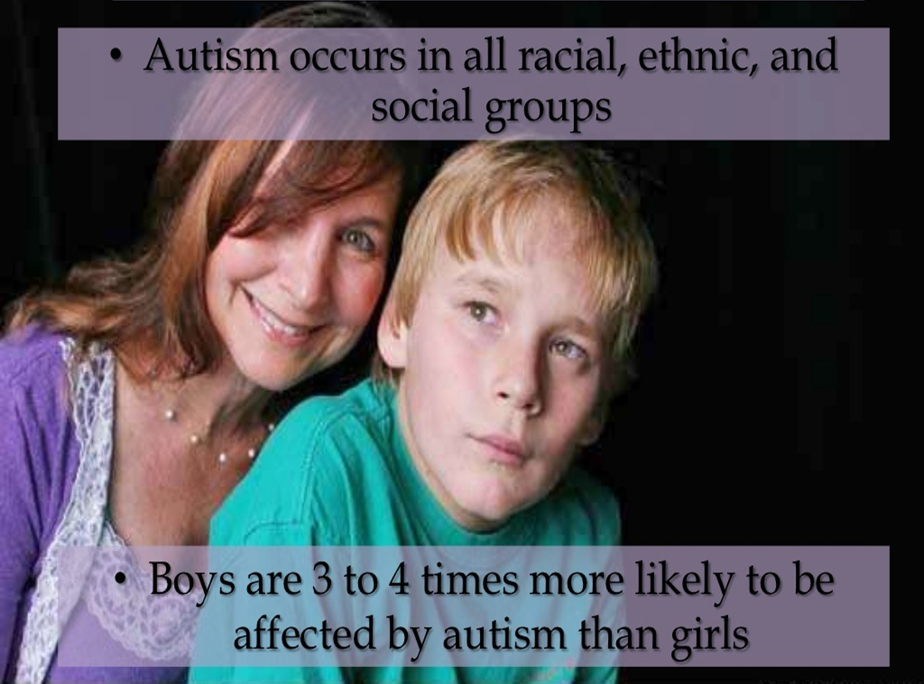

Slide 6
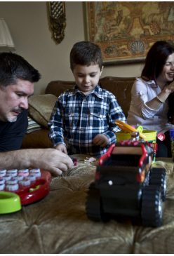
Our Struggles
Normally a diagnosis comes at a very early age leaving parents to do what they feel is best as they attempt to make life altering decisions on their child’s behalf.
This means finding therapists, finding the right school, maybe battling that school, trying, finding and setting diets that will not only help but that their child will actually eat, and the list goes on.

Slide 7
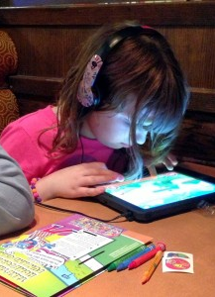

If the child is unable to sleep at night, then the parent can’t either. If the child is unable to attend loud restaurants or other venues, the parent can’t either.
If the child is emotionally overwhelmed, whether anxiety or depression or what ever, then the parent likely will be too.

Slide 8

I am tired…
I am jealous…
I am scared…
I feel alone…
I am human…
I want to talk about
my child but I find it
hard sometimes…
I am tired…
I am jealous…
I am scared…
I feel alone…
I am human…
I want to talk about
my child but I find it
hard sometimes…

Slide 9
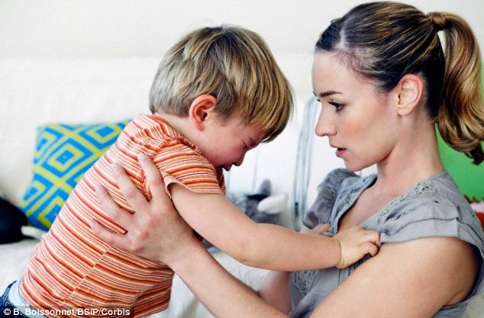
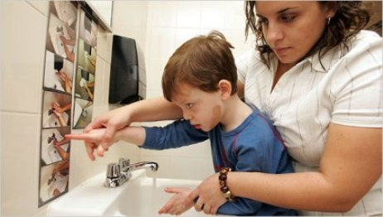
Persons with Autism are not the struggle.
You can classify autism itself as a struggle, if you want, but really, the real struggles are the situations and events that may or may not be due to the autism.

Slide 10

Our Struggles cont.
Never treat the child as if they are a burden. Never tell anyone, not them, not others and not even yourself, that the child is the source of your struggles. They’re not. The child has struggles. You have struggles. The child is not one of them

Slide 11

When you think of someone as a struggle or a burden, you’re essentially reducing that person down to
some kind of a heavy load that will weigh you
down as you carry them with you. That’s
not really how you see them.
At least, I hope not.
Because they’re not.

Slide 12

The people that actually have the disorder have even greater struggles, many of which they likely find themselves unable to explain….

Slide 13
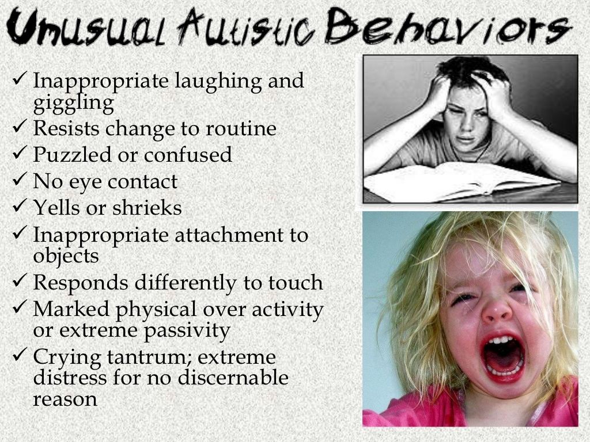
Autistic Behaviour

Slide 14
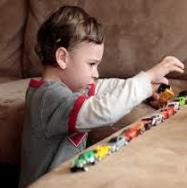
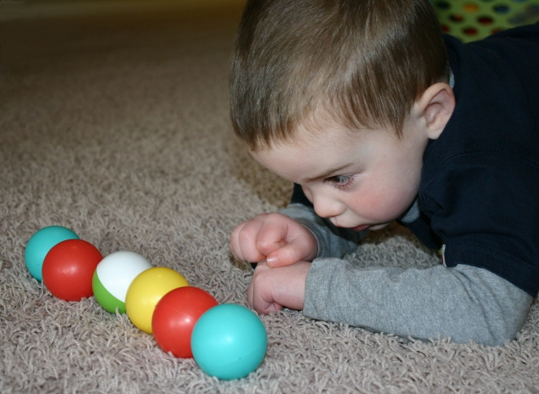
Patterns of Behavior
Difficulty with everyday changes - (substitute teachers, moving furniture, meeting new people)
Difficulty with transitions - (between materials, activities, setting)
Scripted routine play patterns
Non-functional rituals and routine ways to do things Intense focus on and interest in certain topics, videos, characters
Stereotypic behaviours (rocking, flapping, toe-walking)

Slide 15
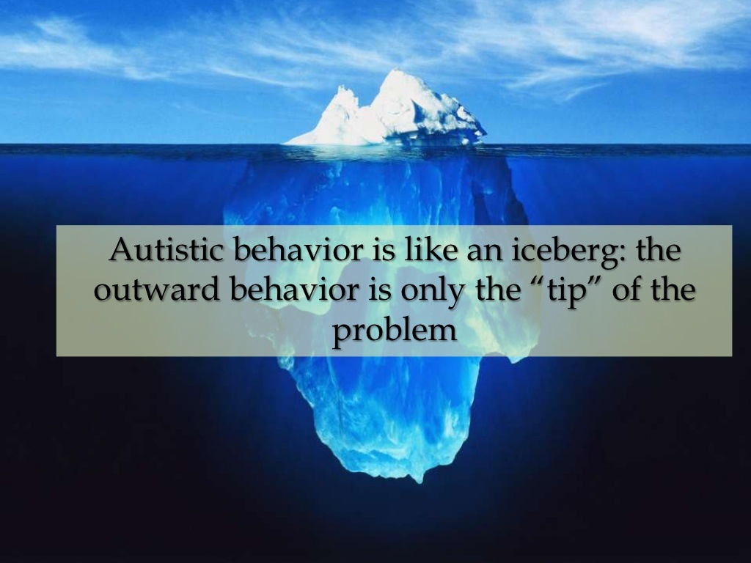

Slide 16
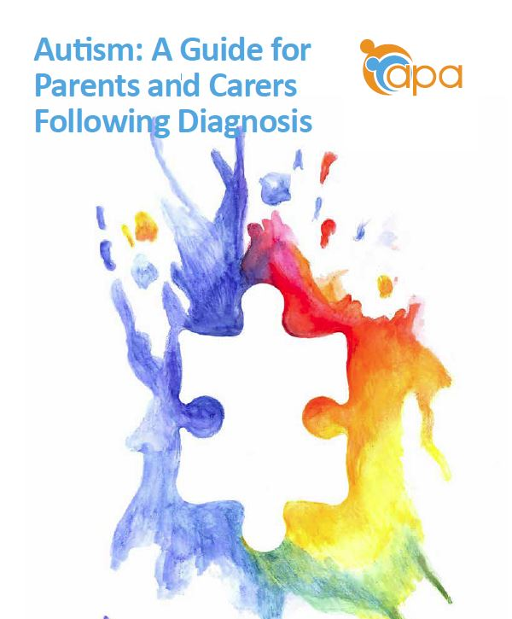
Our Published Guide New Parents

Slide 17

APA Resource Library for Parents/Caregivers

Slide 18
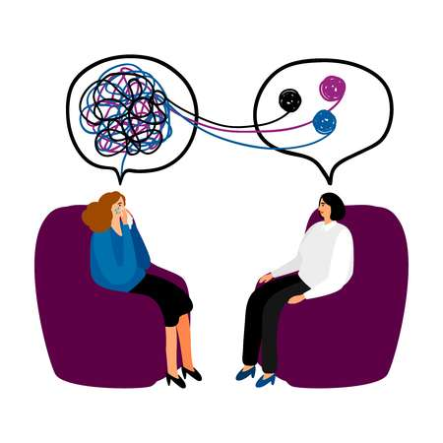
Free Counselling Sessions for our Members

Slide 19
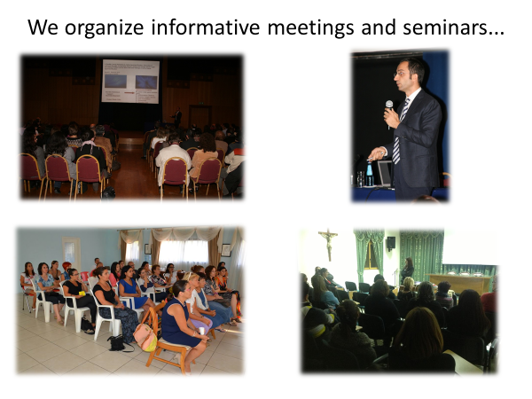

Slide 20
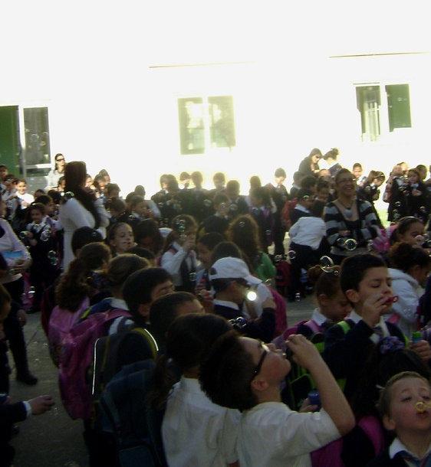
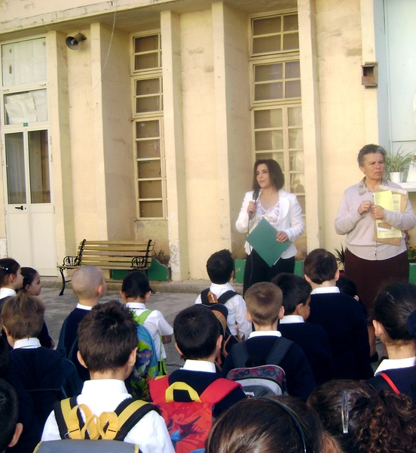

Slide 21
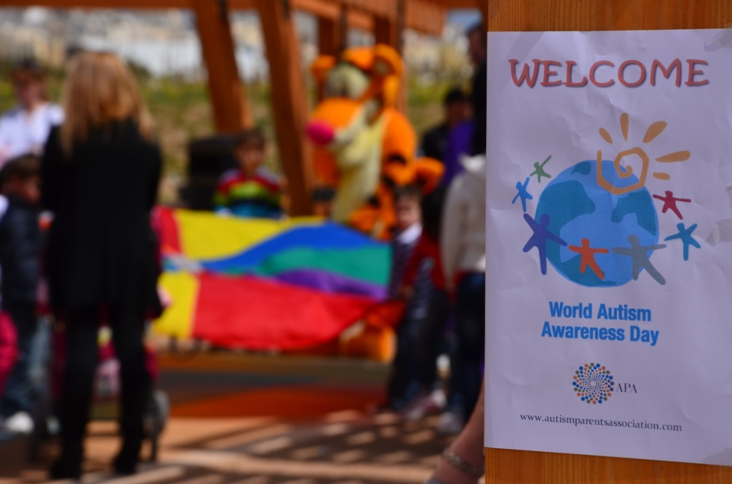

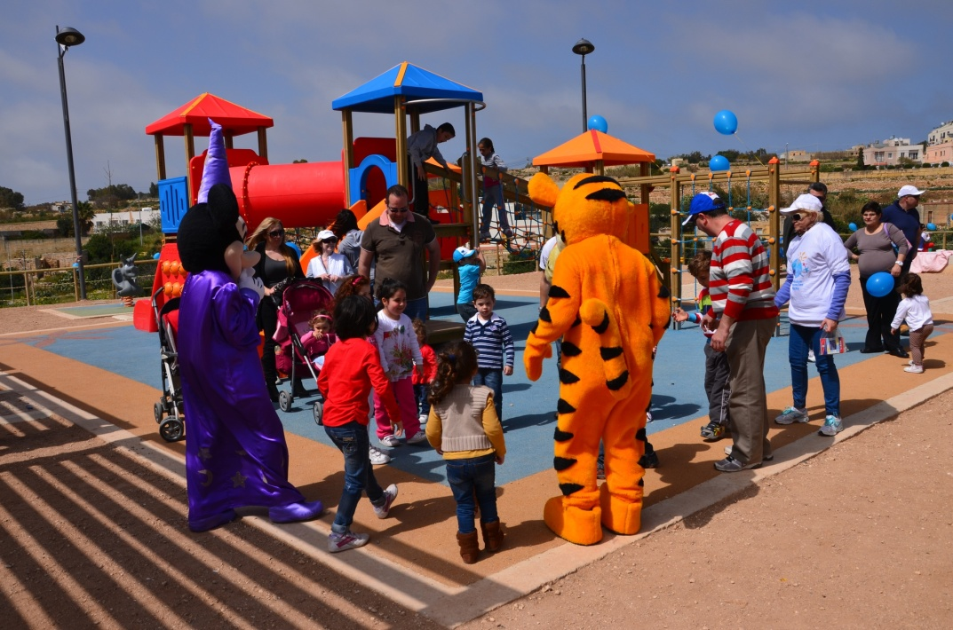

Slide 22

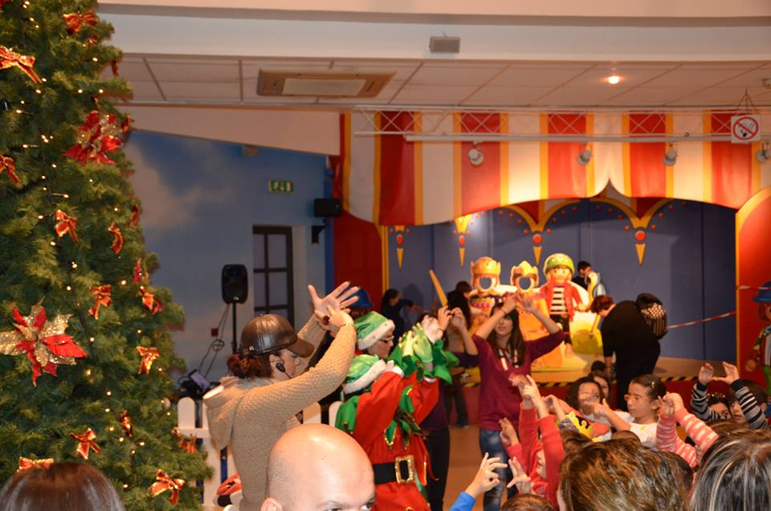
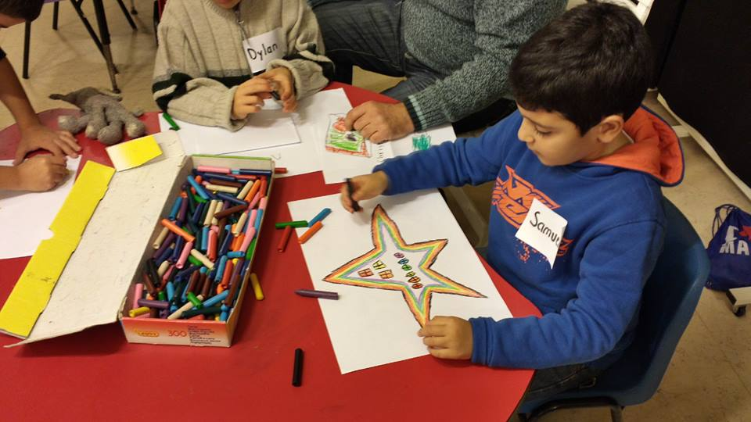
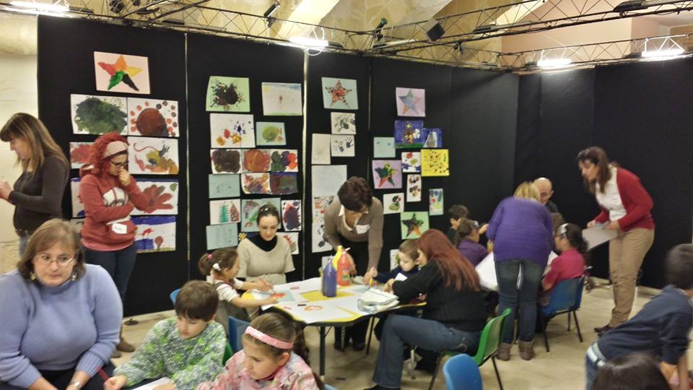

Slide 23
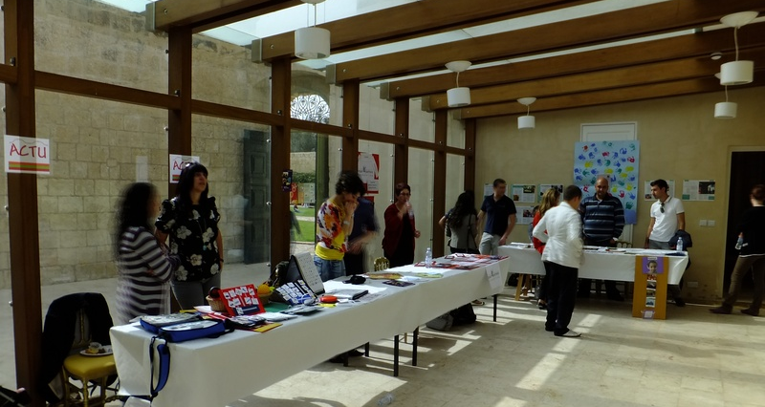
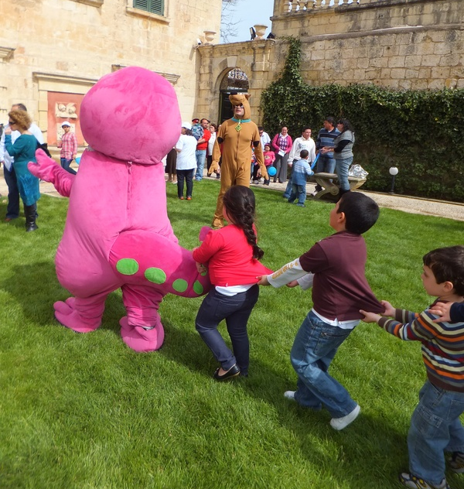
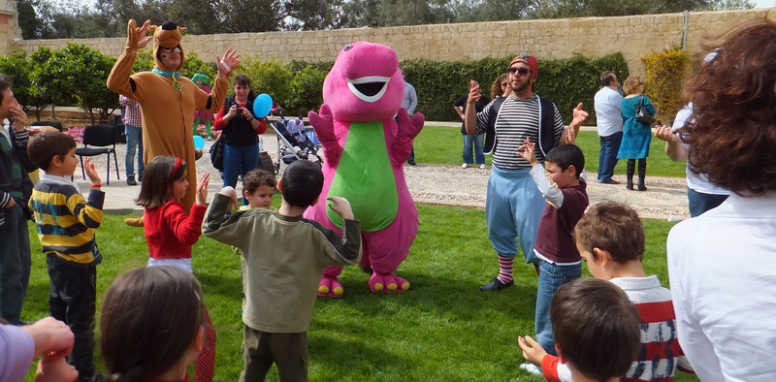

Slide 24
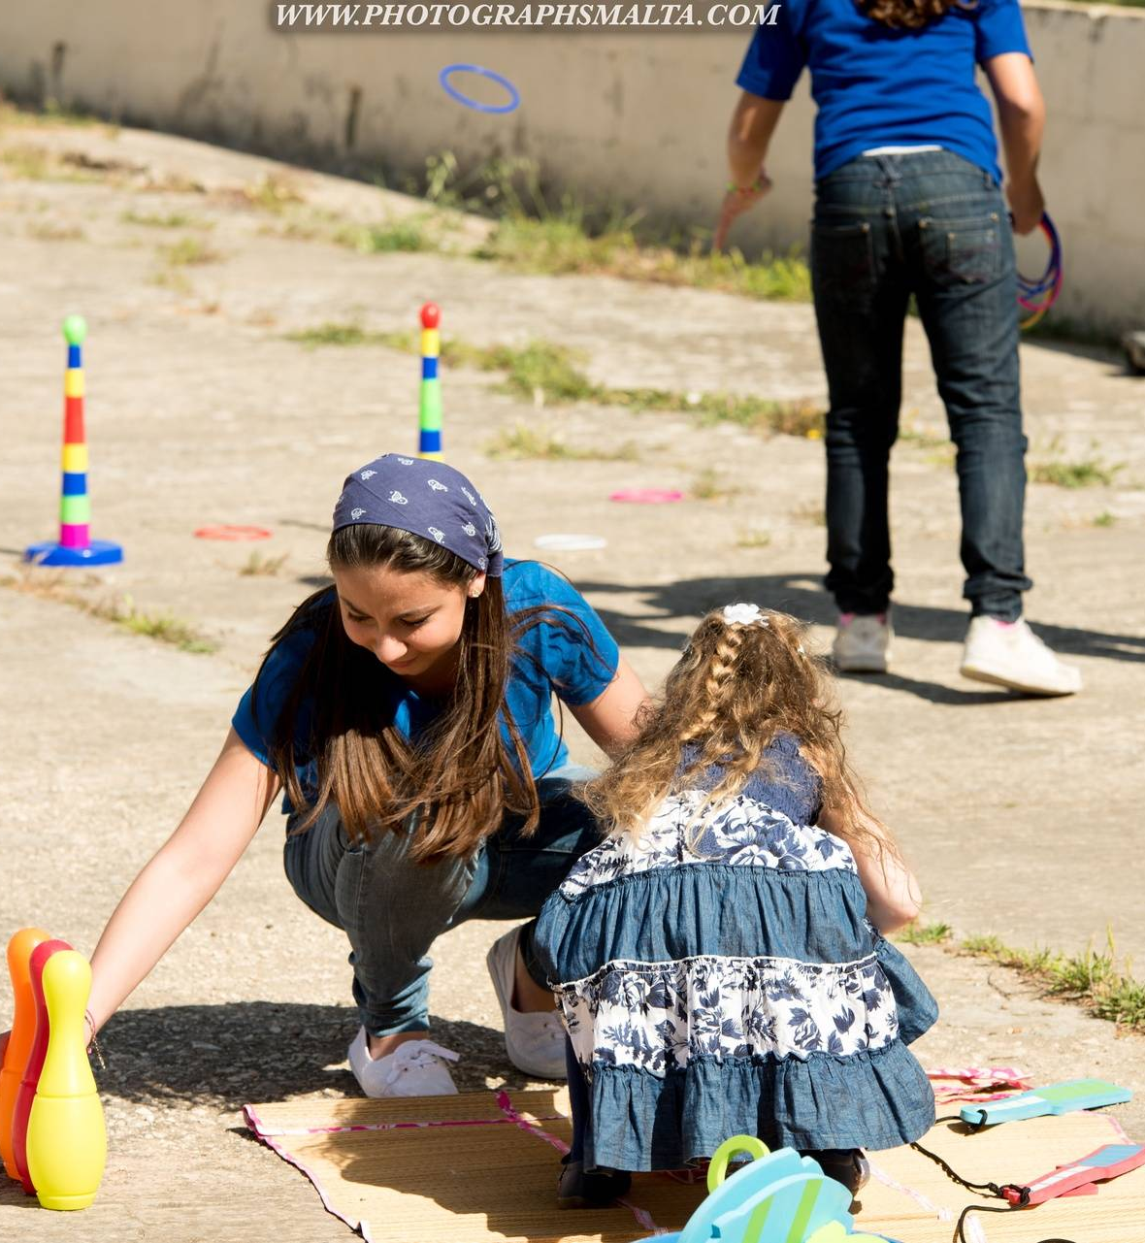


Slide 25






Slide 26


Slide 27
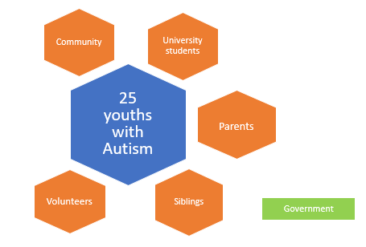
Social Integration Program for Teens (SIPT)
APA identified a lack of integration of youths with Autism in the Community.
APA embarked on a project where 25 youths aged 14 and over benefited from a fortnightly Saturday program.
A pilot project launched 2016-2017 funded by the Voluntary Organizations Project Scheme
A 2-year project followed from 2017-2019 funded the Malta Community Chest Fund
From 2019 onwards we signed a JV with RMHC (Ronald McDonald House of Charities)
Benefits and successes
Improved mental health
A sense of belonging - Improvement in behavior
Empowered
Interaction
Learning and having fun in a safe environment

Slide 28


