Slide 1
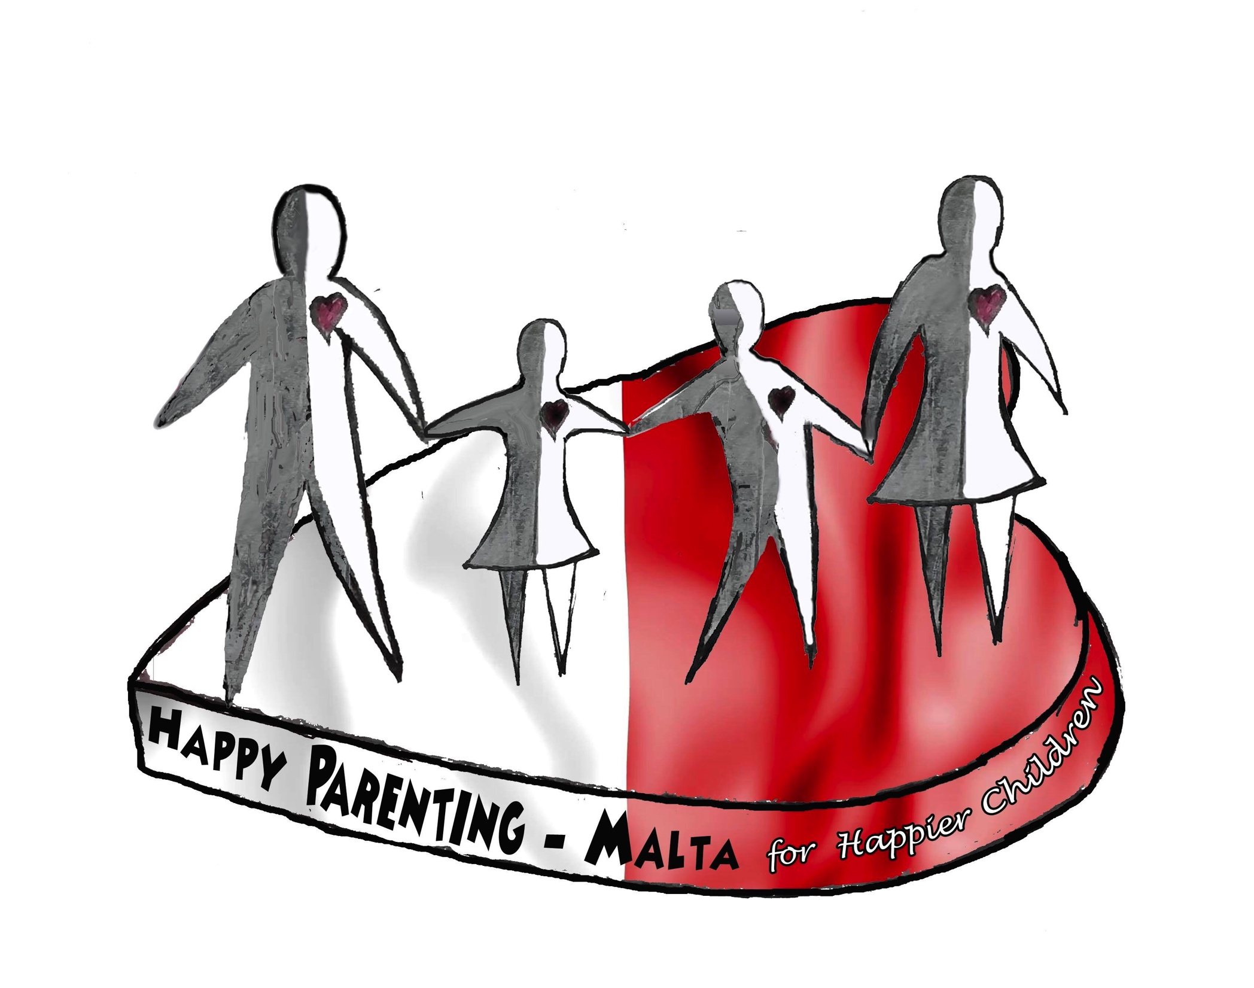
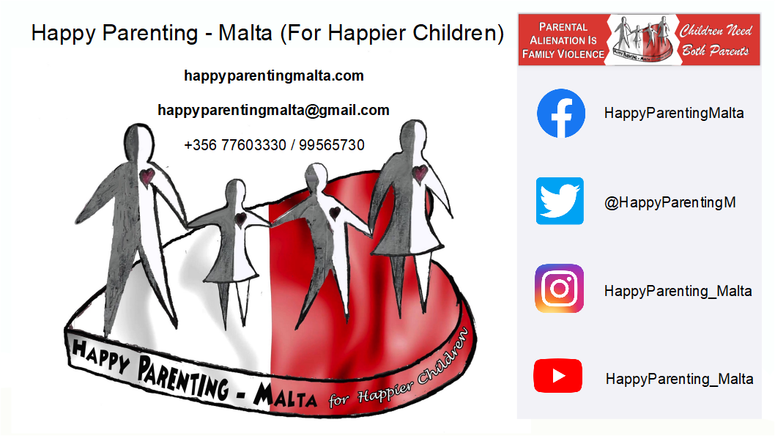
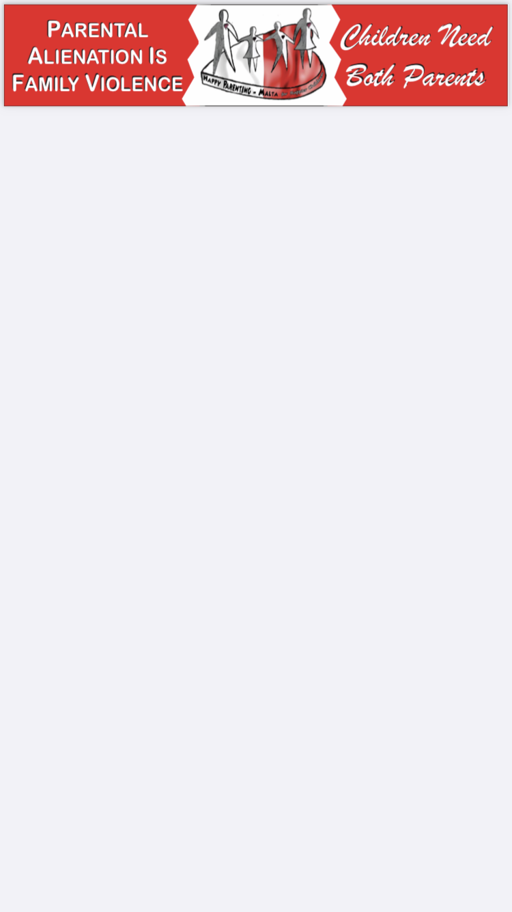

Slide 2


Slide 3
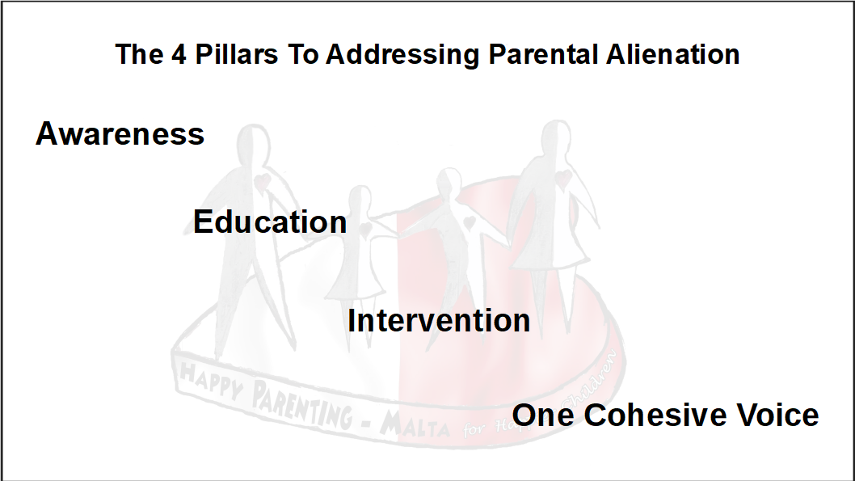

Slide 4

What is Parental Alienation?

Slide 5
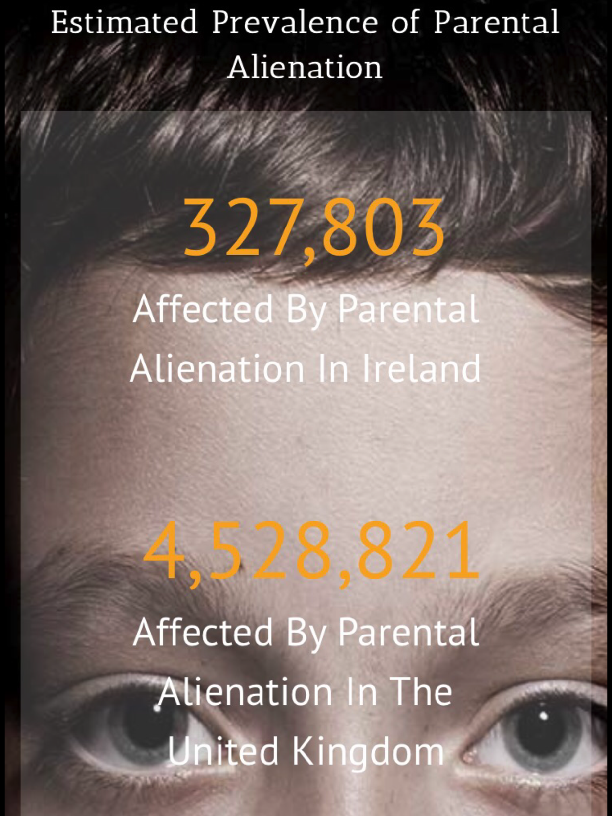

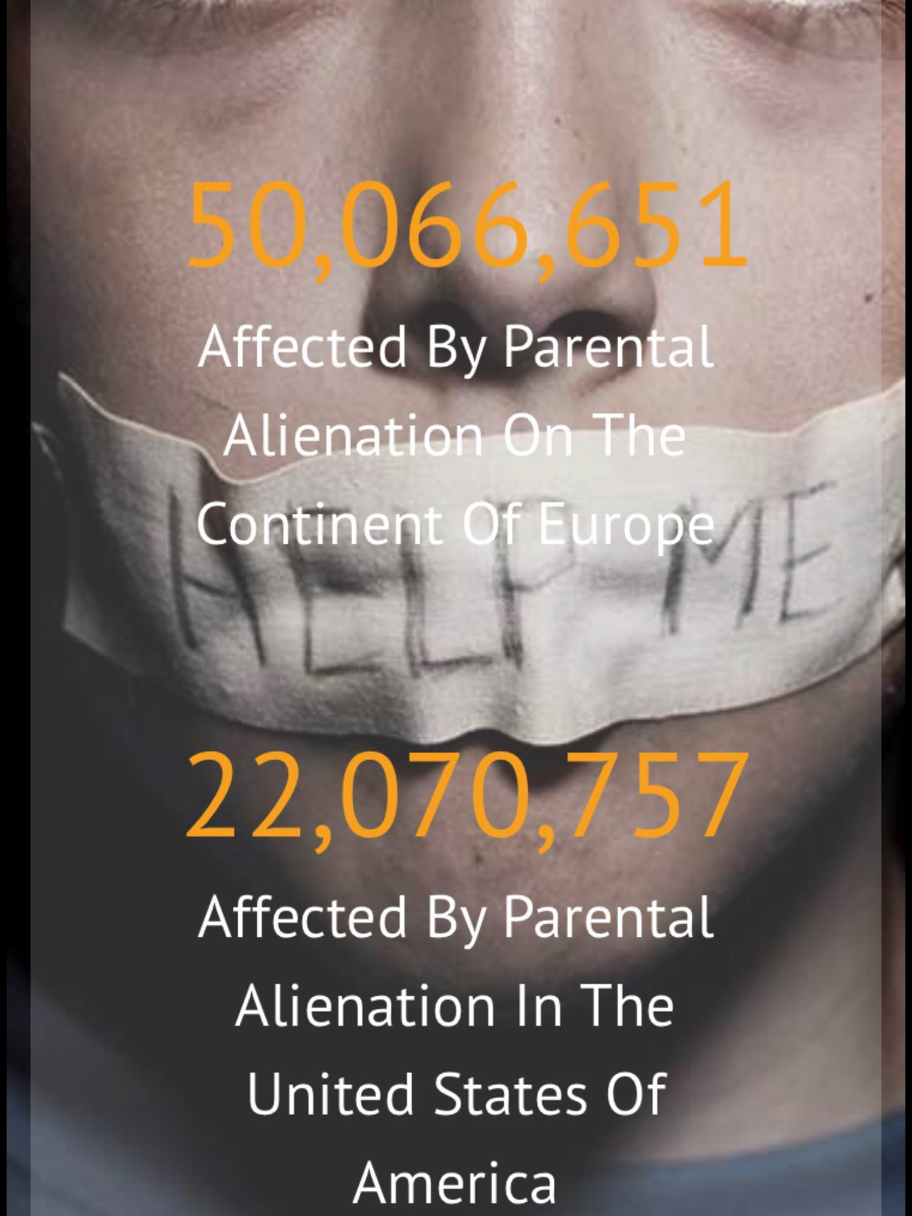
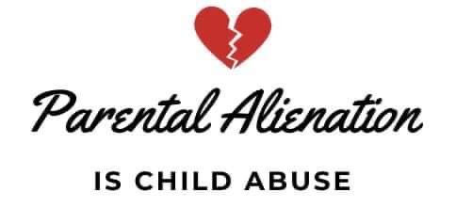

Slide 6
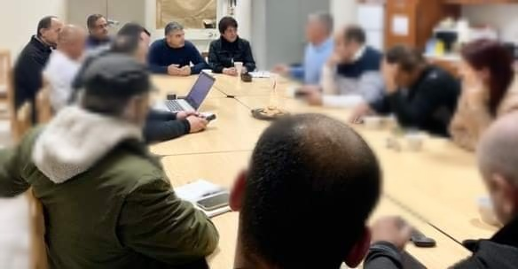
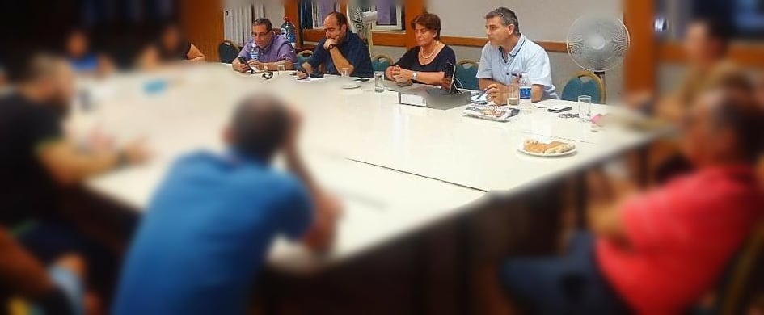
“If you don’t encourage the child to have a relationship with the other parent, you’re a bad parent or a bad grandparent.
You can either encourage it or discourage it.”
03/10/2015

Slide 7
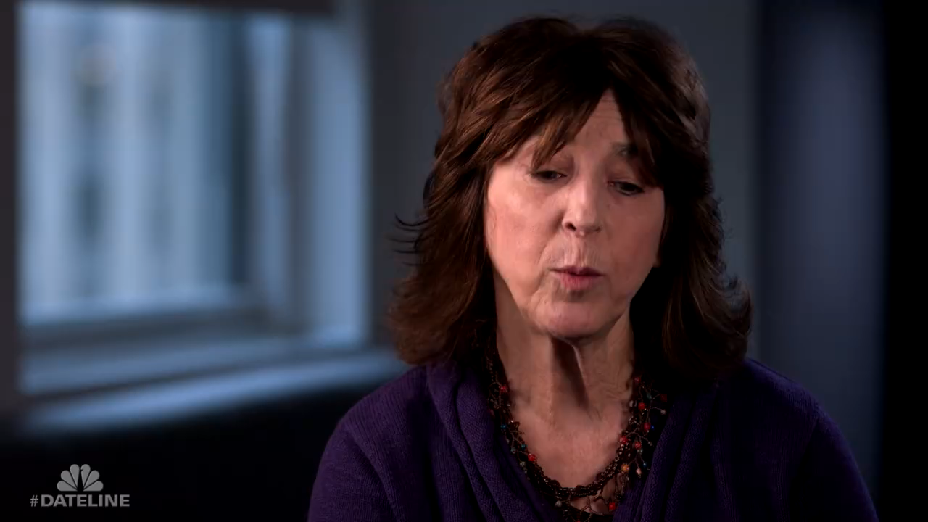
Dr. Amy Baker - The Dangers of Parental Alienation

Slide 8
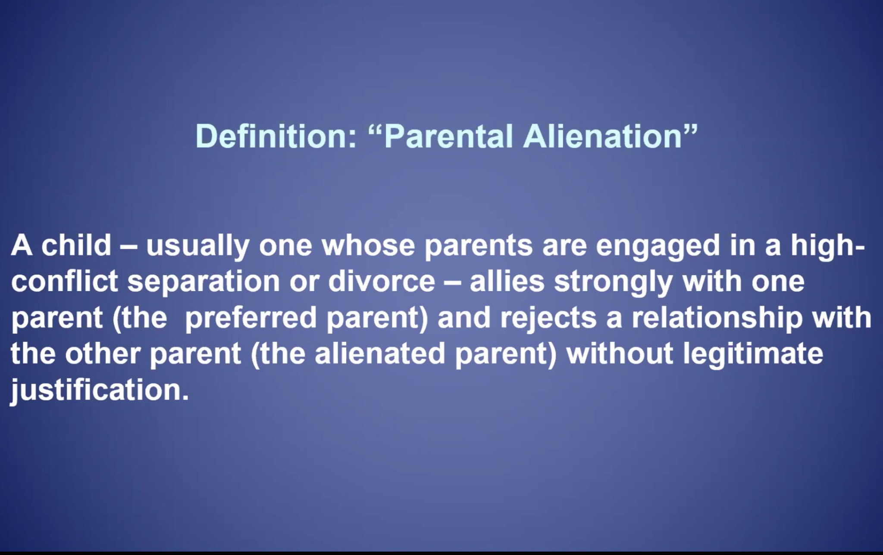
WHAT IS
PARENTAL ALIENATION?
DO WE REALLY UNDERSTAND WHAT IT MEANS?

Slide 9
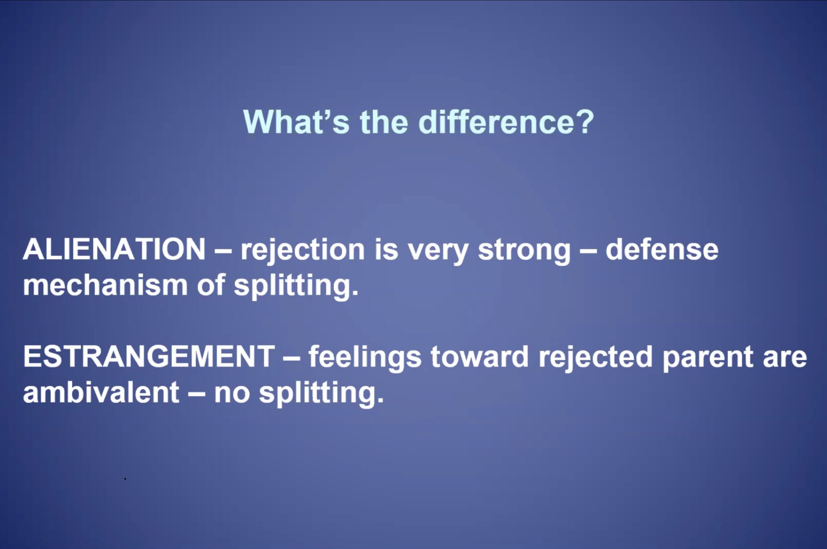
Parental Alienation effects
Children and their Targeted
Parent extended family
members and the whole of
our Society.

Slide 10
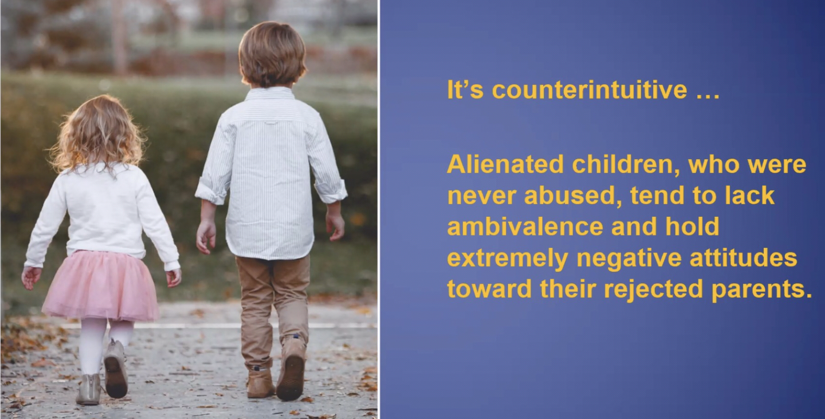
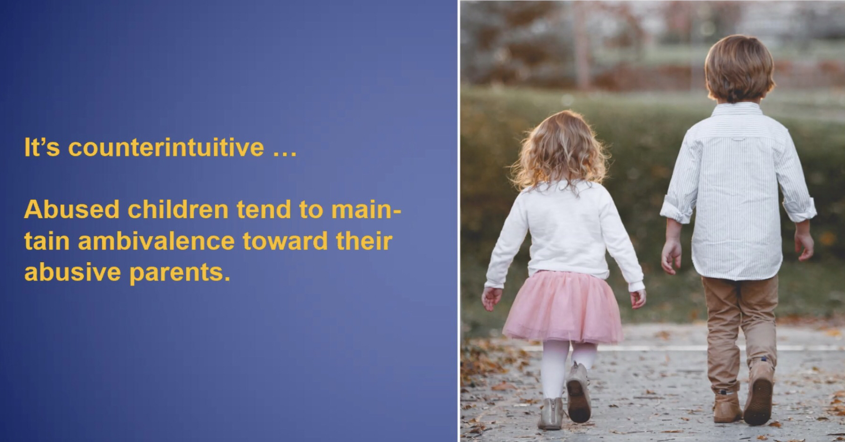
Using a child as an Object is a Cult Leader act,
by using and abusing aimed at the Targeted
Parent and mainly the children Themselves.
KEEP CHILDREN OUT OF SUCH BATTLE.

Slide 11
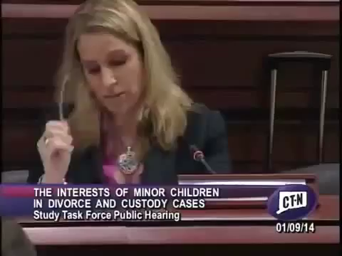
Dr. Steve Miller

Slide 12

Dr. Steve Miller

Slide 13
Parental Alienation
is a Mental Health issue!
- Narcissistic Personality Disorder
- Borderline Personality Disorder
- Antisocial Personality Disorder
- Sociopathic Personality Disorder
- Histrionic Personality Disorder
- Parenting Intrusive/Controlling
Help raise Parental
Child Alienation Awareness

Slide 14
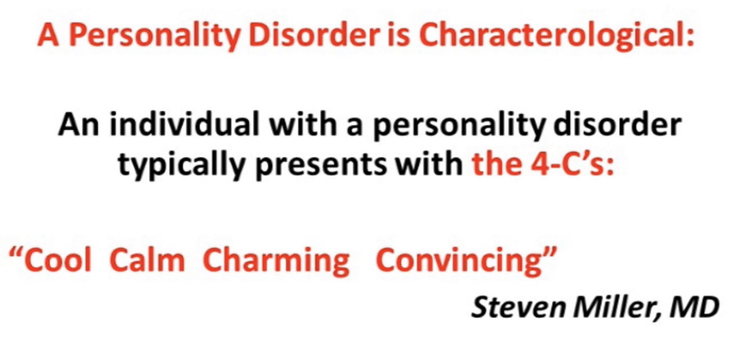
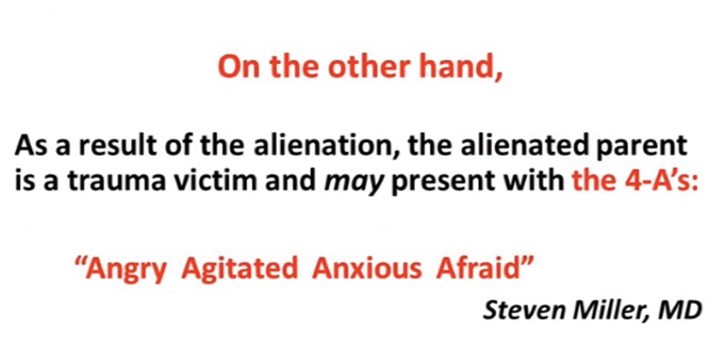

Slide 15
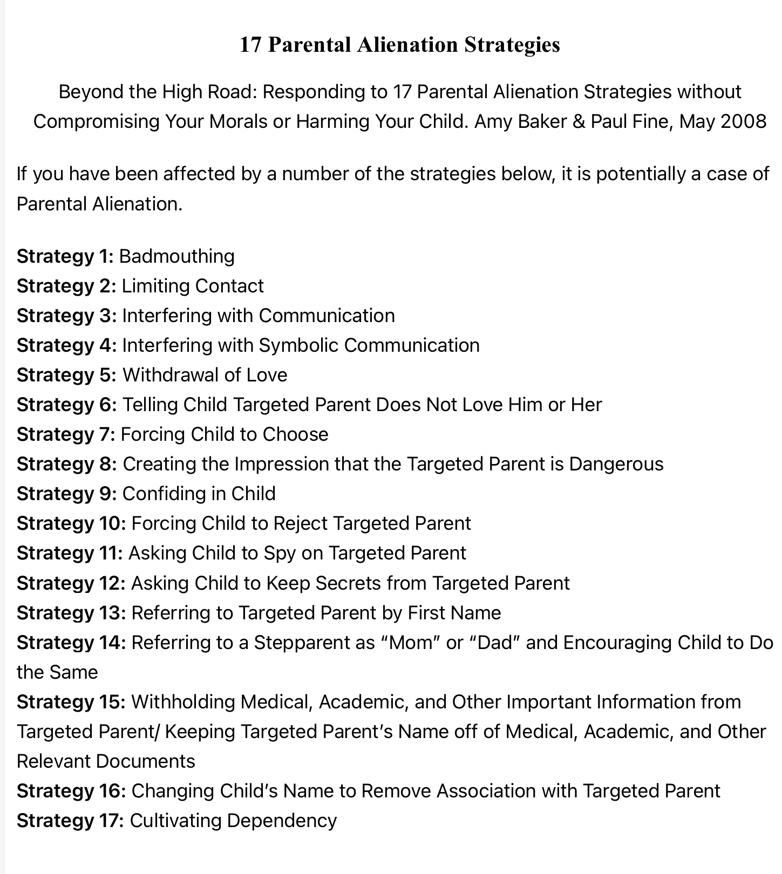

Slide 16
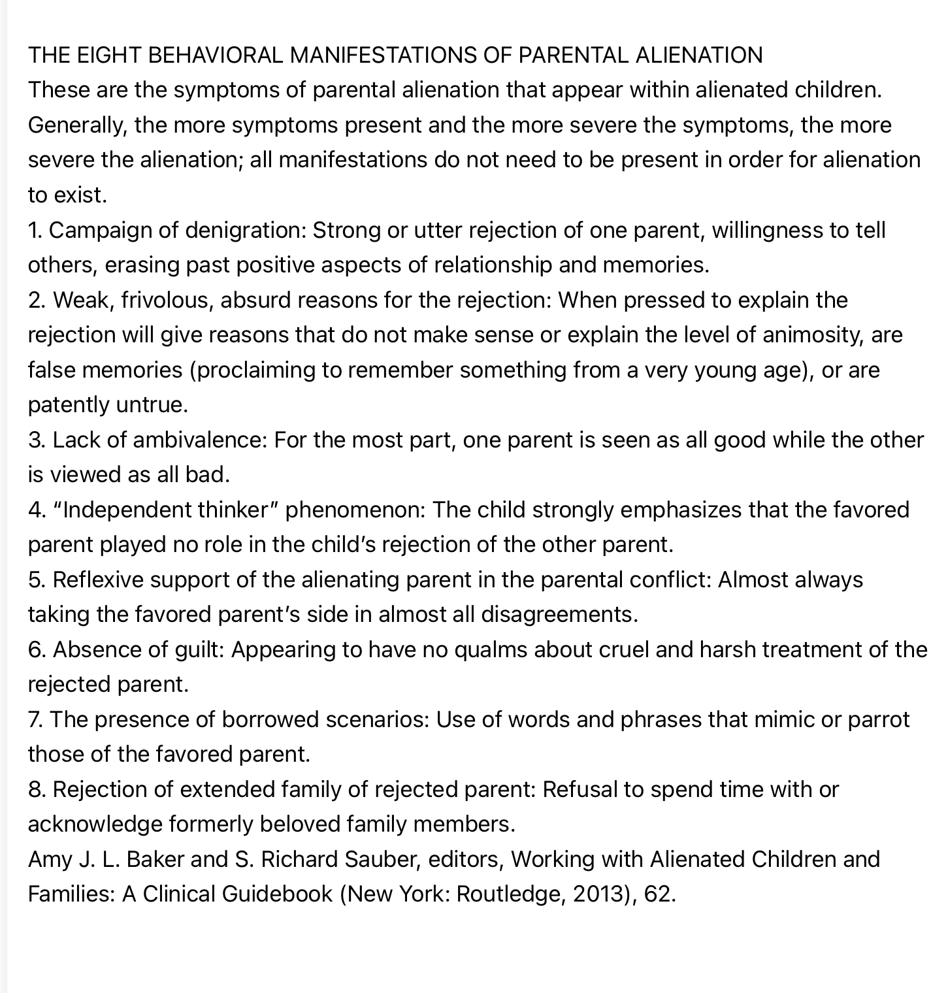
CHILDREN ARE THE ULTIMATE VICTIMS OF PARENTAL ALIENATION
The trauma in an Alienated child lasts FOREVER

Slide 17
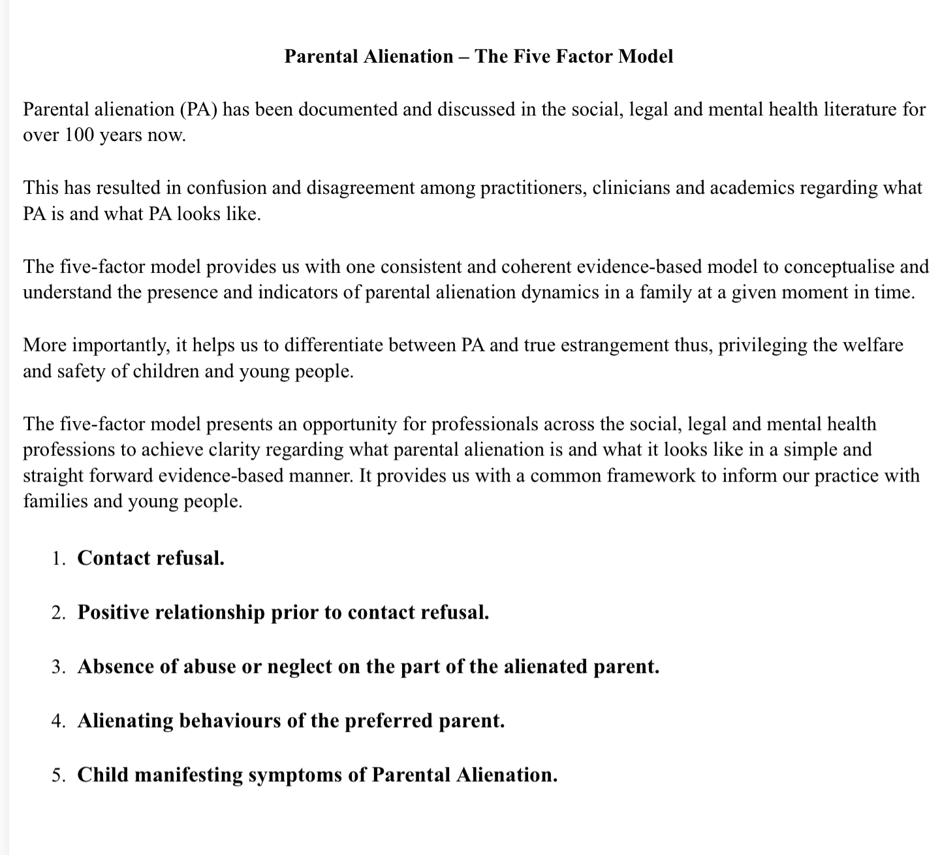
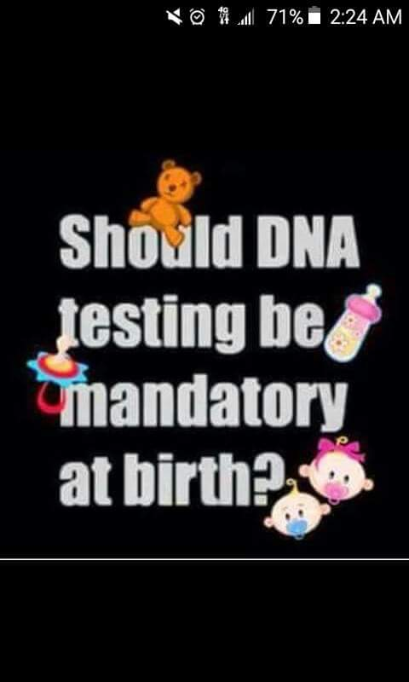
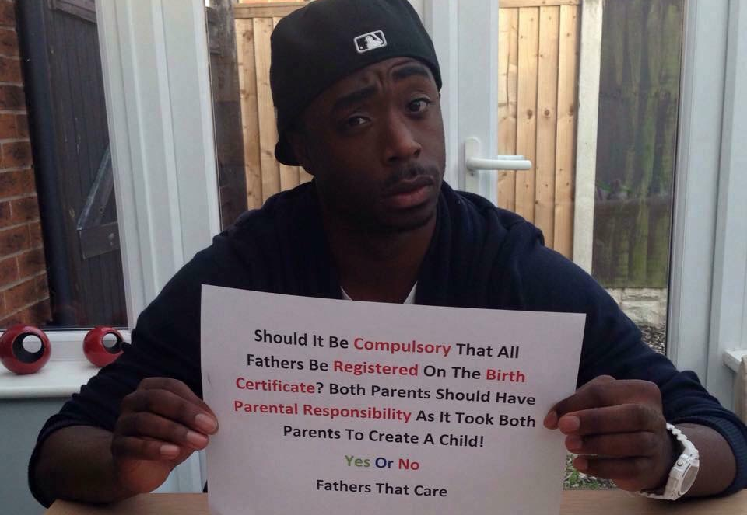

Slide 18
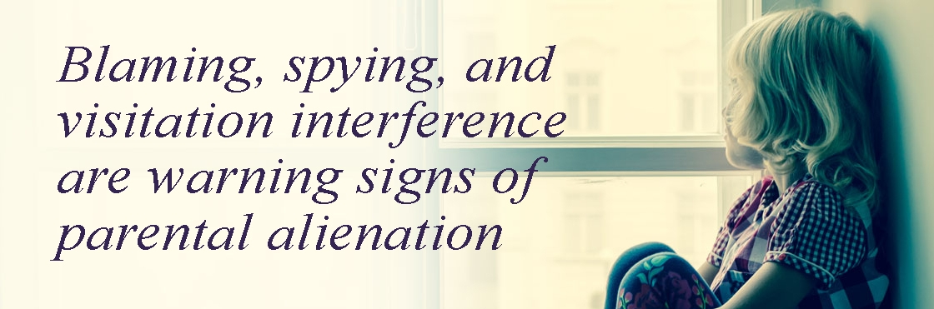
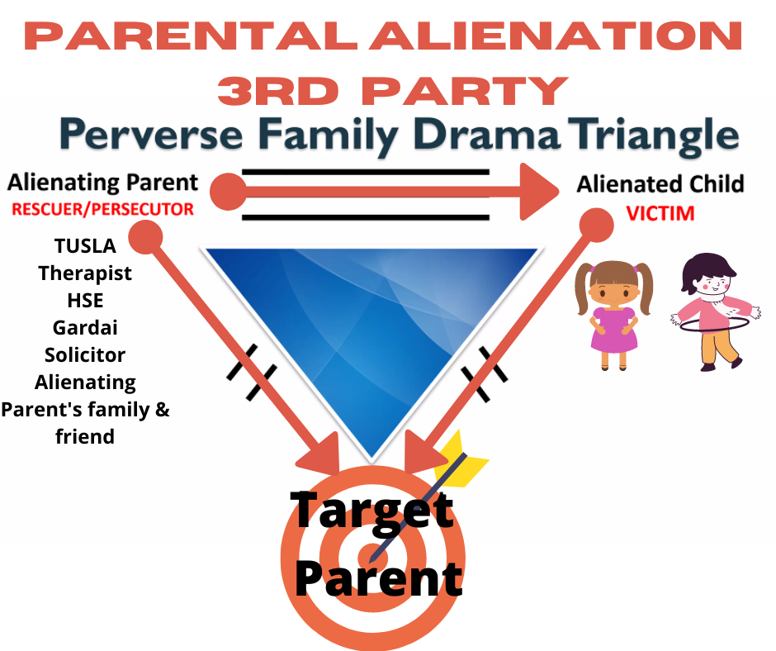

Slide 19
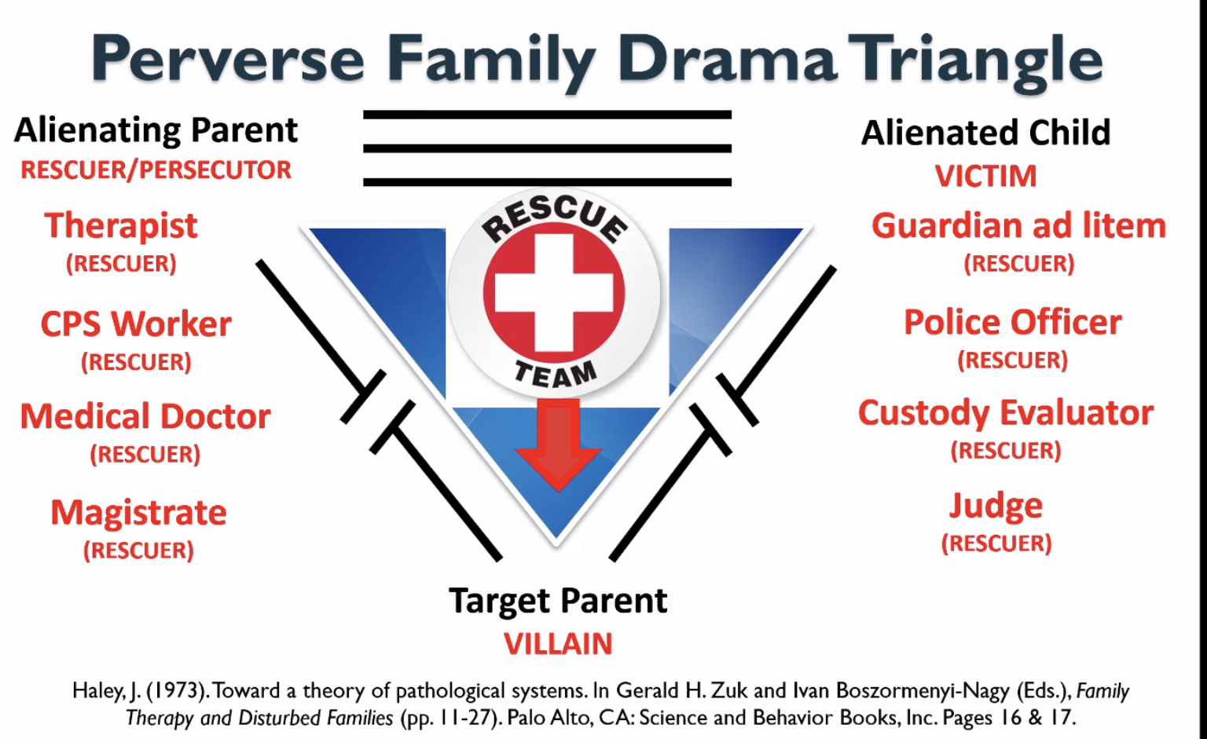
Alienating Parent will induce
Fear into their child, to Reject
and Hate the Targeted Parent.
Child feelings of being
Afraid, Unlovable by
their Rejected Parent and is
Unavailable.

Slide 20
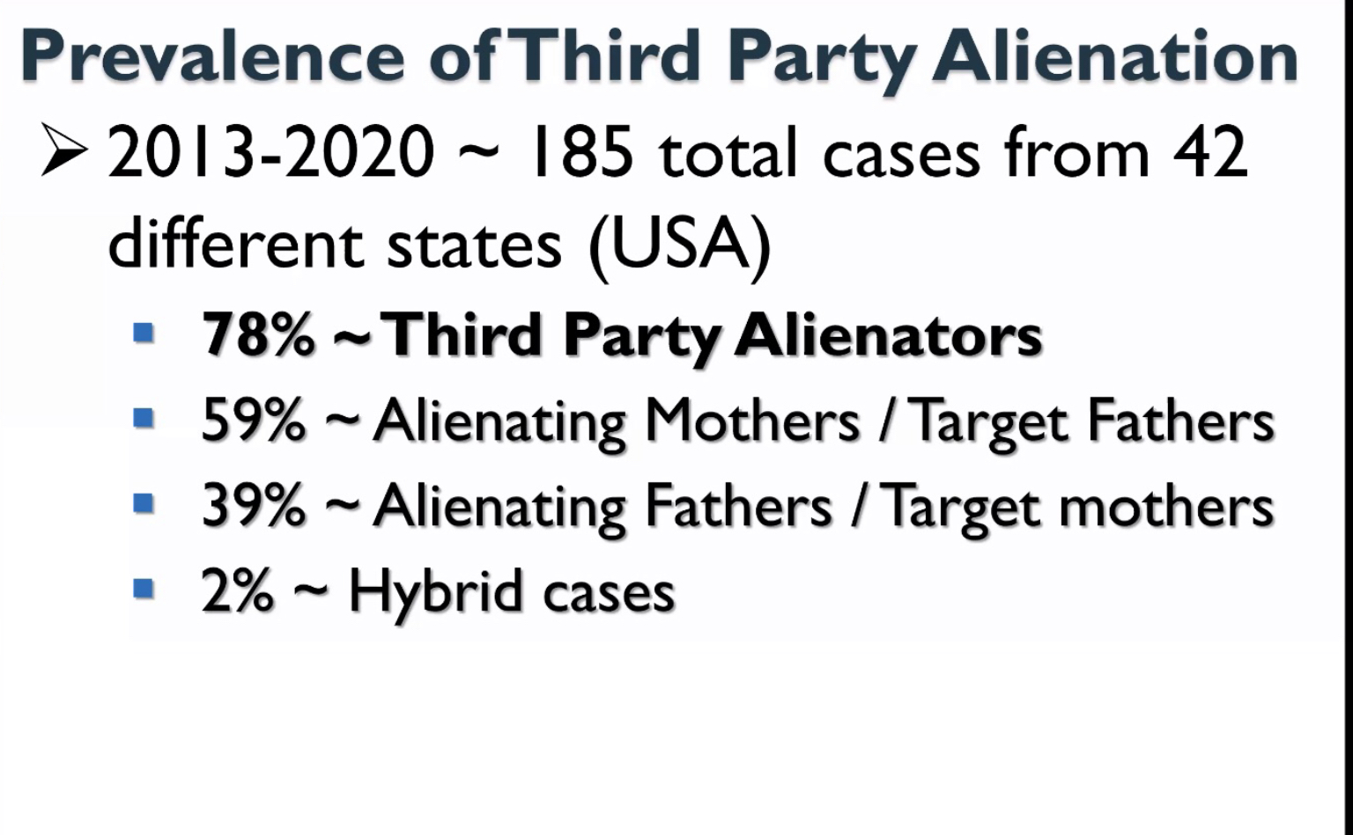
The Targeted Parent and others must make the child feel
Safe, Loved and be Available.
The opposite
feelings from their Alienating Parent,
of Child feelings being
Scared, Abandoned and Unloved.

Slide 21
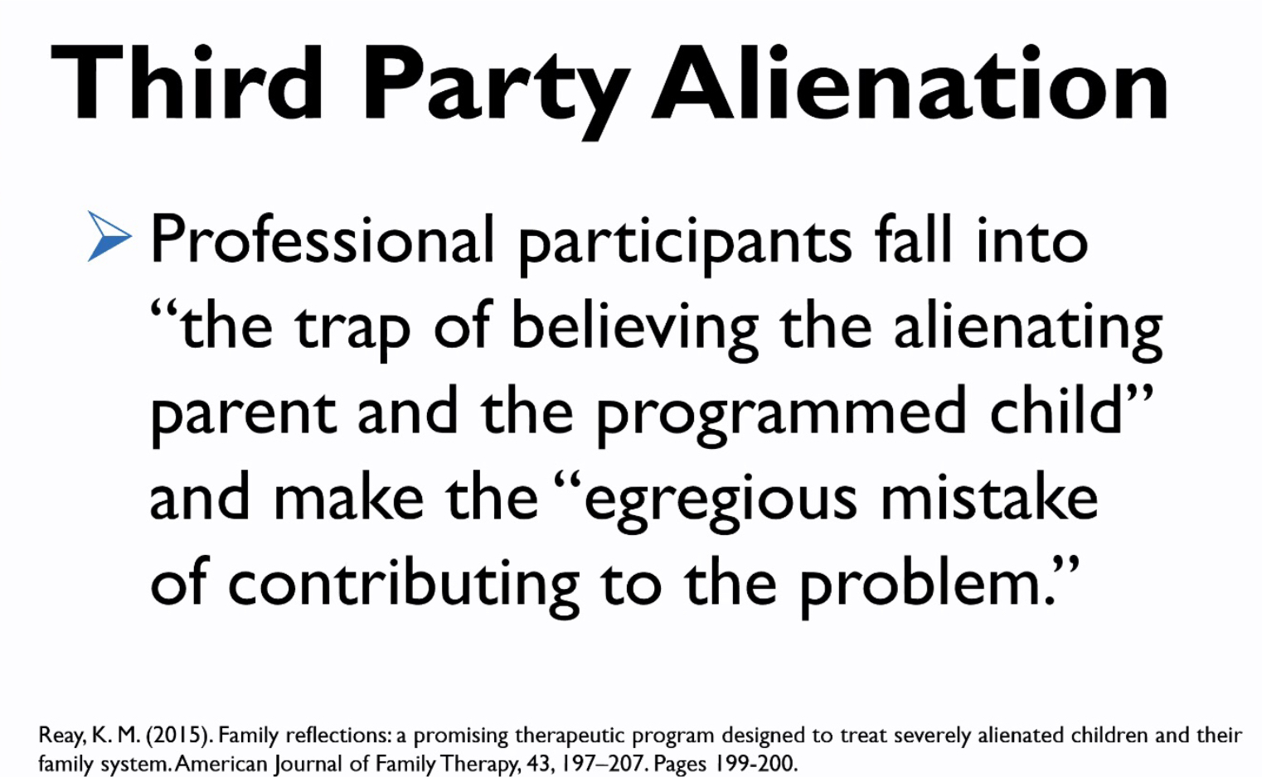
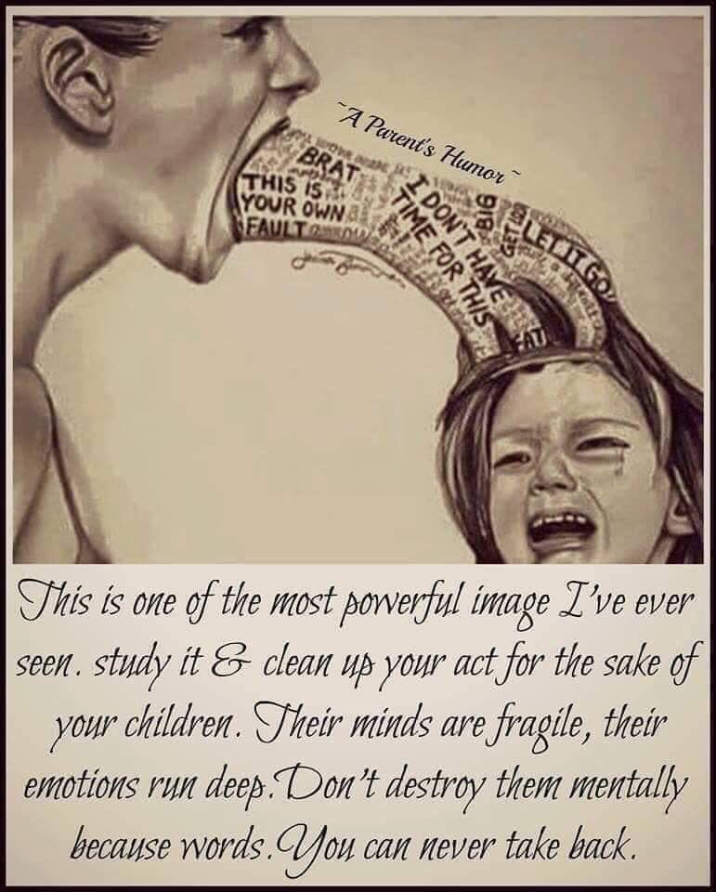
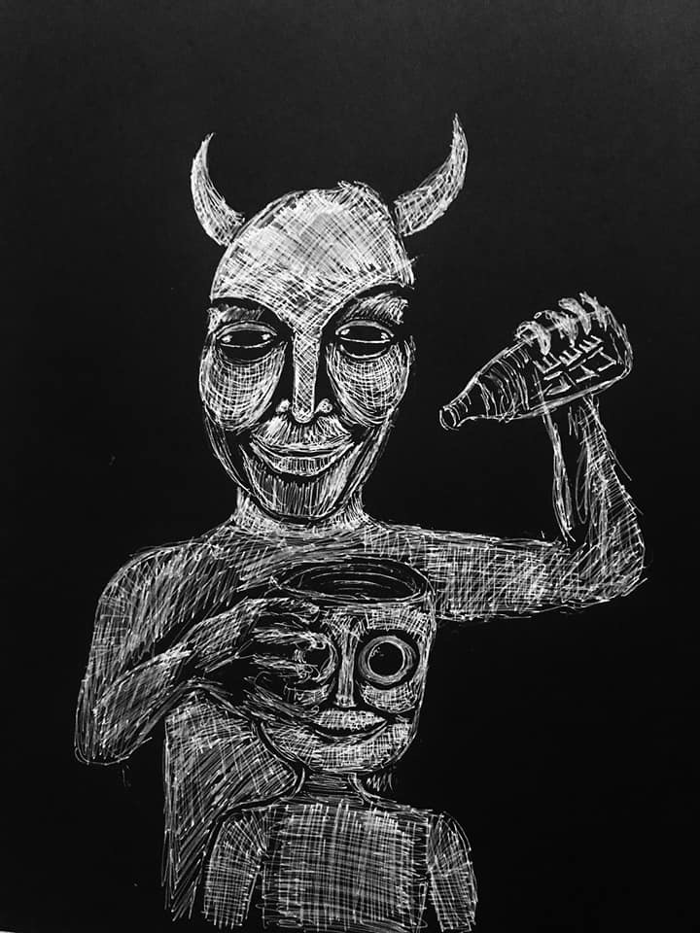
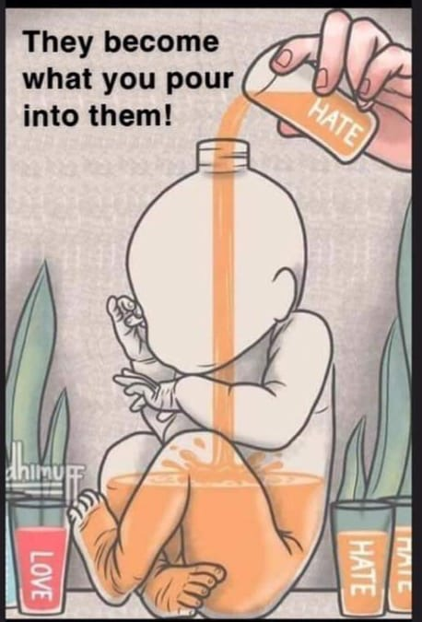

Slide 22
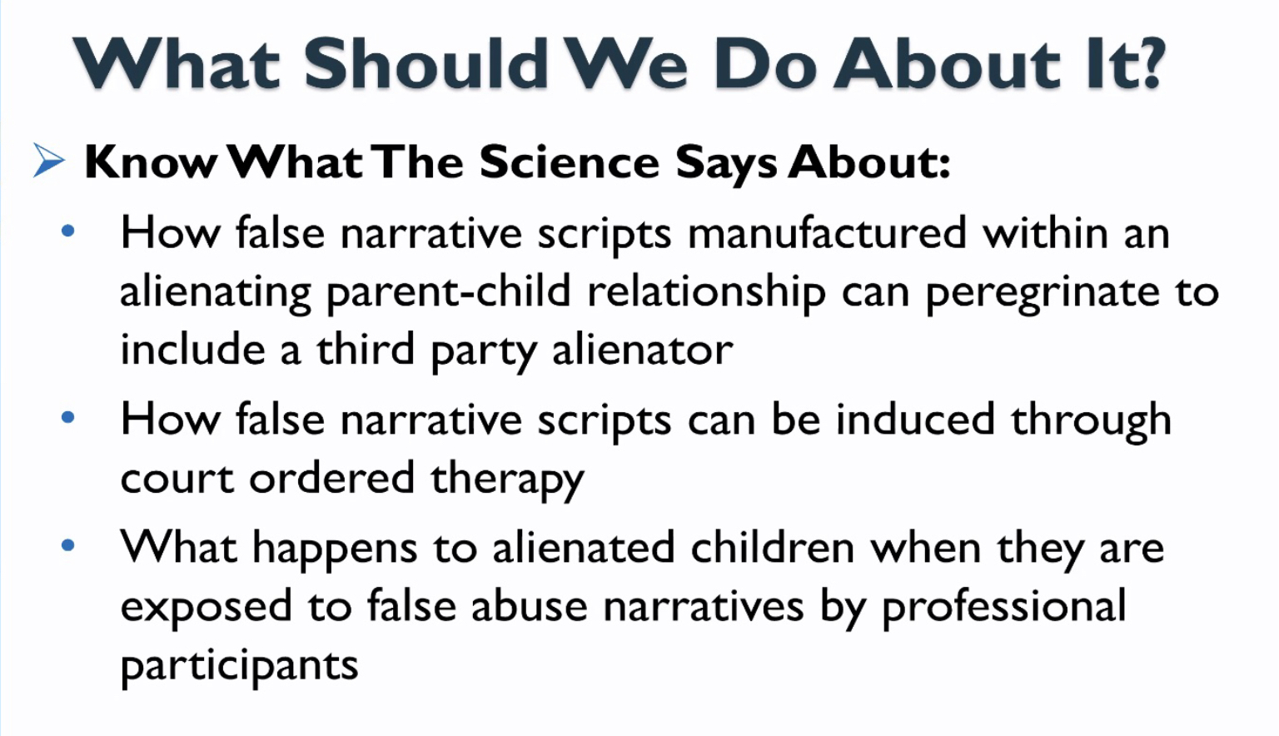
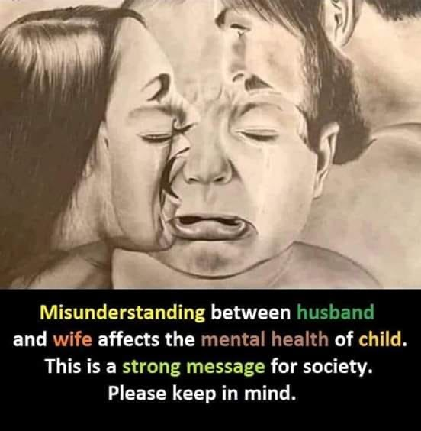
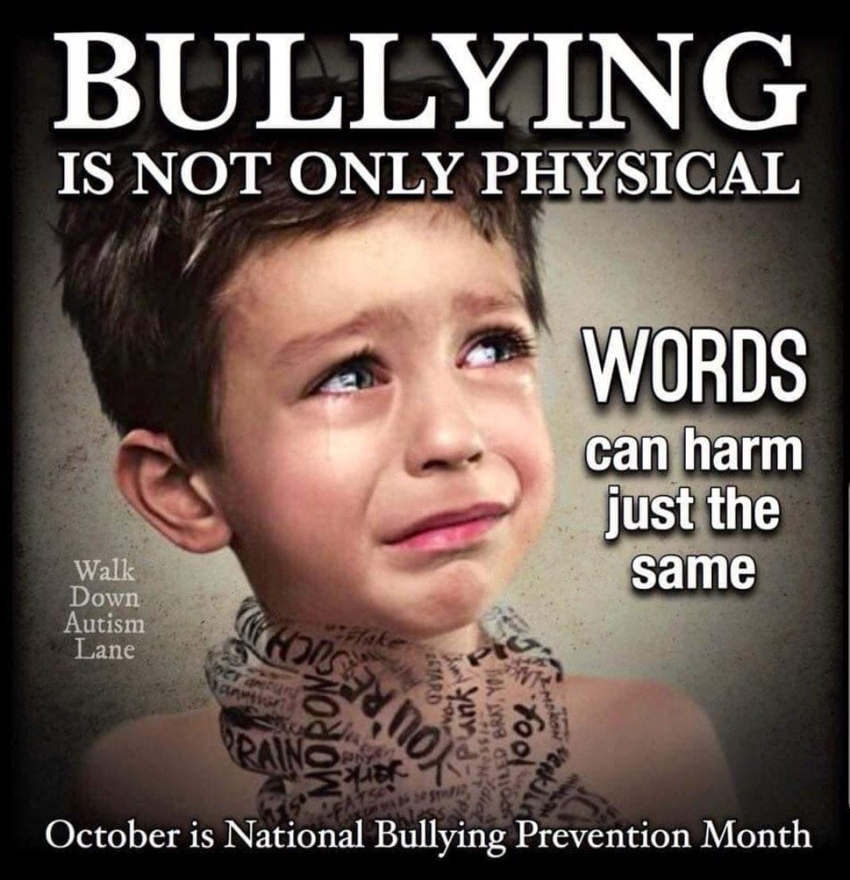

Slide 23
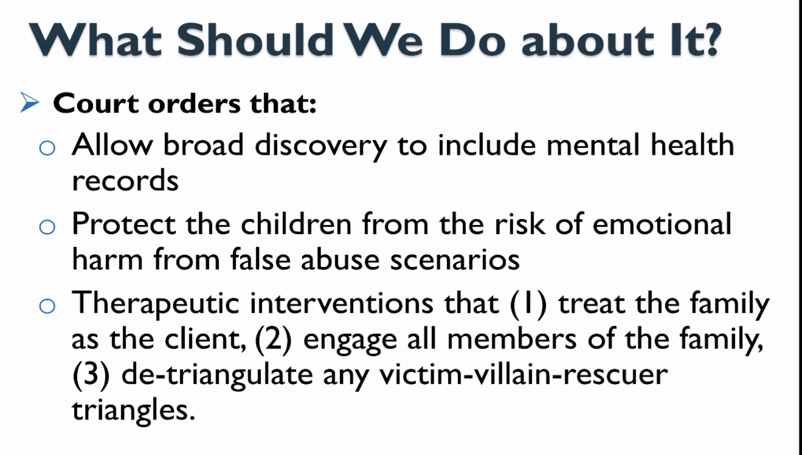
The issue of Parental Alienation is
Domestic Family Violence and not being
recognized by the current Family and
Criminal Courts
In fact giving more Power and Control
to the Alienating Parent.

Slide 24
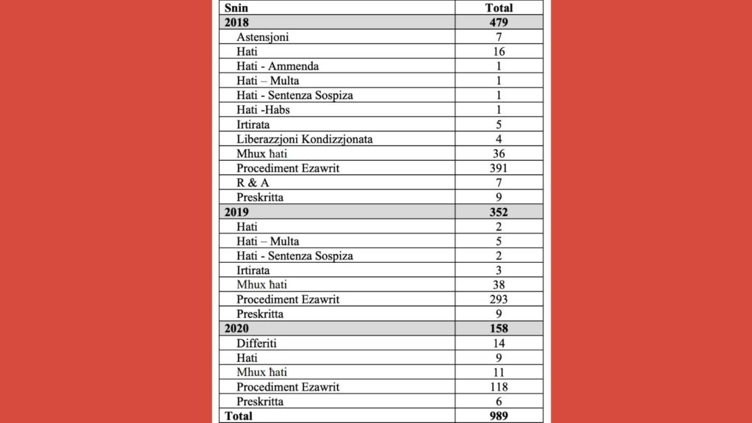
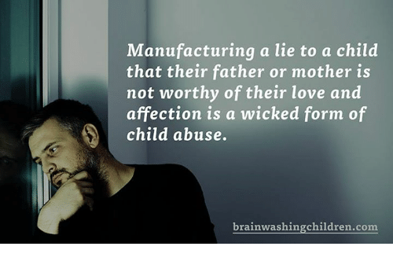

Slide 25
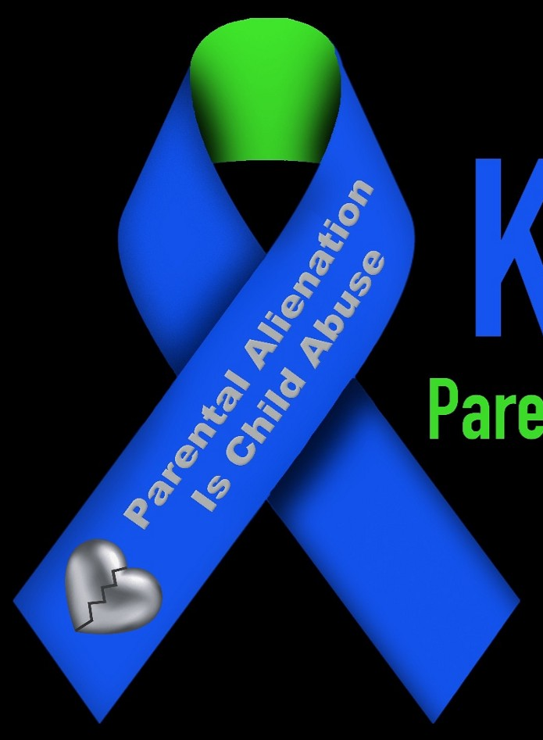
STOP
THE
SILENCE

Slide 26

Your Child Loves Both Parents.

Slide 27
