Slide 1
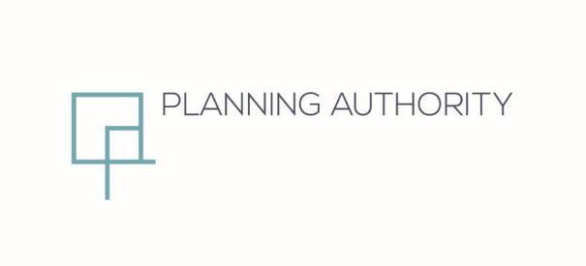
Partial Review to CMLP (2006)
Tal-Handaq North, Qormi
Area of Containment
Presentation to the Standing Committee on Environment and Development Planning
20th October 2021

Slide 2
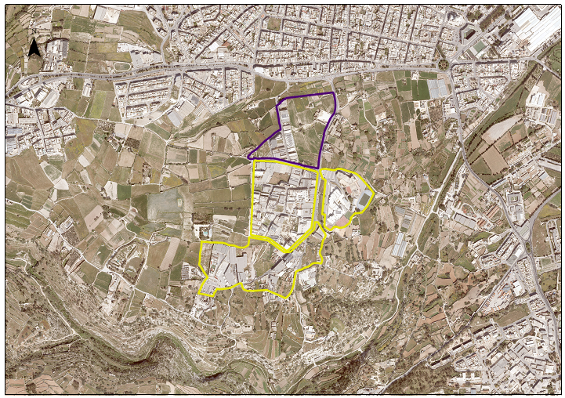
Qormi
Triq Guze Duca
Triq Guze Duca
Handaq North AoC
Handaq EHub
St Ignatius College
Handaq South AoC
Wied il-Kbir Protected Area

Slide 3
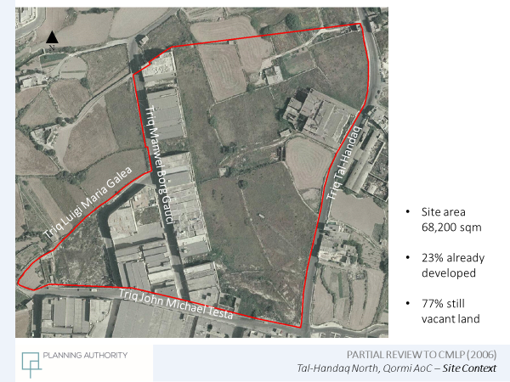

Slide 4
Plan Formulation Process
Publication of objectives for the Partial Local Plan Review in June 2016
Publication of the draft policy in September 2017
Publication of the revised draft policy in February 2021
Receipt of Minister’s position statement in May 2021
SEA Screening process
Final consideration by the Standing Committee in terms of Schedule III of the Act

Slide 5
Revised draft policy of February 2021
Development densities set at 2.75 levels
All vehicular routes to be 13.7m
Inclusion of pedestrian links
Centrally located green strip to be replaced by 5% amenity spaces in Zone B
Inclusion of independent offices in Zone B capped at 10,000sqm
Comprehensive planning areas based on land ownership
Provision of GI to be mandatory
The UIF payment scheme shall apply
Green transport Plans required with comprehensive areas

Slide 6
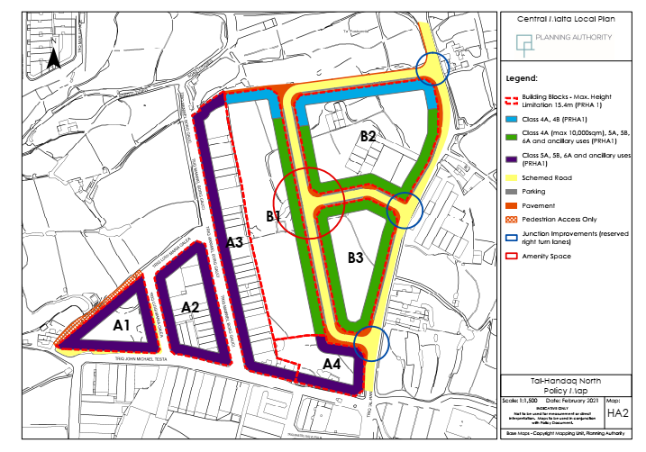

Slide 7
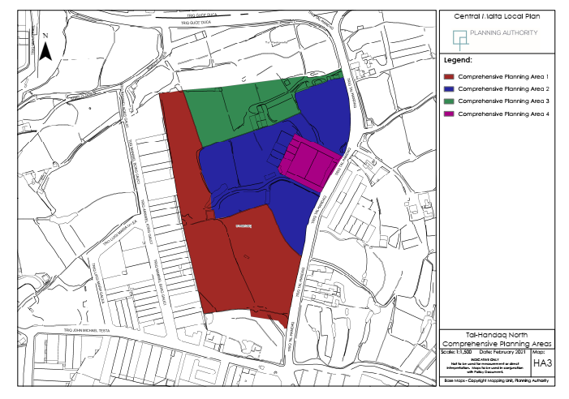

Slide 8
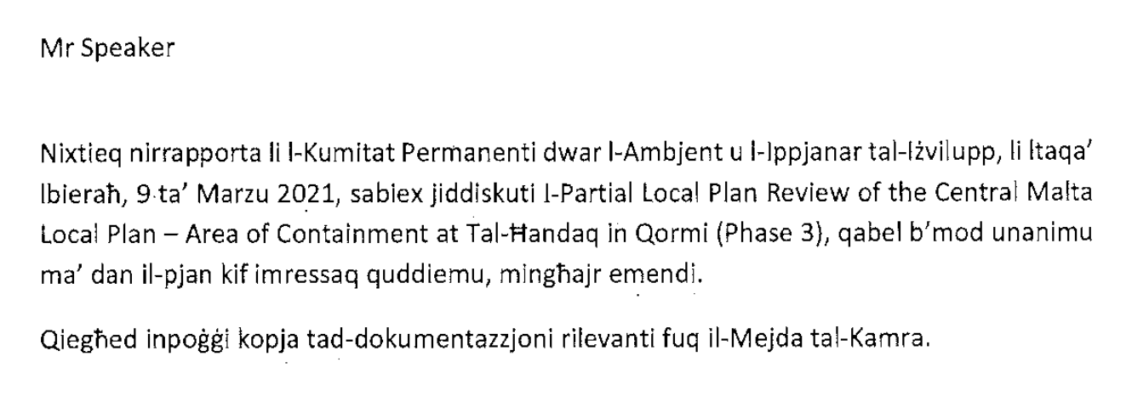
Comments by Standing Committee
Revised policy open for consultation till 1/4/2021
email address: handaq_north@pa.org.mt

Slide 9
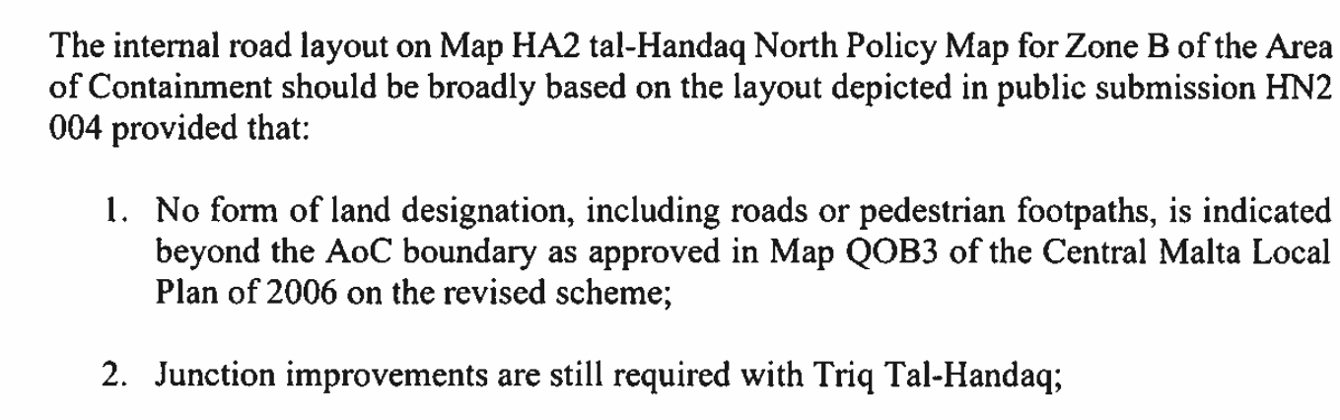
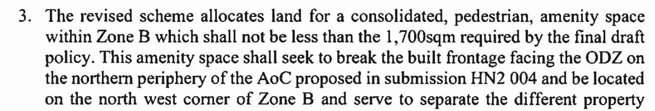
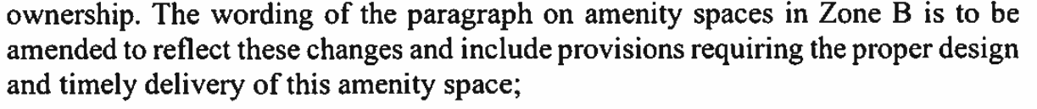
Minister’s Position Statement

Slide 10
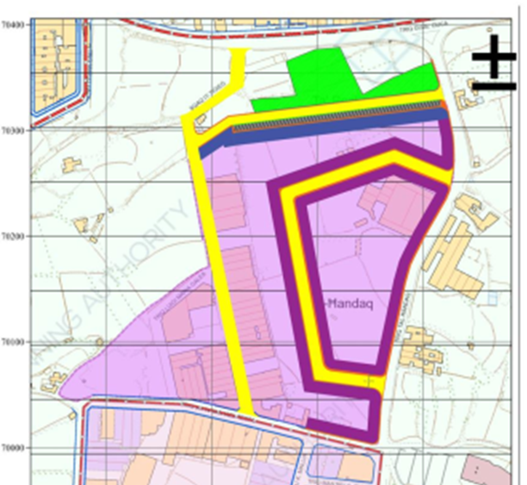
Minister’s Position Statement
Submission HN2 004

Slide 11
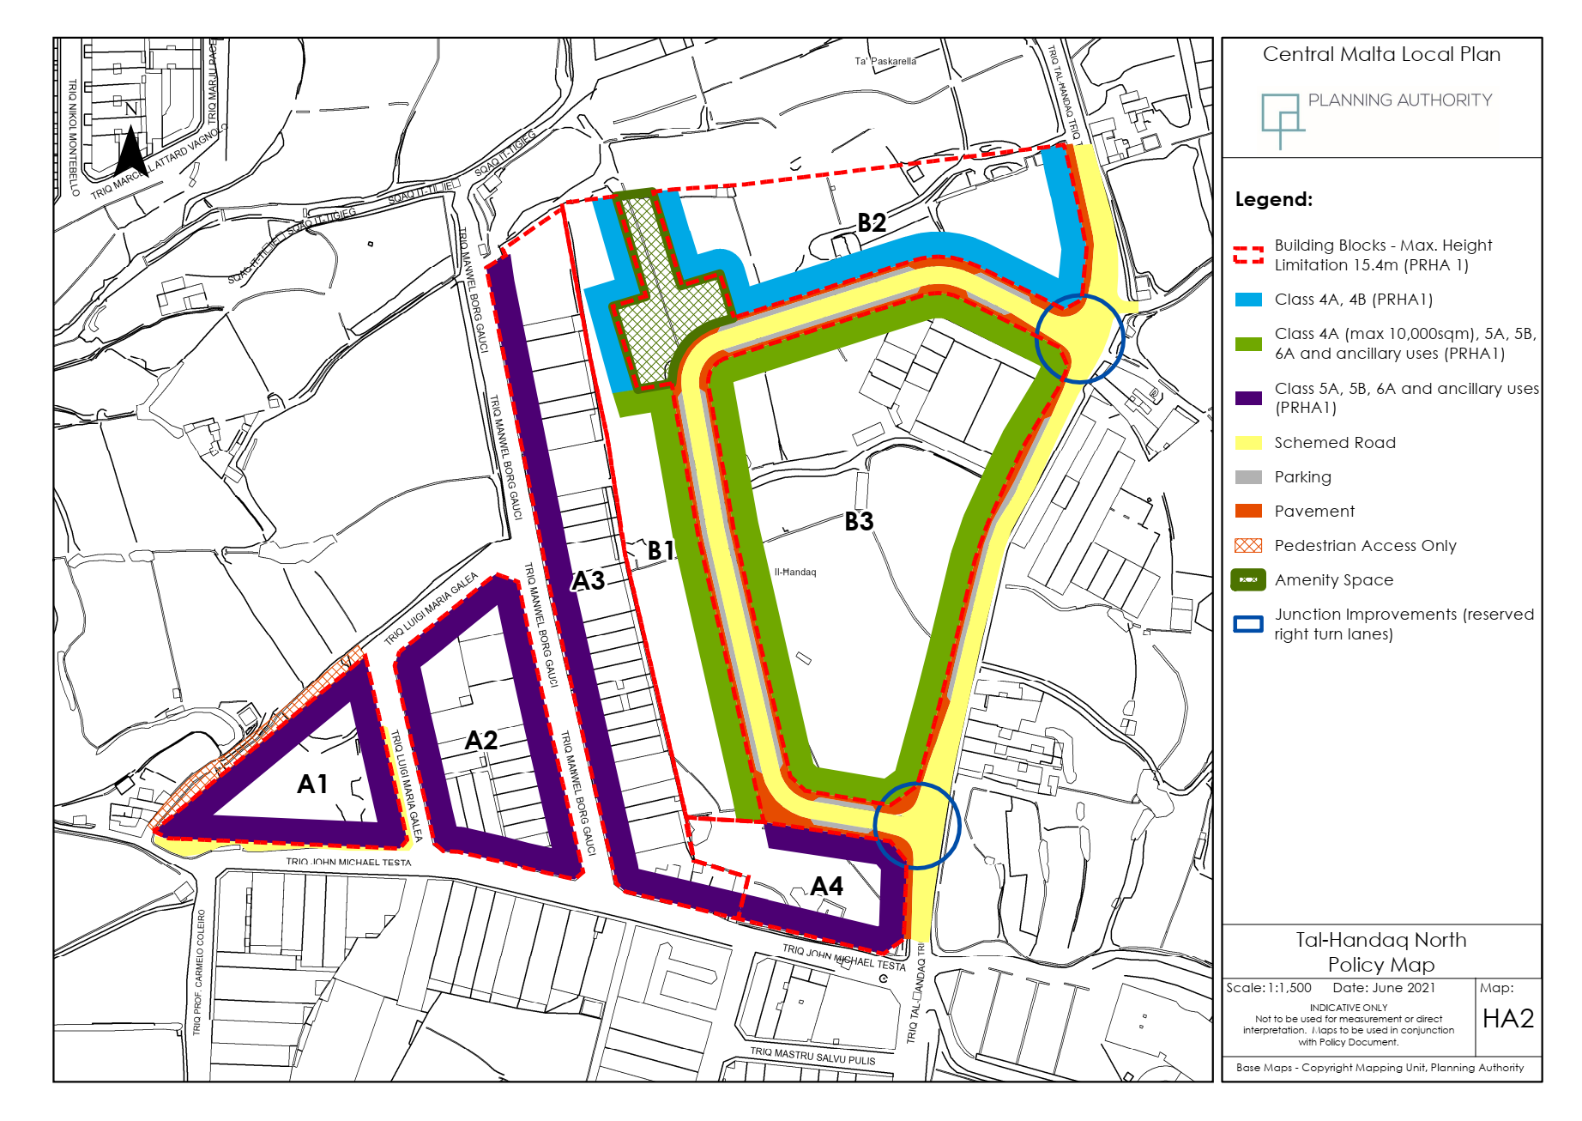
Amended Final Draft

Slide 12
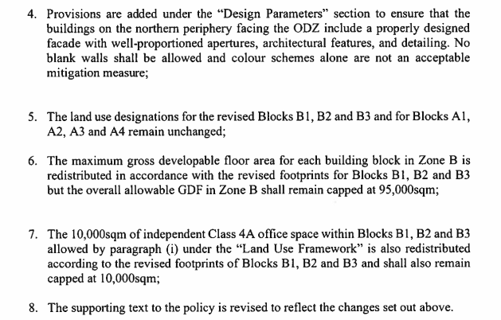
Minister’s Position Statement

Slide 13

Amended Final Draft
Revised Design Parameters

Slide 14
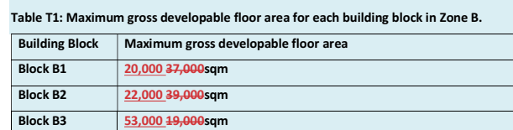
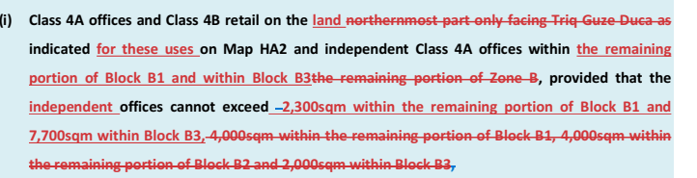
Amended Final Draft
Redistribution of floorspaces due to revised layout
Redistribution of office floorspaces

Slide 15
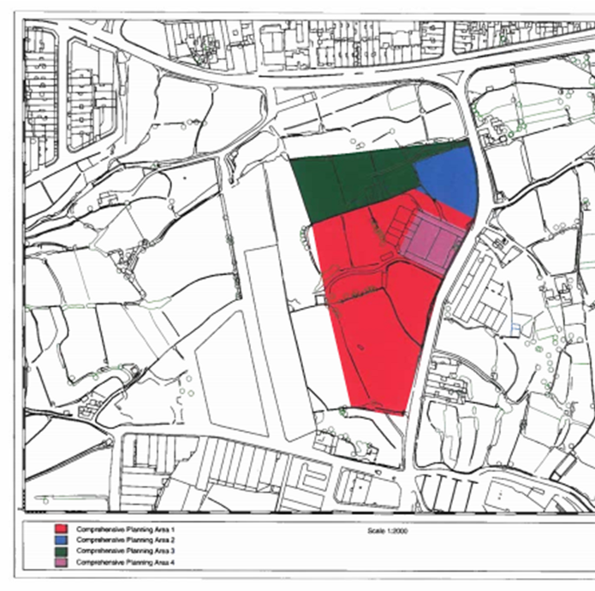
Minister’s Position Statement
Revised comprehensive planning areas

Slide 16
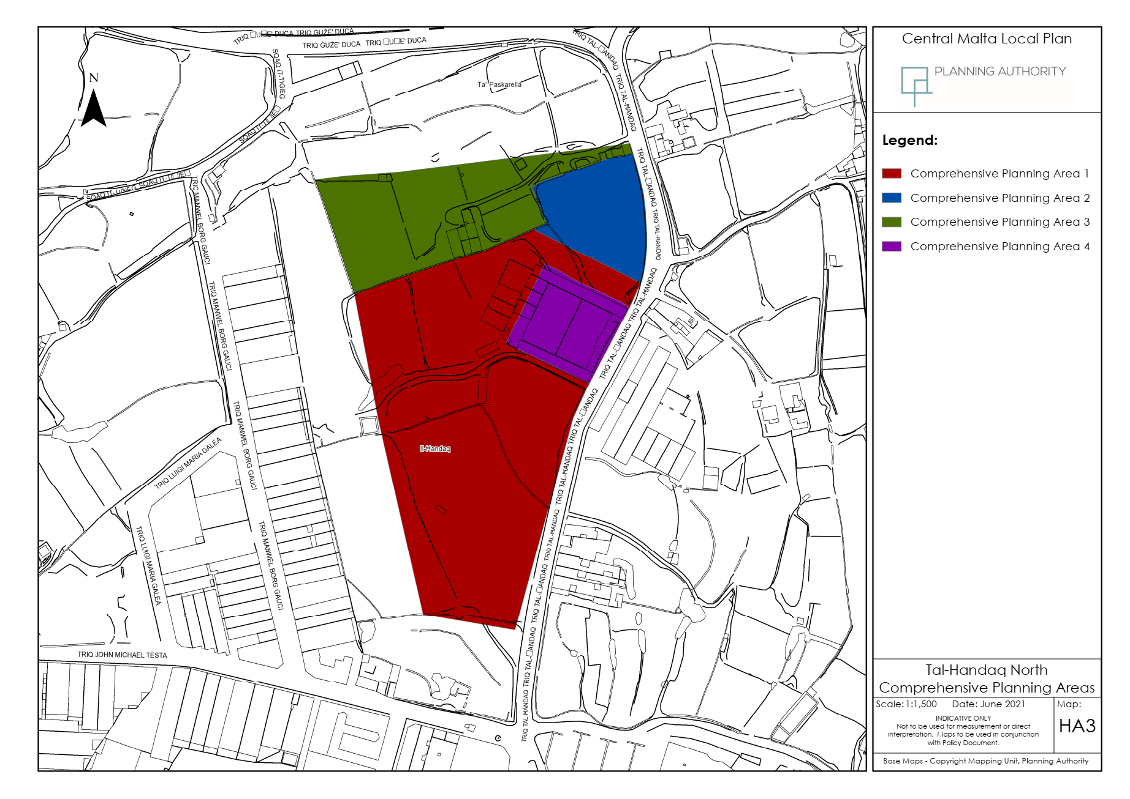
Amended Final Draft

Slide 17
SEA Screening Process
Sea Screening process identified following potential environmental impacts:
(1) the potential loss and/or contamination of groundwater recharge;
(2) overloading of wastewater infrastructure;
(3) increase in air pollution

Slide 18
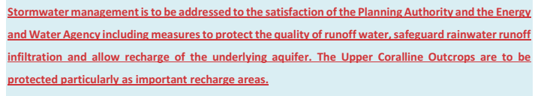
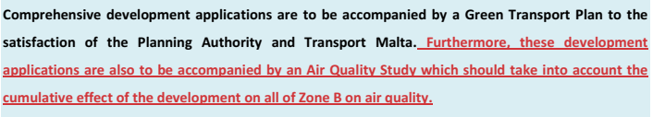
SEA Amended Final Draft
Revisions to protect groundwater:
Revisions to assess air quality impacts:

